Slide 1



Cải thiện An toàn và Sức khỏe cho Lao động trẻ
Ngày Thế giới về An toàn
và Sức khỏe tại Nơi làm việc
28 tháng 04 năm 2018
Notes:
Every year, the ILO celebrates the World Day for Safety and Health at Work on the 28 April to promote the prevention of occupational accidents and diseases.
This year, the World Day focuses on improving the safety and health of young workers.
The “Generation Safe & Healthy” campaign wants to highlight the importance of guaranteeing a future generation of safe and healthy workers, decreasing the incidence of occupational injuries and diseases among young workers and reducing the number of children performing hazardous work.

Slide 2

Thế nào là “lao động trẻ”?

Slide 3
Lao động trẻ là những người ở độ tuổi hoàn thành giáo dục bắt buộc và bắt tay vào công việc đầu tiên (15-24 tuổi)
Lao động trẻ có thể phân làm hai nhóm chính:
Trên độ tuổi lao động tối thiểu nhưng dưới 18 tuổi
Từ 18 đến 24 tuổi

Slide 4
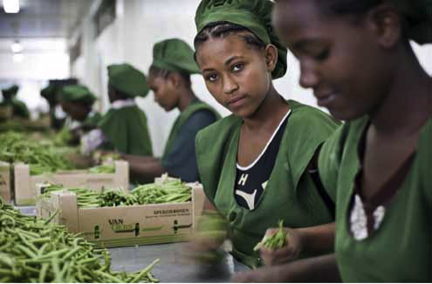
Lao động trẻ có nguy cơ bị tai nạn lao động và bệnh nghề nghiệp cao hơn?

Slide 5
Số liệu thống kê cho thấy lao động trẻ có tỉ lệ tai nạn lao động (không gây tử vong) cao hơn nhiều so với lao động lớn tuổi hơn
Tại Châu Âu: lao động trẻ từ 18-24 tuổi có tỉ lệ tai nạn lao động cao hơn 40%
Tại Mỹ: lao động trong độ tuổi 15-24 có tỉ lệ tai nạn lao động cao gấp hai lần
Notes:
The answer is yes.
Young workers experience significantly higher rates of occupational injury than adult workers.
In Europe, the incidence of non-fatal injury at work was more than 40 per cent higher among young workers aged 18–24 than among older workers.
Young workers are also more vulnerable to occupational diseases because they are still developing, both physically and mentally, and this makes them more susceptible to harm from hazardous chemicals and other agents.

Slide 6
Lao động trẻ cũng dễ mắc các bệnh liên quan tới công việc hơn….
nhưng hầu hết số liệu thống kê không mô tả được thực trạng này do phơi nhiễm tích lũy, thời gian ủ bệnh dài, khó khăn trong việc thu thập số liệu chính xác …vv
Notes:
The answer is yes.
Young workers experience significantly higher rates of occupational injury than adult workers.
In Europe, the incidence of non-fatal injury at work was more than 40 per cent higher among young workers aged 18–24 than among older workers.
Young workers are also more vulnerable to occupational diseases because they are still developing, both physically and mentally, and this makes them more susceptible to harm from hazardous chemicals and other agents.

Slide 7
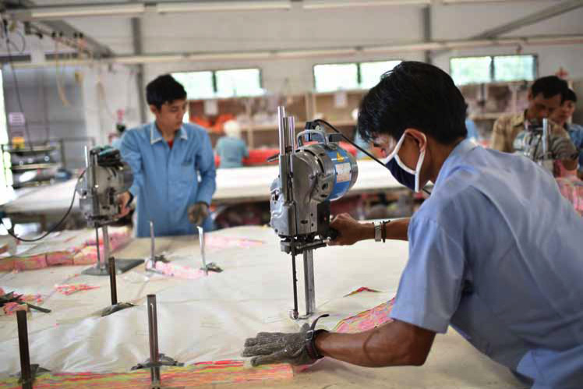
Tại sao Lao động trẻ có nguy cơ bị tai nạn lao động và bệnh nghề nghiệp cao hơn?
Notes:
Many different factors interact to increase the risk of young workers suffering occupational injuries and diseases.
What are some of these factors that threaten the safety and health of young workers?

Slide 8
Các yếu tố rủi ro đặc thù đối với lao động trẻ
  Đặc điểm của lứa tuổi
  đang trong giai đoạn phát triển thể chất
  đang trong giai đoạn phát triển tâm lý
  Bị ảnh hưởng bởi độ tuổi
  Kĩ năng nghề nghiệp và kinh nghiệm làm việc
  Trình độ học vấn
Các yếu tố khác kết hợp với tuổi trẻ làm tăng rủi ro về An toàn Sức khỏe nghề nghiệp (giới tính, khuyết tật, di cư)
Notes:
There are a number of factors that are specific to young workers which increase the risk of suffering harm from workplace hazards.
For example, the body of young workers (especially adolescents) is still developing.
Because of their psychosocial and emotional stage of development, young workers tend to be less able to discern the consequences of their actions or to assess risks associated with various situations, and are more susceptible to social and motivational pressures, including the desire to belong, to be considered attractive, and to achieve independence. These traits affect young people’s decision making and can result in risk taking. They can also make young workers reluctant to speak up about difficulties related to doing their work or about hazardous physical and psychological conditions.
Young workers often lack the skills and experience that they need for the work to which they are assigned, including an understanding of the safety and health hazards and risks associated with it.
Awareness of workplace safety also appears to be positively influenced by education. More highly educated workers have a better understanding of safety, are most compliant with safety procedures and record lower accidents than workers with less education.
There are also other factors that in combination with age increase the risk of occupational accidents and diseases. These include gender, disability and migration status.
For example, young people with disabilities tend to be at higher risk for exclusion, isolation, bullying and abuse, and they also tend to have fewer educational and economic opportunities.
Young boys are more likely to be engaged in hazardous work, but young girls are more likely to be working in informal employment, often unpaid family work, and this makes them “invisible”.
Migrant workers have occupational accident rates that are among the highest experienced by any group.

Slide 9
Lao động trẻ gặp phải các mối nguy tại nơi làm việc
  Mối nguy an toàn
  Mối nguy vật lý
  Mối nguy sinh học
  Mối nguy hóa chất
  Mối nguy Ecgonomy
  Mối nguy tâm lý
Notes:
Several different kinds of hazard can exist in every workplace, with specific consequences for the safety and health of young workers.
Work hazards include:
safety hazards (e.g., working at height; using dangerous machinery or tools; driving or working near vehicles; walking on slippery surfaces; working close to flammable or explosive materials; etc.);
physical hazards (e.g.: noise, vibration, extreme temperatures, radiation, etc.);
biological hazards (e.g.: exposure to bacteria, parasites, viruses, dangerous animals, insects and plants, which can result in different types of disease); chemical hazards (including gases, dusts, fumes, vapours and liquids);
ergonomic hazards (e.g.: carrying heavy loads, fast or repetitive movements, poorly designed machines, equipment and work processes that cause workers to adopt awkward positions) and
psychosocial hazards (e.g.: task design, workload and pace of work, work schedules, decision-making power and control, organizational culture, work-life balance, interpersonal relationships at work, including workplace violence and harassment. etc.).
Young workers can be particularly vulnerable to these hazards.
For example, exposure to toxic chemical when young can cause serious harm to reproductive systems and hormonal balance.
Adolescents carrying heavy loads face higher risk of musculoskeletal disorders (MSDs) such as skeletal damage and impaired growth.
Young workers appear to be more vulnerable to workplace bullying and often they don’t speak up because of the fear of negative consequences.

Slide 10
Lao động trẻ làm việc tại
Kinh tế phi chính thức
Việc làm không theo tiêu chuẩn
Các ngành có nguy cơ cao (ví dụ: nông nghiệp và xây dựng)
Notes:
As young workers tend to have limited job skills, work experience and bargaining power, their opportunities are often limited to entry-level jobs and jobs that are undesirable because of low pay, excessive hours, precariousness and the hazardous nature of the work.
Large numbers of young people work in the informal economy, where jobs tend to give workers significant exposure to work hazards and provide them with limited social protection coverage.
Young workers are much more likely than adults to be engaged in unstable jobs, where they tend to have limited access to training and skills development because their work is only short-term, and they are usually less informed about hazards and risks at work. They tend to need to change jobs often, and as a result rarely have the time or opportunity to become familiar with the OSH rules before they have to change and adapt again.
Young workers are often employed in very hazardous sectors, such as agriculture and construction.
Agriculture is considered one of the most hazardous sectors for workers of all ages. Agricultural workers have high rates of occupational accident and disease, as they are exposed to a variety of hazards.
Construction has one of the highest rates of occupational accidents and diseases of all industries, mainly because of the very hazardous nature of many construction tasks (e.g.: use of dangerous machinery and materials, work at height, etc.) and the characteristics of this sector (e.g.: the high proportion of small firms and extended contracting chains, multi-employer worksites, high turnover and the extensive use of inexperienced, seasonal and migrant workers).

Slide 11

Yếu tố rủi ro đặc thù đối với lao động trẻ
Kỹ năng và kinh nghiệm
làm việc
Giai đoạn phát triển
tâm lý và cảm xúc
Giai đoạn phát triển
thể chất
Trình độ học vẩn
Các mối nguy lao động trẻ thường gặp tại nơi làm việc
Yếu tố khác
Mối nguy an toàn
Yếu
Mối nguy tâm lý
Mối nguy vật lý
Mối nguy Écgonomy
Mối nguy sinh học
Mối nguy hóa chất
World Day for Safety and Health at Work 2018
Improving the safety and health of young workers

Slide 12
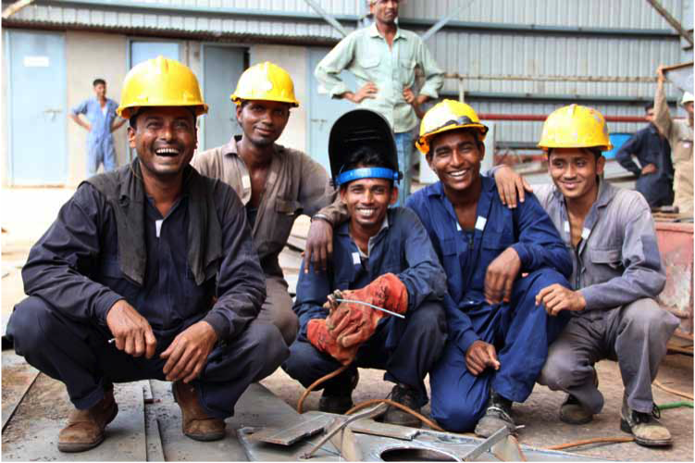
Tiêu chuẩn lao động nào của ILO bảo vệ an toàn và sức khỏe cho lao động trẻ?
Notes:
The ILO promotes decent work for all women and men through the adoption of international labour standards.
So, what are the ILO conventions and recommendations protecting the safety and health of young workers?

Slide 13
Các tiêu chuẩn An toàn Sức khỏe nghề nghiệp (ATSKNN)
Thúc đẩy môi trường làm việc bền vững, an toàn và đảm bảo sức khỏe cho mọi người lao động, bao gồm lao động trẻ
Các Công ước chính của ILO đưa ra các nguyên tắc cần thiết về ATSKNN
  Công ước số 155 (ATSKNN)
  Công ước số 161 (Các dịch vụ ATSKNN)
  Công ước số 187 (Khung thúc đẩy về ATSKNN)
  Có rất ít Công ước đưa ra biện pháp bảo vệ cụ thể đối với lao động trẻ
Notes:
The right to safe and healthy work for all workers, including both young and adult workers is recognized by the ILO Constitution (1919) , the Philadelphia Declaration (1944) and more than 40 international labour standards on OSH.
The key ILO standards on OSH establish the essential principles on OSH.
The Occupational Safety and Health Convention, 1981 (No. 155) set out the basic principles for national and enterprise-level policies and strategies to improve OSH. The Convention defines employers’ responsibilities, the rights of workers and their representatives, and requirements regarding information, education and training.
The Occupational Health Services Convention, 1985 (No. 161) provide for the establishment of enterprise-level occupational health services.
The Promotional Framework for Occupational Safety and Health Convention, 2006 (No. 187) promote an OSH culture of prevention through the development and implementation of national policies, systems and programmes on OSH. The accompanying Recommendation No. 197 states that the national system should implement appropriate measures for the protection of all workers, in particular workers in high-risk sectors and vulnerable groups of workers such as those in the informal economy, migrant and young workers.
While most of ILO OSH conventions provide for the protection of all workers from occupational accidents and diseases, some set out specific measures for the protection of young workers.
The Construction Recommendation, 1988 (No. 175) requires a minimum age (as prescribed by national laws or regulations) for drivers and operators of lifting appliances (Para. 29).
The Asbestos Recommendation, 1986 (No. 172) requires to devote special attention to the employment of young persons of less than 18 years of age in activities involving a risk of occupational exposure to asbestos.
The Conditions of Employment of Young Persons 1965 (Underground Work) Recommendation (No. 125) calls for the adoption of measures to protect the life and health of young workers in underground mines.
The Welfare Facilities Recommendation, 1956 (No.102) in its Paragraph 16 (1) states that in undertakings where any workers, especially women and young workers, have in the course of their work reasonable opportunities for sitting without detriment to their work, seats should be provided and maintained for their use.
For example, the Medical Examination of Young Persons (Industry) Convention, 1946 (No. 77), the Medical Examination of Young Persons (Non-Industrial Occupations) Convention, 1946 (No. 78) and the Medical Examination of Young Persons (Underground Work) Convention, 1965(No. 124) require that there be pre-employment medical examinations for children and young persons under the age of 18 years, in order to check their fitness for the work in question, and they require that there be medical supervision until workers reach the age of 18. These requirements are extended to the age of 21 for occupations that involve high health risks. The Medical Examination of Young Persons Recommendation, 1946 (No. 79) in fact recognises that in most cases, the adolescent stage of development does not end at 18 years of age. Consequently, special protection is still needed beyond the age of 18, and it is desirable to extend the age limit for compulsory medical examinations to at least 21 years for all young workers employed in industrial or non-industrial occupations. This extension should apply to, but not be limited to, all mining occupations, all employment in hospitals, and employment in public entertainment such as dancing and acrobatics.
The Safety and Health in Agriculture Convention, 2001 (No. 184) has a section on young workers and hazardous work. The accompanying Recommendation (No. 192) provides for the adoption of health surveillance measures for young workers.

Slide 14
Các tiêu chuẩn về Lao động trẻ em
Bảo vệ đặc biệt đối với trẻ em (dưới 18 tuổi)
Độ tuổi tối thiểu được phép làm việc (phụ thuộc vào loại hình công việc)
  Công ước số 138 (Độ tuổi Lao động Tối thiểu)
Công việc nặng nhọc, nguy hiểm là một trong bốn hình thức lao động trẻ em tồi tệ nhất
  Công ước số 182 & Khuyến nghị số 190 (Các hình thức Lao động trẻ em tồi tệ nhất)
Notes:
A young worker under the age of 18 is still considered a child and protected by child labour standards.
The Minimum Age Convention (No. 138) determines the minimum age for employment in different types of work and in countries exhibiting different levels of development. Article 3 provides that the minimum age for any type of employment or work that by its nature or the circumstances in which it is carried out is likely to jeopardize the health, safety or morals of young persons shall not be less than 18 years with some exceptions.
The Worst Forms of Child Labour Convention (No.182) includes hazardous work as one of the four worst forms of child labour, the elimination of which is considered an urgent priority for national and international action. The convention requires that national authorities, in consultation with organizations of employers and workers, develop a hazardous work list. This list should take into account the kinds of hazardous work referred to in the Worst Forms of Child Labour Recommendation (No. 190). These include:
work that exposes children to physical, emotional or sexual abuse
work that takes place underground, under water, at dangerous heights, or in confined spaces
work with dangerous machinery, equipment and tools, or work that involves the manual handling or transport of heavy loads
work in an unhealthy environment, which may, for example, expose children to hazardous substances, agents or processes, or to temperatures, noise levels, or vibrations damaging to their health
work under particularly difficult conditions, such as work for long hours or during the night, or work that does not allow for the possibility of returning home each day.

Slide 15
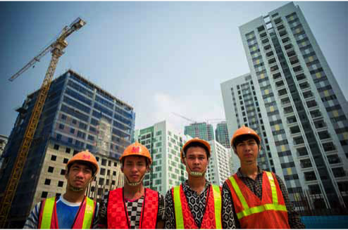
Chúng ta làm gì để bảo vệ Lao động trẻ?
Notes:
So, what can be done to improve OSH for young workers?

Slide 16
Cải thiện thu thập dữ liệu
Xây dựng và thực thi
pháp luật và chính sách
Cải thiện
Xây dựng
Đẩy mạnh tuyên truyền
và Nghiên cứu
Nâng cao năng lực cho
chính phủ, người sử dụng lao động
và người lao động
Đẩy mạnh
Nâng cao năng lực
Lồng ghép ATSKNN vào giáo dục
Lồng ghép ATSKNN
Notes:
We identified 5 areas for action:
Improving the collection and analysis of data and information on OSH and young workers.
In this context, all workers, including youth, should understand the importance of reporting occupational accidents and diseases to the employer as they can contribute to improve OSH measures. Young workers in particular should be encouraged to participate in the reporting of workplace accidents. Without encouragement and reassurance, young workers often fear that speaking up about a workplace injury will result in their employer acting in a way that is unfavourable to them.
Developing, updating and implementing policies, laws, regulations and guidelines to better protect the safety and health of young workers.
Laws and regulations usually protect young workers under 18 years old. However, special attention can be extend beyond the age of 18, particularly for very hazardous work.
Capacity building aimed at helping governments, employers, workers and their organizations address the OSH needs of young workers.
Employers and workers should be familiar with the process of risk management, which include the identification of work hazards, the assessment of the associated risks, taking into account for specific worker vulnerabilities, and the adoption of effective prevention and risk control measures.
Even if employers are responsible for the safety and health within the enterprise and for implementation of OSH measures, collaboration with workers is necessary for the improvement of working conditions.
Integrating OSH education into general education and into vocational training programs.
This is a very important issue that we discuss in the next slide.
Strengthening advocacy, awareness and research on young workers’ vulnerability to OSH hazards and risks
Awareness-raising campaigns on OSH and the use of real-world experiences are effective ways of disseminating information and sensitizing workers, parents, employers, schools, and communities about young workers’ rights and vulnerabilities. These campaigns can be organized by governments or national institutions, employers’ organizations, trade unions, youth associations, NGOs, schools and other civil society organizations.

Slide 17
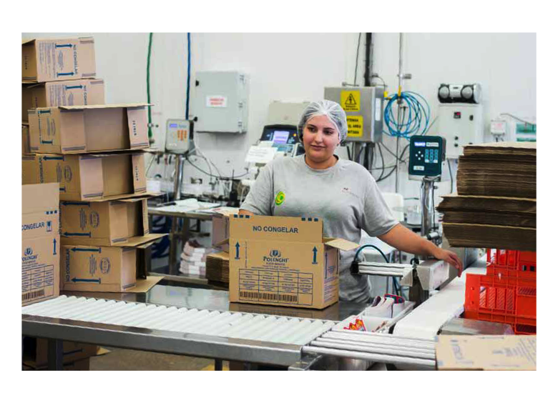
Cải thiện thu thập và phân tích thông tin và số liệu về ATSKNN và lao động trẻ
Notes:
1. Improving the collection and analysis of data and information on OSH and young workers.
The development of an effective OSH system at the national and enterprise levels requires reliable data on OSH, such as data on occupational accidents and diseases. Accurate data in fact are critical for identifying workplace hazards, hazardous sectors and vulnerable groups of workers; as well as for setting priorities and measuring progress
All workers, including youth, should understand the importance of reporting occupational accidents and diseases to the employer as they can contribute to improve OSH measures. Young workers in particular should be encouraged to participate in the reporting of workplace accidents. Without encouragement and reassurance, young workers often fear that speaking up about a workplace injury will result in their employer acting in a way that is unfavourable to them.

Slide 18
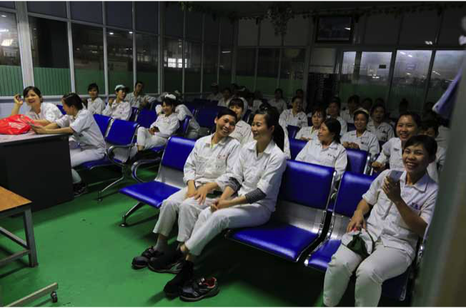
Xây dựng, sửa đổi và thực thi chính sách, pháp luật, quy định, hướng dẫn để đảm bảo tốt hơn an toàn và sức khỏe cho lao động trẻ
Notes:
2. Developing, updating and implementing policies, laws, regulations and guidelines to better protect the safety and health of young workers.
A national OSH policy should aim at the development of a national preventative safety and health culture. Priority areas for action and workers at higher risk, such as young workers, should be identified and addressed when developing such policies.
Laws and regulations should reflect international standards on improving OSH and eliminating child labour. The concern for the safety and health of young workers should not be limited to young people under the age of 18; it should extend to all young workers. It should be expressed in national laws, regulations and policies that address the risk factors that cause young workers to suffer harm from workplace hazards.
Guidelines and tools to promote compliance with OSH requirements are also very important. Governments and other national institutions, as well as employers’ and workers’ organizations, should develop these tools with specific focus on young workers’ needs.

Slide 19

Nâng cao năng lực nhằm hỗ trợ các cơ quan quản lý nhà nước, người sử dụng lao động, người lao động, tổ chức đại diện của họ đáp ứng nhu cầu về ATSKNN cho lao động trẻ
Notes:
3. Capacity building aimed at helping governments, employers, workers and their organizations address the OSH needs of young workers.
To fulfil their duty to protect workers’ safety and health, employers should be familiar with the process of risk management, which include the identification of work hazards, the assessment of the associated risks, taking into account for specific worker vulnerabilities, and the adoption of effective prevention and risk control measures. Employers’ organizations have a critical role to play in helping their members acquire adequate skills and understand the importance of risk management.
Collaboration with workers is necessary for the improvement of working conditions. In order to adequately represent young workers, OSH representatives need to be aware of the risk factors that young workers face and they should be provided with information and guidance on how to address the OSH vulnerabilities of young workers.
Governments, employers’ organizations and trade unions must play an important role in bringing about OSH in the informal and rural economies, both of which employ large numbers of young workers and child labourers, and in which hazardous working conditions are often found.

Slide 20
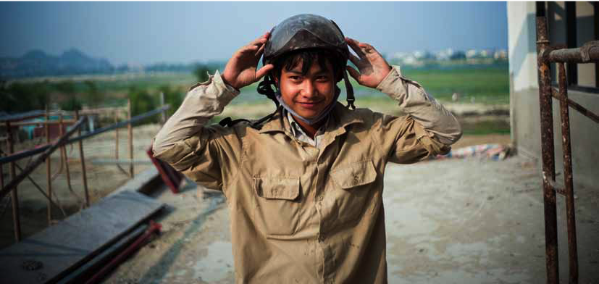
Lồng ghép ATSKNN vào giáo dục phổ thông và dạy nghề để xây dựng thế hệ người lao động an toàn và khỏe mạnh hơn
Notes:
4. Integrating OSH education into general education and into vocational training programs
It is a highly effective way of building OSH awareness, knowledge and skills among young workers and young employers. As young people are the future of any society, and important drivers of cultural change, basic OSH information should be integrated into school curricula, technical training and educational programmes. This would help ensure that young people are aware of the need to protect their safety and health, and that they are aware of their right to do so.
A recent study conducted by the French National Research and Safety Institute for the Prevention of Occupational Accidents and Diseases (INRS) found that for young workers who received OSH teaching at school, the occupational accident rate was 50 per cent lower than for young workers who did not.
Effective OSH education enables young people to adopt prevention-oriented attitudes and behaviours; develop the skills and abilities needed for the identification of hazards and risks; and develop effective OSH solutions, whether these young people be in school, at work, or otherwise contributing to society.

Slide 21

Đẩy mạnh tuyên truyền, nâng cao nhận thức và nghiên cứu về các nguy cơ và rủi ro lao động trẻ gặp phải
tại nơi làm việc
Notes:
5. Strengthening advocacy, awareness and research on young workers’ vulnerability to OSH hazards and risks
Continuing support for conducting and disseminating OSH research on young workers is critical. Hopefully, an increasing number of OSH agencies and institutions are studying young workers.
Awareness-raising campaigns on OSH and the use of real-world experiences are effective ways of disseminating essential information and of sensitizing workers, parents, employers, schools, and communities about young workers’ rights and vulnerabilities. These campaigns can be organized by governments or national institutions, employers’ organizations, trade unions, youth associations, NGOs, and other civil society organizations.
Trade Unions are increasingly recognizing the importance of affiliating young workers and engaging them directly in the organization of campaigns and actions to promote their rights at work.

Slide 22

Nâng cao tiếng nói của Lao động trẻ đối với vấn đề An toàn và Sức khỏe nghề nghiệp
Notes:
Young workers need to advocate for their labour rights, including the right to safe and healthy work adapted to their needs.
But, how can they voice their concerns?

Slide 23
Tạo điều kiện cho lao động trẻ tham gia xây dựng văn hóa phòng ngừa về An toàn và Sức khỏe nghề nghiệp
  Cung cấp cho lao động trẻ nguồn lực và cơ hội để hỗ trợ họ hoạch định tương lai
  Cho phép thanh niên và tổ chức đại diện của thanh niên tham gia xây dựng và thực hiện các biện pháp và chương trình hướng tới phòng ngừa tai nạn lao động và bệnh nghề nghiệp
Notes:
What does it mean a culture of prevention on OSH?
It means:
respect for the right to a safe and healthy work environment at all levels,
active participation of governments, employers, and workers in securing a safe and healthy work environment
high priority to the principle of prevention
Directly involving young workers and their organizations in the development and implementation of such preventive culture is critical, as it makes it possible for their concerns to be addressed during the discussion about how to create a generation of safe and healthy workers.
Moreover, because large numbers of young workers are involved in non-standard forms of employment and in informal work, they are “invisible” and deprived of bargaining power and effective representation. Their relative lack of power and voice contributes to the unfortunate situation whereby young workers a group are overlooked in the OSH legal and policy framework, and also overlooked during the design of OSH training and awareness campaigns, and when research priorities are determined.
Public institutions must be prepared to support young people in their efforts to determine their future by providing them with resources and opportunities to be actively engaged.

Slide 24
Kế hoạch Hành động về An toàn và Sức khỏe cho Lao động trẻ
  Tháng 9/2017: Đại hội Thế giới về An toàn và Sức khỏe cho Lao động trẻ
  Tham vấn với các Quán quân thanh niên tại nhiều diễn đàn quốc tế và khu vực
  Góp ý của các chuyên gia An toàn Sức khỏe nghề nghiệp
  Ban soạn thảo họp tại ILO Geneva
  Tháng 4/2018: Công bố Kế hoạch Hành động về An toàn và Sức khỏe cho Lao động trẻ
Notes:
A culture of prevention on OSH means that there is respect for the right to a safe and healthy work environment at all levels, and that governments, employers, and workers actively participate in securing a safe and healthy work environment through a system of defined rights, responsibilities and duties. The principle of prevention is given high priority.
When building a sustainable culture of prevention with respect to OSH, special attention should be given to hazardous sectors and industries and to vulnerable workers, such as young workers employed in workplaces where the risk of workplace harm is high.
Directly involving young workers and their organizations in the development and implementation of such preventive culture is critical, as it makes it possible for their concerns to be addressed during the discussion about how to create a generation of safe and healthy workers.
Civil society and traditional OSH institutions and their social partners often lack the knowledge and means to advocate effectively on young people’s behalf.
Moreover, because large numbers of young workers are involved in non-standard forms of employment and in informal work, they are “invisible” and deprived of bargaining power and effective representation. Their relative lack of power and voice contributes to the unfortunate situation whereby young workers a group are overlooked in the OSH legal and policy framework, and also overlooked during the design of OSH training and awareness campaigns, and when research priorities are determined.
Public institutions must be prepared to support young people in their efforts to determine their future by providing them with resources and opportunities to be actively engaged.

Slide 25
Xin cảm ơn!
28 tháng 04 năm 2018
Ngày Thế giới về An toàn và Sức khỏe tại Nơi làm việc
www.ilo.org/safeday
Notes:
Thank you for your attention.
For more information about the World Day for Safety and Health at Work campaign and materials, please visit www.ilo.org/safeday.

