Slide 1
Sustainable Development Goals (SDGs) &
Child Labour and Forced Labour

Slide 2
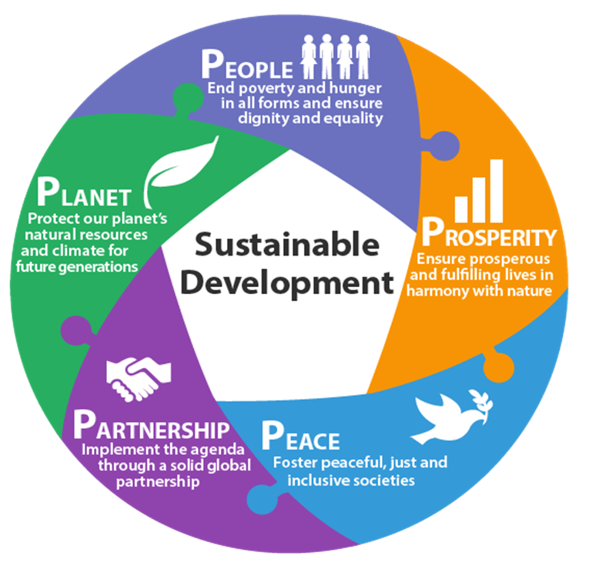
People, Planet, Prosperity, Peace & Partnership
These 5 elements underpin
the 17 SDGs

Slide 3

The 17 SDGs: Adopted by the UN General Assembly
in September 2015
Notes:
As you can see, Goal 8 is right in the centre of the 17 Goals. This shows how central it is and how linked it is with all the other Goals.

Slide 4

Child labour and forced labour perpetuates
poverty in a ”viscious spiral”
The link between poverty and labour exploitation is well established
Target 1.2 (eradication of extreme poverty) and 1.3. (reduce by half poverty in all its dimensions) can only be achieved if child labour and forced labour is eradicated
Target 1.3 (social protection) and target 1.4 (access to economic resources) are direct contributions to preventing child labour
Notes:
The links between poverty and child labour/forced labour are well established, reasonably obvious and often quite well known, so you may not need to spend large amounts of time on this. Sometimes partners are very clear that poverty causes child labour/forced labour, but less clear that child labour and forced labour perpetuate intergenerational poverty – if so this should be explained.

Slide 5
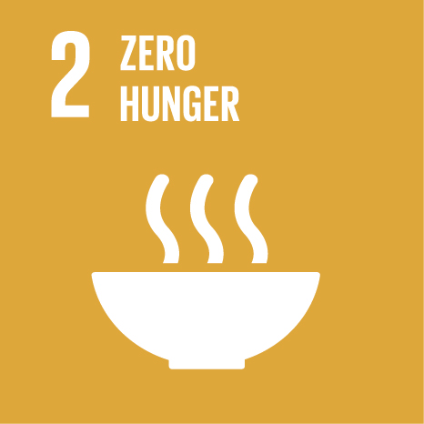
Hunger is a root cause of child labour
2.1 By 2030, end hunger and ensure access by all people, in particular the poor and people in vulnerable situations, including infants, to safe, nutritious and sufficient food all year round.
Ending food insecurity and hunger prevents child labour.

Slide 6

Health issues and labour issues are inter-linked
3.3 By 2030, end the epidemics of AIDS, tuberculosis, malaria and neglected tropical diseases and combat hepatitis, water-borne diseases and other communicable diseases.
3.5 Strengthen the prevention and treatment of substance abuse, including narcotic drug abuse and harmful use of alcohol.
3.7 By 2030, ensure universal access to sexual and reproductive health-care services, including for family planning, information and education, and the integration of reproductive health into national strategies and programmes.
3.8 Achieve universal health coverage, including financial risk protection, access to quality essential health-care services and access to safe, effective, quality and affordable essential medicines and vaccines for all.
Notes:
3.3. AIDS and other diseases that kill or permamnently injure parents/adult care givers increase child vulnerability to, amongst others, child labour (for example orphans growing up with ageing grand parents who are unable to provide for them are at extreme risk of child labour all over Africa – direct link here to provision of social protection (pension, child grants) to mitigate the risk)
3.5 Substance abuse among adult care givers push children out from home and renders them vulnerabel to school drop out, street life etc. Moreover, child labourers and victims of forced labour are sometimes drugged to keep them working/make them docile
3.7 In a number of countries, child labour is directly correlated with family size
3.8 universal health cover is an essential element of social protection that may prevent child labour and forced labour. Note also, that forced labour is associated with unregistered migration and therefore victims of forced labour more often than not do not have access to health care even though they are at extreme risk of injury and illness

Slide 7

Children should be in school not in workplaces!
Reaching the education targets is a direct contribution to elimination of child labour
But the education targets will not be reached if child labour persists
Ensuring training and education opportunities for young people is also a direct contribution to preventing human trafficking and forced labour
Notes:
The heading is a paraphrasing of an ITUC campaign slogan.
This is a well established area that partners are often familar with and hence you may be able to simply remind them of the ”viscious spiral” of poor education, poverty and child labour/forced labour that needs to be broken by making quality education and training accessible to ALL children (free and compulsory basic education is still a key response). Remember to stress gender dimensions that may be relevant in your context.

Slide 8

Labour exploitation has a gender dimension too!
5.1 End all forms of discrimination against all women and girls everywhere.
5.2 Eliminate all forms of violence against all women and girls in the public and private spheres, including trafficking and sexual and other types of exploitation.
5.3 Eliminate all harmful practices, such as child, early and forced marriage and female genital mutilation.
5.4 Recognize and value unpaid care and domestic work through the provision of public services, infrastructure and social protection policies and the promotion of shared responsibility within the household and the family as nationally appropriate.
Notes:
Overall, child labour and forced labour is gendered: boys and girls, women and men tend to end up in exploitative labour situations that fit within stereotypical gender roles (i.e. girls and women become domestic labourers (slaves) and men end up on fishing vessels).
5.1 – girls more likely than boys to do triple burden (school. Labour and unpaid domestic work) and do invisible work and therefore be under-represented in child labour statistics – but remember, that sometimes boys are more at risk than girls (for example in some pastoralist communities)
5.2 – this is self explanatory – trafficking for domestic labour is often an overlooked problem – don’t forget though that men and boys – especially when that are victims of WFCL/forced labour – are also at extreme risk of violence and discrimination
5.3 Early marriage is associated with school drop out and child labour (as an economic activity) as well as excessive amounts of unpaid family/domestic labour
5.4 double/triple burden on girls and women

Slide 9

Fetching water may amount to child labour…
6.1 By 2030, achieve universal and equitable access to safe and affordable drinking water for all
This will be direct contribution to preventing child labour by limiting demand on children’s time and labour in communities with access to water currently
Notes:
Fetching of water and fire wood was shown to be major causes for children not attending schools regularly in studies in South Africa (2009) and Zambia (2010).
Stress also, that fetching water not only inhibits school attendance – it may also be heavy work, causing physical injuries and long-term muscular-skeltal disorders.

Slide 10

…and so may fetching firewood!
7.1 By 2030, ensure universal access to affordable, reliable and modern energy services.
As in the case of water, fetching firewood is time demanding and heavy and may keep children away from school.
Target 7.1. may therefore be important to prevent child labour.

Slide 11

From the perspective of elimination
child labour and forced labour this is goal no. 1!
8.7 Take immediate and effective measures to eradicate forced labour, end modern slavery and human trafficking and secure the prohibition and elimination of the worst forms of child labour, including recruitment and use of child soldiers, and by 2025 end child labour in all its forms.

Slide 12
From the perspective of elimination
child labour and forced labour this is goal no. 1!
Indicator 8.7.1:
Percentage and number of children aged 5-17 engaged in child labour, by sex and age group
Alliance 8.7 established to promote global cooperation towards realization of target 8.7
8.7 is THE TARGET but other targets are important too:

Slide 13
The other targets
8.1 Sustain per capita economic growth in accordance with national circumstances and, in particular, at least 7 per cent gross domestic product growth per annum in the least developed countries.
8.2 Achieve higher levels of economic productivity through diversification, technological upgrading and innovation, including through a focus on high-value added and labour-intensive sectors.
8.3 Promote development-oriented policies that support productive activities, decent job creation, entrepreneurship, creativity and innovation, and encourage the formalization and growth of micro-, small- and medium-sized enterprises, including through access to financial services.
8.4 Improve progressively, through 2030, global resource efficiency in consumption and production and endeavour to decouple economic growth from environmental degradation, in accordance with the 10-year framework of programmes on sustainable consumption and production, with developed countries taking the lead.
8.5 By 2030, achieve full and productive employment and decent work for all women and men, including for young people and persons with disabilities, and equal pay for work of equal value.
8.6 By 2020, substantially reduce the proportion of youth not in employment, education or training.

Slide 14
The other targets
8.8 Protect labour rights and promote safe and secure working environments for all workers, including migrant workers, in particular women migrants, and those in precarious employment.
8.9 By 2030, devise and implement policies to promote sustainable tourism that creates jobs and promotes local culture and products.
8.10 Strengthen the capacity of domestic financial institutions to encourage and expand access to banking, insurance and financial services for all.
8.A Increase Aid for Trade support for developing countries, in particular least developed countries, including through the Enhanced Integrated Framework for Trade-Related Technical Assistance to Least Developed Countries.
8.B By 2020, develop and operationalize a global strategy for youth employment and implement the Global Jobs Pact of the International Labour Organization.

Slide 15

Industries are only sustainable without
forced labour and human trafficking
Competing for scarce (scarce) natural resources in an unsustainable way may cause forced labour as a ”cost-cutting” measure
Conversely, improving environmental and economic sustainability through technology can lead to improved productivity and less need for child labour and less use of forced labour
The reputational risks associated with forced labour and child labour may threaten the very existence of an industry or enterprise – that is not sustainable!
Notes:
A good example of the link between unsustainable environmental practises, unsustainable economics and the use of forced labour is a substantial part of the fishing industry in Asia, where over fishing and environmental degredation has caused economic pressure, leading to (possibly increased) use of forced labour.
In Malawi, tractor pooling among small scale farmers (notably in tobacco growing areas) has increased productivity and lowered the need for child labour.

Slide 16
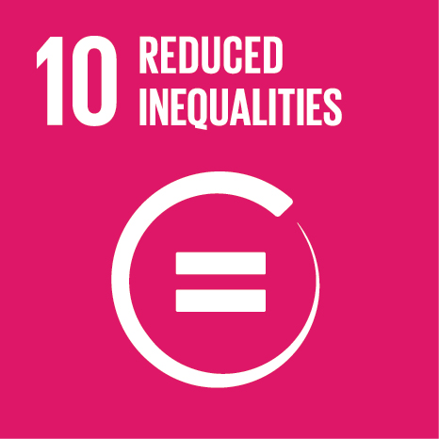
Inequality breeds exploitation
Ethnic minorities, migrants and socially marginalised communities, children and adults are at higher risk of child labour and forced labour.
Also, forced labour and child labour reinforce patterns of extreme inequality.
Again, the vicious spiral needs to be incepted to create a virtuous cycle.

Slide 17
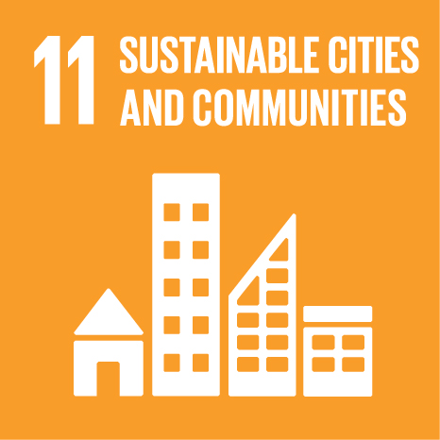
Yes, there is a link!
11.1 By 2030, ensure access for all to adequate, safe and affordable housing and basic services and upgrade slums.
Housing links with poverty and child labour as a survival strategy.
Safe, affordable housing and community services is an element of ensuring the family resilience that prevents child labour and forced labour.
Notes:
Services include, for example waste management and safe water.

Slide 18

You get what you pay for!
Demand for products that are (too!) cheap may cause forced labour and child labour in global supply chains.
Forced labour and child labour MUST be eliminated from supply chains before they can be considered sustainable.
Notes:
There is a growing international recognition – and global businesses increasingly see erdication of labour exploitation as a non-competition issues that they must collaborate on to satisfy consumer demands – this also means that those who continue exploitative and abusive practises face increased risk of reputational damage, trade sanctions and, ultimately, economic losses.
Here you may high light the UN Global Compact and the ILO’s child labour platform as well.

Slide 19

Climate change causes child labour!
13.1 Strengthen resilience and adaptive capacity to climate-related hazards and natural disasters in all countries.
Climate change – natural disasters – food insecurity and depletion of household resources – child labour as a “survival strategy”.
Notes:
The point here is of course that things are interconnected and that the impact of climate change can be a root cause of child labour –hence climate change adaptation is directly relevant to the elimination of child labour even if it does not seem immediately obvious.

Slide 20


Natural resources are a precondition for eradicating poverty induced labour exploitation
Notes:
The example from the Asian fishing industry illustrates clearly, how the depeletion of natural resources and labour exploitation are linked – hence, preservation of natural resources is indirectly a vital contribution to eliminating child labour and forced labour.

Slide 21

Wars and injustice breed child labour and
forced labour is linked with organised crime
16.1 Significantly reduce all forms of violence
and related death rates everywhere.
16.2 End abuse, exploitation, trafficking and all forms of violence against and torture of children.
16.3 Promote the rule of law at the national and international levels and ensure equal access to justice for all.
16.4 By 2030, significantly reduce illicit financial and arms flows, strengthen the recovery and return of stolen assets and combat all forms of organized crime.
16.5 Substantially reduce corruption and bribery in all their forms.
Notes:
The growing tendency for Syrian refugee children in Libanon illustrates very clearly how war breeds child labour through displacement and loss of livelihoods (16.1)
Trafficking in children is a WFCL and chid labourers are at increased risk of suffering violence and exploitation in general, so target 16.2 links directly with target 8.7
Trafficking of persons for forced labour is directly linked with transnational, organised crime syndicates and therefore falls directly under target 16.4
Corruption (16.5) is linked with the persistence of child labour indirectly: Funds that ”disappear” into corrupt practises are not available for public services, such as education, that prevent child labour. Moreover, child labour perpetuates poverty and poor education and this provides fertile ground for corrupt practises (a poorly educated, disempowered population is less likely to question curroption and demand justice).

Slide 22

We are all in this together!
Needless to say, that:
In a globalised world the persistence of forced labour and child labour anywhere is a problem everywhere!
Signing up the SDGs requires commitment in action and allocation of resources by all countries.

