Slide 1
Development Processes & Issues
Annotated generic slides for partner orientation, May 2016
(based on presentations developed for use in Suriname and Timor Leste)
Notes:
The slides in this tool can be used as a full presentation or selected slides can be copied into other presentations

Slide 2
Presentation outline
A little background: general framework and purpose
What is in a NAP: Elements of the NAP:
      Main elements
      The M&E framework
      The implementation plan
      Costs and resources
The development process: issues to consider
Initial questions for [country]

Slide 3
General framework
Fundamental principles and rights at work must be a core priority in ILO member states
Explicit obligations to develop NAPs on child labour and forced labour through Convention No. 182 (Elimination of the Wort Forms of Child Labour) and the 2014 Protocol to Convention No. 29 (Abolition of Forced Labour)
NAPs must always be:
  tailored to national circumstances and
  driven by national commitment
Notes:
C182 and the 2014 Protocol provide the most detailed framework for action (especially with accompanying recommendations), but you may want to add additional conventions, depending on the context. If one or more of the fundamental rights conventions are not ratified in your country this could be raised here

Slide 4
Purpose of NAPs
  Highlights child labour/forced labour as national concern
  Provides framework for national dialogue
  Serves as mechanism for priority setting, policy decisions and resource allocation
  Establishes roles and responsibilities of stakeholders
  Stimulates improved performance and learning by doing
  Provides mechanism for assessing progress

Slide 5
Global NAP lessons
These lessons are derived from ILO support to child labour NAPs for over a decade:
  NAP is not a straight jacket!
  Nor a general statement of intent!
  A working document that is meant to be implemented
  Ownership by all concerned national partners and Government leadership is key
  Links up different stakeholders and clarifies their roles in CL/FL elimination
Notes:
Not a straight jacket means the NAP mus be flexible enough to respond to changing circumstances during it’s lifetime - but on the other hand it must be specific. It isn’t a general statemnet of intent or an overall policy – the NAP must contain specific, achieveable results and concrete actvities, specific, designated roles for specific designated partners etc.

Slide 6
  Should be based on solid knowledge (e.g. survey)
  Requires analysis and clear priority setting
  Practical solutions/implementation framework
  Clear M&E framework to measure progress
  Includes narrative analysis and “log frame” type matrices – balance depends on circumstances in each country
  Often linked to specific national policy/policies
Notes:
By practical solutions we mean relevant, specific and implementable interventions that are presented in a clear way – for example an implementation framework (unless the NAP contain a very detailed results framework or log frame)

Slide 7
What is in a NAP? The main elements
  Introduction
  Analysis (causes and consequences)
  Strategy description
  Objectives, (outcome/output), key activities
  Partners (consider partners’ capacity)
  M&E
  Budget/resources
Level of detail – needs to be considered/decided
Notes:
Partners capacity: It is no use allocating responsibility to partners that do not have capacity to match. Some countries (e.g. Ghana) undertakes partner capacity mapping/assessment to be able to determine who will be responsible for what

Slide 8
OVERALL OBJECTIVE
IMMEDIATE OBJECTIVES | OUTCOMES/ RESULTS | KEY ACTIVITIES | IMPACT INDICATORS | IMPLEMENTING PARTNERS
By 20XX this impact will have been achieved….. Several immediate objectives are usually needed for a NAP | For each objective, results, that will lead to achieving the objective, need to be specified | List of activities needed to achieve results | SMART indicators to measure impact (will be detailed further in M&E plan) | Specific list of partners responsible for implementing and coordinating activities in column 3
Notes:
This table is meant to illustrate to partners what needs to go into a NAP and how it can be presented in an easy, schematic way – it is NOT a blue print and should be adjusted to context. This includes adjusting terminology to one that is familiar to partners (e.g. use ”results” or ”outcomes” as is more familiar in column 2)

Slide 9
Overall goal: by 2020 the worst forms of child labour will be eliminated in a country
Notes:
This is an actual exerpt from a NAP (work in progress) in Suriname (though the country name has been removed). It is meant as an example to give partners an idea of what a NAP matrix may look like. If you work in another region, you may want to substitute with an example from a country in the region
Additional examples (full NAPs or excerpts) can be shared as hand-out/electronically

Slide 10
What is in a NAP? The M&E Framework
M&E framework – no NAP is complete without it!
Can be done as part of main NAP (recommended) or later
What to measure: impact, progress or both?
Should include indicators, means of verification (MoV) and targets for progress monitoring
Matrices, matrices, matrices…….
Notes:
Please, also refer to M&E plan tool
Example: Thailand NAP I no M&E framework – almost impossible to measure progress => NAP II (2015) includes M&E framework as part of main NAP

Slide 11
OBJECTIVES | INDICATORS | RESULTS | TARGETS | MOVS | FREQUENCY
This column contains the NAP objectives | SMART indicators to measure impact can be listed here Indicators are ”proxies” used to measure those tings that we cannot measure directly (e.g. ”awareness”) Indicators can be both qualitative and quantitative | This column contains the results in NAP | Targets (or bench marks) can be a way to steer implementation and to measure progress (i.e. did we achieve the target) | Means of verification (MOVs) establishes how we will get the information we need to verify our indicators and targets. If we cannot get the information required, the indicator/target will be of no use Gathering information may be costly (time etc.). Consider this as well | Here we can define how often we will gather information to for each indicator/target
Notes:
This matrix is another example – it should be adjusted to context.

Slide 12
What is in a NAP? The Implementation Plan
Defines the practical ”how to do it”
Is the link that allows mainstraming of child labour issues into existing programmes
Can be part of overall NAP or completed after the main NAP is adopted
Can be very detailed
Adds flexibility
Can be ”periodic”, e.g. yearly if not part of main NAP
Must be aligned with national planning/budget cycles
Notes:
Please, refer also to the tool on implementation plans

Slide 13
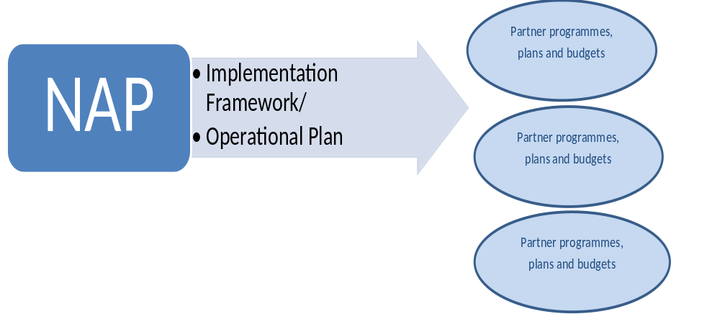
The implementation plan is “THE BRIDGE” between the NAP (as a national policy document) and organizational work plans and budgets

Slide 14
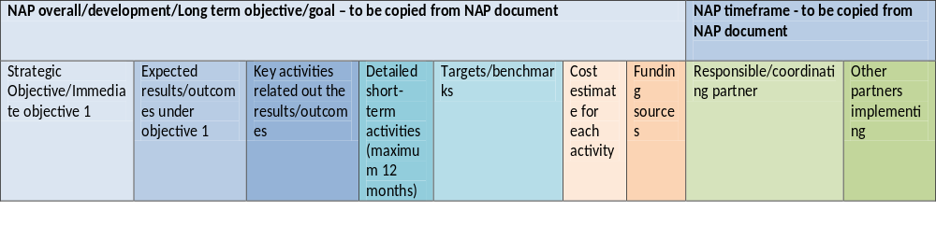
Notes:
This is the template from the implementation plan tool (based on the LAO PDR implementation plan)
Example: In Lao PDR, the NAP on Child Labour was fairly generic and did not give detailed guidance on the activities and who would be responsible for implementing them. Hence, the implementation plan was developed AFTER the NAP was adopted to guide implementation. Developing the implementation plan after the NAP, meant a more speedy adoption of the NAP and provides a measure of flexibility during implementation, as the implementation plan is easier to revise and adjust to developments than the NAP itself

Slide 15
What is in a NAP? Costing and resources
Activity based budgets are fundamental to results based management
So, NAP must give solid idea about activities before costing can be done
If detailed activities are not included in the NAP they must be included in the Implementation Framework/Operational Plan
Resources constitute more than funds (human resources, knowledge, skills, logistics)
Resources can be mobilised in several ways, so when costing think about where resources may come from
Notes:
Please, refer also to the NAP costing and budgeting tool. A number of slides in this presentation are identical to the slides in the budgeting presentation. Hence this presentation may substitute the budgeting presentation

Slide 16
Mobilising existing resources:
Mainstreaming and integration with existing budgets and programmes (both government, social partners, NGOs etc.)
Some activities are already funded through other plans (for example education sector plan)
Map out where programmes and funds cover already (requires working in partnerships)

Slide 17
Identify activities and programmes where child labour initiatives can be included without extra costs
MOL can take the lead – but must work with other line ministries and with relevant planning and finance departments
Applies not only to government! Civil society organisations also have on-going programmes

Slide 18
Need to align programming and budget cycle with existing cycles (national planning and budget cycles)
Some countries do mapping/study of existing budgets and cycles (e.g. Ghana)
General analysis may also help (child friendly budget analysis, educational expense analysis etc.) This may have been done already

Slide 19
A note on Government resources:
Advocating for additional government resources (new budget lines): Can be lengthy process, so sometimes best for long term activities
Child friendly budget analysis and advocacy may help

Slide 20
Other domestic resources that may be tapped:
Private sector (especially if win-win for companies), Public Private Partnerships
Community resources often more extensive than first believed, cost-sharing – Community committees key to mobilising
Fund raising drives

Slide 21
External resources:
International development partners, skills in proposal drafting required
Regional partners
Funds, in-kind, technical support all increase resource base

Slide 22
Resource Mobilisation Strategy/Plan
Consider doing a Resource mobilisation strategy/plan:
Resource mobilisation plan can be included in
implementation framework
Can be developed with costing:
When costing, think about where the resources will
come from
Be realistic!

Slide 23
The Formulation Process: Critical Features
Ownership and leadership:
  The relevant government department* must take leadership
  All partners/stakeholders must buy-in. Partners need to decide on strategy to ensure this
Participation and consultation
  Need for broad coalition
  Roles of key stakeholders must be clear
Roles: providers of technical assistance vis-à-vis mandated institutions
Informed choices: Need for solid knowledge base
Levels of involvement (and subsequent implementation): Central vs. local control; decentralisation
Stages of development of national action plan: framework first, detailed plans after official adoption or more detailed plans from the beginning?
Who will do the drafting? Drafting committee, support from external resource people, consultants…..
Notes:
You can change this to actual name of the relevant department in your country
Please, also refer to the ownership negotiation tool
Decentralisation or not? Zambia and Uganda: Extensive NAP consultations locally – very time demanding! Size of the country and level of decentralisation in administration important to make decision on this
“devil is in the detail” – so detailed plans take time! But need to make sure they are in place…LAO follow the framework first model - so did Thailand in NAP 1 – but they never got to details! So NAP 2, implementation and M&E framework are integral part of the plan

Slide 24
The Formulation Process: Key Steps
Not always sequential
NATIONAL SURVEY
Background studies and gap analysis
Consultations to develop NAP framework/
overall priorities
Drafting
More consulta-tions and validation
Adoption/
launch
(may require building political commitment)
Implementa-tion (plan)
M&E, NEW PHASE?
Notes:
Order often reversed on survey and background study
Consultations can be organised in various ways: as national/local workshops, as a series of small group consultations, in writing etc. Often, more than one form of consultation at different stages will be needed

Slide 25
Additional Resources
Multiple resources available on www.ilo.org/childlabour
For example:
Implementing the Roadmap for Achieving the Elimination of the Worst Forms of Child Labour by 2016 (2013)
Employers and Workers Handbook on Hazardous Child Labour (2011)
Mainstreaming child labour concerns in education sector plans and programmes (2011)

Slide 26
Initial issues to agree on in [country]
Guiding questions for discussion of priorities:
Which are the most critical steps in this process in [country]?
What kind of time-frame do you foresee?
Who should be consulted?
How would you like to organise consultations?
Who will draft the NAP?
Who will oversee the process?
Do you have the knowledge base you need to develop the NAP? If not, how to generate it?

Slide 27
Thank you for your attention!
Any questions?

