Slide 1

Meaningful youth engagement for decent work
A training package on engaging young people in employment programmes

Slide 2
Context and Purpose of the training
    Organised under the framework of the PROSPECTS initiative Advancing Young People’s Engagement and Meaningful Participation
    Building internal ILO capacity to work better for and with young people in promoting decent work, with a particular focus on displaced youth
    Pilot training - we welcome your feedback!
    Leverages the ILO Meaningful Youth Engagement for Decent Work: A training package on engaging young people in employment programmes

Slide 3



Agenda - Today
Laying the Foundation
Define meaningful youth engagement and explore the five key dimensions that contribute to effective participation.
From Consultation to Leadership
Examine the four degrees of youth engagement and apply strategies to engage young people at every level.
Unlocking Opportunities across the Programme Cycle
Identify new opportunities and mechanisms to strengthen youth engagement across different phases of a programme cycle.

Slide 4



Agenda - Tomorrow
Understanding youth and their structures
Identify youth demographics, recognize marginalized groups, and develop outreach strategies to ensure inclusive engagement.
The Youth Engagement Challenge
Develop a youth engagement initiative tailored to an employment programme and address challenges with practical solutions.
Recognizing the Principles of Youth Engagement
Discover the key principles of youth engagement that ensure participation is meaningful.

Slide 5

Logistics and housekeeping
    We encourage you to keep your video on!
    Chat box for questions/comments
    Breakout rooms for group activities

Slide 6


Meet your Facilitators
    Lead facilitator(s)
    Youth facilitator(s)
Name
Title
Name
Title

Slide 7

Time to introduce yourselves!
    Name
    Location
    Job title/area of work

Slide 8
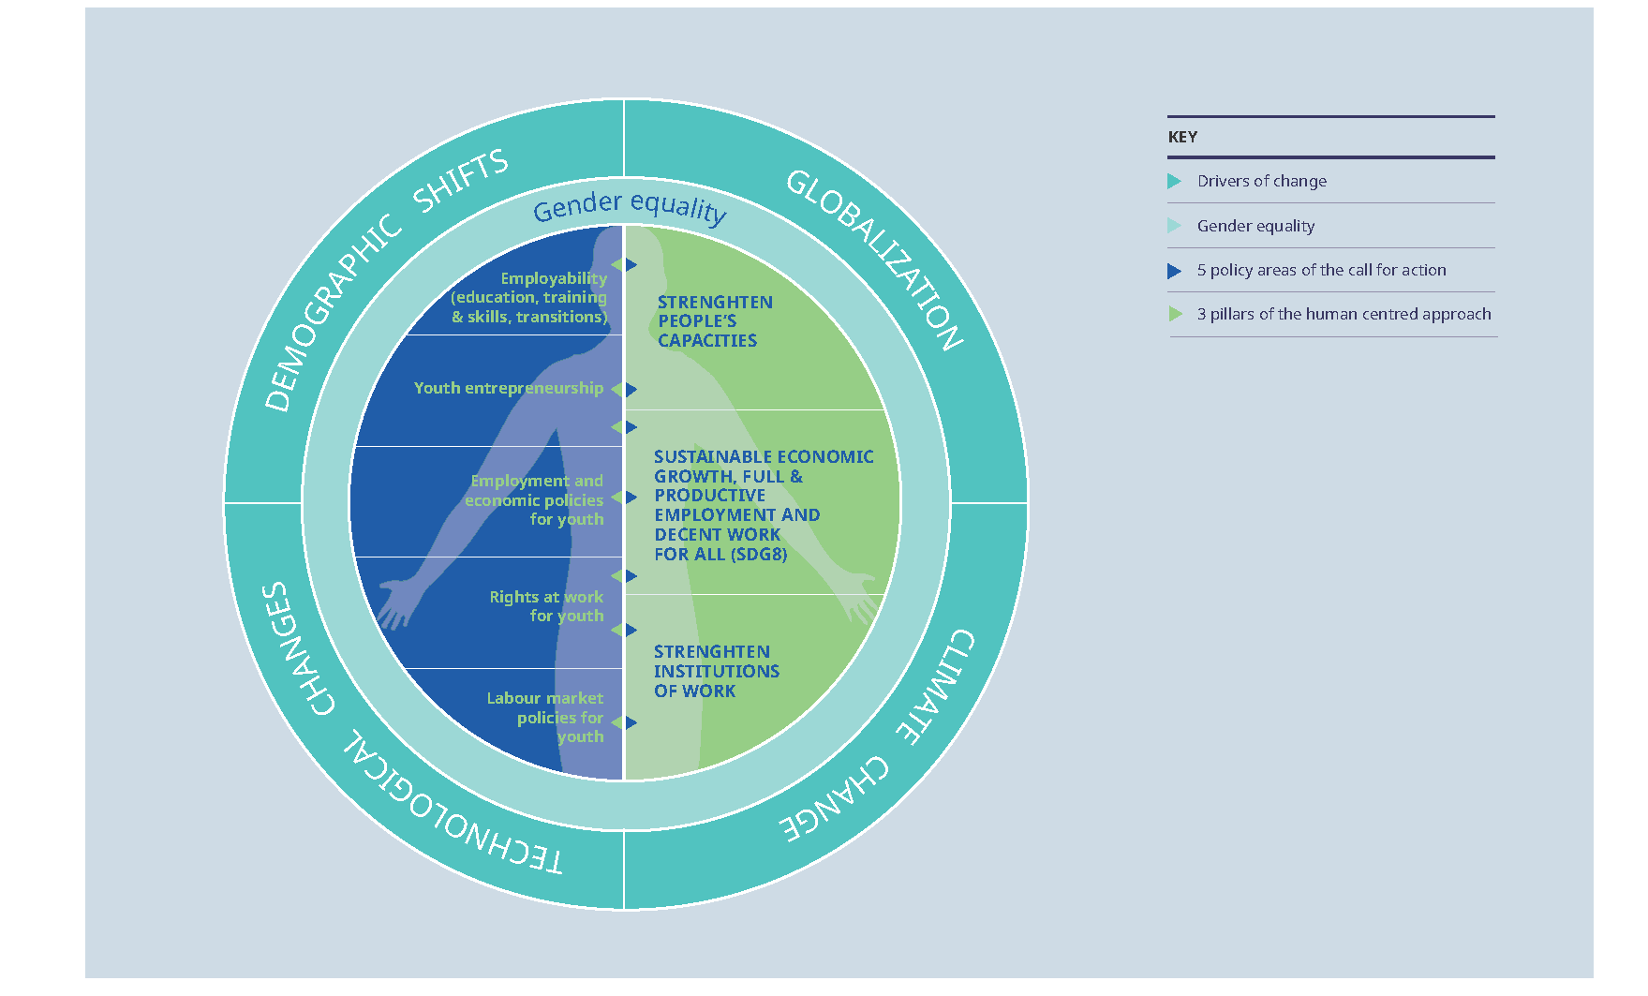
ILO Youth Employment Strategy Fit to Address Global Challenges
(2020-2030)
    Employment and economic policies for youth employment
    Youth Employability
    Labour market policies for youth
    Youth entrepreneurship and self-employment
    Rights for young people
Youth-inclusive social dialogue key instrument to foster youth agency in the world of work!

Slide 9

Decent Jobs for Youth
The global initiative to scale up action and impact on youth employment in support of the 2030 Agenda for Sustainable Development.
    The global initiative to scale up action and impact on youth employment in support of the 2030 Agenda for Sustainable Development.
A key avenue for the ILO to mobilise action to promote more and better jobs for youth, with meaningful youth engagement at its core.

Slide 10


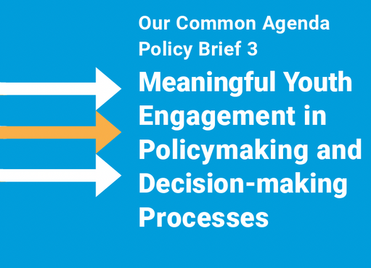
Global momentum for meaningful youth engagement
Global level
Regional and national levels
    EU Youth Strategy 2019-2027
    African Youth Charter
    ILO-AU Youth Employment Strategy for Africa
    Netherlands’ Youth @ Heart Strategy

Slide 11


Laying the Foundation
Define meaningful youth engagement and explore the five key dimensions that contribute to effective participation.

Slide 12

WHO is youth?
There is no universal definition of “youth”
    The UN defines “youth” as anyone from 15-24 years old.
    The AU defines youth as anyone between the ages of 15-35 years.
Important to think beyond an age group: Individual demographics, experience of being “youth” navigating transitions matter!
Notes:
The first thing to know is that there is no universal definition of “who is youth”.
The UN defines “youth” as anyone between the ages of 15 and 24.
For the ILO, youth is defined as persons aged between 15 and 29 years old.
AU defines youths as people between the ages of 15-35 years.
For Kenya it’s those between 18-34 years of age.
So, as you can see, many agencies, organizations, institutions adapt their definition to their national or regional context and also depending on the work they do.
So, there is no one single definition.
When defining youth, we can not just use an age bracket, because these age brackets are socially constructed.
So, we need to look beyond that, we need to look at other dimensions.

Slide 13






Why engage young people?
Notes:
The first thing to know is that there is no universal definition of “who is youth”.
The UN defines “youth” as anyone between the ages of 15 and 24.
For the ILO, youth is defined as persons aged between 15 and 29 years old.
AU defines youths as people between the ages of 15-35 years.
For Kenya it’s those between 18-34 years of age.
So, as you can see, many agencies, organizations, institutions adapt their definition to their national or regional context and also depending on the work they do.
So, there is no one single definition.
When defining youth, we can not just use an age bracket, because these age brackets are socially constructed.
So, we need to look beyond that, we need to look at other dimensions.

Slide 14



Why engage young people?
For young people
For youth employment programmes and policies
For communities and societies
Fulfils young people’s fundamental right to participation
Develops core skills and technical knowledge
Enhances youth agency and their ability to advocate for decent work
Increases relevance, responsiveness and effectiveness
Strengthens accountability and ownership
Drives innovation and creativity
Drives innovation in youth employment solutions
Strengthens youth engagement in communities
Advances SDG 8 on Decent Work and Economic Growth
Notes:
The first thing to know is that there is no universal definition of “who is youth”.
The UN defines “youth” as anyone between the ages of 15 and 24.
For the ILO, youth is defined as persons aged between 15 and 29 years old.
AU defines youths as people between the ages of 15-35 years.
For Kenya it’s those between 18-34 years of age.
So, as you can see, many agencies, organizations, institutions adapt their definition to their national or regional context and also depending on the work they do.
So, there is no one single definition.
When defining youth, we can not just use an age bracket, because these age brackets are socially constructed.
So, we need to look beyond that, we need to look at other dimensions.

Slide 15

What is meaningful youth engagement?
“A participatory process that actively involves young people as stakeholders, contributors, partners and leaders throughout the entire lifecycle of an employment programme.
This engagement spans all programming phases - governance, design and planning, implementation, monitoring, and evaluation - and must be reinforced by capacity-building and the creation of an enabling environment that supports their meaningful participation.”
Notes:
The first thing to know is that there is no universal definition of “who is youth”.
The UN defines “youth” as anyone between the ages of 15 and 24.
For the ILO, youth is defined as persons aged between 15 and 29 years old.
AU defines youths as people between the ages of 15-35 years.
For Kenya it’s those between 18-34 years of age.
So, as you can see, many agencies, organizations, institutions adapt their definition to their national or regional context and also depending on the work they do.
So, there is no one single definition.
When defining youth, we can not just use an age bracket, because these age brackets are socially constructed.
So, we need to look beyond that, we need to look at other dimensions.

Slide 16

Five dimensions of meaningful youth engagement
1.Voice
5. Accountability
2. Space
4. Influence
3. Audience
Notes:
The first thing to know is that there is no universal definition of “who is youth”.
The UN defines “youth” as anyone between the ages of 15 and 24.
For the ILO, youth is defined as persons aged between 15 and 29 years old.
AU defines youths as people between the ages of 15-35 years.
For Kenya it’s those between 18-34 years of age.
So, as you can see, many agencies, organizations, institutions adapt their definition to their national or regional context and also depending on the work they do.
So, there is no one single definition.
When defining youth, we can not just use an age bracket, because these age brackets are socially constructed.
So, we need to look beyond that, we need to look at other dimensions.

Slide 17

Group Activity
    Reflect on the assigned dimension and discuss:
    What does this dimension look like in practice?
    Why is it important for youth engagement?
    What are the barriers to achieving it?
Group 1 – Voice
Group 2 – Space
Group 3 – Audience
Group 4 – Influence
Group 5 – Accountability
Notes:
The first thing to know is that there is no universal definition of “who is youth”.
The UN defines “youth” as anyone between the ages of 15 and 24.
For the ILO, youth is defined as persons aged between 15 and 29 years old.
AU defines youths as people between the ages of 15-35 years.
For Kenya it’s those between 18-34 years of age.
So, as you can see, many agencies, organizations, institutions adapt their definition to their national or regional context and also depending on the work they do.
So, there is no one single definition.
When defining youth, we can not just use an age bracket, because these age brackets are socially constructed.
So, we need to look beyond that, we need to look at other dimensions.

Slide 18

Reflection: How are you engaging youth?
Let’s take a look to see if your youth employment programme is hitting the mark across each of the five dimensions of meaningful youth engagement.
Read the statements and choose whether you are Agree, Disagree or are Unsure
Notes:
The first thing to know is that there is no universal definition of “who is youth”.
The UN defines “youth” as anyone between the ages of 15 and 24.
For the ILO, youth is defined as persons aged between 15 and 29 years old.
AU defines youths as people between the ages of 15-35 years.
For Kenya it’s those between 18-34 years of age.
So, as you can see, many agencies, organizations, institutions adapt their definition to their national or regional context and also depending on the work they do.
So, there is no one single definition.
When defining youth, we can not just use an age bracket, because these age brackets are socially constructed.
So, we need to look beyond that, we need to look at other dimensions.

Slide 19
From Consultation to Leadership
Examine the four degrees of youth engagement and apply strategies to engage young people at every level.

Slide 20
HOW to engage youth?
YOUTH CONSULTED
YOUTH CONTRIBUTING
YOUTH AS PARTNERS
YOUTH AS LEADERS
Who initiates the project?
How do youth engage?
Who has control over the outcome?
Notes:
The first thing to know is that there is no universal definition of “who is youth”.
The UN defines “youth” as anyone between the ages of 15 and 24.
For the ILO, youth is defined as persons aged between 15 and 29 years old.
AU defines youths as people between the ages of 15-35 years.
For Kenya it’s those between 18-34 years of age.
So, as you can see, many agencies, organizations, institutions adapt their definition to their national or regional context and also depending on the work they do.
So, there is no one single definition.
When defining youth, we can not just use an age bracket, because these age brackets are socially constructed.
So, we need to look beyond that, we need to look at other dimensions.

Slide 21
HOW to engage youth?
YOUTH CONSULTED
YOUTH CONTRIBUTING
YOUTH AS PARTNERS
YOUTH AS LEADERS
E.g. Young people consulted in the development of a national youth employment strategy
E.g. Young people contribute to outreach efforts in enrolling youth in an EIIP programme
E.g. Partnering with youth trainers and facilitators in the delivery of a capacity-building training for rural youth.
E.g. Providing youth with financial and technical support to lead their own entrepreneurship projects.
Notes:
The first thing to know is that there is no universal definition of “who is youth”.
The UN defines “youth” as anyone between the ages of 15 and 24.
For the ILO, youth is defined as persons aged between 15 and 29 years old.
AU defines youths as people between the ages of 15-35 years.
For Kenya it’s those between 18-34 years of age.
So, as you can see, many agencies, organizations, institutions adapt their definition to their national or regional context and also depending on the work they do.
So, there is no one single definition.
When defining youth, we can not just use an age bracket, because these age brackets are socially constructed.
So, we need to look beyond that, we need to look at other dimensions.

Slide 22

Group Activity
YOUTH CONSULTED
YOUTH CONTRIBUTING
YOUTH AS PARTNERS
YOUTH AS LEADERS
Group 1
Group 2
Group 3
Group 4
    Reflect on the assigned degree and discuss:
    A real or realistic example from your experience or context
    What helped/can help to make this degree of engagement work? (e.g. tools, methods, approaches etc.)
    What are the potential challenges in supporting this degree of engagement?
Notes:
The first thing to know is that there is no universal definition of “who is youth”.
The UN defines “youth” as anyone between the ages of 15 and 24.
For the ILO, youth is defined as persons aged between 15 and 29 years old.
AU defines youths as people between the ages of 15-35 years.
For Kenya it’s those between 18-34 years of age.
So, as you can see, many agencies, organizations, institutions adapt their definition to their national or regional context and also depending on the work they do.
So, there is no one single definition.
When defining youth, we can not just use an age bracket, because these age brackets are socially constructed.
So, we need to look beyond that, we need to look at other dimensions.

Slide 23
YOUTH CONSULTED

Slide 24
Youth Consulted
YOUTH CONSULTED
Youth consultations are a structured way to gather insights from young people and their structures about their needs, challenges and solutions related to accessing decent work opportunities.
    Top tips and effective approaches:
    Use facilitators experienced or trained in engaging youth
    Allocate sufficient human and financial resources
    Ensure that participants understand their role in the consultation process and how their insights and inputs will be used.
    Methods include: Surveys and questionnaires | Individual interviews | Group discussions | Participatory workshops
Notes:
The first thing to know is that there is no universal definition of “who is youth”.
The UN defines “youth” as anyone between the ages of 15 and 24.
For the ILO, youth is defined as persons aged between 15 and 29 years old.
AU defines youths as people between the ages of 15-35 years.
For Kenya it’s those between 18-34 years of age.
So, as you can see, many agencies, organizations, institutions adapt their definition to their national or regional context and also depending on the work they do.
So, there is no one single definition.
When defining youth, we can not just use an age bracket, because these age brackets are socially constructed.
So, we need to look beyond that, we need to look at other dimensions.

Slide 25


Youth Consulted: Some examples
YOUTH CONSULTED
Young people consulted in the development of research, tools and guides.
Young people consulted in the design of youth employment strategies.
    Virtual interviews and focus group discussions with young people
    Work Wise Youth: Identified priority rights at work for young people and informed the development of youth-friendly learning approaches.
    Panorama Laboral: Gathered youth perspectives on the key challenges and solutions related to youth employment.
    Informed the design of the Nigerian Youth Employment Action Plan (2021-2024)
Notes:
The first thing to know is that there is no universal definition of “who is youth”.
The UN defines “youth” as anyone between the ages of 15 and 24.
For the ILO, youth is defined as persons aged between 15 and 29 years old.
AU defines youths as people between the ages of 15-35 years.
For Kenya it’s those between 18-34 years of age.
So, as you can see, many agencies, organizations, institutions adapt their definition to their national or regional context and also depending on the work they do.
So, there is no one single definition.
When defining youth, we can not just use an age bracket, because these age brackets are socially constructed.
So, we need to look beyond that, we need to look at other dimensions.

Slide 26
YOUTH CONTRIBUTING

Slide 27
Youth Contributing
YOUTH CONTRIBUTING
Engaging youth and their structures in specific and limited roles. This could include tasks such as data collection, advocacy or training & peer mentorship.
    How to select the right role for youth contributors?
    What are the core objectives of this programme and which tasks or activities would benefit from youth involvement?
    What skills and experience are necessary for the identified roles?
    What level of commitment and availability is required for the role?
    What support, training, and incentives are needed for youth to succeed in this role?
Notes:
The first thing to know is that there is no universal definition of “who is youth”.
The UN defines “youth” as anyone between the ages of 15 and 24.
For the ILO, youth is defined as persons aged between 15 and 29 years old.
AU defines youths as people between the ages of 15-35 years.
For Kenya it’s those between 18-34 years of age.
So, as you can see, many agencies, organizations, institutions adapt their definition to their national or regional context and also depending on the work they do.
So, there is no one single definition.
When defining youth, we can not just use an age bracket, because these age brackets are socially constructed.
So, we need to look beyond that, we need to look at other dimensions.

Slide 28
Youth Contributing
YOUTH CONTRIBUTING
    Top tips and effective approaches
    Define roles and responsibilities - clearly communication expectations, deliverables and timelines.
    Train and support youth contributors - Youth need clear guidance to carry out their roles effectively.
    Balance structure and creativity - Allow young people autonomy within their roles while providing clear objectives and goals.
Notes:
The first thing to know is that there is no universal definition of “who is youth”.
The UN defines “youth” as anyone between the ages of 15 and 24.
For the ILO, youth is defined as persons aged between 15 and 29 years old.
AU defines youths as people between the ages of 15-35 years.
For Kenya it’s those between 18-34 years of age.
So, as you can see, many agencies, organizations, institutions adapt their definition to their national or regional context and also depending on the work they do.
So, there is no one single definition.
When defining youth, we can not just use an age bracket, because these age brackets are socially constructed.
So, we need to look beyond that, we need to look at other dimensions.

Slide 29

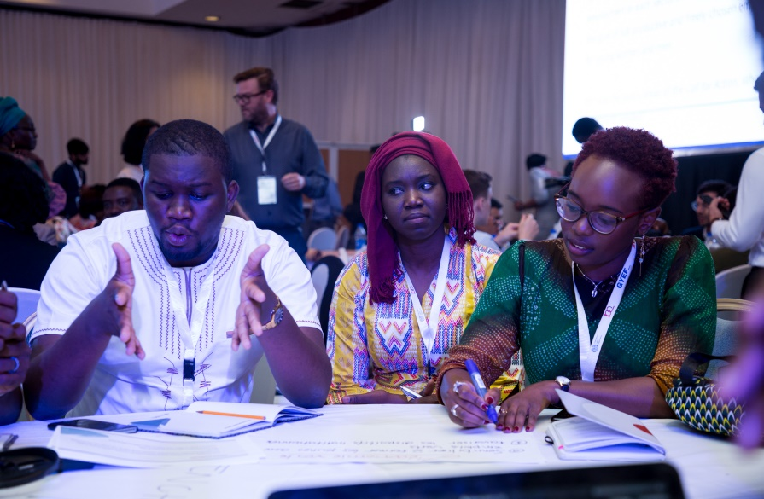
Youth Contributing: Some examples
YOUTH CONTRIBUTING
    Global Survey on Youth and COVID-19
    Youth-led organizations such as AIESEC, European Youth Forum, UNMGCY contributed to survey design, dissemination and report.
    Think Young developed communications materials and infographics.
    Youth consulted
    Youth took on roles as moderators and facilitators
    Tripartite youth committee drafted the Abuja Youth Statement as a youth contribution to advance the ILO’s Call for Action on Youth Employment 2020–2030.
Notes:
The first thing to know is that there is no universal definition of “who is youth”.
The UN defines “youth” as anyone between the ages of 15 and 24.
For the ILO, youth is defined as persons aged between 15 and 29 years old.
AU defines youths as people between the ages of 15-35 years.
For Kenya it’s those between 18-34 years of age.
So, as you can see, many agencies, organizations, institutions adapt their definition to their national or regional context and also depending on the work they do.
So, there is no one single definition.
When defining youth, we can not just use an age bracket, because these age brackets are socially constructed.
So, we need to look beyond that, we need to look at other dimensions.

Slide 30
YOUTH AS PARTNERS

Slide 31

Youth as Partners
YOUTH AS PARTNERS
Partnering and sharing power with youth involves engaging them as equal stakeholders in programme decision-making, design and implementation.
Programmes that adopt this model often establish:
    Joint governance structures and participatory decision-making spaces to ensure that young people influence and engage in strategic decisions.
    Co-led implementation modalities to ensure youth are engaged in operational and programme delivery processes and activities.
Top tips
    Secure organizational buy-in and commitment
    Develop clear guidelines and decision-making processes
    Provide training and capacity-building for young people
Notes:
The first thing to know is that there is no universal definition of “who is youth”.
The UN defines “youth” as anyone between the ages of 15 and 24.
For the ILO, youth is defined as persons aged between 15 and 29 years old.
AU defines youths as people between the ages of 15-35 years.
For Kenya it’s those between 18-34 years of age.
So, as you can see, many agencies, organizations, institutions adapt their definition to their national or regional context and also depending on the work they do.
So, there is no one single definition.
When defining youth, we can not just use an age bracket, because these age brackets are socially constructed.
So, we need to look beyond that, we need to look at other dimensions.

Slide 32
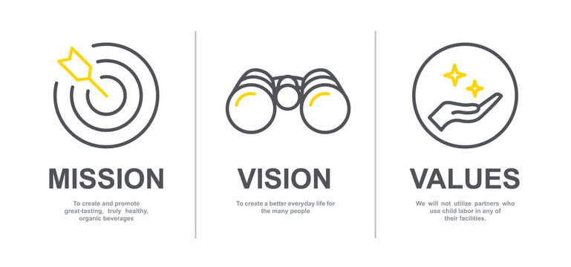

AU-ILO Youth Employment Strategy for Africa: YES-Africa
YOUTH AS PARTNERS
Vision
All youth are empowered to transform their lives and communities through productive and decent employment for a sustainable and inclusive future in Africa.
Mission
To call upon African governments, social partners, development partners and other stakeholders to invest in and promote the creation of decent jobs for youth.

Slide 33
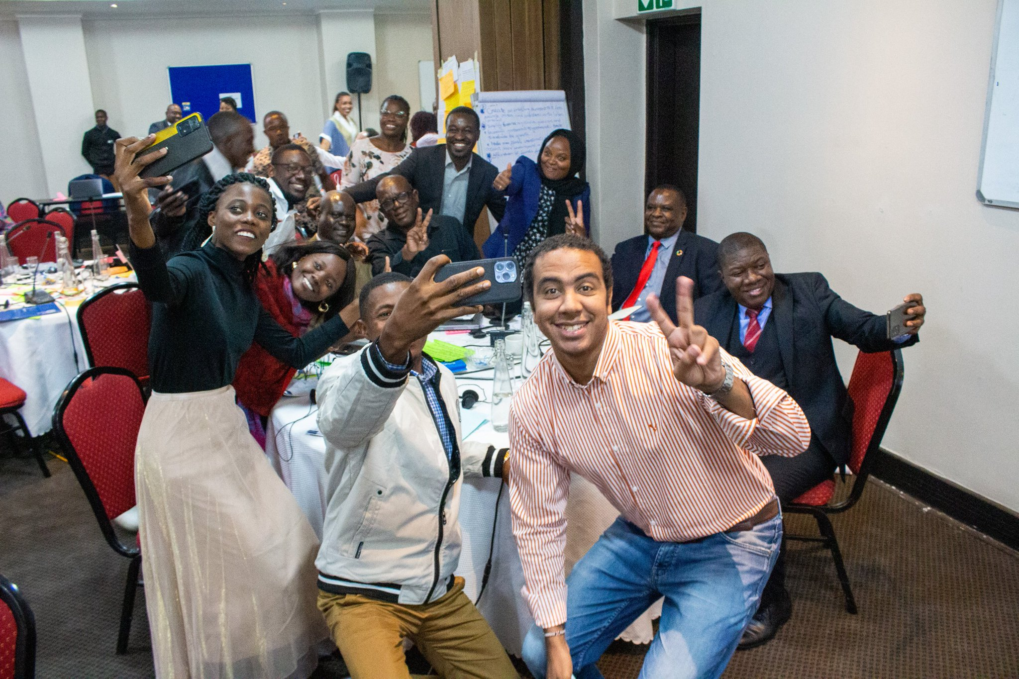
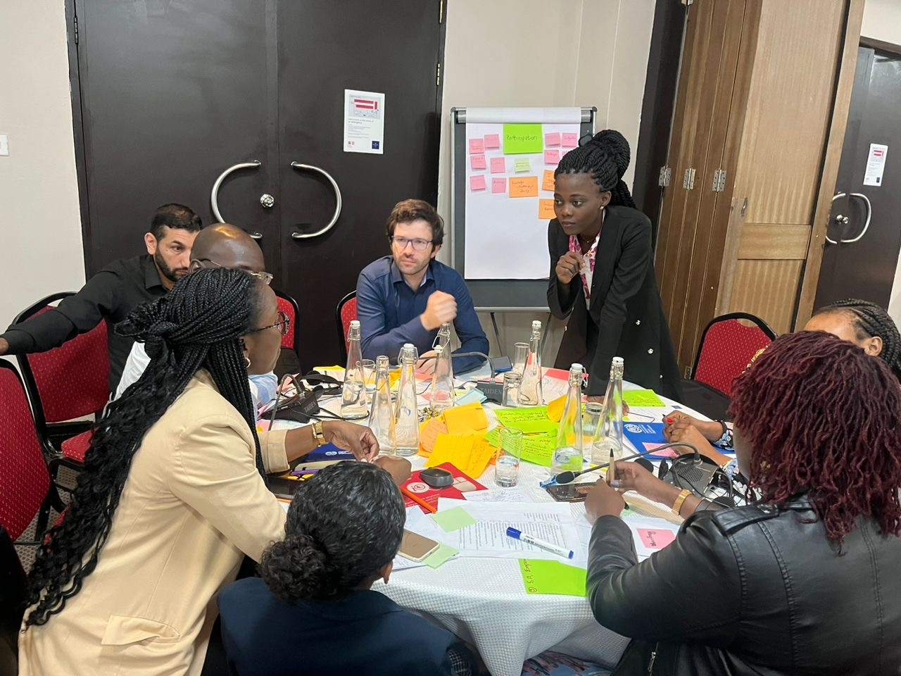
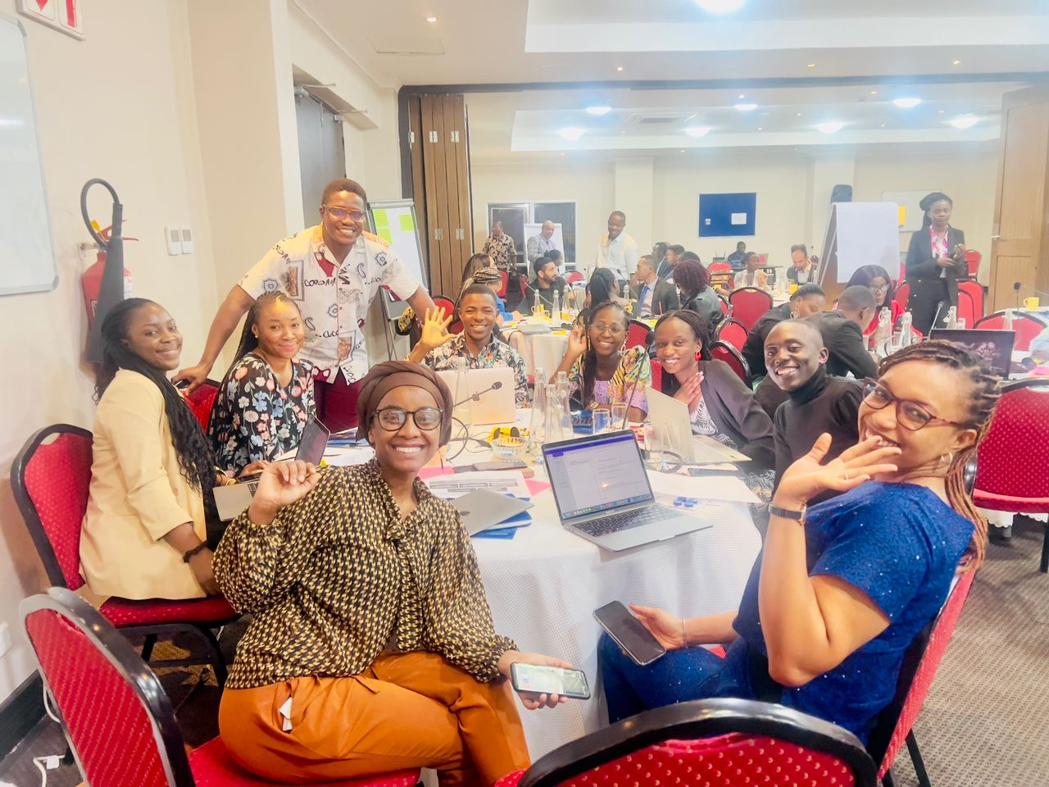
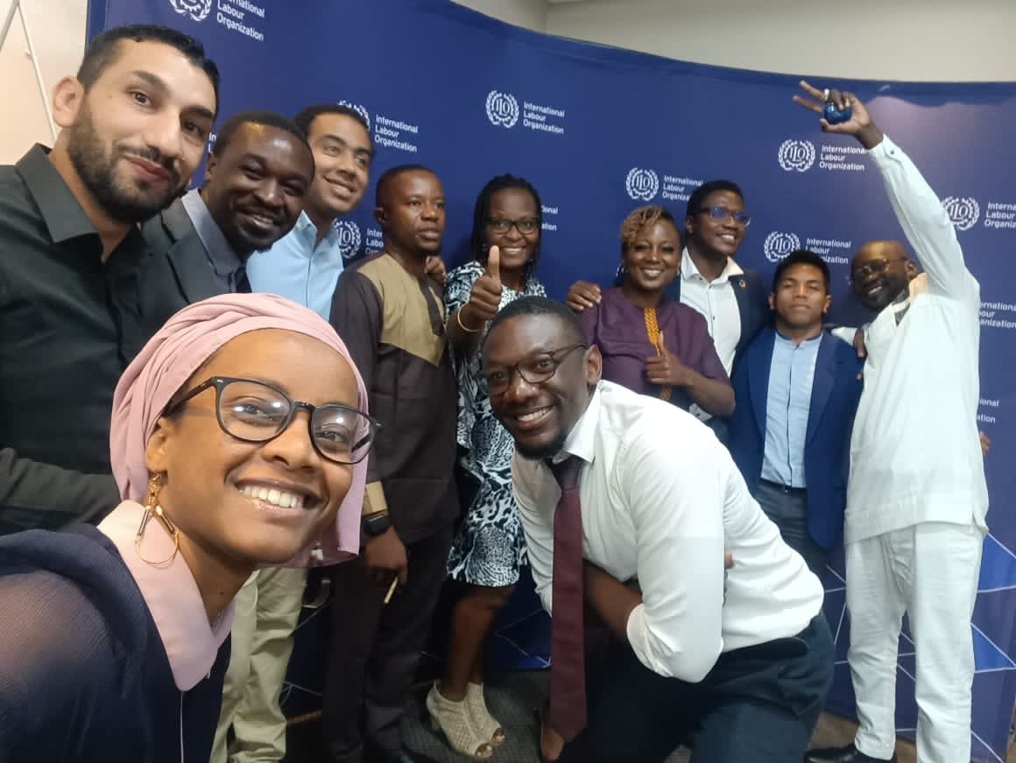
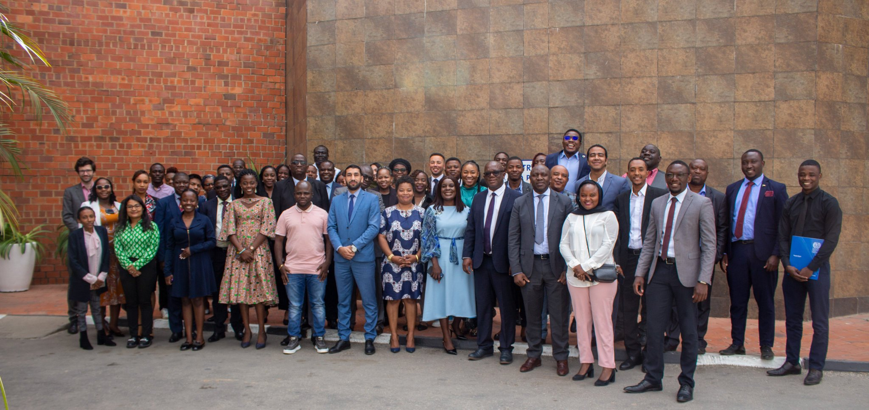
YES-Africa: developed for and with young people
    Presented at the AU STC on Youth, Culture and Sports: May 2023, Addis Ababa, Ethiopia
    Youth co-creation workshops: May/August 2023, Lusaka, Zambia
    Consultations & validation with governments, social partners and youth from Oct-Dec ’24
    Endorsement by the AU Specialised Technical Committee on Labour and Employment in Aug. 2024
Notes:
VALIDATION WORKSHOP: countries with in-person participation
DWT/CO-Yaoundé: Cameroon
CO-Kinshasa: DRC
CO-Abidjan: Côte d'Ivoire
DWT/CO-Cairo: Egypt
CO-Addis: Ethiopia
CO-Dar: Kenya (host), Rwanda
CO-Algiers: Morocco
CO-Harare: Namibia
CO-Abuja: Nigeria
DWT/CO-Pretoria: South Africa

Slide 34
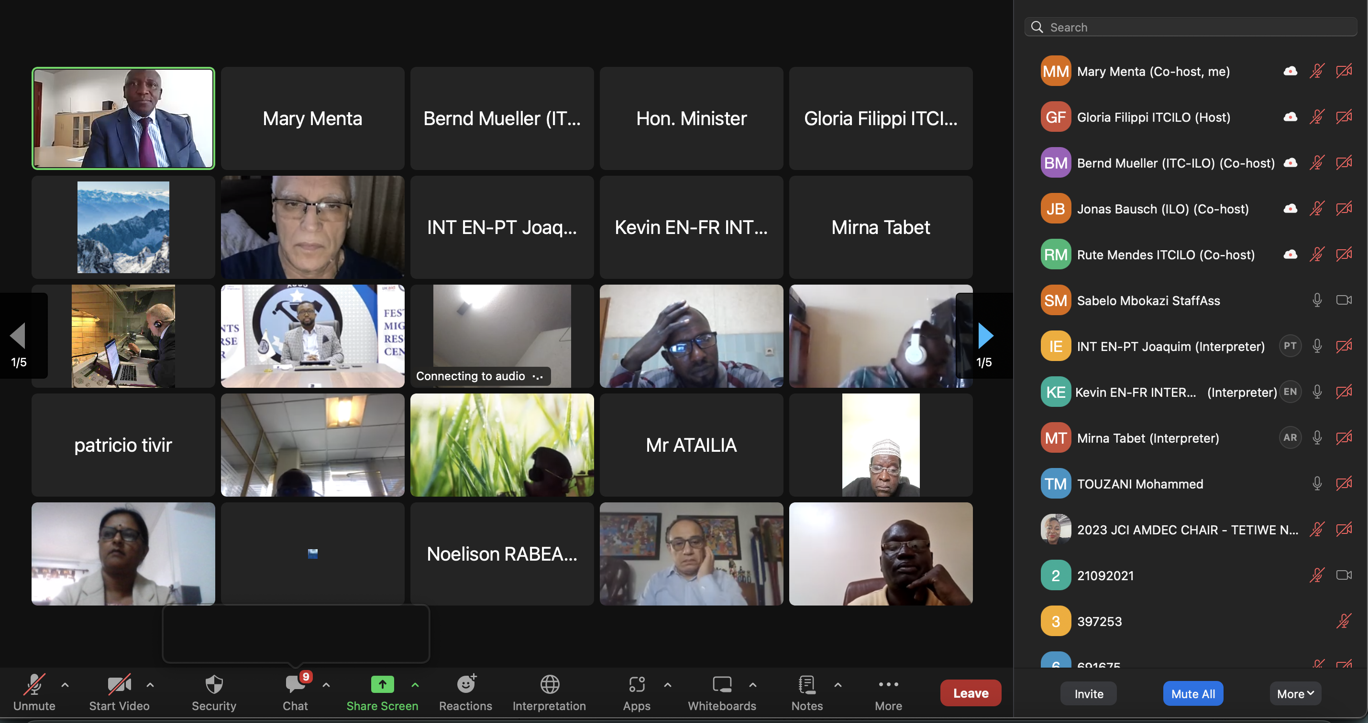
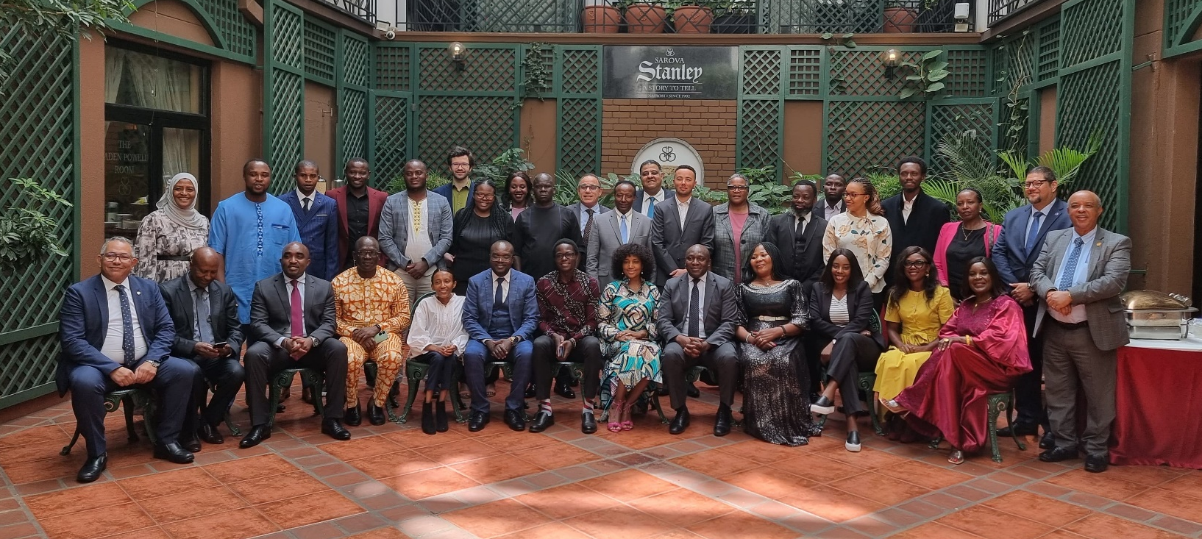
YES-Africa: the journey so far
II. Consultations and validation
    Virtual consultations: 25-26 October 2023: 120 tripartite participants from 30 countries
    Hybrid validation: 11-12 December 2023 (Nairobi, Kenya): over 100 tripartite participants online & offline, from 30+ countries
Notes:
VALIDATION WORKSHOP: countries with in-person participation
DWT/CO-Yaoundé: Cameroon
CO-Kinshasa: DRC
CO-Abidjan: Côte d'Ivoire
DWT/CO-Cairo: Egypt
CO-Addis: Ethiopia
CO-Dar: Kenya (host), Rwanda
CO-Algiers: Morocco
CO-Harare: Namibia
CO-Abuja: Nigeria
DWT/CO-Pretoria: South Africa

Slide 35
YES-Africa principles
Social justice and socio-economic inclusion
Political will, shared responsibility and mutual accountability
Panafricanism
Gender-responsiveness
Inclusive social dialogue
Meaningful youth participation, engagement and leadership
A human-centred, rights-based and non-discriminatory approach
Environmental sustainability
An innovative, coherent and integrated approach
An evidence-based and impact-oriented approach

Slide 36
YOUTH AS LEADERS

Slide 37
Youth as Leaders
YOUTH AS LEADERS
Engaging youth as leaders can either involve young people or youth-led organisations leading one or more components of a youth employment programme initiated by the organisation or it can involve facilitating and supporting young people to lead their own projects, activities and initiatives decent work opportunities.
    Top tips and effective approaches:
    Collaborate with recognised youth-led organisations and networks rather than individual youth
    Create an accessible and equitable selection process
    Allocate adequate human and financial resources
    Fostering collaboration and peer learning among youth-led organisations can amplify their impact
Notes:
The first thing to know is that there is no universal definition of “who is youth”.
The UN defines “youth” as anyone between the ages of 15 and 24.
For the ILO, youth is defined as persons aged between 15 and 29 years old.
AU defines youths as people between the ages of 15-35 years.
For Kenya it’s those between 18-34 years of age.
So, as you can see, many agencies, organizations, institutions adapt their definition to their national or regional context and also depending on the work they do.
So, there is no one single definition.
When defining youth, we can not just use an age bracket, because these age brackets are socially constructed.
So, we need to look beyond that, we need to look at other dimensions.

Slide 38
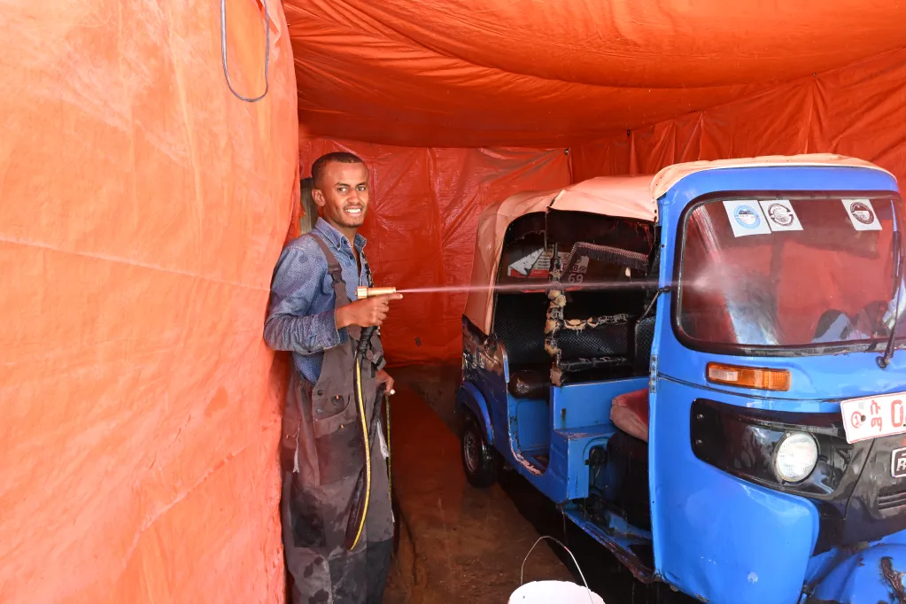
Youth as Leaders: Some examples
YOUTH AS LEADERS
    Youth-to-Youth Fund in Ethiopia
    Providing technical assistance and financial support to 10 youth-led organisations in Addis Ababa and the Somali region to lead their own youth employment innovations promoting and creating employment opportunities for their peers.
Notes:
The first thing to know is that there is no universal definition of “who is youth”.
The UN defines “youth” as anyone between the ages of 15 and 24.
For the ILO, youth is defined as persons aged between 15 and 29 years old.
AU defines youths as people between the ages of 15-35 years.
For Kenya it’s those between 18-34 years of age.
So, as you can see, many agencies, organizations, institutions adapt their definition to their national or regional context and also depending on the work they do.
So, there is no one single definition.
When defining youth, we can not just use an age bracket, because these age brackets are socially constructed.
So, we need to look beyond that, we need to look at other dimensions.

Slide 39
Unlocking Opportunities across the
Programme Cycle
Identify new opportunities and mechanisms to strengthen youth engagement across different phases of a programme cycle.

Slide 40
WHERE: Youth engagement in a programme/policy life-cycle
Planning and design
There are four stages where youth engagement can take place within a programme/policy cycle
Governance & decision-making
Implementation and monitoring
Evaluation and reporting
Notes:
The first thing to know is that there is no universal definition of “who is youth”.
The UN defines “youth” as anyone between the ages of 15 and 24.
For the ILO, youth is defined as persons aged between 15 and 29 years old.
AU defines youths as people between the ages of 15-35 years.
For Kenya it’s those between 18-34 years of age.
So, as you can see, many agencies, organizations, institutions adapt their definition to their national or regional context and also depending on the work they do.
So, there is no one single definition.
When defining youth, we can not just use an age bracket, because these age brackets are socially constructed.
So, we need to look beyond that, we need to look at other dimensions.

Slide 41
Mechanisms to support youth engagement
Youth Advisory Groups
Participatory Mapping
Co-Design Workshop with Youth
Youth-to-Youth Trainers and Mentors
Youth Participatory Action Research and Evaluation
(Y-PARE)
Youth as Advocates
Youth as Enumerators in Data Collection and Feedback
Notes:
The first thing to know is that there is no universal definition of “who is youth”.
The UN defines “youth” as anyone between the ages of 15 and 24.
For the ILO, youth is defined as persons aged between 15 and 29 years old.
AU defines youths as people between the ages of 15-35 years.
For Kenya it’s those between 18-34 years of age.
So, as you can see, many agencies, organizations, institutions adapt their definition to their national or regional context and also depending on the work they do.
So, there is no one single definition.
When defining youth, we can not just use an age bracket, because these age brackets are socially constructed.
So, we need to look beyond that, we need to look at other dimensions.

Slide 42
Reflection: Using different modalities of youth engagement
Co-Design Workshop with Youth
Youth-to-Youth Trainers and Mentors
    How can each mechanism be used to support youth engagement in practice?
    At which phase/s of programme cycle the mechanism could be applied?
    Which degree/s of youth engagement the mechanism presents?
Youth Advisory Groups
Participatory Mapping
Youth as Enumerators in Data Collection and Feedback
Youth Participatory Action Research and Evaluation
(Y-PARE)
Youth as Advocates
Notes:
The first thing to know is that there is no universal definition of “who is youth”.
The UN defines “youth” as anyone between the ages of 15 and 24.
For the ILO, youth is defined as persons aged between 15 and 29 years old.
AU defines youths as people between the ages of 15-35 years.
For Kenya it’s those between 18-34 years of age.
So, as you can see, many agencies, organizations, institutions adapt their definition to their national or regional context and also depending on the work they do.
So, there is no one single definition.
When defining youth, we can not just use an age bracket, because these age brackets are socially constructed.
So, we need to look beyond that, we need to look at other dimensions.

Slide 43
Today we looked at…
Laying the Foundation
Define meaningful youth engagement and explore the five key dimensions that contribute to effective participation.
From Consultation to Leadership
Examine the four degrees of youth engagement and apply strategies to engage young people at every level.
Unlocking Opportunities across the Programme Cycle
Identify new opportunities and mechanisms to strengthen youth engagement across different phases of a programme cycle.

Slide 44
And tomorrow we will look at…
Understanding youth and their structures
Identify youth demographics, recognize marginalized groups, and develop outreach strategies to ensure inclusive engagement.
The Youth Engagement Challenge
Develop a youth engagement initiative tailored to an employment programme and address challenges with practical solutions.
Recognizing the Principles of Youth Engagement
Discover the key principles of youth engagement that ensure participation is meaningful.

Slide 45
Meaningful youth engagement for decent work
A training package on engaging young people in employment programmes

Slide 46
Today we will look at…
Understanding youth and their structures
Identify youth demographics, recognize marginalized groups, and develop outreach strategies to ensure inclusive engagement.
The Youth Engagement Challenge
Develop a youth engagement initiative tailored to an employment programme and address challenges with practical solutions.
Recognizing the Principles of Youth Engagement
Discover the key principles of youth engagement that ensure participation is meaningful.

Slide 47
Understanding youth and their structures
Identify youth demographics, recognize marginalized groups, and develop outreach strategies to ensure inclusive engagement.

Slide 48
WHO is youth?
There is no universal definition of “youth”
    The UN defines “youth” as anyone from 15-24 years old.
    The AU defines youth as anyone between the ages of 15-35 years.
Important to think beyond an age group: Individual demographics, experience of being “youth” navigating transitions matter!
Notes:
The first thing to know is that there is no universal definition of “who is youth”.
The UN defines “youth” as anyone between the ages of 15 and 24.
For the ILO, youth is defined as persons aged between 15 and 29 years old.
AU defines youths as people between the ages of 15-35 years.
For Kenya it’s those between 18-34 years of age.
So, as you can see, many agencies, organizations, institutions adapt their definition to their national or regional context and also depending on the work they do.
So, there is no one single definition.
When defining youth, we can not just use an age bracket, because these age brackets are socially constructed.
So, we need to look beyond that, we need to look at other dimensions.

Slide 49
Youth and their structures
    Youth structures:
    Include formal organisations or informal groups that work towards addressing youth-related issues.
    May be youth-focused or youth-led.
    Can serve as vital bridges between programmes and young people, offering trusted networks and platforms for dialogue and collaboration.
  Young people face diverse and overlapping vulnerabilities that shape their experiences and access to opportunities.
  Young women
  Youth with disabilities
  Young workers in the informal economy
  Young people in hazardous occupations
  Young people engaged in (the worst forms of) child labour or forced labour
  Young people from minority linguistic, religious and ethnic groups
  Indigenous young people
  Youth in contexts of forced displacement
Notes:
The first thing to know is that there is no universal definition of “who is youth”.
The UN defines “youth” as anyone between the ages of 15 and 24.
For the ILO, youth is defined as persons aged between 15 and 29 years old.
AU defines youths as people between the ages of 15-35 years.
For Kenya it’s those between 18-34 years of age.
So, as you can see, many agencies, organizations, institutions adapt their definition to their national or regional context and also depending on the work they do.
So, there is no one single definition.
When defining youth, we can not just use an age bracket, because these age brackets are socially constructed.
So, we need to look beyond that, we need to look at other dimensions.

Slide 50
Youth and their structures: Examples
  Young researchers and academic networks
e.g. youth-led or youth-focused academic collectives generating data, analysis, and policy recommendations
  Informal youth groups and grassroots movements
e.g. community-based groups engaging in advocacy, peer support, or local development initiatives
  Clubs and volunteer groups
e.g. youth-led clubs around interests such as sports, arts, STEM, environmental activism, or civic engagement
  Youth representing employers’ and workers’ organizations
e.g. youth committees within trade unions, youth delegates in employers’ federations
  Youth-led organizations
e.g. formal and registered entities led by young people, working on social, economic, or environmental issues
  Youth councils and advisory boards
e.g. national, local, or institutional bodies that represent youth interests and advise decision-makers
Notes:
The first thing to know is that there is no universal definition of “who is youth”.
The UN defines “youth” as anyone between the ages of 15 and 24.
For the ILO, youth is defined as persons aged between 15 and 29 years old.
AU defines youths as people between the ages of 15-35 years.
For Kenya it’s those between 18-34 years of age.
So, as you can see, many agencies, organizations, institutions adapt their definition to their national or regional context and also depending on the work they do.
So, there is no one single definition.
When defining youth, we can not just use an age bracket, because these age brackets are socially constructed.
So, we need to look beyond that, we need to look at other dimensions.

Slide 51
Effective outreach strategies
WRITE YOUR SUBTITLE HERE
Engage governments, employers’ and workers organisations’
Leverage digital and mobile engagement
Activate peer-led outreach including collaborating with youth-led structures
Enable community-based engagement
Collaborate with diverse partners that have experience working with young people
Notes:
The first thing to know is that there is no universal definition of “who is youth”.
The UN defines “youth” as anyone between the ages of 15 and 24.
For the ILO, youth is defined as persons aged between 15 and 29 years old.
AU defines youths as people between the ages of 15-35 years.
For Kenya it’s those between 18-34 years of age.
So, as you can see, many agencies, organizations, institutions adapt their definition to their national or regional context and also depending on the work they do.
So, there is no one single definition.
When defining youth, we can not just use an age bracket, because these age brackets are socially constructed.
So, we need to look beyond that, we need to look at other dimensions.

Slide 52





Group Activity
A 23-year-old university grad struggling to find work.
A 28-year-old young refugee trying to access employment in her host country.
An 18-year-old young woman looking for career guidance.
A 25-year-old low-skilled worker looking for income-generating opportunities.
A 21-year-old rural youth looking to learn/upgrade skills to access better quality jobs.
Group 1
Group 2
Group 3
Group 4
Group 5
What barriers might this young person face in engaging with the programme?
What outreach strategies can be used to engage them?
Notes:
The first thing to know is that there is no universal definition of “who is youth”.
The UN defines “youth” as anyone between the ages of 15 and 24.
For the ILO, youth is defined as persons aged between 15 and 29 years old.
AU defines youths as people between the ages of 15-35 years.
For Kenya it’s those between 18-34 years of age.
So, as you can see, many agencies, organizations, institutions adapt their definition to their national or regional context and also depending on the work they do.
So, there is no one single definition.
When defining youth, we can not just use an age bracket, because these age brackets are socially constructed.
So, we need to look beyond that, we need to look at other dimensions.

Slide 53
The Youth Engagement Challenge
Develop a youth engagement initiative tailored to an employment programme and address challenges with practical solutions.

Slide 54
Group Activity
Select a youth employment programme that a group member is working on, that can be used for an example case study.
For the selected project, discuss how meaningful youth engagement can be built into the project considering:
  The youth engagement activity/mechanism
  The degree/s of engagement it represents
  Which project phase/s the activity will take place in
  Which youth/youth structures the activity will engage - ensuring representation of marginalised youth
  Three potential indicators to measure success
  Three potential operational/implementation challenges
Notes:
The first thing to know is that there is no universal definition of “who is youth”.
The UN defines “youth” as anyone between the ages of 15 and 24.
For the ILO, youth is defined as persons aged between 15 and 29 years old.
AU defines youths as people between the ages of 15-35 years.
For Kenya it’s those between 18-34 years of age.
So, as you can see, many agencies, organizations, institutions adapt their definition to their national or regional context and also depending on the work they do.
So, there is no one single definition.
When defining youth, we can not just use an age bracket, because these age brackets are socially constructed.
So, we need to look beyond that, we need to look at other dimensions.

Slide 55
GROUP PRESENTATIONS

Slide 56
Addressing your challenges
Challenges
Solutions
Notes:
The first thing to know is that there is no universal definition of “who is youth”.
The UN defines “youth” as anyone between the ages of 15 and 24.
For the ILO, youth is defined as persons aged between 15 and 29 years old.
AU defines youths as people between the ages of 15-35 years.
For Kenya it’s those between 18-34 years of age.
So, as you can see, many agencies, organizations, institutions adapt their definition to their national or regional context and also depending on the work they do.
So, there is no one single definition.
When defining youth, we can not just use an age bracket, because these age brackets are socially constructed.
So, we need to look beyond that, we need to look at other dimensions.

Slide 57
Measuring success
Youth-level indicators
Programme-level indicators
These focus on how well the programme supports youth engagement, including its relevance, relationships between staff and youth, resource allocation, safeguarding measures, and whether there was a concrete strategy for meaningful participation.
Planned engagement: A youth engagement strategy is developed and implemented that includes an outreach plan articulating young people will be engaged and how.
Dedicated resources: Proportion (%percentage) of budget the programme allocated for youth engagement in the programme.
These help measure how many young people were engaged, their backgrounds, and whether the programme truly strengthened their skills, amplified their voices, and created leadership opportunities.
Inclusive engagement: Number/proportion (%) of youth from marginalised groups that are are engaged in the programme
Principles that make engagement meaningful: Number/proportion (%) of youth who report their voices are valued and their concerns are considered.
Engagement across the programme cycle: Number/proportion (%) of youth participating in the programme –
    Governance
    Planning and design
    Implementation and monitoring
    Evaluation and reporting
Sole proprietorship
Notes:
The first thing to know is that there is no universal definition of “who is youth”.
The UN defines “youth” as anyone between the ages of 15 and 24.
For the ILO, youth is defined as persons aged between 15 and 29 years old.
AU defines youths as people between the ages of 15-35 years.
For Kenya it’s those between 18-34 years of age.
So, as you can see, many agencies, organizations, institutions adapt their definition to their national or regional context and also depending on the work they do.
So, there is no one single definition.
When defining youth, we can not just use an age bracket, because these age brackets are socially constructed.
So, we need to look beyond that, we need to look at other dimensions.

Slide 58
Recognizing the Principles of Youth Engagement
Discover the key principles of youth engagement that ensure participation is meaningful.

Slide 59
Principles of youth engagement
Meaningful
engagement
Tokenistic
engagement
VS
Identify:
Boosters that make engagement meaningful Blockers that make engagement tokenistic
Notes:
The first thing to know is that there is no universal definition of “who is youth”.
The UN defines “youth” as anyone between the ages of 15 and 24.
For the ILO, youth is defined as persons aged between 15 and 29 years old.
AU defines youths as people between the ages of 15-35 years.
For Kenya it’s those between 18-34 years of age.
So, as you can see, many agencies, organizations, institutions adapt their definition to their national or regional context and also depending on the work they do.
So, there is no one single definition.
When defining youth, we can not just use an age bracket, because these age brackets are socially constructed.
So, we need to look beyond that, we need to look at other dimensions.

Slide 60
Principles of youth engagement
Principle 1:
Inclusive and representative engagement
Principle 2: Relevant and context-specific engagement
Principle 3: Transparent and informed engagement
Principle 4: Voluntary engagement
Principle 5: Safe and risk-sensitive engagement
Principle 6: Respected and valued engagement
Principle 7: Resourced and supported engagement
Principle 8: Accountable engagement
Notes:
The first thing to know is that there is no universal definition of “who is youth”.
The UN defines “youth” as anyone between the ages of 15 and 24.
For the ILO, youth is defined as persons aged between 15 and 29 years old.
AU defines youths as people between the ages of 15-35 years.
For Kenya it’s those between 18-34 years of age.
So, as you can see, many agencies, organizations, institutions adapt their definition to their national or regional context and also depending on the work they do.
So, there is no one single definition.
When defining youth, we can not just use an age bracket, because these age brackets are socially constructed.
So, we need to look beyond that, we need to look at other dimensions.

Slide 61
Training evaluation
Tell us what you thought!
Notes:
The first thing to know is that there is no universal definition of “who is youth”.
The UN defines “youth” as anyone between the ages of 15 and 24.
For the ILO, youth is defined as persons aged between 15 and 29 years old.
AU defines youths as people between the ages of 15-35 years.
For Kenya it’s those between 18-34 years of age.
So, as you can see, many agencies, organizations, institutions adapt their definition to their national or regional context and also depending on the work they do.
So, there is no one single definition.
When defining youth, we can not just use an age bracket, because these age brackets are socially constructed.
So, we need to look beyond that, we need to look at other dimensions.

Slide 62


Reflections and takeaways
Tell us what you thought!
Notes:
The first thing to know is that there is no universal definition of “who is youth”.
The UN defines “youth” as anyone between the ages of 15 and 24.
For the ILO, youth is defined as persons aged between 15 and 29 years old.
AU defines youths as people between the ages of 15-35 years.
For Kenya it’s those between 18-34 years of age.
So, as you can see, many agencies, organizations, institutions adapt their definition to their national or regional context and also depending on the work they do.
So, there is no one single definition.
When defining youth, we can not just use an age bracket, because these age brackets are socially constructed.
So, we need to look beyond that, we need to look at other dimensions.

Slide 63
THANK YOU

