Slide 1

The ILO and Gender Equality: An Introduction
José E. Alvarez

Slide 2
ILO Documents Reasons for Male/Female Wealth Gap
Male/Female Gaps in:
Formal Labor Participation
Income
Unpaid Work
Under-employment (e.g. part- time work)
Social Security Coverage
Participation in Informal Economy

Slide 3

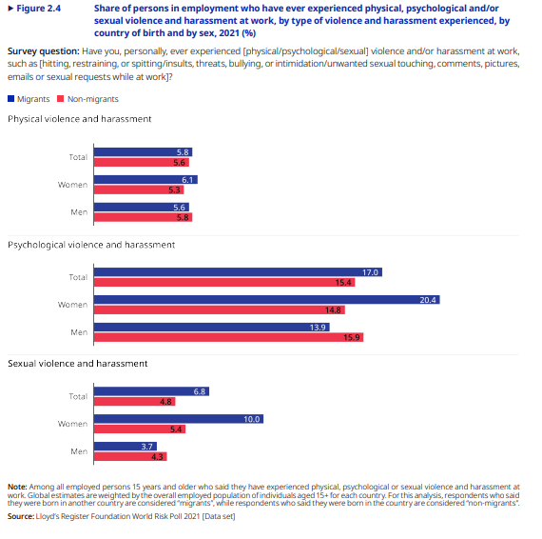
The ILO’s Contribution to Gender-Disaggregated Data

Slide 4
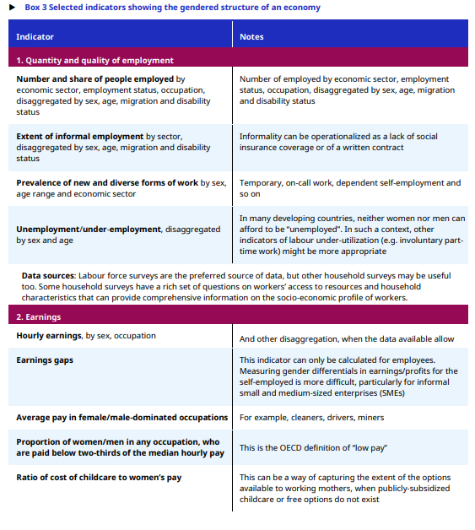
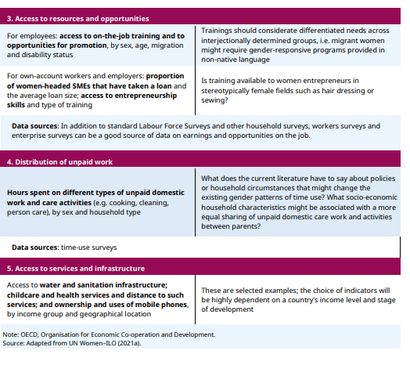
From Specific Labor Standards to National Employment Policies

Slide 5

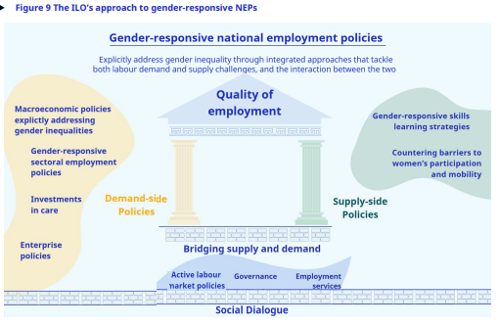
The ILO’s Gendered Technical Assistance

Slide 6
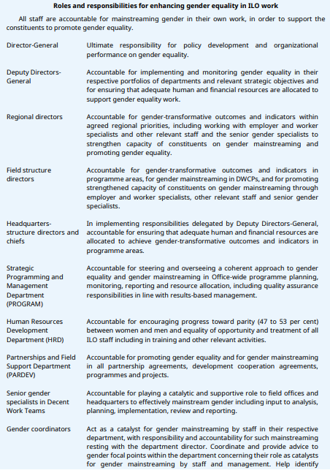
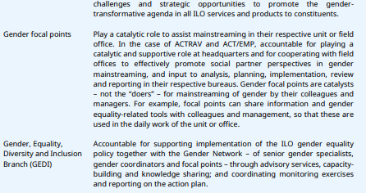
The International Labour Office’s Internal Gender Equality Architecture

Slide 7
The ILO’s Progress from ‘Protecting’ Women to Advancing Gender Equality: A (Selective) Timeline
1919 Constitution: Preamble (protection of women, equal remuneration for work of equal value), Art. 3 (for issues ‘specially affecting women’ at least one of the advisers to delegates should be a woman), Art. 9 (a ‘certain number’ of the staff of the international labor office shall be women)
1919, inaugural labor conference: Maternity Protection Conv. (3), Night Work (Women) Conv. (4)
1944: Declaration of Philadelphia (annex to Constitution)
1948: Night Work Conv. Revised (89)
1951: Equal Remuneration Conv. (100)
1958: Discrimination (Employment and Occupation) Conv. (111)*
1981: Workers with Family Responsibilities Conv. (156)*
1990: Protocol to the Revised Night Work (Women) Conv.
1995: Action Plan to promote gender equality/gender mainstreaming within labor office (extended to all ILO activities in 1999)
1996: Home Work Conv. (177)
1998: Declaration on Fund. Principles and Rts at Work
2000: Maternity Protection Conv. (183)
2008: Declaration on Social Justice for a Fair Globalization
2009: Resolution concerning the promotion of gender equality, pay equity and maternity protection
2011: Domestic Workers Conv. (189)
2019: Violence and Harassment Conv. (190)
“The Committee considers that all ILO standards are, in practice, instrumental to the achievement of gender equality at work, regardless of whether or not they refer explicitly to gender equality.”Committee of Experts on the Application of Conventions and Recommendations (CEACR), Achieving gender equality at work, International Labour Conference, 11th Session, 2023

Slide 8
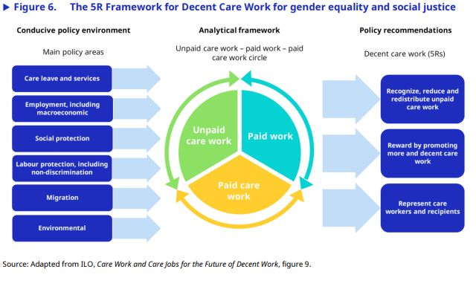

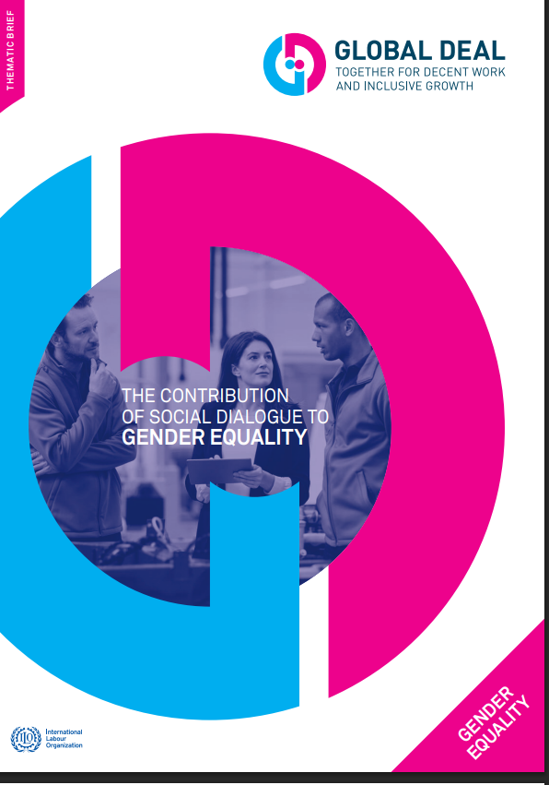
ILO Policy Frameworks for Gender Equality

Slide 9
What explains the ILO’s turn to gender equality?
The role of (tripartite) leadership
The ILO’s resort to constitutional evolution as interpretative principle
The impact of gender-disaggregated data production
The impact of the ILO’s turn to technical assistance
The appeal of ‘soft’ power
Silo-breaking interactions with the UN’s Agenda for Sustainable Development
Synergies with human rights regimes, particularly CEDAW, and broader social movements

Slide 10
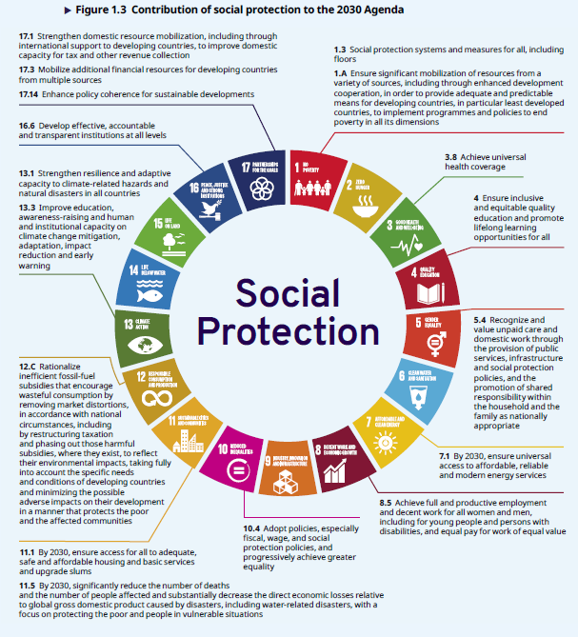
The overlap between ILO standards and the UN’s SDGs
Particular SDGs relevant to Gender Equality:
SDG 5 (gender equality)
SDG 3 (good health/well-being)
SDG 8 (decent work & ec. growth)
But in reality gender inequalities are relevant to all 17 SDGs

Slide 11
Both CEDAW and the ILO go beyond formal equality by . . .
Requiring all appropriate measures by the state to advance de facto and not just de jure substantive equality
Addressing direct and indirect discriminatory distinctions, exclusions, restrictions, practices or omissions that underlie structural inequalities and require more than formally neutral laws/practices
Requiring equal enjoyment of human rights across the ICCPR/ICESR divides (directing attention to fundamental political, economic, social, cultural, civil rights)
Directing govts to act across the ‘public’/‘private’ divide
Directing attention to the need to modify social, cultural patterns of conduct, elimination of all prejudices, customary or other practices, or stereotypes (including inside the family)
Authorizing special measures (‘affirmative action’) to accelerate gender equality

Slide 12
Common Ground: CEDAW’s requirements to respect, protect, and fulfill equal rights to . . .
Specific Labor Rts:
Article 11 (1): non-discrimination in employment to ensure equal rts of men and women to:
(a) inalienable right to work
(b) same employment opportunities
(c) free [equal] choice of profession, promotion, job security, all benefits . . .
(d) equal remuneration, including benefits
(e) social security, including paid leave
(f) health and safety protections, including to safeguard reproduction
(2) To prevent discrimination, states shall take appropriate measures to:
(a) prohibit dismissals on grounds of pregnancy, maternity leave, marital status
(b) provide maternity leave with pay, comparable social benefits
(c) supportive social services to enable combining work with family obligations
(d) special protection to women during pregnancy
But also various other rts to advance the economic empowerment of women:
Article 13: duties on states to take all appropriate measures to eliminate discrimination in other areas of economic and social life to ensure rts to family benefits; bank loans, mortgages, and other forms of financial credit
Article 14 to eliminate discrimination against women in rural areas and with respect to social security; agricultural credit and loans, marketing facilities, appropriate technology and equal treatment in land, agrarian reform and land resettlement; adequate living conditions in relation to housing . . .
Article 15 rts to equality before the law and with respect to civil matters, legal capacity, rights to conclude contracts and administer land
Article 16 in all matters relating to marriage and family relations, to same rights in respect to ownership, acquisition, management, administration, enjoyment, and disposition of property

Slide 13
CEDAW’s jurisprudence on economic empowerment (through the GRs, COs, Views, Inquiry Reports of the CEDAW Committee)
Formal and substantive equal treatment in employment and
. . . in marital/family relations
. . . with respect to civil and political Rts
. . . rts to land
. . . rts to adequate housing
. . . rts to all forms of intellectual property
. . . with respect to access to credit, other forms of economic empowerment
. . . social benefits
. . . rts to protection against all forms of gender-based violence

Slide 14
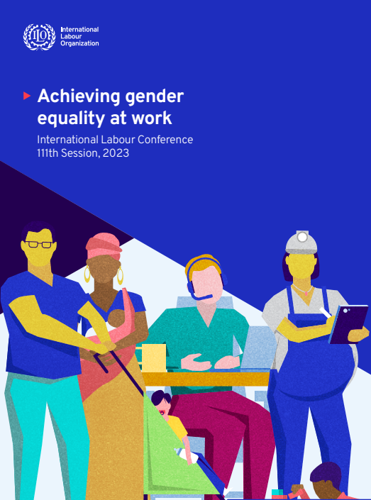
The ILO’s gender equality jurisprudence (through its conventions, recommendations, and procedures for standard setting and dispute settlement)
Example: Surveying/Responding to State Reports on gender equality/non-discrimination (Conv./Rec. 111), workers with family responsibilities (Conv. 156/Rec. 165), and maternity protection (Conv. 183/Rec. 191)
Gender equality and the evolving meaning of discrimination
The meaning of gender equality at work
National equality policies
Family responsibilities and decent work/gender equality
Setting a comprehensive approach to maternity protection that enables gender equality
Formulation of national policies on gender equality and measuring progress
Protecting against discrimination at all stages of employment (equality prescriptions from access to jobs to termination)
Prescriptions for maternity protection at the workplace
Prescriptions for reconciling work and family responsibilities
Prescriptions for enforcing/safeguarding relevant rights
Gender equality as catalyst for sustainable development

Slide 15
Some common critiques of the ILO and CEDAW Regimes with respect to gender equality
Both focus on promulgating standards but are weak on implementation, compliance or effectiveness
Both focus on formally gender neutral laws and ignore structural underpinnings of inequality or specialized needs of women and girls
3. Both enable ‘neo-liberal’ economic policies and/or otherwise privilege the values or standards characteristic of the Global North
4. Both focus on the public sphere, deflecting attention from the responsibility of market actors or cultural norms such as those that favor ‘the family’
5. Both legalize what needs to be political
6. Both internationalize what needs to be local
7. Both emphasize top-down governance at odds with democratic governance
For all these reasons: both are insufficiently transformational with respect to advancing gender equality

Slide 16
Responding to or adding nuance to the critiques . . .
Both regimes’ implementation/compliance effects extend beyond Geneva
2. Both the CEDAW and ILO regimes have evolved over time
3. Both take nuanced positions on ‘neo-liberal’ recipes for economic development, avoid universalizing the ostensible needs of privileged women from ‘the West,’ and welcome prescriptions for change coming from non-Western countries
4. Both puncture the private sphere and address structural causes of discrimination in both the Global North and South

Slide 17
But both regimes’ gender equality efforts face daunting challenges
Because of bureaucratic challenges, pathologies, or path dependencies
Because of their respective focus (on the world of work or on discrimination ‘against women’)
Because of sovereign backlash against human rights, including ‘women’s’ or ‘gender’ rights
Because of a populist backlash against other international regimes
Because of continued fragmentation among international regimes

Slide 18

The ILO’s Transformational Promise
Impact beyond Geneva (e.g., at the national and sub-national levels, including courts, legislatures, municipalities)
Impact beyond ‘legal compliance’ (e.g., through SDGs)
Continuous ‘progressive’ interpretative innovations of what gender equality requires in the world of work
Continuous ‘progressive’ expansions of the meaning of ‘discrimination’

