Slide 1

Enhancing social dialogue towards a culture of safety and health

Slide 2
Building and maintaining a preventative safety and health culture
  a culture in which the right to a safe and healthy working environment is respected at all levels, where governments, employers and workers actively participate in securing a safe and healthy working environment through a system of defined rights, responsibilities and duties, and where the principle of prevention is accorded the highest priority
Promotional Framework for Occupational Safety and Health Convention, 2006 (No. 187)

Slide 3
At the national level…
    The government as a whole commits to building and maintaining a preventative safety and health culture, ensuring OSH is considered a priority in the national agenda.
    Adequate means and resources are allocated to increase general awareness of OSH, knowledge of hazards and risks, and understanding of their prevention and control.
    Through social dialogue, the tripartite constituents actively participate in all phases of the OSH decision-making processes.
    Social dialogue contributes towards:
  improving the quality of OSH policies and strategies;
  building ownership and commitment;
  facilitating their rapid and more effective implementation.

Slide 4
At the workplace level…
    Compliance with OSH regulations
    Integration of OSH management systems into the business’s general management structure
    Culture change to achieve a positive OSH culture
  OSH considered as a core value of the enterprise, integrated into every aspect of the enterprise’s dealings
  open communication and dialogue built on trust and mutual respect
  positive OSH leadership by employers and top management
  training and information for all workers to ensure they can actively participate in actions to improve OSH

Slide 5
The key role of social dialogue during the COVID-19 crisis
At the national level, governments who prioritized the active participation of employers’ and workers’ organizations in OSH governance have been able to collectively develop and implement emergency laws, policies and interventions.
At the workplace level, workers’ participation and engagement, through joint OSH committees and workers OSH representatives, have been key in promoting compliance and designing and applying suitable and effective measures to eliminate hazards or minimize risks that are adapted to the workplace and workers’ needs.

Slide 6

Why is it important to voice concerns around safety and health at work?

Slide 7
What is social dialogue?
  Social dialogue refers to all types of negotiation and consultation, or simply the exchange of information between, or among, representatives of governments, employers and workers on issues of common interest relating to economic and social policy.
  Social dialogue may:
    be informal or institutionalized, and often includes both;
    take place at different levels (international, national, regional, local or workplace);
    involve the social partners in different economic sectors, within a single sector or in a single company or group of companies.

Slide 8
The various forms of social dialogue
    Tripartite process, with the government (Ministry of Labour and/or other Ministries concerned) as an official party to the dialogue.
    Tripartite “plus” process (when dealing with issues beyond the world of work), with actors representing specific concerns and interests of the civil society.
    Bipartite relations, between labour and management (or employers’ and workers’ organizations)
  Collective bargaining: consisting of: all negotiations which take place between an employer, a group of employers or one or more employers’ organisations, on the one hand, and one or more workers’ organisations, on the other, for: (a) determining working conditions and terms of employment; and/or (b) regulating relations between employers and workers; and/or (c) regulating relations between employers or their organisations and a workers’ organisation or workers’ organisations.
  Workplace cooperation: ranging from information sharing to consultation or joint decision-making.

Slide 9
Social dialogue: at the heart of the ILO
  The tripartite structure of the ILO allows employers, workers and governments to take part in the decision-making on international labour matters, to promote social justice and decent work for all.
  Social dialogue is embedded in the ILO Constitution and in almost all international labour standards, as a key method to achieve sustainable decisions and peaceful workplace relations.
  There are specific Conventions promoting social dialogue, i.e.:
    Tripartite Consultation (International Labour Standards) Convention, 1976 (No. 144)
    Freedom of Association and Protection of the Right to Organise Convention, 1948 (No. 87) and Right to Organise and Collective Bargaining Convention, 1949 (No. 98) – fundamental Conventions
    Collective Bargaining Convention, 1981 (No. 154)
  Social dialogue is echoed in one of the categories of fundamental principles and rights at work, namely freedom of association and the effective recognition of the right to collective bargaining
  The ILO Declaration on Social Justice for a Fair Globalization (2008) and the ILO Centenary Declaration for the Future of Work (2019) reiterate the relevance of social dialogue to building up social cohesion and a productive economy.

Slide 10
Participation and consultation at the core of ILO standards on OSH
Occupational Safety and Health Convention, 1981 (No. 155) calls for:
    a national policy on OSH (formulated; implemented and reviewed in consultation with most representative organizations of employers and workers), which:
  promotes communication and cooperation at different levels (from workplaces to national)
  indicates the respective OSH functions and responsibilities of the public authorities, employers, workers and others, taking into account the complementary character of such responsibilities
    at the workplace level, establishment of the arrangements needed to:
  enable workers and their representatives to cooperate with employers in the field of OSH
  provide adequate information and training
  allow workers or their representatives to enquire into, and be consulted on, all aspects of OSH associated with their work

Slide 11
Occupational Health Services Convention, 1985 (No. 161) calls for:
    consultation with the most representative organizations of employers and workers to formulate, implement and periodically review a coherent national policy on occupational health services
    cooperation and participation of the employer, the workers and their representatives in the implementation of the organizational and other measures relating to occupational health services on an equitable basis

Slide 12
Promotional Framework for Occupational Safety and Health Convention, 2006 (No. 187)
    promotes a national preventative safety and health culture, built on social dialogue
    calls for tripartite consultations on:
  the formulation, implementation and periodical review of a coherent national policy on OSH
  the establishment, maintenance, progressive development and periodical review of a national system for OSH
  the formulation, implementation, monitoring, evaluation and periodical review of a national programme on OSH
    provides that the national OSH system shall include arrangements to promote, at the level of the undertaking, cooperation between management, workers and their representatives as an essential element of workplace-related prevention measures

Slide 13

At the national level: the role of the social partners in building a preventative safety and health culture

Slide 14
Participation of the social partners in the OSH governance
    Creating a sound culture of prevention on OSH requires the participation of employers’ and workers’ organizations in the governance of safety and health at work.
    The tripartite partners may have different interests and perspectives. Tripartite consultation and discussion may contribute towards an improvement in communication and lead to a better understanding of any concerns and constraints they might have (paving the way for joint and agreed actions and for the development of a collaborative culture for addressing OSH challenges).
    Strong coordination among all the stakeholders is required to define common goals, priorities, objectives and targets for strengthening the OSH national system, bringing about more efficient use of the available resources.

Slide 15
Adopting sound OSH policies through social dialogue
  The Occupational Safety and Health Convention, 1981 (No. 155) and the Promotional Framework for Occupational Safety and Health Convention, 2006 (No. 187) call for the adoption of a coherent national OSH policy.
  Such a policy should:
    be built through tripartite consultation and discussion (this confers legitimacy and favours its implementation);
    include (at least):
  government commitment to the prevention of occupational accidents and diseases;
  the main principles guiding national action on OSH;
  spheres of action on OSH;
  functions and responsibilities of the main stakeholders (i.e., relevant public authorities, employers and workers and their organizations), recognizing the complementary character of those responsibilities.

Slide 16
Implementing effective OSH regulatory frameworks
  A comprehensive and functional regulatory framework should:
    cover all workers and all branches of economic activity;
    address all OSH-related risks to which workers may be exposed.
  An effective OSH regulatory framework usually includes:
    a single overarching OSH Act (defining the basic OSH rights);
    laws and regulations (completing the OSH act and covering specific sectors or hazards);
    codes of practice and technical standards (complementing the law by providing more specific guidance to employers and workers on how to comply with the law);
    collective bargaining agreements (resulting from negotiations between employers and workers and their respective organizations).
    When developing OSH legislation, the integration of social dialogue at various levels favours the sustainability and enforcement of such laws, even when they are complex.

Slide 17
  The COVID-19 pandemic has correlated with an increase in bipartite and tripartite agreements with a view to mitigating the risk of contamination in the workplace.
83% of trade unions surveyed have adopted social dialogue as a response to the pandemic
83% of trade unions surveyed have engaged in tripartite consultations
59% of 133 countries surveyed have adopted tripartite dialogue in response to the COVID-19 crisis, with one of the priority areas for negotiation being occupational safety and health measures
  Trade unions in a global survey noted that COVID-19 increased the impact of OSH on their collective bargaining agendas
  Both tripartite and bipartite agreements focused on various fields of action, i.e.:
  requirements for risk assessment
  telework arrangements
  provisions on systematic testing
  vaccination
COVID-19 and recovery: The role of trade unions in building forward better (2021)
A global trend analysis on the role of trade unions in times of COVID-19: A summary of key findings (2021)

Slide 18

During COVID-19 crisis, social dialogue has been essential for ensuring the implementation of measures put in place.
Austria: social partners negotiated an agreement on systematic testing in the workplace for particular sectors at increased risk of viral transmission.
South Africa: tripartite discussions resulted in requirements for employers to undertake a risk assessment of the workplace before workers returned to work and to create a plan for their return to work.
National consultation has sometimes been followed up by further dialogue and agreements at the regional or sectoral level (to adapt to the specific context).
Singapore: tripartite partners agreed upon Safe Management Measures (mandatory for all employers to operate during COVID-19) and additional sector-specific requirements, covering an extensive number of sectors (from aviation, to arts and culture and land transportation).

Slide 19
Throughout the COVID-19 pandemic, the scope of dialogue was also expanded to include collaboration between the labour sector and the public health sector.
In such public health crises, workplaces have a role to play in the overall mitigation of community spread, as they are settings where people often gather in close proximity to each other.
Philippines: Tripartite national level dialogue on Public health – labour collaboration on the prevention of COVID-19 at the workplace provided an opportunity for the authorities to explain the benefits of emergency volunteer workers, as well as to inform workers likely to be infected by COVID-19 of available social protection measures. It resulted in the establishment of an interdisciplinary knowledge management system, which would harness available epidemiological, labour inspection, social protection and international best practice data, with a view to continuously monitoring risks at the workplace and further guiding OSH policies and programmes.

Slide 20
Promoting compliance
  Social partners are key actors in the initiatives, schemes and activities to promote, monitor and enforce compliance with relevant OSH laws and regulations at the workplace, through:
    collaboration and support to labour inspection activities;
    other mechanisms to promote compliance (i.e., advisory services, codes of conduct, contractual requirements, awareness-raising and incentives) – with stronger impact when developed jointly by employers’ and workers’ organizations.

Slide 21
A functioning tripartite body to ensure consultation and collaboration
  Convention No. 187 calls for the establishment of a national tripartite advisory body (or bodies) addressing OSH issues.
  Tripartite OSH bodies (or councils/committees) have been set up in many countries. They provide a forum for the representatives of government (Ministry of Labour and other relevant ministries and institution), employers and workers to regularly discuss about OSH, ensuring consultation on relevant issues and a periodic review of OSH policies and programmes.
The tripartite composition can expanded to involve representatives of additional institutions.
Brazil: the Permanent Joint Tripartite Commission (Comissão Tripartite Paritária Permanente, CTPP), is made up of eighteen members, representing (in equal number) the federal executive branch, employers and workers. In addition, it is possible to invite a maximum of six specialists and/or representatives of other bodies or international organizations to participate in meetings of the CTPP or other the thematic commissions (without the right to vote).

Slide 22
The functions of these bodies vary considerably from country to country, ranging from a consultative role to a decision-making role in the definition of national policies, priorities, and action plans, as well as in the drafting of laws and regulations.
Oman: the tasks of the National OSH Committee include: (a) drafting a OSH national plan; (b) investigating serious work accidents; (c) coordinating between the Ministry of Manpower and other ministries, the private sector and other concerned parties to implement OSH programmes; (d) disseminating good practices on OSH; (e) promoting research and studies on OSH; (f) promoting employers’ and workers’ participation in the field of OSH and in the successful implementation of OSH programmes; (g) exchanging experience with associations, committees and other parties working in the field of OSH; (h) advising on OSH legislation; (i) organizing meetings to discuss OSH matters; (j) cooperating with Arab and international organizations concerned with OSH.
 To have a global overview of the national tripartite OSH bodies, consult the ILO LEGOSH database, section 8: Consultation, collaboration and co-operation with workers and their representatives

Slide 23
During the COVID-19 pandemic, many tripartite OSH bodies took part in the decision-making process at the national level; they have also been involved in the definition of lockdown and restriction measures, return to work strategies, and other instructions or guidance to mitigate the impact of COVID-19.
Congo: the National Consultative Labour committee reviewed draft legislation on teleworking.
Honduras: the tripartite National Commission for Workers’ Health was reactivated for updating OSH legislation and its national OSH programme to include issues of emerging importance such as psychosocial risks and hazards related to COVID-19.
Paraguay: the Tripartite Labour Consultative Council validated some framework OSH protocols for essential sectors of the economy, which were developed in accordance with ILO guidelines for a safe and healthy return to work in times of COVID-19.

Slide 24
Other relevant activities of social partners in the field of OSH
  ◆ Guidance and technical assistance to positively influence employers’ and workers’ attitudes towards OSH compliance and creating a more preventative culture.
  In addition to providing information, training and advice, employers’ and workers’ organizations can also encourage the exchange of experiences and bolster collaboration.
◆ Awareness-raising campaigns to disseminate essential information and make employers, workers and communities familiar with their rights and responsibilities in the field of OSH. Such campaigns can have a stronger impact when jointly designed and implemented by employers’ and workers’ organizations.
  ◆ OSH research (participating in the governance of OSH knowledge bodies) to ensure that the outcomes of OSH knowledge development efforts meet priority workplace needs.
  ◆ Collection of data and information on OSH to adopt informed, evidence-based policies, strategies and standards.

Slide 25
During the COVID-19 pandemic, social partners have been very active in producing guidance materials and other resources and organizing awareness raising campaigns on several OSH issues, such as preventative measures for mitigating the spread of COVID-19 (including by promoting vaccination and effective teleworking practices) and for managing psychosocial risks, including violence and harassment
Belgium: cooperation between social partners resulted in the “Generic guide for combatting the spread of Covid-19 at work”, which is adaptable to different sectors and emphasizes the importance of social dialogue at the enterprise level.
South Africa: the Southern African Clothing and Textile Workers’ Union (SACTWU) led a successful vaccination campaign for workers (through primary health care clinics). The campaign raised workers’ awareness of the benefits of vaccination, helping sway many of those who had been initially hesitant. As a result, garment sector workers had double the vaccination rates of the national average.
Nicaragua: the Senior Council of Private Enterprise (COSEP) launched the campaign If COVID-19 does not discriminate, neither should you, with webinars and platforms for exchanging best practices among stakeholders
United Kingdom: the Prince’s Responsible Business Network created the Mental health for employers toolkit, to help employers assess their workforce’s mental well-being and champion positive health.

Slide 26
Social partners have also carried out surveys and studies to ascertain employers’ and workers’ opinions on critical aspects of the organization and implementation of preventative measures in enterprises.
The International Organization of Employers (IOE) and the ILO produced a joint global survey of employer and business membership organizations (EMBOs) to examine the impacts and responses to COVID-19 in workplaces. The survey identified the need of EMBOs to receive more guidance on teleworking policies, as well as ways to implement government requirements for mitigating the risk of the virus in the workplace.
The International Trade Union Confederation (ITUC) surveyed 148 trade unions in 107 countries to collect data on workplace safety measures and workers’ experiences during the pandemic. This survey identified gaps in access to safe workplaces and global concerns about the provision of PPE.

Slide 27

At the workplace level: employer and worker cooperation for effective
OSH management

Slide 28
The roles of employers and workers: basic OSH rights and responsibilities
Employers’ responsibilities
    Ensure that (so far as is reasonably practicable) workplaces, machinery, equipment and processes under their control are safe and without risk to health
    Ensure that (so far as is reasonably practicable) chemical, physical and biological substances and agents under their control are without risk to health when the appropriate protective measures are taken
    Provide (where necessary) adequate PPE (at no cost to workers)
    Provide (where necessary) measures to deal with emergencies and accidents
    Ensure that workers and their representatives are consulted, informed, and trained on OSH
Workers’ rights and duties
    Right to remove themselves from a work situation which they have reasonable justification to believe presents an imminent and serious danger to their life or health, without undue consequences
    Right to receive adequate information and training on OSH
    Right to enquire into (and to be consulted on) all aspects of OSH associated with their work
    Duty to co-operate with the employer in the field of OSH (e.g. comply with OSH instructions and procedures; use PPE correctly; report to supervisor hazardous situation; etc.)

Slide 29
Ensuring worker and employer cooperation on OSH
  Participative arrangements in the workplace are associated with:
    improved OSH management practices
    better OSH performance
    reduced accidents and injury rates
    higher productivity
64% fewer safety incidents
58% fewer hospitalisations
in workplaces that are promoting workers’ engagement while implementing a positive OSH culture
Over 300 million workers around the world feel that they cannot report OSH issues to their employers without fear of punishment
  Harter et al., The relationship between engagement at work and organizational outcomes: 2020 Q12 Meta-Analysis
  Lloyd’s Register Foundation
  World Risk Poll 2019

Slide 30
Worker OSH representatives
  Key functions:
    representing workers in all matters relating to OSH
    monitoring the measures taken by employers to meet their OSH responsibilities
    investigating OSH issues raised by workers
    inquiring into any potential risk to workers’ safety and health that arises from their work
    making representations to management on matters that affect the safety and health of workers
    collaborating with and assisting the employer to address OSH risks
    promoting and encouraging the cooperation of workers in the field of OSH
    participating and representing workers in decision-making processes regarding OSH
    investigating occupational accidents and diseases, as well as near misses
◆ Evidence shows a positive relationship between the engagement of workers’ representatives on OSH in the workplace and better OSH performance

Slide 31
Joint OSH committees
  Joint OSH committees are bipartite bodies, composed of an equal number of workers’ and employers’ representatives, established at the workplace and assigned to various functions to ensure cooperation between the employers and workers so as to achieve and maintain safe and healthy working conditions and a sound working environment.
  Functions, rights and powers are usually similar to those of workers’ OSH representatives – often higher number of statutory and complex tasks than those of individual workers’ representatives, as joint OSH committees have more human resources and capacity.
  The establishment of joint OSH committees is mandatory in many countries, although this is often contingent upon the size of the enterprise. In countries where national OSH legislation does not regulate joint OSH committees, collective agreements may assume this function.
Sri Lanka: an agreement between the Joint Apparel Association Forum (JAAF) and a group of unions established provisions for bipartite health committees in garment factories in order to address COVID-19-related OSH risks and improve workers’ safety and health.

Slide 32
Promoting OSH management systems - built on social dialogue
  OSH management systems are a logical and useful tool for the continual improvement of OSH performance within an organization.
  They include a set of actions and processes that establish, monitor and evaluate the organization’s efforts to keep workers safe and healthy, and comply with national laws.
  Key elements for their successful application:
    integrating the OSH management system within overall business management
    ensuring both the commitment of management and the active participation of workers in their joint implementation

Slide 33
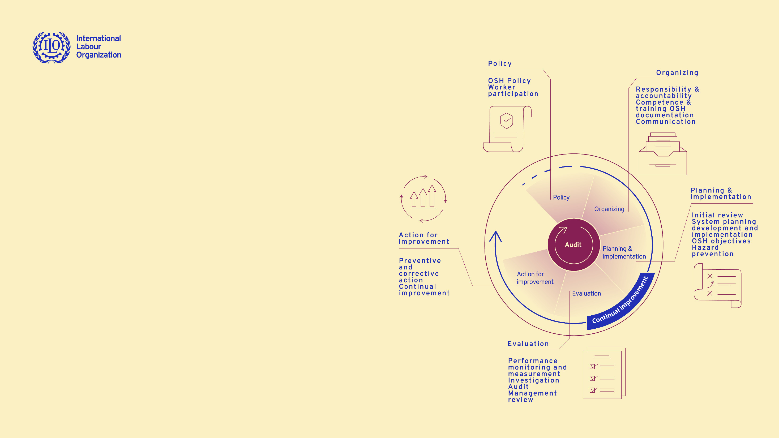
ILO Guidelines on Occupational Safety and Health Management Systems (ILO-OSH 2001)
    Workers’ participation is an essential element of the OSH management system and is required at all its stages
    Employers should ensure that workers and their OSH representatives are consulted, informed and trained on all aspects of OSH, including emergency arrangements, associated with their work.
    Employers should make arrangements for workers and their OSH representatives to have time and resources to participate actively in the processes of organizing, planning and implementation, evaluation and action for improvement of the OSH-MS.
    The employer should ensure, as appropriate, the establishment and efficient functioning of a safety and health committee and the recognition of workers’ OSH representatives, in accordance with national laws and practice.

Slide 34
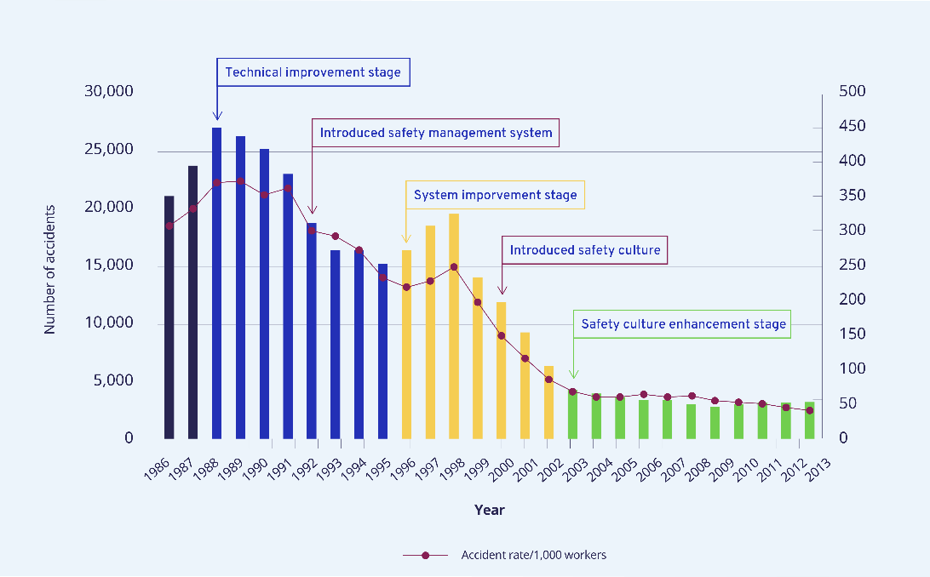
Creating a positive OSH culture
OSH management systems are only effective when accompanied by a positive OSH culture in the workplace, where management and workers value the right to a safe and healthy working environment and actively participate towards this end.
Hong Kong Special Administrative Region, China
The incidence of occupational injuries and diseases in the region from 1986 to 2013 decreased, thanks to the implementation of various OSH actions.
Technology and OSH management systems have made great strides in creating a safer world, but it was the introduction and enhancement of a safety culture within the workplace that markedly reduced the number of accidents.

Slide 35
Positive OSH culture
  Open communication and dialogue between workers and employers, where workers feel comfortable sharing their thoughts about incidents and concerns.
  Leadership and commitment to OSH by employers and senior management.
    Core values
    Social involvement
    Justice
    Trust
    Sustainability
    Participation
    Resilience and flexibility
    Development and growth
    ◆ Influence on OSH and business performances.
Stages of development
Pathological
  employers and workers do not care about violating safety rules
Reactive
  safety becomes important only after an accident
Calculative
  systems are in place to manage all hazards
Proactive
  workers avoid problems in advance to improve the work environment
Generative
  OSH is built into ways of working and thinking (dynamic OSH culture)

Slide 36
Involving workers in the risk assessment process
    As part of OSH management, employers should regularly conduct a risk assessment, which should include:
    identifying hazards;
    evaluating the associated risks; and
    taking sensible and proportionate measures to control such risks.
    A well-conducted workplace risk assessment:
    contributes to the protection of workers’ health and well-being;
    benefits businesses through a better organization of working practices (potentially increasing productivity).
    Employers should ensure that workers and/or their representatives are fully involved in the risk assessment process, as they have useful information about how the work is done – and this will help make the risk assessment more thorough and effective.

Slide 37
During the COVID-19 pandemic, the active participation of workers and their representatives in any decision-making process contributed to the adoption of sustainable and appropriate solutions to face new hazards and risks and resulted in a stronger commitment to the decisions taken.
  Ireland: the HSE produced guidance stressing how essential it was to consult with workers at every stage of implementing COVID-19 measures in the workplace. It also underlined the need to appoint a COVID-19 Lead Worker Representative to assist in implementing and communicating COVID-19 measures.
Often, the need to work from home posed considerable challenges to ensure safe and healthy working conditions, for which both employers and workers were not always prepared physically, mentally or infrastructure-wise. Regular communication about concerns and challenges experienced is essential to ensure cooperation between employers and people who are working from home.
A multinational aerospace company (Mercury Systems) has surveyed its workers regularly during COVID-19-induced teleworking, to identify areas of concern for workers and receive feedback
A software company based in UK (Sage) created a live anonymous poll for workers to report observations regarding OSH plans adopted to deal with COVID-19 pandemic.

Slide 38
  The ILO produced a number of tools to support employers and workers in managing OSH risks during the COVID-19 pandemic, including:
Anticipate, prepare and respond to crises – Invest now in resilient occupational safety and health systems (World Day for Safety and Health at Work Report, April 2021);
Prevention and mitigation of COVID-19 at work: Action checklist (April 2020);
In the face of a pandemic: Ensuring safety and health at work (World Day for Safety and Health at Work Report, April 2020);
A safe and healthy return to work during the COVID-19 pandemic – Policy Brief (May 2020);
A Safe Return to Work: Ten Action Points (May 2020);
Managing work-related psychosocial risks during the COVID-19 pandemic (June 2020);
Practical Guide on Teleworking during the COVID-19 pandemic and beyond (July 2020);
COVID-19 and health facilities: Checklist of measures to be taken in health facilities (July 2020);
Hand hygiene at the workplace: an essential occupational safety and health prevention and control measure against COVID-19 – Briefing Note (September 2020); and
Prevention and mitigation of COVID-19 at work for small and medium-sized enterprises: Action Checklist and Follow-up (August 2020)
 The ILO has also developed a range of sectoral briefs that include sections focused on OSH issues

Slide 39

Strengthening social dialogue to promote OSH during crises and beyond

Slide 40
    The COVID-19 pandemic has exposed all people in the world of work to the risk of infection with the novel coronavirus, as well as to new and emerging risks related to this emergency and the newly adopted work practices.
    Country responses to the COVID-19 pandemic have shown the importance of the participation of social partners in OSH governance, contributing to improve the quality of policies and strategies and facilitating their rapid and effective implementation (by building ownership and commitment).
    Social partners have also been key in ensuring effective and coordinated communication and information to promote compliance, and contributed to the subsequent adoption of adequate OSH measures at the workplace.
    Collaboration and dialogue with other relevant stakeholders, such as partnerships with public health and emergency services actors on issues of common concern, have proven to be vital to reduce the spread of COVID-19 (i.e., vaccination campaigns).
    We must carry this lesson with us to exit this crisis and help us face any future crises that might lie ahead, constantly striving to reduce OSH risks and prevent work-related accidents and diseases.

Slide 41
Global Call to Action for a human-centred recovery from the COVID-19 crisis that is inclusive, sustainable and resilient (International Labour Conference, June 2021)
    Targets four key areas:
  Inclusive economic growth and employment
  Protection of all workers
  Universal social protection
  Social dialogue
    Recognizes that safe and healthy working conditions are fundamental to decent work and asks countries to strengthen OSH measures by cooperating with public institutions, private enterprises, employers, workers and their representatives on the provision of tailored practical guidance; support for risk management; introduction of appropriate control and emergency preparedness measures; measures to prevent new outbreaks or other occupational risks; and compliance with health measures and other COVID-19- based rules and regulation.
    Recognizes the role that social dialogue, both bipartite and tripartite, has played in the immediate response to the COVID-19 pandemic in many countries and sectors and its importance to support delivery of the outcomes it sets out.

Slide 42
Thank you
www.ilo.org/safeday

