Slide 1


Slide 2
A safe and healthy working environment: a fundamental principle and right at work
  June 2022: the International Labour Conference adopted the Resolution on the inclusion of a safe and healthy working environment in the ILO’s framework of fundamental principles and rights at work
    Amendment of paragraph 2 of the ILO Declaration on Fundamental Principles and Rights at Work (1998) to include “a safe and healthy working environment” as a fundamental principle and right at work
    The Occupational Safety and Health Convention, 1981 (No. 155) and the Promotional Framework for Occupational Safety and Health Convention, 2006 (No. 187) to be considered as fundamental Conventions
  All ILO Member States have now an obligation arising from the very fact of membership in the Organization to respect, to promote and to realize, in good faith and in accordance with the Constitution, the fundamental right to a safe and healthy working environment, whether or not they have ratified the relevant Conventions.

Slide 3

The fundamental OSH Conventions
Convention No. 155
    Policy approach to OSH
    Actions required at both national and enterprise levels
Convention No. 187
    Continuous improvement of OSH and progressive achievement of a safe and healthy working environment through a national policy, national system and national programmes
    National preventive safety and health culture

Slide 4
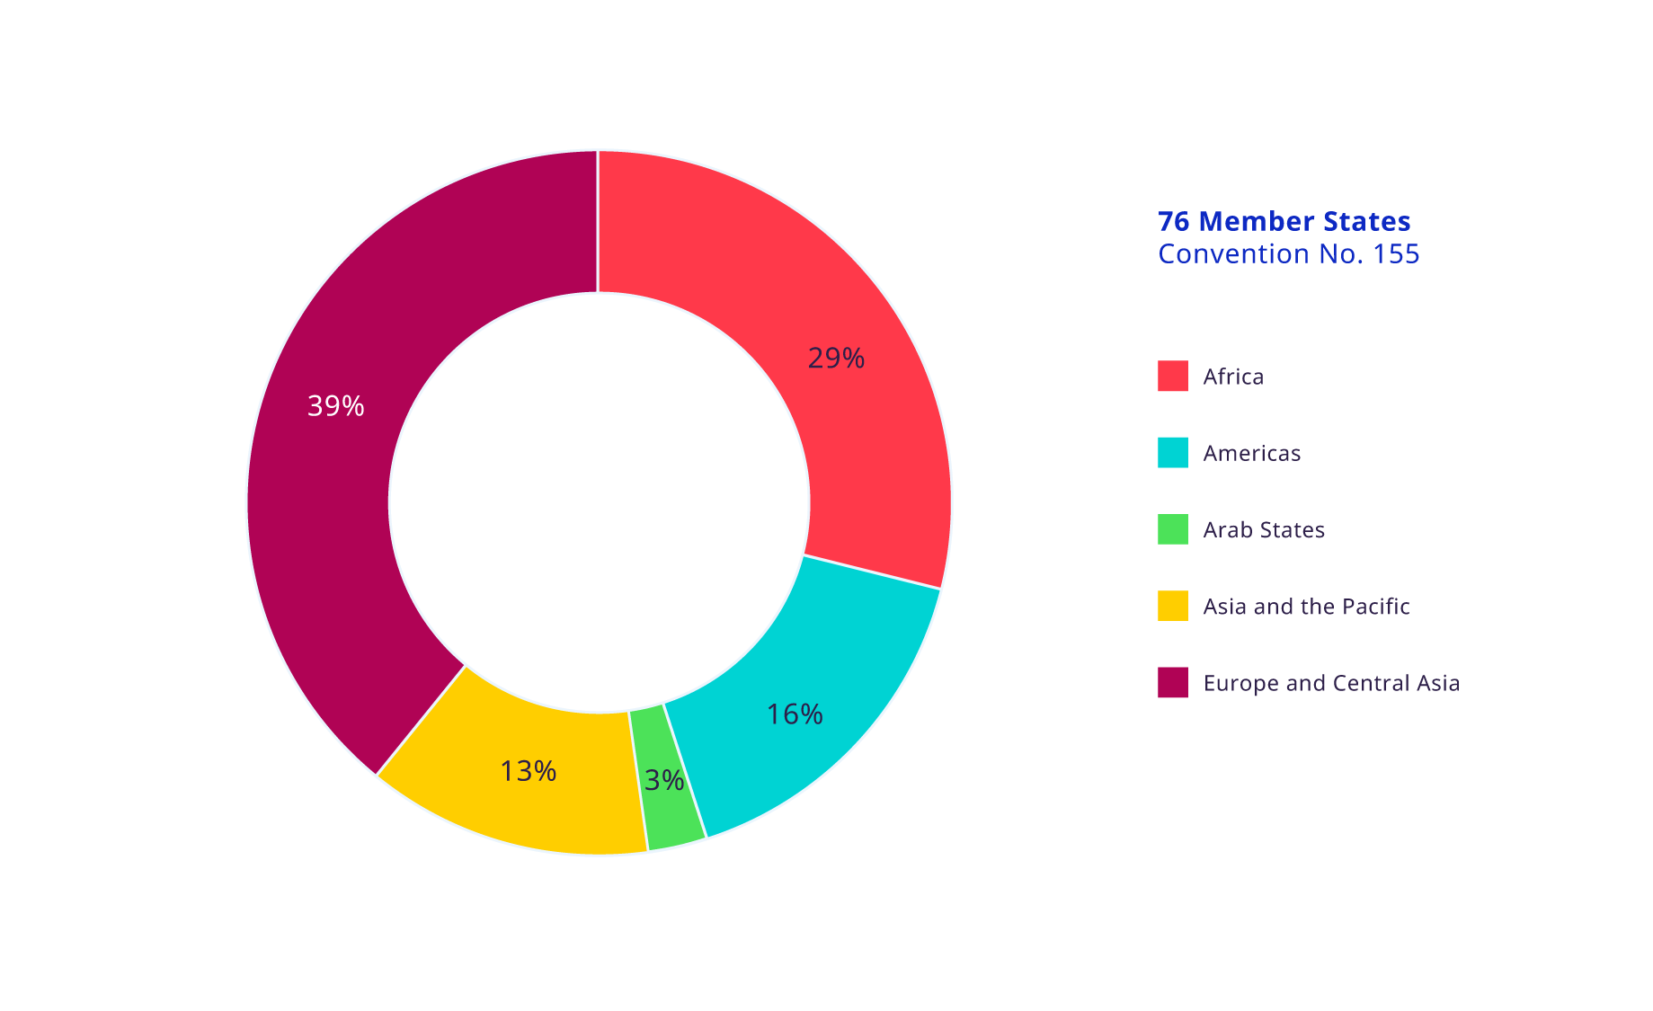
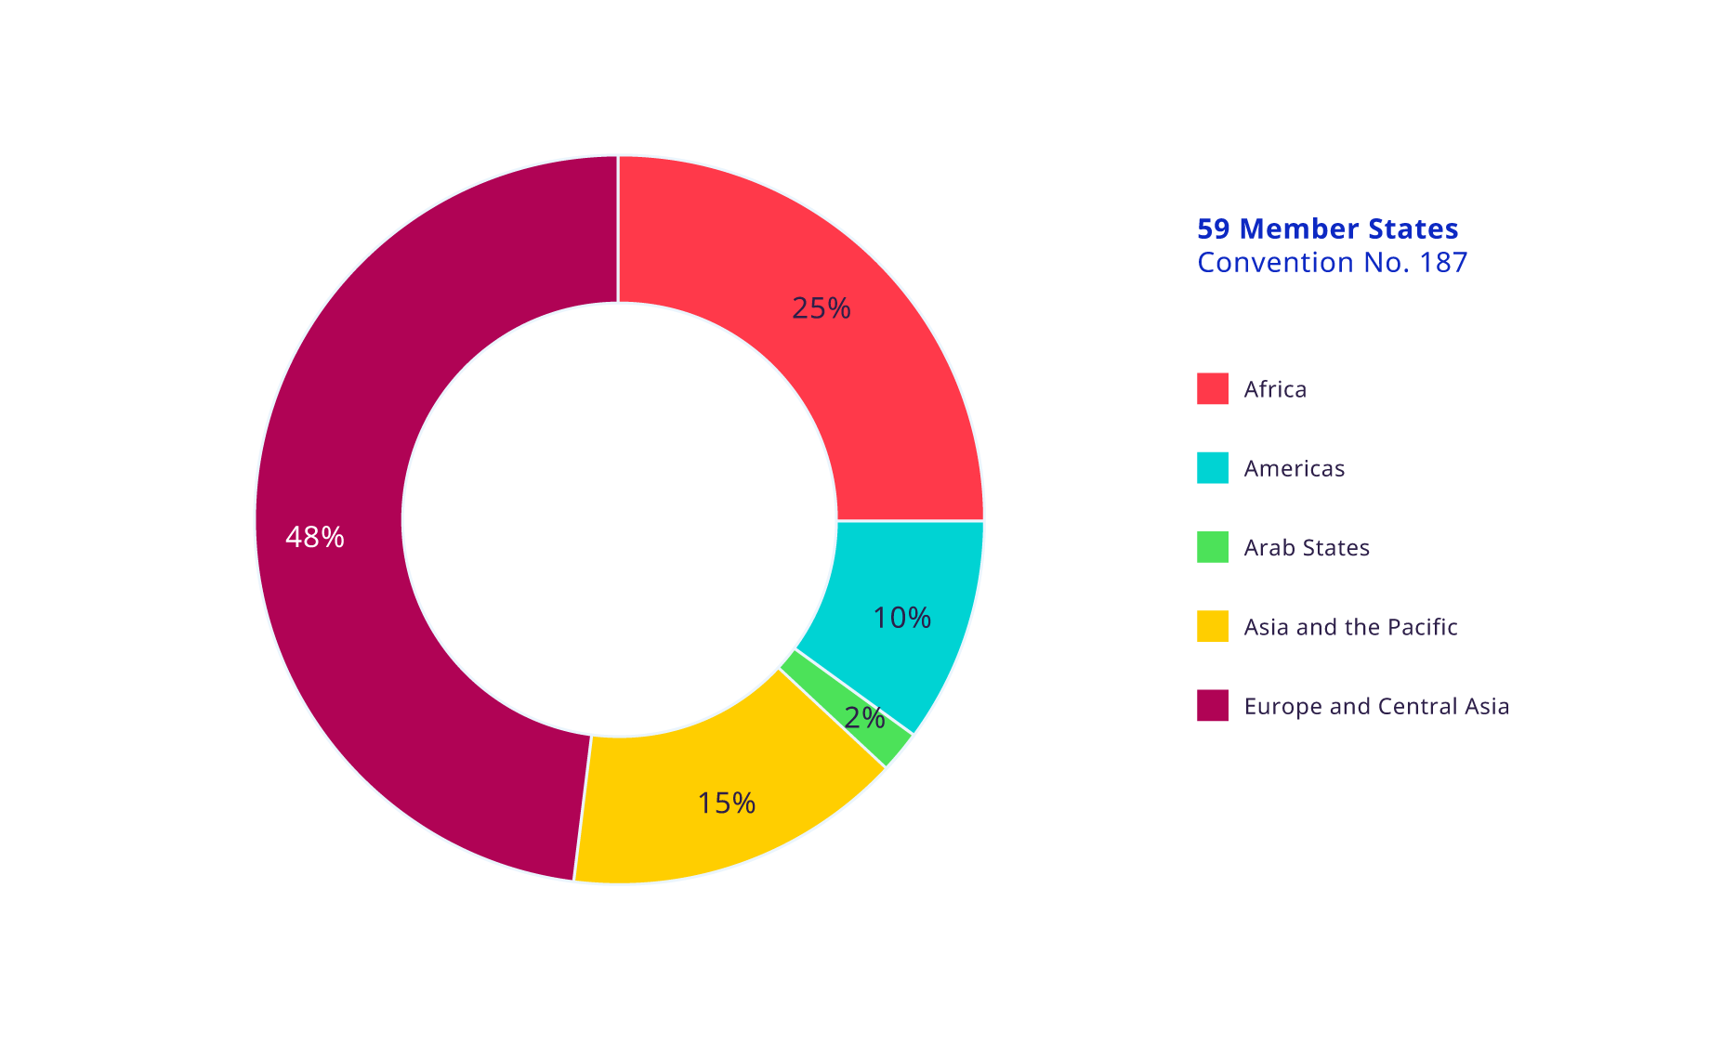
Distribution of Member states that have ratified the fundamental OSH Conventions
Convention No. 155
Convention No. 187

Slide 5
Where are we now?
  Overview of the global implementation status of some key elements contained in the fundamental OSH Conventions, essential for the realization of a safe and healthy working environment:
    Existence of a national authority responsible for OSH
    Existence of national tripartite body on OSH
    Inclusion of key provisions in the national legal framework
    Protection against undue consequences for workers who remove themselves from dangerous work situations
    Requirement to establish a joint OSH committee at the workplace level to promote cooperation between management, workers and their representatives
    Adoption of a national policy
    Development of a national programme on OSH
    Establishment of a national recording and notification system for occupational accidents and diseases

Slide 6
Authority or body responsible for OSH
    Both Conventions Nos. 155 and 187 require the establishment of an authority or body responsible for OSH.
    OSH bodies are usually charged with developing and implementing the national OSH policy, programme and legislation, in consultation with the most representative organizations of employers and workers.
    They may also be responsible for other elements of the national OSH system (e.g., providing advice and information on OSH, funding or conducting research on OSH).
Nearly all ILO Member States have an authority or body responsible for OSH.
87% of OSH bodies are housed in the ministry of labour or a similar body.
In the other cases, OSH bodies are housed in ministries of social affairs, ministries of health or ministries of economic development.

Slide 7
National tripartite body on OSH
    Convention No. 187 requires ILO Member States to set up, where appropriate, a national tripartite advisory body addressing OSH issues.
    National tripartite OSH bodies are composed of government representatives and an equal number of representatives of employers’ and workers’ organizations [sometimes, the tripartite composition can be expanded to involve the representatives of additional institutions, e.g., OSH institutes].
    Tripartite OSH bodies may also be established at regional or local levels, as well as at sectoral levels, especially in hazardous industries.
79% of ILO Member States have a national tripartite body

Slide 8
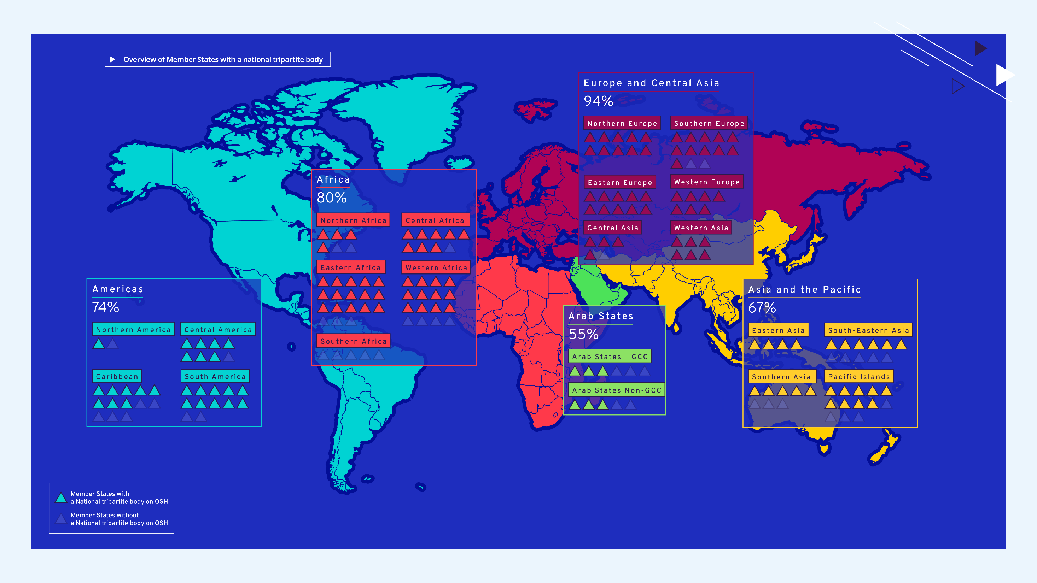

Slide 9
National tripartite body on OSH
Country examples
Mexico: OSH National Advisory Committee
    Led by the Ministry of Labour and composed of an equal number of representatives from the government, employers’ and workers’ organizations.
    Complemented by federal tripartite bodies, chaired by the head of the government of the federal district and composed of tripartite representatives.
Türkiye: OSH Council
    Highest advisory board on developing polices and strategies on OSH.
    Composed of representatives of government, workers’ and employers’ organizations.
    Tripartite composition expanded to involve other non-governmental groups (e.g. engineering and medical associations).
    Meetings twice a year.

Slide 10
Legal framework on OSH
    A comprehensive, prevention-based OSH legal framework is a necessary component of a national OSH system.
    OSH laws should be generally applicable to all branches of economic activity and all workers.
    Key elements of OSH legislation include:
      Principle of prevention
      National infrastructure to govern OSH
      Continuous improvement of national OSH governance
      General outcome-based OSH duties for all relevant stakeholders
      Workplace processes to manage OSH
      Participative, collaborative and cooperative arrangements at the workplace
      Collaboration of undertakings engaging in activities simultaneously at one workplace
      The right for workers to remove themselves from dangerous situations
      Other key prerogatives of workers (OSH training, PPE, etc.)
      Legally defined sanctions and sanctioning procedures

Slide 11
Protection against undue consequences for workers who remove themselves from dangerous work situations
    Convention No. 155 requires that national action be taken to protect workers against undue consequences if they remove themselves from a work situation that they have reasonable. justification to believe presents an imminent and serious danger to their life and health.
    This right plays a vital role in preventing occupational accidents and diseases.
68 % of ILO Member States protect workers from undue consequences if they remove themselves from dangerous situations.
80 % of ILO Member States that have ratified Convention No. 155 recognize the workers’ right to remove themselves from a dangerous work situation without undue consequences

Slide 12
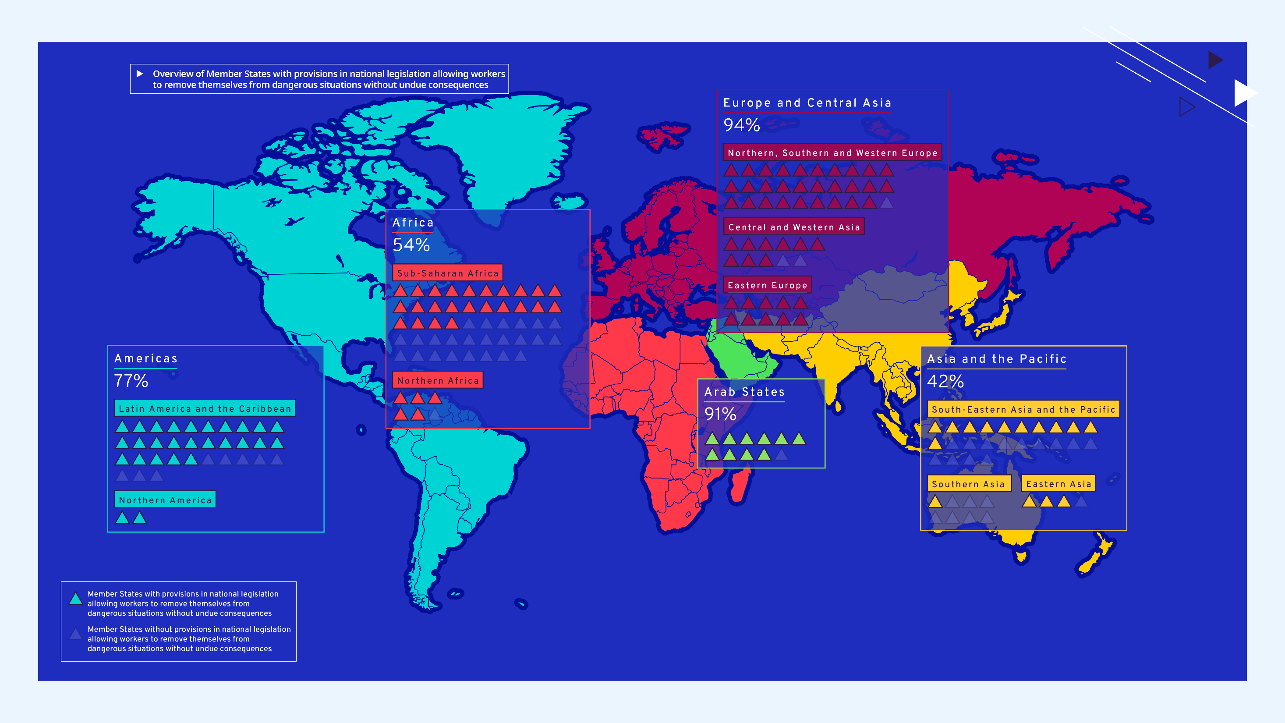

Slide 13
Requirement to establish a joint OSH committee at the workplace level
    Convention Nos. 155 and 187 promote cooperation at the workplace level between management, workers and their representatives.
    The accompanying Recommendations Nos. 164 and 197 provide further detail on the establishment in the workplace of joint OSH committees and the designation of workers’ OSH representatives.
    Joint OSH committees are a successful way to enable workers and employers to work together in a collaborative and coordinated way to address OSH issues in the workplace.
73 % of ILO Member States have provisions in national legislation for the establishment of workplace joint OSH committees.
92 % of high-income countries that have ratified Convention No. 155 require the establishment of workplace joint OSH committees.

Slide 14
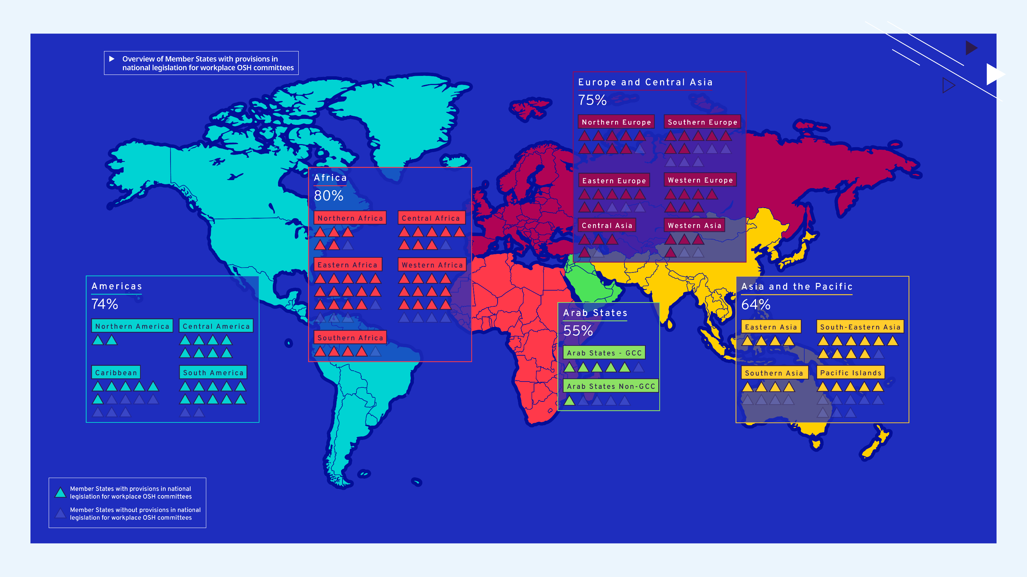

Slide 15
Requirements to establish a joint OSH committee at the workplace level
Country examples
Djibouti
    OSH committees must be created in all industrial enterprises, buildings and public services with ≥ 50 workers (including with temporary contracts).
    The committee should include the employer, the OSH responsible person, a workers’ representative (or two, when > 150 employees) and the enterprise doctor or nurse.
    The OSH committee must be convened by the employer at least 3 times a year, in case of hazardous situations or following serious accident.
Finland
    Workers in enterprises with ≥ 10 employees working regularly are entitled to elect an OSH representative.
    In enterprises with ≥ 20 employees working regularly, an OSH committee must be established for a period of two years at a time.

Slide 16
National OSH policy
    Both OSH fundamental Conventions Nos. 155 and 187 require Member States to formulate, implement and periodically review a national policy on OSH, in consultation with the most representative organizations of employers and workers.
    According to Convention No.155, the aim of the policy shall be to prevent work-related accidents and diseases, by minimising, so far as is reasonably practicable, the risks in the working environment.
    Convention No. 187 adds the promotion of basic principles such as assessing occupational risks or hazards; combating occupational risks or hazards at source; and developing a national preventive safety and health culture.
47 % of ILO Member States have a national OSH policy.
26 % of low-income countries have a national OSH policy.

Slide 17


Slide 18
National OSH policy
Country examples
El Salvador
    OSH policy published in 2019.
    Key principles: participation; universality; integration; equity and equality; non-discrimination.
    Goal: Promoting OSH through the creation of a preventive OSH culture.
    Definition of strategic axes: national regulatory framework for OSH; roles and competencies in the implementation of the policy; continued education and training; OSH management systems; medical surveillance; health protection measures; and OSH information systems and research.
Malaysia
    OSH Policy launched in 2019, signed by the Prime Minister.
    Commitment of the OSH department to creating and maintaining a quality, safe and healthy workplace free of hazards and risks.
    Focus on ensuring that all workers receive relevant information, directives, trainings and supervision on how to perform tasks in a correct and quality manner without being exposed to risks to health.

Slide 19
National OSH policy
Country examples
Saudi Arabia
    National policy on OSH adopted in 2021.
    Definition of the key principles, the overall goal and detailed objectives of the policy, as well as monitoring and performance indicators.
    Commitment to the enhancement and development of OSH.
    Development of partnerships at the regional and international levels in the field of OSH.
Zimbabwe
    National OSH Policy adopted in 2014, aimed at reducing occupational accidents and diseases.
    Promotion of OSH through a tripartite approach.
    Emphasis on workers rights to fair and safe labour practices; to be informed of any OSH risks and their effects; and to be consulted in the development of OSH measures.
    Areas of strategic focus: OSH awareness; operational policies and standards; accreditation of OSH practitioners; compliance and enforcement; decent work; hazard identification and risk assessment; accident prevention culture; and OSH education and training.

Slide 20
National OSH programme
    Convention No. 187 requires Members to formulate, implement, monitor, evaluate and periodically review a national programme on OSH, in consultation with the most representative organizations of employers and workers.
    A national OSH programme refers to any national programme that includes objectives to be achieved in a predetermined time frame, priorities and means of action formulated to improve OSH, and means to assess progress.
    Countries have developed OSH programmes as specific national strategies on OSH or as OSH plans integrated into broader programmes.
34 % of ILO Member States have a national OSH programme.
8 % of low-income countries have a national OSH programme.
83 % of countries with an OSH programme also have a national OSH policy.

Slide 21
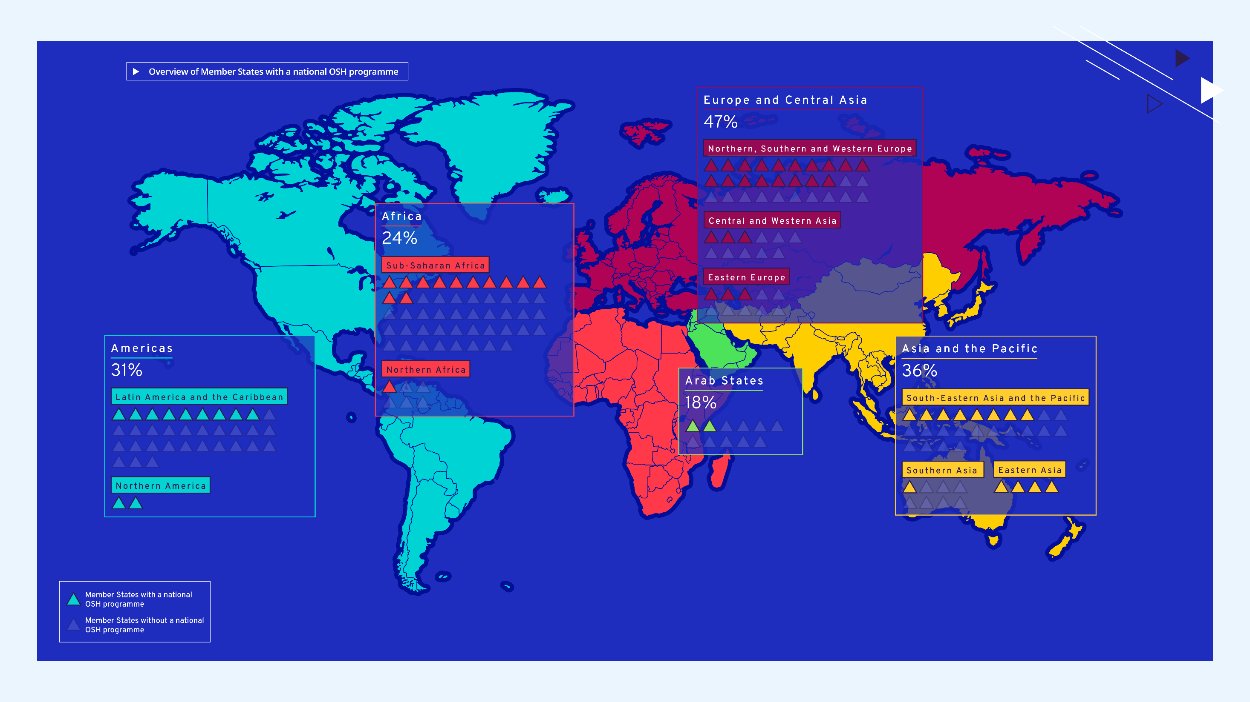

Slide 22
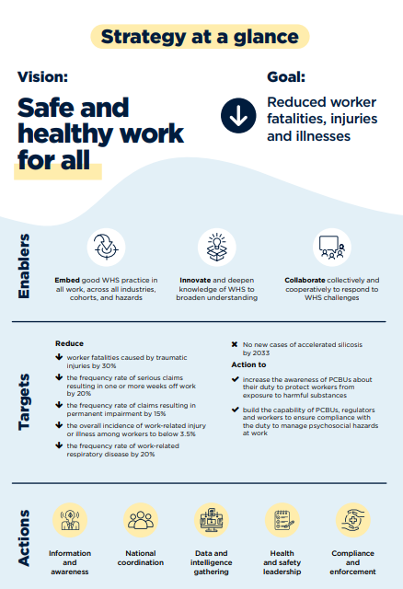
National OSH programmes
Country examples
Australia: the Work Health and Safety Strategy 2023–2033
    The strategy contributes to Australia’s national vision “Safe and healthy work for all”, with the primary goal of reducing worker fatalities, injuries and illnesses.
    The strategy defines key enablers, targets, actions and system-wide shifts required to achieve the goal over the upcoming ten years.
Malta: Strategic Plan for OSH (2022–2027)
    The plan defines five activity areas: legislation, compliance and enforcement; capacity-building; communication of the benefits of OSH; action against existing and emerging risks; and evaluation of effectiveness.
    For each area, desired outcomes, concrete objectives and main deliverables are defined.

Slide 23
National OSH programmes
Country examples
Bangladesh: National Plan of Action on OSH (2021–2030)
    First ever national OSH programme, based on situational analysis and stakeholder consultations.
    Definition of strategic objectives, with key activities and timeframes, including to improve the OSH regulatory and institutional frameworks; improve management of chemicals and hazardous substances; prevent occupational diseases; promote workers’ participation and empowerment; promote OSH in SMEs; implement national surveillance system; promote international cooperation on OSH; mobilize resources for OSH.
Ecuador: National Policy on Health at Work 2019–2025
    The strategy underpins the shift from a curative to a preventive model in the national health system.
    It contains key objectives related to health promotion and prevention of work accidents and diseases; social dialogue; creation of OSH tools to support productivity; development of practical solutions, knowledge and evidence in the field of OSH; OSH improvements in the informal sector.

Slide 24
National recording and notification system for accidents and diseases
    Provisions governing recording and notification systems are outlined in both fundamental OSH Conventions No.155 and 187.
    The Protocol of 2002 to Convention No. 155 was specifically adopted to promote the harmonization of recording and notification systems.
    The collection and analysis of data of occupational accidents and diseases is essential for identifying their causes and detecting new hazards and emerging risks. This is key to define priorities and design effective preventive strategies on OSH, at all levels
    Underreporting of occupational diseases and injuries remains a global challenge, even where reporting and notification systems exist.
91 % of ILO Member States have established a system for the recording and notification of occupational injuries and diseases.
41 % of ILO Member States with a recording and notification system in place provided data to the ILO in the past five years.

Slide 25

We have an essential responsibility to ensure that people go to work and come home alive, uninjured, and healthy. This year, on World Day for Safety and Health at Work, we can celebrate an important step towards this goal: the designation of a safe and healthy working environment as a fundamental principle and right at work.
Gilbert F. Houngbo , 11th ILO Director-General

