Slide 1
Module/Unit 5
Counselling Needs Assessment
(Clear job objective)

Slide 2
Learning objectives
    After completing the unit, the participants will be able to:
    Inform, guide and advise jobseekers in choosing a career
    Provide information on labour market trends
    Know what jobs are in demand in the current time and in the future

Slide 3
Personal and environmental factors
Clear job objective
Career counselling
Assisting jobseekers select an appropriate occupation
Realistic career goal
Notes:
Career counselling assists jobseekers, or persons interested in entering the labour market, to select an appropriate occupation.
The process will examine and address issues related to both personal and environmental factors, in order to help the jobseeker set a clear job objective.

Slide 4
Counselling needs assessment
Personal / Environmental Factors
Clear Job Objective
+
INTERESTS
Points to Consider….
REVIEW OCCUPATIONAL INFORMATION
APTITUDES
FINANCIAL CONSIDERATIONS
RESEARCH OCCUPATIONAL SECTORS
FAMIILY RESPONSIBILITIES
DISCUSSIONS WITH PEOPLE WITHIN THE OCCUPATION
OTHER CONSTRAINTS
=
REALISTIC CAREER GOAL
Notes:
Assisting job seekers select an appropriate occupation

Slide 5
Clear job objective
    Understands their likes and dislikes
    Self-awareness
    Clear focus on what they would like to do
    Occupational choice is clear in terms of education, working conditions and earnings potential

Slide 6
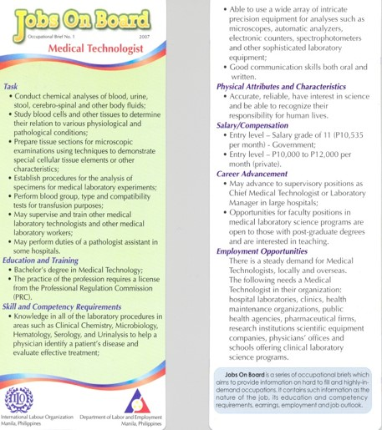
Deciding on a career path
    Labour market information
    Job descriptions
    Wages attached to the job/occupation
    Working conditions
    Future trends and developments
Notes:
Once the personal and environmental factors have been resolved satisfactorily, the jobseeker can progress to a more focused employment discussions/goal. However, when making a decision on a career objective or path, specific information on occupations might be necessary.
Labour market information (LMI) on current and future occupations are also very important in career counselling. Other equally important information includes the actual duties attached to a specific occupation or jobs plus information on wages and working conditions attached to the occupation.
Most employment offices have a range of publications providing this information, as well as access to the Internet to enable jobseekers to research this information on their own. Career counsellors may also suggest that, once the jobseeker has narrowed down their list of possible occupations, they speak to any friends and family members who already work in these occupations to find out first-hand what the work is actually like.
The sample “Jobs on Board” were occupational flyers developed and shared with young university graduates. The occupations were derived from projections on new jobs needed by the economy for the next 2 years.

Slide 7
Occupational Information
    Having access to occupational information through the Indonesia’s National Standard Occupational Classification (NSOC) or National Industrial Standard Classification of Occupations
    Important for jobseeker to understand tasks listed in their chosen occupational field
    Jobseeker can also talk to people who are working in the same occupation
    Career fairs offer opportunities to learn the wide range of occupations especially those in demand in the locality

Slide 8
Factors affecting Jobseeker’s decision
    Pandemic has caused economic declines in the country and other countries resulting in job uncertainty
    Increasing scientific research and rise of new information technology
    Labour market re-structuring due to rise in new products and services
    Changing work environments: economic perspectives; new modes of working (work from home)
    Technology: rapid changing technologies require new skills and occupations; skills for the future
    Existence of vulnerable occupations
    Climate change: job losses but new and emerging jobs (green jobs)

Slide 9
Jobs most in-demand in Indonesia & Asia
    Careers in health care, education and digital services are set to be among the fastest-growing in Southeast Asia for 2021
    Surge in demand for medical professionals, teachers and creatives in 2021, as the coronavirus changes the face of the region’s jobs landscape.
    Further surge of frontline e-commerce workers, health-care professionals, workplace diversity experts

Slide 10
Jobs most in-demand in Indonesia & Asia
    Continued demand for technical specialists, such as data analysts and engineers
    Trends have emerged in direct relation to the global pandemic, and reflect the current landscape
    Rise of medical roles: includes frontline medical staff like doctors and nurses and also social workers and mental health professionals.

Slide 11
Jobs most in-demand in Indonesia & Asia
    Due to rapid rate of digitalization shift to online retail due to lockdowns which opened up new roles in e-commerce and supply chain.
    These trends have led businesses to implement new digital technologies, resulting in a surge in demand for software and cybersecurity specialists.

Slide 12
Any question?

Slide 13
Group work

Slide 14
Role play

