Slide 1
Module/Unit 7
Employment Counselling
(Job search skills)

Slide 2
Learning objectives
    After completing the unit, the participants will be able to:
    Guide jobseekers using necessary tools and facilities to search for job opportunities
    Assist jobseekers to market their skills and experience to achieve their job objective

Slide 3
Job search skills
Ability to maintain a job
Employment counselling
Assisting jobseekers to effectively market themselves
to enterprises with job vacancies
Employment resource centre/facility (e.g. Linkedln; company websites, etc.)
Job matching links
Job search techniques
Job-finding clubs, job fairs
Access to internet sites and LMI
Importance of lifelong learning
Developing good work habits
Life skills coaching
Notes:
Employment counselling
This is the stage where the jobseeker is provided with the necessary tools, facilities and skills to search for job opportunities and to successfully market their abilities to potential employers.

Slide 4
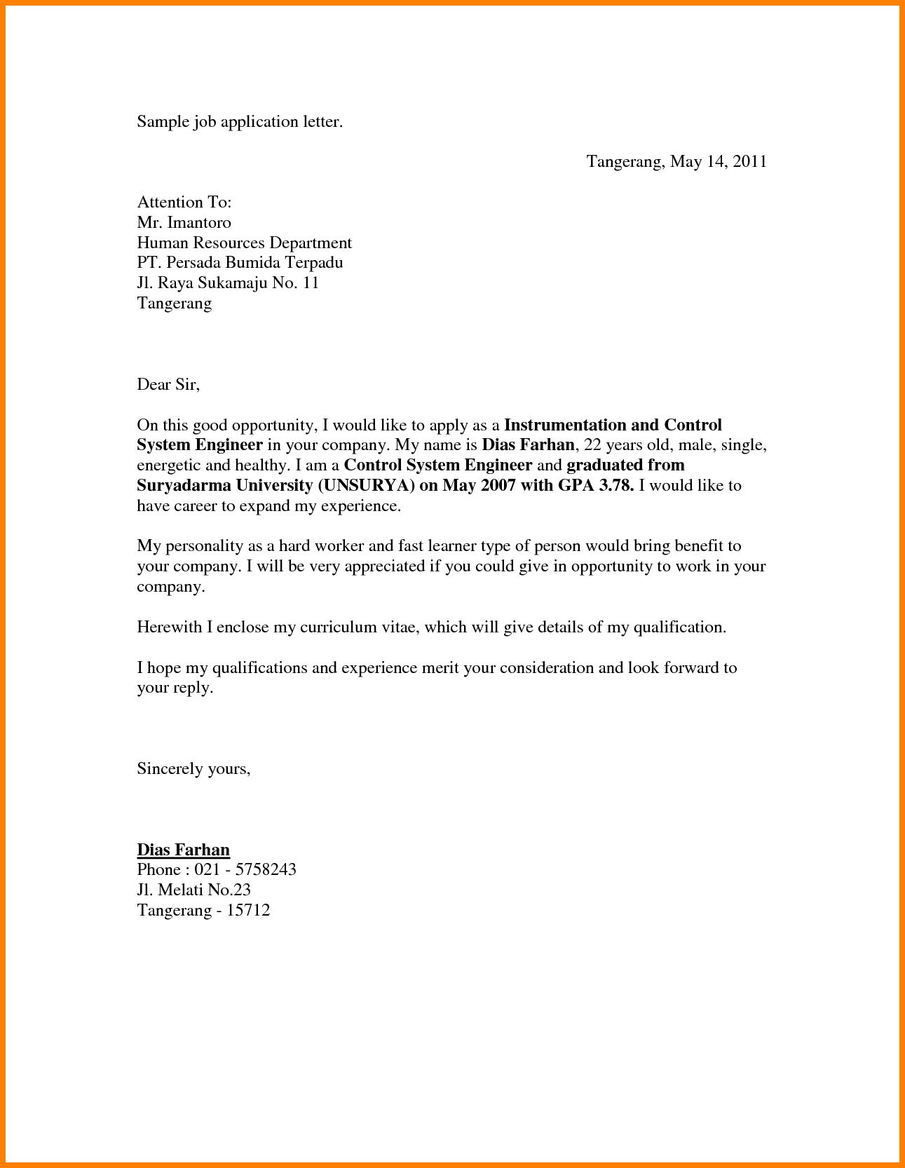
Services under Employment counselling
    basic job-search techniques;
    assistance in preparing an effective resumé or cv, and information on where to search for job openings;
    how to prepare for interviews;
    what to do by way of follow-up once a job interview has taken place; and
    when accepted in the job, how to continue to stay in the job and the necessary core skills/soft skills to adapt on-the-job
Notes:
Usually, this counselling process, out of necessity takes place in a one-on-one setting but there are also instances where the services provided during employment counselling are done in a group setting.

Slide 5
Ability to market their skills and experience to achieve their work objectives
    Job search skill
    Developing a good resume or cv and application letter
    Understanding their value in the labour market and being able to demonstrate this to a potential employer
Notes:
Conducting a better job search using the best tools available to them as jobseeker can bring them to the state where they are ready to compete with others who are looking for work.
The ESC is perfectly suited to provide information to jobseekers. Whether they need to prepare an up-to-date and attention-grabbing curriculum vitae, or a concise and informative resume and application letter. ESC can offer short seminar, provide informative brochures, or the employment officer can personally review the document and provide helpful guidance. Jobseekers can also be advised to search for examples of curriculum vitae or resumes on line if they are interacted in a more independent approach
It should be emphasized that sending as many CVs and application letters as possible is quite important. Students should not get discouraged if they are unsuccessful. Studies have shown that although families and personal networks play an important role in securing a job in Indonesia, those who get jobs in Indonesia have applied to more jobs than those who do not get jobs (ILO School to Work Transition Study, 2006).

Slide 6
Job search skills
    There are two channels to look for a job:
    Formal, advertised job market
      classified ads
      job clubs
      internet
      job fairs
      television, radio
      recruitment agencies/search firms etc.
    Informal market
    networking made up of relatives, friends, neighbors etc.
Notes:
It is quite important for the jobseeker to know where and how to look for a job.
There are two ways to look for a job:
Formal advertised job market
Informal market
The formal advertised job market includes:
Classified ads(newspapers, journals, magazines, etc.)
Job clubs
Internet (job search websites, company websites)
Job fairs
Shop windows, public places, community billboards
Television, radio
Search firms, recruitment agencies
The informal market is all about networking. The network includes relatives, friends, neighbors, teachers, interest groups, community etc.

Slide 7
Ability to maintain a job
    When accepted in the job, how to continue to stay in the job
    Ability to adapt to changing work environment
    Practicing necessary core skills/soft skills (e.g. discipline in the workplace; practicing teamwork; to adapt on-the-job
    Responding appropriately to supervision
    Improving chances of moving up and getting a promotion—advancing in the job
Notes:
Depending on the personal factors identified during career counselling, there are different ways of closing the gap gap between the jobseeker’s existing skills and experience and those required to pursue their career choice. Therefore, there will be varied approaches in vocational counselling and the development of individual plans suited to individual needs and circumstances.
There are options other than formal classroom training and these can include:
(1) on-the-job training(OJT) to upgrade or enhance existing skills;
(2) apprenticeship training-- providing some source of income while acquiring the skills and practical experience necessary for a skilled trade; and/or
(3) internship programmes, to provide work experience to supplement technical training for new graduates.

Slide 8
Any question?

Slide 9
Group work

Slide 10
Role play

