Slide 1
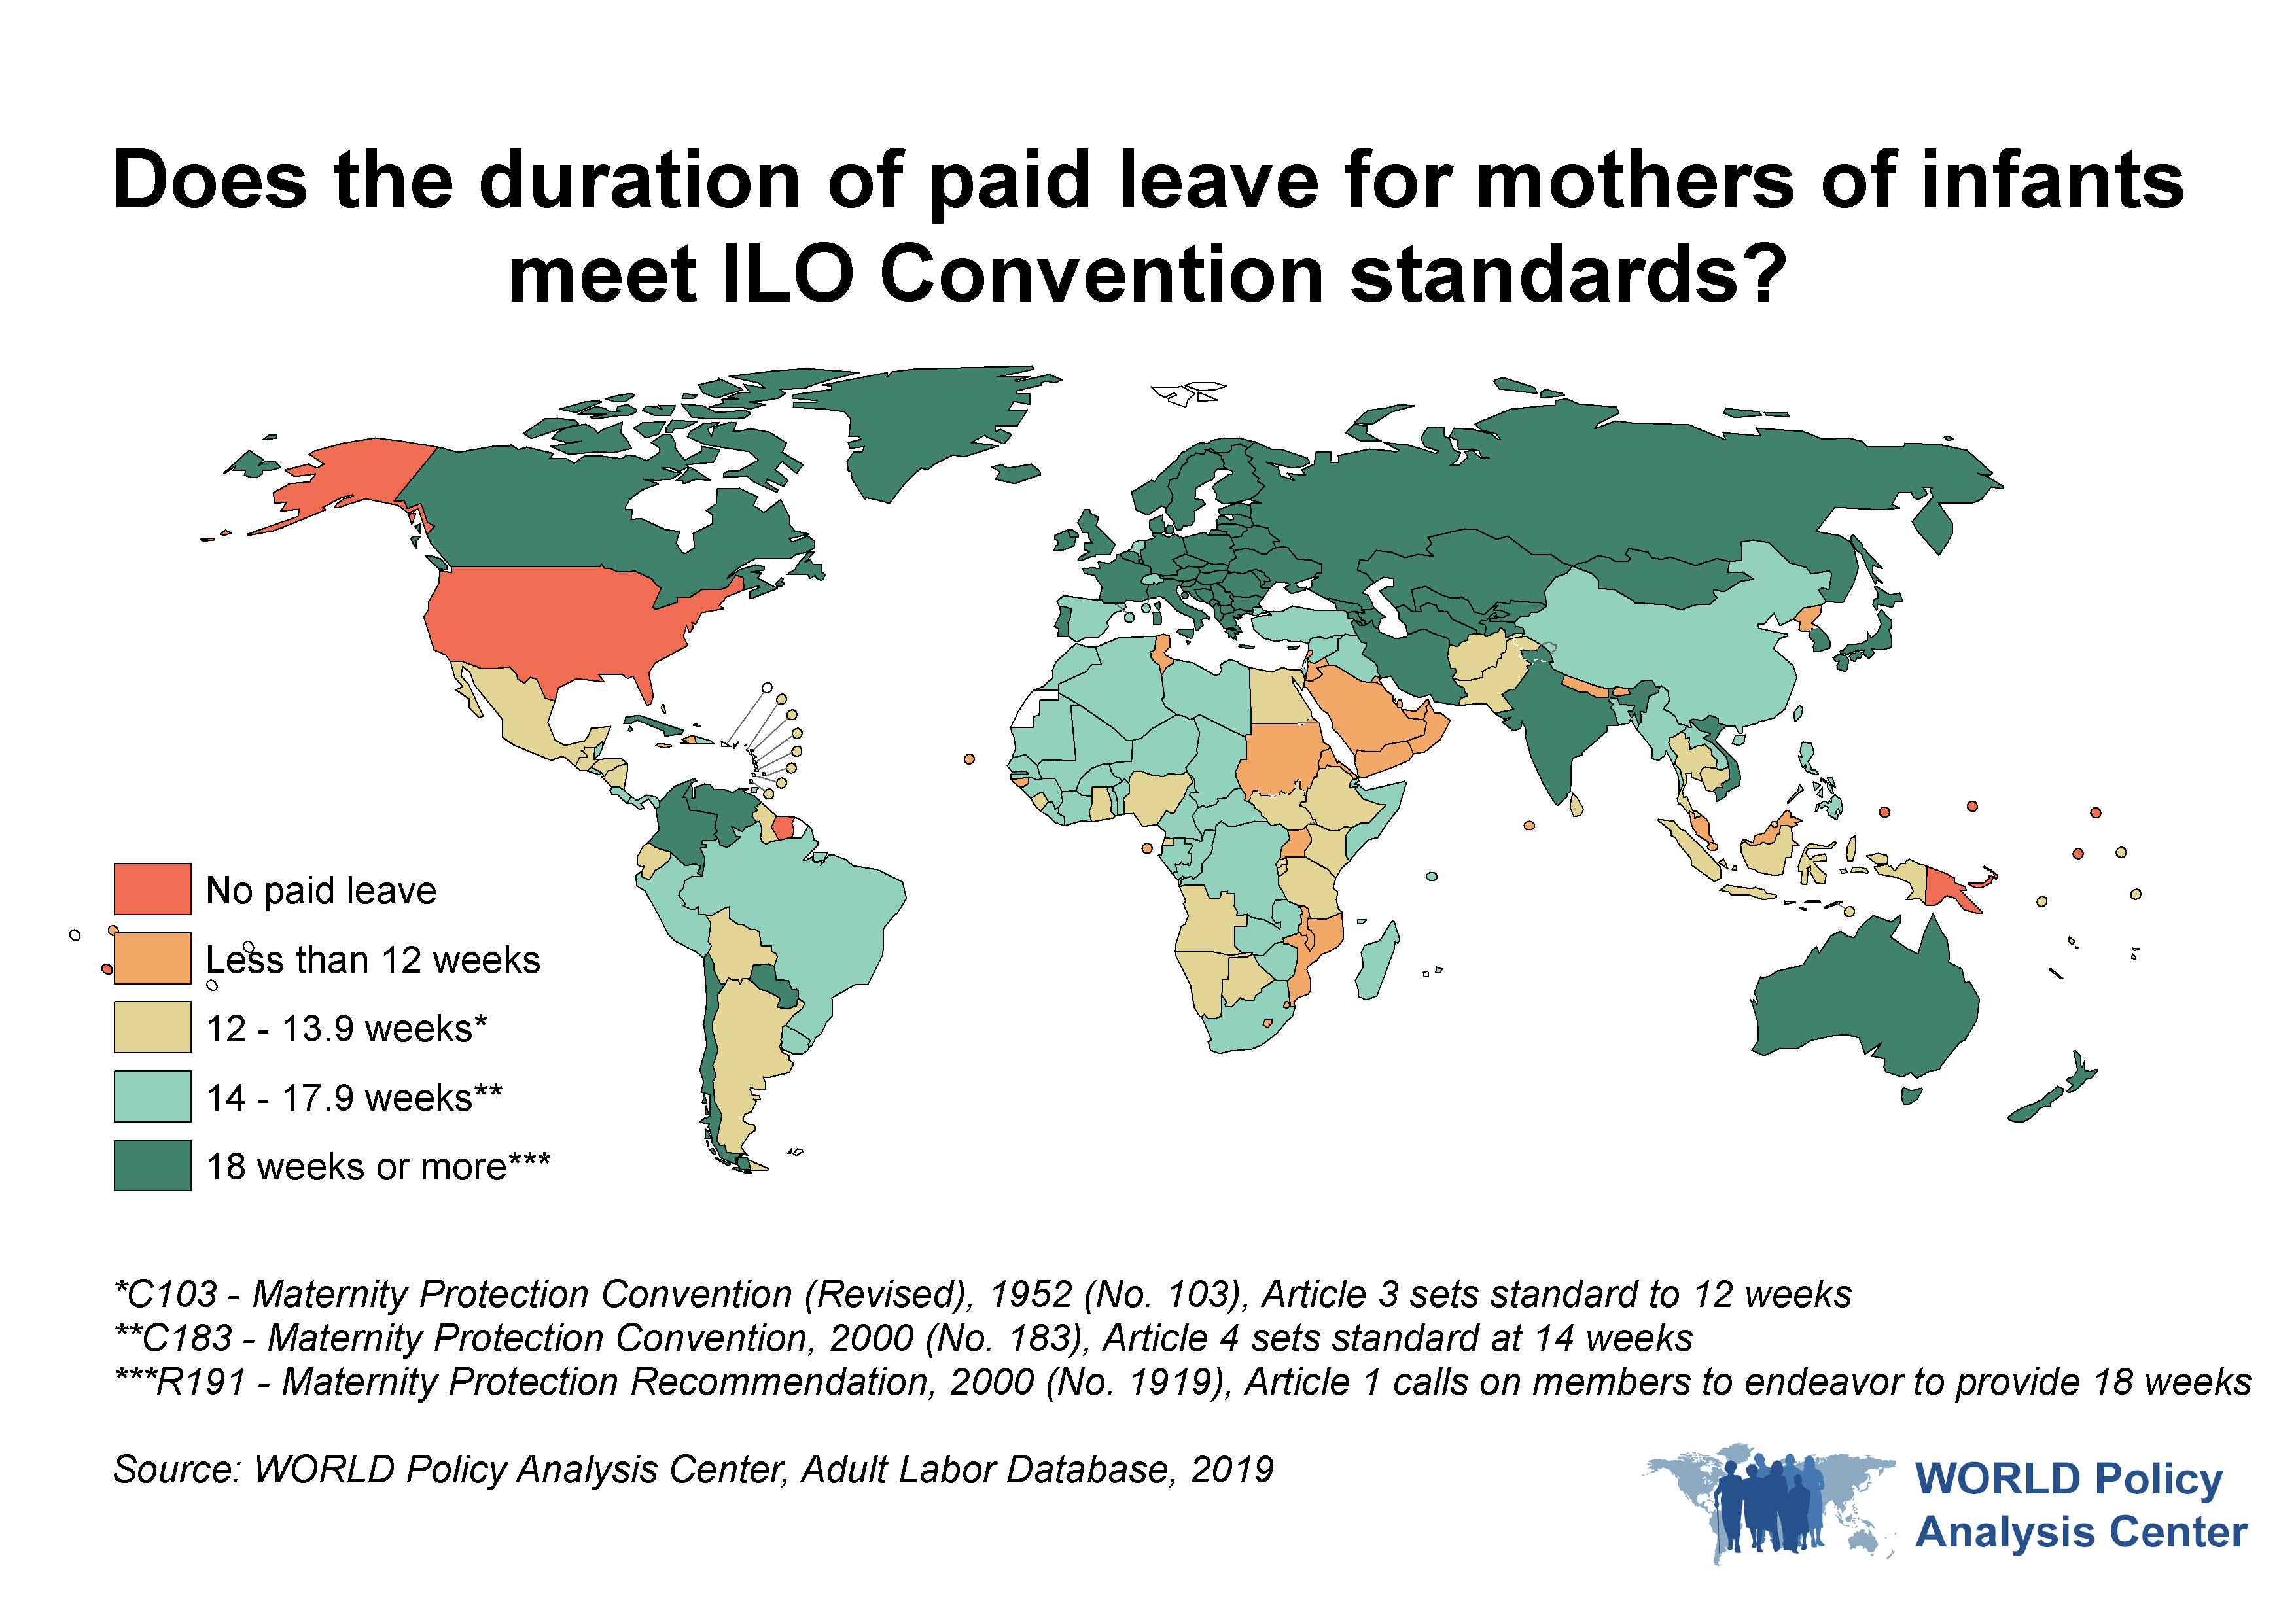

Slide 2
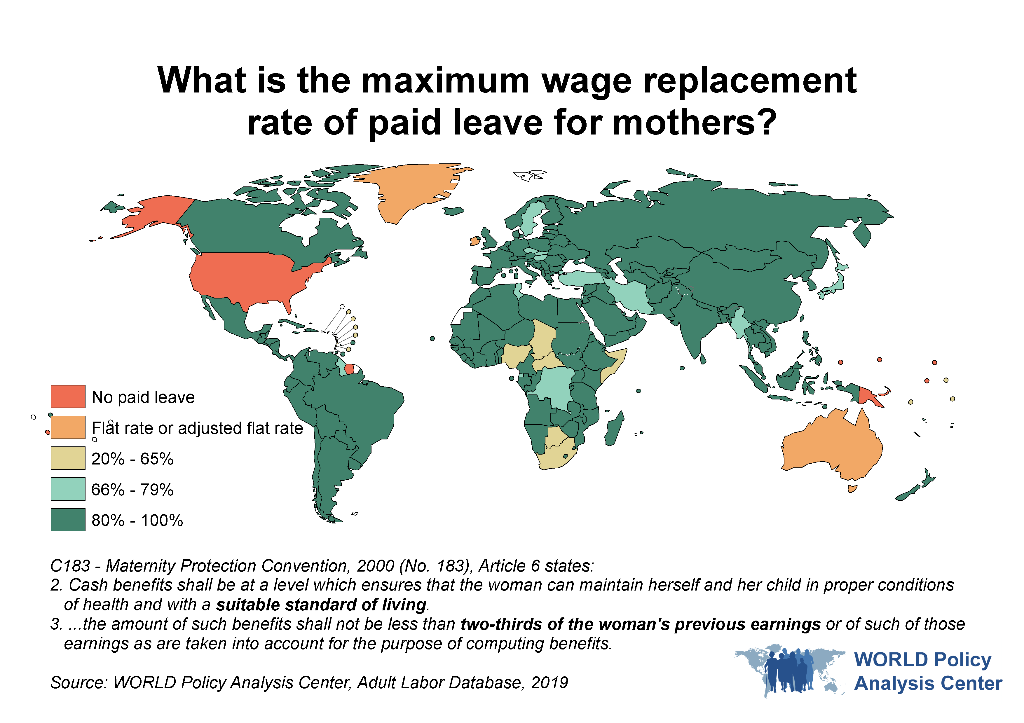

Slide 3
By country income level,* how did the percentage of countries guaranteeing mothers of infants at least 14 weeks of paid leave change from 1995 to 2019?
*Country income level is based on the World Bank's income level categorization in May 2018 and does not reflect change over time.
Source: MACHEquity & WORLD Policy Analysis Center, Adult Labor Database (1995-2019)

Slide 4
How did the duration of paid leave for fathers of infants
change from 1995 to 2019?
Source: MACHEquity & WORLD Policy Analysis Center, Adult Labor Database (1995-2019)

Slide 5
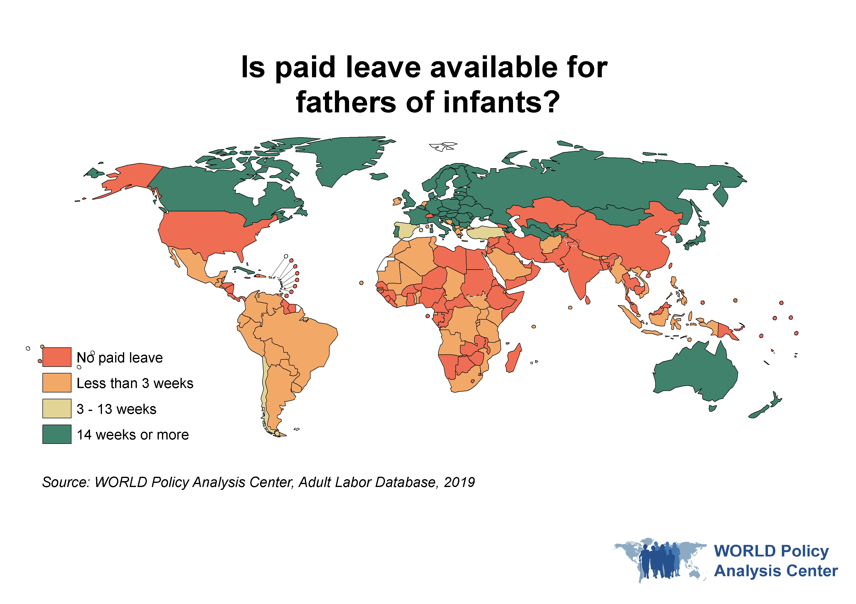

Slide 6
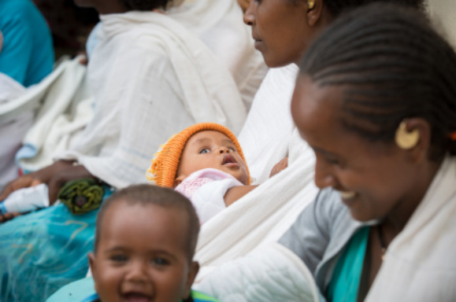

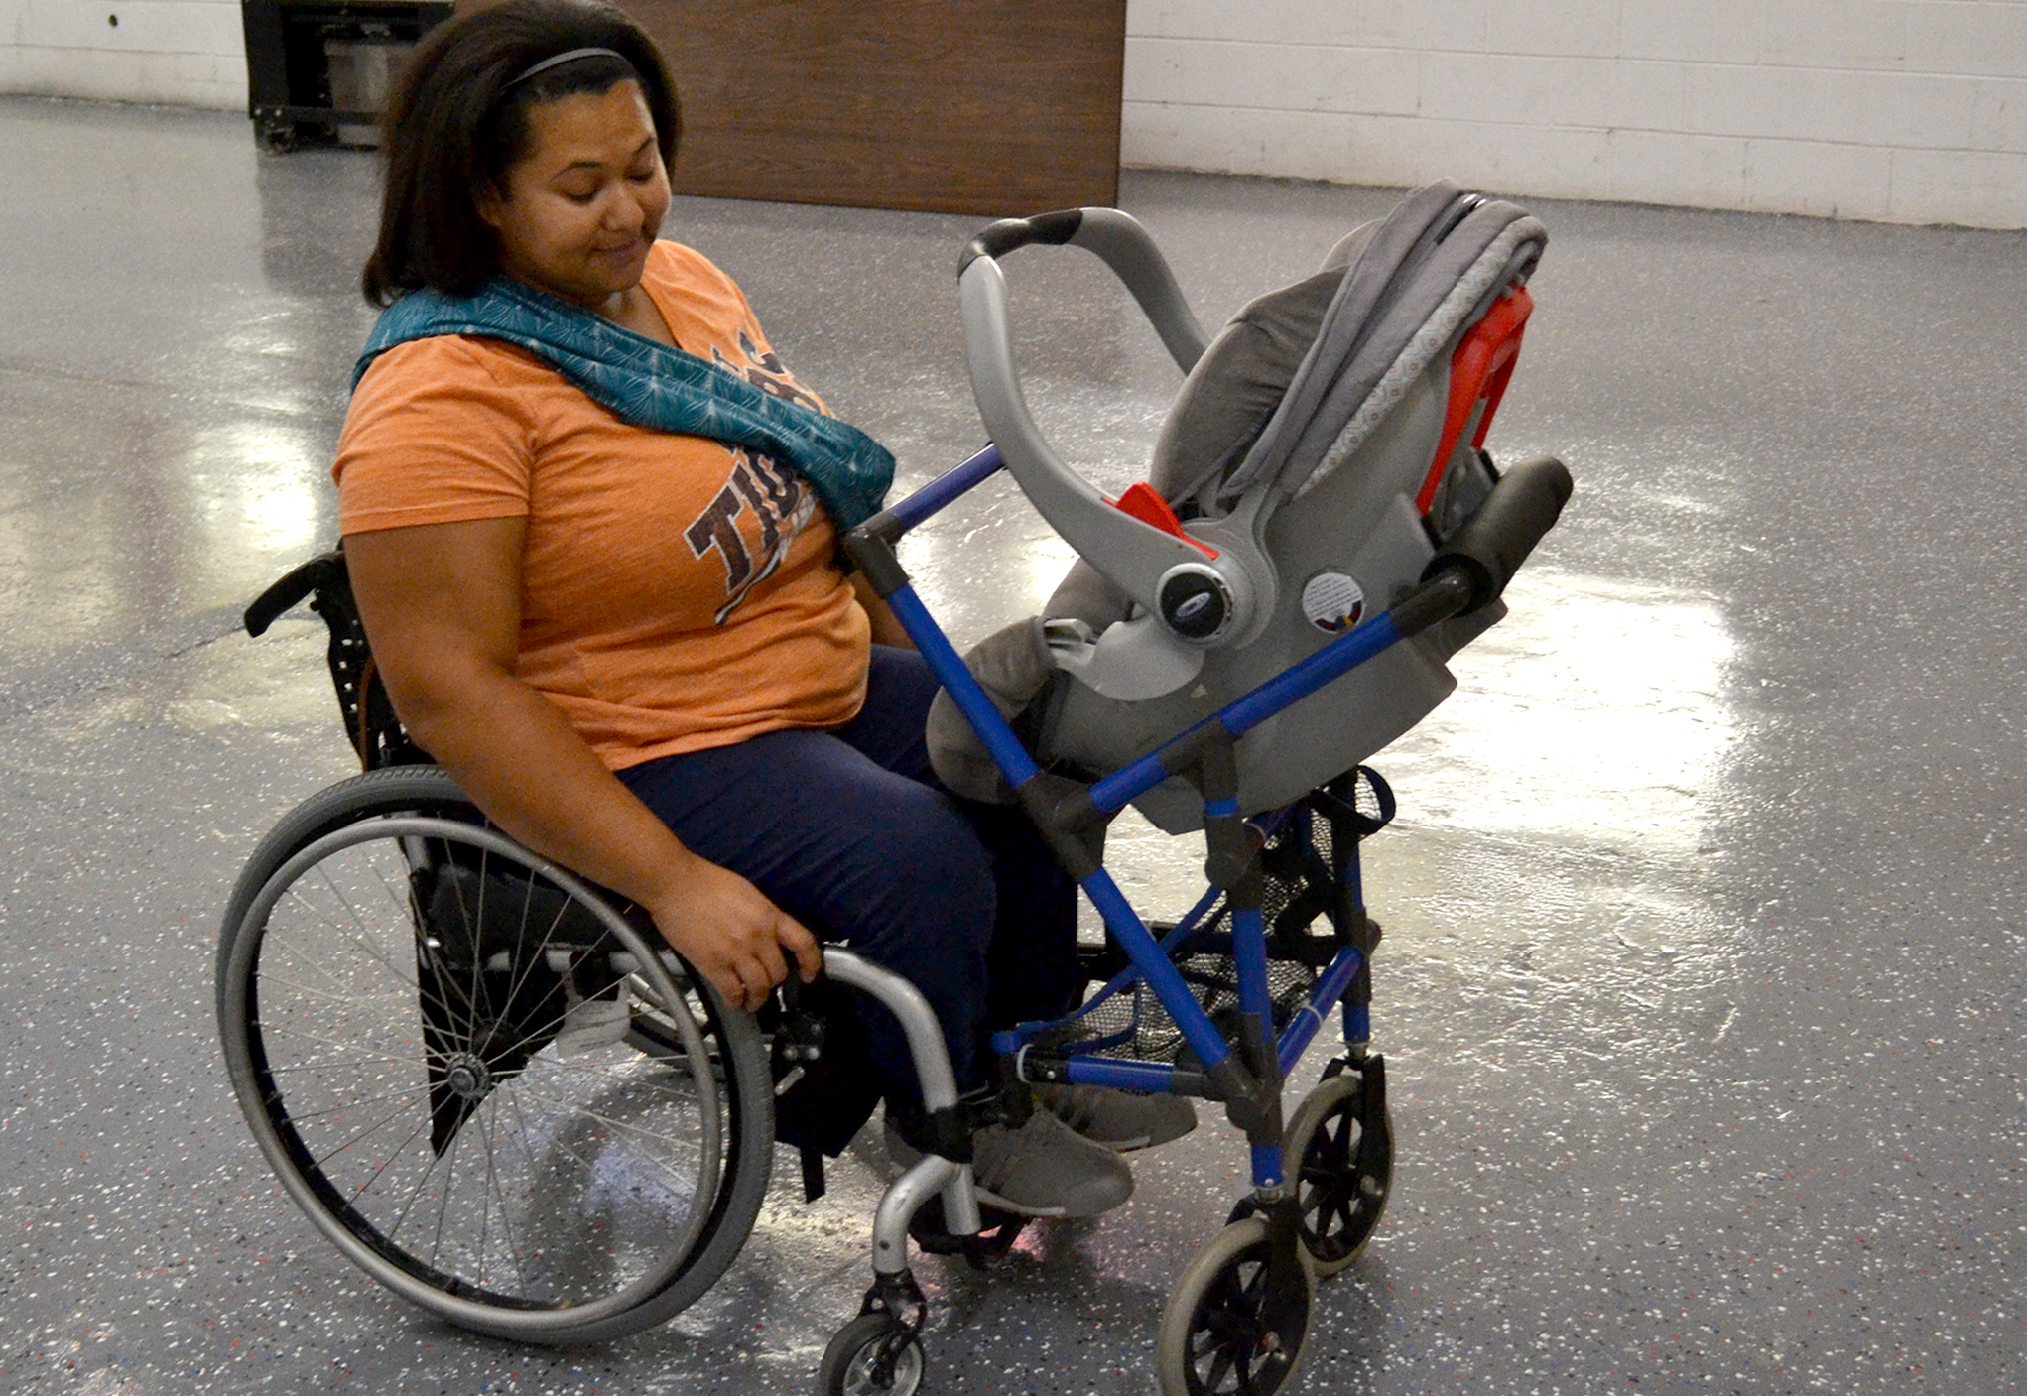


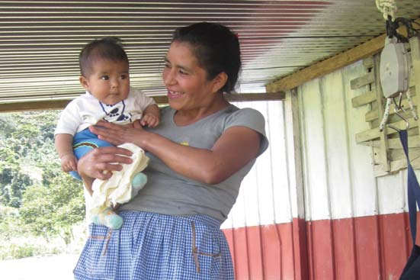
The importance of covering all parents, caregivers, and families

Slide 7
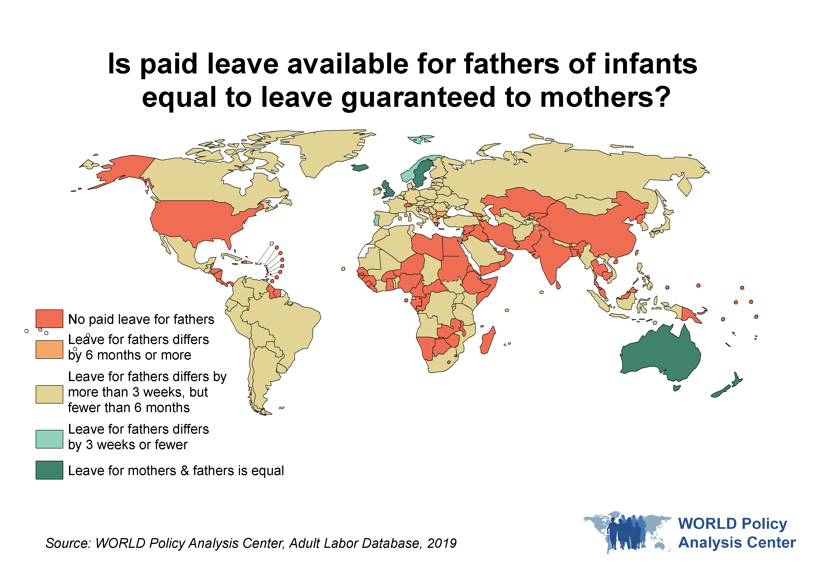
How dissimilar is the leave available to fathers and mothers?

Slide 8
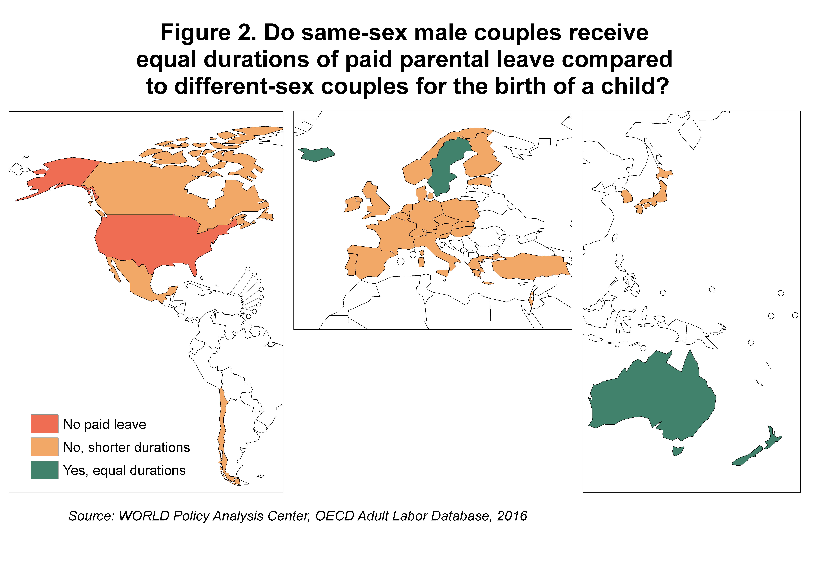
Do same sex parents receive equal durations of paid leave as different-sex parents for the birth of a child?
Do same-sex male couples receive equal durations
of paid leave compared to different-sex couples for
the birth of a child?
*
Source: WORLD Policy Analysis Center, OECD Adult Labor Database, 2016
Orange indicates that either same sex female or same sex male parents receive a shorter leave duration
Green means that all parents receive equal duration of leave

