Slide 1
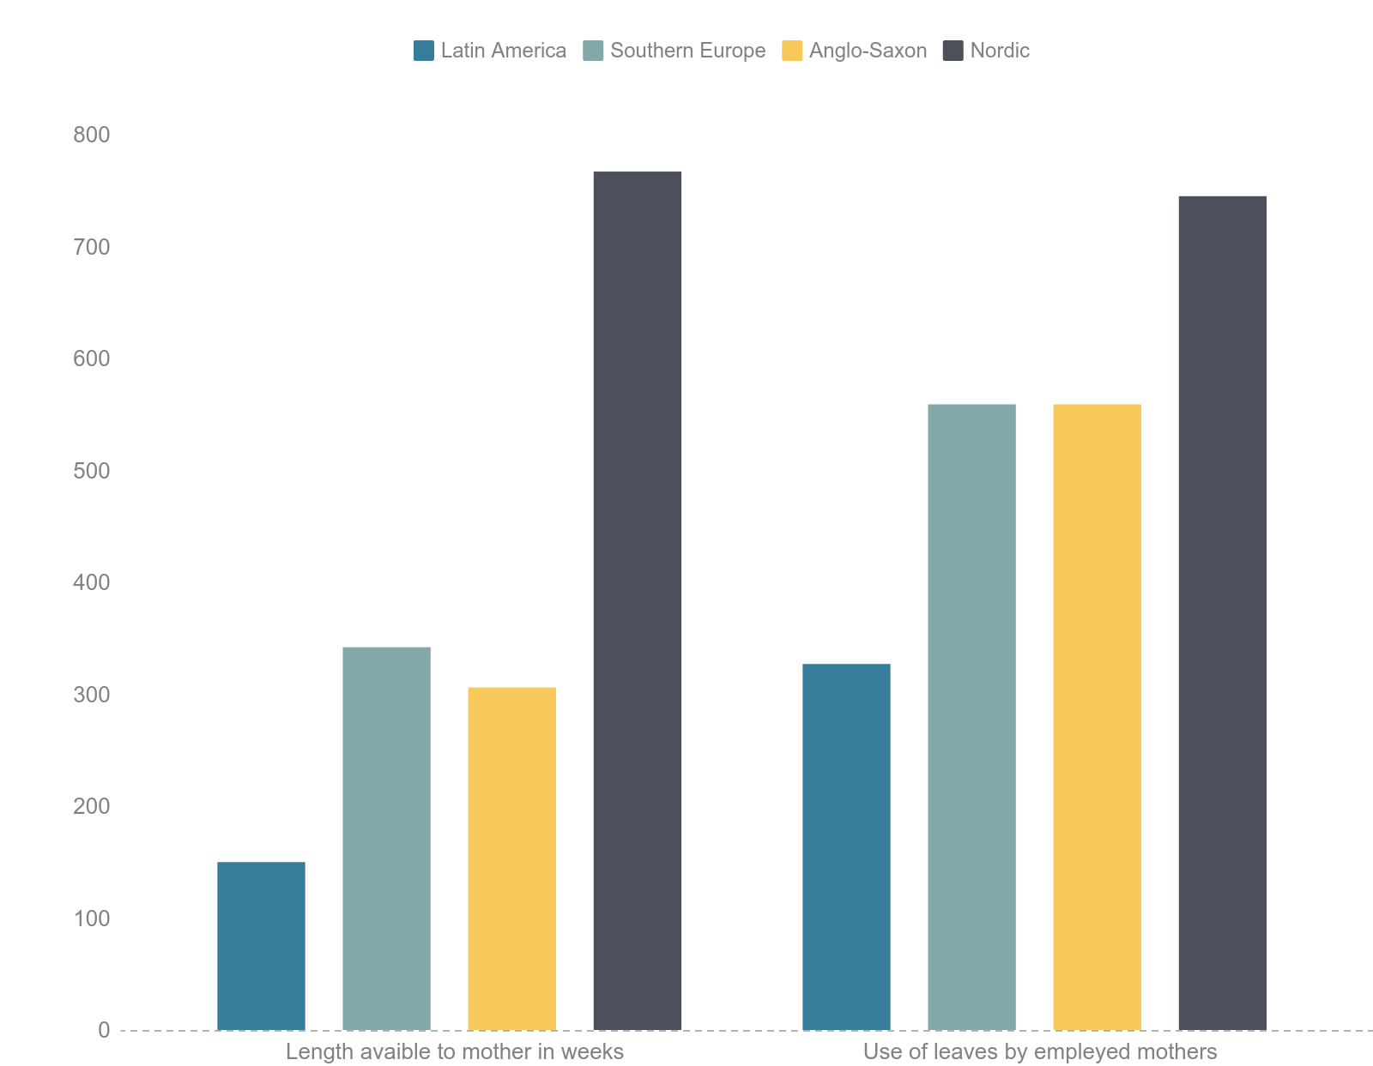
Length available to mothers, in weeks
Access by employed mothers
77
Nordic
Nordic
Maternity leave
Latin America
in a comparative perspective
Southern Europe
Anglo-Saxon
31
34
Southern Europe
15
Anglo-Saxon
Latin America
Latin America
Source: Filgueira and Martínez Franzoni, 2019; based on OECD data.
Notes:
First round

Slide 2
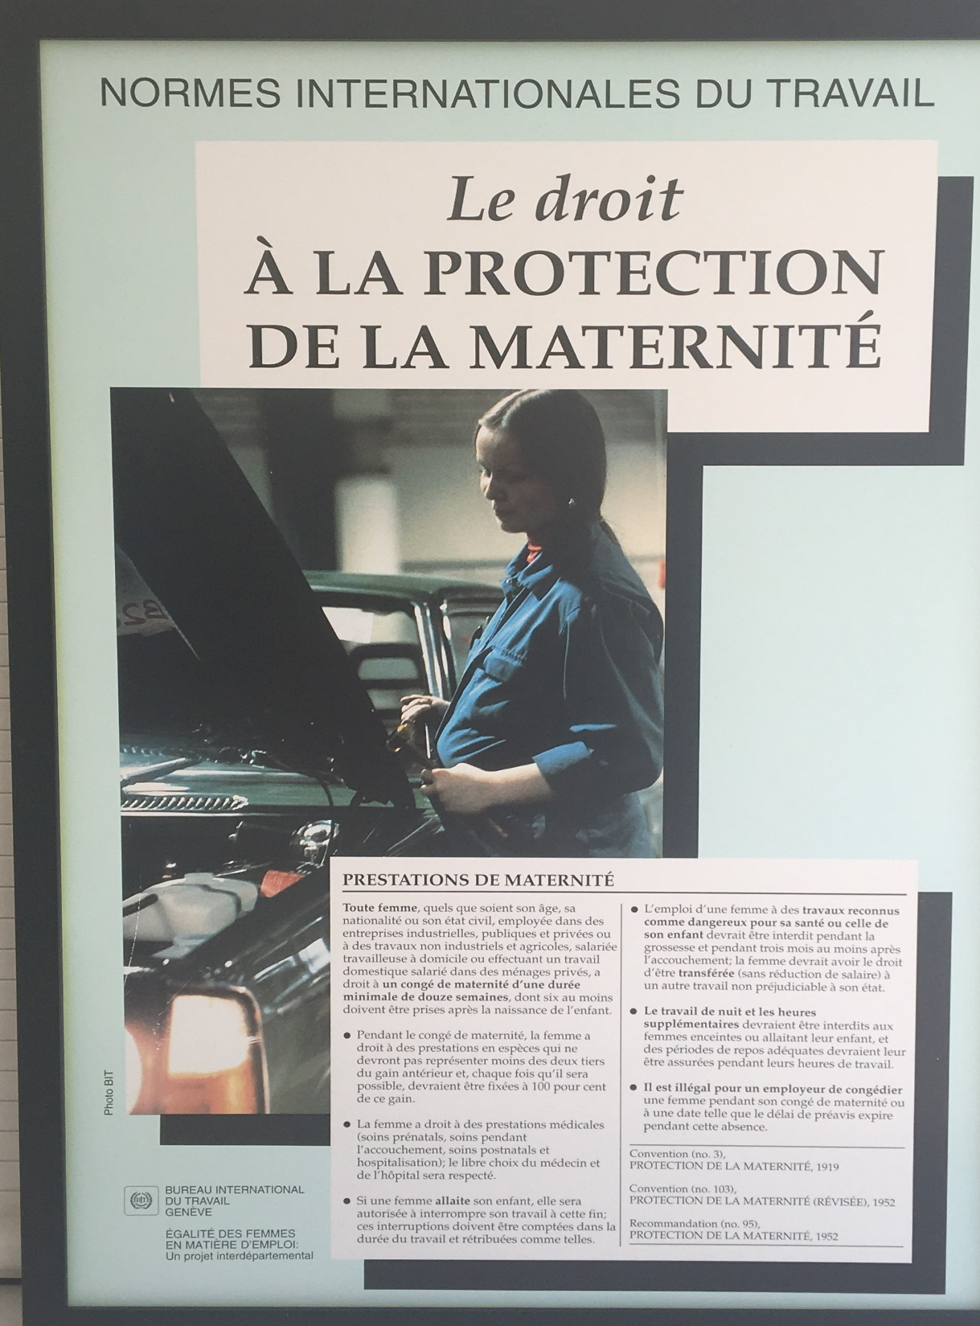
International Labour Standards
The Right to Maternity Protection
‘Maternity Benefits
Every woman, regardless of her age, nationality or marital status, employed in public or private industrial enterprises, in non-industrial or agricultural work, whether she is a salaried homeworker or a salaried worker in private households, is entitled to a maternity leave of at least twelve weeks, at least six of those weeks should be taken after the child is born.’
_______________________________________________________
Convention (no. 3), Maternity Protection, 1919
Convention (no. 103), Maternity Protection (Revised), 1952
Recommendation (no. 95), Maternity Protection, 1952
_______________________________________________________
+ Convention (No. 183), Maternity Protection, 2000: 14 Weeks

Slide 3
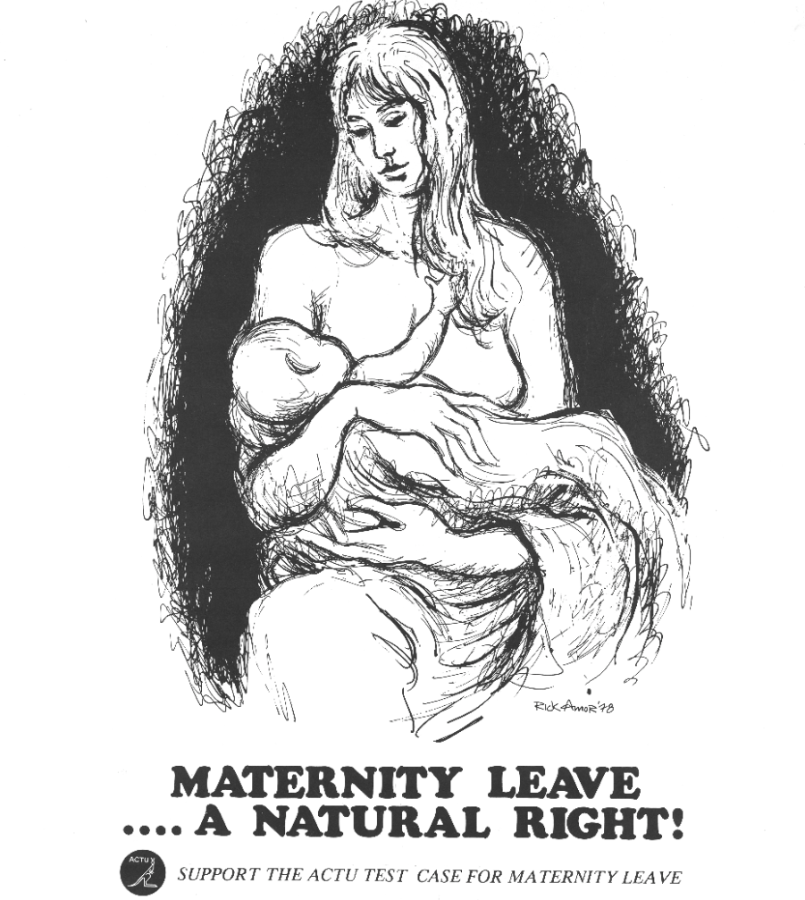
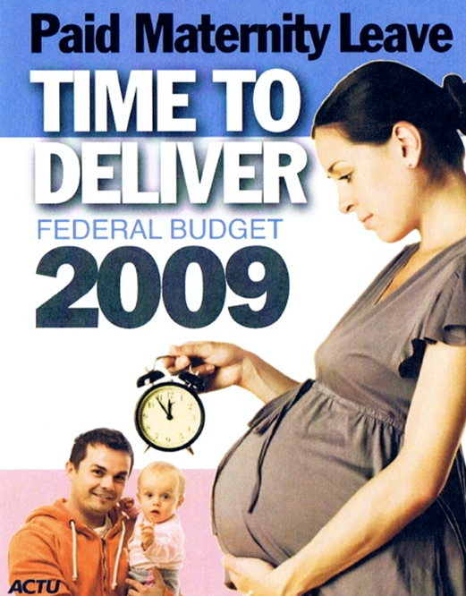
AUSTRALIAN CAMPAIGNS: 1979 and 2009

Slide 4
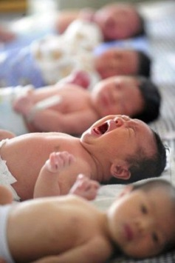
New born in italy is a big issue: the trend is steadily decreasing
-1.4 %
+2.3 %
-1.2 %
-2.7 %
-2.3 %
+0.7 %
-3,7 %
-2,3 %
-3,3 %
-2,5 %
-3,2* %
15,0%
15,2%
10,2%
11,3%
12,4%
13,4%
13,7%
14,4%
14,9%
14,4%
14,3%
14,4%
+10,8%
+12,6%
+6,2%
+1,5%
+1,8%%
-6,8%
+6,1%
-5,3%
-4,8%
-3,6%
-2,3%
Jan - Apr 2018
-2,0%
Italy has one of the lowest birth rate (-3 % Istat 2017)
25% of women quit the job after the birth of their first son (Manageritalia/Istat 2017)
51% of women are unemployed
Source: Italian National Statistic Institute ISTAT, update Sept 2018 – data 2018 Apr

Slide 5

Baby Decalogue – 10 SIMPLE RULES TO SUPPORT PARENTS IN THEIR JOURNEY
2. Inform the mother of the existence of CentroPsicheDonna
and offer her
a psychological support of the Association
for herself, her baby and her partner
3. Establish
a communication channel during maternity leave
to share information about business and new Company projects
1. Make aware
mother and father
of all the rights and duties
that concern
motherhood and fatherhood
4. Organize a
Course on Nutrition
to accompany mother, during and after the pregnancy, in a very delicate moment from a physicological
point of view
6. Offer
to the working father
and mother a
Mother package
every year, for three years
containing Mellin’s products for the baby from zero to three years old
5. Increase
the pay with an additional economic contribution during the period of optional maternity leave
giving 60% instead of 30% of the total salary
(doubling the social security contribution)
7. Warrant
to the father
10 days of paid paternity
allowing him to live first important moments of his baby’s life
8. Postpone or anticipate
for mother and father the starting and ending working time when children start going to nursery or to school
9. Listen
mother’s needs when she returns at work after the maternity leave planning a meeting
with the HR Director.
10. Support
the families (also in economical terms) in the education and health care of the children
(Welfare)

Slide 6




OUR JOURNEY TO SUPPORT PARENTS IN THE WORKPLACE
2011
2013
2016
2017
2018
MAAM
Baby Decalogue
launched in ELN Italy
ELN HR Global Marketplace
Best Practice
Tackling Childcare
in the Workplace
Commitment
A partnership to promote
better career opportunities
for employees
and better services for babies
(Clinton Foundation Initiative)
Italy Pilot in 2018
for Danone Global Parental Policy
1) MAAM – A digital tool “Maternity as a Master” for parents in the 3 CBUs in Italy:
Maternity/Paternity becomes Learning
3) “Parto e Riparto” launched in Italy internally and externally

Slide 7

A unique program for new-parents
OUR GREAT RESULTS AFTER 8 YEARS OF PARENTAL JOURNEY BASED ON OUR 500 EMPLOYEES IN THE 3 CBU OF DANONE ITALY
100% mums come back to the job after pregnancy
  7,5% new borns in the company since 2011 up to now
    45% mums manager in 2017 (+5% vs 2011)
      42% mums promoted when back to job
        100% of our Dads benefits from the 10 days of paternity leave vs. 4 by law
          85% of our mums says that they breastfeed (internal survey – July 2018)
            0.7% absenteeism (vs 5.4% Italy)

Slide 8
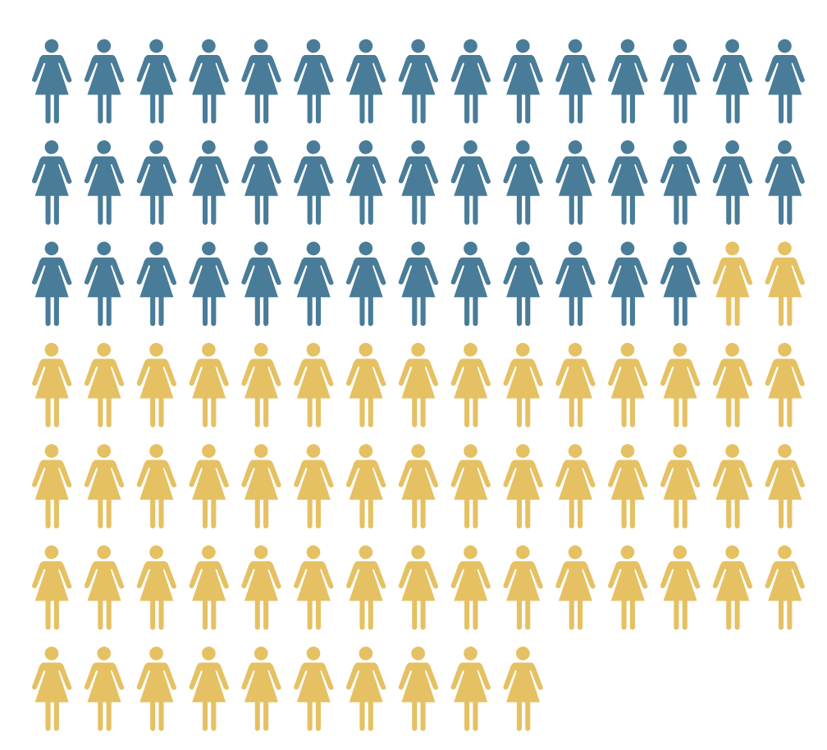

Hours devoted by women and men to unpaid work in Uruguay by age and income (quintiles)
Daiyly dours
lower income
Source: Filgueira and Martínez Franzoni, 2017; based on ECLAC data
Men
Age
Notes:
Second round

Slide 9
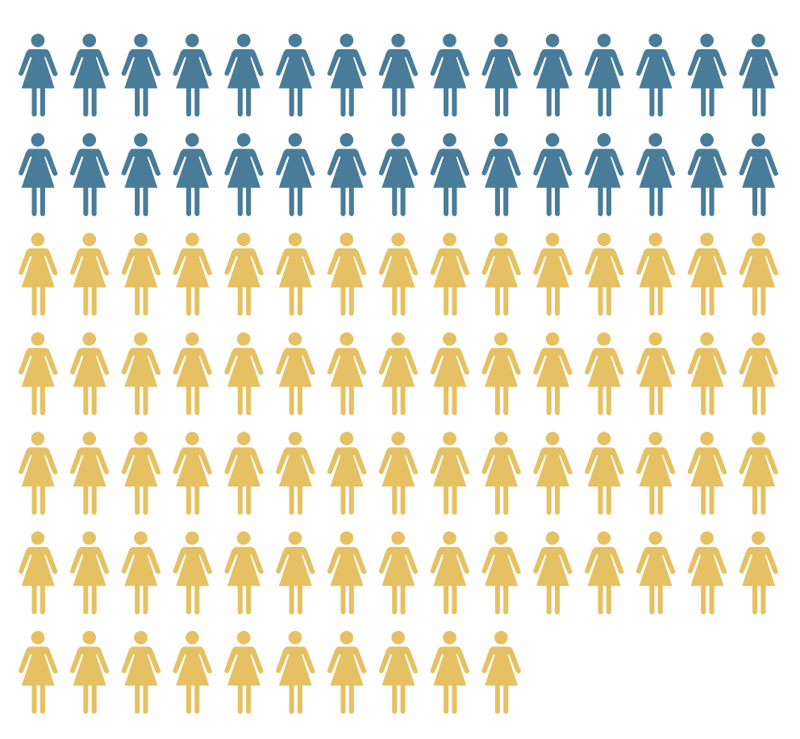
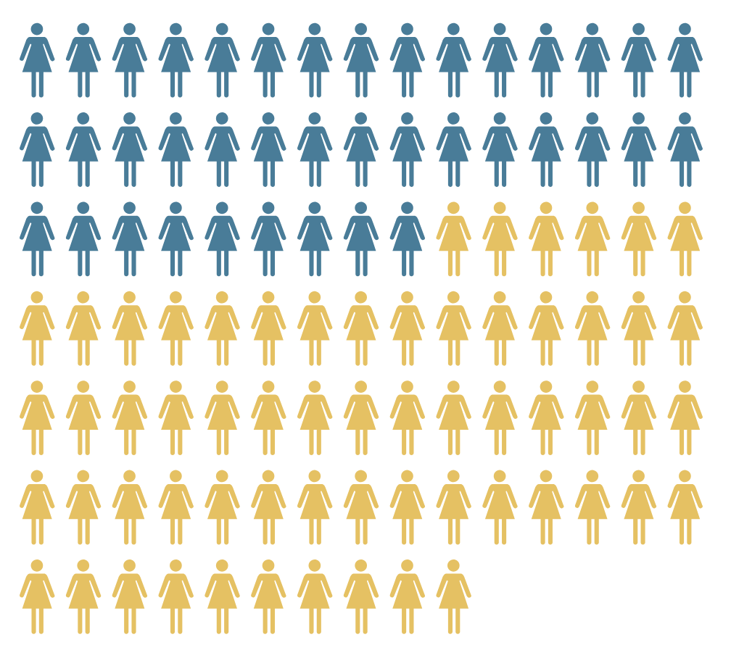
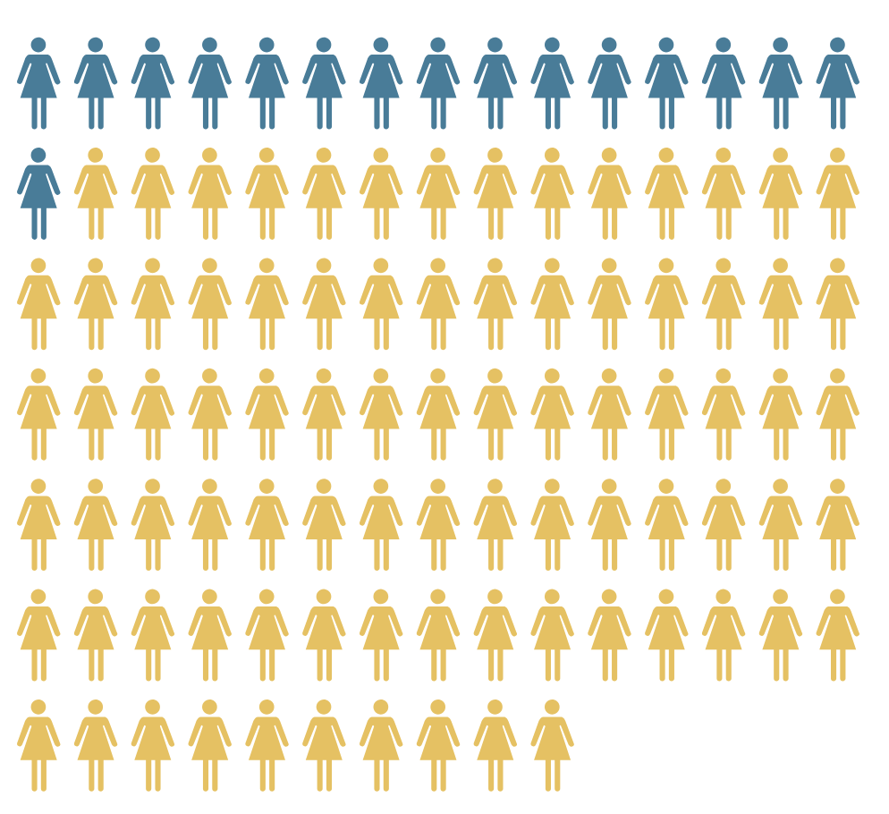
Unpaid care work
Female and male time devoted to unpaid care work according to time use surveys
(average hours per week)
Gap between women and men
Latin America
Southern-Europe
Anglo-Saxon
Nordic
18 hour gap
3.5 hour gap
Source: Filgueira and Martínez Franzoni, 2019; based on OECD data.
Notes:
Third round

Slide 10
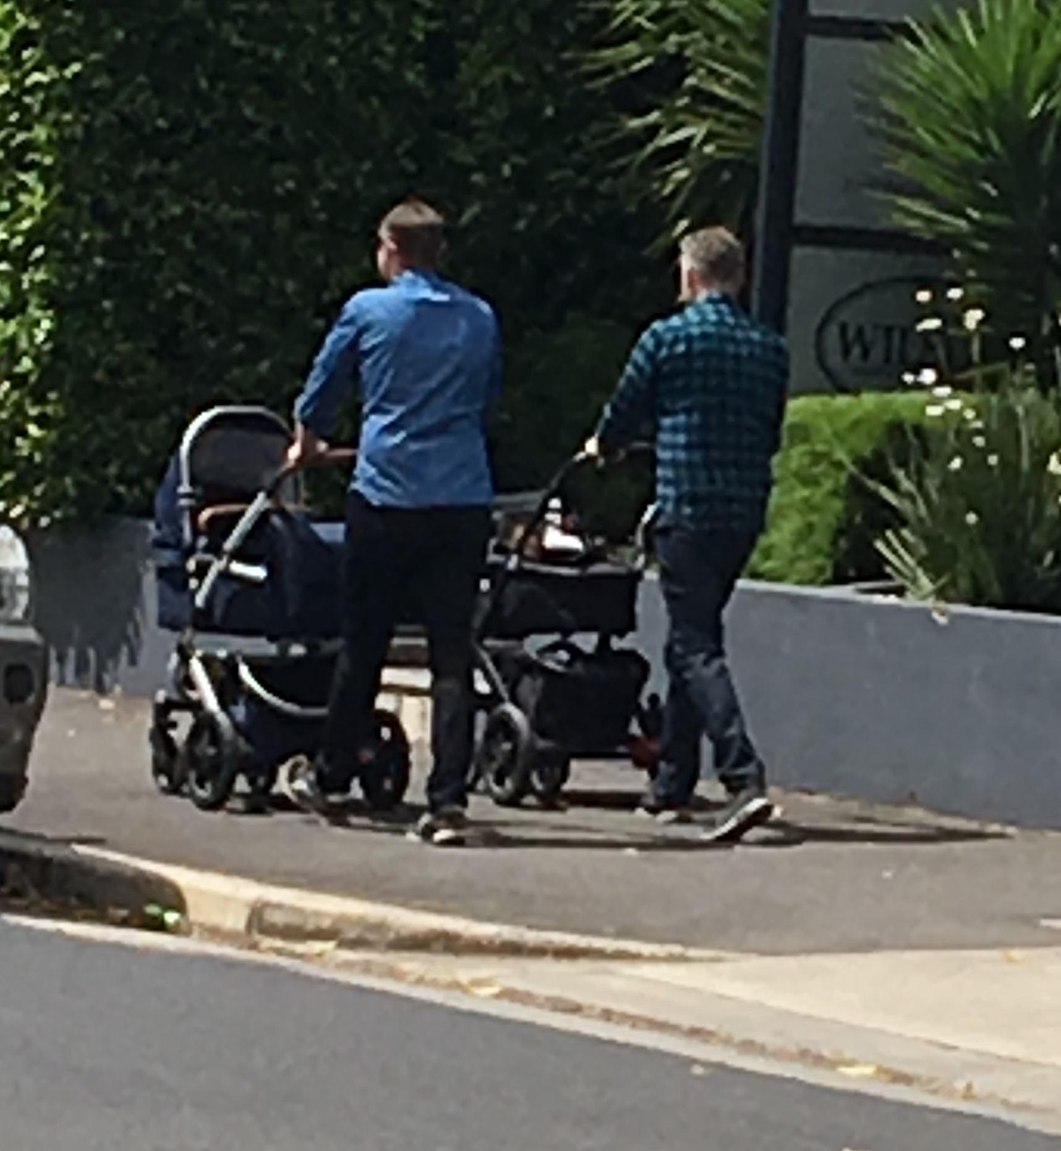
The future - of work and care
Paternity leave
Child care
Flexibility
Changing gender roles

Slide 11


MAAM Maternity as a Master: a new way to learn
A digital tool (pc, mobile), for new mums and dads, that demonstrates how soft skills improve through maternity and paternity
2.
4.
Turns family life experiences into natural and zero-cost gyms that develop key skills for men and women
Grows a pool of female resources: women returning from maternity leave are stronger and have better managerial skills
1.
3.
5.
Reduces the costs of managing women’s return to work after childbirth
Improves the company climate and employer branding, making companies more attractive to Millennials and Gen Z
Inexpensive, voluntary,
fast and
easy to deploy
A Community of mums and dads of different Companies is always available to share the phases of this experience

Slide 12

MAAM Maternity as a Master in danone
76% of our mums and dads is attending the master*:
83% OF THEM sayS THEIR SOFT SKILLS ARE IMPROVED, 79% FEELS MORE ENERGIZED, 75% FEEL CLOSER TO THE COMPANY IN TERMS OF ENGAGEMENT
+ 35%
ABILITY TO MANAGE PRIORITIES AND TIMING
+ 35%
EMPATHY
+ 35%
ABILITY TO DELEGATE
+ 15%
ABILITY TO TAKE DECISIONS
+ 20%
INTELLECTUAL AGILITY
+ 10%
ABILITY TO MANAGE COMPLEXITY
*SOURCE: PARTICIPANTS IN DANONE COMPANY

Slide 13
The future - of work and care
Paternity leave
Child care
Flexibility
Changing gender roles

Slide 14



Allocation of maternity costs:
14 weeks Maternity Protection, ILO Convention 183
Source: Salvador, Enríquez, Martínez Franzoni & Arza, 2018.
Social insurance
Employers
Families
Notes:
Fourth round

