Slide 1

LEGAL ACTION
Individual legal assistance Strategic litigation
RESEARCH
Surveys Statistics
POLICY & GUIDANCE
Advice Recommandations
COLLECTIVE ACTION
Awareness raising
Promotion
Training

Slide 2
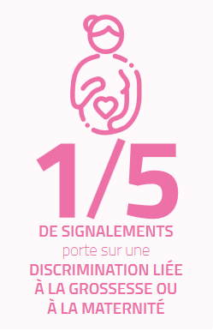

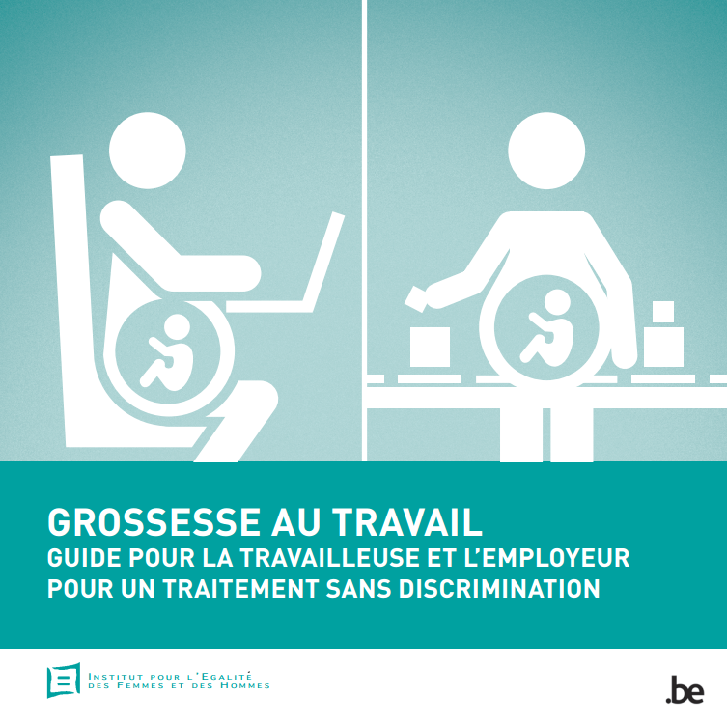

1 in 3 thinks applying for a jobs while pregnant is pointless
6% of pregnant employees were fired or quit
3 in 4 pregnant workers are confronted with a form of discrimination, disadvantage or tension

Slide 3

LEGAL ACTION
Individual legal assistance Strategic litigation
POLICY & GUIDANCE
Advice Recommandations
COLLECTIVE ACTION
Awareness raising
Promotion
Training

