Slide 1
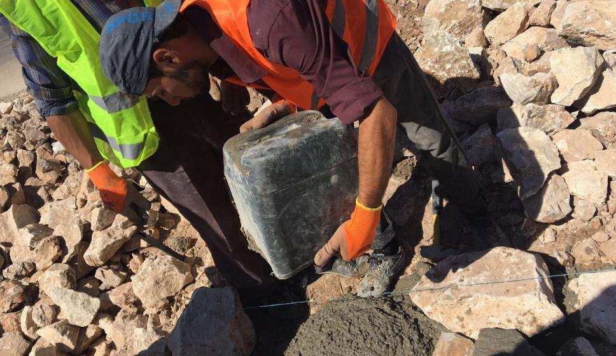
Labour Intensive Approaches
MSSRP-Jordan
  Bashar El-Samarneh, ILO
* MSSRP: Municipal Services and Social Resilience Project

Slide 2
Integrating the Labour Intensive Approaches in the MSSRP Interventions
    ILO – MOLA Partnership
    Labour Intensive Approaches
    MSSRP Context
    Good Practices and Challenges

Slide 3
Introduction
  The Municipal Services and Social Resilience Project (MSSRP) aims to financing investments that provide employment opportunities for Jordanians and Syrians and foster collaboration and social cohesion.
  Under this core objective of the MSSRP, the Ministry of Local Administration (MOLA) has contracted the International Labour Organization (ILO) to apply the Labour Intensive Approaches in the project’s interventions.
This project has emanated as a response to the Government of Jordan’s request to address the impact of the influx of Syrian Refugees on the Jordanian hosting communities.
  Waleed Al-Masri, Minister of Local Adminstration

Slide 4
ILO – MOLA Partnership
Effective Strategy

Slide 5
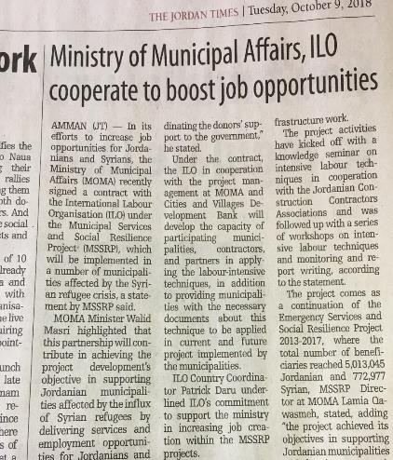

Agreement for Provision of Technical Assistance (JOR/17/02/IBR)
ILO and MOLA/ MSSRP
Institutionalizing the LIPW:
  Providing a seat for the ILO at the Management Unit of the MSSRP has helped to demonstrate the benefits:
    Building Trust through showing real cases from ILO experience
    Providing immediate support to ease the inclusion of LIPW Approaches into the project’s processes and documents,
    Generate awareness among project’s stakeholders of the social benefits to support recruiting local Jordanians and Syrian refugees at the construction sector,.
Notes:
Providing a seat for the ILO at the Management Unit of the MSSRP has helped to demonstrate the benefits of such approaches on creating meaningful employment and enhanced the adaptation of LIPW inside the MSSRP stakeholders:

Slide 6
Labour Intensive Approaches
Increase Labour Content

Slide 7
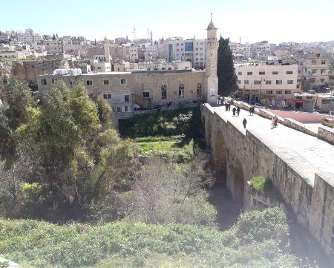
Optimizing Labour Content at Construction Projects
Modify Initial Plans
The application of LIPW in projects starts at an early stage. Looking at the municipal plans and responses to address local challenges by focusing on local resources.
  LIPW promotes investing in maintenance/ rehabilitation programmes which have high impact on local employment and lower costs. Also promote the utilization of local resources.
  Jerash Municipality as an example had proposed the rehabilitation of existing facilities, adjusting with the tourism context of the city:
    No new construction, but an existing building to be repaired,
    Landscaping works for the green areas surrounding the project,
    An extension project built on previous national program,

Slide 8
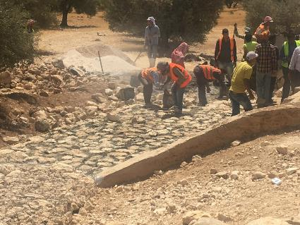
Optimizing Labour Content at Construction Projects
Design Adjustment
  Another example of design modification was to increase labour-based works quantities as much as possible. This can be done through applying Task-Based method in calculating employment which depends mainly on productivity of workers.
  Task-based system monitor employment through working day indicator. This indicator helped engineers to quantify jobs and link it with project’s quantities.
  ILO worked closely with Karak Municipality to draft their proposal resulting increase in labour content from 20% to 30%. Design adjustments were:
    New building areas were reduced, while high labour intensity works were increased,
    Changing type of retaining walls from expensive reinforced walls to gabion walls (while securing the design loads)

Slide 9
Optimizing Labour Content at Construction Projects
Apply/ monitor additional particular conditions at Contracts (MG Cycle 1)
    During the preparation phase of contracts, contractual amendments were provided to the projects, followed by monitoring tools and procedures to ensure applying these changes.
    Between 2018 and 2019 twelve projects were targeted to increase the employment content at them. Then monitored and completed in 2019.
  The results were very positive and show the possibility to optimize local labour content at conventional types of projects:
    12 Projects Monitored and Completed,
    5% planned local labour +8% achieved labour content
    2 Walk paths projects achieved more than 20% labour content.

Slide 10
Labour Intensity for municipal Projects
  The Labour Intensity is the value of wages in the project to the total values of this projects. This percentage varies according to the amount of labour-based works included in the project:
40 – 60% Routine Maintenance/ Tiling/ Green works
20 – 50% Rehabilitation and repair works
10 – 30% New construction projects

Slide 11
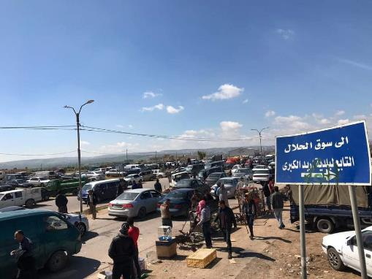
Wide Range of Works under Municipal Sector
  The Labour Intensive Approaches can be applied at Municipal sector in many areas:
    Routine Maintenance programmes for schools, roads, parks, and other public facilities (including waste management and disinfection of open spaces during the COVID-19 pandemic),
    Landscaping works for public areas such as open markets, linear parks, disabilities’ paths and ramps, transportation facilities and stone tiling for roads.
    Forestry works and planting, rehabilitation for storm water channels inside cites, sweeping and cleaning services, and other green works

Slide 12
MSSRP Context
Mainstreaming LIPW

Slide 13
Mainstreaming Labour Intensive Approaches
Decent Work Provisions
Reporting and Supervision
Using Task-Based system
Recruitment Process
MSSRP Employment requirements
Gender Inclusion and equity
Environmental and Social Safeguards
Protection from Violence and Harassment
New
COVID-19 Responses
Policies and Regulations
  The principles of Labour Intensive Approaches and Decent Work were embedded into the MSSRP operational documents to ensure suitable environment to apply these approaches:
    Technical Manual to provide general guidance for LIPW application,
    Amended Particular Conditions for the Construction Contract used for implementing projects,
    Developing necessary templates and tools for monitoring employment generation.

Slide 14
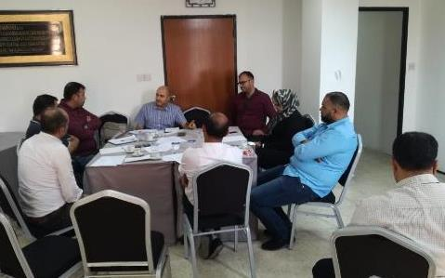
Mainstreaming Labour Intensive Approaches
Capacity Building for MSSRP Stakeholders:
    General awareness and seminars to inform MSSRP stakeholders of the new approaches,
    Training sessions for technical staff responsible to implement LIPW. From municipalities and contractors,
    On-job coaching to provide mentorship and support during implementation.
Notes:
ILO provided different levels of activities to build technical competencies for national partners. These trainings covered many areas starting from design and planning, then tendering and procurement, gender auditing and implementation. The pace of these trainings were attached to the progress of the MSSRP activities and delivered to the relevant audience :

Slide 15




Mainstreaming Labour Intensive Approaches
Institutional arrangement during implementation:
Selection of Interventions
Stakeholders Roles
Pre-agreed criteria was developed to select relevant interventions. This criteria provides commitment and ownership for the MSSRP objectives.
Due to various stakeholders and various interests, careful coordination plan was tracked to comply with the MSSRP requirements.
Recruitment of Workers
Monitoring Tools
Transparent recruitment processes are applied in coordination with employment centers and local organizations.
Through regular field visits the contractors and municipalities were provide with technical feedback and support to comply with LIPW requirements.

Slide 16
LIPW not required under Municipal Grants but Government partners adopted measures anyway (up to 10% labor-content)
Selection of Interventions
Identify Criteria for Selection – minimum 30% LI
Proposal Preparation/ Capacity Building
Evaluation of Proposals – Awarding fund
Innovation Fund

Slide 17

Stakeholders Roles
Local Community
Donors – WB Team
Private Sector Contractors
MOLA/ Municipalities
Selection of projects, social cohesion
Monitoring through youth teams (new)
Implementing: Design, Tendering, Execution.
Comply with RF – MSSRP, disbursement of payments (contractors – workers)

Slide 18
Recruitment of Workers
01
02
03
04
Outreach activities: announcement of number of jobs, workers nationality and gender and type of works
Applying to jobs through Employment services centers, and screening the eligible applicants.
Conduct public lottery for the eligible applicants. Signing contracts with selected workers.
Use waiting lists from unselected applicants to replace workers during implementation.

Slide 19
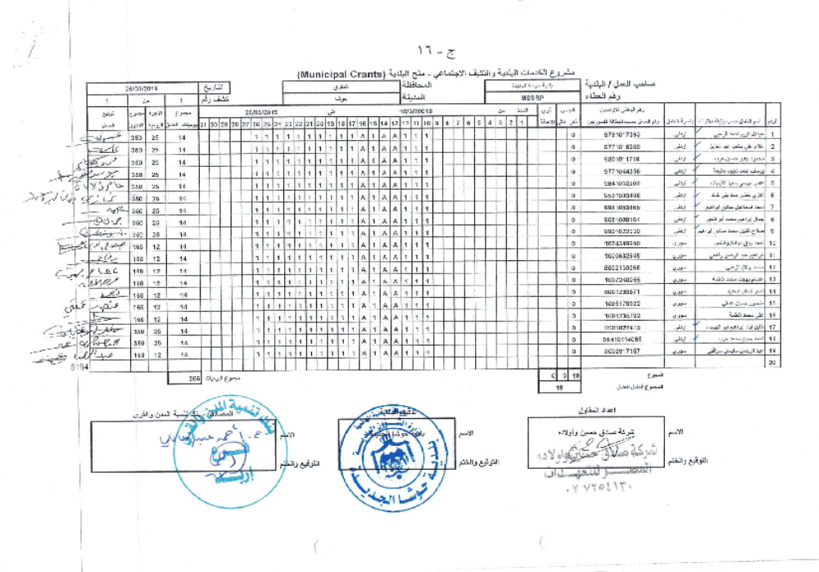
Monitoring Tools
Employment Generation Indicators
    Number of working days – Muster payroll sheets, segregated into nationality, gender, skillfulness, PWDs,
    Number of jobs – minimum 60 working days per job,
    Social Protection – registration under national SSC schemes,
    Workers’ productivity – task system
    Indirect employment (EIA)

Slide 20
Good Practices and Challenges

Slide 21
Good Practices and Challenges
    Resistance to applying Labour Intensive schemes due to the misconceptions on using labour instead of machine. Examples of such misconceptions are:
    Attracting local workers was always a challenge in the construction sector in Jordan.
    LIPW implies to replace machine with manual laborers, cost effectiveness question, (blended methods)
    Questions on quality and time (intensive labour linked with intensive supervision and coaching),
    Good practices as well were leant:
    The proposals’ competition concept between municipalities was new, and this causes some delays in the process, but on the long-run will have good impact on the ownership of project and operations,
    Partnership with local organizations
    Other practices can be provided through the process.
Notes:
Two year passed from the launching of MSSRP, and throughout the age of this project many challenges faced the progress of the project as well other good practices:
We faced some resistance in the beginning to apply Labour Intensive schemes due to the misconceptions on using labour instead of machine. This was address through more awareness on the social benefits and ability of these approaches to be incorporated in the pre-planned intervention with some improvement and modification. Giving more orientation and guidance to all stakeholders is essential,
Attracting local workers was always a challenges in the construction sector in Jordan. Decent Work principles enforced into contracts and projects provide equality, social protection and fair income,
The proposals’ competition concept between municipalities was new, and this causes some delays in the process, but on the long-run will have good impact on the ownership of project and operations,
Partnership with local organization such as Contractors Association and Engineers Association strengthen the establishment of LIPW technical presence,
Other practices can be provided through the process.

Slide 22
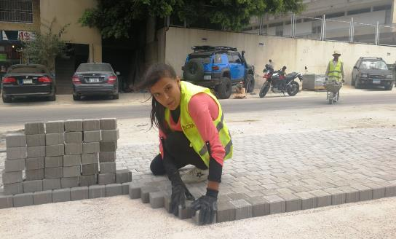
Gender Mainstreaming through MSSRP intervention
Dair Abi Saeed project (MG-1), successful initiative on tiles’ grouting – shifted from male-only task into potential women task.
  Including Women and persons with disabilities at construction sector in Jordan is not natural. Yet LIPW can promote gender inclusion through different strategies:
    Enforcing minimum quotas at contracts, along with monitoring tools,
    Specify relevant tasks assigned to women and PWDs,
    Using Task-Base system to ensure clear guidelines and standards for productivity,
    Applying protection conditions from harassment, and other violence-based acts.
Notes:
Labour Intensive Approaches were proven in many countries around the world as successful modality in responding to national crisis. COVID-19 pandemic is one of these crisis that has two dimensional impacts – health and economic.

Slide 23

LIPW – Relevant Response to COVID-19 Impacts and recovery
  LIPW respond in the following areas:
    Provide immediate support to vulnerable groups through short-term jobs, decent and productive,
    Constitute and activate necessary occupational safety and health measures in the workplace with required tools to implement and monitor,
    Regulate social protection schemes through amending the contractual documents and monitoring processes,
    Support the local economies through the usage of local available resources such as workers, material and systems.
Notes:
Labour Intensive Approaches were proven in many countries around the world as successful modality in responding to national crisis. COVID-19 pandemic is one of these crisis that has two dimensional impacts – health and economic.

Slide 24
Thank You

