Slide 1
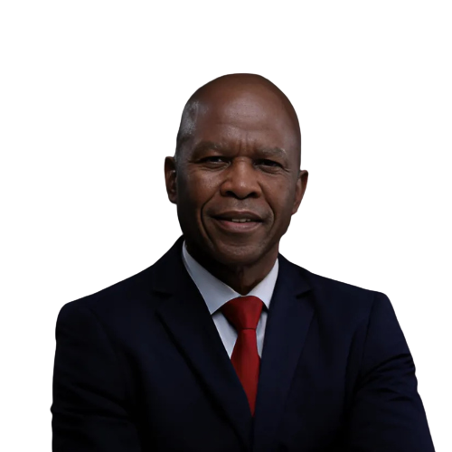
DR THABO MASHONGOANE
Chief Executive Officer of Mining Qualifications Authority – South Africa
27 May 2026
An accomplished leader with a profound background in vocational education, skills development, and management. With over 40 years of experience, he has played a pivotal role in shaping South Africa’s vocational training landscape. Currently, as the CEO of the Mining Qualifications Authority (MQA), Dr Mashongoane continues to champion skills development and policy implementation, working closely with government agencies, industries, and educational institutions. His expertise extends to the governance and performance evaluation of SETAs, and he plays a significant role in advocating for the alignment of skills training with emerging market demands. He holds a PhD in Education.

Slide 2









OBJECTIVE OF THE PRESENTATION
To provide an overview of the skills development and TVET system in South Africa
Discuss the role of Sector Education and Training Authorities (SETAs) in skills development and enterprise development.
Discuss the role of social partners and the private sector in policy development and implementation, including governance and institutional arrangements, financing, skills needs anticipation and delivery, and monitoring and evaluation.
Examples of successful public–private partnership (PPP) models in skills development that could be replicated or adapted in other regions or countries.

Slide 3
LEARNER PATHWAY – SOUTH AFRICAN SKILLS SYSTEM
Basic Education:
Grade R - 12
PSET Pathways
TVET Colleges
Vocational & occupational qualifications
CET Colleges Adult Education & Foundational Learning
Universities
Degrees & professional qualifications
Workplace Learning
Learnerships
Apprenticeships
Work-Integrated Learning
Internships
Candidacy Programmes
Bursaries
Lecturer support
Supported by SETA grants

Slide 4
THE ARCHITECTURE OF SKILLS DEVELOPMENT IN SA
South Africa has a structured, demand-driven, and funded skills system that links employers, education, and the state.
The Three Pillars of the System:
PILLAR | ROLE | KEY INSTITUTIONS | ROLE OF PRIVATE SECTOR
Governance & Policy | Sets national strategy, oversees quality, and coordinates funding. | Department of Higher Education & Training (DHET); National Skills Authority (NSA); Quality Council for Trades & Occupations (QCTO); SAQA | Social partners (SPs) and private sector (PS) are members of Boards of NSA, QCTO and SAQA
Funding | Collects levy, disburses grants, develops & implements sector skills plans. | 21 Sector Education & Training Authorities (SETAs) | About 80% board members of SETAs are SPs and PS. (e.g. organised labour & mining companies have equal nos of seats)
Training Provision | Provides theoretical and practical training. | TVET Colleges, CET Colleges, Universities, accredited private providers. | Funding support thru co-payments Collaboration & partnerships Offer workplace experience Partner on curriculum design and occupational relevance. Support research & innovation.

Slide 5



THE LEVY-GRANT MECHANISM IN SOUTH AFRICA
A structured, levy-funded system designed for sector-specific impact.
THE LEVY SYSTEM:
THE DISTRIBUTION:
20% to the National Skills Fund (NSF) for strategic, cross-cutting projects.
80% returned to 21 Sector Education and Training Authorities (SETAs), including the MQA.
THE SETA MANDATE:
Develop Sector Skills Plans (SSPs) to identify hard-to-fill vacancies and skills gaps.
Register learnerships, apprenticeships, and skills programmes.
Manages the collection of Work Skills Plan (WSP) & Annual Training Report (ATR) from mining companies.
WSP/ATR submissions determine access to both mandatory grant & discretionary grant.
Disburse mandatory grants (20% of levy) to compliant employers for their own training.
Award discretionary grants for strategic priority projects (e.g., artisan development, youth employment, community training).
KEY PARTNERS:
THE MQA RECEIVES
Employers pay 1% of payroll into a national skills levy.
Universities, TVET Colleges, Community Education, Training (CET) Colleges, private training institutions, Mining companies and
over R1.5 billion annually in levies, reinvesting over 94% directly into skills development projects.
2024-2025 Annual Performance
2024-2025 - 2nd Time 100% Performance!
2024-2025 – 4th Ag Clean Audit Outcome

Slide 6
PPP Model for training provision
Work-Integrated Learning (WIL) Placement Model – Universities & TVETs
The Challenge:
Graduates emerge with theoretical knowledge but lack the practical workplace experience required by employers – creating a cycle of “no job without experience, no experience without a job.”
The PPP Structure:
PARTNER TYPE | ORGANISATION(S) | ROLE
SETA (Public) | MQA | Provides discretionary grants to cover learner stipends and training costs
Employers (Private) | Mining companies (e.g., Sibanye-Stillwater, Impala Platinum) | Offer structured workplace placements, supervision, and mentoring
Education Institutions | Universities (e.g., WITS, UP) & TVET Colleges | Identify eligible students, align academic calendars, provide theoretical grounding
Objective:
Place students and graduates into structured workplace learning to complete their qualifications and improve employability.

Slide 7
WHY IT IS REPLICABLE PPP MODEL
Simple, low-complexity model: SETA provides funding, employers provide space, education institutions provide leaners or students.
Directly addresses youth unemployment by converting learners into job-ready candidates.
Can be scaled across any sector (healthcare, agriculture, ICT, logistics).
Replication Checklist:
Establish a tripartite Memorandum of Agreement (MoA) between SETA, employer, and training institution.
Define minimum training duration, outcomes, and assessment criteria.
Disburse stipends to learners (removes financial barrier to unpaid internships).
Require employers to report on learner progress and completion.

Slide 8
LESSONS FOR REPLICATION
Policy Coherence is Foundational:
A Dedicated Funding Mechanism Works:
Social Partnership is Non-Negotiable:
Data Drives Decision-Making:
TVET & CET Colleges are Strategic Assets:
Skills plans must be legally and strategically linked to national development plans (NDP, MTDP) and sectoral strategies (JET, beneficiation).
The 1% levy-grant system ensures predictable, ring-fenced resources for skills development.
Tripartite Boards (employers, labour, government) ensure relevance, accountability, and buy-in.
Mandatory WSP/ATR submissions provide real-time intelligence on hard-to-fill vacancies and emerging occupations.
With targeted support (lecturer development, WIL, infrastructure), public colleges can deliver at scale.

Slide 9

THANK YOU

