Slide 1

In the face of a pandemic:
Ensuring Safety and Health at Work

Slide 2
Epidemics and pandemics in the 21st century
Origins
Dynamics
Global spreading
Re-emerging known epidemic diseases (e.g. Ebola, cholera, yellow fever, HIV, etc.)
Newly-emerging infectious diseases (e.g. SARS, H1N1 influenza, MERS, Covid-19)
Emergence in a community
Outbreak with localized transmission
Outbreak amplification into an epidemic or pandemic
Reduced transmission
Unprecedented high speed of transmission worldwide
    Global integration
    Travels
    Urbanization

Slide 3
The Covid-19 pandemic
January 2020: outbreak of a new coronavirus disease in Hubei (China)
11th March 2020: WHO declared Covid-19 pandemic
    Impact on the world of work
    Increased unemployment and underemployment
    Worsened OSH and working conditions
    Reduced access to social protection
    Particularly negative effects on specific groups more vulnerable to adverse labour market outcomes

Slide 4
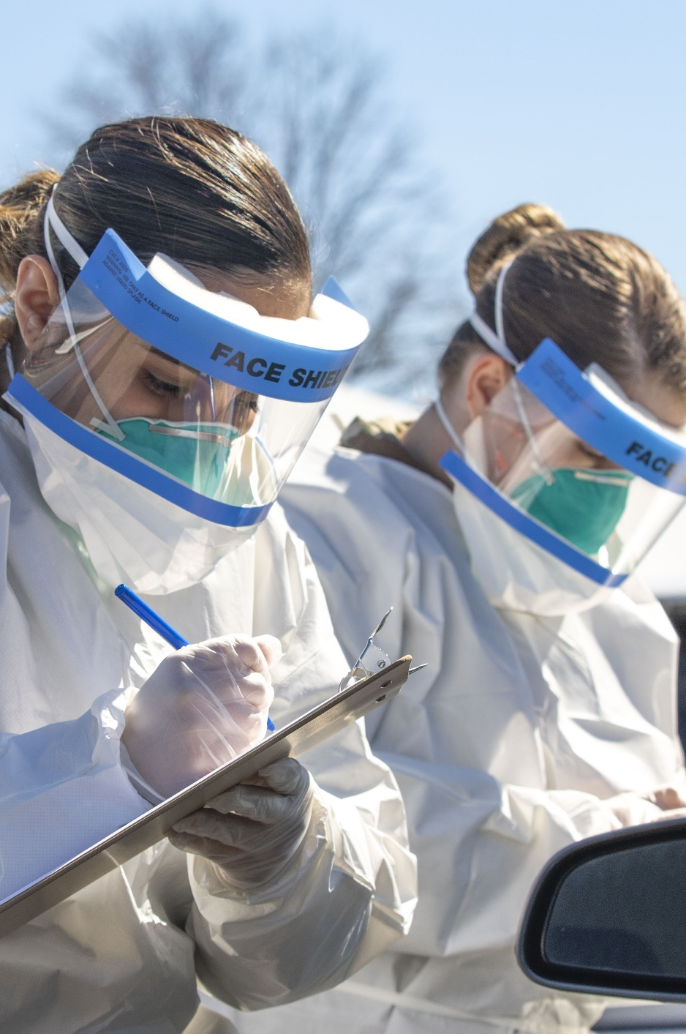


Why a focus on safety and health at work?
    Identification of workers / occupations / sectors at increased risk of contagion
    Implementation of control and prevention measures based on risk assessment
    Dissemination of information on preventive and protective measures to reduce the spread of infectious diseases, in collaboration with public health authorities

Slide 5
OSH rights and responsibilities according to ILO standards

Slide 6
Employers’ roles and responsibilities
    Ensure that, so far as is reasonably practicable, the workplaces, machinery, equipment and processes under their control are safe and without risk to health.
    Ensure that, so far as is reasonably practicable, the chemical, physical and biological substances and agents under their control are without risk to health when the appropriate measures of protection are taken.
    Provide, where necessary, adequate protective clothing and protective equipment (at no cost to workers)
    Provide, where necessary, for measures to deal with emergencies and accidents, including adequate first-aid arrangements.
    Ensure that workers and their representatives are consulted, informed, and trained on OSH
    Occupational Safety and Health Convention (No. 155) and Recommendation (No. 164)

Slide 7
Workers’ rights and responsibilities
    Right to remove themselves from a work situation which they have reasonable justification to believe presents an imminent and serious danger to their life or health, without undue consequences
    Right to receive adequate information and training on OSH
    Right to enquire into (and to be consulted on) all aspects of OSH associated with their work
    Duty to co-operate with the employer in the field of OSH (e.g. comply with OSH instructions and procedures; use PPE correctly; report to supervisor hazardous situation; etc.)
Occupational Safety and Health Convention (No. 155) and Recommendation (No. 164)

Slide 8
Protecting workers from the risk of contagion during an outbreak

Slide 9
Assessment of the risk of contagion at work
    Probability to be exposed to the risk of contagion, taking into account the characteristic of the infectious disease (i.e., transmission patterns) and the possibility that workers may encounter infectious persons or may be exposed to contaminated environments or materials (e.g., laboratory samples, waste) in the course of their duties
    Severity of the resulting health outcomes, taking into account individual affecting factors (including age, underlying diseases and health conditions), as well as the measures available to control the impact of the infection

Slide 10

Emergency response workers
    Health care workers
    Laboratory personnel
    Death care workers
    Emergency transport workers
    Cleaners and waste management workers in health-care and emergency facilities
    Others (e.g. police officers, civil protection personnel, military personnel, fire fighters)

Slide 11
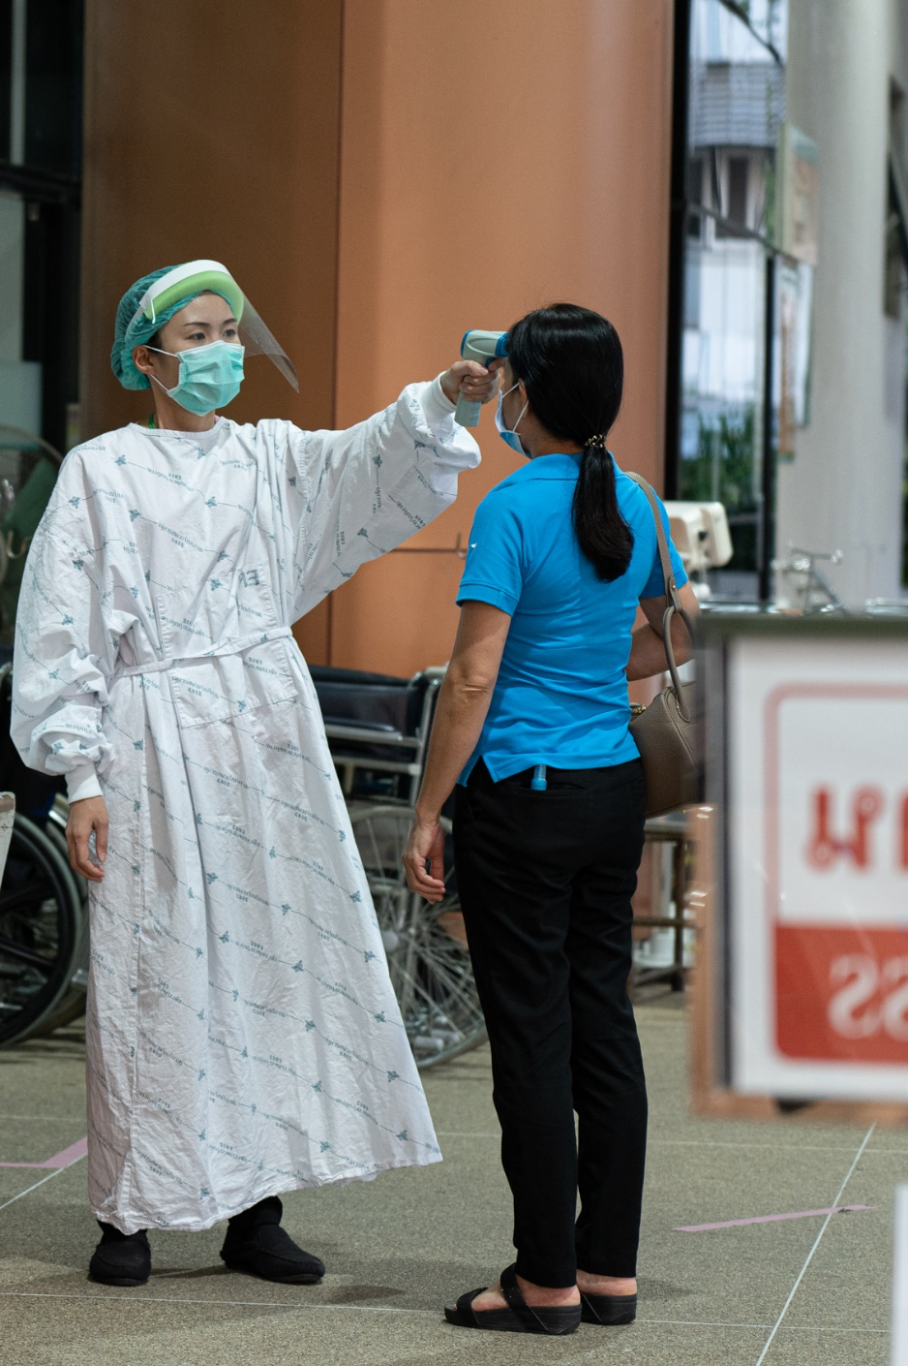
Emergency response workers
Risk of contagion
    Contact with infectious patients and co-workers
    Contact with infectious blood, tissue and bodily fluids
    Contact with bodies of persons who have died from highly infectious diseases
    Contact with contaminated materials, surfaces and environments
    Medical equipment and personal protective equipment (PPE) not properly used, cleaned or disinfected

Slide 12
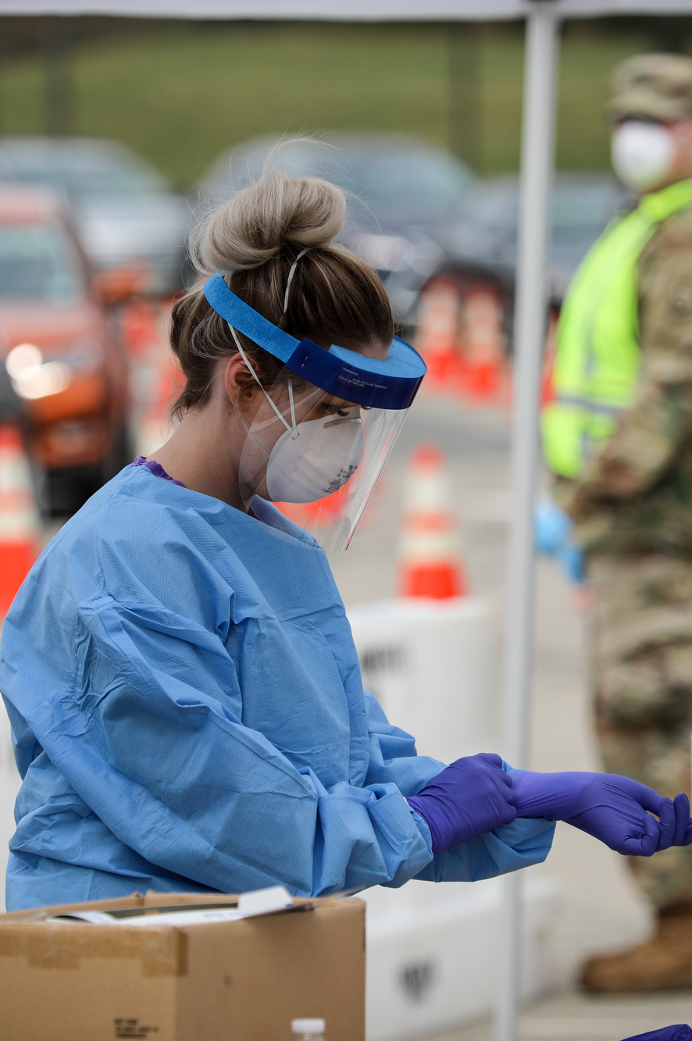
Emergency response workers
Examples of measures to prevent contagion
    Environmental and engineering controls aiming at reducing the spread of pathogens and the contamination of surfaces and objects (physical distance between patients and health-care /emergency workers; ventilated isolation rooms; etc.)
    Administrative measures aiming to prevent risky behaviour (infection prevention and control (IPC) procedures; OSH training; health monitoring and surveillance; etc.)
    Appropriate PPE and training on how to put on, remove, and dispose of them

Slide 13



Workers in essential activities
    Workers who interact with potentially infectious individuals (e.g., workers in shops and supermarkets, banks, schools, delivery services, restaurants, sports and tourist facilities, etc.)
    Workers in high-density work, due to the proximity with other workers in semiconfined settings (e.g., factories, call centers, open space offices, etc.)

Slide 14
Examples of measures to prevent contagion
    Physical distance (e.g., introducing working shifts; using phone calls and virtual meetings; etc.)
    Hygiene (e.g. providing hand disinfectants; promoting good respiratory hygiene at the workplace; etc.)
    Cleaning (e.g. regularly cleaning and disinfecting the surfaces of desks, workstations and working objects; regularly disinfecting common areas; etc).
    Training and communication (e.g. on the preventive measures adopted; on their right to remove themselves from a work situation that poses an imminent and serious danger for life or health, etc.)
    Personal protective equipment (PPE).
    Response (e.g., arranging for isolation of any person who develops symptoms at the work site and adequately disinfecting the work site; providing health surveillance of persons who have been in close contact with the infected worker).

Slide 15
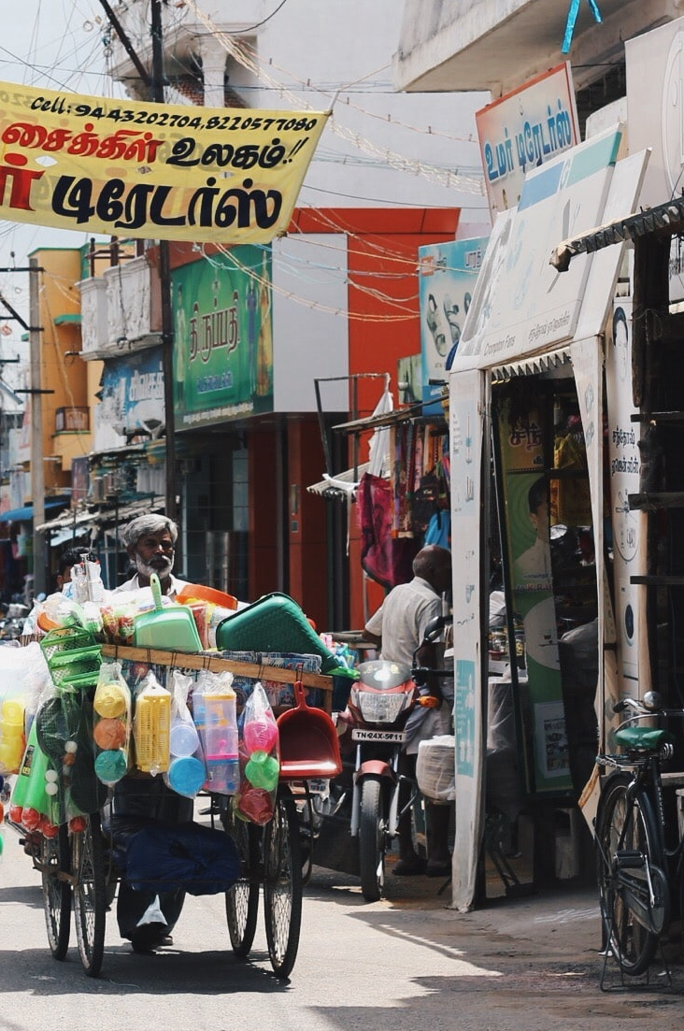
Informal workers
    May need work despite restrictions on movement and social interaction
    May not be able to comply with OSH measures and precautions
    Lack sufficient protection (e.g., social protection, sick leave, unemployment benefits)

Slide 16
Addressing stress, psychosocial risks and violence and harassment

Slide 17
Stress and psychosocial factors during a pandemic
    Common psychosocial factors
    Fear for one’s own health and well-being or that of family members and co-workers
    Lack of safety equipment for personal protection
    Isolation
    Lack of social support
    Tension between established safety protocols and the desire to care for or support individual
    Difficulty in maintaining self-care activities (e.g. exercise, good eating habits, rest, etc.)
    Common responses
    Stress
    Low mood
    Low motivation
    Anxiety and depression
    Serious effects on mental health

Slide 18
Job uncertainty
    A large number of workers, entrepreneurs and self-employed persons out of work
    Temporary closure of businesses imposed (e.g. during confinement)
    Changes in work processes and arrangements
    Present and future uncertainty of the work situation
    Increased stress
    Anxiety, depression and burnout
    Reduced motivation
    Low compliance with safety efforts (higher work-related injuries)

Slide 19
Workers in the emergency response and in essential services
Common psychosocial factors
    Fear of being infected at work and then passing on the disease to families
    Lack of access to PPE and support
    Working in environments with low capacity to apply optimal OSH measures
    Increased workload (reduction in staff, work longer and consecutive shifts)
    Reduced rest periods
    Increased violence and harassment (both physical and psychological)
    Increased social stigma and discrimination (because of a perceived link with a disease)
    Increased fatigue and stress
    Negatively impact mental health and well-being
    Increase the risk of work injuries and accidents

Slide 20
Workers in the emergency response and in essential services
Examples of OSH measures to prevent and reduce stress
    Good communication and up-to-date information
    Multidisciplinary sessions to identify concerns and to work together on strategies to solve problems
    Checklist to assess personal strengths and limitations, and recognize signs of stress and burnout
    Buddy system to provide psychological support and monitor stress and burnout
    Regulated rest periods for taking sufficient rest breaks during the work day
    Opportunities to promote physical health (e.g., exercise, healthy eating habits)
    Psychological support for workers to share fears and worries confidentially
    Role-modelling (managers/supervisors conduct themselves in ways that show how to mitigate stress)
    Campaigns to reduce stigma
    Participatory techniques which can promote dialogue, innovative solutions and positive changes in attitude

Slide 21

People working from home
Common psychosocial factors
    Inadequate information
    Isolation
    Long working hours
    Blurring lines between work and family life
    Multiple burdens (working duties, household chores, caretakers, home-schooling, etc.)
    Frustration and boredom
    Domestic violence

Slide 22
People working from home
Examples of OSH measures to prevent and reduce stress
    Management commitment and support and connection with supervisors and colleagues
    Clear expectations (e.g., results to achieve, tasks, etc.)
    Flexibility
    Disconnection from work at specified times reserved for rest and personal life
    Appropriate equipment (e.g., laptops, apps for teleworking, adequate IT support) and dedicated workspace
    Training
    Good system of communication
    Support services, including employee assistance programs

Slide 23
Managing other OSH risks

Slide 24
Ergonomics
    Manual handling of loads
    Awkward postures
    … associated with longer working time, higher work load and high-pressure
    Musculoskeletal injuries
    Diminished work capacity
    Reduced ability to adhere to strict work practices
    Increased absenteeism
    Higher risk of workplace accidents

Slide 25
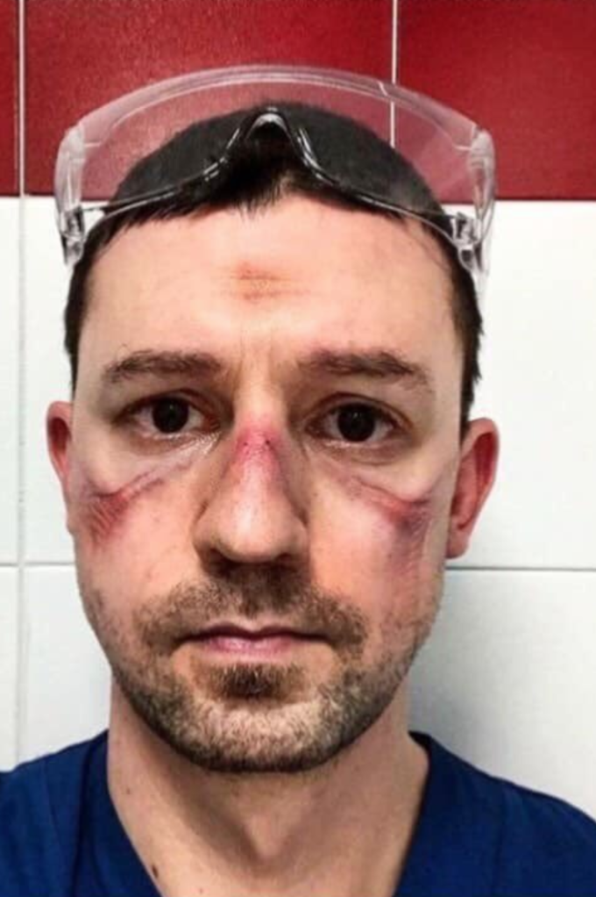
OSH risks associated with the use of heavy PPE
Health care workers may also face risks arising from the prolonged use of heavy PPE:
    Heat stress and dehydration
    Dizziness
    Physical markings on faces

Slide 26
Chemicals
Cleaning and disinfection with chemicals become key elements to prevent contagion in all workplace
Quaternary ammonium and sodium hypochlorite (frequently used to disinfect against Covid-19) may
    increase risk of COPD
    reduce fertility
    affect asthma symptoms
All workers must be properly trained on the correct and safe use of chemicals and briefed on their risks and exposure levels

Slide 27
People working from home
Home settings often do not meet the same OSH standards as those available at the official worksites, in relation to both:
    facilities and equipment
    physical environment (such as heat, cold, lighting, electrical safety, home hygiene, etc.)
    Workers should receive adequate information on:
    reviewing where the screen is located to avoid glare;
    How best to place equipment to minimize twisting or overreaching;
    Varying work tasks to change positions;
    Taking regular breaks and to stand and move for one minute every hour

Slide 28
Joint efforts to protect the safety and health of all

Slide 29
ILO key pillars in responding to the Covid-19 crisis
    Stimulating the economy and employment, through active fiscal policy, accommodative monetary policy, lending and financial support to specific sectors, including the health sector.
    Supporting enterprises, jobs and incomes, by extending social protection for all, implementing employment retention measures, providing financial/tax and other relief for enterprises.
    Protecting workers in the workplace, by strengthening OSH measures, adapting work arrangements (e.g. teleworking), preventing discrimination and exclusion, providing health access for all, expand access to paid leave.
    Relying on social dialogue for solutions, by strengthening the capacity and resilience of employers’ and workers’ organizations, strengthening the capacity of governments, strengthen social dialogue, collective bargaining and labour relations institutions and processes.

Slide 30
Integrating OSH into government crisis responses
Promote safe and decent working conditions, including the provision of personal protective equipment and medical assistance for all workers, comprising those engaged in rescue and rehabilitation activities
Review, establish, re-establish or reinforce labour legislation, if necessary, including provisions on labour protection and safety and health at work
ILO Employment and Decent Work for Peace and Resilience Recommendation, 2017 (No. 205)

Slide 31
Social dialogue on OSH in times of a pandemic
Employers and their organizations
    Collaborate with government to shape policy measures that are conducive for business resilience and sustainability
    Observe advice/guidance provided by public authorities
    Communicate critical information to workers
    review or draw up a business continuity plan
    Identify and mitigate risks of contagion to workers
    Promote workplace hygiene
Workers and their organizations
    Participate in decision-making and policy responses to epidemics
    Actively cooperate with employers in the implementation of the preventive and protective measures.
    Strictly follow the workplace hygiene practices and adopt a responsible behaviours

Slide 32
A particular role for OSH practitioners
    Facilitate access to reliable information
    Promote understanding of the disease and its symptoms
    Support in the risk assessment and management process (i.e. identification of infectious and non-infectious hazards and assessment of associated risks; adoption of preventive and control measures; monitoring and review)
    Help in development or update of plans for the prevention, containment, mitigation and recovery

Slide 33
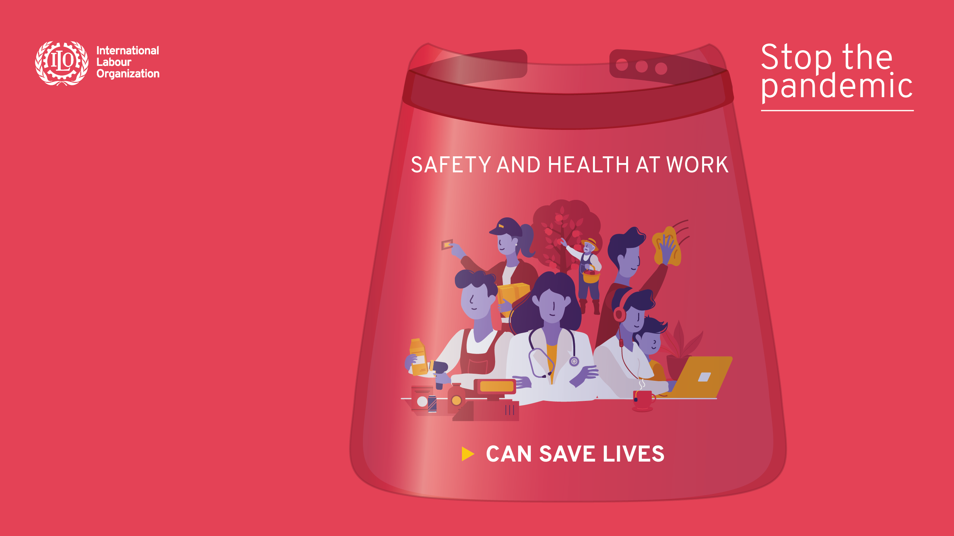
Thank you
www.ilo.org/safeday

