Slide 1
The Impact of Labour Laws on the Labour Share of National Income, Productivity, Unemployment and Employment:
Evidence from the 2023 Update of the CBR-LRI Dataset
Bhumika Billa, Louise Bishop, Simon Deakin and Kamelia Pourkermani
Centre for Business Research, University of Cambridge
RDW, Geneva, July 2025

Slide 2
Outline
Introduction to the Cambridge leximetric database
Trends revealed by the new version of the CBR-LRI
Econometric analysis: the economic and social impacts of labour laws

Slide 3
The Cambridge Leximetric Database
Building a statistical measure of labour and corporate laws
The Labour Regulation Index (CBR-LRI) has recently been updated to the end of 2022
> 100 countries, > 50 years, 40 indicators, = nearly 250,000 individual observations
>1,000 changes coded since the last version of the datset was published in 2013

Slide 4
Method
‘Leximetric’ manual coding of laws using texts as primary sources
Coding protocol used to ensure consistency
5 areas of labour laws covered: laws governing different forms of employment (self-employment, part-time work, fixed-term employment, temporary agency work); working time; dismissal; employee representation; industrial action
We are in the process of adding further sub-indices of platform work, minimum wages, migration, and enforcement

Slide 5
General trends
There has been an incremental and steady improvement in worker protection through laws around the world since the 1970s
During the Covid-19 emergency, several countries, mostly in the European Union but also in China, imposed tighter restrictions on collective redundancies, some of which have been unwound since the emergency ended in 2022
There is a trend to include platform workers within the scope of labour laws, through presumptions of employee status (e.g Spain’s Riders’ Law; new EU norms), judicial clarifications (the UKSC Uber judgment), and regulations setting a floor to platform work independently of employee status (e.g. China’s Guiding Opinions on Protecting Workers in New Forms of Employment, 2021)

Slide 6
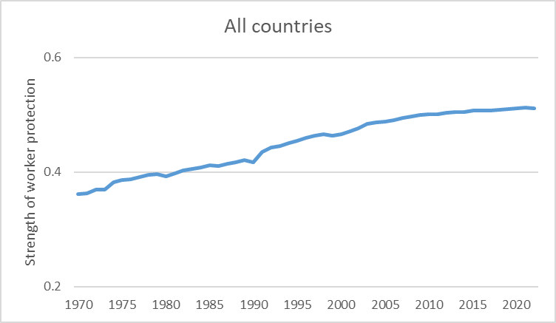
We see a steadily rising trend in labour law protections since the 1970s

Slide 7
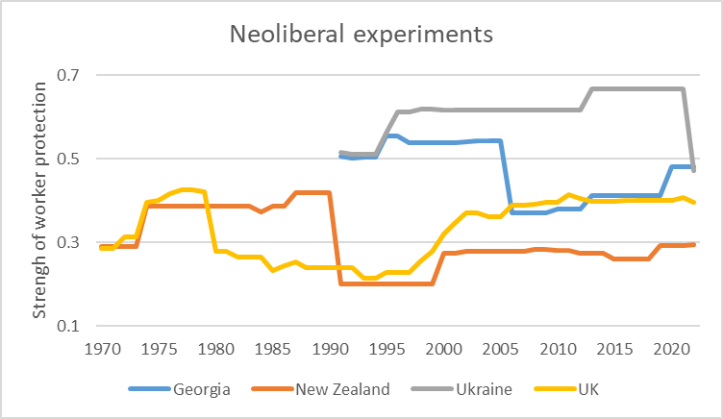
Deregulatory episodes are rare

Slide 8
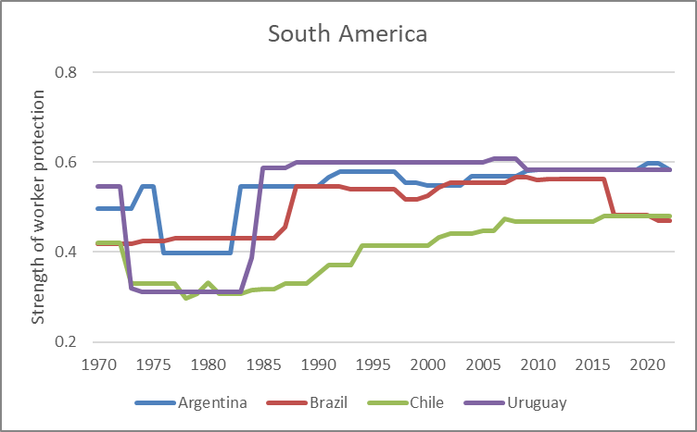
In South America, rising labour protection is associated with periods of democratic governance

Slide 9
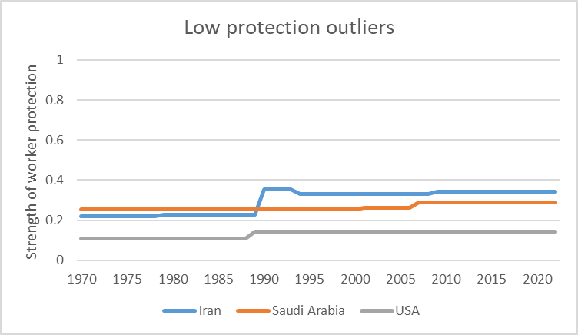
A few countries show almost no change over time

Slide 10
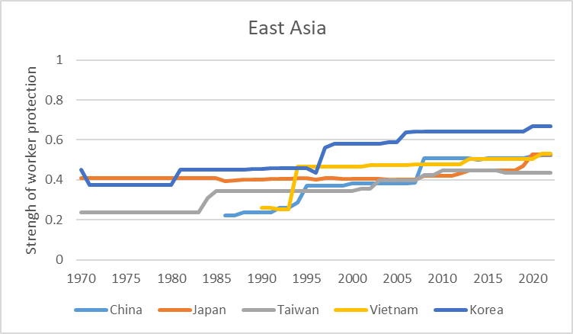
Labour protection is rising in east Asia

Slide 11
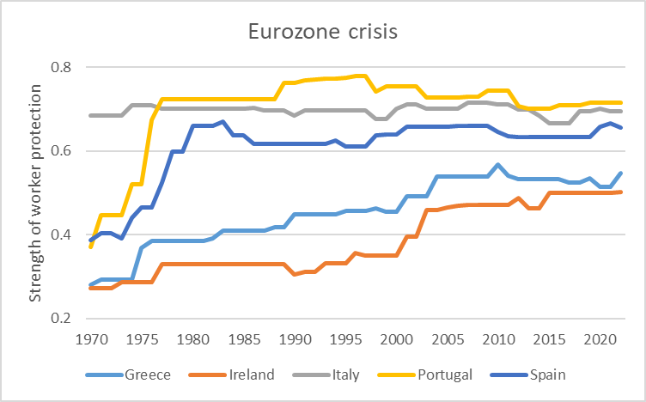
In the EU, financial crisis did not lead to significant deregulation of labour laws when viewed against earlier gains, and during the Covid pandemic labour protections strengthened again

Slide 12
Theorising the impacts of labour laws
Labour regulation can be positive for innovation and productivity
However, increased productivity may lead to unemployment if firms use increases in efficiency to shed labour
Improvements in productivity may be captured by capital in the form of dividends and rents (the ‘capital share’) at the expense of wages and salaries (the ‘labour share’)

Slide 13
Recent empirical findings (1)
Increases in labour protection across a panel of all 117 countries in the CBR-LRI over the period 1990 to 2013 are associated with rises in labour’s share of national income, employment increases and unemployment declines; some models also show productivity gains (Adams et al., 2019).
Stronger labour regulations are associated with a smaller informal sector, when combined with effective state-level institutions, including respect for the rule of law (Blanton and Peksen, 2019).
There is a positive correlation between the strengthening of employee representation laws and scores on the Human Development Index in a panel of five middle income countries (Brazil, China, Russia, India and South Africa) (Deakin et al., 2014)
The strengthening of codetermination laws is associated with an increase in firms’ capital stocks (Jäger et al., 2022)

Slide 14
Recent empirical findings (2)
Certain types of labour laws, including dismissal protections (Acharya et al., 2013) and employee representation laws (Belloc, 2016, 2019), are positively correlated with firm-level innovation, as measured by the number of patents filed
Where labour laws are stronger, industries with a high degree of sunk costs exhibit increasing levels of automation (Presidente, 2023)
Legislation strengthening workers’ rights is associated with reductions in dividends and other capital disbursements to shareholders (Haw et al., 2018)

Slide 15
Econometric method
Time series analysis
Impulse response function: impact of legal change modelled as ‘shock’ impacting economy over a period of time
We estimate the average effect for each country over the c. 50 years of the dataset
We can decompose the analysis into a study of the effects of particular types of labour law (laws governing precarious/flexible work, working time, dismissal, employee representation, collective bargaining)

Slide 16
Exploratory analysis
There is in general a positive impact of labour regulation on the labour share of national income and on productivity
There is no systematic difference between countries by region or state of development, but there are some effects associated with ‘varieties of capitalism’
But timings vary: productivity effects are often observed with a lag
The relationship between productivity and employment is not constant across countries or types of law

Slide 17
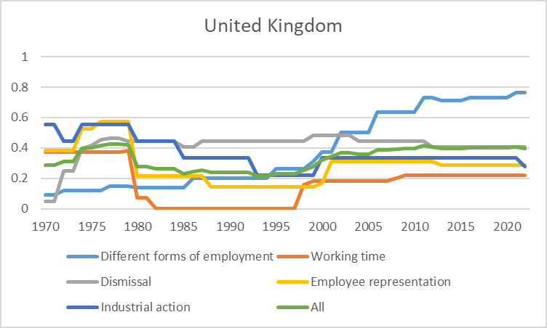
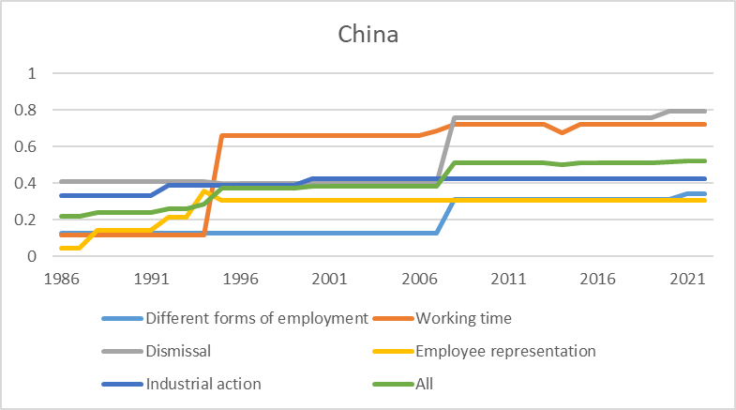
Case study: comparing trends in the UK and China

Slide 18
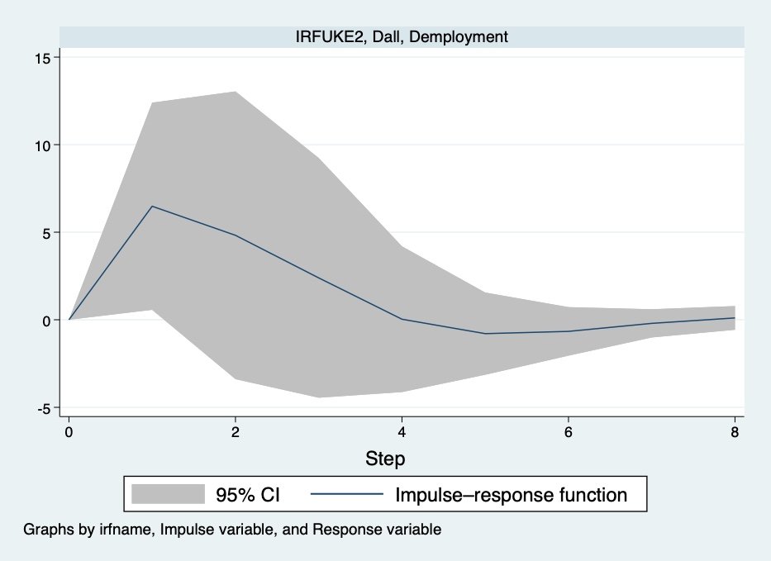
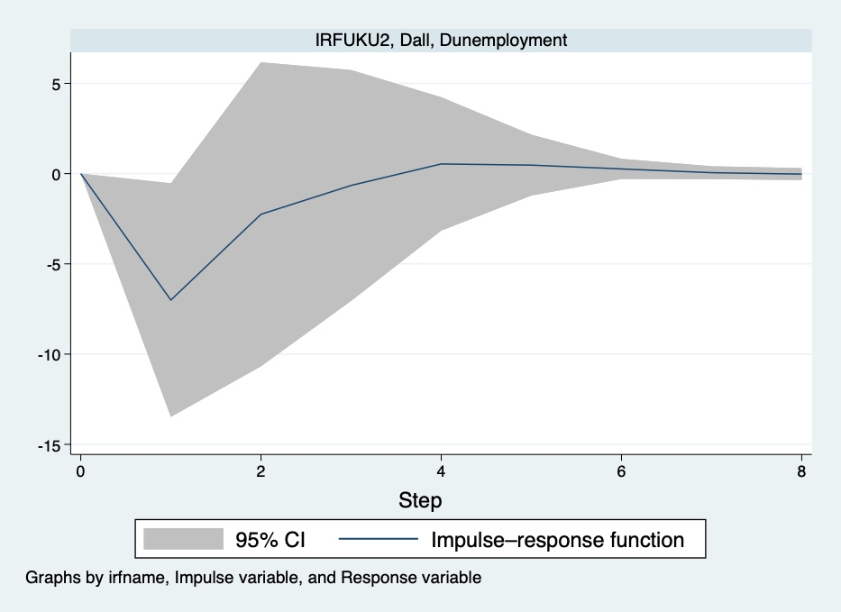
The UK: overall, rising employment, falling unemployment

Slide 19
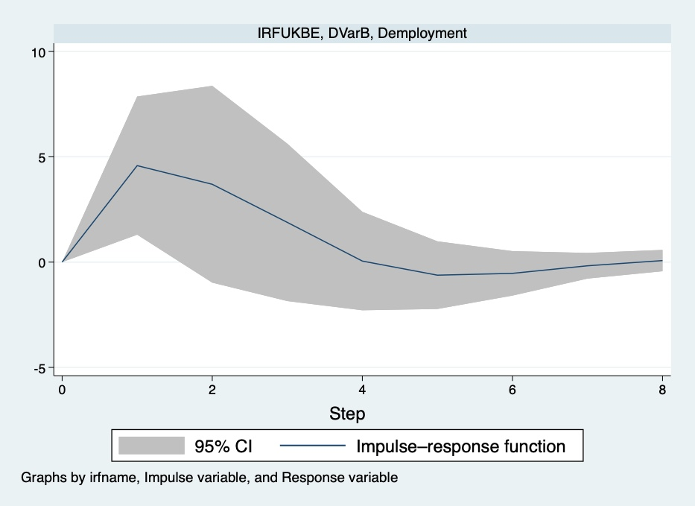
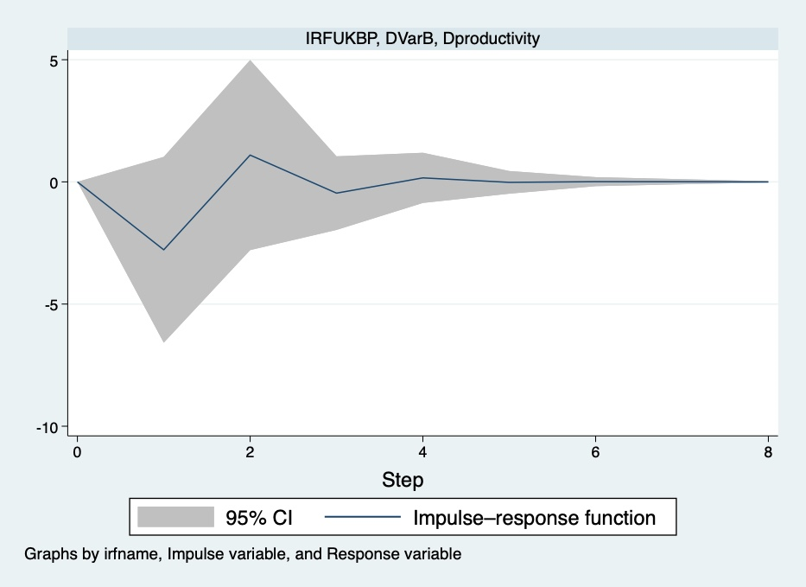
Working time, employment and productivity in the UK

Slide 20
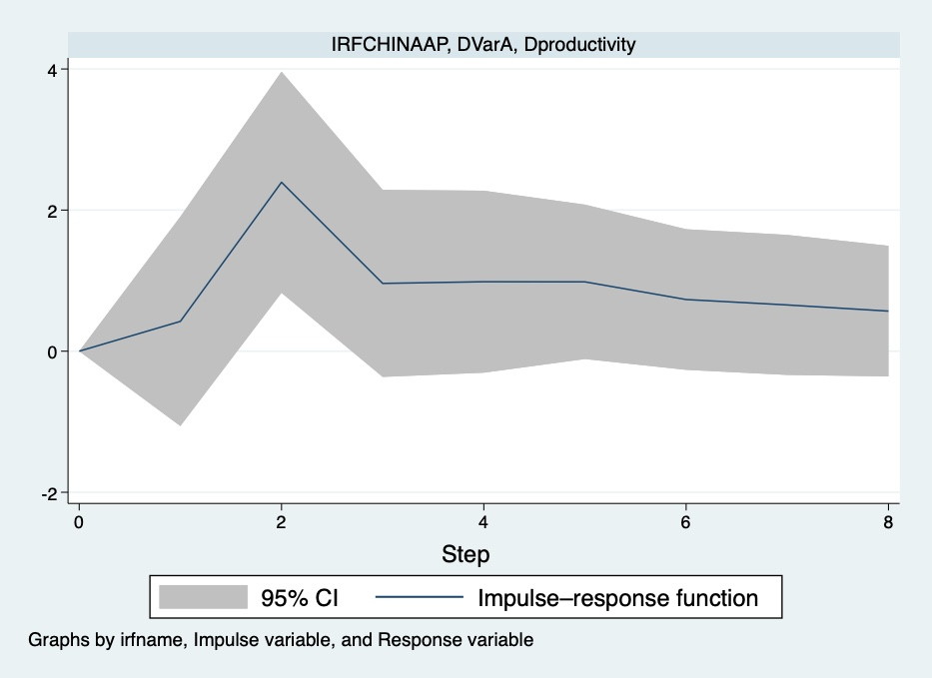
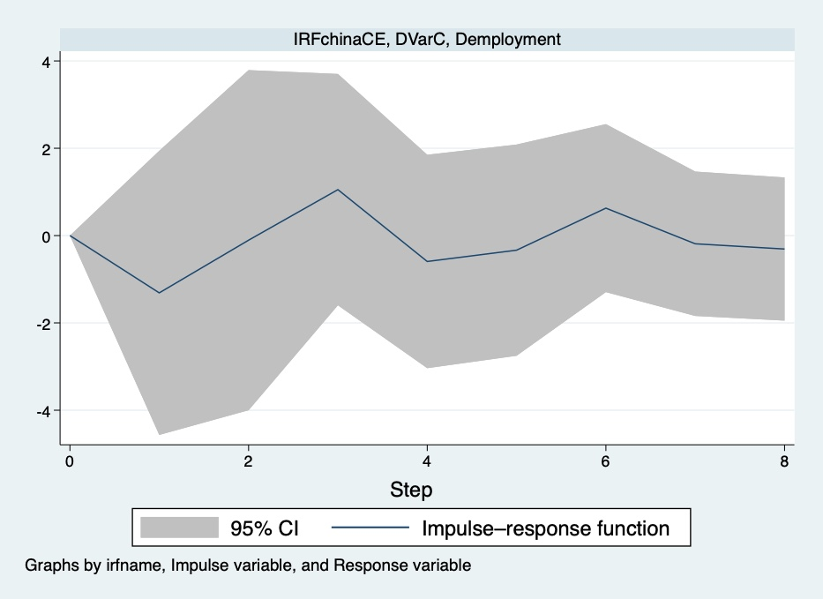
Dismissal law, productivity and employment in China

Slide 21
Conclusions
Having data on long-run trends in labour laws is revealing of possible economic and social impacts
The research is historical, and is neither a prediction or a forecast of future trends
Need to deepen analysis to take into account other variables likely to impact on productivity, including training and finance, and institutional features, including state capacity and enforcement of labour laws

