Slide 1
ILO’s Comprehensive Strategy to Prevent and Reduce Inequalities in the World of Work
Alessandro Batazzi
Inequalities Specialist
WORKQUALITY Department
: batazzi@ilo.org
: +41 22 799 6575

Slide 2
Inequalities hinder the achievement of Social Justice for All
Reducing inequalities between and within countries has become a key policy priority for many developing actors, as also reflected in SDG 10
Concerns have been growing in recent decades over rising economic inequality within countries and the widening disparity between the inordinate wealth accruing to the richest one per cent of the population -- and the incomes of the rest. Social justice remains elusive for too many.
Inequalities of opportunity and of outcome are both challenges that lead to lower workers’ engagement and reducing them can lead to workers being more fulfilled and better performing.
Notes:
There are multiple reasons explaining why inequalities is an area of action for the ILO in this moment in time
First off, reducing inequalities is increasingly present in the agenda of development actors and in the global discourse.
There is growing concern on the levels of inequality world wide and, As you might know, the SDG report of 2023 highlighted how SDG 10 is lagging behind when compared to other goals.
Furthermore, at the HLPF of 2023, a series of high level experts and policy makers launched a call for action to increase efforts to tackle inequalities
The ILO is aware of these issues, and in particularly that reducing inequalities is inherently linked to achieve social justice for all

Slide 3
The ILO and Inequalities
Reducing inequalities and promoting equality of opportunity and treatment have always been inherent to the work of the ILO. The ILO Constitution emphasizes that “universal and lasting peace can be established only if it is based upon social justice” and calls for, among other things, equal remuneration for work of equal value, and policies to “ensure a just share of the fruits of progress to all”. The 1944 Declaration of Philadelphia also refers to the principle of equal opportunity on multiple grounds, including gender and ethnicity.
The ILO Centenary Declaration for the Future of Work (Centenary Declaration) reiterated this commitment. The Declaration notes that “persistent poverty, inequalities, and injustices … in many parts of the world constitute a threat to those advances [in economic and social progress] and to securing shared prosperity and decent work for all”.
At its 334th Session (October–November 2018), the Governing Body decided to place an item for a general discussion on “inequalities and the world of work” on the agenda of the 109th Session of the International Labour Conference.
Notes:
That being said, the ILO has been working on reducing inequality and promoting equality of opportunity and treatment since its creation.
The ILO Constitution of 1919 emphasizes that “universal and lasting peace can be established only if it is based upon social justice” and calls for, among other things, equal remuneration for work of equal value, and policies to “ensure a just share of the fruits of progress to all”
The 1944 Declaration of Philadelphia and the Centenary Declaration further echo these principles, but most recently the ILO began a process of reflection with a general discussion on “inequalities and the world of work” at the 109th ILC

Slide 4
Institutional Context
ILC Discussion, June 2021 – Inequalities in the World of Work
ILC 109/Resolution XVI - Resolution concerning inequalities and the world of work
ILO GB 344, March 2022 - Plan of Action
ILO GB 346, November 2022 - Comprehensive and integrated ILO strategy to reduce and prevent inequalities in the world of work
Guiding Document
Notes:
A process started in 2021 to reinforce the work of the Organisation on Inequalities
The general discussion on inequalities was held at the ILC in 2021, resulting in the adoption of a resolution and in a request to prepare a plan of action, subsequently submitted at the GB in March 2022.
The plan of action also called for the preparation of a comprehensive and integrated strategy to reduce and prevent inequalities in the world of work, examined and endorsed by the GB in November of 22

Slide 5
Strategy Goals
“The extent, pervasiveness and consequences of inequalities today require the ILO to deepen the inequality-reducing effect of its action, strengthen its influence within the multilateral system, and show the importance of acting upon both distribution and redistribution levers and policies.“
The Strategy Seeks to
position the ILO as a key actor in ongoing debates and initiatives of the multilateral system, notably in the United Nations (UN) system and international financial institutions, to counter inequalities at global and country levels; and
help ILO constituents to develop comprehensive and integrated policy frameworks and measures to reduce and prevent both vertical and horizontal inequalities in the world of work.
The above will be achieved through:
Mainstreaming the reduction of inequalities across the world of work
Country Support - Designing and implementing country-specific approaches to prevent and reduce inequalities in the world of work (in selected pilot countries)
Support the positioning of the Office in the multilateral system as a leading inequality actor in the multilateral system, in synergy with the Global Coalition on Social Justice
Knowledge Development, Research, and Tools Development
Communication
Notes:
The strategy identifies 5 goals for the Organisation
Mainstreaming the reduction of inequalities across the world of work
Country Support
External relations
Knowledge development and research to better identify effective policy responses to tackle inequalities in the world of work
Communication, which is linked to the other four, through a specific strategy that will help improve understanding of why addressing the causes of inequality in the world of work is instrumental in advancing social justice, promoting decent work and contributing to world peace.

Slide 6
Comprehensive and integrated ILO strategy to reduce and prevent inequalities in the world of work - The Strategy
Thematic Areas for Priority Policy Action:
Employment creation
Equal access to quality education and training, including lifelong training, and quality public services from early childhood
Adequate protection of all workers and a fair share of the fruits of growth
Transition to the formal economy
Gender equality and non-discrimination, equality for all, diversity and inclusion
Trade and development for a fair globalisation and shared prosperity
Universal and adequate social protection

Slide 7
Country Support
Current pilot countries (identified by ROs in consultation with constituents):
    Namibia [also GA Pathfinder country]
    Philippines [also GA Pathfinder country]
    Chile
    Iraq
    Europe TBD
Countries chosen on the basis of: Contextual levels of inequalities along different dimensions; Political will to tackle inequality; Potential Complementarity with ongoing actions (and other partners)

Slide 8
Country Support
Development of Country-specific approaches rooted in the Strategy
Application of the Guiding Principles and identification of policy mix based on the 7 Thematic Areas for Priority Action
Implementation (policy review, technical assistance, mobilisation of expertise from Task Force)
COs working on “inequalities diagnostics”, i.e. reports on contextual levels, needs, policy priorities
Following finalisation of the report (including with consultations with Task Force), consultation and validation with constituents to determine an implementation roadmap

Slide 9
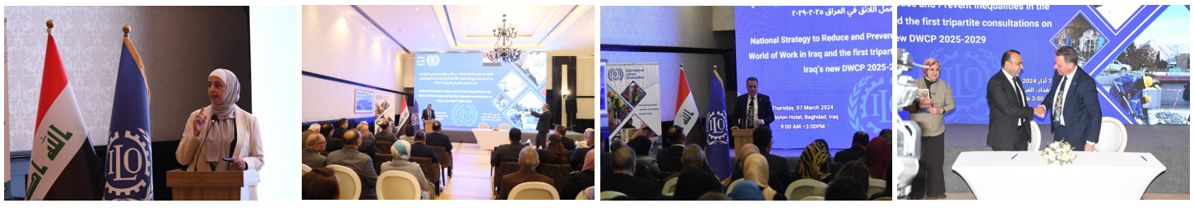
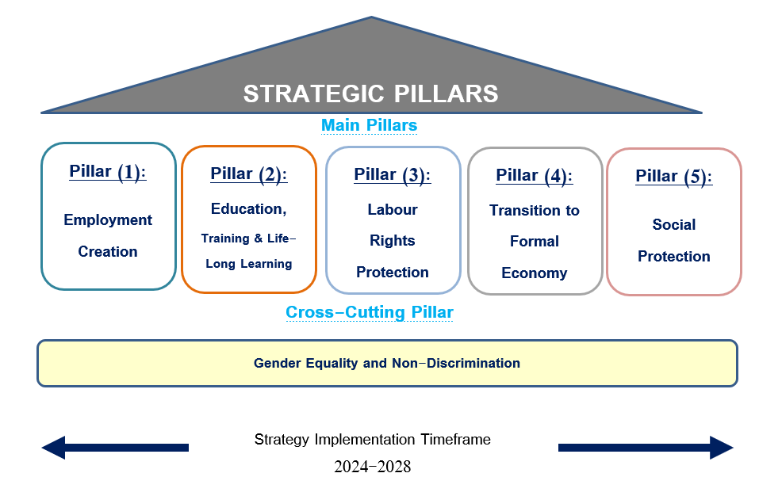
Iraq
Iraq National Strategy to Prevent and Reduce Inequalities in the World of Work for the Years 2024-2028 launched 07/03/2024
Developed over 4 months through extensive research and national consultation and collaboration; effectively embedded inequality-reduction in whole-of-govt. approach

Slide 10
Namibia
Inequality Diagnostic launched with University of Cape Town / African Centre of Excellence for Inequality Research
Diagnostic will contribute to the UNCT new inequality framework for the new UNSDCF
Timeline:
    04/07/2024 - Inception Report
    07-08/2024 – Key stakeholder interviews (link with GA)
    16/09/2024 (tbc) – Consultation workshop
    14/10/2024 (tbc) – Final validation workshop
Diagnostic will start identifying/building the country-specific approach, to be fully developed in Phase II

Slide 11
Thank You

