Slide 1

1st year Annual Report
8th SPIAC-B
22nd of September 2016

Slide 2

Content overview
Members
Publications
Webinars
Online Communities
The Ambassador Programme
Way forward

Slide 3

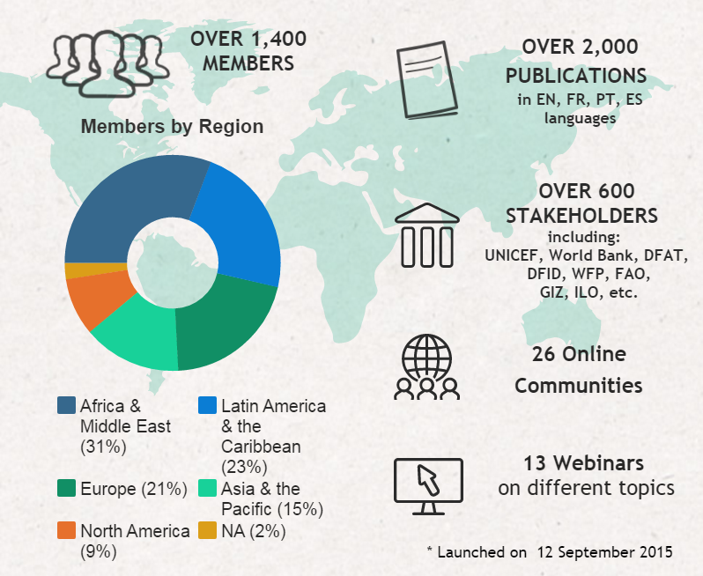

Slide 4

Members

Slide 5


Wide range of members
Total number of members as of 12 September 2016: 1,447
839 likes
708 followers

Slide 6

Where do members come from?
Europe
22%
(312)
9%
(131)
Asia and the Pacific
North America
15%
(224)
3% (49)
Middle East & North Africa
27%
(391)
24%
(347)
Sub- Saharan Africa
Latin America & the Caribbean

Slide 7
What organization type do members represent?

Slide 8
Which institutions are the most represented?
*
* Ministry of Social and Agrarian Development

Slide 9
What are the members’ professional positions?
(320)
(256)
(227)
(145)
(112)
(82)
(73)
(65)
(54)
(43)
(29)
(6)
(1)

Slide 10
10 most proactive members
Members’name | Amount of publications included | Organization represented
Raiden Dillard | 118 | World Bank
Ngoc-Dung Tran | 108 | World Bank
Triashtra Lakshmi | 107 | DFAT
Aderonke Gbadamosi | 42 | HelpAge
TNP2K Knowledge Unit | 27 | TNP2K
Tania Tasnin | 19 | BRAC
Markus Loewe | 12 | DIE-GDI
Carolina Aulicino | 11 | CIPPEC
Massimiliano Terzini | 11 | FAO
Ana Lopez | 9 | World Bank
Beatriz Morales | 8 | ECLAC

Slide 11

Publications

Slide 12
Publications Search
socialprotection.org redirects the user to 2,096 publications, revised and categorized by its knowledge management team
Almost 30% of the content available on socialprotection.org
was included by members themselves

Slide 13
Publications by programme
Programme | Amount of publications
1/ Social Assistance | 1,118
Social Transfers (General, in Kind and Cash transfers) | 844
Subsidies | 104
2/ Social Insurance | 458
Old age pension | 213
Health insurance | 113
3/ Labor market programs / public work / productive inclusion | 344
Training | 85
Cash for work | 52
Total of publications categorized under social protection programmes | 1,875

Slide 14
Publications by topic
Topic | Amount of publications
Coverage | 531
Financing social protection | 524
Targeting | 480
Programme design and implementation | 478
Social protection systems | 344
Monitoring and evaluation | 294
Governance | 293
Benefits payment/ Delivery | 241
Social protection definition and features | 232
Benefits level | 197
Labour regulation | 168
Total number of publications categorized under a topic | 1698

Slide 15
Publications by cross cutting areas
Cross Cutting Area | Amount of publications
Poverty | 798
Labour market (child labour, informality, labour allocation, unemployment) | 511
Health (child, maternal , HIV) | 422
Risk and vulnerability | 384
Education | 346
Social inclusion | 270
Food security | 269
Gender | 254
Inequality | 238
Agriculture and rural development | 178
Total amount of publications categorized under cross cutting areas | 1,669

Slide 16
Most proactive organizations
Other proactive institutions:
Inter-American Development Bank, Centro de Politicas Publicas del Chile, Indonesian Ministry of Social Affairs, Secretariat of Social Policies of the Trade Union Confederation of the Americas, Social Protection Human Rights, Uganda Social Protection Platform, World Solidarity (WSM Nepal)

Slide 17

Webinars

Slide 18
Webinars by numbers
General Indicators | Average
Actual Duration (minutes) | 124
Registrants | 197
Attendees | 93
Attendance Rate (%) | 49,23%
Average Attendance Interest Rating | 52,18%
Total amount of questions and comments | 42,8
Questions only | 22,7
Number of Surveys Submitted | 30,5
Number of YouTube views | 125
Webinars as an innovative knowledge exchange format
Recordings make the knowledge available regardless of the time zone

Slide 19
A total of 13 realized Webinars
 | Webinar title | Organisers | Attendees
1 | Child Allowance Webinar Series (3 webinars) | United Nations Children's Fund (UNICEF) and the International Policy Centre for Inclusive Growth (IPC-IG) | 144
2 | Towards universal social protection: Latin American pathways and policy tools | Economic Commission for Latin America and the Caribbean (ECLAC) Institute for Applied Economic Research (IPEA) International Policy Centre for Inclusive Growth (IPC-IG) | 89
3 | Kenya’s Single Registry for Social Protection | Australian Department of Foreign Affairs and Trade (DFAT), Oxford Policy Management and Development Pathways | 117
4 | La política fiscal como mecanismo para combatir la desigualdad: análisis en Brasil y Guatemala | Organization of American States (OAS), through its Inter-American Social Protection Network (RIPSO) | 50
5 | Gender and Social Protection: Current Issues and Policy Trends | International Policy Centre for Inclusive Growth (IPC-IG) and Food and Agriculture Organization of the United Nations (FAO) | 148
6 | A Framework and Practical Guidance on Linking Humanitarian Cash Transfers with Long-Term Social Safety Nets | The Cash Learning Partnership (CaLP) and Oxford Policy Management (OPM) | 181
7 | Turkey’s Integrated Social Assistance Services System Webinar | Australian Department of Foreign Affairs and Trade (DFAT), Oxford Policy Management and Development Pathways | 66
8 | Social protection and the empowerment of rural women in Africa | International Policy Centre for Inclusive Growth (IPC-IG) and Food and Agriculture Organization of the United Nations (FAO) | 112
9 | The Bolsa Familia Programme: Access to and Dissemination of Information | Brazil Learning Initiative for a World Without Poverty (WWP) | 143
10 | Fiscal Space for Social Protection: Inequality and Redistribution: Taxes and Transfers | HelpAge International and the International Policy Centre for Inclusive Growth (IPC-IG) | 83
11 | Shock-responsive social protection in practice: perspectives from Kenya and Mozambique | Oxford Policy Management (OPM) in partnership with the Hunger Safety Net Programme (HSNP), Kenya | 131
12 | The ISPA Tool: Assessing the Quality of Social Protection Payment Delivery Mechanisms | Inter Agency Social Protection Assessments (ISPA) - Coordination Team | 103
13 | Fiscal Space for Social Protection: Harmonization of Contributory and Non-Contributory Programmes | HelpAge International and the International Policy Centre for Inclusive Growth (IPC-IG) | 78

Slide 20
Registrants and Attendees

Slide 21
Webinar audience
In total, 101 countries were represented by the attendees

Slide 22
Types of institutions attending the webinars

Slide 23
Types of experts attending the webinars

Slide 24

Online Communities

Slide 25
A total of 26 Online Communities
Online Community Title | Institutions | Type | # members
Social Registries and Integrated MISs for Social Protection | DFAT, OPM | Webinar series, Event follow up | 100
Brazil-Africa Social Protection Community | IPC | DFID project | 80
Community of Practice on Cash Transfer in Africa / Communauté de Pratique sur les Transferts Sociaux Monétaires en Afrique | CoP | Event follow up (COP) | 58
The Child Allowance Online Community | IPC | Webinar series | 57
Social Protection for Employment – Community (SPEC) | DFAT | Event follow up | 56
Gender-Sensitive Social Protection | IPC, FAO | Webinar series | 52
Cooperação Sul-Sul em Proteção Social e Segurança Alimentar | IPC | DFID project | 43
NutriSSAN: N4G Global Network / Rede Global de Ensino, Pesquisa e Extensão em Nutrição e SSAN | MCTI | Event follow up, Int. Network | 40
Ambassador Programme Online Community | IPC | Private working group | 38
Social Protection in humanitarian, fragile and risk-prone contexts/La Protection Sociale dans les contextes de crise humanitaire et situations de risque | Unicef | Webinar series | 36
Curso Monitoria e Avaliação - CAP Universidade Eduardo Mondlanne / IPC-IG | IPC | DFID project | 35
Fiscal space for social protection: knowledge sharing initiative | IPC, HelpAge | Webinar series | 32
ISPA Website Launch | ISPA | Private working group | 29
The Brazilian experience of Social Protection Programmes | WWP | Webinar series | 23
SPIAC-B Informal Working Group on Social Protection Capacity Strengthening | SPIAC-B | Private working group | 23
Working Group: Food Security and Nutrition-Specific Inter-Agency Social Protection Assessment Tool (FSN-ISPA) | FAO | Private working group | 18
Evaluating National Integrated Cash Transfer Programs | Transfer Project | Event follow up | 17
ISPA Social Protection Payment Delivery | ISPA | Webinar series | 11
Working Group of the Asia Pacific Report on Social Protection | DFAT | Private working group | 10
CoP francophone - elaboration du rapport sur la rencontre annuelle | CoP | Event follow up (COP) | 9
Berlin Global Learning Forum 2015 | GIZ | Event follow up | 6
SPIAC-B informal group: Social Protection in humanitarian, fragile and risk-prone contexts | UNICEF, OPM | Private working group | 5
Graduation Program Community of Practice | World Bank | Private working group | 3
Regional Conference on Social Development in Latin America and the Caribbean | ECLAC | Event follow up | 2
International Seminar - Early Childhood Development | MDS
Social Protection Systems Window | UNICEF

Slide 26
Added value of Online Communities
  One-stop shop
    Gather all the relevant and qualitative information concerning one specific topic (ex: MIS)
    Facilitate group work (ex: report redaction for the COP)
  Networking
    Network with people interested in similar topics, even outside of the OC
    Can facilitate exchanges between groups not speaking the same language (COP anglophone and francophone)
    Follow up on webinars
  Knowledge Sharing and Production
    Learn from each other’s experiences and good practices for successful project implementation
    Work with external experts and partners for regional and sector-specific information exchange
    Research collaboration on specific topics

Slide 27
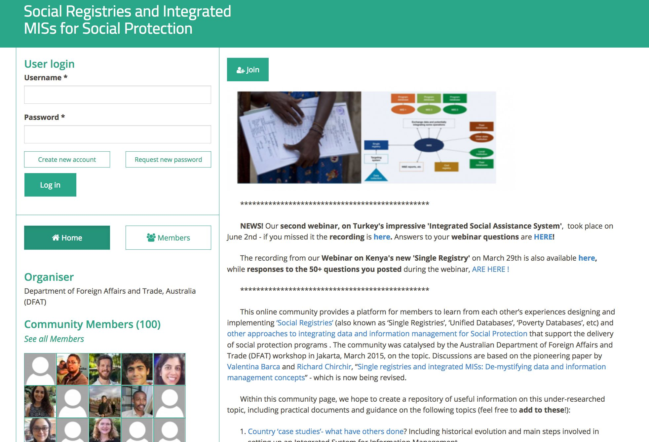
Concrete Example

Slide 28

The Ambassador Programme

Slide 29
The Ambassador Programme
We have recently launched the second edition of the Ambassador Programme:
35 Ambassadors were selected via the United Nations Volunteer website for a period of six months
Regions covered
  Europe & Central Asia, Latin America & Caribbean, Middle East & North Africa, North America, South Asia, Sub-Saharan Africa
Activity Areas
  Content sourcing and upload
  Knowledge Exchange and Networking
  Promotion
Objective
  Ensure up-to-date and relevant content concerning the Ambassador’s regional and thematic interests is available on the site.
  Promote and provide opportunities for engagement with socialprotection.org interactive features.
  Increase the visibility of socialprotection.org, especially in developing countries

Slide 30

Traffic on the platform

Slide 31
A constant increase in visitors
New sessions per subcontinent from September 2015 to September 2016
Region | Amount of new sessions
Latin America | 13,740
Africa | 7,649
Asia | 5,810

Slide 32

Way forward

Slide 33
Services of the socialprotection.org Team
  Help desk for usage of all features of the platform
  Content-related research support
  Organization, realization and impact analysis of Webinars
  Structuring of content and layout of Online Communities
  Elaboration of communications strategy for Webinars, Webinar Series und Online Communities
  Establishment of linkages between members
  Campaigning of events, news etc. on demand in Social Media and Newsletter

Slide 34
Improving and expanding
Technical development (2nd phase)
  Provide the platform in French and Spanish
  Expand the Virtual Campus feature (LMS) – self paced courses
  New functionalities for the Online Communities
  Implement notification system
Outreach
  Increase engagement with developing countries
  Increase the presence of members and content from Asia
  Keep content updated aligned to ongoing discussions

Slide 35
Desired improvements
Technical development (3rd phase)
  Expand the Virtual Campus feature (LMS) – tutorial and video courses
  Integrate the webinar tool into the platform
  Create and maintain a blog
  Automated analytical reports
  Provide platform in all UN languages
  Upgraded social space and mobile app
Outreach
  Expand Human Resources to attend all demands

Slide 36
All this is only possible with your engagement and financial support
THANK YOU!

Slide 37
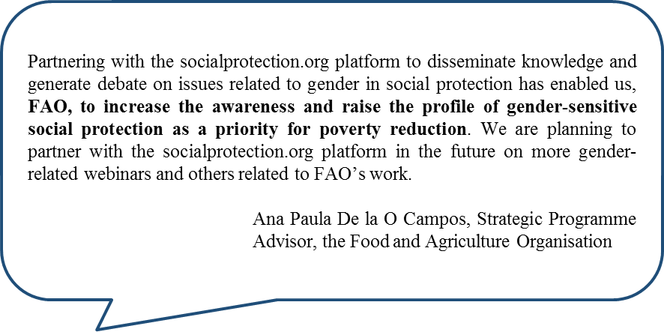
Statements from members

Slide 38
Statements from members
We from the Rede Global NutriSSAN would like to express our gratitude to this platform which has been crucial in providing the Rede with visibility in its objectives of disseminating, sharing and propagating the scientific and traditional knowledge, techniques and technology, on food and nutrition security.
Rede Global NutriSSAN

Slide 39
Statements from members
The celebration of the first year of Socialprotection.org is a great chance to highlight the usefulness of this web-based platform devoted to one of the key development issues for the 21st century. Here at the Economic Commission for Latin America and the Caribbean (ECLAC), we are grateful to the Socialpotection.org team for sharing our research and initiatives to a broader audience and also for giving us a chance to keep up-to-date on new and emerging social protection topics brought about by academia, think tanks, governments and international organizations.
Simone Cecchini, Social Development Division, ECLAC

Slide 40
Statements from members
Never before had the community of practitioners working in this field had the opportunity to share their knowledge to this extent, and the impacts in terms of changing practice are already tangible. The tailored search function of content, the outreach granted by the online communities, the incredible webinar platform and above all the flexibility and availability of the socialprotection.org staff.
Valentina Barca, Consultant at Oxford Policy Management

Slide 41
Statements from members
Congratulations to the socialprotection.org team on your one year anniversary! The platform has made remarkable achievements in its first year by offering access to over 2,000 recent publications and hosting useful webinars and online communities. DFAT’s Social Protection Hub is proud to be part of the journey of socialprotection.org. We have benefited immensely from being able to use the platform to conduct online communities, namely the Social Registries and Integrated MISs for Social Protection Community and the Social Protection for Employment-Community (SPEC). DFAT is using these communities to share and increase knowledge on these important topics, and keep our stakeholders learning long after the workshops have ended. There is huge potential for these communities to make an even bigger contribution to global social protection learning and the improvement of systems.
Hannah Derwent, Assistant Director, Social Protection-Australian
DFAT
Fazley Mahmud, Social Protection Specialist at Social Protection Hub
DFAT initiative

