Slide 2
Climate change and OSH
    Climate change is already having serious impacts on planetary health, human health and the world of work.
    Workers are frequently the first to be exposed to the effects of climate change, often for longer periods and at greater intensities (ILO 2023).
    Climate change effects can lead to a deterioration of working conditions and an increased risk of occupational injury, disease and death (Kiefer et al. 2016).
    Numerous health effects in workers may result, including injuries, cancer, cardiovascular disease, respiratory conditions, macular degeneration and mental health issues.

Slide 3
The impact of climate change on the world of work
    Climate change effects on OSH are unevenly distributed across regions and sectors.
    Workers particularly at risk:
      Outdoor workers in physically demanding sectors, such as agriculture, construction and transportation.
      Indoor workers in hot and poorly-ventilated environments.
      Workers in emergency services, health care sector and other public services.
      Pregnant women, children, older adults and persons with disabilities.
      Workers in the informal economy, migrants and those in micro- and small-sized enterprises.
    Financial implications due to lost productivity, business disruptions and damaged infrastructure.

Slide 4
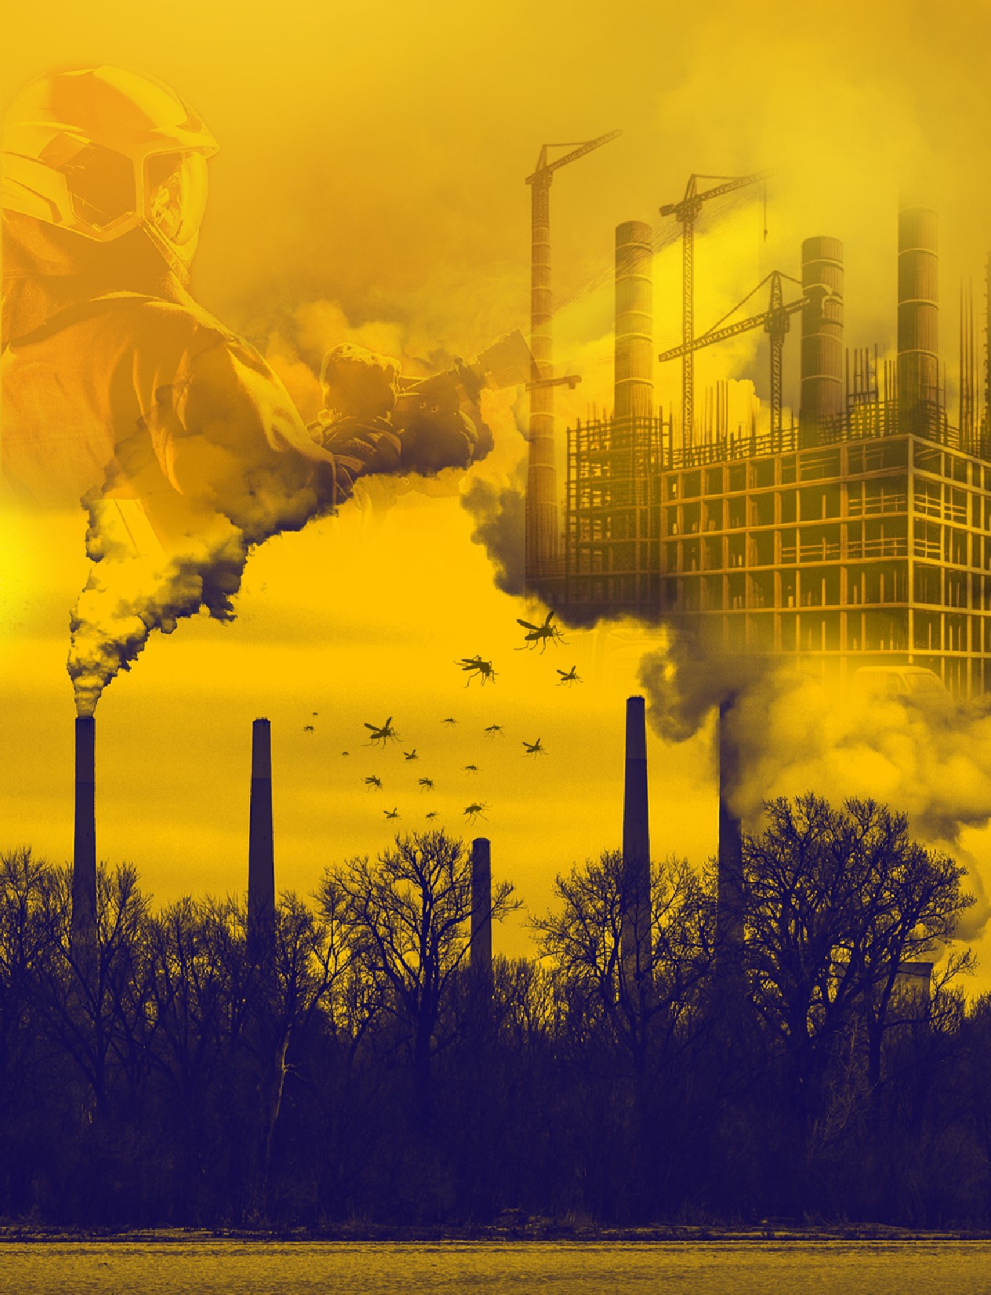
Key climate change issues impacting workers’ health and safety

Slide 5
Excessive Heat
Solar UV radiations
Extreme weather events
Air pollution
Vector-borne diseases
Agrochemicals

Slide 6
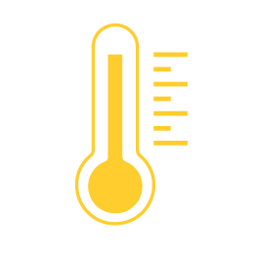
Excessive heat
    Rising global temperatures may result in more frequent and severe heatwaves
    Heat-related risks are influenced by environmental conditions, physical exertion and clothing
    High risk jobs: Outdoor workers in physically demanding jobs and indoor workers in poor ventilated workplaces where temperature is not regulated
    Primary health impacts: Heat stress, heat stroke, heat exhaustion, rhabdomyolysis, heat syncope, heat cramps, heat rash, cardiovascular disease, acute kidney injury, chronic kidney disease, physical injury and mental health conditions
At least 2.41 billion
workers exposed (ILO 2024)
22.85 million occupational injuries
18,970 work-related deaths
2.09 million DALYS in 2020 (ILO 2024)

Slide 7

Solar UV radiation
    Thinning of the ozone layer is impacting the quantity of solar UV radiation reaching earth
    Workers may unknowingly face dangerously high levels of solar radiation exposure
    High risk jobs: Outdoor workers
    Primary health impacts: Sunburn, eye damage, weakened immunity and various skin cancers
1.6 billion
workers exposed (Pega et al. 2023)
Over 18,960 work-related deaths in 2019 due to non-melanoma skin cancer alone (Pega et al. 2023)

Slide 8

Extreme weather events
    Projected increases in the frequency, duration and intensity of extreme weather events (heat waves, winter storms, tropical cyclones, droughts and torrential rains)
    Possible consequences include wildfires, flooding, famines, major industrial accidents and water-borne diseases
    Workers may be exposed during the event, in the immediate aftermath or during clean-up operations
    High risk jobs: Emergency workers, workers involved in clean-up, agriculture workers and fishing workers
    Primary health impacts: Traumatic injury, burns, respiratory tract injury, diseases from biological hazards, toxic effects from chemicals, physical and emotional fatigue, anxiety, stress and PTSD
Limited data on occupational exposures
2.06 million
deaths due to weather, climate and water hazards (not just occupational exposures) from 1970 to 2019 (WMO 2021).

Slide 9

Workplace air pollution
    Modified weather patterns have influenced levels of both outdoor and indoor air pollutants.
    Greater exposures are observed for outdoor workers in areas with high levels of air pollution generated by heavy traffic or industries.
    High risk jobs: All workers, particularly outdoor workers, transport workers and firefighters.
    Primary health impacts: Cancer (lung), stroke, respiratory disease, cardiovascular disease and eye irritation.
Over 1.2 billion
workers exposed (WHO 2018)
860,000
work-related deaths (outdoor workers only) (ILO 2021a)
By 2060, 3.7 billion lost working days annually due to exposure to air pollutions (OECD 2016)

Slide 10

Vector-borne diseases
    Climate change has been linked with an increased risk of vector-borne diseases in workers through:
      Effects on vector population sizes, survival rates and reproduction.
      Broader impacts on natural ecosystems and human systems e.g. changes in land use from droughts.
    High risk jobs: Outdoor workers.
    Primary health impacts: Malaria, Lyme disease, dengue, schistosomiasis, leishmaniasis, Chagas disease and African trypanosomiasis, among others.
Limited data on occupational exposures
14,576
work-related deaths due to malaria (Takala et al. 2023)
Over 700,000
deaths annually (not just occupational exposure) (WHO 2020).

Slide 11

Agrochemicals
    Pesticide use can be impacted by climate change (loss of fertile soil, pest occurrence, crop characteristics).
    Highly hazardous pesticides (HHPs) continue to be a major concern
    High risk jobs: Agriculture, forestry, chemical industries, pesticide sales, greenspace and vector control.
    Primary health impacts: Poisoning, cancer, neurotoxicity, endocrine disruption, reproductive disorders, cardiovascular disease, chronic obstructive pulmonary disease, endocrine disruption and immune suppression.
Between 1990 and 2021,
global consumption of
agricultural pesticides
increased by 96%
(Statistica 2023)
Over 300,000
deaths annually due to pesticide poisoning (Jørs et al. 2018)

Slide 12
Spotlight on Climate Change and Mental Health
    Job insecurity due to climate change can cause distress, especially in communities reliant on specific industries that will be impacted more significantly
    Specific occupations like those in disaster relief and recovery, construction, agriculture, and healthcare have been found to be particularly at risk for mental health issues due to climate change, including PTSD, depression and anxiety.
    Climate change impacts, such as excessive heat, can lead to sleeping disorders, behavioral changes, and decreased concentration, impacting work safety and productivity.

Slide 13

Protecting workers in a changing climate

Slide 14
ILO action to protect workers in a changing climate
    Promoting, respecting and realizing the fundamental principle and right at work of a safe and healthy working environment means also addressing dangerous climate change impacts in the workplace.
    International labour standards and other instruments provide guidance to protect workers against the different workplace hazards and risks, including those related to climate change.
    The 2015 Guidelines for a Just Transition towards Environmentally Sustainable Economies and Societies for All can be used to ensure that no workers are left behind during the transition to a green economy.
    The ILO Global Strategy on OSH 2024-30 highlights that OSH concerns related to climate change should be positioned high on global and national policy agendas.
    The 2023 International Labour Conference’s General Discussion Committee on Just Transition emphasized urgent implementation of OSH measures for workers affected by climate risks.
    ILO engages in initiatives at the sub-regional level, such as Vision Zero Fund activities related to safeguarding safety and health in supply chains.

Slide 15
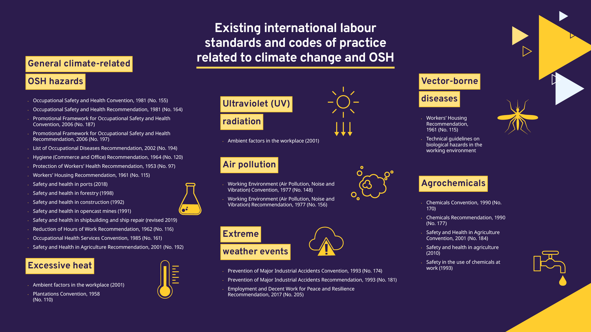

Slide 16

National responses to key climate change issues
National policies and strategies
National OSH legislation
Collective agreements
Technical guidelines
Training programmes and awareness raising initiatives
Public health initiatives targeting workers

Slide 17
National policies and strategies
    OSH concerns related to climate change can be integrated into public health, environmental and climate change policies and strategies (i.e., explicitly refer to the protection of the health of workers).
    Sometimes, hazards and risks related to climate change are identified as priorities in national OSH policies and strategies, defining actions and initiatives to be implemented in the coming years (i.e., excessive heat).

Slide 18
Examples of national OSH policies and strategies
  Chile: The OSH National Policy 2024-2028 includes the implementation of policies aimed at preventing “occupational risks derived from exposure to extreme temperatures”
  Japan: Prevention of heat stroke is one of the targeted outcomes of the 14th National Occupational Accident Prevention Plan (2023-27), with two specific indicators: (1) increased number of establishments addressing heat stress based on the WBGT value; (2) reduction of the rate of heat stroke death.
  Belgium: The National Plan of Action to Improve Workers Wellbeing 2022-2027 acknowledges that climate change will directly and indirectly effect the well-being of workers. It specifically refers to major weather fluctuations, for example due to periods of extreme heat.
  Guyana: The 2018 National Policy on Occupational Safety and Health, calls relevant ministries to develop policies in the oil and gas sector with the aim to prevent environmental pollution due to air pollution, and the subsequent damage to productive lands, crops and livestock.

Slide 19
Laws and regulations
    OSH legislations have historically addressed the protection of workers against extreme temperature, non-ionizing radiation (including solar UV radiation), air pollution, biological hazards (including vector-borne diseases) and hazardous chemicals (including agrochemicals).
    Some OSH laws also refer to the protection of workers during extreme weather events and natural disasters, requiring workplace emergency response plans.
    Sometimes, legislation may require the employer to perform risk assessment and to adopt some specific measures (e.g., acclimatization, hydration, ventilation, breaks, information and training, PPE and safety equipment, and other control measures).
    Occupational exposure limits have been adopted in some countries for exposure to heat and to air pollutants, but are very rare for other hazards, such as solar UV radiation or agrochemicals.
    In some countries, OSH legislation provides for regular medical surveillance for prevention or early recognition of the diseases associated with heat, solar UV radiation, air pollution, vector-borne diseases and agrochemicals
    Some countries include in the national list of occupational diseases heat-related diseases, diseases caused by solar UV radiation, diseases caused by biological hazards and/or pesticide-related disorders.

Slide 20
Examples of legislation regarding maximum work temperatures
Austria | Air temperature of the work premises should be between 19 and 25°C for work involving low physical stress and between 18 and 24°C for work involving normal physical effort.
Brazil | Work must stop in cases WBGT raises beyond 29.4°C for low intensity work, 27.3°C for moderate intensity work, 26.0°C for high intensity work and 24.7°C for very high intensity work.
China | Outdoor work must cease when air temperature exceeds 40°C.
India | WBGT should not exceed 30°C in factory workrooms.
Singapore | The temperature in any working chamber, man-lock or medical lock in a worksite shall not exceed 29°C.
Spain | In enclosed workspaces the temperature must be between 17 and 27°C for sedentary work and 14 and 25°C for light work.
Thailand | Work must be stopped when WBGT raises beyond 34.0°C for low intensity work, 32.0°C for moderate intensity work and 30.0°C for very high intensity work.
Vietnam | Indoor workplace temperatures should not exceed 34°C, 32°C and 30°C for light, medium and heavy work, respectively.

Slide 21
Examples of provisions addressing excessive heat
Qatar: Ministerial Decision No. 17
    Workers cannot work outside between 10:00 to 15:00 from 1 June to 15 September. Regardless of the time, all work must stop if the WBGT rises beyond 32.1°C in a particular workplace.
    Yearly health checks for workers, as well as obligatory risk assessments for enterprises to mitigate heat stress, to be carried out in collaboration with workers.
    Employers must provide training on heat stress before the hot season starts, and workers should be given free and cool drinking water and access to shaded rest areas.
Belgium: Code du bien-être au travail
    Employers must carry out a risk analysis of the climatic thermal environments present in the workplace.
    When temperatures exceed certain values a programme of technical and organization measures should be drawn up to prevent or minimize exposure. Measures include technical adaptations, such as ventilation, reducing the physical workload by adapting work equipment or work methods and limiting the duration and intensity of exposure.
Spain: Royal Decree-Law 4/202358
    Enacted in May 2023 to introduce urgent measures to address issues caused by weather conditions and to prevent labour risks during high temperatures.
    Includes protective measures for outdoor workers, based on occupational risk assessments, task characteristics, and workers' personal or health conditions.
    Measures include restricting certain tasks during extreme weather, ensuring that salaries are not reduced if work is interrupted.

Slide 22
Examples of provisions addressing extreme weather events
Egypt: Labour Code (No.12 of 2003)
    Employers should carry out an analysis of the risk of natural disasters and prepare an emergency plan for the protection of workplaces and workers in the event of such a disaster.
    Workers should receive training on the plan and practical drills should be conducted to ascertain its efficacy.
Uruguay: Decree 38/022 on work in adverse weather conditions in rural areas
    Developed in 2022 as a specific response to climate change.
    Acknowledges the need for greater protection of workers’ health due to diverse natural events, such as winds, thunderstorms or heat waves.
    Employers in rural sectors must suspend work when there are risks to safety and health derived from rain, wind, electrical storms and other extreme weather events. Workers also have the right to remove themselves from dangerous situations.
    General protocol with minimum workplace measures, based on the type of extreme weather event and the characteristics and location of the workplace.

Slide 23
Examples of provisions addressing solar UV radiation, air pollution and vector-borne diseases
Chile: Ministry of Health Decree No. 594 of 2000.
    Workers performing work in direct solar radiation from 1 September to 31 March, between 10 a.m. and 5 p.m., and those who perform regular functions under direct solar UV radiation with an UV index equal to or greater than 6, at any time of the year, are considered exposed to UV radiation.
    Public and private care establishments shall notify the Regional Health Authority of data on cases of erythema and sunburn obtained on occasion of work.
    Employers of exposed workers must carry out management of the UV radiation risk by taking appropriate control measures.
Samoa: Occupational Safety and Health Act
    Effective arrangements shall be “taken to eliminate, isolate or minimize the harmful and potentially harmful effects to employees of any (…) atmospheric pollutants”.
Mexico: Official Standard NOM- 032-SSA2-2010
    Includes establishment of epidemiological surveillance, prevention and control of vector-borne diseases.
    The diseases include dengue fever, malaria, Chagas disease, onchocerciasis, leishmaniasis, West Nile fever, Rickettsiosis and Chikungunya fever.

Slide 24
Example of legislation addressing the combined risks of agrochemical exposure with excessive heat
Costa Rica: Decree no. 33507-MTSS Occupational Health Regulations in the Management and Use of Agrochemicals
    The application of pesticides must be done in the cool hours of the day, in the early hours of the morning or in the late hours of the afternoon.
    Pesticide applications should be avoided during times when the highest temperatures prevail.
    The application of pesticides is prohibited from 10.00 to 14.00, using a back pump, spray boom or manual sprinklers and those mechanical equipment whose cabins are not hermetically sealed, you should not work continuously for more than four hours in the application of pesticides.

Slide 25
Examples of diseases included in national occupational disease lists
  Malaysia: Conditions resulting from severe heat exposure, such as heat cramps or heat stroke
  Namibia: Diseases caused by hot or cold work environments, and all work involving exposure to the risk concerned
  Lebanon: Diseases which result from exposure to UV radiation or any work that exposes workers to UV radiation exceeding national averages
  Switzerland: Skin modifications resulting from photoexposure
  Latvia: Certain vector-borne diseases, for example tick-borne encephalitis, Lyme disease and tularaemia
  Barbados: Infectious or parasitic diseases contracted in an occupation where there is a particular risk of contamination
  Thailand: Diseases caused by chemical agents and particularly by pesticides
  Mozambique: Poisoning due to pesticides
  Singapore: Organophosphate poisoning

Slide 26
Collective agreements
    Improved OSH measures for workers across industries, such as construction, food and beverage supply chains, agriculture, and transportation, have been facilitated by collective agreements.
Examples
Brazil
    Poor OSH conditions are widespread among seasonal workers in Brazilian farms producing tropical fruit for export.
    On fruit farms in the São Francisco valley, unions and employers have agreed a sector-wide collective agreement.
    This covers OSH measures ranging from the provision of weather shelters, eating facilities, toilets and drinking water, to first aid and provisions for pregnant and nursing women.
    Research showed that collective bargaining has improved conditions for both temporary and permanent workers.
United States
    Concerns had previously been raised regarding the dangers UPS drivers face from heat, which can reach nearly 50°C inside trucks.
    In 2023, the Teamsters, one of the largest unions in the United States, negotiated a new five-year deal with UPS to add air conditioning, exhaust heat shields, fans and improved ventilation to UPS trucks.
    The 2023-2028 UPS Teamsters National Master Agreement is an example of how successful negotiations between employers' organizations and workers' groups can lead to significant improvements in OSH conditions for workers in a specific sector.

Slide 27
Technical guidelines
    Numerous technical guidelines have been produced by international and national OSH bodies and authorities, addressing workplace hazards related to climate change.
    Guidelines cover topics such as sun safety, extreme weather events and vector-borne diseases.
    In some cases, guidance on specific situations (e.g. wildfire smoke) have been developed.
Example of guidelines related to air pollution
Safe Work Australia
  The guidelines follows the Hierarchy of Controls:
    Elimination – e.g. relocate work to areas with good air quality or postpone outdoor work.
    Substitution - Minimise risks by substituting the hazard with a safer alternative e.g. work inside where possible.
    Engineering controls - Protect workers by isolating them from air pollution e.g. use air purifiers or air locks.
    Administrative controls - Methods of work, processes or procedures designed to minimise risk e.g. rotate staff and increasing frequency of rest times and reduce the physical intensity of work to reduce how much air pollution is inhaled.
    PPE - Suitable, properly fitting, well-maintained and workers must be instructed on their proper use e.g. use P2 or N95 masks for respiratory protection

Slide 28
Training programmes and awareness raising initiatives
    Some government authorities, employers’ and workers’ organizations, NGOs, OSH bodies and other bodies have developed training programmes, campaigns and advisory initiatives.
    Awareness raising campaigns and community engagement strategies often involve targeting worker populations that are most at risk, such as in those in agricultural areas.
Example of training programme on excessive heat
United Arab Emirates
    The government launched the “Safety in the Heat” programme in collaboration with the Abu Dhabi Public Health Centre (ADPHC 2023).
    Focuses on educating approximately 800,000 workers and employers on effective strategies for managing excessive heat in the workplace
    Measures include hydration, salt intake, rest breaks, gradual adjustment to heat, reduced work demands, and monitoring at-risk individuals, as well as training on handling heat-related illnesses.

Slide 29
Examples of awareness raising initiatives
United States: Emergency preparedness
    During National Preparedness Month in September, the Department of Labor's Occupational Safety and Health Administration was involved in publicizing the importance for employers to plan ahead, to prepare for and respond to climate-related risks .
    The message of the campaign focused on four steps to keep workers safe during an emergency:
    Develop a plan specific for your workplace;
    Make a list and check it twice;
    Educate and properly train your employees, and
    Review, practice and refine your plan.
Oman: Agrochemicals
    The General Directorate of Agriculture and Livestock in Al Dhahirah, Oman organized a two-day workshop for farmers on the safe and effective use of pesticides (ALROYA 2020).
    The workshop involved lectures on the dangers of pesticides on human health and practical training sessions to educate farmers on safe work practices.
    Farmers were also trained on modern safe techniques in agriculture and alternatives to pesticides.

Slide 30
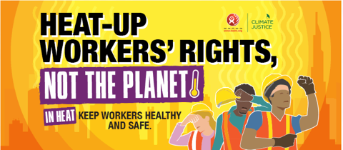
Examples of awareness raising campaigns developed by social partners
Confederation of British Industry (CBI)
    The CBI is an employers’ organization which represents 170,000 businesses of all sizes and sectors, across every region in the United Kingdom.
    It is involved in awareness raising on the dangers of poor air quality in the workplace.
    The organization found that improved workplace air quality could give significant productivity benefits, in terms of reduced absenteeism due to ill-health, as well as less presenteeism, where employees are present at work despite being unwell.
Building and Wood Workers’ International (BWI)
    In 2023, the Building and Wood Workers’ International (BWI) launched a new campaign dubbed as “Heat-up Workers’ Rights, Not the Planet”.
    It sought to recognise the importance of health and safety under extreme heat and extreme weather events, and to demand better jobs and conditions for workers in the time of a climate emergency.
    The campaign included organizing workplace actions in support of workers’ rights to health and safety, putting posters in workplaces. Sharing messages on social media to raise awareness and writing to relevant government ministries.

Slide 31
Public health initiatives targeting workers
    Climate change is an issue in which the health concerns of workers and the public at large clearly interconnect, thus it can be beneficial to integrate OSH initiatives within public health programmes and campaigns.
    Skin cancer prevention programmes have been set up in some countries to detect changes to skin in high-risk workers particularly exposed to solar UV radiations.
    Sometimes, public health initiatives aimed at controlling vector-borne diseases have been targeted worker populations that are most at risk.

Slide 32
Examples of broader initiatives
Singapore: Dengue control programme
    The programme collaborates closely with government ministries, as well as town councils, communities, the private sector, and academic and research institutions.
    Beyond nationwide general messaging, community engagement strategies also target specific population groups.
    For example, domestic helpers and construction workers are targeted with behaviour change messaging through outreach and roadshows at dormitories, shopping malls and other meeting places.
Australia: Skin cancer prevention programme
    Different initiatives exist to reduce skin cancer incidence, morbidity and mortality through targeted prevention and early detection programmes.
    Cancer Council Australia recommends that all workplaces which require employees to work outdoors have a comprehensive sun protection programme that includes periodic assessment of the UV radiation exposure risk for workers, the introduction of sun protective measures, and education and training for all outdoor personnel.
    The SunSmart initiative in the state of Victoria offers advice and UV safety training to workers from different industries, including construction, agriculture, fisheries and transportation.

Slide 33
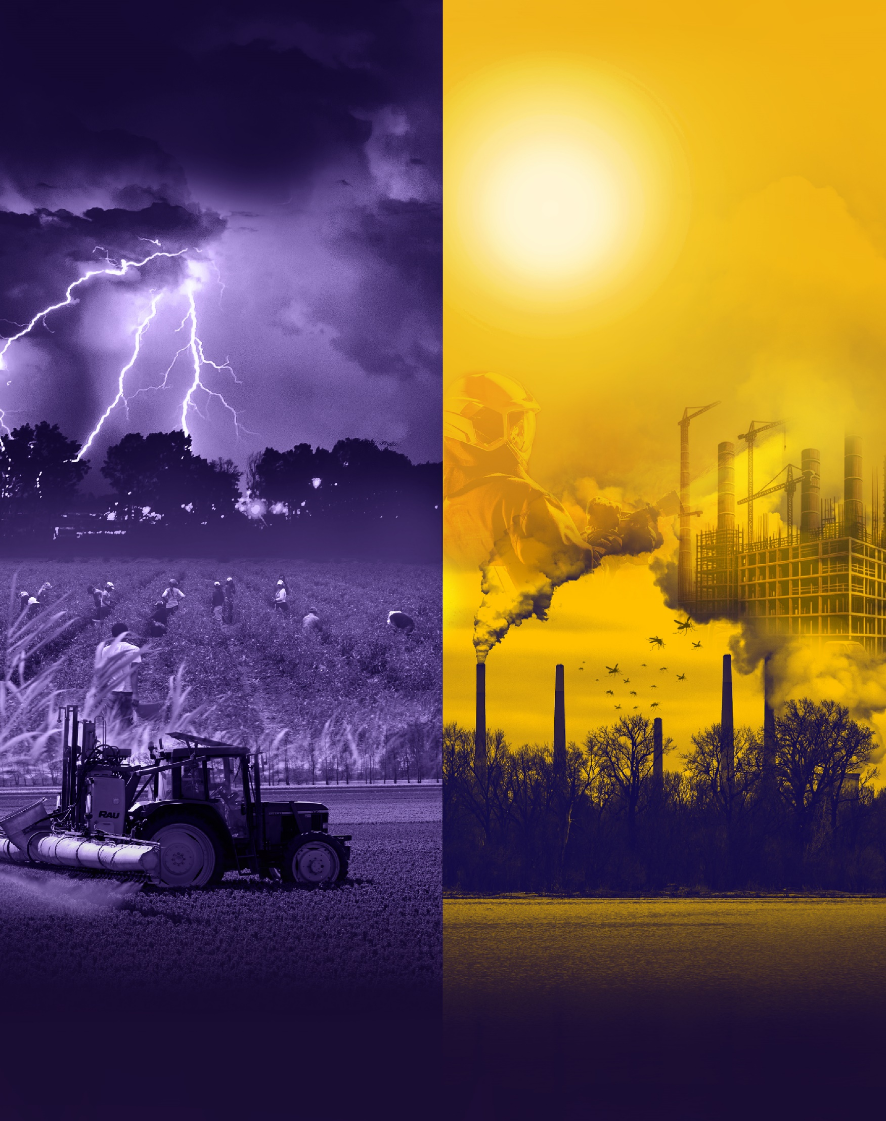
Key takeaways

Slide 34
    Climate change poses significant challenges to worker safety and health globally.
    Numerous health conditions are linked to climate change, including cancer, cardiovascular disease, respiratory illnesses, and mental health disorders.
    Legislation may need re-evaluation or new regulations as climate hazards evolve.
    Mainstreaming OSH into climate policies and integrating climate concerns into OSH practices is crucial.
    Enhanced research is needed due to limited evidence in critical areas.
    Collaboration between governments and social partners is vital for climate mitigation and adaptation policies.
    Vulnerable worker populations, such as agricultural and outdoor laborers in hot climates, may require additional protective measures.

Slide 35
Other considerations…
    COP28 introduced a Health Day, highlighting the significance of prioritizing human health in the fight against climate change.
    The political attention on the climate-health nexus may improve advocacy for workers’ safety and health.
    Any new legislation or policies should leverage synergies with existing legislation, such as the United Nations Framework Convention on Climate Change (UNFCCC) and the Global Framework for Chemicals (GFC).
    Coordination among government departments is essential for coherent OSH policies.
    Enterprises are reducing workplace emissions and adopting sustainable practices for climate change mitigation, by finding ways to reduce workplace emissions and implementing sustainable work practices.
    Green industries and technologies offer long-term mitigation solutions but may introduce new OSH hazards.
    Training programs are crucial to educate employers and workers on climate change risks and protection measures based on climate change assessment and the Hierarchy of Controls.

Slide 36
References
          ADPHC. 2023. ‘Safety in Heat’. 2023. https://www.adphc.gov.ae/Public Health Programs/Injury Prevention/Safety in Heat.
          ALROYA. 2020. ‘ورشة عمل تدريبية حول الإستخدام الآمن للمبيدات في الظاهرة’. جريدة الرؤية العمانية. 9 March 2020.
          Boedeker, Wolfgang, Meriel Watts, Peter Clausing, and Emily Marquez. 2020. ‘The Global Distribution of Acute Unintentional Pesticide Poisoning: Estimations Based on a Systematic Review’. BMC Public Health 20 (1): 1875. https://doi.org/10.1186/s12889-020-09939-0.
          Carvalho, Fernando P. 2017. ‘Pesticides, Environment, and Food Safety’. Food and Energy Security 6 (2): 48–60. https://doi.org/10.1002/fes3.108.
          Delcour, Ilse, Pieter Spanoghe, and Mieke Uyttendaele. 2015. ‘Literature Review: Impact of Climate Change on Pesticide Use’. Food Research International, Impacts of climate change on food safety, 68 (February): 7–15.
          Kiefer, Max, Julietta Rodríguez-Guzmán, Joanna Watson, Berna van Wendel de Joode, Donna Mergler, and Agnes Soares da Silva. 2016. ‘Worker Health and Safety and Climate Change in the Americas: Issues and Research Needs’. Revista Panamericana de Salud Publica = Pan American Journal of Public Health 40 (3): 192–97.
          ILO. 2019. ‘Working on a Warmer Planet: The Effect of Heat Stress on Productivity and Decent Work.’
          ———. 2021a. ‘Exposure to Hazardous Chemicals at Work and Resulting Health Impacts: A Global Review’.
          ———. 2021b. ‘New Legislation in Qatar Provides Greater Protection to Workers from Heat Stress’. News. 27 May 2021. https://www.ilo.org/beirut/countries/qatar/qatar-office/WCMS_794475/lang--en/index.htm.
          ———. 2023. ‘Chemicals and Climate Change in the World of Work: Impacts for Occupational Safety and Health - Research Report’.
          ———. 2024. ‘Exposure to Heat Stress in the Working Environment and Resulting Health Impacts: A Global Research and Policy Review’.
          IPCC. 2021. ‘Summary for Policymakers. In: Climate Change 2021: The Physical Science Basis. Contribution of Working Group I to the Sixth Assessment Report of the Intergovernmental Panel on Climate Change.’ Cambridge University Press.
          OECD. 2016. ‘The Economic Consequences of Outdoor Air Pollution’.
          Pega, Frank, Natalie C. Momen, Kai N. Streicher, Maria Leon-Roux, Subas Neupane, Mary K. Schubauer-Berigan, Joachim Schüz, et al. 2023. ‘Global, Regional and National Burdens of Non-Melanoma Skin Cancer Attributable to Occupational Exposure to Solar Ultraviolet Radiation for 183 Countries, 2000–2019: A Systematic Analysis from the WHO/ILO Joint Estimates of the Work-Related Burden of Disease and Injury’. Environment International 181 (November): 108226.
          Statistica. 2023. ‘Global Pesticide Consumption 1990-2021’. Statista. 2023. https://www.statista.com/statistics/1263077/global-pesticide-agricultural-use/.
          Takala, Jukka, Alexis Descatha, A. Oppliger, H. Hamzaoui, Catherine Bråkenhielm, and Subas Neupane. 2023. ‘Global Estimates on Biological Risks at Work’. Safety and Health at Work 14 (4): 390–97. https://doi.org/10.1016/j.shaw.2023.10.005.
          WHO. 2018. ‘First Global Conference on Air Pollution and Health’. 2018. https://www.who.int/news-room/events/detail/2018/10/30/default-calendar/air-pollution-conference.
          ———. 2019. ‘Exposure to Highly Hazardous Pesticides: A Major Public Health Concern’. 2019. https://www.who.int/publications-detail-redirect/WHO-CED-PHE-EPE-19.4.6.
          ———. 2020. ‘Vector-Borne Diseases’. 2020. https://www.who.int/news-room/fact-sheets/detail/vector-borne-diseases.
          WMO. 2021. ‘WMO ATLAS OF MORTALITY AND ECONOMIC LOSSES FROM WEATHER, CLIMATE AND WATER EXTREMES (1970–2019)’.

