Slide 1
Training module
OSH in Global Supply Chain Starterkit
This module is a basis to be adapted to your country and project context

Slide 2

Overview
Background
Learning objectives and steps
Step 1: Value chain selection
Step 2: Value chain mapping
Step 3: Value chain analysis: drivers and constraints for OSH improvement
Step 4: Intervention design

Slide 3
Background

Slide 4
Occupational safety and health
A global challenge
Elements of definition
The anticipation, recognition, evaluation and control of risks
arising in or from the workplace
that could impair the health and well-being of workers,
taking into account the possible impact on the surrounding communities and the general environment
Global estimates
2.3 million deaths annually from work.related injuuries and diseases
Almost 2 million out of those 2.3 million death are from work-related diseases
And this is only a small part of the overall costs in human suffering, lost work days and productivity – with over 300 million non-fatal work-related injuries and illnesses.
ILO instruments address OSH through over 40 Conventions, Protocols and Recommendations, including:
Occupational Safety and Health Convention, 1981 (No. 155) and its Protocol of 2002
Occupational Health Services Convention, 1985 (No. 161)
Promotional Framework for Occupational Safety and Health Convention, 2006 (No. 187)

Slide 5

Occupational Safety and Health
At the core of the sustainable development agenda
Target 8.8
«Protect labour rights and promote safe and secure working environments for all workers, including migrant workers, particularly women migrants, and those in precarious employment».
Target 3.9
«By 2030 substancially reduce the number of deaths and illnesses from hazardous chemicals and air, water, and soil pollution and contamination».
Target 3.4
«By 2030 reduce by one-third pre-mature mortality from non-communicable deseases through prevention and treatment, and promote mental health and well-being».

Slide 6
Why is it interesting to look at OSH in Global supply chains?
Safety and health: the entry point to harness the power of global supply chains towards improved working conditions in sourcing countries
The very basis of decent working conditions.
A collaborative topic bringing stakeholders together.
A topic for which there is a business case.
Strong synergies with environmental improvements.
Safety and health: a factor affecting competitiveness
Costs and impact on productivity and development.
A new requirement within trade agreements
A topic that relates to a number of SDGs – especially 3, 8 and 12.
A core part of the ILO mandate
OSH menzioned as a priority within the work to be done on Global Supply Chains during the ILC 2016 discussion.
OSH part of the ILO work plan on GSCs.

Slide 7
What does the existing research say?
Existing evidence
Only a small part of the literature on Global Supply Chains addresses specific decent work issues such as OSH.
A top-down approach is prevalent and does not allow to gather substantial information on suppliers, especially below tier 1.
Strong focus is placed on manufacturing (especially garment / electronics) and sub-contracting of labour (especially construction and services provided on-site).
Research on the impact of global suppy chains and sub-contracting arrangements indicate a double and somewhat contradictory impact on OSH outcomes down the chain:
Outsourcing and sub-contracting tend to create uncertainties on the requirements, responsibilities and arrangements for safety and health at the workplace.
At the same time, global supply chains usually have more internal resources (both financial and in terms of capacities) and create requirements for OSH that may be higher than local legislation in sourcing countries.
Research gaps
Outside of manufacturing.
Below tier one.

Slide 8

What does the existing research say?
Summary of findings – Joint ILO-EU project on OSH in GSCs
Invisible workers bear alone the consequences of low-visibility risks. Casual workers at the bottom supply chains benefit from little protection and are exposed to occupational risks related to chemical handling or ergonomic risk factors often aggravated by climatic factors (tropical countries with high levels of heat and humidity). Those can have chronic health consequences that are less visible than catastrophic accidents where resources tend to be concentrated.
Women and youth’s specific needs are often overlooked. Women and youth are predominantly employed on a temporary basis with little visibility in GSCs. They are subsequently less organized and their specific needs in terms of safety and health are often not properly addressed, in particular for pregnant or lactating women.
High seasonality and low product differentiation are barriers to organization (employers, producers, workers) and subsequent OSH awareness. Seasonality encourages non-standard employment patterns that increase workers’ vulnerability to occupational risks and their consequences.

Slide 9
What does the existing research say?
Summary of findings – Joint ILO-EU project on OSH in GSCs
Impacts are highly dependent on context and include both drivers and constraints for OSH improvement.
Impacts are often indirect and multi-layered.
Examples
  In supply chains where relationships between buyers and suppliers are highly transactional and product differentiation and visibility is low, there is typically more time pressure and less stability of orders for suppliers down the chain. This can result in higher probability of work accidents and diseases.
  Integration in the global economy can result in functional upgrading. This is often accompanied by the apparition of new risks in evolving workplaces.
  In supply chains where high importance is put on product quality and global buyers’ image, new demands for risk management systems throughout the supply chain appear.
  In supply chains where relationships between buyers and suppliers are collaborative, there are transfers of knowledge and technology to better manage occupational risks and improve productivity. This is often the case when global buyers are highly dependent on their suppliers for the provision of relatively scarce products.
  When good practices on safety and health exist in a global supply chain, these are not necessarily widely adopted at sourcing country level. Good practices spread to non-GSC workplaces only where relevant institutions actively take this mandate forward.
  In many GSCs, increasing demands for environmental management and the adoption of greener practices contribute to the elimination or reduction of risks to workers and their communities

Slide 10
Lessons learned
Summary of findings – Joint ILO-EU project on OSH in GSCs
OSH practices and outcomes are strongly dependent on the supply chain internal processes, commercial practices and business and institutional environment.
It is necessary to understand how the supply chain works, identify safety and health hazards and risks, assess vulnerabilities and identify their root causes and who can influence them positively.
No single intervention or player can improve compliance and OSH outcome on their own.
For OSH policies to meet their aim of improving OSH outcomes, an understanding of the supply chain is paramount.
A mix of market and policy interventions is necessary.
Some indirect interventions may be necessary.
Need for tailored intervention models, no “one-size-fits-all”

Slide 11
Approaching OSH in global supply chains
Summary of findings – Joint ILO-EU project on OSH in GSCs
The joint ILO-EU project developed a methodology for developing interventions on OSH in a global value chain, based on the ILO Market Systems for Decent Work approach. It is a tool to scope interventions that would effectively improve OSH within GVCs and beyond. Indeed, the methodology allows to identify:
  Main OSH risks and hazards as well as vulnerable groups at different tiers of value chains;
  Commercial practices and institutional gaps in which vulnerabilities are rooted;
  Actors, incentives and capacities to contribute to OSH improvement;
  A mix of public and private interventions that can improve OSH outcomes in a systemic manner.

Slide 12

Useful Resources
Findings of the Joint ILO-EU project on OSH in GSCs
Summary of findings. Available at: http://www.ilo.org/safework/projects/WCMS_522931/lang--en/index.htm
Perspective from relevant research areas. Available at: http://www.ilo.org/safework/projects/WCMS_593280/lang--en/index.htm
Key research findings. Available at: http://www.ilo.org/safework/projects/WCMS_554169/lang--en/index.htm
Case studies of drivers and constraints for OSH improvement in three global value chains from Colombia, Indonesia and Madagascar. Available at: http://www.ilo.org/wcmsp5/groups/public/---ed_dialogue/---lab_admin/documents/publication/wcms_593288.pdf
Executive Summary of the case studies. Available at: http://www.ilo.org/safework/projects/WCMS_588089/lang--en/index.htm
Case studies in English. Available at: http://www.ilo.org/safework/projects/WCMS_593288/lang--en/index.htm

Slide 13
Learning objectives and steps

Slide 14

Learning objectives
Expected outcome
The main outcome is the design of tailored, evidence-based interventions that can effectively prevent occupational accidents and diseases in a given global supply chain.
Expected outputs
The outputs that can be expected from the application of the starter kit are:
A holistic understanding of a given value chain, its institutional environment, its decent work deficits, its drivers and constraints and how those affect the nature, severity, probability of occupational risks and their impact on various groups of workers in the value chain
An identification of strategic entry points for improvement, which may be different from traditional interventions on OSH as they may be multi-layered and indirect, or related to other inter-linked working conditions
A basis for project development, planning and implementation steaming from the designed intervention models.
Target audience
The present toolkit is designed to guide development professionals in charge of projects aiming at preventing accidents and diseases in global supply chains to:
Select a value chain with potential for OSH improvement and replication
Analyse the value chain to understand how it works and what are the influences at play that impact OSH outcomes
Tailor intervention models that can effectively foster prevention of accidents and diseases and position their organisation within this intervention model.
In the present guide, a focus is put on positioning the ILO within intervention models, as the primary target audience of this guide is composed of persons implementing ILO projects.

Slide 15
Steps
The Steps described here follow the Guide and Toolkit of the Starterkit.
Definitions used for the purpose of this training are available in the Glossary of the Guide.
Step 1
Value Chain Selection
Step 2
Value Chain Mapping
Step 3
Value Chain Analysis: assessment of drivers and constraints for OSH improvement
Step 4 Intervention Design

Slide 16
Step 1
Value chain selection

Slide 17
Objectives
This step is the starting point of the project. The value chains assessment and selection will serve to further research drivers and bottlenecks for OSH improvement in the selected value chain. The thorough desk review and assessment of three (3) to five (5) global value chains operating in the country will allow an in-depth analysis of the most relevant value chain to select for the entirety of the project.
The expected outputs for this step are:
  A report on the selection process
  A completed selection matrix supporting your choice
  Selected global supply chain(s) based on a scoring template in order to focus the mapping, analysis and intervention model.

Slide 18

Value Chain Selection Process
Desk work
1. Choose three to five value chains to include in the selection process. Choose them in function of their importance regarding lead exports of the country and in consultation with respective ILO Country Offices.
2. Assess and analyse the selected value chains based on a desk review. The information compiled will serve to score each criterion in order to select the most appropriate value chain for the project.
  i. Topics: The desk review of each value chain is organised around defined topics which contain a number of criteria.
  ii. Criterion: Each topic contains various criterion to consider during the desk review in order to obtain an overview of the value chain and its environment.
  iii. Indicators: Each criterion has a set of indicators to consider in order to efficiently guide the desk review.
  iv. Sources: In order to collect relevant information for each topic, criterion and indicator, relevant sources are provided for the desk review.
3. Based on the data and information collected, use the scoring and selection matrices, to select the most appropriate value chain.

Slide 19
Value chain selection process
Desk work
Selection criteria by topic
Source
Scoring
Market position
International integration
Demand
Competitiveness
Environmental and social dimensions
Inclusiveness
Environmental footprint
Vulnerability to climate change
Desk work
Global databases
National statistical institutions / relevant minitries’ public information
Scientific literature
Other agencies assessments and reports
Internal consultations
Interviews of specialists
 | Supply chain no. 1 | Supply chain no. 2 | Supply chain no. 3
Market position
Employment and working conditions
Environmental and social dimensions
Sector organization and regulation
Potential for transferability
Total (weighted I+II+III+IV+V)
Employment and working conditions
Employment
Working conditions
Occupational Safety and Health
Sector organization and regulation
Composition
Organization and collaboration
Investment and institutional capacity
Regulation and enforcement

Slide 20
Value Chain Selection Process
Desk work
Collect information, analyze and score each value chain for each topic. Topics, criterion and their indicators can be adapted depending on country context and project objectives.
Topics:
Market Position
Employment and Working Conditions
Identification of the Risk Factors
Environmental and Social Dimensions
Sector Organization and Regulations
Potential for Transferability.
Example: Market position
Criteria | Description of information found | Score
Importance of the sector for the local economy
Prospects for growth in demand
Competitiveness and profitability

Slide 21
Value Chain Selection Process
Desk work
Example: Collected information for the Banana Market Position
Criteria | Description of information found | Score
Importance of the sector for the local economy | Colombia is the world fourth exporter of bananas. The value of those exports is affected by fluctuant exchange rates with the dollar, as banana exports are paid in dollars, not Colombian pesos. Banana exports represented 0.4% of GDP in 2014 (i.e. 961 million USD in 2014). It is the third agricultural export of the country. Exports represent about 5% of the local production of banana. | 4

Slide 22



Value Chain Selection Scoring
Desk work
Scoring the value chain on the sub criteria is done by using scores between 1 and 5.
The scores are given based on the current state of the subsector itself and, for some criteria that cover trends or growth potential, on prospects.
The score is as much as possible based on data and figures that are available from your own observations and experiences, secondary data, previous analyses and trade and market statistics.
Example: Market Position

Slide 23
Value Chain Selection Scoring
Desk work
The criteria are selected to reflect value chain performance both in economic, institutional, social and environmental sense.

Slide 24

Group Exercice
STEP 1 - TRAINING MATERIAL NO. 3 - Selection Exercise
A desk review was conducted on two value chains from Indonesia integrated in global supply chains. Below you will find the synthesis of the information encountered during the desk review. On this basis:
  Read carefully the information for each topic and criterion;
  Score each criterion and compile the result for each topic;
  Report all the topics’ score in the selection matrix;
  Select the most appropriate value chain;
  Write a conclusion justifying your decision.

Slide 25
Useful Resources
Publication
This selection tool was adapted from the ILO-GIZ Guidelines for Value Chain Selection, where additional sources and insights can be found.
Deutsche Gesellschaft für Internationale Zusammenarbeit (GIZ) GmbH & ILO. 2015. Guidelines for Value Chain Selection: Integrating economic, environmental, social and institutional criteria. Available at: http://www.ilo.org/wcmsp5/groups/public/---ed_emp/---emp_ent/documents/instructionalmaterial/wcms_416392.pdf
Tools from the toolbox
STEP 1 - CASE STUDY NO. 2 - The roll-out of STEP ONE in the coffee value chain of Colombia
STEP 1 - RESEARCH TOOL NO. 1 - Sources for Value Chain Selection
STEP 1 - RESEARCH TOOL NO. 2 - Scoring Sheet Value Chain Selection
STEP 1 - TEMPLATE NO. 2 - Supply Chain Selection Report
STEP 1 - TEMPLATE NO. 3 - Project Factsheet
STEP 1 - TOR NO. 1 - Terms of Reference for the Value Chain Selection
STEP 1 - TRAINING MATERIAL NO. 3 - Selection Exercise
STEP 1 - TRAINING MATERIAL NO. 4 - Presentation of Step 1

Slide 26
Step 2
Value chain mapping

Slide 27
Objectives
The main objective of this Step is to gather information and conduct a mapping of the selected value chain and its supporting functions, which will be used for the selection of key informants and workplaces for primary data collection in the next step (Step 3).
It is essential to map the selected global value chain from the first production stages to the end consumer in order to fully understand the role of each actors and to be able to select the right set of informants to interview and workplaces to observe in the next step.
On the basis of a desk review, create a rapid overview of the market system in which the value chain evolves:
  Provide a detailed typology of actors, production processes and describe the structure and flow of the chain in logical clusters
  Identify the supporting functions and provides a general overview of the market and institutional system in which the value chain is operating
  Identify the information gaps to address in the next step

Slide 28
Mapping process
Desk work
To perform an effective value chain mapping, an efficient desk study and possible complementary interviews with key players are necessary. Map the gathered information about the value chain and its market and institutional environment, as per the visual representation below and identify the information gaps.
The value chain mapping provides a detailed typology of actors, a vision of the scale of the value chain as well as an identification of the supporting functions. The mapping process should answer the following questions:
  What are the production stages and respective production processes?
  What are the different types of actors involved in the value chain?
  What are the supporting functions?

Slide 29
Mapping visual representation
Desk work
Inputs and machines providers
Service providers
Labour providers
Market and institutionnal environment
Value chain actors
Producer / Plantations
Transformation / exporter
Importer / traders
Global buyers / retailers
Market and institutionnal environment
Social partners
Line Ministries
Certification schemes
multi-stakeholder platforms

Slide 30
Example
Market and institutionnal environment
Service providers
Certification schemes
Inputs and machine providers
Desk work
Lychee value chain
Producers
Smallholders / Plantations
Collector / Transporter
Transformation / exporter
Importer / traders
Global buyers / retailers
Product
Fresh lychee
Fresh lychee
Treated packed fresh lychee
Canned lychee
Frozen lychee pulp
Treated packed fresh lychee
Lychee juice
Fresh lychee
Canned lychee
Lychee juice
Size and employment
Est. 45,000 workers
Est. 4,000 workers
29 companies
Est. 25,000 workers
Less than 10 actors
-
Average selling price per kilo 2016
Up to 0.22 €
On average 0.22 €
1.15 €
2.10 €
-
Operations
Planting
Pruning
Harvesting / Picking
Packing
Loading
Loading
Transporting
Unloading
Weighting and grading
Treating (sulphur) / peeling
Sorting, packing /canning
Freezing
Loading / unloading
Transporting
Transporting
Transforming and packing (juice only)
Marketing / trading
Transporting
Loading / unloading
Storing
Selling
Social partners
Ministry of Labour
Ministry of Agriculture
Ministry of Health
Ministry of Trade
Development partners
Market and institutionnal environment

Slide 31
Mapping Process
Value chain actors
Desk work
Identification of the production stages and processes
Input provision
Production
Collection, transport intermediaries
Transformation
Export and import
Commercialisation and distribution.
Quantification of the value chain
Size and scale of main actors (small, medium, big companies)
Production volume
Number of jobs
Sales and export destination and concentration
Geographical distribution.
Preliminary review of common occupational risks and hazards at each production stage
This information can be found via different sources:
Existing workplace risk assessments or risk mappings
Existing awareness raising material from Occupational Health Services or prevention institutions
Existing videos or workers’ testimony on occupational risks
Existing data on the causes of accidents and diseases.

Slide 32
Mapping Process
Supporting Functions
Desk work
Supporting industries
Responsible authorities for the implementation of the regulatory environment
Responsible authorities for prevention, promotion and protection and compensation
Providers of services related to employment and skills (public or private).
Social partners and collective bargaining institutions
Private compliance initiatives and certifications.

Slide 33
Mapping process – useful matrix
Transformation process
Products
Size and types of actors
Type of actors
Operations
Main risk factors
Supporting industries
Supporting functions
Desk work

Slide 34
Example
Transformation process | Agriculture | Drying and ginning | Spinning and other transformations | Manufacture of fabric | Confection
Products | 4,892 Tons of Cotton Seeds | Cotton fibres | Cotton yarn Hydrophilic Cotton, Carded Cotton, Candle Wick | Cotton fabrics Hydrophilic gauze | Cotton, linen and synthetic products: Sweaters, suits, T-shirts, shirts, trousers, etc.
Size and types of actors | 7,495 Producers affiliated to 4 Approved operators: MSG, INDOSUMA, TIANLI and KFBMH | 4 Approved operators: MSG, INDOSUMA, TIANLI and KFBMH 93% for export | SOMACOU with 400 employees (280 on permanent contracts and 120 on fixed term contracts) | SOMACOU with 400 employees (280 on permanent contracts and 120 on fixed term contracts) | Free textile enterprises. 102 companies with more than 100,000 employees. Subcontractors (no information available on their number / size).
Type of actors | Farmers, Agricultural workers, Traders. | Employers / managers, Workers, Traders. | Employers / managers, Workers, Traders. | Employers / managers, Workers, Traders. | Employers / managers, Workers, Traders.
Operations | Soils preparation, Culture, Interview, Harvest, Transport. | Drying Separation of cotton fibres from seeds, (ginning) Additional cleaning | Threshing, Carding, Drawing, Torsion, Envidage, Dyeing and Coiling | Weaving, treatment and dyeing | Folding, small hands, finishing, pointer, machinist, pressing, knitting, stitching, looping, embroidery, storekeeper, machinist mechanic, chain manager, sampling
Main risk factors | Heavy loads, Exposure to heat, Exposure to chemicals (fertilizers, pesticides) Biological and ergonomic risks to evaluate. | Handling of industrial machinery, Exposure to dust | Manipulation of industrial machinery, exposure to dust and chemicals (dyes), fire caused by metal debris in cottons and electrical infrastructure | Handling of industrial machinery, exposure to chemicals (shades) Old electrical infrastructures | Handling of industrial machinery, heavy loads, exposure to chemicals (shades) Old electrical infrastructures
Supporting industries | Input suppliers, machinery suppliers | Machinery Suppliers, Transportation Companies | Machinery Suppliers, Transportation Companies | Machinery Suppliers, Transportation Companies | Machinery suppliers, transport companies, import / export companies
Supporting functions | Interministerial Committee of Cotton Inter-professional Cotton Council of Atsimo Andrefana (CIC) The Minister of Agriculture Ministry of Industry and Private Sector Development World Bank through the PIC Project Auditors / Certifications cooperatives Farmers associations Associations of agricultural workers | Interministerial Committee of Cotton Inter-professional Cotton Council of Atsimo Andrefana (CIC) The Minister of Agriculture Ministry of Industry and Private Sector Development World Bank through the PIC Project Ministry of Labour Work inspection SMIE CNAPS Workers' unions | Ministry of Industry and Private Sector Development Business Grouping (SIM) Trade unions / workers union federations Ministry of Labour Work inspection SMIE CNAPS Auditors / Certifications | Ministry of Industry and Private Sector Development Business Grouping (SIM) Trade unions / workers union federations Ministry of Labour Work inspection SMIE CNAPS Auditors / Certifications | Ministry of Industry and Private Sector Development Ministry of Commerce and Consumer Affairs Grouping of companies (GEFP, SIM, GEM, etc.) Economic Development Board of Madagascar Ministry of Labour Work inspection SMIE CNAPS Auditors / Certifications

Slide 35
Group Exercice
STEP 2 - TRAINING MATERIAL NO. 5 - Value Chain Mapping Exercise
Read carefully the information provided;
Perform an effective value chain mapping considering the information included in the case study below.
Map the actors, the supporting functions and the enabling environment. Provide and adapt the methodology used to map the selected value chain. Please adapt the map to the case study context and include all relevant information.
Fill the mapping table template below accordingly.

Slide 36
Useful Resources
Publication
This mapping tool was adapted from the ILO Market Systems for Decent Work approach and more specifically the Guide “Value Chain Development for Decent Work”, where additional sources and insights can be found.
ILO. 2015. Value chain development for decent work: how to create employment and improve working conditions in targeted sectors. International Labour Office. - 2nd ed. - Geneva: ILO, 2015. Available at: http://www.ilo.org/wcmsp5/groups/public/---ed_emp/---emp_ent/---ifp_seed/documents/instructionalmaterial/wcms_434363.pdf
Tools from the toolbox
STEP 2 - CASE STUDY NO. 3 - The roll-out of STEP 2 in the coffee value chain of Colombia
STEP 2 - TEMPLATE NO. 4 - Report for the Value Chain Mapping
STEP 2 - TOR NO. 2 - Terms of Reference for the Value Chain Mapping
STEP 2 - TRAINING MATERIAL NO. 5 - Value Chain Mapping Exercise
STEP 2 - TRAINING MATERIAL NO. 6 - Presentation of Step 2

Slide 37
Step 3
Value chain analysis: assessment of drivers and constraints for OSH improvement

Slide 38
Objectives
This step completes step 2 with an analytical answer to the question: What are the drivers and constraints for OSH improvement in the value chain?
The analysis identifies:
  The main occupational hazards and risks at each stage of the value chain in the country of production and the way in which they are managed;
  The groups of workers that may be particularly vulnerable;
  The determinants and root causes of identified OSH practices and outcomes as well as vulnerable groups, may they lie in market practices or policy and institutional gaps;
  The stakeholders of the value chain and its institutional and market environment as well as the inter-actions and power play between them.

Slide 39

Process
Overview
Field work
The following sources of information need to be gathered for each stage of the value chain and each type of actors/function:
  Perception and practice from management;
  Perception and practice from workers;
  Workplace practices;
  Perception, practice and data from institutional supporting functions (in particular OH services, labour inspection and social security institutions as relevant) and social partners as well as other stakeholders as relevant (i.e. certification schemes, training institutions, rural extension services, etc.).
In order to gather this information, a list or sample of key informants representative of the different categories of actors need to be developed and four types of research tools need to be developed and implemented:
  Interview guide for semi-structured interviews with management;
  Focus group guide for semi-structured focus groups with workers;
  Observation guide for observation by the researcher(s) of OSH workplace practices;
  Interview guide for semi-structured interviews with institutional supporting functions and social partners.
In addition to interviews and observations, the precise identification of some hazards and risks may require desk review work prior or post-interview / observation. For example, if you find out during observations and interviews that chemicals are being used, in which case it will be necessary to collect their names / brands and do some research to find out more on their acceptable levels of exposure, effects on health, appropriate controls, etc.

Slide 40
Process
Selecting key informants and workplaces
Field work
Once the basic structure of the value chain is mapped and you have an understanding of how the different stages of the value chain connect to one another within Step 2, it is time to select the key informants and actors to be interviewed and observed.
To establish a sample of actors to be interviewed and workplaces to be observed, the sample must be:
Representative of each type of market actor and possible geographical differences: a minimum number of interviewees must be included for each type of actor to ensure triangulation of information;
Include each identified support function.
You need to ensure that the sample encompasses front line supervisory/management staff, as well as a selection of workers undertaking tasks that were typical of the range of OSH exposures potentially occurring. Outside the worksite, a selection needs to be made of key informants among the institutional actors in the local and regional environment such as those identified previously. You need to bear in mind that it is not numerical power. Instead it is an assurance that sufficient key informants have been included to adequately explore the nature and effects of the processes that are under investigation.
In order to build the list of key informants and workplaces to observe, you have to take the mapping completed in Step 2 and ensure that each category or sub-category of actor is represented and that the number of interviews and observations is sufficient to allow for triangulation.
Typically, “categories” for segmentation / stratification correspond first to production stages, then they can be type of ownership (local, FDI, etc.), size of the company (small, medium, large), type of market (high-end / low-end), certified or non-certified workplace (ISO, SA 8000, etc.) or product (Fairtrade, Organic, etc.), etc.

Slide 41
Process
Adapting the research tools
The research methods used at this stage are of different types:
  Key Informants Interviews (KII): Key informants consisted of value chain players, workers, and representatives of trade unions, industry associations, certification bodies, government agencies, and development programs. Interview guidance and schedules are available for adaptation.
  Focus Group Discussions (FGDs): Focus group discussions can be conducted with trade unions, workers, employers, and certification bodies. FGDs are effective in generating broad overviews of issues of concerns to the groups or subgroups represented and, in the triangulation and/or vetting of information obtained from the KII.
  Workplace Observation (WO): observation of work processes in the workplace by the researcher(s), provides an “objective” assessment of the OSH risks, hazards and their controls that allows for a nuanced analysis of the information collected with workers and management.
  Desk Review: Prior to field work and continuing through the report preparation, perform secondary research on specific aspects that may come up during interviews and observations that may require some additional information (hazard-specific for instance).
  Data Analysis and Interview Synthesis and Report Preparation: This method involved the synthesis of interviews, desk researches, and focus group discussions to characterize the value chain and identify drivers of OSH and decent work.
Guides for conducting KII, FDG and WO must be prepared in advance of the field research and adapted to the country and industry context. In the Toolbox you will find examples of contextualized research tools:
  Examples of observation guides for both manufacturing and agricultural worksites;
  Examples of interview and focus group guides for management, workers, farmers and supporting functions for OSH.

Slide 42
Process
Transcription of the results
Desk work
A large amount of information is collected throughout the research process. It is useful to build the templates to organize the information in advance of the start of data collection as it allows for:
  Having a clear picture of what information will be collected and how it will be further analysed.
  Organize the field work in a way that allows time to report information in the data collection templates on a regular basis.
In the countries in which this approach was adopted, the following tools were developed and proved useful in compiling the information collected in a way that later facilitates its interpretation, analysis and report writing:
Template for recording and scoring qualitative observation: The objective of this tool is for the researcher(s) to be able to record in an easily comparable format the observations for each workplace visited along the various categories of observations laid out in the observation guide.
Template for recording interview and focus group notes: The objective of this tool is for the researcher(s) to be able to record in an easily comparable format interview responses against the various questions laid out in the interview and focus group guide.
Template for building global buyer profiles: The objective of this tool is to record in an easily comparable manner information gathered on the end global buyers of the value chain through both desk review and interviews as per the interview guide for global buyers.

Slide 43
Group Exercice
STEP 3 - TRAINING MATERIAL NO. 9 - Observation exercise
This exercise is intended to familiarize yourself with workplace observation from an OSH perspective.
  You will be presented with a number of pictures of workplaces, sometimes with explanations, sometimes without.
  For each picture / explanation, you will need to score your observation from a scale of 0 to 3 as per the table below.
  Then, you will need to provide a justification for your choice.

Slide 44
Process
Analysis
Desk work
The assessment of drivers and constraints includes:
  Assessment of the impact on OSH of the rules governing the business model of the different categories of actors in the value chain and their interplay.
  Assessment of the legal framework and the public and private entities responsible for OSH promotion, prevention, protection and compensation, including the type of scheme and the overall enforcement system.
  Assessment of the other actors that may assume a supporting role affecting OSH awareness, practices and outcomes.
The identification of vulnerable groups includes specific caracteristics of groups whose needs in terms of safety and health in the workplace should be addressed as a priority, because:
  they are particularly exposed to occupational hazards and risks, and / or
  they are not covered by / do not have access to prevention, promotion or protection services, and / or
  they are disprotected from the consequences of a work accident or diseases (absence of access to appropriate medical care, compensation and rehabilitation services).
This process helps not only setting priorities for project interventions but also tailoring them better to their target beneficiaries.

Slide 45
Example
Identified vulnerability profile
Chemical risk exposure in palm oil plantations in Indonesia is gender-specific and rooted in sub-contracting practices. Because women are overly represented in those temporary jobs, they are more exposed to risks that relate to temporary tasks (i.e. fertilizing, applying herbicides and pesticides) that are more easily outsourced. Because they are temporary and outsourced they i) do not benefit from the infrastructure and OSH management system of the main company, and ii) benefit from less legal protection and often are not affiliated to social security, reducing their access to health surveillance and compensation in case of injury or disease. Because they are temporary workers and outsourced (i.e. working for different plantations), it is more difficult for them to organize and they are seldom unionized, which also means they have less access to information on their rights to protection and have little channels to voice their needs in terms of safety and health which may be specific (i.e. when lactating or pregnant, in terms of childcare, working hours, etc.)
Entry points for intervention:
• Modify the labour code section on sub-contracting,
• Reinforce the capacity of the labour inspection to enforce this more restrictive legislation through strategic compliance planning,
• Work with private compliance initiatives to include provisions on sub-contracting in their referential,
• Promote unionization among female workers and workers’ peer sensitization,
• Work with the occupational health division of the Ministry of Health to reinforce local health centres’ capacity to identify pathologies related to chemical exposure,
• Work with the employers’ organization of plantations on a charter of conduct ensuring that all workers present in the plantation get access to the companies’ facilities (medical, sanitary, etc.) irrespective of their contractual status.

Slide 46
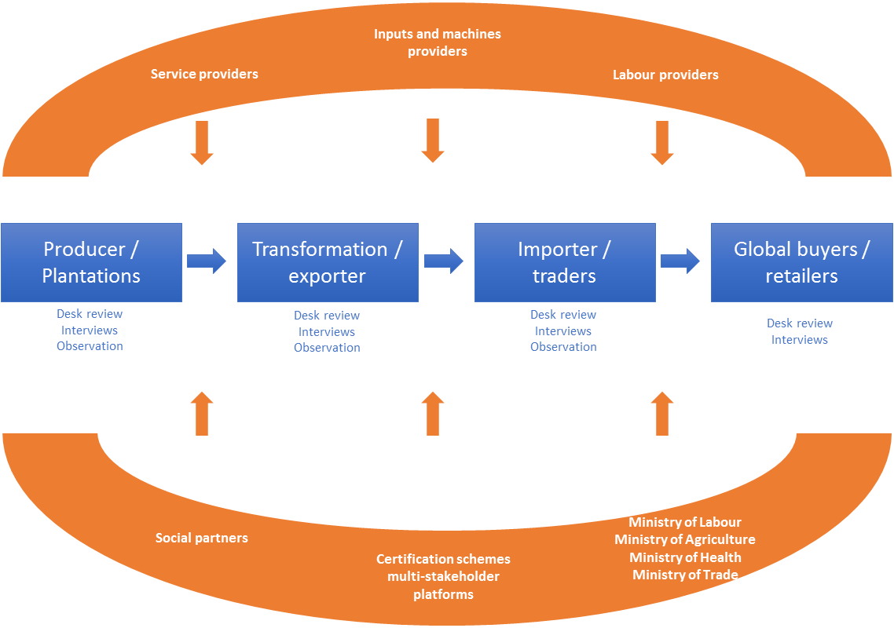
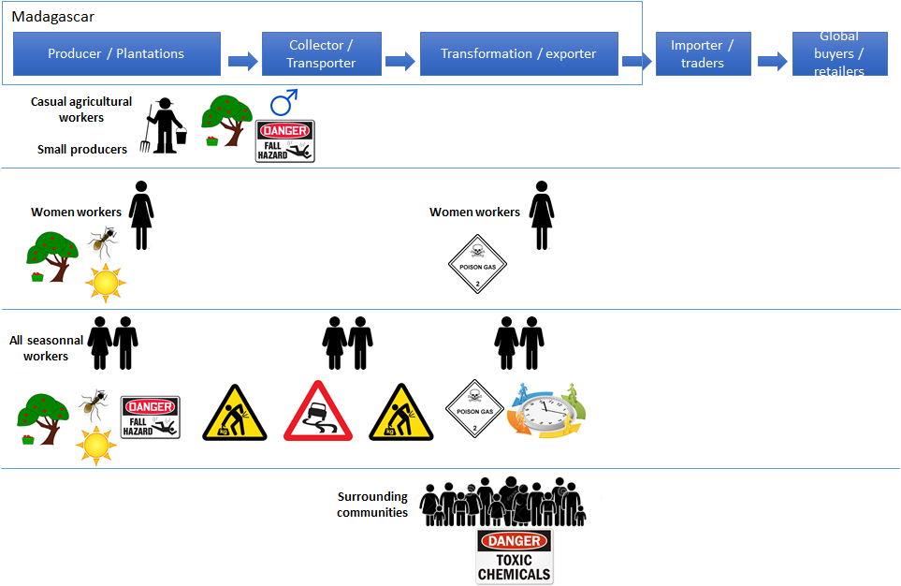
Group Exercice
STEP 3 - TRAINING MATERIAL NO. 8 - Analysis Exercise
You have 50 minutes.
Get ready to present!
  1. Map the chain and its institutional environment
    Map
  2. Identify risks, vulnerabilities and their root causes
    3D mapping
  3. Build intervention models that foster systemic change
    Table
Level of intervention | Intended OSH impact | Description of interventions | Stakeholders involved

Slide 47
Useful Resources
For a full list of publications, please consult the Resource section of the Guide.
Tools from the toolbox:
STEP 3 - RESEARCH TOOL NO. 3 - Research tools used in the Indonesian palm oil value chain
STEP 3 - RESEARCH TOOL NO. 4 - Research tools used in the Malagashy textile value chain
STEP 3 - TEMPLATE NO. 5 - Step 3 Analysis Report
STEP 3 - TEMPLATE NO. 6 - Letter of Request to Access Companies
STEP 3 - TEMPLATE NO. 7 - Template of global buyer profile
STEP 3 - TEMPLATE NO. 8 - Template for recording farm interviews and focus group discussions
STEP 3 - TEMPLATE NO. 9 - Template for recording observations in farms plantations
STEP 3 - TEMPLATE NO. 10 - Template for recording Interviews in management manufacturing
STEP 3 - TEMPLATE NO. 11 - Template for recording of observations in manufacturing
STEP 3 - TEMPLATE NO. 12 - Template for recording interviews and focus group discussions with workers in manufacture
STEP 3 - TOR NO. 3 - ToR for the Field Research and Analysis
STEP 3 - CASE STUDY NO. 4 - The roll-out of STEP 3 in the coffee value chain of Colombia
STEP 3 - TRAINING MATERIAL NO. 7 - Presentation of Step 3
STEP 3 - TRAINING MATERIAL NO. 8 - Analysis Exercise
STEP 3 - TRAINING MATERIAL NO. 9 - Observation exercise

Slide 48
Step 4 Intervention design

Slide 49
Objectives
The objective is to use the information collected and analyzed during steps 1, 2 and 3 to co-construct with stakeholders interventions that can effectively improve OSH in the value chain.
The interventions should:
  Enhance and exploit catalysts for OSH improvement;
  Be realistic in terms of stakeholders’ engagement and resources necessary to implement the proposed interventions;
  Support good practice sharing, partnership and dissemination.

Slide 50

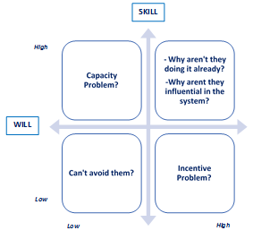
Process
Stakeholders
Consultations
The stakeholders are the ones identified in Steps 2 and 3. They necessarily include all of the participating actors to the field research conducted in Step 3.
The main objectives of the consultations are:
  To share the research findings and gather stakeholders’ feedback on those findings that will support the formulation of concrete recommendations;
  To co-construct consensual interventions with the stakeholders.
During the consultation, the willigness and capacities of stakeholders to contribute to interventions should be assessed.

Slide 51
Process
Priority setting
Desk work
Once the possible interventions to address hazards and risks identified in the value chain and specific vulnerable groups are detailed, a priority setting exercise needs to be performed.
Priority setting should be guided by the following :
  Intervention models should be guided by the Pyramid of control approach and always prioritize the elimination of hazards and risks before envisaging risk reduction strategies (collective or individual) and compensation.
  The willigness and capacities of stakeholders to implement interventions, as per the matrix showed in the previous slide.
Value chain production stage | Expected impact on OSH | Possible intervention | Stakeholders involved | Priority
Production stage and type of actor | Hazard or vulnerability pattern you want to address | What needs to be done and how | Who will implement the intervention? Will and skills? | Rank

Slide 52
Useful Resources
For a full list of publications, please consult the Resource section of the Guide.
Tools from the toolbox:
STEP 4 - CASE STUDY NO. 5 - The roll-out of STEP 4 in the coffee value chain of Colombia
STEP 4 - CASE STUDY NO. 6 - Examples from Colombia
STEP 4 - TOR NO. 4 - ToR Stakeholder Consultations
STEP 4 - TEMPLATE NO. 13 - Consultation Invitation Letter
STEP 4 - TEMPLATE NO. 14 - Conclusions of Consultations
STEP 4 - TEMPLATE NO. 15 - Project Factsheet
STEP 4 - TRAINING MATERIAL NO. 10 - Presentation of Step 4

Slide 53
Thank you for your attention

