Slide 1
Step 1
Value chain selection

Slide 2

Objectives
This step is the starting point of the project. The value chains assessment and selection will serve to further research drivers and bottlenecks for OSH improvement in the selected value chain. The thorough desk review and assessment of three (3) to five (5) global value chains operating in the country will allow an in-depth analysis of the most relevant value chain to select for the entirety of the project.
The expected outputs for this step are:
  A report on the selection process
  A completed selection matrix supporting your choice
  Selected global supply chain(s) based on a scoring template in order to focus the mapping, analysis and intervention model.

Slide 3

Value Chain Selection Process
Desk work
1. Choose three to five value chains to include in the selection process. Choose them in function of their importance regarding lead exports of the country and in consultation with respective ILO Country Offices.
2. Assess and analyse the selected value chains based on a desk review. The information compiled will serve to score each criterion in order to select the most appropriate value chain for the project.
  i. Topics: The desk review of each value chain is organised around defined topics which contain a number of criteria.
  ii. Criterion: Each topic contains various criterion to consider during the desk review in order to obtain an overview of the value chain and its environment.
  iii. Indicators: Each criterion has a set of indicators to consider in order to efficiently guide the desk review.
  iv. Sources: In order to collect relevant information for each topic, criterion and indicator, relevant sources are provided for the desk review.
3. Based on the data and information collected, use the scoring and selection matrices, to select the most appropriate value chain.

Slide 4
Value chain selection process
Desk work
Selection criteria by topic
Source
Scoring
Market position
International integration
Demand
Competitiveness
Environmental and social dimensions
Inclusiveness
Environmental footprint
Vulnerability to climate change
Desk work
Global databases
National statistical institutions / relevant minitries’ public information
Scientific literature
Other agencies assessments and reports
Internal consultations
Interviews of specialists
 | Supply chain no. 1 | Supply chain no. 2 | Supply chain no. 3
Market position
Employment and working conditions
Environmental and social dimensions
Sector organization and regulation
Potential for transferability
Total (weighted I+II+III+IV+V)
Employment and working conditions
Employment
Working conditions
Occupational Safety and Health
Sector organization and regulation
Composition
Organization and collaboration
Investment and institutional capacity
Regulation and enforcement

Slide 5
Value Chain Selection Process
Desk work
Collect information, analyze and score each value chain for each topic. Topics, criterion and their indicators can be adapted depending on country context and project objectives.
Topics:
Market Position
Employment and Working Conditions
Identification of the Risk Factors
Environmental and Social Dimensions
Sector Organization and Regulations
Potential for Transferability.
Example: Market position
Criteria | Description of information found | Score
Importance of the sector for the local economy
Prospects for growth in demand
Competitiveness and profitability

Slide 6
Value Chain Selection Process
Desk work
Example: Collected information for the Banana Market Position
Criteria | Description of information found | Score
Importance of the sector for the local economy | Colombia is the world fourth exporter of bananas. The value of those exports is affected by fluctuant exchange rates with the dollar, as banana exports are paid in dollars, not Colombian pesos. Banana exports represented 0.4% of GDP in 2014 (i.e. 961 million USD in 2014). It is the third agricultural export of the country. Exports represent about 5% of the local production of banana. | 4

Slide 7



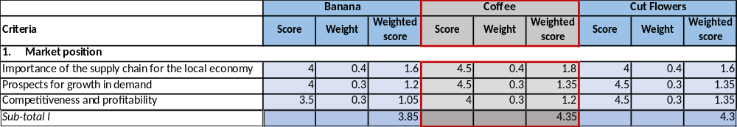
Value Chain Selection Scoring
Desk work
Scoring the value chain on the sub criteria is done by using scores between 1 and 5.
The scores are given based on the current state of the subsector itself and, for some criteria that cover trends or growth potential, on prospects.
The score is as much as possible based on data and figures that are available from your own observations and experiences, secondary data, previous analyses and trade and market statistics.
Example: Market Position

Slide 8
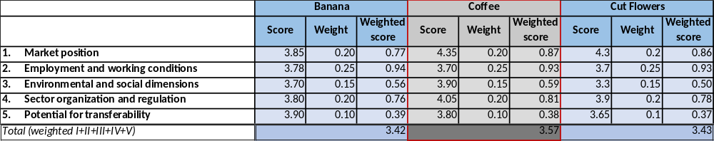
Value Chain Selection Scoring
Desk work
The criteria are selected to reflect value chain performance both in economic, institutional, social and environmental sense.

Slide 9

Group Exercice
STEP 1 - TRAINING MATERIAL NO. 3 - Selection Exercise
A desk review was conducted on two value chains from Indonesia integrated in global supply chains. Below you will find the synthesis of the information encountered during the desk review. On this basis:
  Read carefully the information for each topic and criterion;
  Score each criterion and compile the result for each topic;
  Report all the topics’ score in the selection matrix;
  Select the most appropriate value chain;
  Write a conclusion justifying your decision.

Slide 10

Useful Resources
Publication
This selection tool was adapted from the ILO-GIZ Guidelines for Value Chain Selection, where additional sources and insights can be found.
Deutsche Gesellschaft für Internationale Zusammenarbeit (GIZ) GmbH & ILO. 2015. Guidelines for Value Chain Selection: Integrating economic, environmental, social and institutional criteria. Available at: http://www.ilo.org/wcmsp5/groups/public/---ed_emp/---emp_ent/documents/instructionalmaterial/wcms_416392.pdf
Tools from the toolbox
STEP 1 - CASE STUDY NO. 2 - The roll-out of STEP ONE in the coffee value chain of Colombia
STEP 1 - RESEARCH TOOL NO. 1 - Sources for Value Chain Selection
STEP 1 - RESEARCH TOOL NO. 2 - Scoring Sheet Value Chain Selection
STEP 1 - TEMPLATE NO. 2 - Supply Chain Selection Report
STEP 1 - TEMPLATE NO. 3 - Project Factsheet
STEP 1 - TOR NO. 1 - Terms of Reference for the Value Chain Selection
STEP 1 - TRAINING MATERIAL NO. 3 - Selection Exercise
STEP 1 - TRAINING MATERIAL NO. 4 - Presentation of Step 1

