Slide 1
Step 3
Value chain analysis: assessment of drivers and constraints for OSH improvement

Slide 2

Objectives
This step completes step 2 with an analytical answer to the question: What are the drivers and constraints for OSH improvement in the value chain?
The analysis identifies:
  The main occupational hazards and risks at each stage of the value chain in the country of production and the way in which they are managed;
  The groups of workers that may be particularly vulnerable;
  The determinants and root causes of identified OSH practices and outcomes as well as vulnerable groups, may they lie in market practices or policy and institutional gaps;
  The stakeholders of the value chain and its institutional and market environment as well as the inter-actions and power play between them.

Slide 3

Process
Overview
Field work
The following sources of information need to be gathered for each stage of the value chain and each type of actors/function:
  Perception and practice from management;
  Perception and practice from workers;
  Workplace practices;
  Perception, practice and data from institutional supporting functions (in particular OH services, labour inspection and social security institutions as relevant) and social partners as well as other stakeholders as relevant (i.e. certification schemes, training institutions, rural extension services, etc.).
In order to gather this information, a list or sample of key informants representative of the different categories of actors need to be developed and four types of research tools need to be developed and implemented:
  Interview guide for semi-structured interviews with management;
  Focus group guide for semi-structured focus groups with workers;
  Observation guide for observation by the researcher(s) of OSH workplace practices;
  Interview guide for semi-structured interviews with institutional supporting functions and social partners.
In addition to interviews and observations, the precise identification of some hazards and risks may require desk review work prior or post-interview / observation. For example, if you find out during observations and interviews that chemicals are being used, in which case it will be necessary to collect their names / brands and do some research to find out more on their acceptable levels of exposure, effects on health, appropriate controls, etc.

Slide 4
Process
Selecting key informants and workplaces
Field work
Once the basic structure of the value chain is mapped and you have an understanding of how the different stages of the value chain connect to one another within Step 2, it is time to select the key informants and actors to be interviewed and observed.
To establish a sample of actors to be interviewed and workplaces to be observed, the sample must be:
Representative of each type of market actor and possible geographical differences: a minimum number of interviewees must be included for each type of actor to ensure triangulation of information;
Include each identified support function.
You need to ensure that the sample encompasses front line supervisory/management staff, as well as a selection of workers undertaking tasks that were typical of the range of OSH exposures potentially occurring. Outside the worksite, a selection needs to be made of key informants among the institutional actors in the local and regional environment such as those identified previously. You need to bear in mind that it is not numerical power. Instead it is an assurance that sufficient key informants have been included to adequately explore the nature and effects of the processes that are under investigation.
In order to build the list of key informants and workplaces to observe, you have to take the mapping completed in Step 2 and ensure that each category or sub-category of actor is represented and that the number of interviews and observations is sufficient to allow for triangulation.
Typically, “categories” for segmentation / stratification correspond first to production stages, then they can be type of ownership (local, FDI, etc.), size of the company (small, medium, large), type of market (high-end / low-end), certified or non-certified workplace (ISO, SA 8000, etc.) or product (Fairtrade, Organic, etc.), etc.

Slide 5

Process
Adapting the research tools
Desk work
The research methods used at this stage are of different types:
  Key Informants Interviews (KII): Key informants consisted of value chain players, workers, and representatives of trade unions, industry associations, certification bodies, government agencies, and development programs. Interview guidance and schedules are available for adaptation.
  Focus Group Discussions (FGDs): Focus group discussions can be conducted with trade unions, workers, employers, and certification bodies. FGDs are effective in generating broad overviews of issues of concerns to the groups or subgroups represented and, in the triangulation and/or vetting of information obtained from the KII.
  Workplace Observation (WO): observation of work processes in the workplace by the researcher(s), provides an “objective” assessment of the OSH risks, hazards and their controls that allows for a nuanced analysis of the information collected with workers and management.
  Desk Review: Prior to field work and continuing through the report preparation, perform secondary research on specific aspects that may come up during interviews and observations that may require some additional information (hazard-specific for instance).
  Data Analysis and Interview Synthesis and Report Preparation: This method involved the synthesis of interviews, desk researches, and focus group discussions to characterize the value chain and identify drivers of OSH and decent work.
Guides for conducting KII, FDG and WO must be prepared in advance of the field research and adapted to the country and industry context. In the Toolbox you will find examples of contextualized research tools:
  Examples of observation guides for both manufacturing and agricultural worksites;
  Examples of interview and focus group guides for management, workers, farmers and supporting functions for OSH.

Slide 6
Process
Transcription of the results
Desk work
A large amount of information is collected throughout the research process. It is useful to build the templates to organize the information in advance of the start of data collection as it allows for:
  Having a clear picture of what information will be collected and how it will be further analysed.
  Organize the field work in a way that allows time to report information in the data collection templates on a regular basis.
In the countries in which this approach was adopted, the following tools were developed and proved useful in compiling the information collected in a way that later facilitates its interpretation, analysis and report writing:
Template for recording and scoring qualitative observation: The objective of this tool is for the researcher(s) to be able to record in an easily comparable format the observations for each workplace visited along the various categories of observations laid out in the observation guide.
Template for recording interview and focus group notes: The objective of this tool is for the researcher(s) to be able to record in an easily comparable format interview responses against the various questions laid out in the interview and focus group guide.
Template for building global buyer profiles: The objective of this tool is to record in an easily comparable manner information gathered on the end global buyers of the value chain through both desk review and interviews as per the interview guide for global buyers.

Slide 7

Group Exercice
STEP 3 - TRAINING MATERIAL NO. 9 - Observation exercise
This exercise is intended to familiarize yourself with workplace observation from an OSH perspective.
  You will be presented with a number of pictures of workplaces, sometimes with explanations, sometimes without.
  For each picture / explanation, you will need to score your observation from a scale of 0 to 3 as per the table below.
  Then, you will need to provide a justification for your choice.

Slide 8
Process
Analysis
Desk work
The assessment of drivers and constraints includes:
  Assessment of the impact on OSH of the rules governing the business model of the different categories of actors in the value chain and their interplay.
  Assessment of the legal framework and the public and private entities responsible for OSH promotion, prevention, protection and compensation, including the type of scheme and the overall enforcement system.
  Assessment of the other actors that may assume a supporting role affecting OSH awareness, practices and outcomes.
The identification of vulnerable groups includes specific caracteristics of groups whose needs in terms of safety and health in the workplace should be addressed as a priority, because:
  they are particularly exposed to occupational hazards and risks, and / or
  they are not covered by / do not have access to prevention, promotion or protection services, and / or
  they are disprotected from the consequences of a work accident or diseases (absence of access to appropriate medical care, compensation and rehabilitation services).
This process helps not only setting priorities for project interventions but also tailoring them better to their target beneficiaries.

Slide 9
Example
Identified vulnerability profile
Chemical risk exposure in palm oil plantations in Indonesia is gender-specific and rooted in sub-contracting practices. Because women are overly represented in those temporary jobs, they are more exposed to risks that relate to temporary tasks (i.e. fertilizing, applying herbicides and pesticides) that are more easily outsourced. Because they are temporary and outsourced they i) do not benefit from the infrastructure and OSH management system of the main company, and ii) benefit from less legal protection and often are not affiliated to social security, reducing their access to health surveillance and compensation in case of injury or disease. Because they are temporary workers and outsourced (i.e. working for different plantations), it is more difficult for them to organize and they are seldom unionized, which also means they have less access to information on their rights to protection and have little channels to voice their needs in terms of safety and health which may be specific (i.e. when lactating or pregnant, in terms of childcare, working hours, etc.)
Entry points for intervention:
• Modify the labour code section on sub-contracting,
• Reinforce the capacity of the labour inspection to enforce this more restrictive legislation through strategic compliance planning,
• Work with private compliance initiatives to include provisions on sub-contracting in their referential,
• Promote unionization among female workers and workers’ peer sensitization,
• Work with the occupational health division of the Ministry of Health to reinforce local health centres’ capacity to identify pathologies related to chemical exposure,
• Work with the employers’ organization of plantations on a charter of conduct ensuring that all workers present in the plantation get access to the companies’ facilities (medical, sanitary, etc.) irrespective of their contractual status.

Slide 10
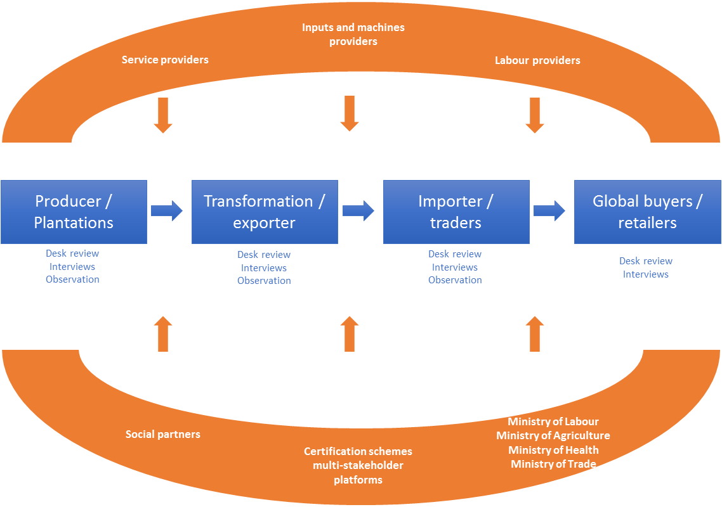
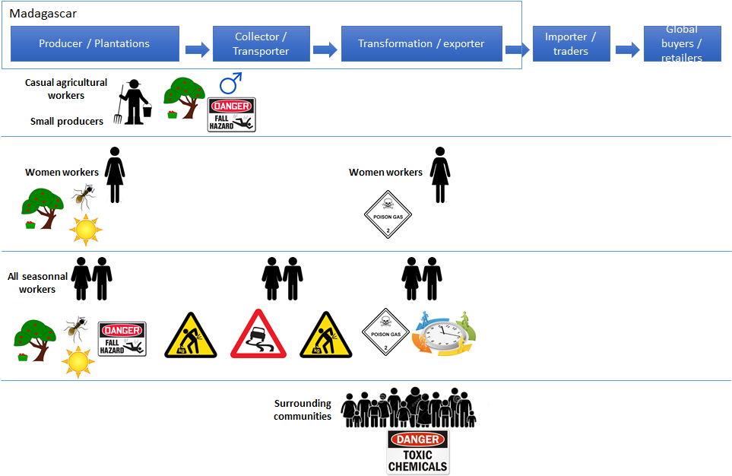
Group Exercice
You have 50 minutes.
Get ready to present!
STEP 3 - TRAINING MATERIAL NO. 8 - Analysis Exercise
  1. Map the chain and its institutional environment
    Map
  2. Identify risks, vulnerabilities and their root causes
    3D mapping
  3. Build intervention models that foster systemic change
    Table
Level of intervention | Intended OSH impact | Description of interventions | Stakeholders involved

Slide 11

Useful Resources
For a full list of publications, please consult the Resource section of the Guide.
Tools from the toolbox:
STEP 3 - RESEARCH TOOL NO. 3 - Research tools used in the Indonesian palm oil value chain
STEP 3 - RESEARCH TOOL NO. 4 - Research tools used in the Malagashy textile value chain
STEP 3 - TEMPLATE NO. 5 - Step 3 Analysis Report
STEP 3 - TEMPLATE NO. 6 - Letter of Request to Access Companies
STEP 3 - TEMPLATE NO. 7 - Template of global buyer profile
STEP 3 - TEMPLATE NO. 8 - Template for recording farm interviews and focus group discussions
STEP 3 - TEMPLATE NO. 9 - Template for recording observations in farms plantations
STEP 3 - TEMPLATE NO. 10 - Template for recording Interviews in management manufacturing
STEP 3 - TEMPLATE NO. 11 - Template for recording of observations in manufacturing
STEP 3 - TEMPLATE NO. 12 - Template for recording interviews and focus group discussions with workers in manufacture
STEP 3 - TOR NO. 3 - ToR for the Field Research and Analysis
STEP 3 - CASE STUDY NO. 4 - The roll-out of STEP 3 in the coffee value chain of Colombia
STEP 3 - TRAINING MATERIAL NO. 7 - Presentation of Step 3
STEP 3 - TRAINING MATERIAL NO. 8 - Analysis Exercise
STEP 3 - TRAINING MATERIAL NO. 9 - Observation exercise

