Slide 1
Step 4 Intervention design

Slide 2

Objectives
The objective is to use the information collected and analyzed during steps 1, 2 and 3 to co-construct with stakeholders interventions that can effectively improve OSH in the value chain.
The interventions should:
  Enhance and exploit catalysts for OSH improvement;
  Be realistic in terms of stakeholders’ engagement and resources necessary to implement the proposed interventions;
  Support good practice sharing, partnership and dissemination.

Slide 3

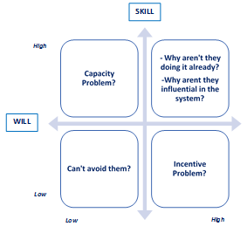
Process
Stakeholders
Consultations
The stakeholders are the ones identified in Steps 2 and 3. They necessarily include all of the participating actors to the field research conducted in Step 3.
The main objectives of the consultations are:
  To share the research findings and gather stakeholders’ feedback on those findings that will support the formulation of concrete recommendations;
  To co-construct consensual interventions with the stakeholders.
During the consultation, the willigness and capacities of stakeholders to contribute to interventions should be assessed.

Slide 4

Process
Priority setting
Desk work
Once the possible interventions to address hazards and risks identified in the value chain and specific vulnerable groups are detailed, a priority setting exercise needs to be performed.
Priority setting should be guided by the following :
  Intervention models should be guided by the Pyramid of control approach and always prioritize the elimination of hazards and risks before envisaging risk reduction strategies (collective or individual) and compensation.
  The willigness and capacities of stakeholders to implement interventions, as per the matrix showed in the previous slide.
Value chain production stage | Expected impact on OSH | Possible intervention | Stakeholders involved | Priority
Production stage and type of actor | Hazard or vulnerability pattern you want to address | What needs to be done and how | Who will implement the intervention? Will and skills? | Rank

Slide 5

Useful Resources
For a full list of publications, please consult the Resource section of the Guide.
Tools from the toolbox:
STEP 4 - CASE STUDY NO. 5 - The roll-out of STEP 4 in the coffee value chain of Colombia
STEP 4 - CASE STUDY NO. 6 - Examples from Colombia
STEP 4 - TOR NO. 4 - ToR Stakeholder Consultations
STEP 4 - TEMPLATE NO. 13 - Consultation Invitation Letter
STEP 4 - TEMPLATE NO. 14 - Conclusions of Consultations
STEP 4 - TEMPLATE NO. 15 - Project Factsheet
STEP 4 - TRAINING MATERIAL NO. 10 - Presentation of Step 4

