Slide 1


Combating child labour in Myanmar: A course for Labour Inspectors

Slide 2



Course Objectives
1.
2.
3.
To raise the awareness of labour inspectors about child labour in Myanmar
To enhance their capacity to identify and address child labour in the workplace
To encourage a leadership role among labour inspectors to support the elimination of child labour in Myanmar

Slide 3
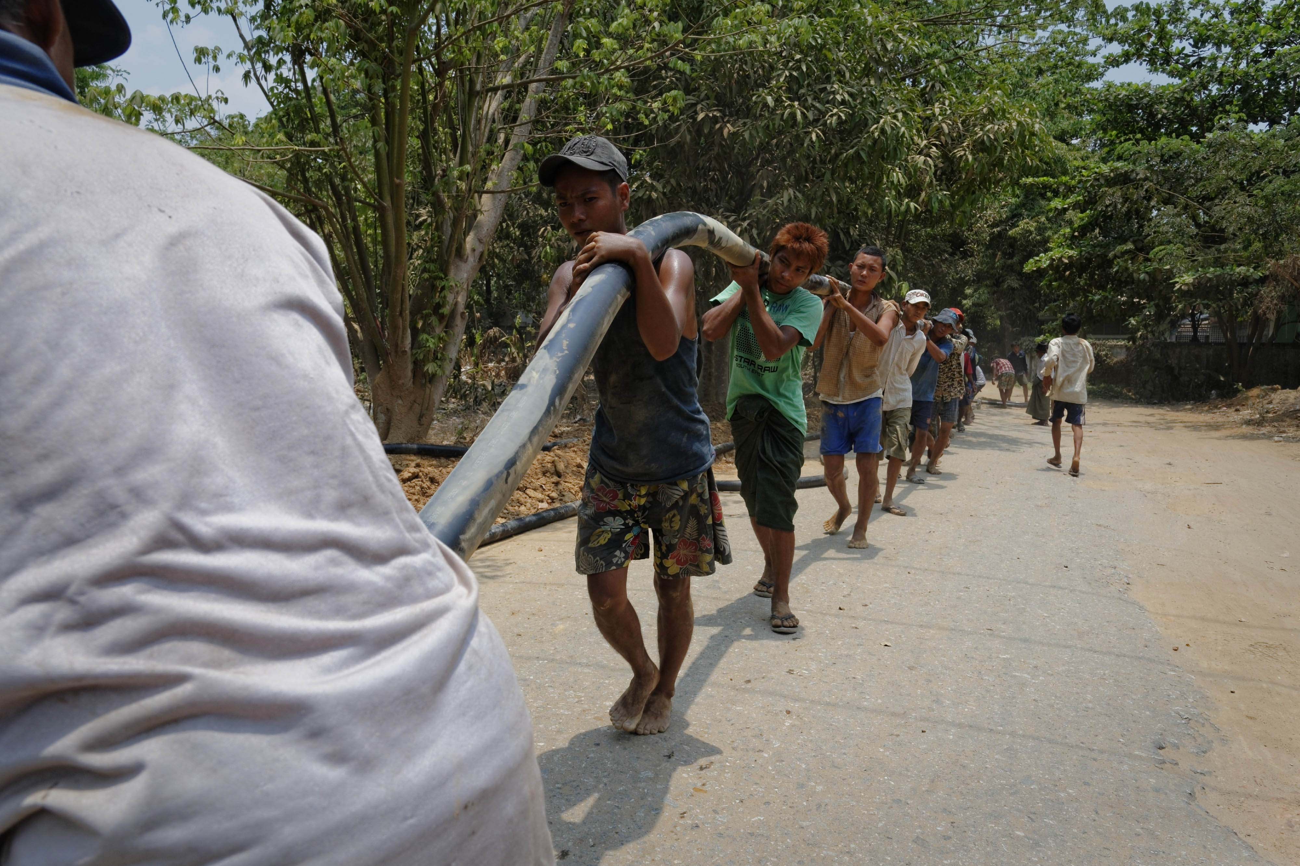
Course Structure
Introducing the ILO
Session 1: Defining and Understanding Child Labour
Session 2: Understanding Global and National Estimates of Child Labour
Session 3: Causes and Consequences of Child Labour
Session 4: Conducting Inspections
Session 5: Removing Children from Work
Wrap-up and Course Evaluation

Slide 4
Exercise 1: Icebreaker – Getting to know each other
Divide into pairs.
Introduce yourself (e.g. personal and professional details).
Identify something you have in common.
Take notes and be prepared to introduce your partner to the rest of the group.

Slide 5
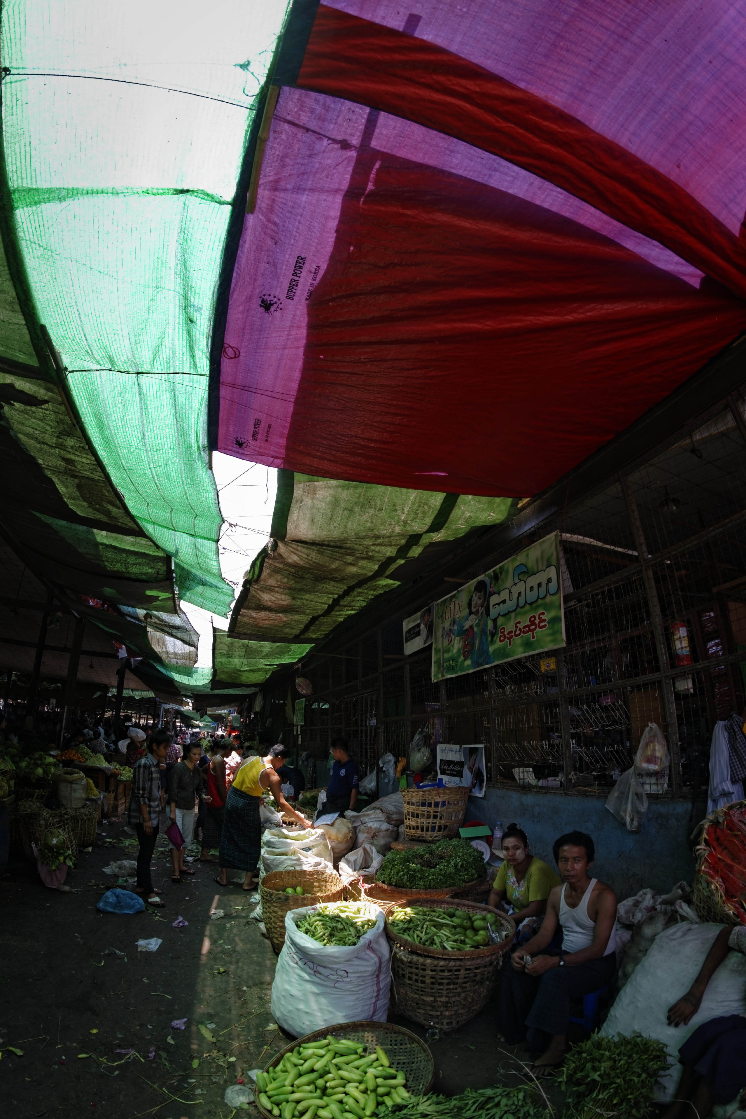
Introducing the ILO: Strategic Objectives
Four strategic objectives:
Promote and realize labour standards and the fundamental principles and rights at work
Enhance opportunities for women and men to secure decent employment
Strengthen coverage and effectiveness of social protection for all
Strengthen tripartism and social dialogue.

Slide 6

Fundamental Principles and Rights at Work
Freedom of association and recognition of the right to collective bargaining
Elimination of all forms of forced and compulsory labour
Abolition of child labour
Elimination of discrimination in respect of employment and occupation
Notes:
Introduce FPRW
And introduce what ILO does on child labour, IPEC: partnership to eliminate child labour, in particular its worst forms

Slide 7
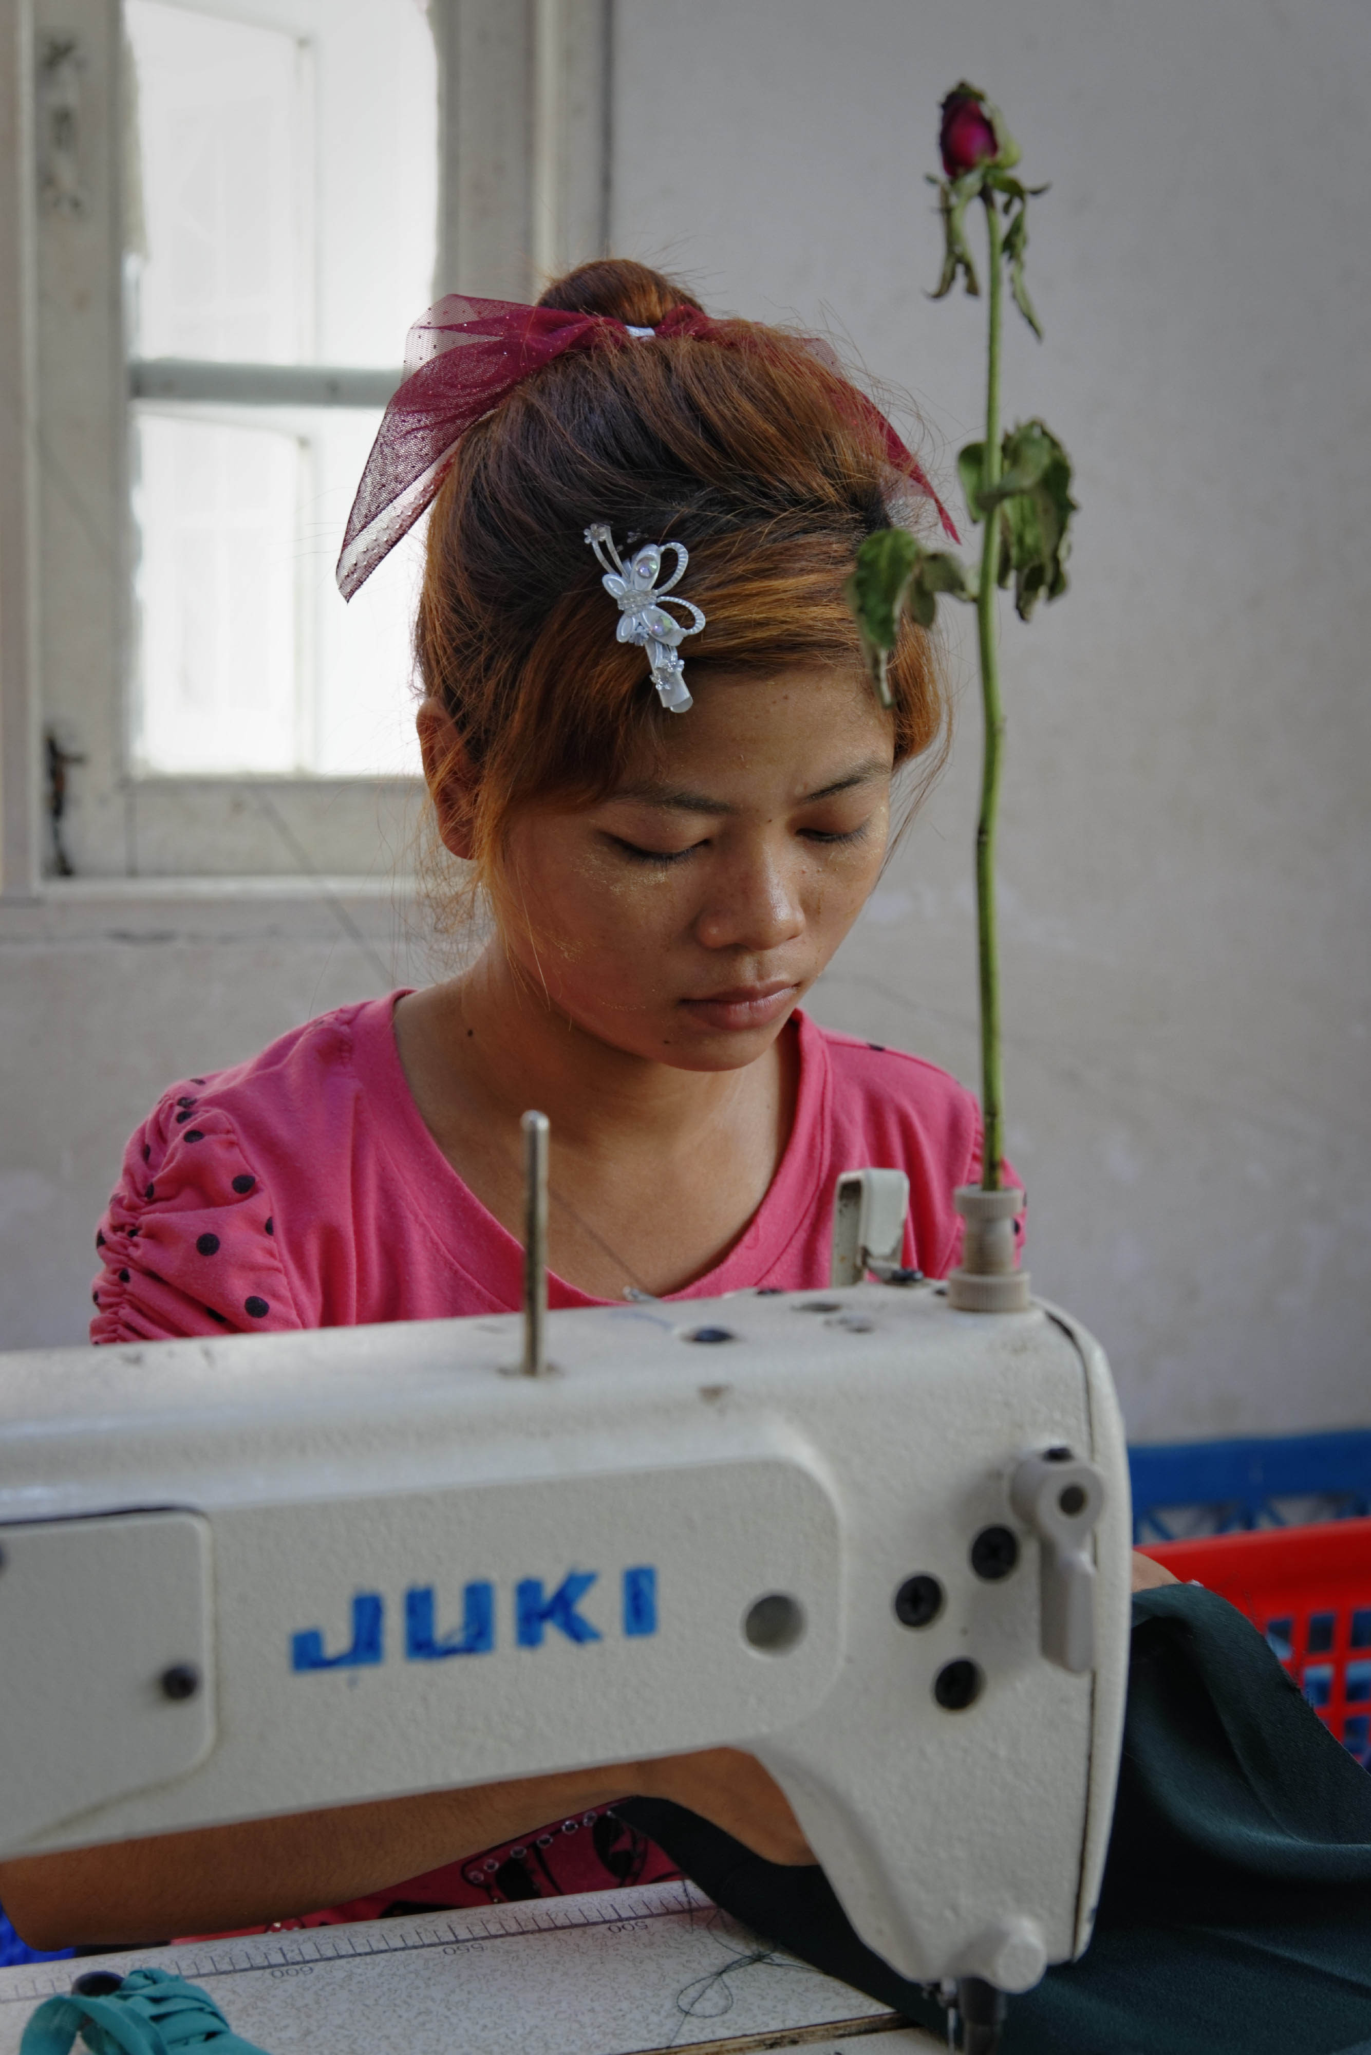
Child Labour and the ILO
International Programme for the Elimination of Child Labour established in 1992
Currently implementing projects and working with partners in 90 countries
Global goal to eliminate child labour worldwide with emphasis on eradicating the Worst Forms of Child Labour

Slide 8
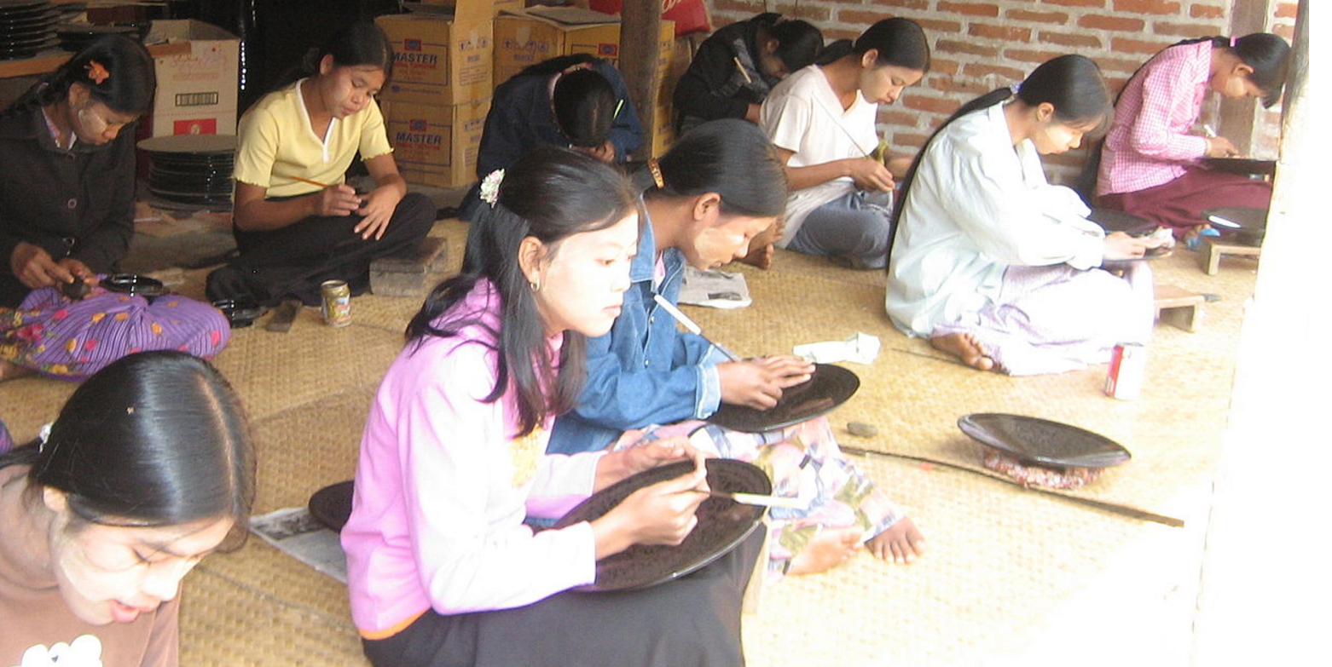
Labour Inspectors and the ILO
Governments are one of three tripartite constituents of ILO at global and national levels
Government voice in ILO standard setting and governance
Labour inspectors’ key role in policy and technical programmes
Central role of labour inspectors in addressing child labour in economy and society

Slide 9
Q&A
Do you have questions/comments about:
ILO?
Fundamental Principles and Rights at Work?
ILO child labour programme?
Role of governments and labour inspectors in the ILO?

Slide 10
Session 1: Defining & Understanding Child Labour

Slide 11
What is Child Labour?
Not all work done by children is considered child labour
Children under 18 years of age but above the minimum age for the type of work they do may legitimately be employed
Some work might be beneficial to their development and prepare them for a productive life as an adult
Work performed by children who are under the minimum age legally specified for such work
Work that is considered a worst form of child labour because of its detrimental nature or conditions; the WFCL are prohibited for all children under the age of 18
Child labour is mentally, physically and morally dangerous for children

Slide 12
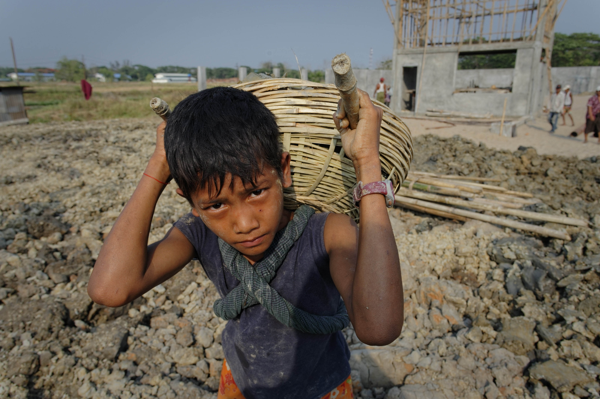
What are the Worst Forms of Child Labour?
All forms of slavery or practices similar to slavery, such as the sale and trafficking of children, debt bondage and forced or compulsory labour.
The use, procuring or offering of a child for prostitution or the production of pornography.
The use, procuring or offering of a child for illicit activities, for example the production and/or trafficking of drugs.
Work which, by its nature or the circumstances in which it is carried out, is likely to harm the health, safety or morals of children.

Slide 13
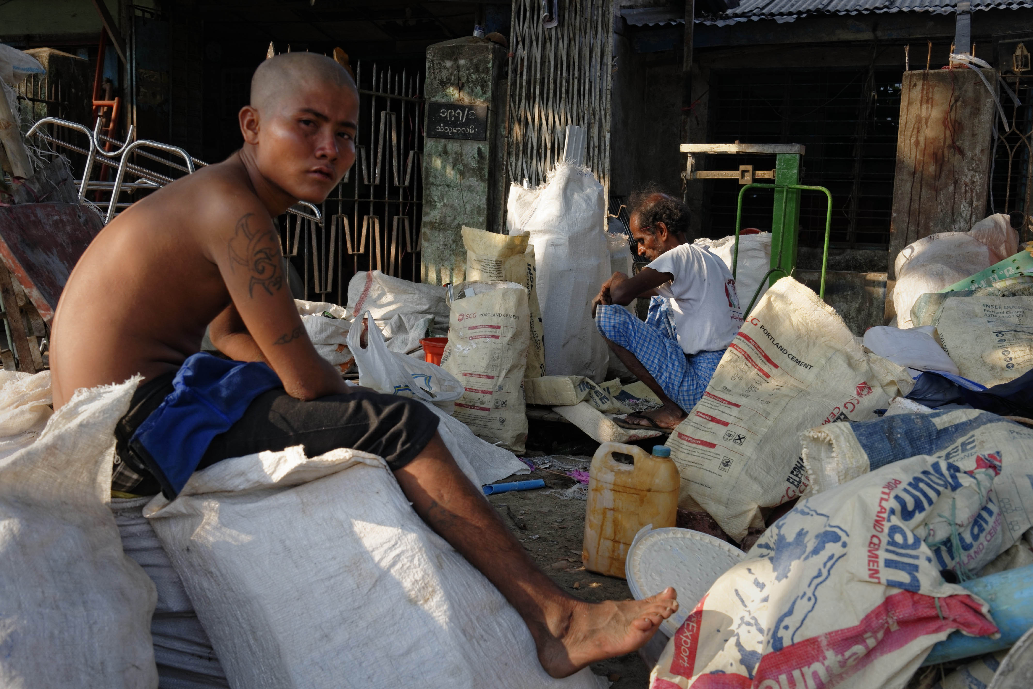
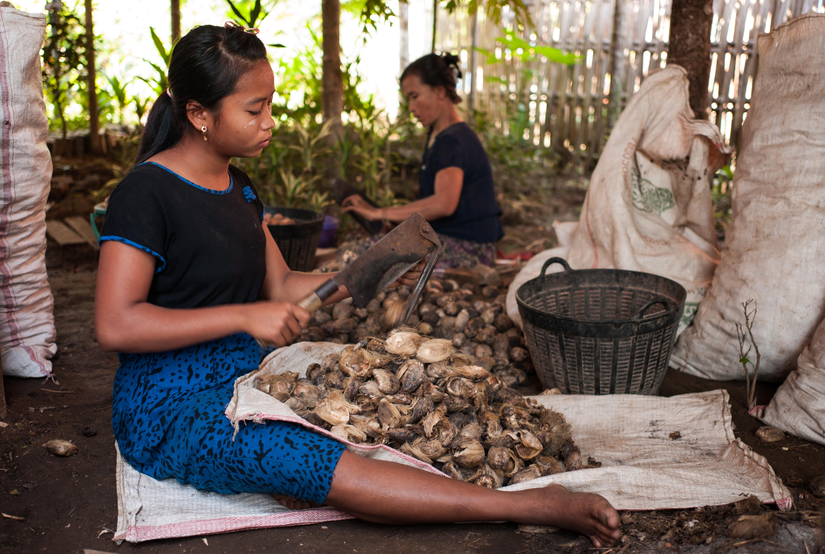
What is Hazardous Child Labour?
Work performed by children in dangerous and unhealthy conditions that can lead to a child being killed, injured or made ill
Represents the largest category of children working in the WFCL
Occurs in agriculture, mining, construction, manufacturing, the service industries and domestic work, most often in informal, unregulated and “hidden” parts of the economy

Slide 14
ILO Standards and Other International Instruments
Ratify:
ILO Convention 138 on the Minimum Age for Employment
ILO Convention 182 on the Worst Forms of Child Labour
UN Convention on the Rights of the Child
ILO Convention 189 on Decent Work for Domestic Workers
Consider:
ILO Recommendation 146 on the Minimum Age for Employment
ILO Recommendation 190 on the Worst Forms of Child Labour
Promote:
ILO Declaration on Fundamental Principles and Rights at Work

Slide 15
Eliminating Child Labour in Myanmar: Legal and Regulatory Tools
Factories Act, 1951
Shops and Establishments Act, 1951
Oilfields (Workers and Welfare) Act, 1951
Maternal and Child Welfare Association Law (and Amendment), 1990
The Child Law, 1993
Anti-Trafficking in Persons Law, 2005

Slide 16
Q&A
Do you have any questions/comments about:
ILO definitions of child labour?
Worst Forms of Child Labour?
Hazardous child labour?
ILO instruments?
National laws and regulations in Myanmar?

Slide 17
Exercise 2: Addressing Gaps in Child Protection: The Role of Labour Inspectors
Divide into small groups.
Nominate a note-taker and presenter.
Discuss the question or topic you are given.
Present the conclusions of your discussion in plenary.

Slide 18
Session 2: Understanding Global & National Estimates of Child Labour

Slide 19
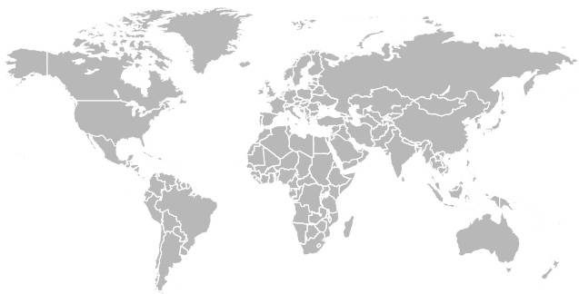
Child Labour in the Global Economy: A Summary of ILO Estimates
152 million children worldwide are in
child labour – 10% of the world’s
children
73 million children are in hazardous work
Second largest number of child labourers are found in the Asia-Pacific region
Notes:
Create handout for participants summarizing estimate per regional, gender and age breakdown

Slide 20
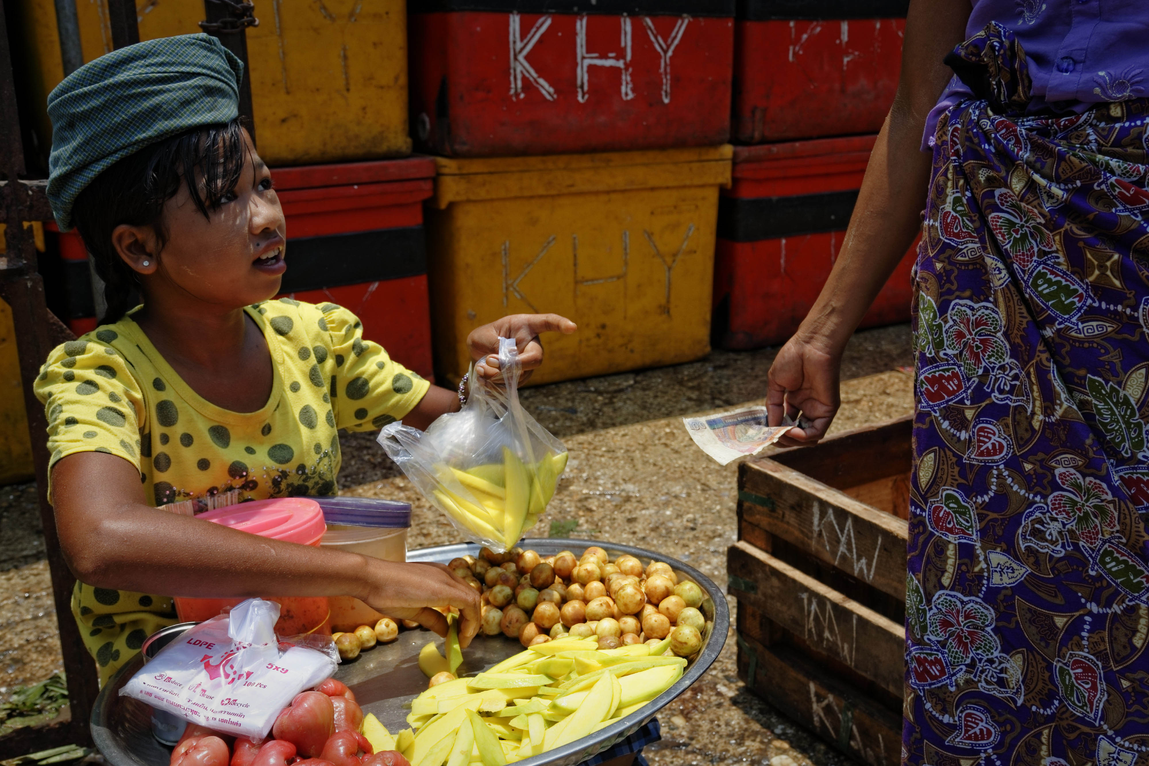
Sector Distribution of Child Labour
Sector | (‘000) | %
Agriculture | 107,543 | 70.9
Industry | 18,007 | 11.9
Services | 26,072 | 17.2
*The industry sub-sectors of most relevance for child labour include construction, mining and manufacturing. *The services sub-sector of most relevance for child labour include hotels and restaurants, wholesale and retail trade (commerce), maintenance and repair of motor vehicles, transport, other community, social services activities and domestic workers.

Slide 21
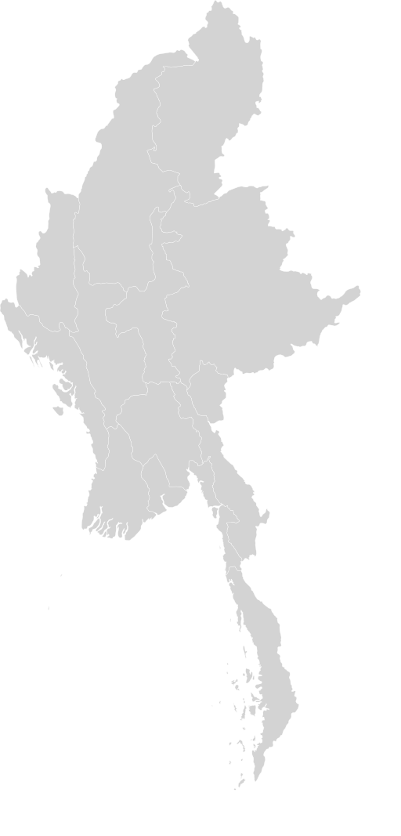
Key Findings from Myanmar’s Child Labour Survey
There are an estimated 1.1 million child labourers in Myanmar
This represents 9.3% of the total number of children in the country
Over 600,000 of these are in conditions of hazardous child labour

Slide 22
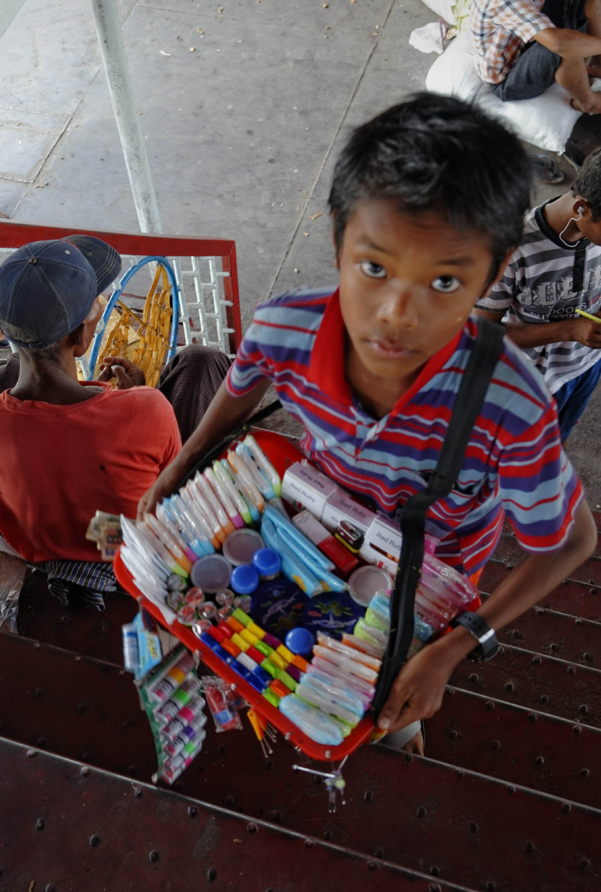
Sectoral Distribution of Working Children in Myanmar
Sector | %
Agriculture, forestry and fishing | 60.5
Manufacturing | 12
Construction | 4
Trades | 11.1
Other services | 6.1
Other industries and occupations | 6.3
Total | 100

Slide 23
Key Indicators (2015 and 2017 Q1)
Description | 2015 LFS |  |  | 2017 LFS Q1
 | Total | Male | Female | Total | Male | Female
Child population (5-17 years) | 12,146,463 | 6,010,459 | 6,136,004 | 12,410,000 | 6,157,000 | 6,253,000
Working child | 1,278,909 | 676,208 | 602,701 | 805,000 | 448,000 | 357,000
Child labour | 1,125,661 | 601,471 | 524,190 | 623,000 | 350,000 | 273,000
Hazardous child labour | 616,815 | 337,318 | 279,498 | 608,000 | 343,000 | 265,000

Slide 24
Key Indicators (2015 and 2017 Q1)
Description | 2015 LFS |  |  | 2017 LFS Q1
 | Total | Male | Female | Total | Male | Female
Proportion of working children(%) | 10.5 | 11.3 | 9.8 | 6.5 | 7.3 | 5.7
Proportion of child labour(%) | 9.3 | 10.0 | 8.5 | 5.0 | 5.7 | 4.4
Proportion of hazardous child labour(%) | 5.1 | 5.6 | 4.6 | 4.9 | 5.6 | 4.2

Slide 25
Q&A
Do you have questions/comments about:
ILO global estimate of child labour?
National data on child labour in Myanmar?

Slide 26
Exercise 3: Mapping Risk of Child Labour in Myanmar
Divide into small groups.
Nominate a note-taker and presenter.
Discuss the question or topic you are given.
Present the conclusions of your discussion in plenary
Notes:
Handout: map of Myanmar outline but with international borders identified with Thailand, Bangladesh

Slide 27
Session 3: Causes & Consequences of Child Labour

Slide 28
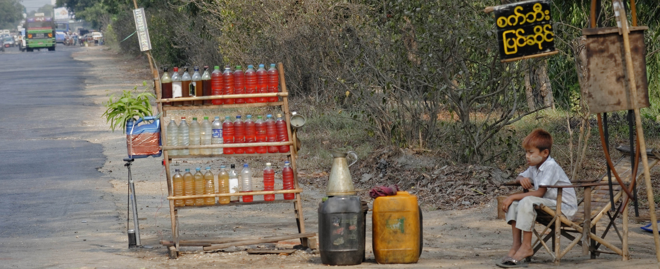
Understanding the Causes of Child Labour
Low household income
Lack of access to quality education
Discrimination
“Distress” migration
Culture or family traditions
“Nimble fingers” argument
Weak or non-existent laws and law enforcement
Absence of worker organization
Supply and demand of child labour

Slide 29
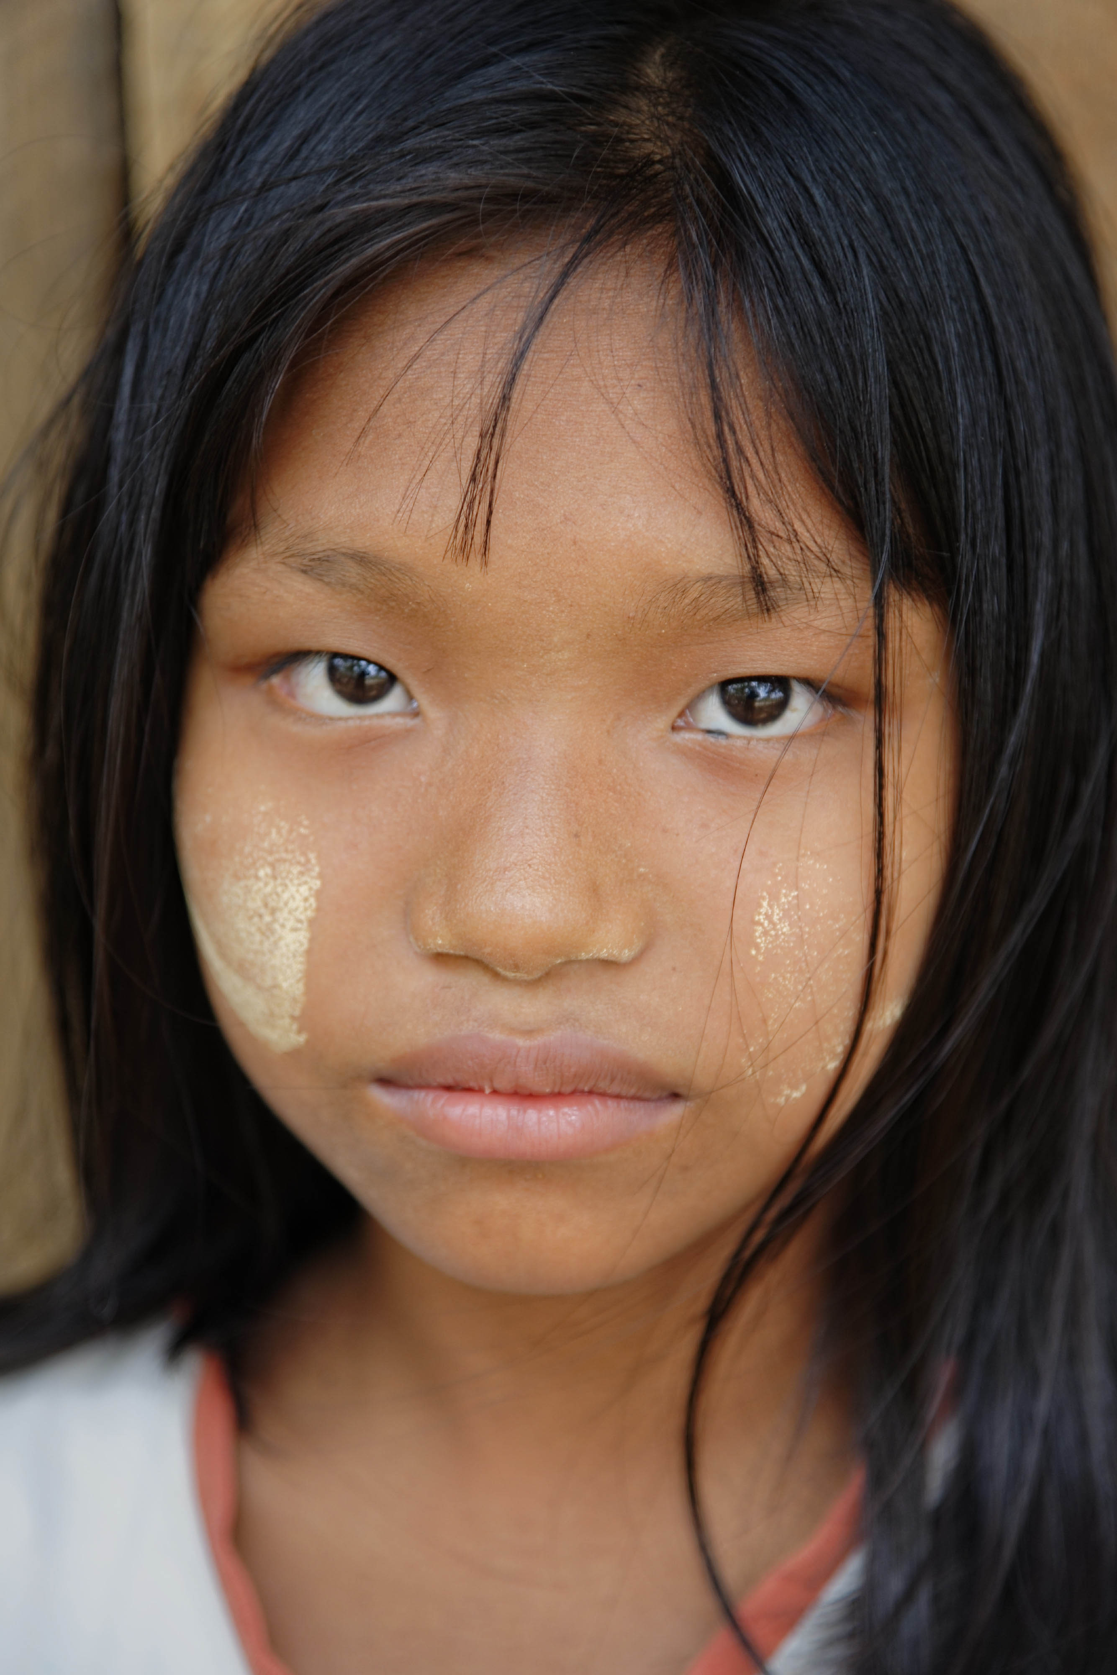
Understanding the Consequences of Child Labour
Child labour can:
Jeopardize children’s health and safety, and affect their physical and psycho-social development;
Impede children’s access to education and/or skills training, thus limiting their economic and social mobility and advancement later in life;
Lead to continued poverty over generations and inhibit children’s access to decent work when they reach the minimum legal age for employment; and
Act as a significant impediment to achieving the Sustainable Development Goals, in particular concerning poverty alleviation and education for all.

Slide 30
Q&A
Do you have questions/comments about:
Causes of child labour?
Consequences of child labour?

Slide 31
Exercise 4: Deepening Understanding of the Causes and Consequences of Child Labour
Divide into 4 groups.
Nominate a note-taker and presenter.
Discuss the question or topic you are given.
Present the conclusions in plenary.

Slide 32
Session 4: Conducting Inspections

Slide 33
Understanding the Purpose of Labour Inspection
Labour inspection has three main functions:
Enforce the law;
Providing information and advice to employers and workers; and
Identify gaps in the law.
*This includes the employment of children and
young persons, child labour and WFCL

Slide 34
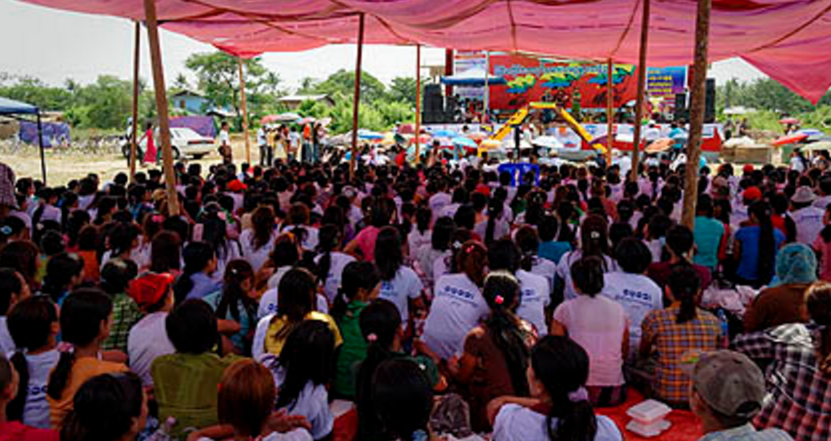
Understanding the Roles and Responsibilities of Labour Inspectors
Promote compliance with the law, including employment of children
Assess conditions with a view to preventing child labour, taking appropriate action to ensure legal compliance
Examine employer records and conditions of work for children under 18
Right of entry into any workplace
Power of injunction

Slide 35
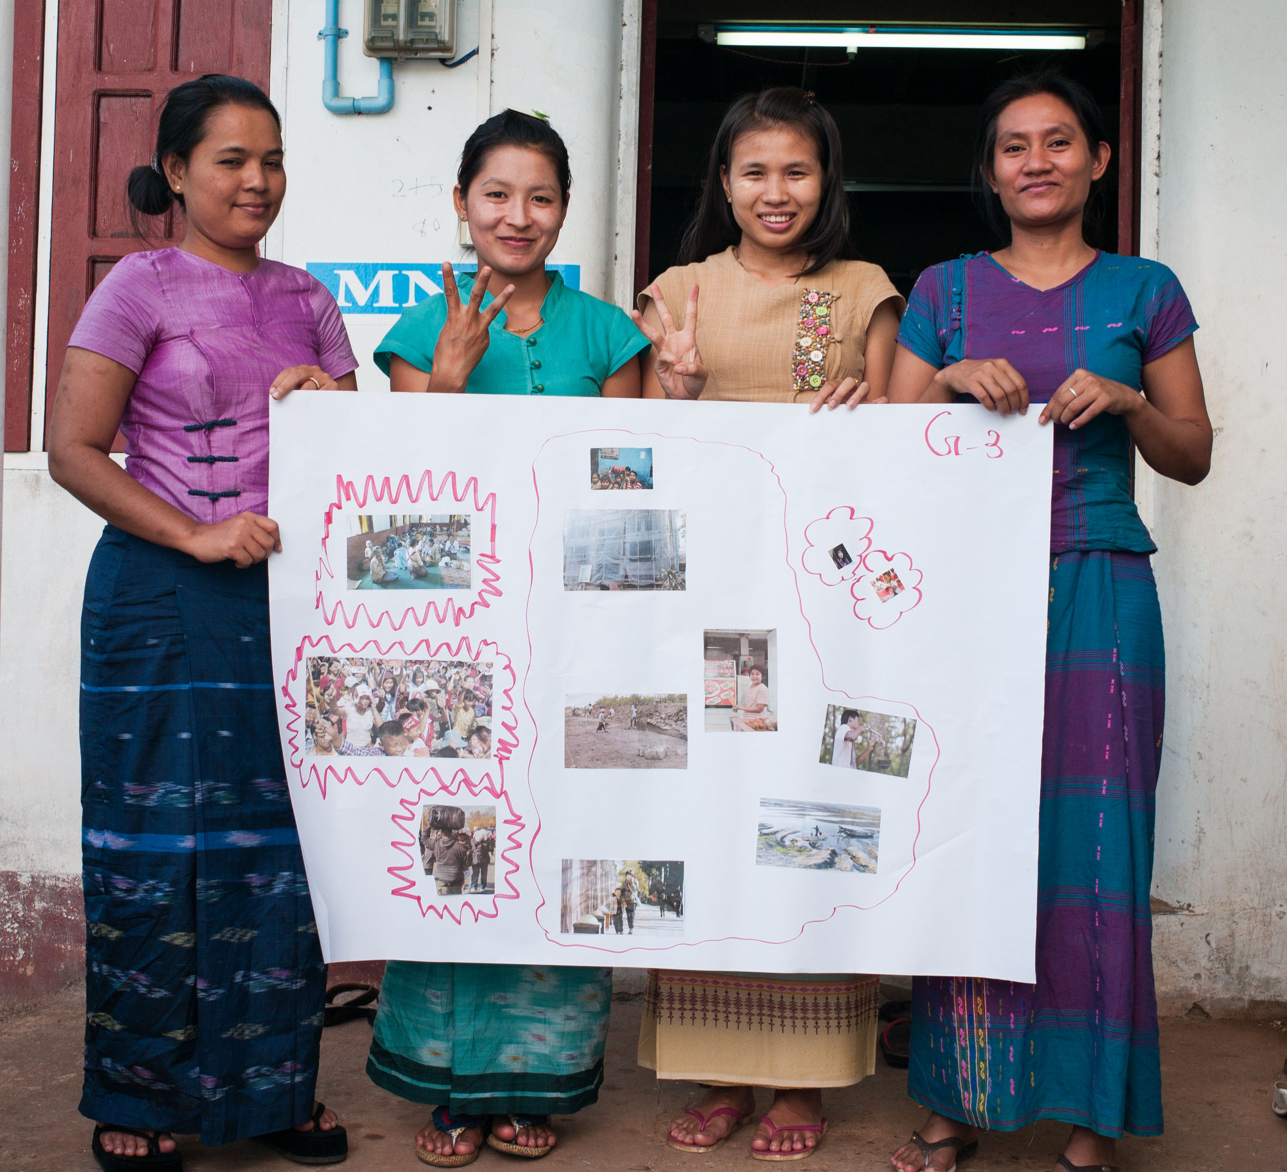
Obligations of Labour Inspectors
Independence and impartiality
Integrity
Confidentiality
Professionalism and competency

Slide 36
Conducting and Strengthening Inspections to Address Child Labour
Announced and unannounced visits
Age verification techniques
Interviewing children
Assessing working conditions and hazards
Speaking with employers and workers

Slide 37
Q&A
Do you have questions/comments about:
The purpose and scope of inspections?
The rights and responsibilities of inspectors?
Conducting inspections?

Slide 38
Exercise 5: Strategies to Identify Child Labour in Practice
Divide into 4 groups.
Nominate a note-taker and presenter.
Discuss the question or topic you are given.
Present your conclusions in plenary.

Slide 39
Group Discussion: Removing a Child from Work
When a case of child labour is found, what steps should labour inspectors take to remove the child?

Slide 40
Guiding Questions to Determine the Best Interests of the Child
If removed from employment, would the child disappear into less visible and potentially more hazardous types of work?
Assuming the work is not hazardous, could it be in the interest of the child to be partially released from work, so that there is time and financial resources for education or other training?
How does the child feel about the work?

Slide 41
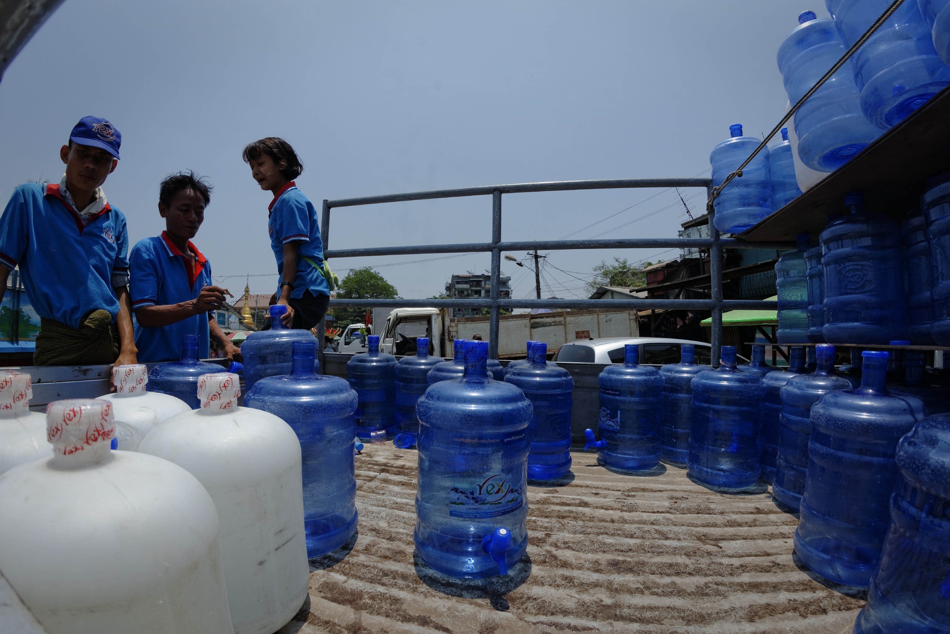
Understanding Child Labour Monitoring
Active process for checking locations and communities where child labour may be found
Direct observation of workplaces and referral to services
CLM plays an important, complimentary role to labour inspection
Monitors do not have same legal authority as inspectors, nor legal right to enter workplaces

Slide 42
Q&A
Do you have questions/comments about:
Removal, referral and remediation?
Working with stakeholders?
Child labour monitoring?

Slide 43
Exercise 6: Following up with Action
Divide into small groups.
Nominate a presenter.
Discuss the question or topic you have been given.
Present your conclusions in plenary.

Slide 44
Course Conclusion & Evaluation

Slide 45
Course Conclusion
Final comments
Tour de table
Follow up & next steps

Slide 46
Course Evaluation
Please complete the course evaluation form provided

Slide 47
Thank you!

