Slide 1


Combating child labour in Myanmar: A course for Workers’ Organizations

Slide 2



Course Objectives
1.
2.
3.
To raise the awareness of workers’ organisations about child labour in Myanmar
To enhance the capacity of workers to address child labour in the workplace and society
To encourage a leadership role among workers’ organisations to support the elimination of child labour in Myanmar

Slide 3
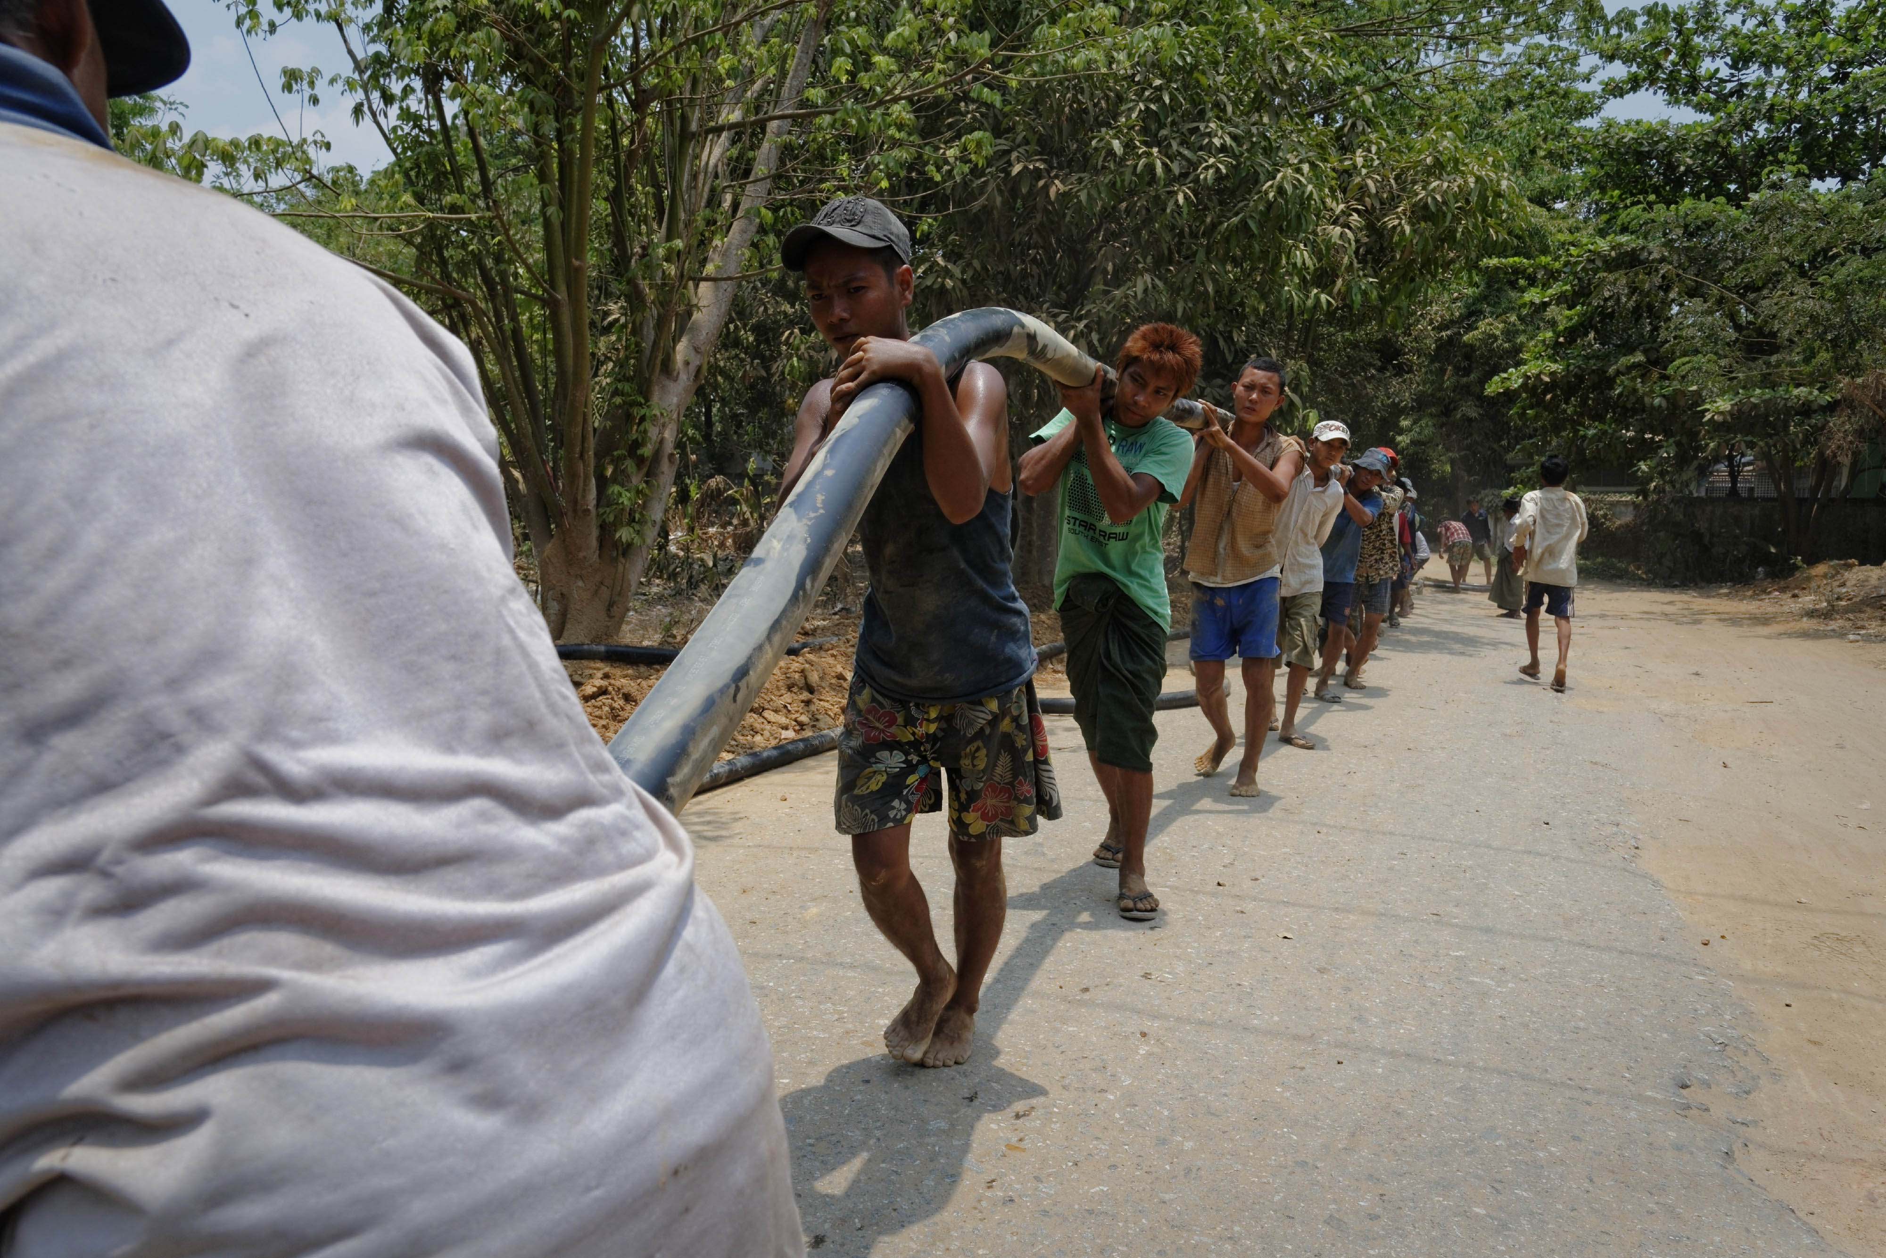
Course Structure
Introducing the ILO
Session 1: Defining & Understanding Child Labour
Session 2: Understanding Global & National Estimates of Child Labour
Session 3: Causes & Consequences of Child Labour
Session 4: Taking Action to Eliminate Child Labour
Wrap-up & Course Evaluation

Slide 4
Exercise 1: Icebreaker – Getting to Know Each Other
Divide into pairs.
Introduce yourself (e.g. personal and professional details).
Identify something you have in common.
Take notes and be prepared to introduce your partner to the rest of the group.

Slide 5
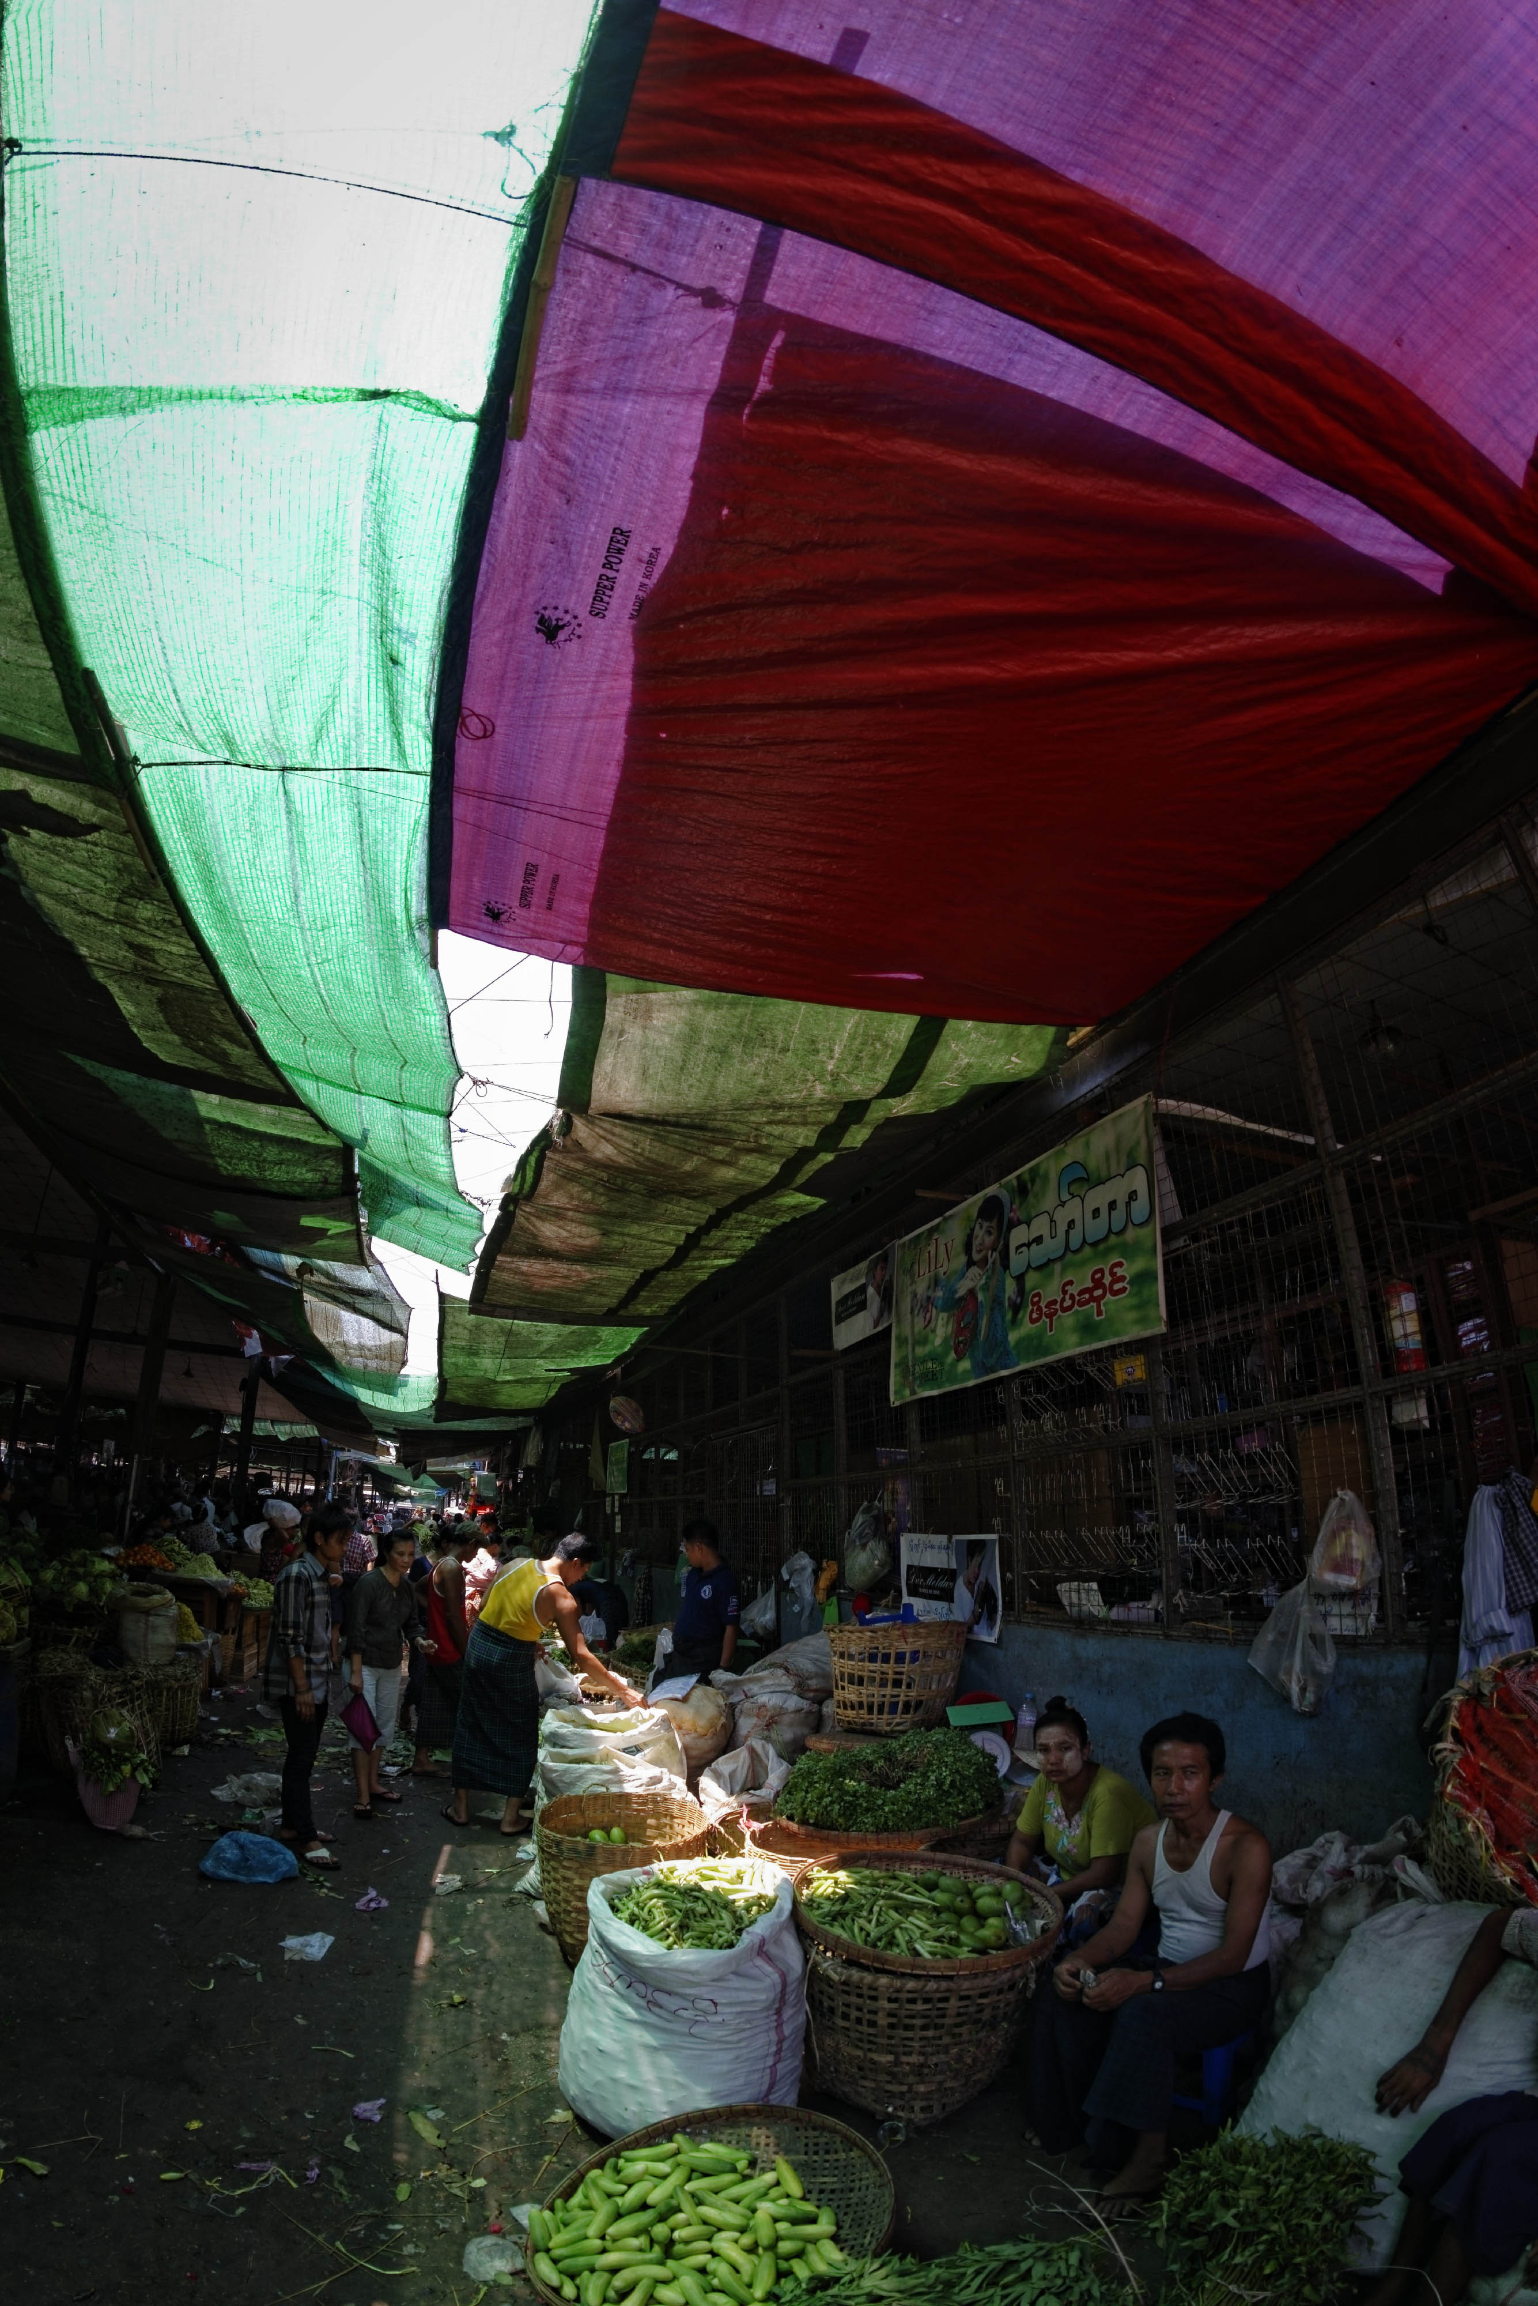
Introducing the ILO: Strategic Objectives
Four strategic objectives:
Promote and realize labour standards and the fundamental principles and rights at work
Enhance opportunities for women and men to secure decent employment
Strengthen coverage and effectiveness of social protection for all; and
Strengthen tripartism and social dialogue.

Slide 6

Fundamental Principles and Rights at Work
Freedom of association and recognition of the right to collective bargaining
Elimination of all forms of forced and compulsory labour
Abolition of child labour
Elimination of discrimination in respect of employment and occupation
Notes:
Introduce FPRW
And introduce what ILO does on child labour, IPEC: partnership to eliminate child labour, in particular its worst forms

Slide 7
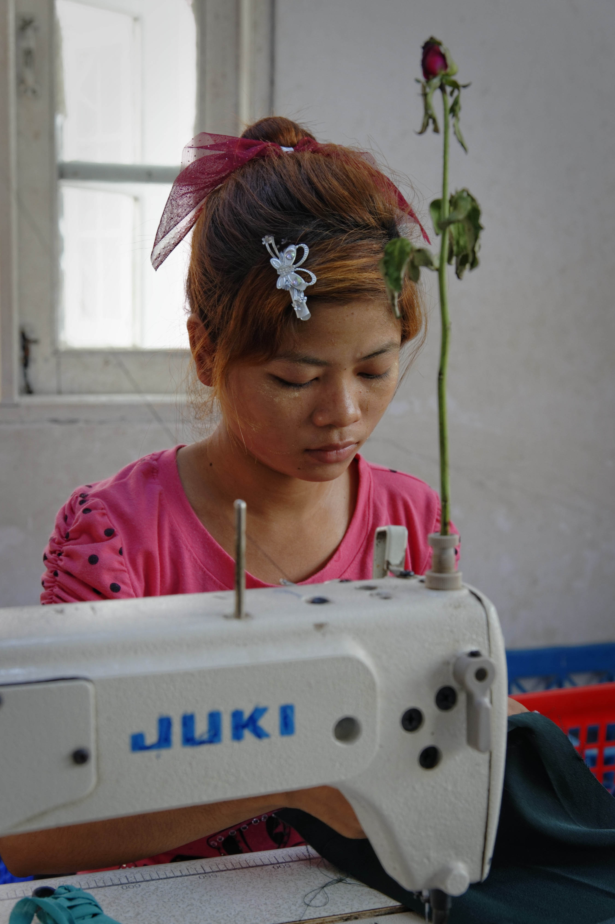
Child Labour and the ILO
International Programme for the Elimination of Child Labour established in 1992
Currently implementing projects and working with partners in 90 countries
Global goal to eliminate child labour worldwide with emphasis on eradicating the Worst Forms of Child Labour

Slide 8
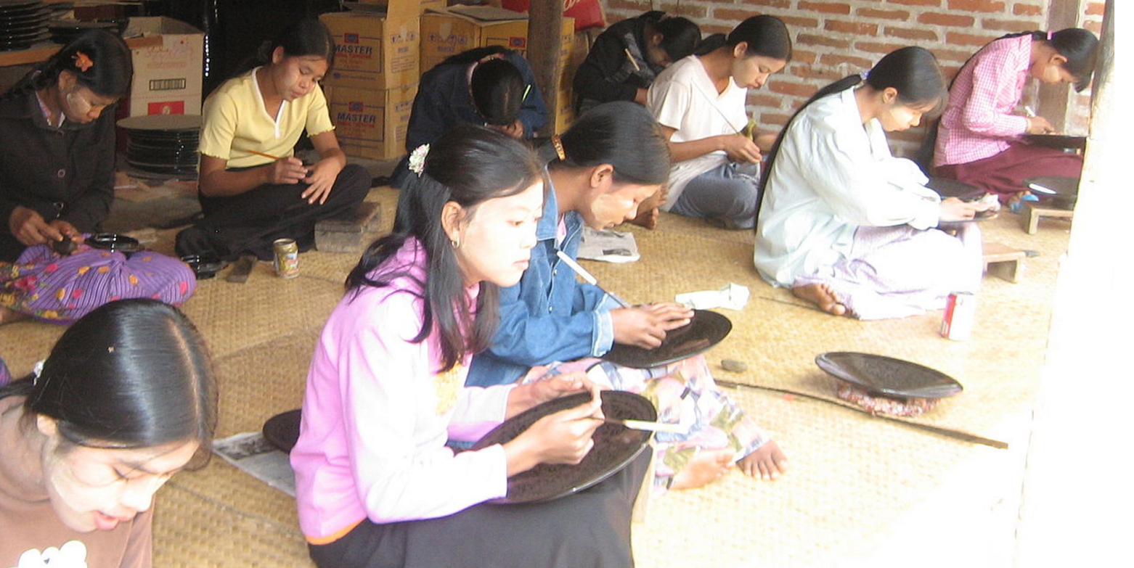
Workers and the ILO
One of three tripartite constituents of ILO at global and national levels
Worker voice in ILO standard setting, technical programmes and governance
Role of workers in addressing child labour in economy and society

Slide 9
Q&A
Do you have questions/comments about:
ILO?
Fundamental Principles and Rights at Work?
ILO child labour programme?
Role of workers in the ILO?

Slide 10
Session 1: Defining & Understanding Child Labour

Slide 11
What is Child Labour?
Not all work done by children is considered child labour
Children under 18 years of age but above the minimum age for the type of work they do may legitimately be employed
Some work might be beneficial to their development and prepare them for a productive life as an adult
Work performed by children who are under the minimum age legally specified for such work
Work that is considered a worst form of child labour because of its detrimental nature or conditions; the WFCL are prohibited for all children under the age of 18
Child labour is mentally, physically and morally dangerous for children

Slide 12
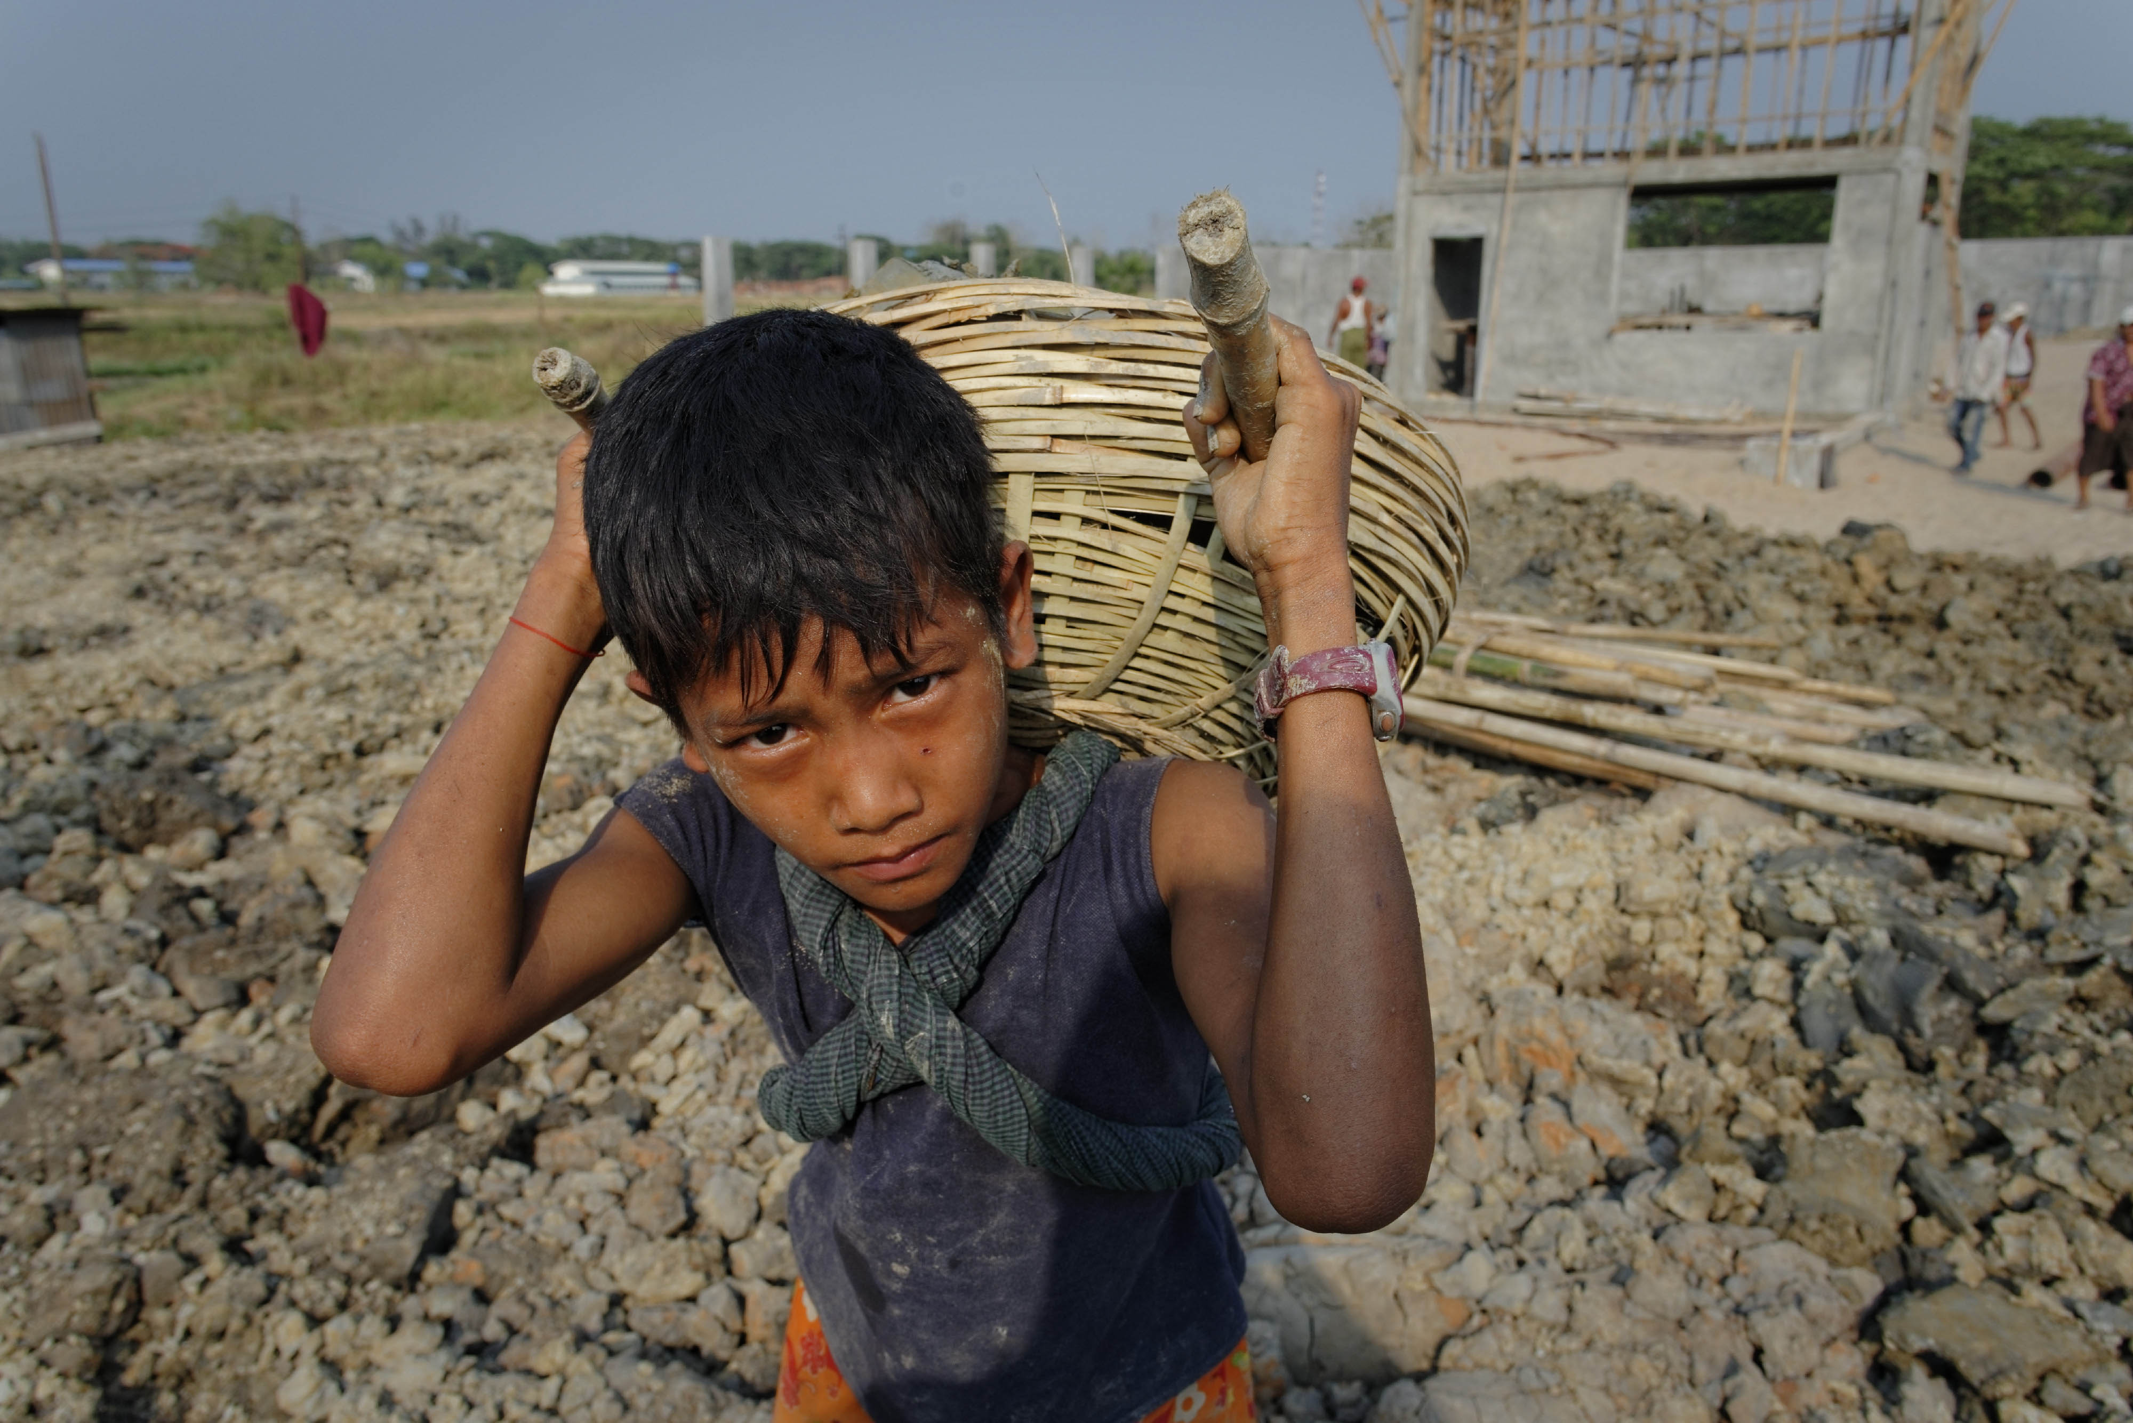
What are the Worst Forms of Child Labour?
All forms of slavery or practices similar to slavery, such as the sale and trafficking of children, debt bondage and forced or compulsory labour.
The use, procuring or offering of a child for prostitution or the production of pornography.
The use, procuring or offering of a child for illicit activities, for example the production and/or trafficking of drugs.
Work which, by its nature or the circumstances in which it is carried out, is likely to harm the health, safety or morals of children.

Slide 13
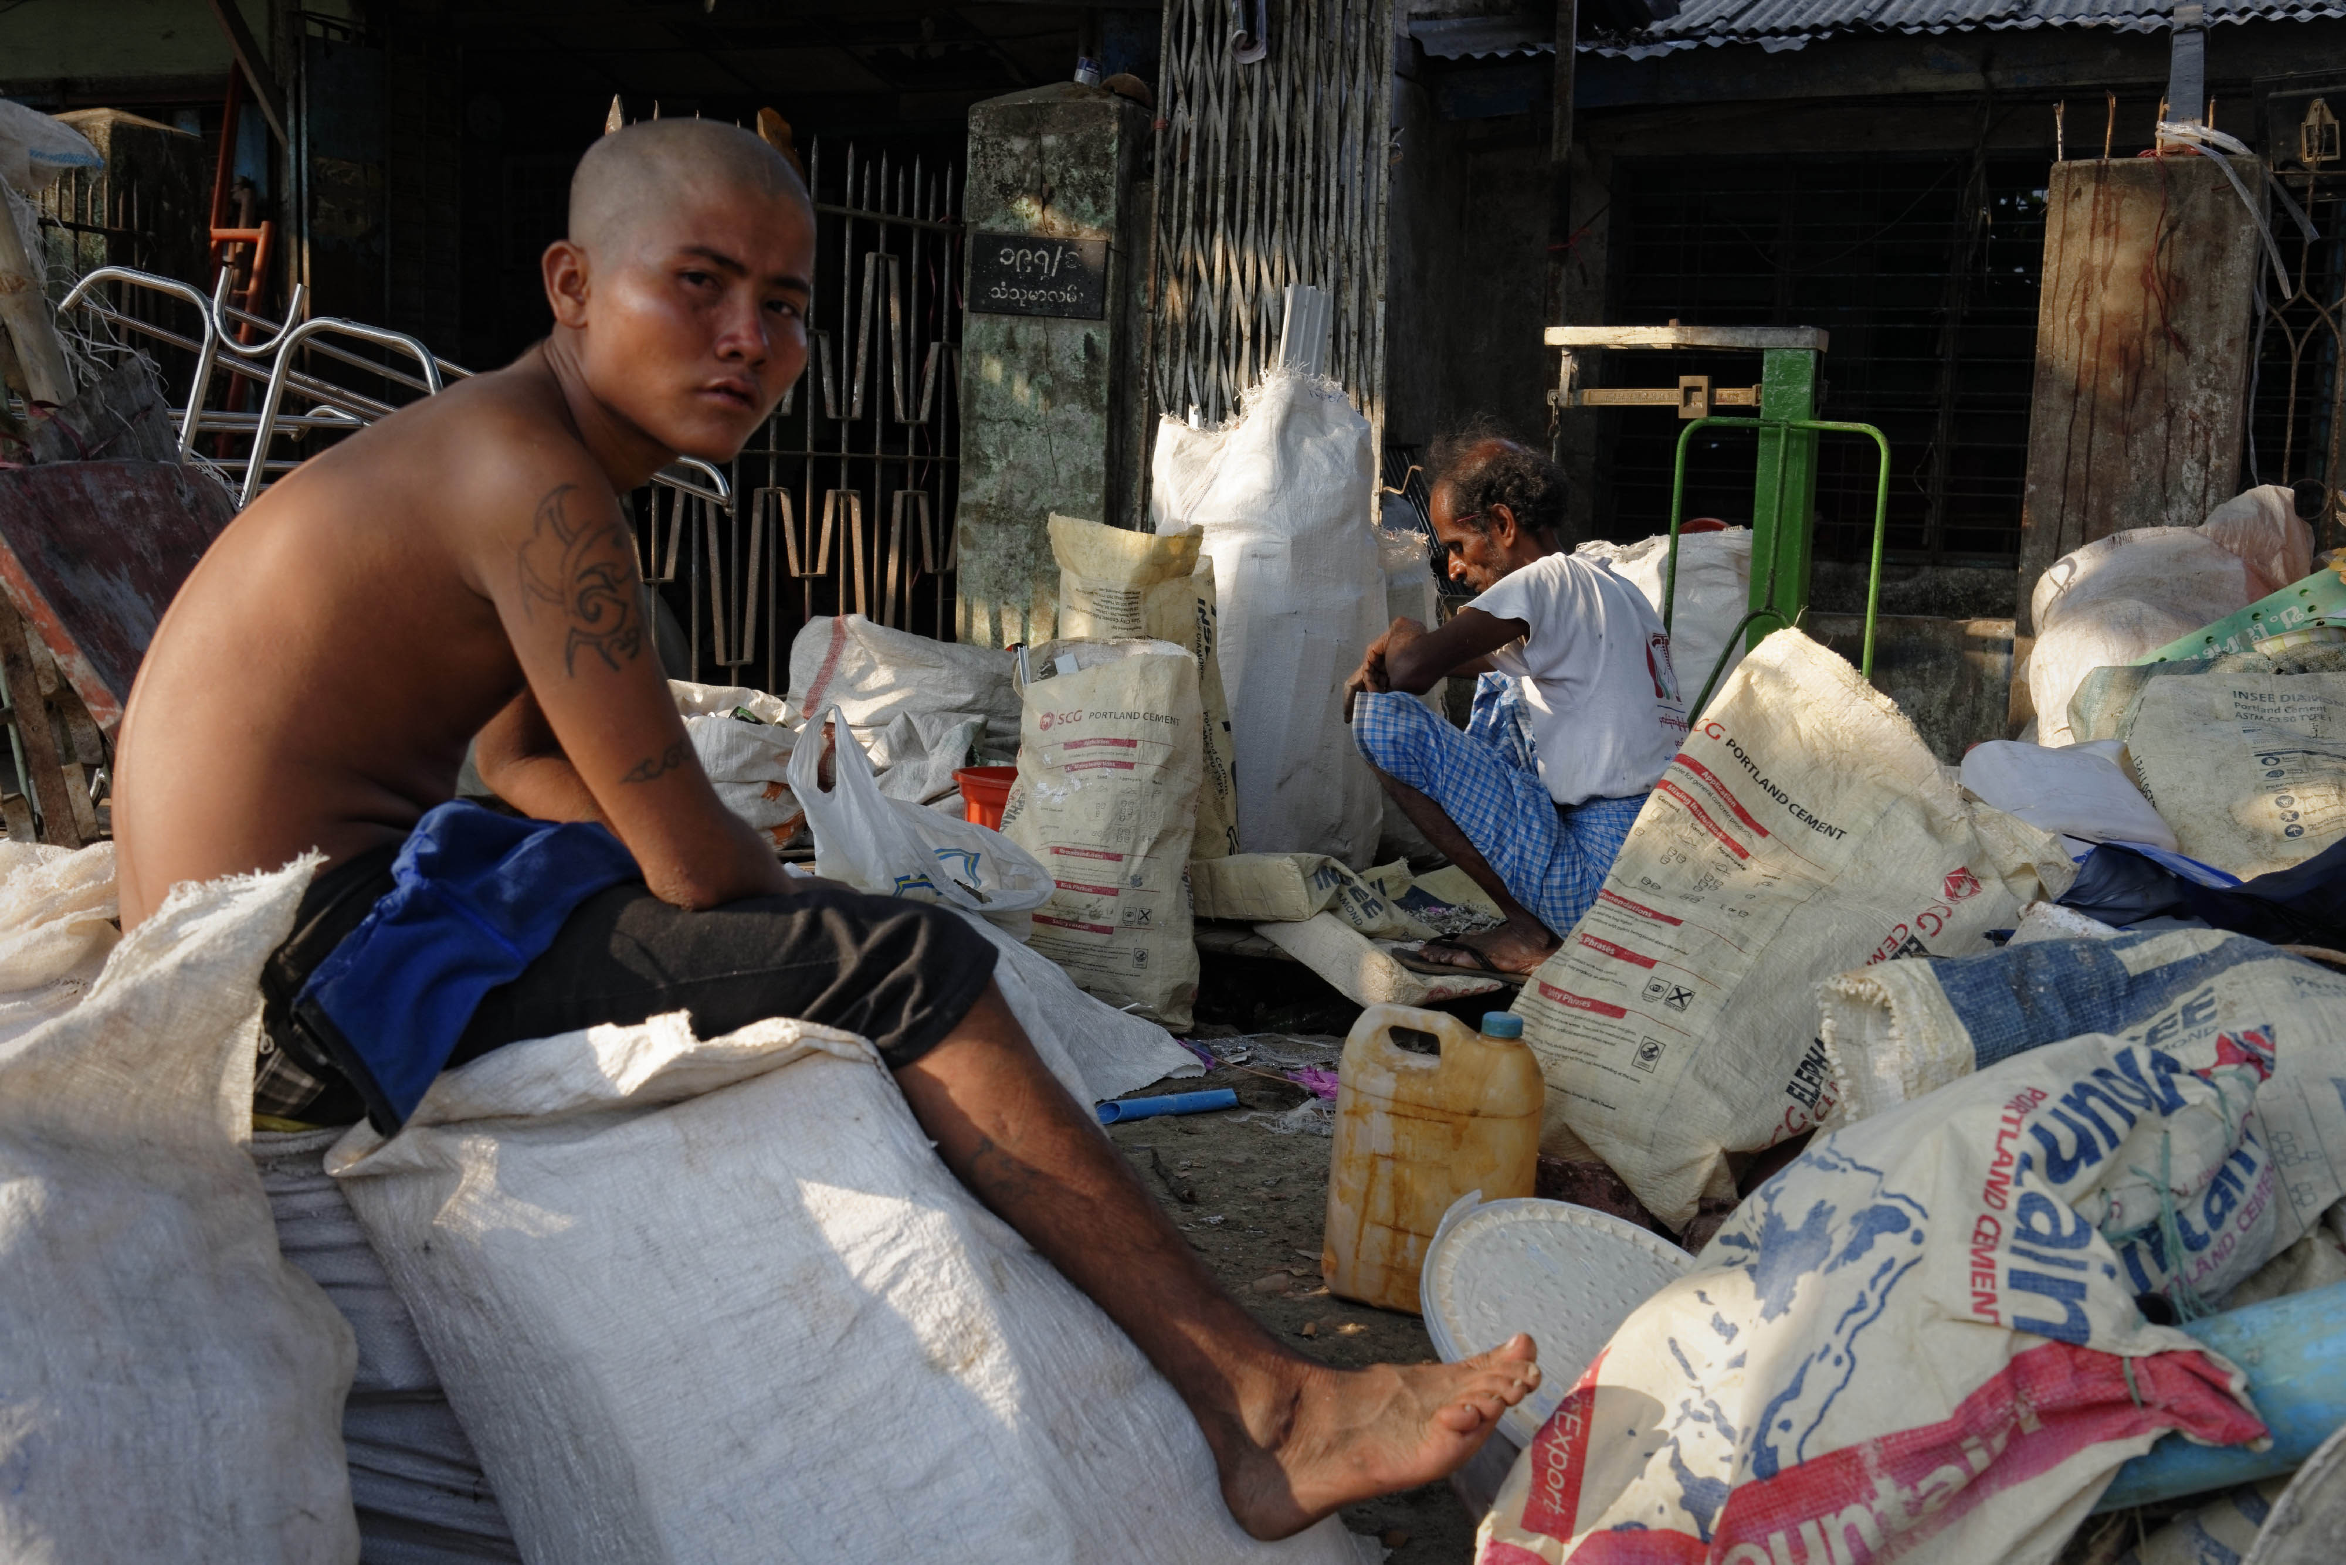
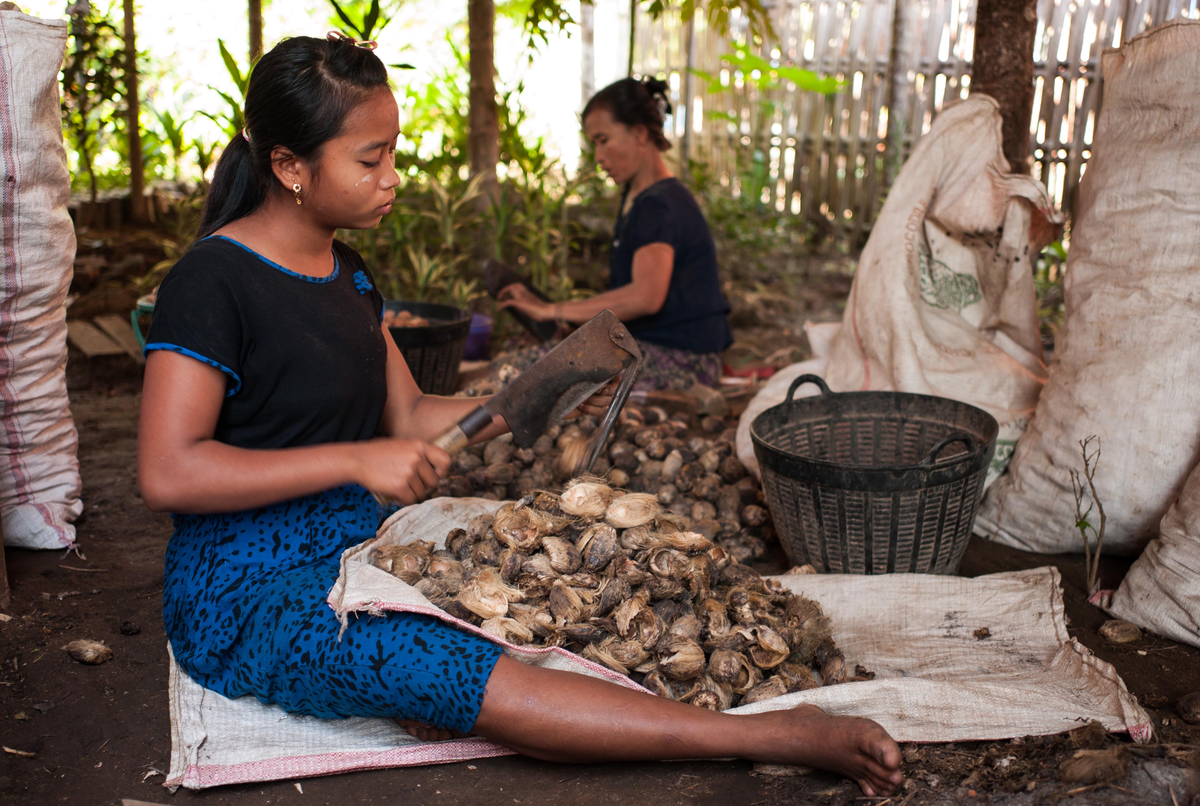
What is Hazardous Child Labour?
Work performed by children in dangerous and unhealthy conditions that can lead to a child being killed, injured or made ill.
Represents the largest category of children working in the WFCL
Occurs in agriculture, mining, construction, manufacturing, the service industries and domestic work, most often in informal, unregulated and “hidden” parts of the economy

Slide 14
ILO Standards and Other International Instruments
Ratify:
ILO Convention 138 on the Minimum Age for Employment
ILO Convention 182 on the Worst Forms of Child Labour
UN Convention on the Rights of the Child
ILO Convention 189 on Decent Work for Domestic Workers
Consider:
ILO Recommendation 146 on the Minimum Age for Employment
ILO Recommendation 190 on the Worst Forms of Child Labour
Promote:
ILO Declaration on Fundamental Principles and Rights at Work

Slide 15
Eliminating Child Labour in Myanmar: Legal and Regulatory Tools
Factories Act, 1951
Shops and Establishments Act, 1951
Oilfields (Workers and Welfare) Act, 1951
Maternal and Child Welfare Association Law (and Amendment), 1990
The Child Law, 1993
Anti-Trafficking in Persons Law, 2005

Slide 16
Q&A
Do you have any questions/comments about:
Child labour?
Worst Forms of Child Labour?
Hazardous child labour?
National laws and regulations in Myanmar?

Slide 17
Exercise 2: Identifying Strengths and Weaknesses in National Law and Regulation
Divide into small groups.
Nominate a note-taker and presenter.
Discuss the question or topic you are given.
Present the conclusions of your discussion in plenary.

Slide 18
Session 2: Understanding Global & National Estimates of Child Labour

Slide 19
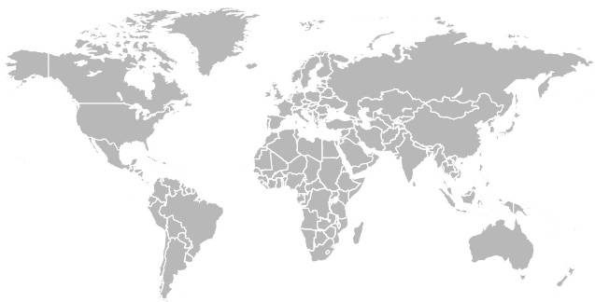
Child Labour in the Global Economy: A Summary of ILO Estimates
152 million children worldwide are in
child labour – 10% of the world’s
children
73 million children are in hazardous work
Second largest number of child labourers are found in the Asia-Pacific region
Notes:
Create handout for participants summarizing estimate per regional, gender and age breakdown

Slide 20
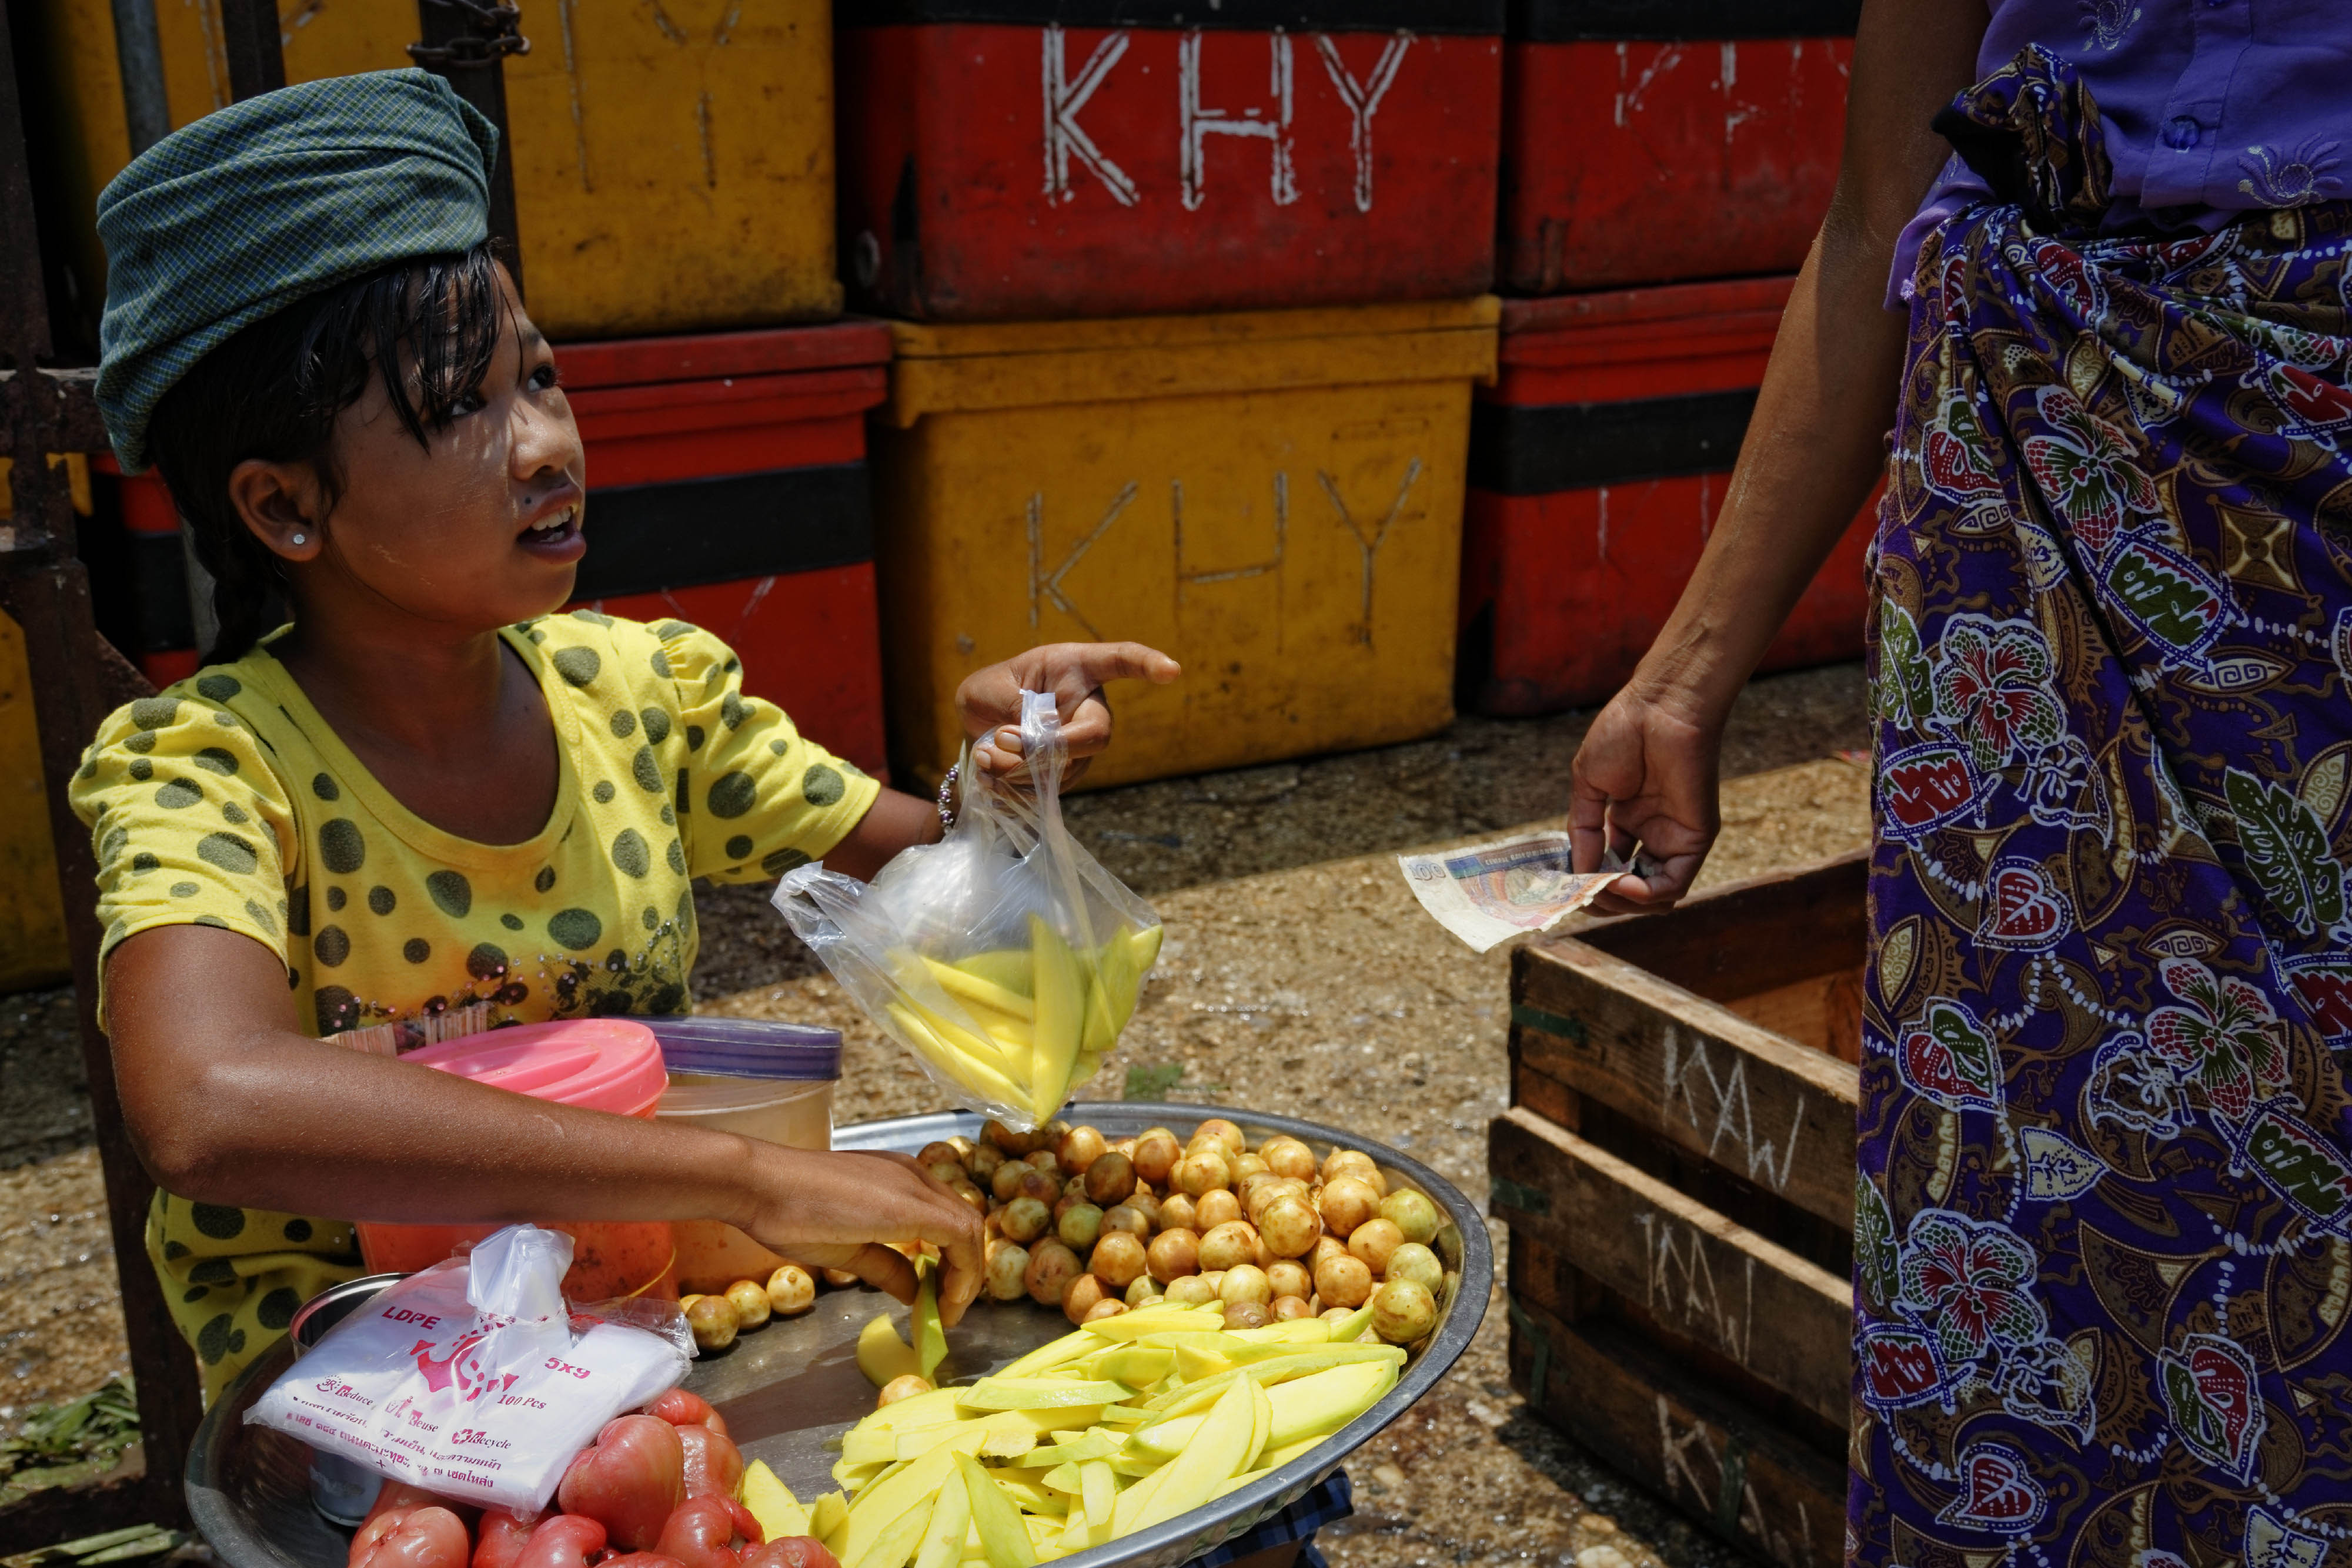
Sector Distribution of Child Labour
Sector | (‘000) | %
Agriculture | 107,543 | 70.9
Industry | 18,007 | 11.9
Services | 26,072 | 17.2
*The industry sub-sectors of most relevance for child labour include construction, mining and manufacturing. *The services sub-sector of most relevance for child labour include hotels and restaurants, wholesale and retail trade (commerce), maintenance and repair of motor vehicles, transport, other community, social services activities and domestic workers.

Slide 21
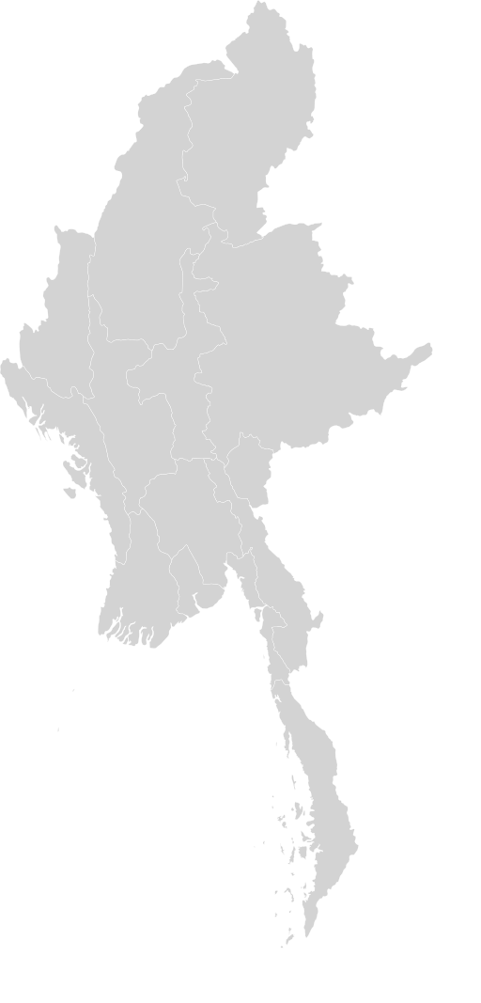
Key Findings from Myanmar’s Child Labour Survey
There are an estimated 1.1 million child labourers in Myanmar
This represents 9.3% of the total number of children in the country
Over 600,000 of these are in conditions of hazardous child labour

Slide 22
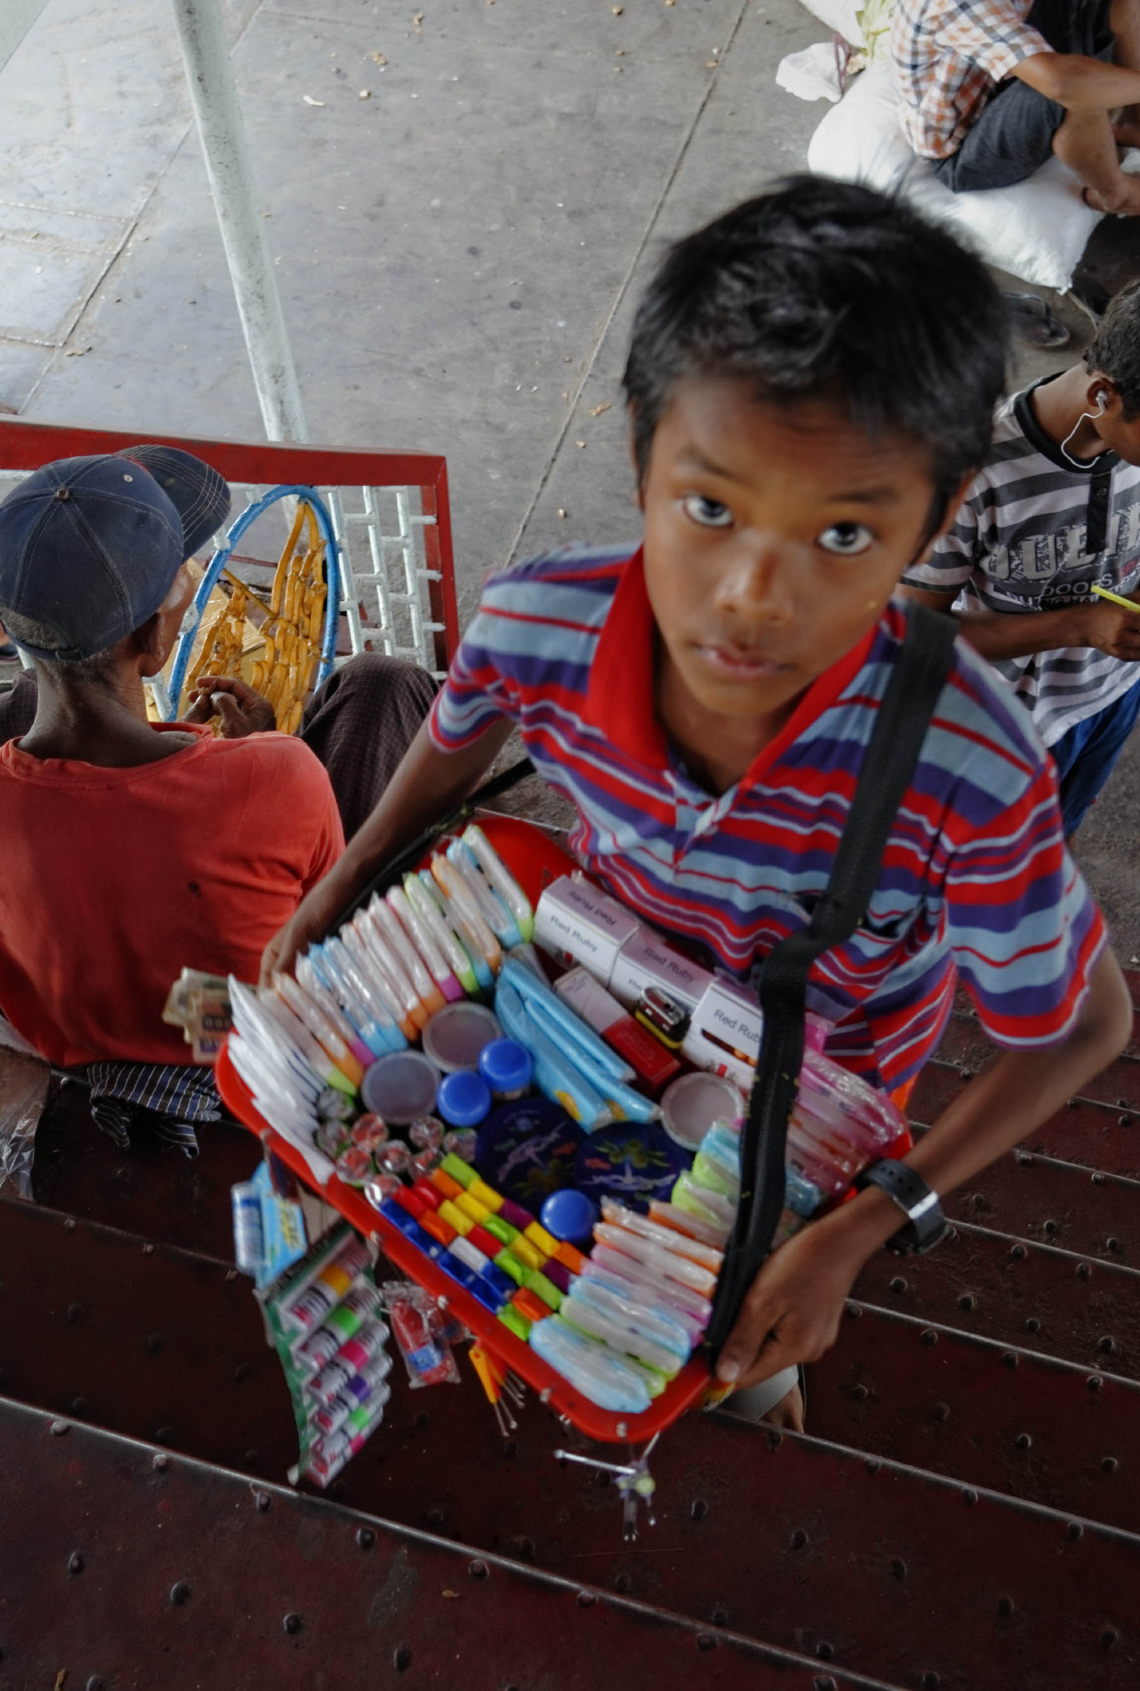
Sectoral Distribution of Working Children in Myanmar
Sector | %
Agriculture, forestry and fishing | 60.5
Manufacturing | 12
Construction | 4
Trades | 11.1
Other services | 6.1
Other industries and occupations | 6.3
Total | 100

Slide 23
Key Indicators (2015 and 2017 Q1)
Description | 2015 LFS |  |  | 2017 LFS Q1
 | Total | Male | Female | Total | Male | Female
Child population (5-17 years) | 12,146,463 | 6,010,459 | 6,136,004 | 12,410,000 | 6,157,000 | 6,253,000
Working child | 1,278,909 | 676,208 | 602,701 | 805,000 | 448,000 | 357,000
Child labour | 1,125,661 | 601,471 | 524,190 | 623,000 | 350,000 | 273,000
Hazardous child labour | 616,815 | 337,318 | 279,498 | 608,000 | 343,000 | 265,000

Slide 24
Key Indicators (2015 and 2017 Q1)
Description | 2015 LFS |  |  | 2017 LFS Q1
 | Total | Male | Female | Total | Male | Female
Proportion of working children(%) | 10.5 | 11.3 | 9.8 | 6.5 | 7.3 | 5.7
Proportion of child labour(%) | 9.3 | 10.0 | 8.5 | 5.0 | 5.7 | 4.4
Proportion of hazardous child labour(%) | 5.1 | 5.6 | 4.6 | 4.9 | 5.6 | 4.2

Slide 25
Q&A
Do you have questions/comments about:
ILO global estimate of child labour?
National data on child labour in Myanmar?

Slide 26
Exercise 3: Mapping Risk of Child Labour in Myanmar
Divide into small groups.
Nominate a note-taker and presenter.
Discuss the question or topic you are given.
Present the conclusions of your discussion in plenary.
Notes:
Handout: map of Myanmar outline but with international borders identified with Thailand, Bangladesh

Slide 27
Session 3: Causes & Consequences of Child Labour

Slide 28
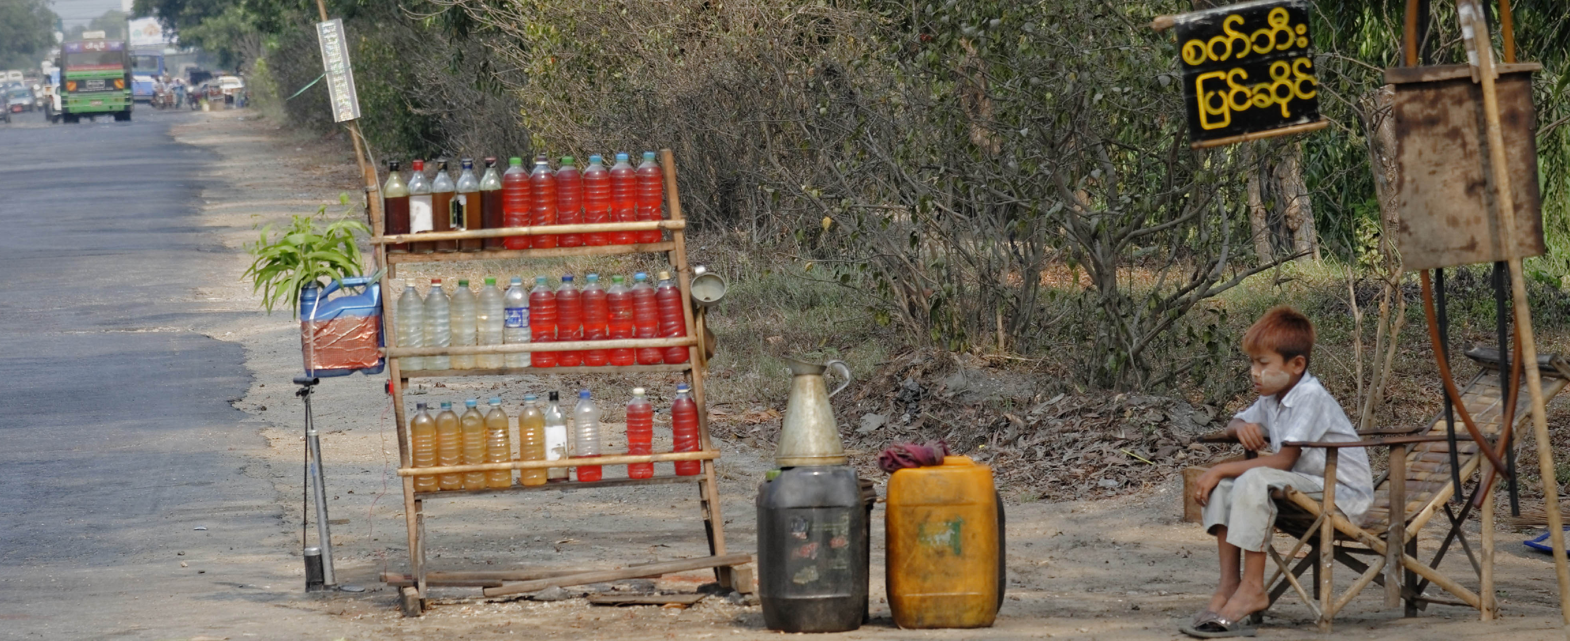
Understanding the Causes of Child Labour
Low household income
Lack of access to quality education
Discrimination
“Distress” migration
Culture or family traditions
“Nimble fingers” argument
Weak or non-existent laws and law enforcement
Absence of worker organization
Supply and demand of child labour

Slide 29
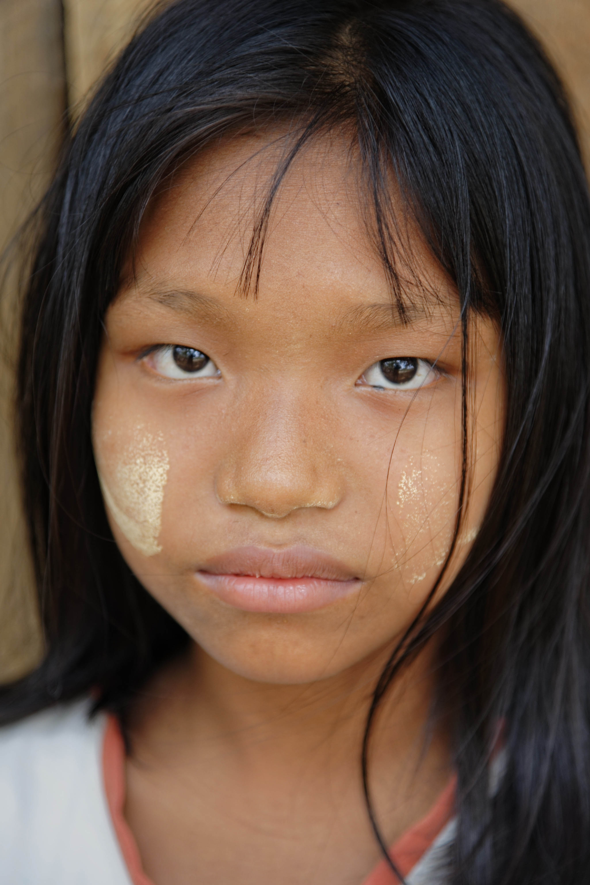
Understanding the Consequences of Child Labour
Child labour can:
Jeopardize children’s health and safety, and affect their physical and psycho-social development;
Impede children’s access to education and/or skills training, thus limiting their economic and social mobility and advancement later in life;
Lead to continued poverty over generations and inhibit children’s access to decent work when they reach the minimum legal age for employment; and
Act as a significant impediment to achieving the Sustainable Development Goals, in particular concerning poverty alleviation and education for all.

Slide 30
Q&A
Do you have questions/comments about:
Causes of child labour?
Consequences of child labour?

Slide 31
Exercise 4: Deepening Understanding of the Causes and Consequences of Child Labour
Divide into small groups.
Nominate a note-taker and presenter.
Discuss the question or topic you are given.
Present the conclusions of your discussion in plenary.

Slide 32
Session 4: Worker Action to Eliminate Child Labour

Slide 33
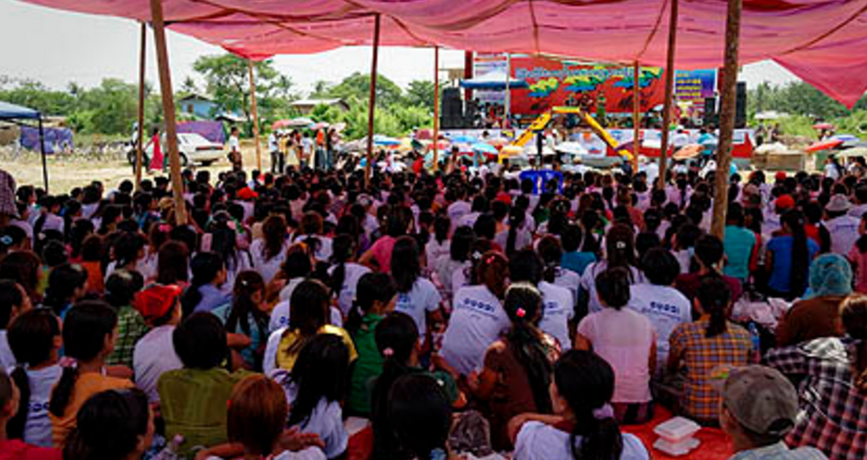
Worker Action in the Workplace and Community
Social dialogue and collective bargaining to eliminate child labour
Workplace safety and health committees
Employer monitoring and identification of work hazards
Worker and community awareness campaigns
Partnerships with civil society and community groups

Slide 34
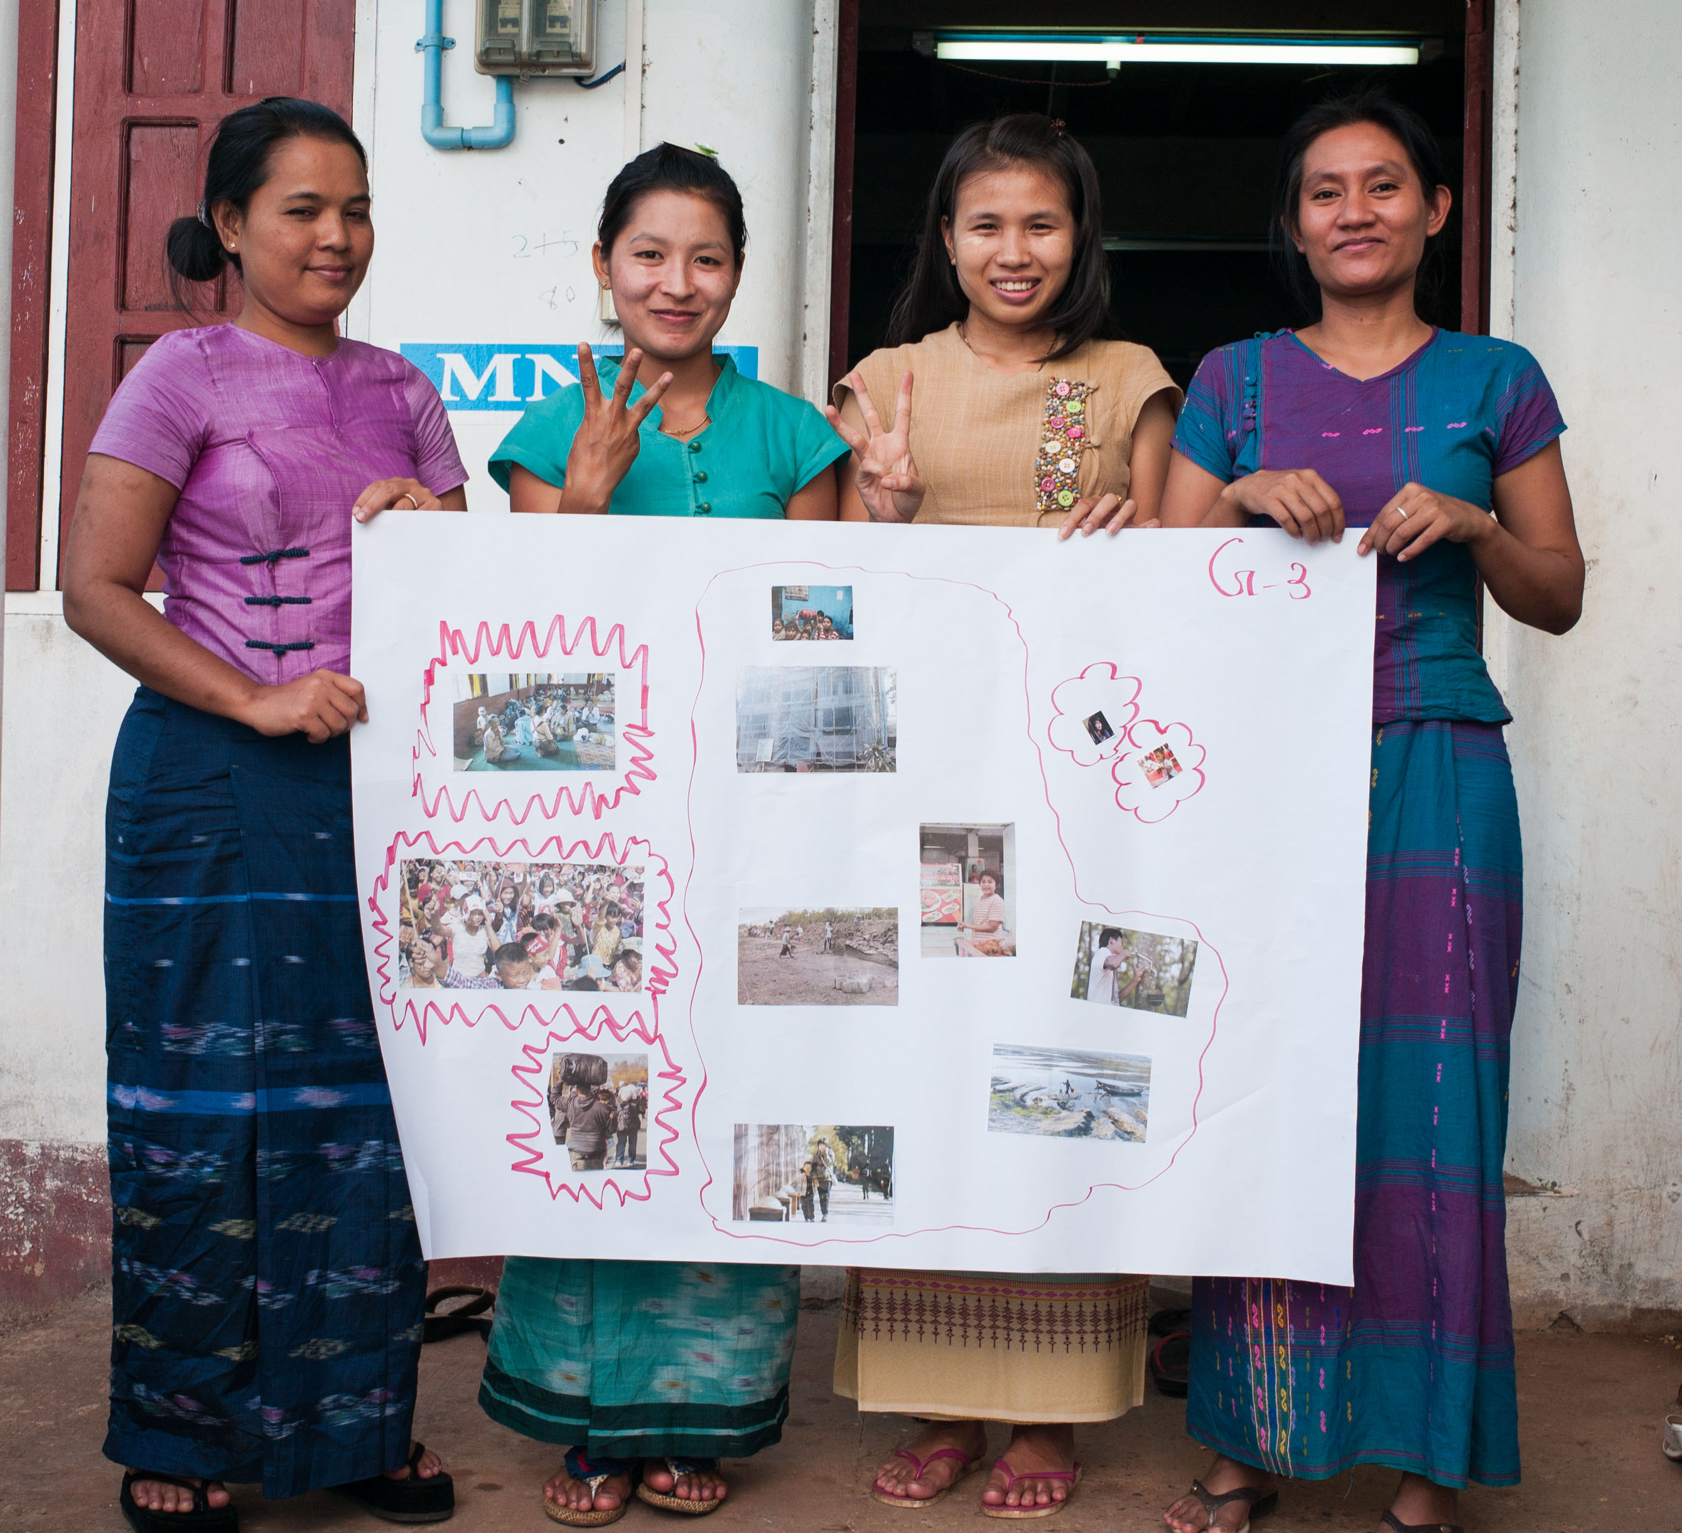
Worker Action in Policy Dialogue
Campaign to promote ratification of ILO Convention
Legal and regulatory reform
Implementation, institution-building and law enforcement
Supporting creation of national list of hazardous work for children

Slide 35
Q&A
Do you have questions/comments about:
Worker engagement through social dialogue?
Action in the community?
Influencing national policy dialogue?

Slide 36
Exercise 5: Strengthening Worker Action to Eliminate Child Labour
Divide into small groups.
Nominate a note-taker and presenter.
Discuss the question or topic you are given.
Present the conclusions of your discussion in plenary.

Slide 37
Exercise 6: Following up with Action
Divide into small groups.
Nominate a presenter.
Discuss the questions you have been given.
Present your conclusions in plenary.

Slide 38
Course Conclusion & Evaluation

Slide 39
Course Conclusion
Final comments
Tour de table
Follow-up and next steps

Slide 40
Course Evaluation
Please complete the course evaluation form provided

Slide 41
Thank you!

