Slide 1


Standard-setting on apprenticeships
110th session of ILC
Presentation of the Office Reports IV (1 and 2):
A framework for quality apprenticeships

Slide 2




Rationale for a new Standard
Following the juridical replacement of two instruments:
1939
The Vocational Training Recommendation
(No. 117)
the Apprenticeship Recommendation, 1939 (No. 60)
Apprenticeship was not comprehensively addressed
under any subsequent
ILO instruments.
The Apprenticeship Recommendation
(No. 60)
1962
110th session of ILC - A framework for quality apprenticeships

Slide 3
Rationale for a new Standard
In 2016, this regulatory gap was identified by the Standards Review Mechanism Tripartite Working Group (SRM TWG).
The 334th ILO Governing Body
in 2018 requested the Office
to place a standard-setting item related to apprenticeships on the agenda of the
110th session of the ILC.
110th session of ILC - A framework for quality apprenticeships

Slide 4


Process until now
Mar 2021
Constituents submitted replies to questionnaires
Jan 2022
2nd Report IV(2) including proposed conclusions based on the replies from constituents
Dec 2019
1st Report IV(1) on law and practice including
a questionnaire
110th session of ILC - A framework for quality apprenticeships

Slide 5
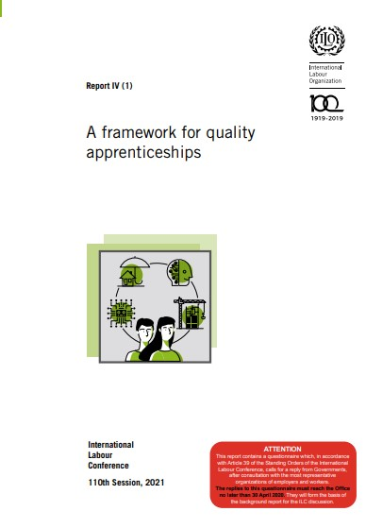
1st Report
1
Concept of apprenticeships
2
Overview of regulatory frameworks
3
Key benefits and challenges
Q
A Questionnaire concerning a framework for quality apprenticeships
110th session of ILC - A framework for quality apprenticeships

Slide 6

2nd Report
1
Introduction and general observations
2
Analysis of replies received for each question & Office commentary
3
Proposed Conclusions
110th session of ILC - A framework for quality apprenticeships

Slide 7
General observations from replies received
Create an enabling environment to promote quality apprenticeships
Ensure equality and diversity
Involve social partners in the design and implementation of policies, systems and programmes
110th session of ILC - A framework for quality apprenticeships

Slide 8
Key issues in the proposed Conclusions
Form of the instrument
Content of the instrument
Definitions, scope and implementation
Traineeships
01
06
Regulatory framework for quality apprenticeships
Promotion of quality apprenticeships and international cooperation
02
Preamble
05
03
04
The apprenticeship agreement
Equality and diversity in quality apprenticeships
110th session of ILC - A framework for quality apprenticeships

Slide 9

Thank you very much for your kind attention.
ilo.org/ilc

