Slide 1
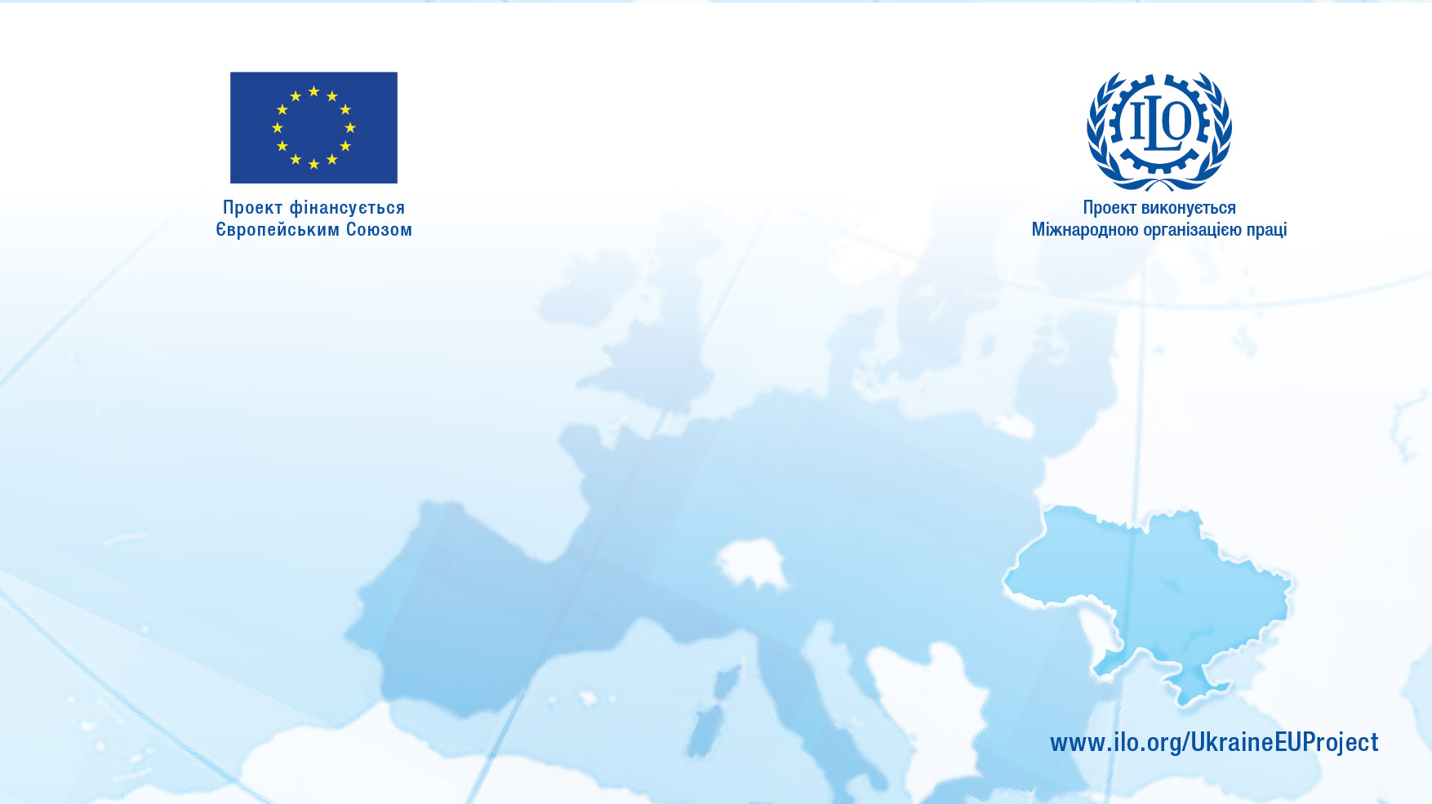
EU-ILO Project
«Enhancing the labour administration capacity to improve working conditions and tackle undeclared work»
Undeclared Work in Ukraine
Compliance and Contribution Collection in the Prevalence of Undeclared Work
International Training Center (ITC) | International Labour Organization (ILO)
Kyiv, Ukraine| 4 September 2018
Антоніу Сантуш / António Santos
Менеджер проекту / Project manager

Slide 2
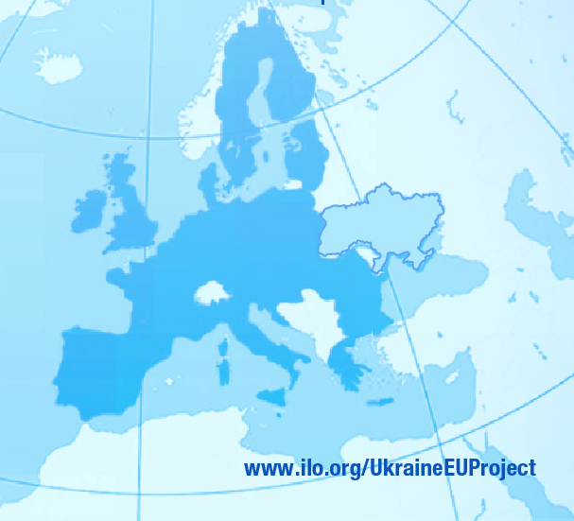
Content
UDW (concept, taxonomy, main causes and main consequences)
UDW in Ukraine (size, nature and most relevant manifestations)
First Ukrainian Undeclared Work Survey main findings (size, nature of undeclared activities, undeclared workers profile and reasons to work undeclared)

Slide 3
UDW concept
Exercise of an
activity
Licit as to its nature
Totally
or partially undeclared to the Labour Administration, Tax Administration or Social Security
Undeclared Work (UDW)
Within the scope of an employment relationship
Of compulsory declaration to Labour Administration, Tax Administration or Social Security
Legal or contractually remunerated

Slide 4
UDW taxonomy
Undeclared Work
Fully Undeclared Work
Partially Undeclared Work
Moonlighters
Recipients of unemployment benefits
Pensionists
Bogus volunteers
Illegal immigrants
Child labour
Human trafficking for sexual or labour exploitation
Concealment / dissimulation of employment relationship
Subdeclaration of Remunerations
Bogus self-employment
Bogus civil contracts
Bogus service providers
Bogus subcontractors/outsourcing
Bogus trainees/internships
Bogus Individual entrepreneurs
Bogus part-time
Bogus absence (part of the month)
Overtime under the counter
Fringe benefits (car, credit card, cell, gas, apt. rent)
Allowances for bogus travels

Slide 5
UDW main causes
Workers | Employers
Not enough regular jobs. | Difficulties to find regular workers.
Its the only way to a find a job in the region/sector. | It is the way the sector works.
Difficulties to access labour market (lack of qualifications, absence of license, age, disability, irregularity of residence). | To reduce personnel costs (salaries, annual leave, overtime, OSH, etc.) and increase income.
It is a seasonal or short-term job. | To improve competitiveness.
To increase net income. | To increase human resources flexibility (in recruitment and dismissal).
Excessive tax burden.
Both parties (worker and employer) benefit from UDW.
Excessive administrative, legal and bureaucratic burdens.
Ignorance of the advantages in declaring.
Not knowing the disadvantages of not declaring.

Slide 6
UDW main consequences
Workers | Employers | States
Indecent working conditions. | Unfair competition. | Unsustainability of social security.
Non-protection against damages arising from occupational accidents and diseases | Difficulties in obtaining credit and to grow. | Imbalance of public finances.
Non-protection regarding several events (unemployment, sickness, retirement, etc.). | Management “Myopia” (competitiveness mainly based on legal infringements). | Insufficiency of state resources for the provision of public services and social protection.
Absence of legal guarantees (salary, protection regarding unlawful dismissals, annual leave, training, limits to working time, rest, OSH conditions, etc.). | Lack of productivity (due to HR turneover, absences and lack of training, lack of economies of experience, etc.). | Increase of the income taxes and of the social contributions taxes.
Inability to obtain the recognition, validation and certification of professional skills and experience. | Difficulties to provide product/service warranties. | Degradation of the working and living conditions due to social dumping.
Sanctions for non-compliance. | Degradation of employer image and lack of access to certain markets | Unfair competition and decrease of foreign investment.
 | Sanctions for non-compliance. | Inequality, segmentation, exclusion and social injustice.

Slide 7
UDW in Ukraine – size and nature
SECTORS OF ACTIVITY | SIZE OF UDW (SURVEY) |  | SIZE OF INFORMAL ECONOMY
 | SUPPLY SIDE | DEMAND SIDE | INFORMAL EMPLOYM. IN FORMAL SECTOR | EMPLOYM. IN INFORMAL SECTOR
Agriculture, forestry and fishing (including gardening) | 8.9% | 16.0% | 6.1% | 57.6%
Industry |  | 24.0% | 6.9% | 1.5%
Construction |  | 24.0% | 32.0% | 25.2%
Wholesale and retail trade (including: selling food from farms; and selling goods/services associated with a hobby) | 22.5% | 24.0% | 24.7% | 3.7%
Transport, storage, postal and courier services (including: automotive maintenance/car repairs; help moving house; and taxi driving) | 10.7% | 15.0% | 10.2% | 2.8%
Temporary accommodation and catering | 2.0% | 55.0% | 29.4% | 0.6%
Provision of other services (including: household services - home maintenance, repairs, cleaning and improvement services; babysitting; ironing; tutoring; and hairdressing and beauty treatments) | 30.3% | 60.0%

Slide 8
UDW in Ukraine – most relevant manifestations of UDW
Informal employment in the formal sector (hired labour without formalized labour relations in registered enterprises)
Employment in the informal sector (economic activities performed by unregistered enterprises or by persons without registration/declaration with competent authorities);
Underreported actual working hours and wages “in envelopes”
Disguised employment (through commercial contracts, independent contractor contracts, bogus self-employment, bogus internships, bogus volunteers and misuse of distant and outsourcing mechanisms)
Unreported secondary employment (“Moonlighting”)

Slide 9
UDW in Ukraine – total informal employment
3,961,200 people, making up to 24.3% of the total employed population (2016)
Majority payroll employees (52,2%)
Majority males (57,9%)
Majority rural residents (52,2%)
Most exposed groups: young people of 15-24 (35,6%) and retired persons with 60-70 (36%)
Mainly in agriculture and construction

Slide 10
UDW in Ukraine – informal employment in the formal sector
1,830,200 people, making up to 11.3% of the total employed population (2016)
Highest rates in Ivano-Frankivsk (26.3%), Lviv (16.7%) and Kherson (14.9%)
Mainly in construction (32.0% of all people employed in the sector), temporary accommodation and catering services (29.4%) and wholesale and retail trade (24.7%)
Predominantly concentrated in urban areas (73.9%)

Slide 11
UDW in Ukraine – employment in the informal sector
2,131,000 people, making up to 13% of the total employed population (2016)
Highest rates in Chernivtsi (40.0%), Rivne (38.5%), Trans-Carpathian (32.6%), Kherson (27.2%) and Ivano-Frankivsk (26.9%)
Mainly in Agriculture, forestry and fishing (57.6%) and construction (25.2%)
Predominantly concentrated in rural areas (74.7%)

Slide 12
UDW in Ukraine – underreported working hours/wages
Up to 85-90% of the reported wages are not declared (Kharazishvili & Dmytrenko, 2010)
Around 12.4% of the employees of formal sector enterprises are paid unreported wages
Weekly average working hours are estimated to be up to 11.3% longer than the reported ones (Labour Force Survey)

Slide 13
First Ukrainian Undeclared Work Survey (UUDWS)
Comissioned by the National University of Kyiv-Mohyla Academy (NaUKMA) and the International Labour Organization (ILO)
Direct method to estimate the size and nature of the undeclared work, using the methodology of the 2 Special Eurobarometer studies “Undeclared work in the European Union” done by TNS Opinion & Social in 2007 and 2013
Conducted by the Kyiv International Institute of Sociology (KIIS), between October and November of 2017
Based on the application of a questionnaire, through 1,000 interviews

Slide 14
UUDWS main findings – size of UDW
7.10% of the respondents admitted having carried out UDW in the last 12 months
33% estimate that at least half (50% or more) of the population of the Ukraine works undeclared
45.8% know personally people that work undeclared

Slide 15
UUDWS main findings – undeclared workers profile
73.8% are males
Main age groups: 35-44 years of age (about 32%), 45-54 years (about 28%) and 25-34 years (23%)
62% live in urban areas
Employment status: unemployed (33.5%), employed (31.2%), self-employed (18.4%), retired (10.5%) and student (1.9%)

Slide 16
UUDWS main findings – nature of main undeclared activities
Home maintenance or home improvement services (25.7%)
Gardening (8.9%)
Selling food (e.g., farm produce) (14.1%)
Car repairs (8.1%)
Selling goods/services associated with my hobby (7.4%)

Slide 17
UUDWS main findings – reasons to work undeclared
Could not find a regular job (19.7%)
This is the normal way how this is done (12.9%)
It was just a seasonal work and so it is not worth to declare it (15.4%)
The State does not do anything for you, so why should I pay taxes (10.8%)
Both parties benefited from it (10.2%)

Slide 18
UUDWS main findings – leading 2 reasons to work undeclared
Lack of regular jobs on the labour market (20%)
Insufficient income from regular job (16%)
The State does not do anything for the people, so why should they pay taxes (19%)
Taxes and/or social security contributions are too high (13%)

Slide 19
Дякую за увагу!
Thank you for your attention!
Gracias por su atención!
Obrigado pela vossa atenção!
robalo@ilo.org

