Slide 1

EU-ILO Project
«Enhancing the labour administration capacity to improve working conditions and tackle undeclared work»
Draft Ukrainian National Action Plan to Fight Undeclared Work
Compliance and Contribution Collection in the Prevalence of Undeclared Work
International Training Center (ITC) | International Labour Organization (ILO)
Kyiv, Ukraine| 6 September 2018
Антоніу Сантуш / António Santos
Менеджер проекту / Project manager

Slide 2
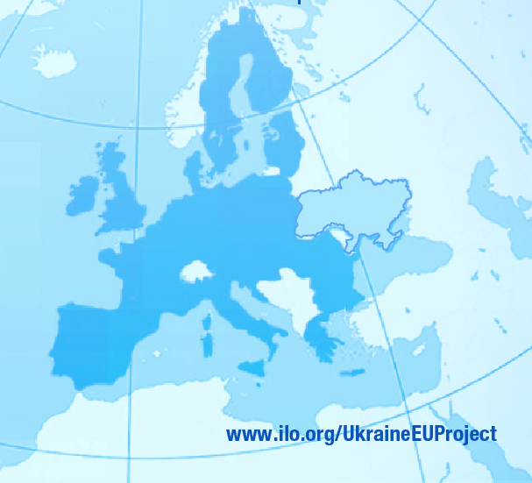
Content
Action Plan Formulation Process
Synthesis
Strategy
Definition of Measures

Slide 3
Strategy – some management definitions
Definitions | Authors
Determining the goals and long-term objectives of an organization and the adoption of means of action and allocation of resources needed to achieve these goals | Alfred Chandler
Pattern of decisions concerning key objectives, policies and action sequence, with high potential effects on the viability and direction of the company as a whole, or that determine its competitive positioning for a prolonged period time | James Brian Quinn
Unified, integrated and comprehensive plan, designed to ensure that the basic objectives of the organization are achieved | William Glueck
Creation of a match between the activities of the organization in search of a favorable competitive position in an industry against the forces that shape the competition and profitability in that industry | Michael Porter
Plan that brings together, in an integrated manner, the objectives, policies and actions of the Organization, aimed at creating a sustainable competitive advantage | Adriano Freire
Plan, road, path, guide or course of action for the future | Henry Mintzberg
Line of action of an organization in order to achieve their purposes | De Wit e Meyer
Pattern of objectives and major policies to achieve them, expressed so as to define what business the company is or should be in and the kind of company that it is or should be | Kenneth Andrews
The decision on where to fight the enemy (i.e., the competition) | Vasconcellos e Sá

Slide 4
Strategy – no consensus on the definition
Strategy
Path, direction
Pattern
(of actions, decisions, objectives)
Objectives and targets
Line (of orientation, action)
Plans
Set of actions and decisions
Policies
Where
Fight against…
Competition (enemy)

Slide 5
Strategy – the return to origins: military science
Etymologically, the word strategy derives from the Greek word στρατηγός (strategos) which means “general” or “the art of the general”
Military definitions | Author
The answer to the questions “where” and “when” | Attila (King of the Huns)
The moment, the place and the necessary forces | Carl von Clausewitz
The art of distributing and applying military means as a way of achieving the ultimate policy | Sir Basil Henry Liddell Hart

Slide 6
Strategy – a synthesis
Strategy
Where
Plan
How

Slide 7
Strategy – a synthesis
Strategy
Where
Plan
How
Define objectives (outcomes, outputs)
Set time-frame (when)
Define activities
Allocate resources (HR/who, financial, material)
Organize
Identify the enemy (UDW and its types)
Define objectives (outcomes, outputs)
Decide where to attack:
Types UDW
Sectors of activity
Regions

Slide 8
Strategy – a synthesis
Strategy
Where
Plan
How
Define objectives (outcomes, outputs)
Set time-frame (when)
Define activities
Allocate resources (HR/who, financial, material)
Organize
Identify the enemy
(UDW and its types)
Define objectives (outcomes, outputs)
Decide where to attack:
Types UDW
Sectors of activity
Regions
Segmentation Matrix
Measures
Action Plan

Slide 9

Strategy – Strategic process
Analysis
Formulation of the Action Plan
Implementation of the Action Plan
Monitoring and Evaluation

Slide 10
Action Plan Formulation - Process
1. Identify the enemy (where)
2. Establish strategic objectives
3. Define measures (how)
4. Establish activities and operational objectives

Slide 11
Action Plan Formulation - Process
1. Identify the enemy (where)
2. Establish strategic objectives
3. Define measures (how)
4. Establish activities and operational objectives
SECTORS OF ACTIVITY | SIZE OF UDW (SURVEY) |  | SIZE OF INFORMAL ECONOMY
 | SUPPLY SIDE | DEMAND SIDE | INFORMAL EMPLOYM. IN FORMAL SECTOR | EMPLOYM. IN INFORMAL SECTOR
Agriculture, forestry and fishing (including gardening) | 8.9% | 16.0% | 6.1% | 57.6%
Industry |  | 24.0% | 6.9% | 1.5%
Construction |  | 24.0% | 32.0% | 25.2%
Wholesale and retail trade (including: selling food from farms; and selling goods/services associated with a hobby) | 22.5% | 24.0% | 24.7% | 3.7%
Transport, storage, postal and courier services (including: automotive maintenance/car repairs; help moving house; and taxi driving) | 10.7% | 15.0% | 10.2% | 2.8%
Temporary accommodation and catering | 2.0% | 55.0% | 29.4% | 0.6%
Provision of other services (including: household services - home maintenance, repairs, cleaning and improvement services; babysitting; ironing; tutoring; and hairdressing and beauty treatments) | 30.3% | 60.0%

Slide 12




Action Plan Formulation - Process
1. Identify the enemy (where)
2. Establish strategic objectives
3. Define measures (how)
4. Establish activities and operational objectives
COD | STRATEGIC OUTCOMES | INDICATOR | FORMULA | BASELINE | TARGET | VERIFICATION SOURCE
SOC1 | Capability to prevent UDW is strengthened. | % reduction on the size of UDW |  |  | 25% | Data from National Statistics Office.
SOC2 | Transition from UDW to regular jobs is encouraged. | % of detected undeclared workers whose situation was regularized |  |  | 75% | Data from SLS, Social Security, Pension Fund and Tax Authorities
SOC3 | Social awareness towards UDW is raised and development of a compliance culture is induced. | % increase on the number of people covered by the information and awareness-raising activities |  |  | 100% | Data from SLS, Social Security, Pension Fund and Tax Authorities
SOC4 | Ability to detect UDW is secure. | % increase on the number of undeclared workers detected |  |  | 100% | Data from SLS, Social Security, Pension Fund and Tax Authorities
SOC5 | Capacity to effectively sanction UDW is reinforced. | % increase on the number of UDW convictions |  |  | 100% | Data from Courts, SLS and Tax Authorities
$$\frac{{Size udw}_{n+2}−{Size udw}_{n}}{{Size udw}_{n}}$$
$$\frac{{Nbr regularized udw}_{n+2}+{Nbr regularized udw}_{n+1}}{{Nbr detected udw}_{n+2}+{Nbr detected udw}_{n+1}}$$
$$\frac{{((Nbr people covered}_{n+2}+{Nbr people covered}_{n+1})/2)−{Nbr people covered}_{n}}{{Nbr people covered}_{n}}$$
$$\frac{{((Nbr detected cases}_{n+2}+{Nbr detected cases}_{n+1})/2)−{Nbr detected cases}_{n}}{{Nbr detected cases}_{n}}$$
$$\frac{{((Nbr convictions}_{n+2}+{Nbr convictions}_{n+1})/2)−{Nbr convictions}_{n}}{{Nbr convictions}_{n}}$$

Slide 13
Action Plan Formulation - Process
1. Identify the enemy (where)
2. Establish strategic objectives
3. Define measures (how)
4. Establish activities and operational objectives
Measures to fight UDW in Ukraine
Approach
Enabling compliance
Deterrence
Measures
11
Preventive measures
M1.1-M1.11
4
Curative measures
M2.1-M2.4
5
Fostering commitment measures
M3.1-M3.5
11
Measures to improve detection
M4.1-M4.11
7
Measures to improve sactions
M5.1-M5.7

Slide 14
Action Plan Formulation – Logical framework
Tasks fo be performed
Definition of a Measure
Activities
Outputs
Outcomes
Expected impact of the results
Results to be achieved through activities

Slide 15
Action Plan Formulation – Outputs & outcomes
SMART Outputs
&
Outcomes
Specific
Measurable
Achievable
Relevant
Time-oriented
Indicators
Targets

Slide 16
Definition of a measure - Identification
IDENTIFICATION
Measure code and designation: | M2.3 - Introduce "service vouchers schemes”.
Strategic outcome pursued: | SOC2 - Transition from UDW to regular jobs is encouraged.
Entity responsible for implementation: | <Responsible entity>
Start date: | <DD/MM/YYYY> | End date: | <DD/MM/YYYY>

Slide 17
Definition of a measure – description and scope
DESCRIPTION & SCOPE
Description of the measure: | M2.3 - Introduce "service vouchers schemes” regarding activities with particular incidence of undeclared work (e.g., home maintenance and repairs; agriculture; gardening; healthcare; domestic services, such as ironing, cleaning and washing; babysitting; car repairs; hairdressers) in order to regulate the labour market and encourage undeclared workers to move to regular jobs.
Geographical scope (National/Regional/Local): | <National> or <Region 1>; <Region 2>; <Region 3>; <Region 4>; <Region 5>
Sectoral scope (General/Specific): | <General> or <Sector 1>; <Sector 2>; <Sector 3>; <Sector 4>; <Sector 5>
Recipients/Beneficiaries: | <Recipient 1>; <Recipient 2>; <Recipient 3>; <Recipient 4>; <Recipient 5>

Slide 18
Definition of a measure – resources and critical success factors
RESOURCES & CRITICAL SUCCESS FACTORS
Other entities to involve: | <Entity 1>; <Entity 2>; <Entity 3>; <Entity 4>; <Entity 5>
Financial resources (UAH): | <Amount>
Human resources: | <Number>; <Professional Category>; <Nbr of 8 hrs days to be allocated during the measure implementation>
Material and equipment resources: | <Quantity>; <Nature>
Critical Success Factors (CSF): | <Critical Success Factor 1>
 | <Critical Success Factor 2>
 | <Critical Success Factor 3>

Slide 19
Definition of a measure – activities and timetable
ACTIVITIES & IMPLEMENTATION TIMETABLE
Activities |  | Time frame
Main tasks | Responsible | 1 | 2 | 3 | 4 | 5 | 6 | 7 | 8 | 9 | 10 | 11 | 12 | 13 | 14 | 15 | 16 | 17 | 18 | 19 | 20 | 21 | 22 | 23 | 24
Set up tripartite work group | SLS
Draft legal act | SLS
Submit to other stakeholders for consultation and feedback | SLS
Submission to MSP for review and approval | SLS
Submission to Parliament | MSP
<Activity 6>
<Activity 7>
<Activity 8>
<Activity 9>
<Activity 10>

Slide 20
Definition of a measure – Outputs⁽¹⁾
Measure Outputs | Indicator | Formula | Baseline | Target | Verification source
MOP1.13.1 - The requirements and design of the system to assess and monitor UDW and the measures taken to combat it are defined. | MOPI1.13.1 - The study, on the requirements and design of the system to assess and monitor UDW and the measures taken to combat it, is submitted and approved before the established deadline. | n.a. | n.a. | End of the 6h month after the entering into force of the present Action Plan. | SLS, Parliament and/or Ministry of Justice
MOP1.13.2 - The development and implementation of the system to assess and monitor UDW and the measures taken to combat it is commissioned. | MOPI1.13.2 - The UDW follow-up system development and implementation is commissioned before the established deadline. | n.a. | n.a. | End of the 12h month after the entering into force of the present Action Plan. | SLS, Tax authority and social security
MOP4.3.1 - First inspection visits are reinforced. | MOPI4.3.1 - % increase of the number of first inspection visits on UDW by the end of the 24h month after the entering into force of the present Action Plan. | n.a. | n.a. | 200% | SLS+Local self-government bodies
MOP4.5.1 - Labour inspection and other public authorities cooperate in the fight against UDW. | MOPI4.5.1 - Number of cooperation protocols signed between SLS and other public authorities by the end of the 12h month after the entering into force of the present Action Plan. | n.a. | n.a. | 3 | SLS
<Measure output 5> | <Measure output indicator 5> | <Formula 5> | <Baseline 5> | <Target 5> | <Entity 5>
⁽¹⁾ More examples of potential outputs and indicators available on the sheet “5-Outputs&Indicators”

Slide 21
Definition of a measure – Outcomes⁽¹⁾
Measure Outcomes | Indicator | Formula | Baseline | Target | Verification source
MOC1.13.1 - A system to assess and monitor UDW and the measures taken to combat it is set up and running. | MOCI1.13.1 - The system to assess and monitor UDW and the measures taken to combat it is implemented before the established deadline. | n.a. | n.a. | End of the 24th month after the entering into force of the present Action Plan. | SLS, Tax authorities and social security
MOC2.1.1 - Active employment measures to tackle UDW are in place. | MOCI2.1.1 - % variation on the number of beneficiaries of the "active employment measures". | n.a. | n.a. | 50% | Data from the social security, employment services, and pension fund
MOC3.1.1 - Society is aware to the phenomenon of UDW and a culture of compliance and fiscal morality is being consistently developed. | MOCI3.1.1 - Total number of persons covered by the information and awareness-raising campaigns and actions on UDW by the end of the 24th month after the entering into force of the present Action Plan. | n.a. | n.a. | 250,000 | Data from SLS, Tax authority, social security
<Measure outcome 4> | <Measure outcome indicator 4> | <Formula 4> | <Baseline 4> | <Target 4> | <Entity 4>
<Measure outcome 5> | <Measure outcome indicator 5> | <Formula 5> | <Baseline 5> | <Target 5> | <Entity 5>
⁽¹⁾ More examples of potential outcomes and indicators available on the sheet “4-Outcomes&Indicators”

Slide 22
Synthesis – Action Plan formulation process

Slide 23
Synthesis – Action Plan measures

Slide 24
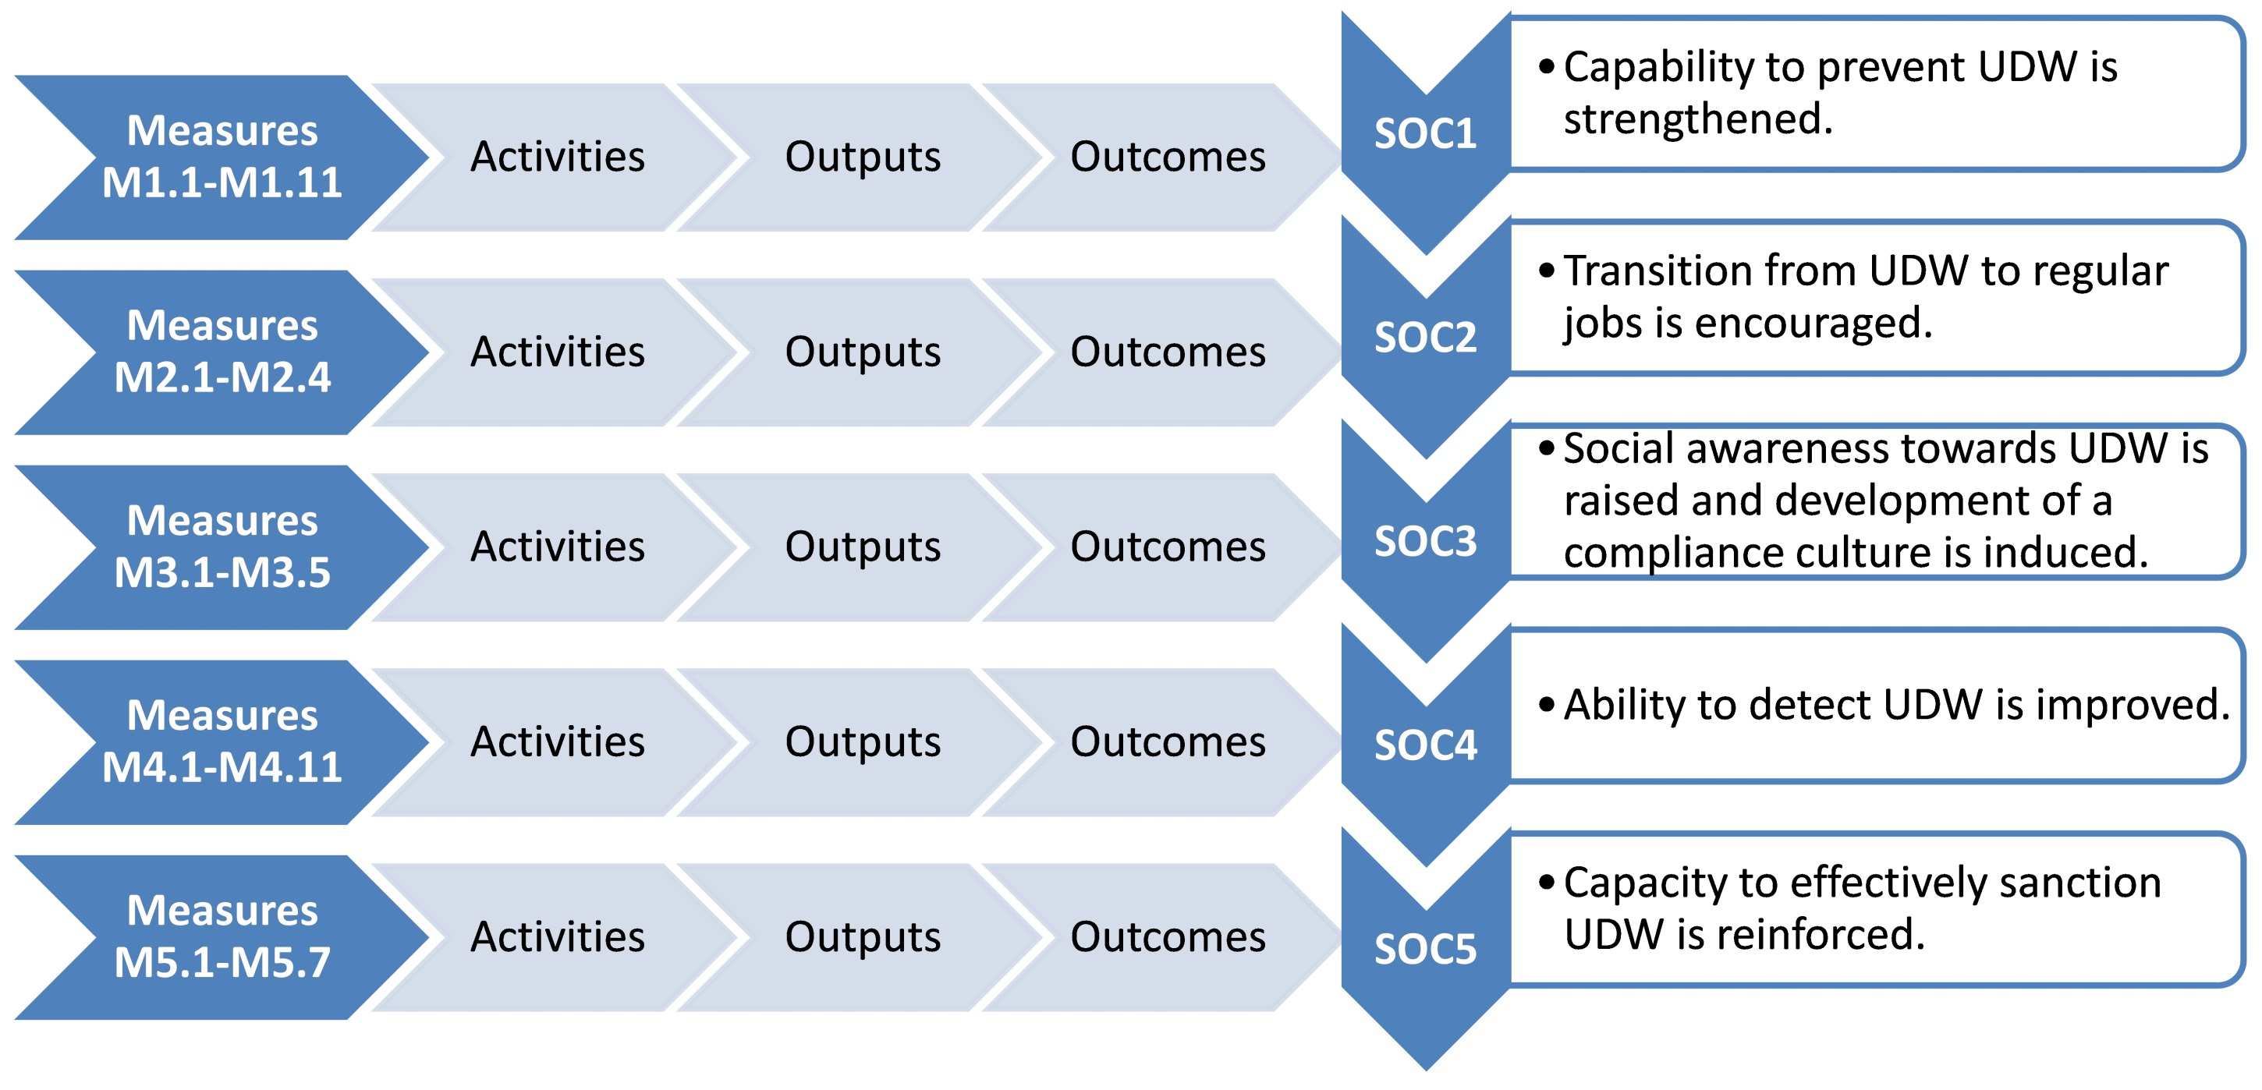
Synthesis – Action Plan logical framework

Slide 25
Draft Ukrainian Action Plan to Fight UDW - internet link
https://www.ilo.org/wcmsp5/groups/public/---ed_dialogue/---lab_admin/documents/projectdocumentation/wcms_644139.pdf

Slide 26
Дякую за увагу!
Thank you for your attention!
Gracias por su atención!
Obrigado pela vossa atenção!
robalo@ilo.org

