Slide 1
The ILO
Supported
Skills Anticipation
Component of SIFA

Slide 2
Skills Initiative for Africa
(SIFA)
A Continental Programme of the African Union Commission (AUC) and the African Union Development Agency (NEPAD), financed by the European Union and the German Government

Slide 3
SIFA-Skills Anticipation Component
Collaborates with
African Union Commission,
AU Development Agency (NEPAD)
German Development Organization (GIZ)
Supports Capacity Building
of Member States to identify, and strategically address current and future labour market skills needs
Ultimate Objective
minimizing gaps between demand and supply of skills within Countries and in the continent

Slide 4
Why Skills Anticipation Component
Mismatch between demand and supply of skills can contributes to costly economic inefficacies, including:-
Difficult transition from education to productive employment
Under-utilization of existing skills
Limited portability of skills and qualifications across countries, and regions

Slide 5
through which
labour market actors identify and prepare to address future skills needs, with the view to avoid gaps between the demand and supply of skills
Skills Anticipation A Strategic Imperative and systematic process

Slide 6
Contributes to broader SIFA Objectives
Conditions for Employment Oriented TVET in
AU Member States Improved
1. Dialogue to promote employment oriented skills development strengthened
(GIZ)
Economic and Social perspectives of Young
Africans Improved
2. Web
based learning/innovation for employment oriented skills development expanded
(GIZ)
3. Capacities for Labour market forecasting and skills anticipation enhanced
(ILO)
4.Foundation for African Continental Qualification Framework laid
(ETF)
5.AUC and NEPAD mandate to promote employment oriented skills development strengthened
GIZ)

Slide 7
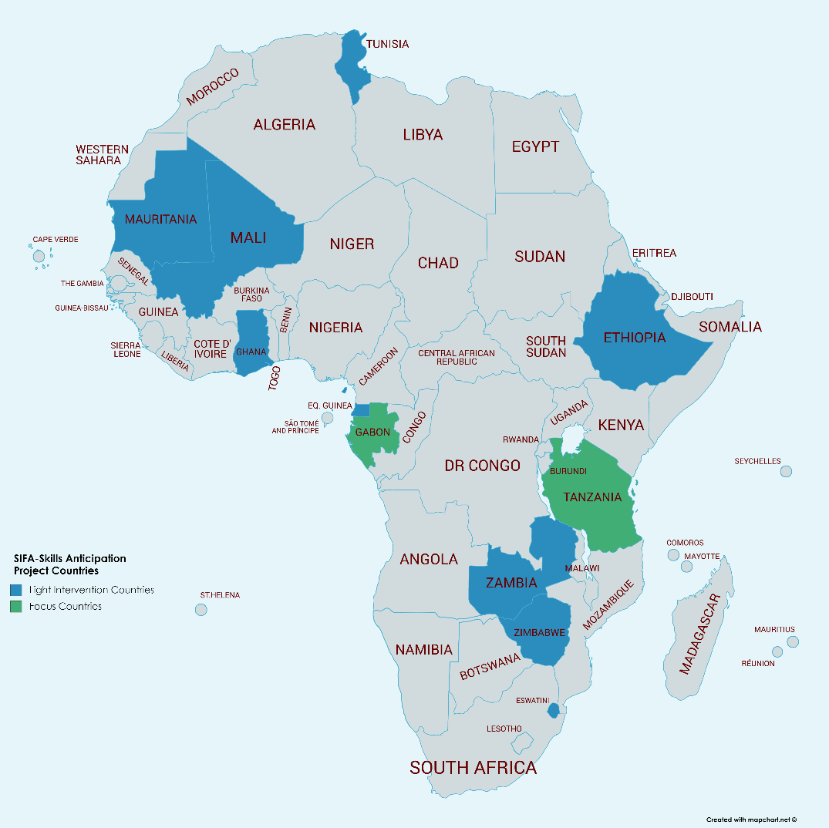
Eleven AU
Member States
targeted

Slide 8

Increase appreciation of skills anticipation as means to achieve labour market responsive skills development in Africa
Provide guidance to Member States on how to use skills anticipation as strategy for addressing imbalance in demand and supply of skills
Provide tools for Rapid Skills Assessment for quick identification of reskilling and upskilling needs arising from impact of COVID 19
Capacity building of African labour market and skills practitioners to generate, analyse and interpret labour market information to promote labour market responsive skills development policies and strategies

