Slide 1
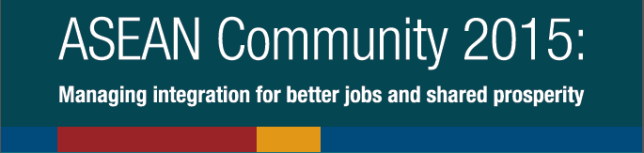





Slide 2
Overview
Background
Findings of the study
  Current situation (Chapters 1-2)
  AEC impact (Chapters 3-6)
Priorities for action (Chapter 7)

Slide 3
Background
Findings of study
  Current situation (Chapters 1-2)
  AEC impact (Chapters 3-6)
Priorities for action (Chapter 7)

Slide 4
BACKGROUND
The study focuses on how the AEC 2015 affects people through the labour market.
  How can integration be managed to ensure decent work and inclusive growth?
  What are implications for job creation, job quality, women?
  What kind of skills will be in demand?
  What will be the effect on labour migration?
  What will be the impact on productivity and wages?
Findings based on innovative CGE model simulations, occupational projections, policy analyses and
ASEAN employers’ survey.
Notes:
Expected impacts of AEC include:
Larger and more integrated markets
Economies of scale and intra-regional comparative advantage in production
More opportunities for businesses and jobs
Wider variety of goods and services for its people
Less intra-regional development gaps
But little research conducted on impact on labour markets
Study incorporates innovative computable general equilibrium (CGE) model. Builds on earlier work by Plummer, Petri and Zhai (2012). Policy shock entails (i) removal of intra-regional tariffs (ii) liberalization of non-tariff barriers by 50 per cent and (iii) trade facilitation in the form of 20 per cent reduction in fixed trade costs. Decomposition by skill level/occupation, gender and industry.
Also presents findings of an occupational projections model that extends CGE model simulations.
Highlights findings of an ILO survey of ASEAN employers on skills and competitiveness.

Slide 5
Background
Findings of study
  Current situation (Chapters 1-2)
  AEC impact (Chapters 3-6)
Priorities for action Chapter 7

Slide 6
IMPRESSIVE ECONOMIC PERFORMANCE,
BUT TOO MANY WORKERS IN ASEAN STILL HAVE POOR QUALITY JOBS.

Slide 7

CURRENT SITUATION
1. ASEAN integration in the global context
$2.4 trillion GDP in 2013; 300 million labour force.
Relative resilience to global economic crises.
  Between 2007-13, ASEAN countries grew faster than the global average.
Changing trade and FDI flows.
  Rising FDI inflows relative to rest of the world.
Rapidly growing middle class.
  From 1991-2013, 83 million workers joined the middle class;
  number expected to reach 144 million by 2017.
But rising inequality is a major concern …

Slide 8

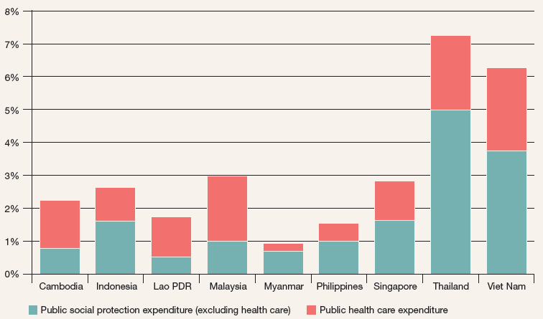
CURRENT SITUATION
1. ASEAN integration in the global context
40% of workers are in
low-income agriculture.
13% youth unemployment.
High informality,
low social protection coverage.
59% in ‘vulnerable’ employment (own
account plus unpaid family workers).
Persisting gender disparities.
Public social security expenditure, most recent year (per cent of GDP)

Slide 9

CURRENT SITUATION
2. Connecting across borders
Massive wage and infrastructure differences across countries.
Building connectivity key to the AEC mission of equitable development.
  Master Plan on ASEAN Connectivity and the Strategic Transport Plan will contribute to strengthening the AEC.
Existing integration agreements provide basis for further cooperation.
  Trade agreements with Australia, China, India, Japan, Rep. of Korea, New Zealand and others.
  Sub-regional economic zones (SIJORI, GMS, IMT-GT).

Slide 10
Background
Findings of study
  Current situation (Chapters 1-2)
  AEC impact (Chapters 3-6)
Priorities for action (Chapter 7)

Slide 11
THE AEC WILL DELIVER BENEFITS TO
THE REGION, BUT RISKS LEAVING SOME BEHIND AND AGGRAVATING INEQUALITIES.

Slide 12

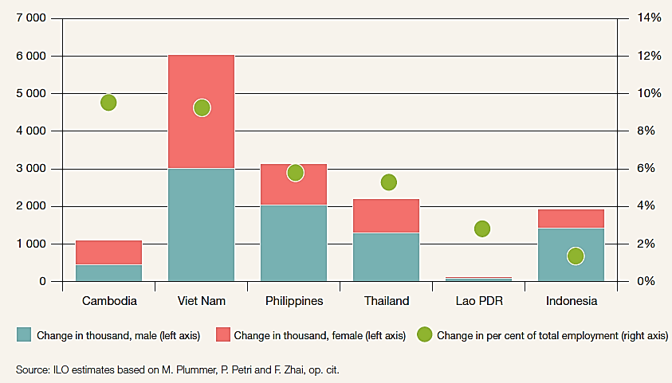
AEC IMPACT
3. Managing structural change for decent jobs
AEC could increase GDP by 7.1% by 2025.
Will create and destroy jobs.
Sectors likely to grow in most countries are trade and transport and construction.
Overall net job gain:
14 million additional jobs by 2025.
Estimated growth in employment under AEC, relative to baseline, 2025 (% of total employment)

Slide 13
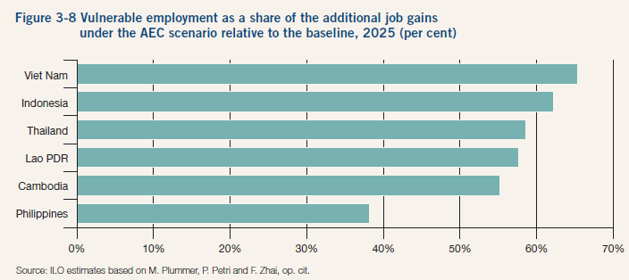
AEC IMPACT
3. Managing structural change for decent jobs
Gains will be uneven - varying by country, sector, gender.
Fewer new jobs for women than men.
Many new jobs could be in sectors that are vulnerable and informal.
Inequalities could worsen.
Vulnerable employment as a share of additional job gains under the AEC scenario, 2025

Slide 14

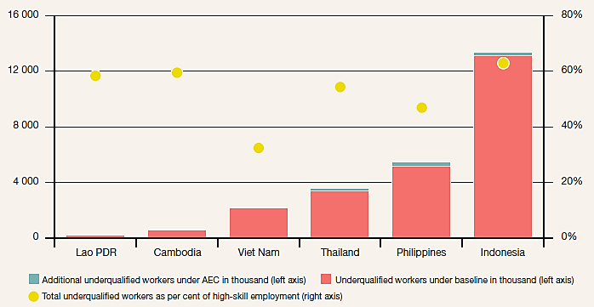
AEC IMPACT
4. Moving up the skills ladder
Different demand for different skill levels:
  High-skill jobs: +41%
  Medium-skill jobs: +22%
  Low-skill jobs: +24%
But skill mismatches are likely to worsen.
  More than half of high-skill jobs may be filled
  by under-qualified workers.
Estimated skills and educational mismatch in high-skilled occupations, 2025

Slide 15

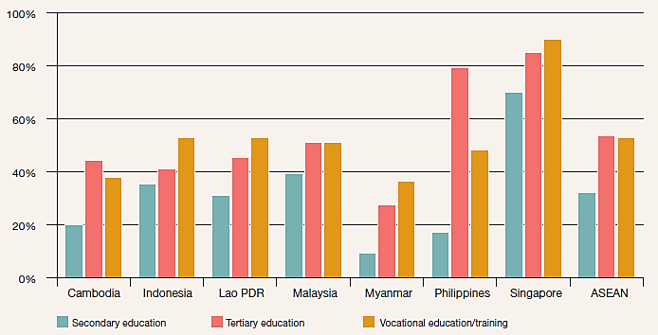
AEC IMPACT
4. Moving up the skills ladder
70% of employers believe secondary school graduates do not have right skills.
Quality and relevance of education and training need to be improved to meet industry requirements.
Share of respondents who agree that skills of secondary, tertiary, and vocational graduates match enterprise needs, 2013

Slide 16

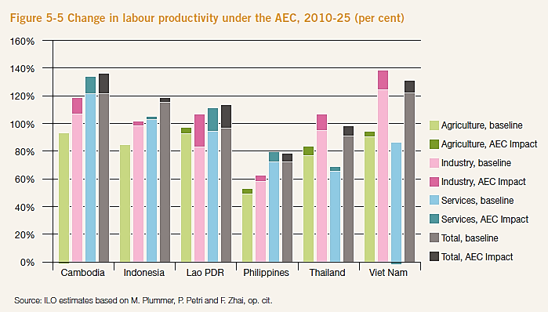
AEC IMPACT
5. Linking wages to productivity
AEC could create huge productivity gains – which could translate into wage gains.
Countries can compete based on higher labour productivity, not on low wages
  Some countries could avoid middle income trap.
Change in labour productivity under the AEC, 2010-25 (per cent)

Slide 17
AEC IMPACT
5. Linking wages to productivity
Significant wage and productivity gaps.
Wages of skilled workers likely to benefit most from AEC.
Sharing productivity gains with low-paid workers key for equitable growth and development.
  Effective minimum wage institutions needed.
Labour productivity and average wages in Thailand’s manufacturing sector, 2001-13
(Index, 2001=100)

Slide 18

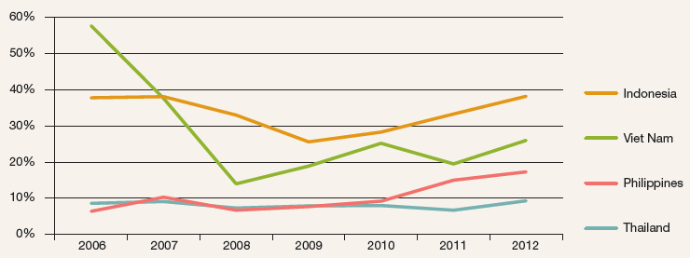
AEC IMPACT
6. Reaping the benefits of labour mobility
Migration between ASEAN countries increasing
  Growth from 1.5m to 6.5m between 1990-2013.
Mainly medium and low skilled workers migrate, further growth likely.
  High demand in construction, agriculture and domestic work.
Migration flows will be driven by demographic and wage disparities.
Intra-ASEAN share of outflow of international migrant workers, 2006-12 (per cent of total)

Slide 19
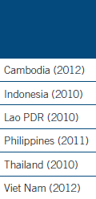
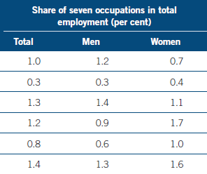
AEC IMPACT
6. Reaping the benefits of labour mobility
Free flow of skilled labour under AEC affects less than 1% of workforce;
little impact expected.
Protection of migrants
and regional and bilateral migration management
key issues.
Poor ratification of ILO Conventions that safeguard rights of migrant workers.
Share of 7 high-skill occupations under AEC in total employment, various years

Slide 20
Background
Findings of study
  Current situation (Chapters 1-2)
  AEC impact (Chapters 3-6)
Priorities for action (Chapter 7)

Slide 21
TO REALIZE THE FULL POTENTIAL OF THE AEC AND DELIVER SHARED PROSPERITY, ASEAN MUST TAKE DECISIVE ACTION … NOW

Slide 22

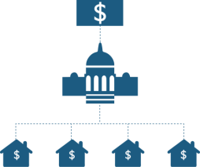

PRIORITIES
Decent work in an integrated ASEAN
A. FACILITATE AND MANAGE STRUCTURAL CHANGE.
B. ENSURE THAT ECONOMIC GAINS LEAD TO SHARED PROSPERITY.
C. STRENGTHEN REGIONAL COOPERATION.

Slide 23
A. FACILITATE AND MANAGE
STRUCTURAL CHANGE
Align industrial and employment policies.
Support small and medium enterprises.
Link education and training systems to private sector demand.
Invest in infrastructure and connectivity.
Establish social protection floor, including for migrant workers.

Slide 24
B. ENSURE THAT ECONOMIC GAINS LEAD TO SHARED PROSPERITY
Strengthen the wage–productivity link through stronger wage setting institutions:
  Minimum wages to protect workers against unduly low wages.
  Collective bargaining to negotiate improvements in
  working conditions and to raise productivity.
Promote gender equality.
Protect migrant workers.
Support youth employment.

Slide 25
C. STRENGTHEN REGIONAL COOPERATION
Implement existing ASEAN commitments.
  Cebu Declaration on Migrant Workers.
  Bandar Seri Begawan Declaration on Strengthening Social Protection.
Extend mutual recognition arrangements to medium skilled workers.
Ratify international labour standards to create level playing field.
Strengthen labour market information and monitoring.
Boost tripartite dialogue.

Slide 26
Ultimately, the success of ASEAN regional integration will depend on how it affects the labour market – and therefore on how it improves the quality of life of women and men in the region.
The full report “ASEAN Community 2015: Managing integration for better jobs and shared prosperity” can be accessed at: www.ilo.org/asia

