Slide 1

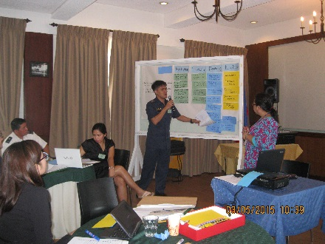
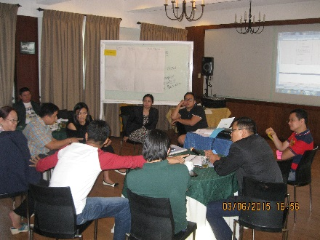
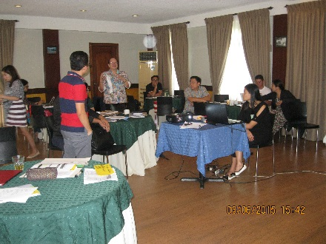
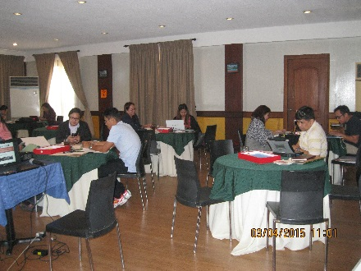
CHALLENGES & OPPORTUNITIES
AO35 Labor Related Cases
Administrative Order No. 35 Secretariat
Department of Justice

Slide 2
THE AO35 OPERATIONAL GUIDELINES
AO35 Operational Guidelines on Extra-Judicial Killings.

Slide 3
t
CHALLENGES:
To secure CONVICTION of AO 35 cases.
Air-tight case build-up.
Lack of coordination/collaboration among the prosecutors, law enforcers and other stakeholders.
Lack of cooperation/reluctance of victims and vital witnesses in the evidence gathering.

Slide 4
N
Gathering and preservation of object evidence.
Lack of clear policies in securing the safety and protection of witnesses and prosecutors.
Jurisdictional and conflict of interest issues of designation AO35 prosecutors due to lack of appointed prosecutors.
Insufficient dissemination of information to the public.

Slide 5
N
Prosecution of cases.
Continuity of service/participation in the investigation and prosecution of cases due to transfer of PNP, NBI, AFP investigators and also re-assignement of prosecutors.
Clogging of courts’ dockets.
Decisions rest on the descretion of courts.

Slide 6
N
OPPORTUNITIES:
Better communication and collaboration among prosecutors and law enforcers and other stakeholders was established leading to faster action in addressing AO35 cases.

Slide 7
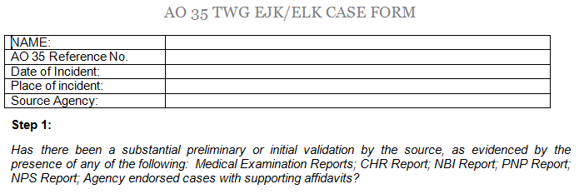
N
The AO35 Case Form

Slide 8
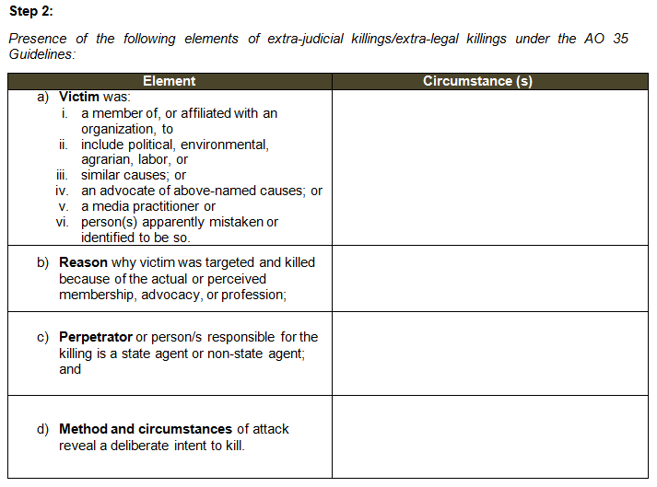
N

Slide 9
N
11 Verified Extra-Judicial Killings (Labor Related)
NAME OF VICTIMS
1. Diosdado Fortuna | 8. Gil Gojol
2. Florante Collantes | 9. Benjamin Bayles
3. Fr. William Tadena | 7. Tirso Cruz
4. Paquito Diaz | 10. Rodel Estrellado
5. Abelardo Ladera | 11. Rolando Pango y Claud
6. Samuel Bandilla

Slide 10
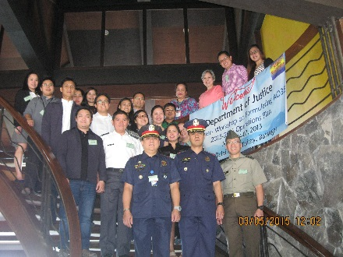
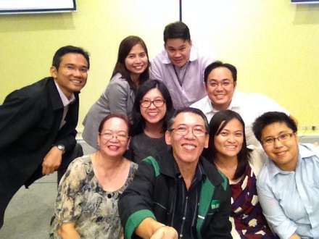
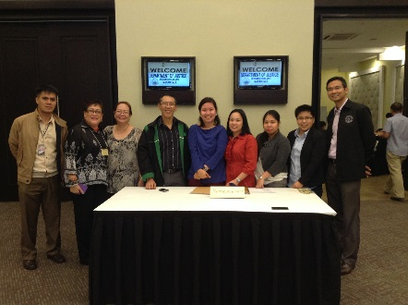
THANK YOU!

