Slide 1
KEYNOTE SPEECH
Connecting Youth to Opportunities. A Call for Evidence-based Action
Presented at the ILO Eastern & Southern Africa Youth Employment Knowledge Sharing Forum
By Godfrey Kanyenze (Dr.)
Labour & Economic Development Research Institute of Zimbabwe (LEDRIZ), 20 July 2015

Slide 2
STRUCTURE OF PRESENTATION
  1.0 Introduction: The ‘Youth Bulge’ in Africa: Reservoir of Working-Age Population
2.0 The Scourge of Youth Un- and Under-Employment, and Poverty in Africa
3.0 Connecting Youth to Opportunities. A Call for Evidence-based Action

Slide 3
Introduction: The ‘Youth Bulge’ in Africa: Reservoir of Working-Age Population
SSA is the youngest continent: in other regions the population is aging.
At 18 years, the median age in Africa is 7 years younger than the next youngest region, South Asia, and half the population is below that age.
Predictions are that SSA will remain the youngest region for the next decades, with the age gap with the other regions widening.
SSA’s population structure resembles a pyramid, with a ‘youth bulge.’
The East Asian and Pacific region’s experience points to the potential growth-enhancing effect of this ‘youth bulge’ as it was associated with a fall in the dependency ratio from 1.1 in 1965 to 1.8 by 1990.
This ‘demographic dividend’ transformed the economy through continued expansion of the working-age population‘ relative to the population, resulting in decreased dependency ratios that fostered increased savings, providing a pool of investible resources that spurred growth.

Slide 4
However, the mere existence of a large working-age population will not result in a ‘demographic dividend’ in the absence of declining fertility rates and hence dependency ratios.
In SSA, the decline in fertility rates has stalled, and in many countries it has not even started to fall.
Therefore, the ‘demographic dividend’ is not automatic as the experiences of Latin America and South Asia demonstrate.
In SSA, the growing population is accompanied by higher dependency ratios, low savings rate, low productivity and hence a limited ‘demographic dividend.’
In context of the huge ‘youth bulge’ in SSA, youth cannot find clear and unconstrained pathways into productive employment , a critical link for leveraging the ‘demographic dividend.’

Slide 5
The Scourge of Youth Un- and Under-Employment, and Poverty in Africa
In the absence of adequate social safety nets results Africa youth are forced to accept low-productivity and low-wage jobs, hence the low unemployment rates.
The average youth unemployment rate for SSA at 12.1% (2000-12), is much lower than that for Europe of 17.8% during the period 2009-12.
At 11.8%, youth unemployment rate in SSA was only higher than that of East Asia at 10.5%, and South Asia at 10%. In 2014
Youth are twice as likely to be unemployed than adults in SSA, compared to a youth-to-adult ratio in Europe of around 2.5.
Hence in SSA, the main labour market challenge is not necessarily open unemployment, but rather under-employment.

Slide 6
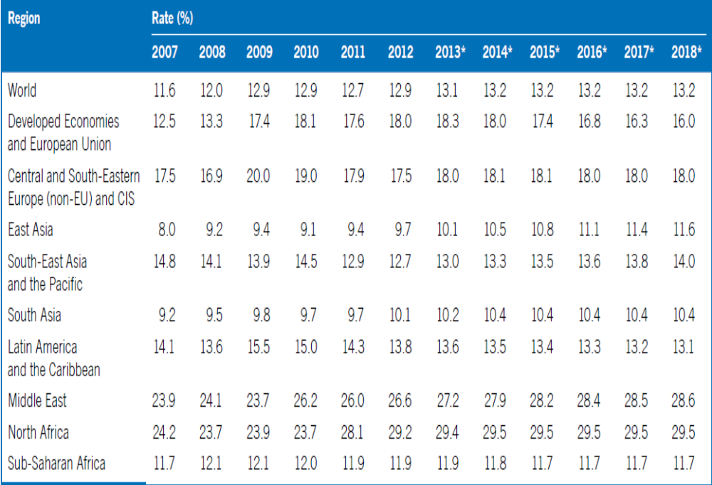
Youth unemployment 2007–18 (rates)

Slide 7
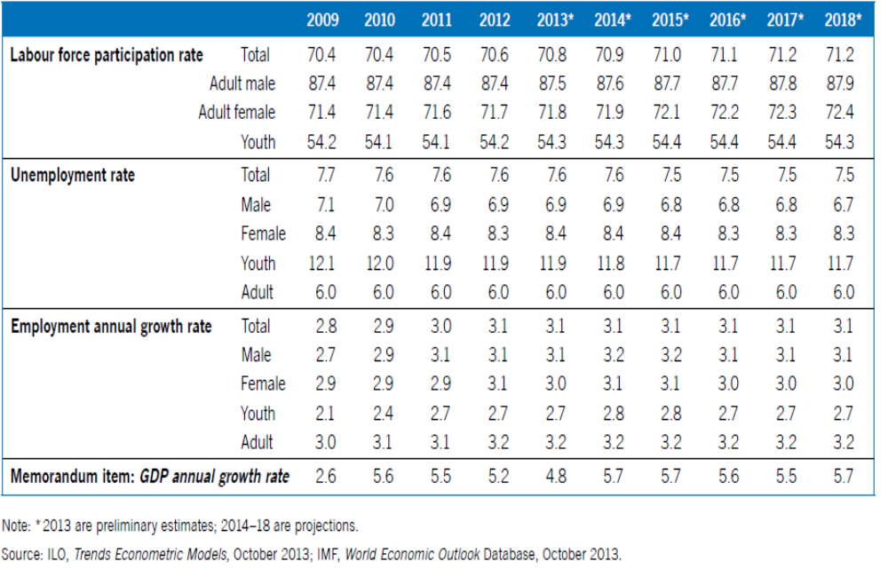
Labour market situation and outlook in Sub-Saharan Africa (%)

Slide 8
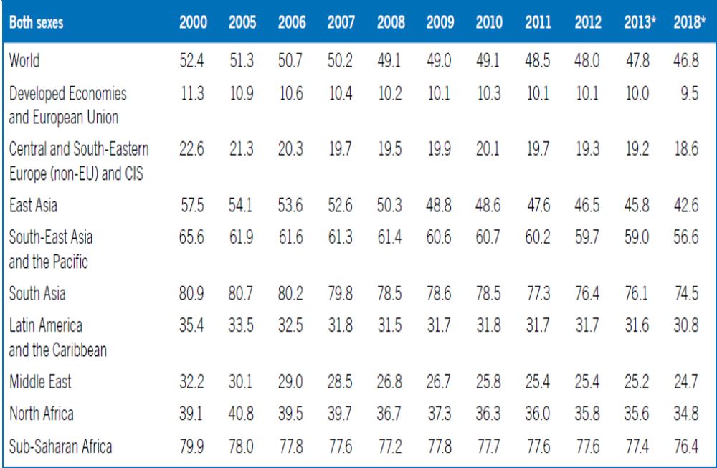
Vulnerable employment shares by sex, world and regions (%)

Slide 9
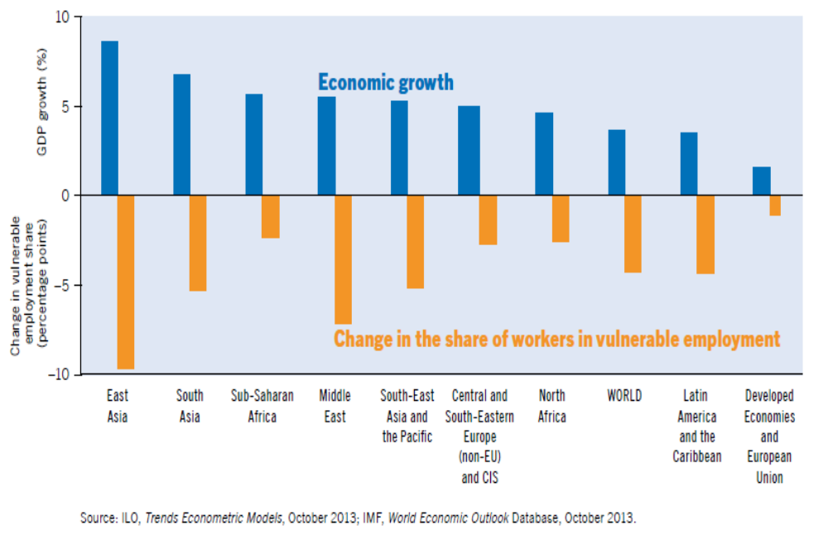
Economic growth and vulnerable employment by region, 2001-12

Slide 10
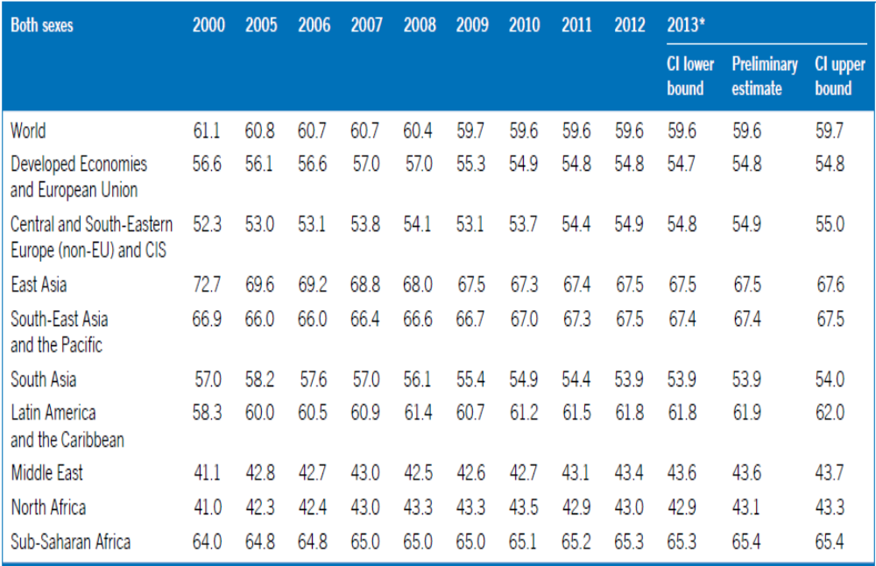
Employment-to-population ratio, world and regions (%)

Slide 11
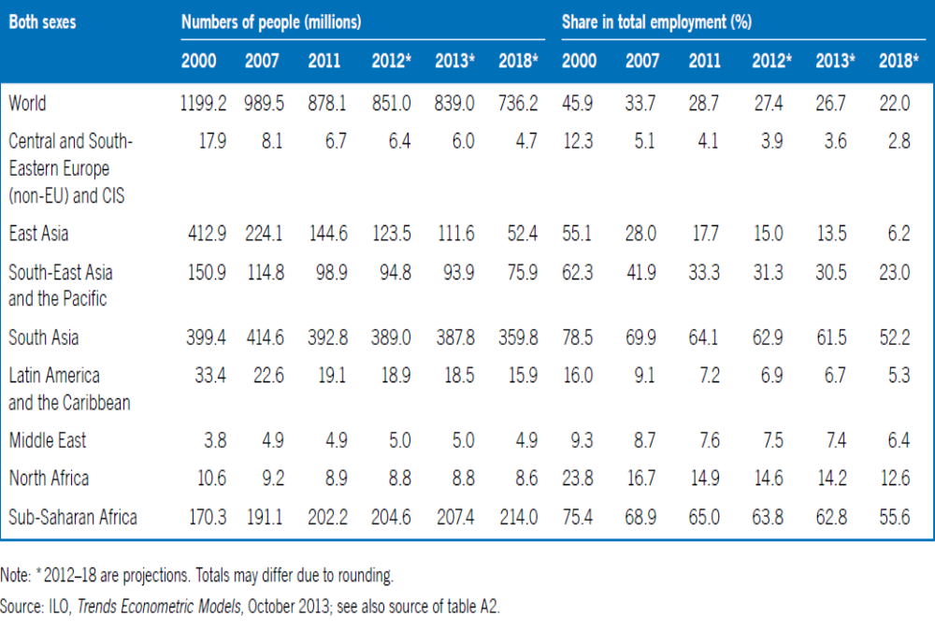
Working poor indicators, world and regions, (US$2 a day)

Slide 12
Africa’s GDP Performance
Improved performance of Africa since the “lost” decade of the 1980s and early 1990s - continent started to catch–up.
SSA experienced economic resurgence, with GDP growth accelerating from an average of 2.3% during 1991-2000 to 5.7% per annum during 2001-12.
Catching-up of African economies is widespread, save for a few countries.
Africa’s economic outlook remains favourable in spite of the persisting recession in the developed countries.
Hence, economic growth continued to be solid in Sub-Saharan Africa.
Despite this positive economic growth, the employment situation has not improved much in SSA with underemployment and informal employment remaining stubbornly high.
While the incidence of poverty declined from 60.8% in 1993 to 46.9% by 2011, economic growth in SSA has however not been as pro-poor as in other parts of the world.

Slide 13
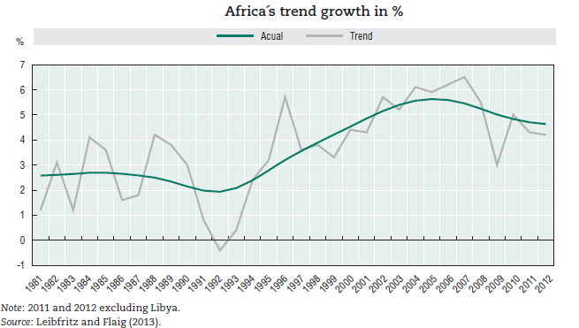

Slide 14
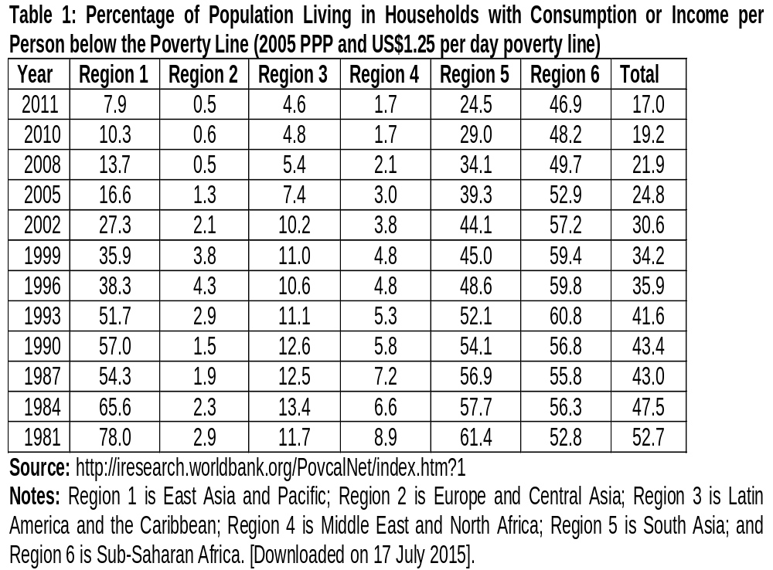

Slide 15
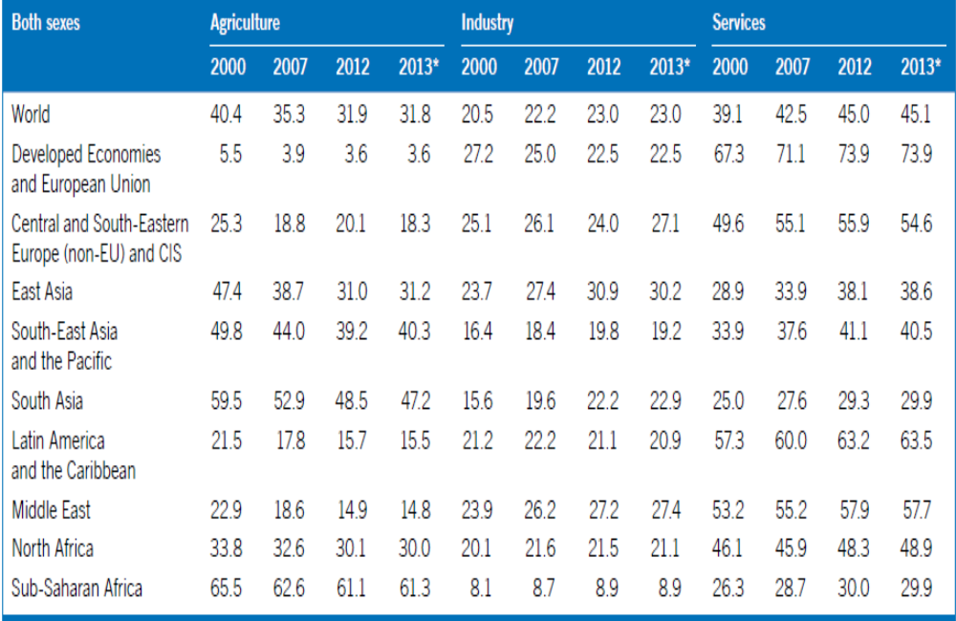
Employment shares by sector and sex, world and regions (%)

Slide 16
On the supply side, the main engines of growth were often agriculture and services, in several resource-rich countries rising production of oil and mining activity.
Manufacturing played a role in only a few countries. The manufacturing sector in Africa is relatively small with an average contribution of only about 10% to GDP.
In SSA, the share manufacturing in GDP decreased significantly between 1991 and 2011, from 16.7 to 11.1%.
In terms of employment, the share of workers in industry in Sub-Saharan Africa, which is estimated at less than 10%, is extremely low.
In all other regions this share is at least 20%, and in the case of East Asia it exceeds 30%.
The proportion of the working-age population in paid employment is also low in Sub- Saharan Africa (13.7%).
Yet the potential to develop labour-intensive manufacturing especially in sub-sectors with linkages to agriculture and extractive industries remains largely unused.
While many African countries have taken measures to diversify their economies, progress has been low.

Slide 17
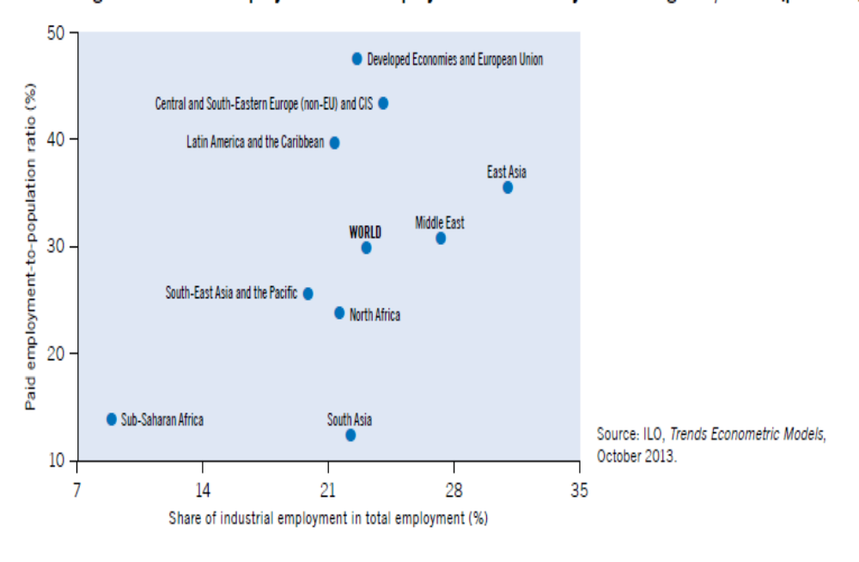
Paid employment and employment in industry across regions, 2012 (%)

Slide 18
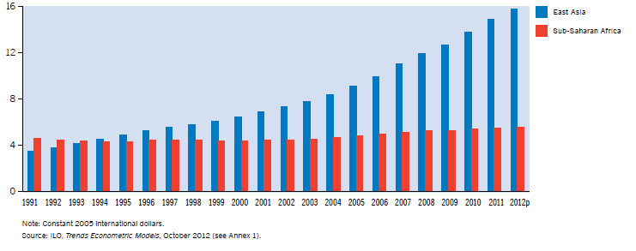
Labour productivity in Sub-Saharan Africa and East Asia, 1991–2012 (’000)

Slide 19
Assessing the Labour market situation
In a nutshell, three indicators are critical for the assessment of the employment situation in developing countries, namely:
The share of the formal segment in total employment;
Output per worker in the non-formal segment; and
The unemployment rate.
Other things being equal:
The larger the share of the formal segment in total employment, the better the employment situation;
The higher the output per worker in the non-formal segment, the better the employment situation;
The higher the employment ratio (the lower the unemployment rate), the better the employment situation.

Slide 20
The theme of the 2013 Africa Economic Outlook of the AfDB is on Structural Transformation and Natural Resources.
It observes that structural transformation towards more productive activities and better jobs is closely linked with a strong natural-resource sector.
Emerging economies, such as Brazil, China and India were more successful than most African countries, recording impressive reductions in poverty for more than two decades largely because they have undergone a more rapid structural transformation - a higher proportion of labour moved from low-productivity to high-productivity sectors.
It further observes that in Africa, structural transformation is in its formative stage in most countries hence the slow pace of poverty reduction. It cites the high proportion of jobs in the primary sector as reflecting a lack of structural change and of productive jobs, but also Africa’s comparative advantage and hence the basis from which structural transformation must take off.
Resource-based raw and semi-processed goods accounted for about 80% of Africa’s exports in 2011, compared with 60% in Brazil, 40% in India and 14% in China.

Slide 21
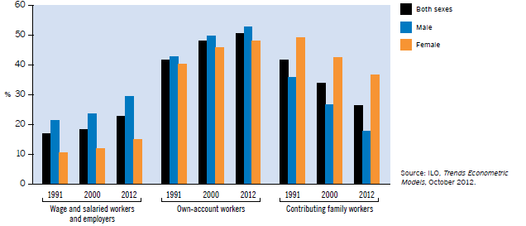
Employment distribution by status in Sub-Saharan Africa, 1991, 2000 and 2012

Slide 22
The reallocation of jobs across sectors is central to the process of structural change and productivity upgrading (structural bonus).
Structural change has potential to produce a faster reduction of vulnerable employment.
Structural change is the most effective driver of growth to bring down rates of vulnerable employment in developing economies, both in the short and in the long run.
It is the across-sector labour productivity component of growth that is associated strongest with the speed at which vulnerable employment decreases, compared with other growth components.
A growth model that is based on structural change lowers the share of workers in vulnerable employment faster than other growth models, if structural change is associated with a reallocation of labour away from agriculture into industry and service sectors. Vulnerable employment is often particularly present in the agricultural sector.
As a consequence, productive structural change is effective in lowering the prevalence of vulnerable employment on average.
Hence, structural change for decent work .

Slide 23
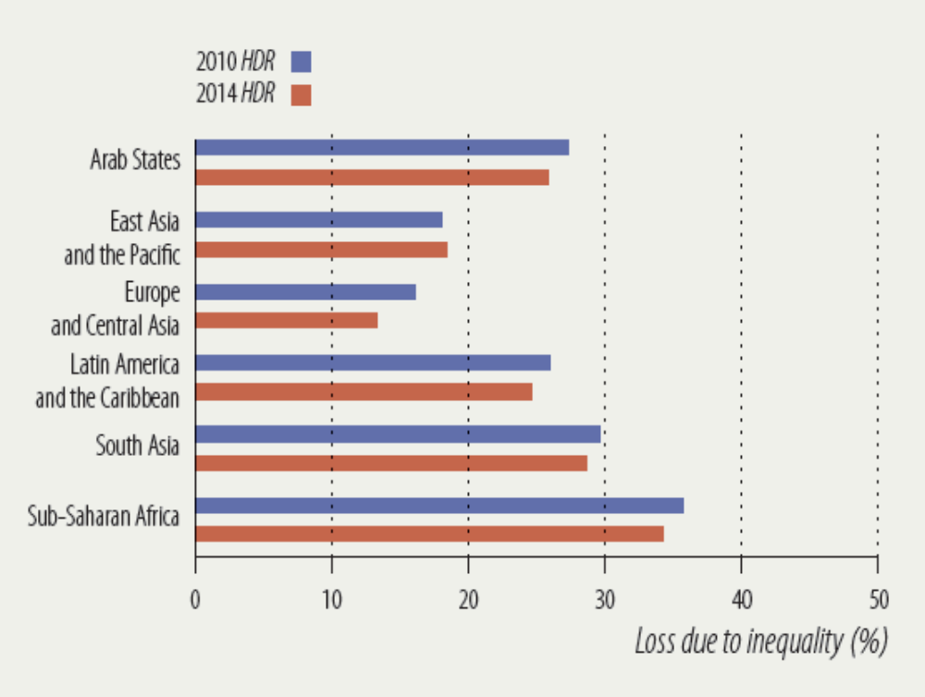

Slide 24
Connecting Youth to Opportunities. A Call for Evidence-based Action
Given the urgency of generating productive employment for the huge army of un- and under-employed youth, against the background of heightened restiveness among the youth at the lack of opportunities as reflected in the Arab Spring, policy makers in SSA have prioritized youth employment.
However, the challenge of youth employment is complex and hence not amenable to easy solutions.
Key is to address the context of low productivity, and hence earnings, in the short, medium and long-run, against a background of high expectations.
In spite of these efforts, most youth in SSA do not have a straight-forward or structured path to sustainable livelihoods.
Magnitude of the challenge requires that all stakeholders, be they governments, private firms, training providers (both private and public), parents and young people themselves to facilitating the transition of youth to sustainable livelihoods

Slide 25
A comprehensive approach is required to addressing the constraints affecting this transition to sustainable productive employment and livelihoods.
Requires that opportunities are improved where the youth are (agriculture and informal economy), and the wage sector by improving their levels of productivity.
This implies the need to take a holistic view by all stakeholders, and especially government if the job is to be done.
Need for country-specific analyses and approaches to understand the specific local issues (i) constraining productivity and earnings growth in agriculture, the informal, and the modern wage sectors; (ii) militating against youth starting and sustaining micro, small and medium enterprises; (iii) undermining the expansion of labor-intensive firms in the modern wage sector; and (iv) what government, NGOs, and other private sector actors can do to address the constraints faced by the youth in making the transition to productive employment.
Successful country- specific approach should be informed by the availability of more and better data on employment - currently sparse and often of low quality.
Hence, the measures should be anchored on a much better evidence base on which approaches are potentially effective and cost-effective, proceeding on an experimentation basis with the promising interventions .

Slide 26
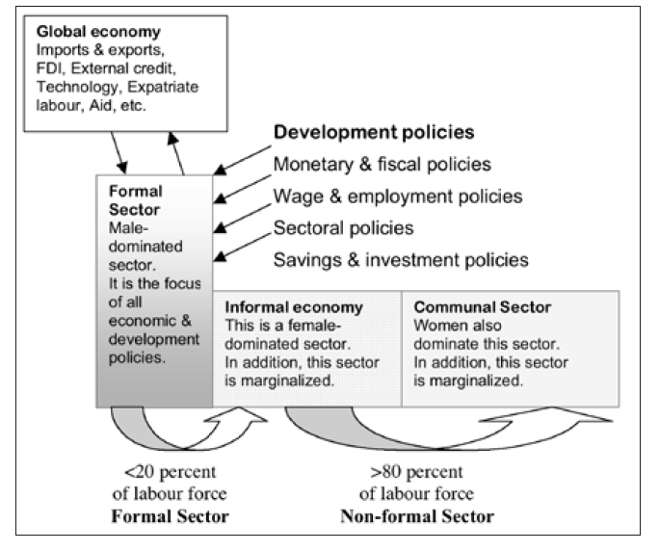
The Dual and Enclave Structure of the SSA Economy

Slide 27
Three factors are critical to achieve social objectives, namely, the ‘growth factor’ (the rate at which an economy grows), the ‘elasticity factor’ (the extent to which growth is associated with employment creation), and the ‘integrability factor’ (the extent to which growth is inclusive, allowing the poor to participate in it and benefitting from it).
Strategies being To leverage job-rich growth, and connect the un- and under-employed to opportunities, the following strategies are being applied by regional governments with the support of the ILO:
Targeting and diversifying resources to productive / job creating sectors of the economy;
Linking employment objectives and promoting the integration of employment targets into National Development Plans and Vision Documents;
Linking macroeconomic and sectoral policies to labour market policies and outcomes;
Treating decent, productive and remunerative jobs as a cross- cutting issue to be integrated in all policy frameworks (macro and sectoral) and action plans;

Slide 28
Setting employment targets in priority sectors in terms of job creation (including backward and forward linkages through increased resources allocation);
Adopting and implementing a Social Protection Floor (SPF), which is the first level of social protection in a national social protection system setting out a basic set of social rights derived from human right treaties, including access to essential services (e.g. health, education, housing, water and sanitation, and others) and social transfers, in cash or in kind, to guarantee income security, food security, adequate nutrition and access to essential services;
Promoting social justice and fighting inequalities;
Facilitating transition to formality and decent work; and
Setting up/strengthening effective inter-ministerial mechanism for stakeholder coordination and participation (see ILO mission reports to Botswana, Namibia, Lesotho, Rwanda among others).

Slide 29
An integrated strategy for growth and job creation covers both labour demand (job opportunities) and supply (employability), active labour market policy measures.
On the supply-side, a well-linked education and training system and closer cooperation between this system and the private sector facilitates a smoother transition from school to work.
Often, the educational system does not provide the appropriate labour force needed by the domestic market, resulting in a labour market mismatch.
Moreover, young people’s employment is limited to the non-formal economy, which is not covered by formal skills development, including recognition and certification of skills acquired through informal channels.

Slide 30
However, the major criticism is that these interventions have not been well coordinated, resulting ‘…in the inefficient use of limited resources; overlaps and duplication; and a failure to exploit untapped potential for synergies and cooperation.’
There is a strong case for better coordination of youth employment interventions given its cross-cutting nature that requires a multi-stakeholder approach.
An integrated model based on the collective impact approach, where a group of actors commit themselves to a common agenda for solving youth employment by better aligning and synchronizing the various coordination elements.

Slide 31
Hence this employment knowledge sharing forum offers an opportunity to assess the various interventions and identify the promising ones that could be up-scaled and adopted/adapted by other countries, thus short-circuiting the learning curve.
Interventions must produce sizable, sustained effects on youth employment.
Some of the interventions to be shared focus are on specific aspects (e.g. labour demand or labour supply), while others such as the ‘skills for youth and rural development’ being piloted in Benin, Burkina Faso and Zimbabwe combine both skills acquisition and business development, with a multi-stakeholder approach that includes co-ordination mechanisms at all levels.
Lastly, a practical dimension is offered with the study visit of training for rural economic empowerment programme (TREE) sites in Mutoko and Mrewa, and the Quality of delivery of training in Informal Apprenticeship (QIA) sites in Glen View and Chitungwiza.

Slide 32


