Slide 1


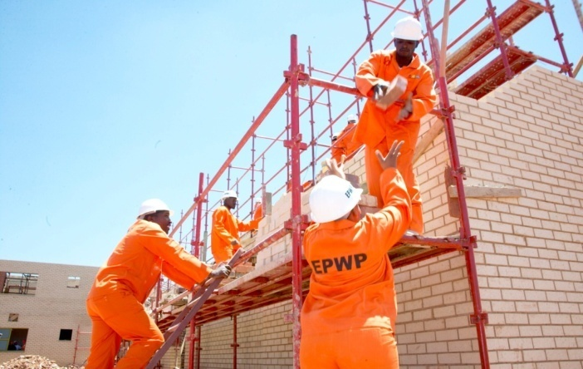
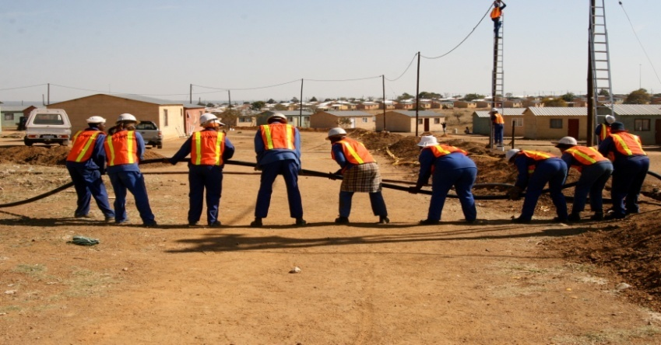

EASTERN AND SOUTHERN AFRICA YOUTH EMPLOYMENT KNOWLEDGE SHARING FORUM
HARARE, 19 TO 22 JULY 2015
Lessons from the South Africa Expanded Public Works Programme (EPWP)
Presented By Gamelihle Sibanda, ILO Chief Technical Adviser to the EPWP

Slide 2

Outline
BACKGROUND OF EPWP
  Origin of EPWP
  The “Trilemma” facing EPWP
  Facts about the EPWP
  EPWP Universal Principles
  Targeting of Participants in EPWP Phase 3
YOUTH EMPLOYMENT
  National Development Plan Employment Scenarios
  Youth Employment Projections
  Examples of EPWP Programmes in the four Sectors
  Case studies
  Outcomes and Mitigation
  Challenges and Mitigation
  Replicability and Upscaling
  Sustainability

Slide 3
EPWP BACKGROUND

Slide 4
Origin of EPWP
Post the second democratic election challenges: unemployment; poverty; inequality, low skills base and poor social services.
At the Growth and Development Summit (GDS) in June 2003, Government, Business and Labour agreed government expenditure be targeted for employment-intensive programmes through the EPWP.
Although the Basic Income Grant (BIG) was policy instrument envisaged to respond to unemployment challenges. Government preferred to link productive work with income transfer.
Cabinet approved the conceptual framework for EPWP in November 2003. The programme aimed drawing significant numbers of the unemployed into productive work and that these workers gain skills while they work, and thus take an important step to get out of the pool of those who are marginalised.

Slide 5
THE “TRILEMMA” FACING EPWP
Social Protection (income)
Provision of Assets & Services
Employment
EPWP’s development contribution comes through providing all three of these outcomes- but there are trade-offs involved when one tries to maximize one
For different sub-programmes and sectors the balance between these three outcomes varies quite considerably
Increasing one output- results in decreases in the other- the nature of these trade-offs differ between Sectors and Sub-programmes

Slide 6
FACTS ABOUT THE EPWP
It makes systematic use of public expenditure to stimulate productive employment through application of labour-intensive methods in provision of services and assets
Major strength - is that it is not donor funded; it leverages regular government budget
It operates in four sectors; Infrastructure, Environment and Culture, Social and Non State sectors
It is implemented by public entities in all spheres of government
National ministries, provincial departments and local authorities are expected to prioritise the programme in their day to day initiatives
  Overall coordination by EPWP unit in Department of Public Works, including policy framework, reporting, monitoring and evaluation – overall link to office of Deputy President

Slide 7
FACTS ABOUT THE EPWP – THE FOUR SECTORS
SECTOR | ACTIVITIES | AUTHORITIES
Infrastructure | Construction, rehabilitation and maintenance of roads, water services, sanitation, public housing, schools etc | Departments of Transport, Water Affairs, Human Settlements (Housing), Education
Social | Home based care, Early Childhood Development | Dept. of Social Development, Health and Education
Environmental | Protection of forests and parks, waste management, cleaning public spaces, fire prevention, removal of invasive species | Dept of Environmental Affairs, Water Affairs, Forestry
Non-state | Community driven- generally cross cutting, health, education, small infrastructure, environment | Implementation by NGOs and community based organisations with funding from government

Slide 8
FACTS ABOUT THE EPWP
Target of 1 million work opportunities in Phase 1 of the EPWP (2004/05 – 2008/09) achieved a year ahead of time
Targeted 4.5 million work opportunities in Phase 2 (2009/10 – 2013/14) and achieved over 4 million
Target for Phase 3 (2014/15 – 2018/19) up-scaled to 6.0 million work opportunities or 2.5 million Full Time Equivalent (person years) or 585 million workerdays.
Over the next five years the programme is expected to inject over US$ 4.5 billion into local economies in the form of wages – both urban and rural
And upgrade skills through accredited and non accredited training to enhance future employability

Slide 9
OBJECTIVES OF EPWP PHASE 3
For the EPWP to be effective and achieve the vision set out in the NDP it is proposed that the EPWP has a clear and limited mandate.
“To provide work opportunities and income support to poor and unemployed people through the labour-intensive delivery of public and community assets and services, thereby contributing to development.”

Slide 10
EPWP Phase 3 Universal Principles
Adherence to the EPWP Minimum wage and employment conditions under the Ministerial Determination
The EPWP Ministerial determination of 2012 sets out a minimum wage for the EPWP and the EPWP must seek to achieve full compliance with this determination. There is currently substantial non-compliance with the minimum wage.
Selection of workers based on a clearly defined process and defined criteria
The selection of each worker should be done on a clear set of criteria to minimize patronage and abuse during selection and ensure target group benefits. The selection should also happen in accordance with clear transparent and fair procedures.
Work provides or enhances public goods and community services
The work output of each EPWP project should contribute to delivery of services and creation of community assets.
Minimum labour intensity appropriate to sector
A minimum labour-intensity benchmark appropriate to each sector should be set as sectors differ too much to apply a common standard across all sectors. Furthermore programmes within each sector would also be encouraged to set their own benchmarks.

Slide 11
TARGETING OF PARTICIPANTS IN EPWP PHASE 3
The EPWP targets the poor and unemployed
Targeting done through a combination of:
      Geographical Targeting: Focus on poor communities and those with high number of unemployed
      Self-Targeting: Through the EPWP Minimum wage rate
      Community Targeting: Community selects those most in need through based on transparent criteria and process

Slide 12
TARGETING OF PARTICIPANTS BY DEMOGRAPHICS
Targeting of vulnerable groups
Category | Phase II Targets | Phase III Targets
Women | 55% | 55%
Youth between 16 and 35 | 40% | 55%
Persons with disabilities | 2% | 2%
The 2013 National Youth Employment Accord advocates for a Youth target of 80% for Public Employment Programmes. The EPWP Phase 3 Youth Target is 55%. This will be progressively increased towards 80% for new entrants into the EPWP.

Slide 13
YOUTH EMPLOYMENT

Slide 14
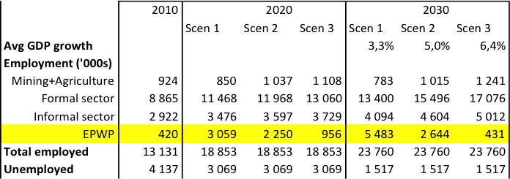
NDP EMPLOYMENT SCENARIOS
NDP proposes that public employment programmes target 2 million FTEs by 2020 or about 50% of unemployed

Slide 15
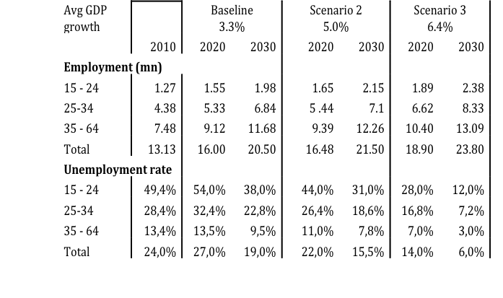
YOUTH EMPLOYMENT PROJECTIONS

Slide 16
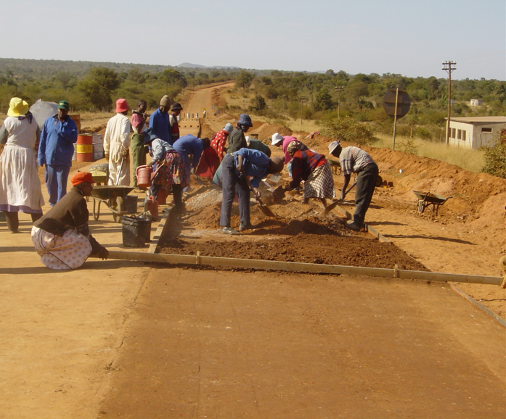
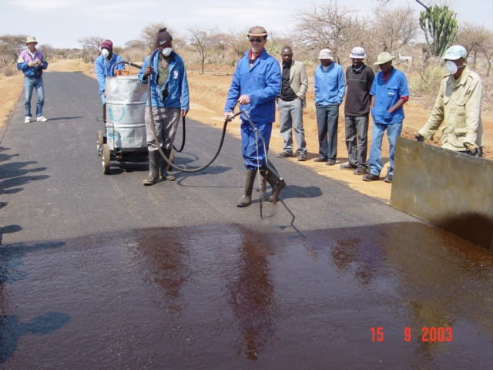
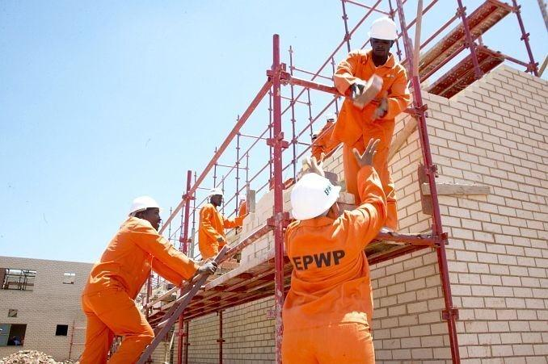
HIGHLIGHTS OF SOME INFRASTRUCTURE SECTOR PROGRAMMES
Road Works
Road Works and
Building Construction

Slide 17
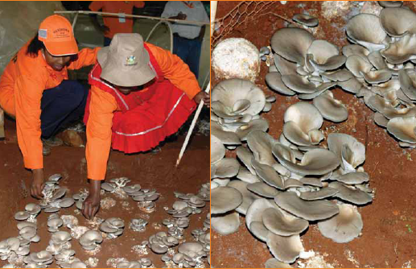

HIGHLIGHTS OF SOME ENVIRONMENT SECTOR PROGRAMMES
Agricultural Production
Hotel Chefs Graduating

Slide 18

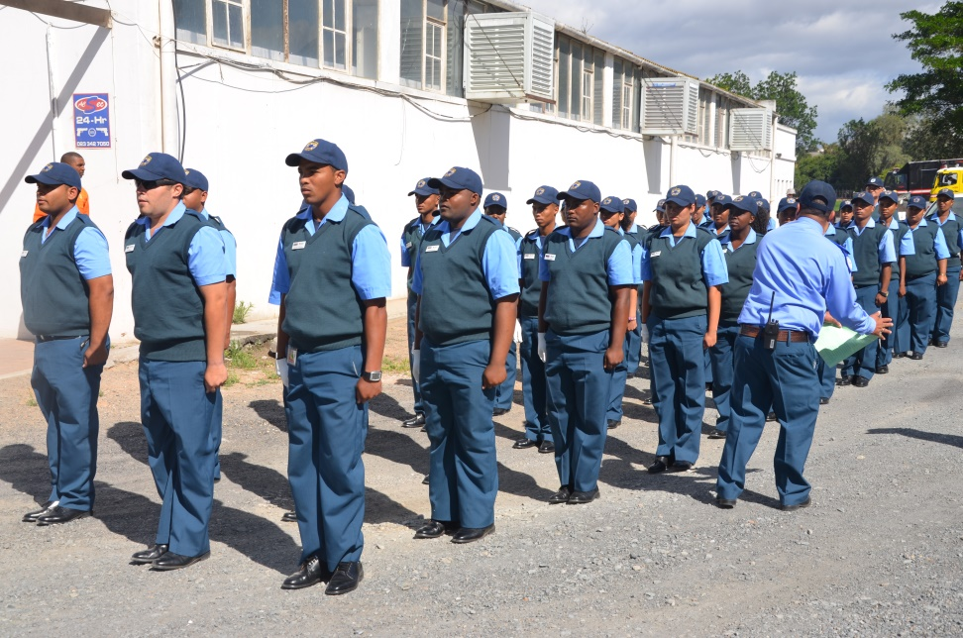
HIGHLIGHTS – SOCIAL SECTOR PROGRAMMES/PROJECTS
Early Childhood Learning
Community Policing

Slide 19
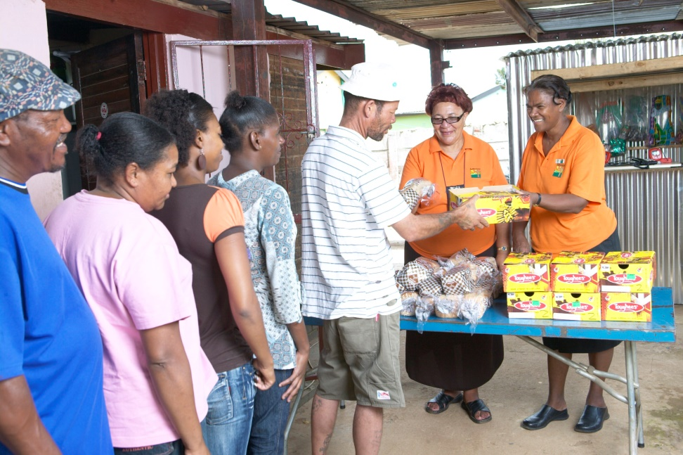
HIGHLIGHTS OF SOME NON STATE SECTOR PROGRAMMES
Wage Subsidy
Handing out Food Parcels
NGOs given wage subsidy to employ more workers

Slide 20
CASE STUDY: ARTISAN DEVELOPMENT PGRAGRAMME
Programme of the Dept. of Public Works in partnership with Manufacturing, Engineering and Related Services Sector Education and Training Authority (merSETA) +
Phase 1 launched in July 2014 targeting 109 apprentices on 3 to 4 yrs. programmes - theory plus on-the-job training
Phase 2 in Aug 2015 will target 221 total 330
Cumulative Government expenditure by end of 2019 will be R43m (US$ 3.5 million)
Trades include auto-tronic, boiler making, diesel mechanic, automotive electrician, fitter and turner, motor mechanic, auto electrician, air conditioning and refrigeration.

Slide 21
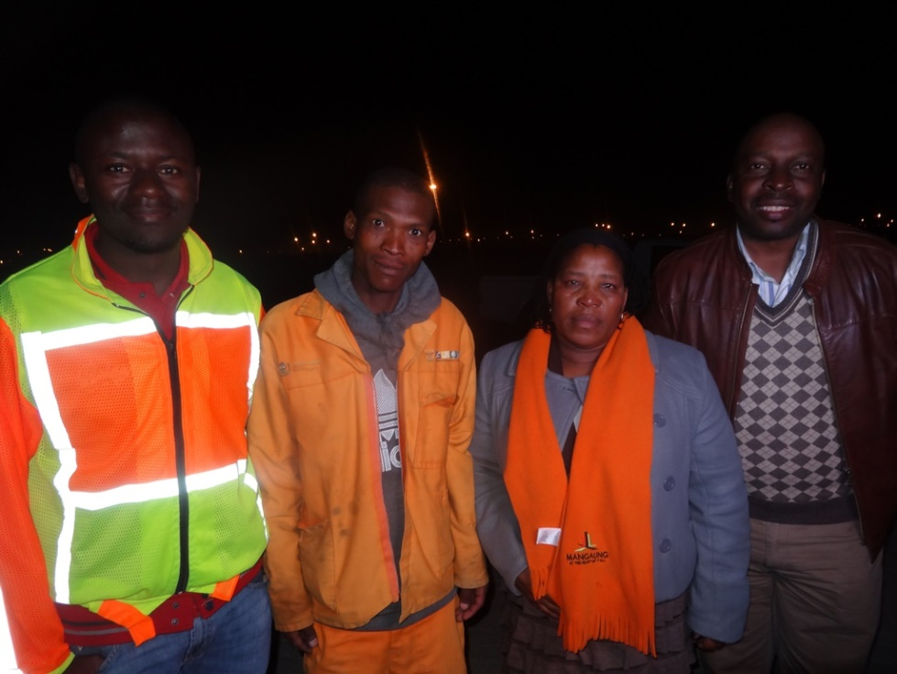
CASE STUDY: FORMER GANG MEMBERS JOIN EPWP
“I will not rob people again, thanks to the EPWP that has given me a job and trained me on skills that I will use to look for another job when this project comes to an end” Youth ex-Gang member
Project Engineer, Reformed Ex Gang Member, Councillor and ILO official
About 15 former gang members who used to rob residents were offered work by EPWP and received training on various skills
Crime plummeted in the town

Slide 22
SUMMARY – OUTCOMES AND IMPACT
Employment target of 40% youth exceeded in Phase 2. Phase 3 Target increased to 55%
Employment for youth who had never worked in their lives
Skills upgraded through accredited and project-based training to enhance future employability
Enhanced social capital through networks formed at workplace, improved self worth and ability to articulate own ideas
Social cohesion e.g.. sense of ownership of created community assets, less social evils (crime, drugs) with fewer idle minds
In 2014, 7 out of 10 of those who participated in the EPWP and other Government job creation programmes were employed. 4 out of 5 participants who were employed had a formal sector job (Statistics South Africa)

Slide 23
SUMMARY – CHALLENGES AND MITIGATION
CHALLENGE | MITIGATION
Facebook generation does not find unskilled manual labour attractive | Self-targeting through minimum wage Accredited training for better jobs Various types of work in four sectors (Infrastructure, Environment and Culture, Social and Non State) including glamorous hospitality industry
Officials of some Public Bodies (Government funded entities) have perception that employment creation is an additional burden over their already busy schedules | Use of stick and carrot Programme linked to office of Deputy President to deal with high level non-compliance Incentives to encourage voluntary compliance
Ensuring smooth transition (avoid time delays) from theoretical training to work placement for experiential learning | Engaging with private sector when participants are recruited and joint planning to foster seamless transition

Slide 24
SUMMARY – REPLICABILITY AND UPSCALLING
Leveraging of regular budget instead of reliance on external donor funding
Clear employment creation targets disaggregated by gender, age and persons with disability
Value addition to employment opportunities e.g. vocational skills training
Code of Good Practice to regulate temporary employment conditions without diluting decent work principles

Slide 25
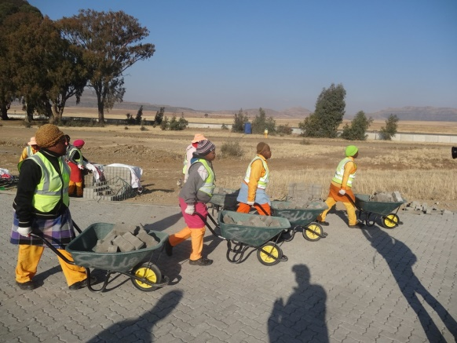
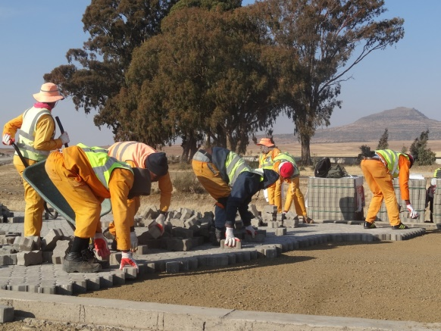
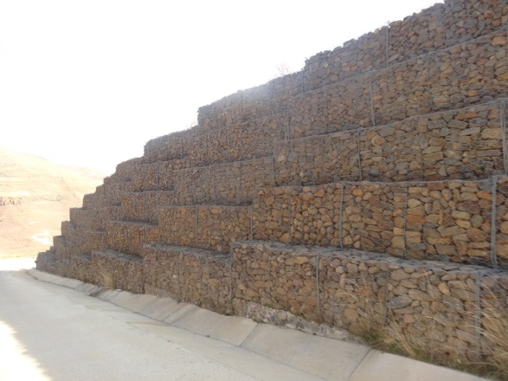
SUMMARY – SUSTAINABILITY
EPWP is mainstreamed through Government planning and funding processes
Decent work principles embedded into the labour policies and practices
“How to” Guidelines to assist new-comers in an environment of high staff turnover
Productive infrastructure to provide long term employment through maintenance work opportunities

Slide 26
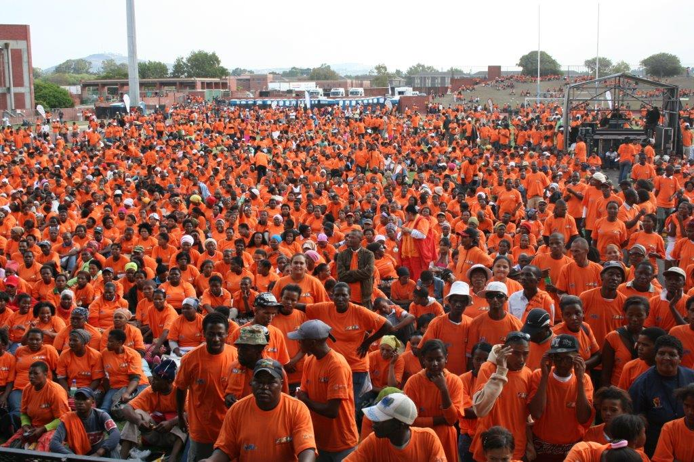
EPWP LEARNERS AT EXIT WORKSHOP

