Slide 1

DATA SYSTEMS/GIRAICT SKILLS AND EDUCATION PROGRAM.
By: Nadia Uwamahoro
Co-founder
“Boosting ICT penetration in Rwanda”

Slide 2
Content
Data systems Ltd
Overview of ict in Rwanda
Job creation via outsourcing
GiraICT Devices Package for teachers and students
Images
GiraICT Devices scheme for teachers and students
Image sketch, classroom interior design images, 3D view & Drafted Image and Photo
Infrastructure image design
Students in class (photo)
GiraICT Multipoint Platform Vs Traditional PC Workstation..
Contacts

Slide 3
DATA SYSTEMS LTD
Data Systems Ltd is a professional IT outsourcing company which is based in Kigali / Rwanda, with different branches in Uganda and Ghana.
We provide IT Outsourcing Services, management and Data analysis solution and implement document management systems.
We have a global partnership with Microsoft, Intel, Lenovo, Lenovo, Nokia, Samsung, Ok-PRINTER, Airtel, MTN, Fugitsu, Huawei, Brainshare and Kofax.
We run different projects in Rwanda including GiraICT a project with the objectives of increasing ICT skills and improve the quality of education by the use of technology in Africa starting from Rwanda.

Slide 4
OVERVIEW OF ICT IN RWANDA
Information and Communication Technology is a central engine to driving Rwanda’s transformation to a knowledge based economy, a fact Rwanda has acknowledged by allocating a budget to ICT - as a percentage of its GDP - that is at par with OECD countries.
Rwanda continues to be one of the fastest growing African countries in ICT and there are several avenues for growth for the ICT sector – from e-commerce and e-services, mobile technologies, applications development and automation to becoming a regional center for the training of top quality ICT professionals and research. A robust ICT industry can create wealth, jobs and entrepreneurs.

Slide 5
RWANDA’S ICT COMPETITIVE ADVANTAGE
Cheap labor compared to other countries in the Region
Young and dynamic workforce (98% of the population is under 50 years and 43% is under 16 years)
Most favorable business environment in the Region (8th best place to do business in the world 2012)
Low levels of corruption - Zero tolerance (Transparency international Bribery index 2012 ranked Rwanda as least bribery prone in the EAC)
World class ICT infrastructure
Strong & visionary leadership
Bi-lingual business environment (French and English)

Slide 6
MOBILE BROADBAND PENETRATION
Rwanda’s network coverage accounts for 99.79% of the country and the current subscriber base is at 63.5% ( 6,689,158 subscribers December 2013 ). The long term outlook of growth in these numbers is 7,437,196 by Q4 2016
Rwanda’s Internet penetration grew from less than 1% in 2000 to 13% at the end of December 2013. In addition to existing ICT infrastructure as well as access network rollout program, investment in a 4G LTE network is expected to increase penetration to at least 95% by end of 2016.

Slide 7
JOB CREATION VIA OUTSOURCING DIGITAL SERVICES
Our approach to ‘delivery’ in BPO combines building and managing call centers , create mobile and web application for African and non African clients (most specially in the us and Middle East) .
We help clients with experience- centric solutions that empower them in enhancing business efficiencies, streamlining operations and reducing costs. Through our GLOCAL delivery model we ensure that we bring the right local skill sets and global experience together to serve our customers better.

Slide 8
JOB CREATION VIA OUTSOURCING DIGITAL SERVICES……
The Company employs an average of 10 people in Rwanda, 5 people in Ghana and 2 People in Uganda permanent
We also employees an average of 100 temporary employees per year via GiraICT and our outsourcing company.
One of our success stories happened in Ghana where we have been able to employee 100 young people into a one year document management and electronic archiving project (EDMS) for Ghana Revenue Authority and office of Ghana Birth and Death registry.

Slide 9
ONE LAPTOP PER TEACHER …
We provide ICT training and a Computing Devices (laptop and tablets) to teachers on a loan scheme.
A range of well known brands such as Microsoft, HP, Lenovo, Samsung, I-surf that suits different budgets.
All the devices the devices provided is equipped with digital education content and books according to the country curriculum stored into our Learning platform that facilitates sharing and storage of content on computers and phones.
Affordable Data plan designed for academia

Slide 10
GIRAICT PACKAGE FOR SCHOOL AND STUDENTS…
Giraict also provides smart computer labs to schools and turns this labs into ict incubations that becomes hubs to train teachers and students in entrepreneurship and ICT skills that are needed into the market.
Each student get an access to our e-learning, a direct access to the school content and our mentorship program.
Each student or teacher can access the school content anytime being offline or online.
Every student and teacher also beneficiate of 1TB storage on our cloud and hosting space for free.

Slide 11
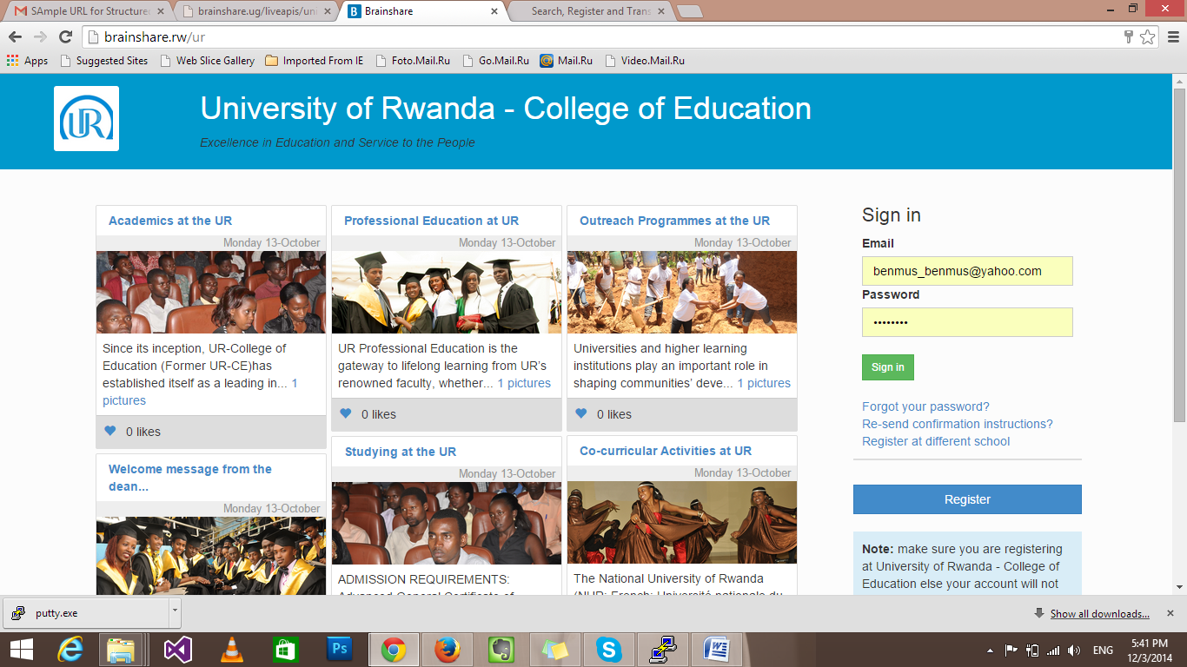
Different solutions for SMES and Corporate…

Slide 12
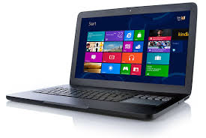
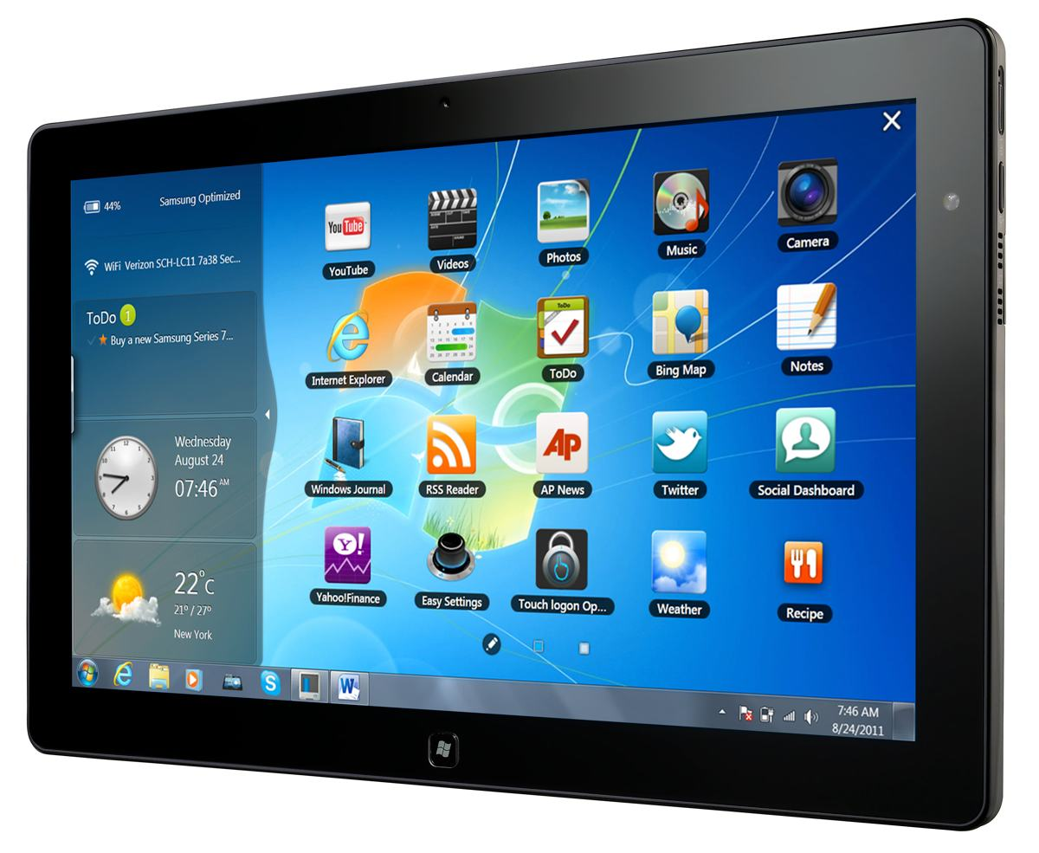

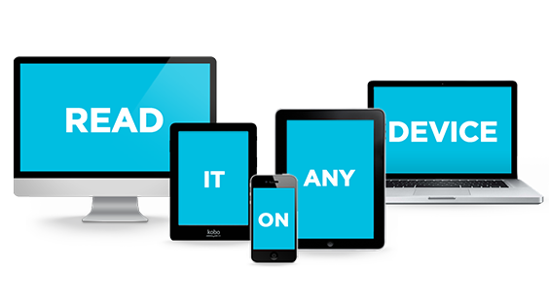
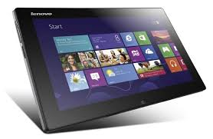
Images
Laptops
Tablets
All in one

Slide 13
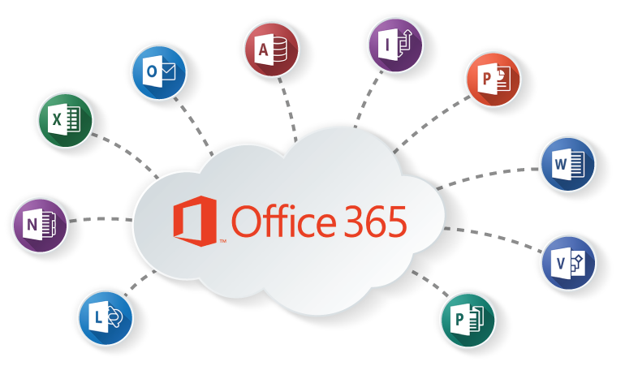

Office 365
This Office 2013 is made available in several distinct editions aimed towards different markets. All traditional editions of Microsoft Office 2013 contain Word, Excel, PowerPoint and OneNote and are licensed for use on one computer and can be available by default (offline) and also online.
1 Year FREE for STUDENTS

Slide 14

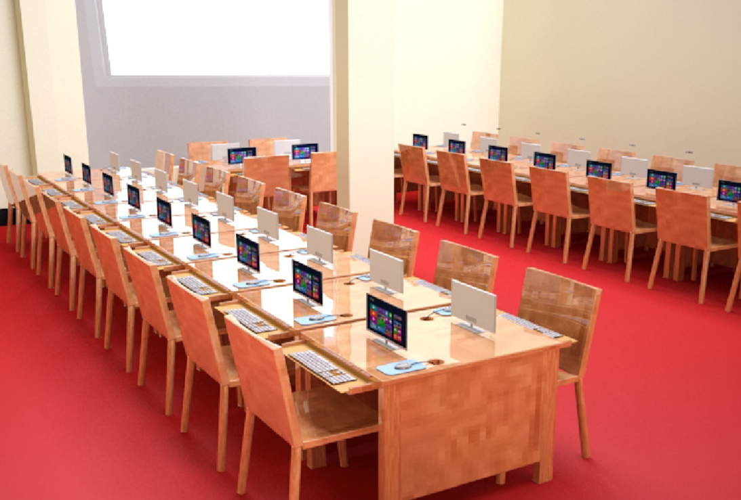
3D view

Slide 15
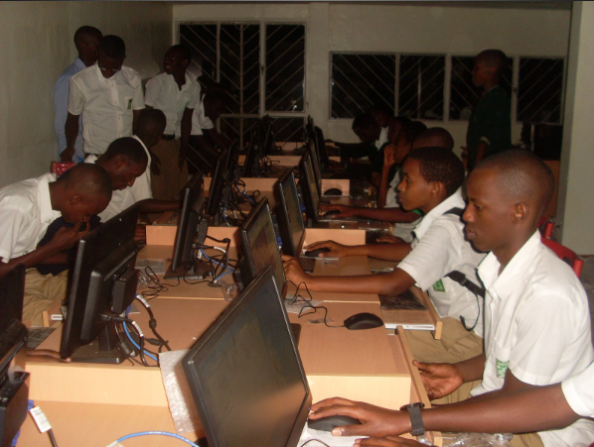
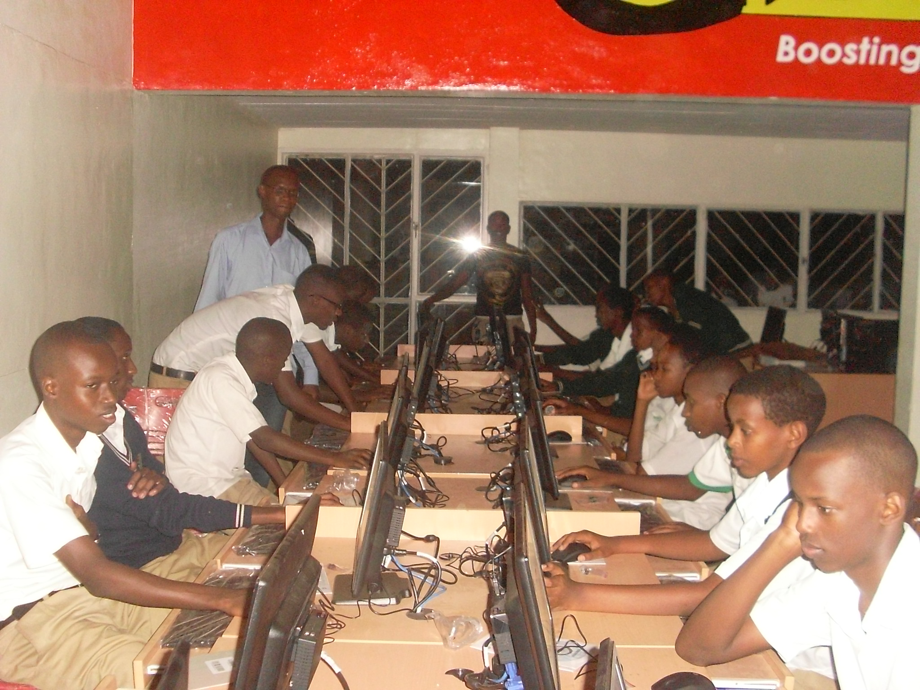
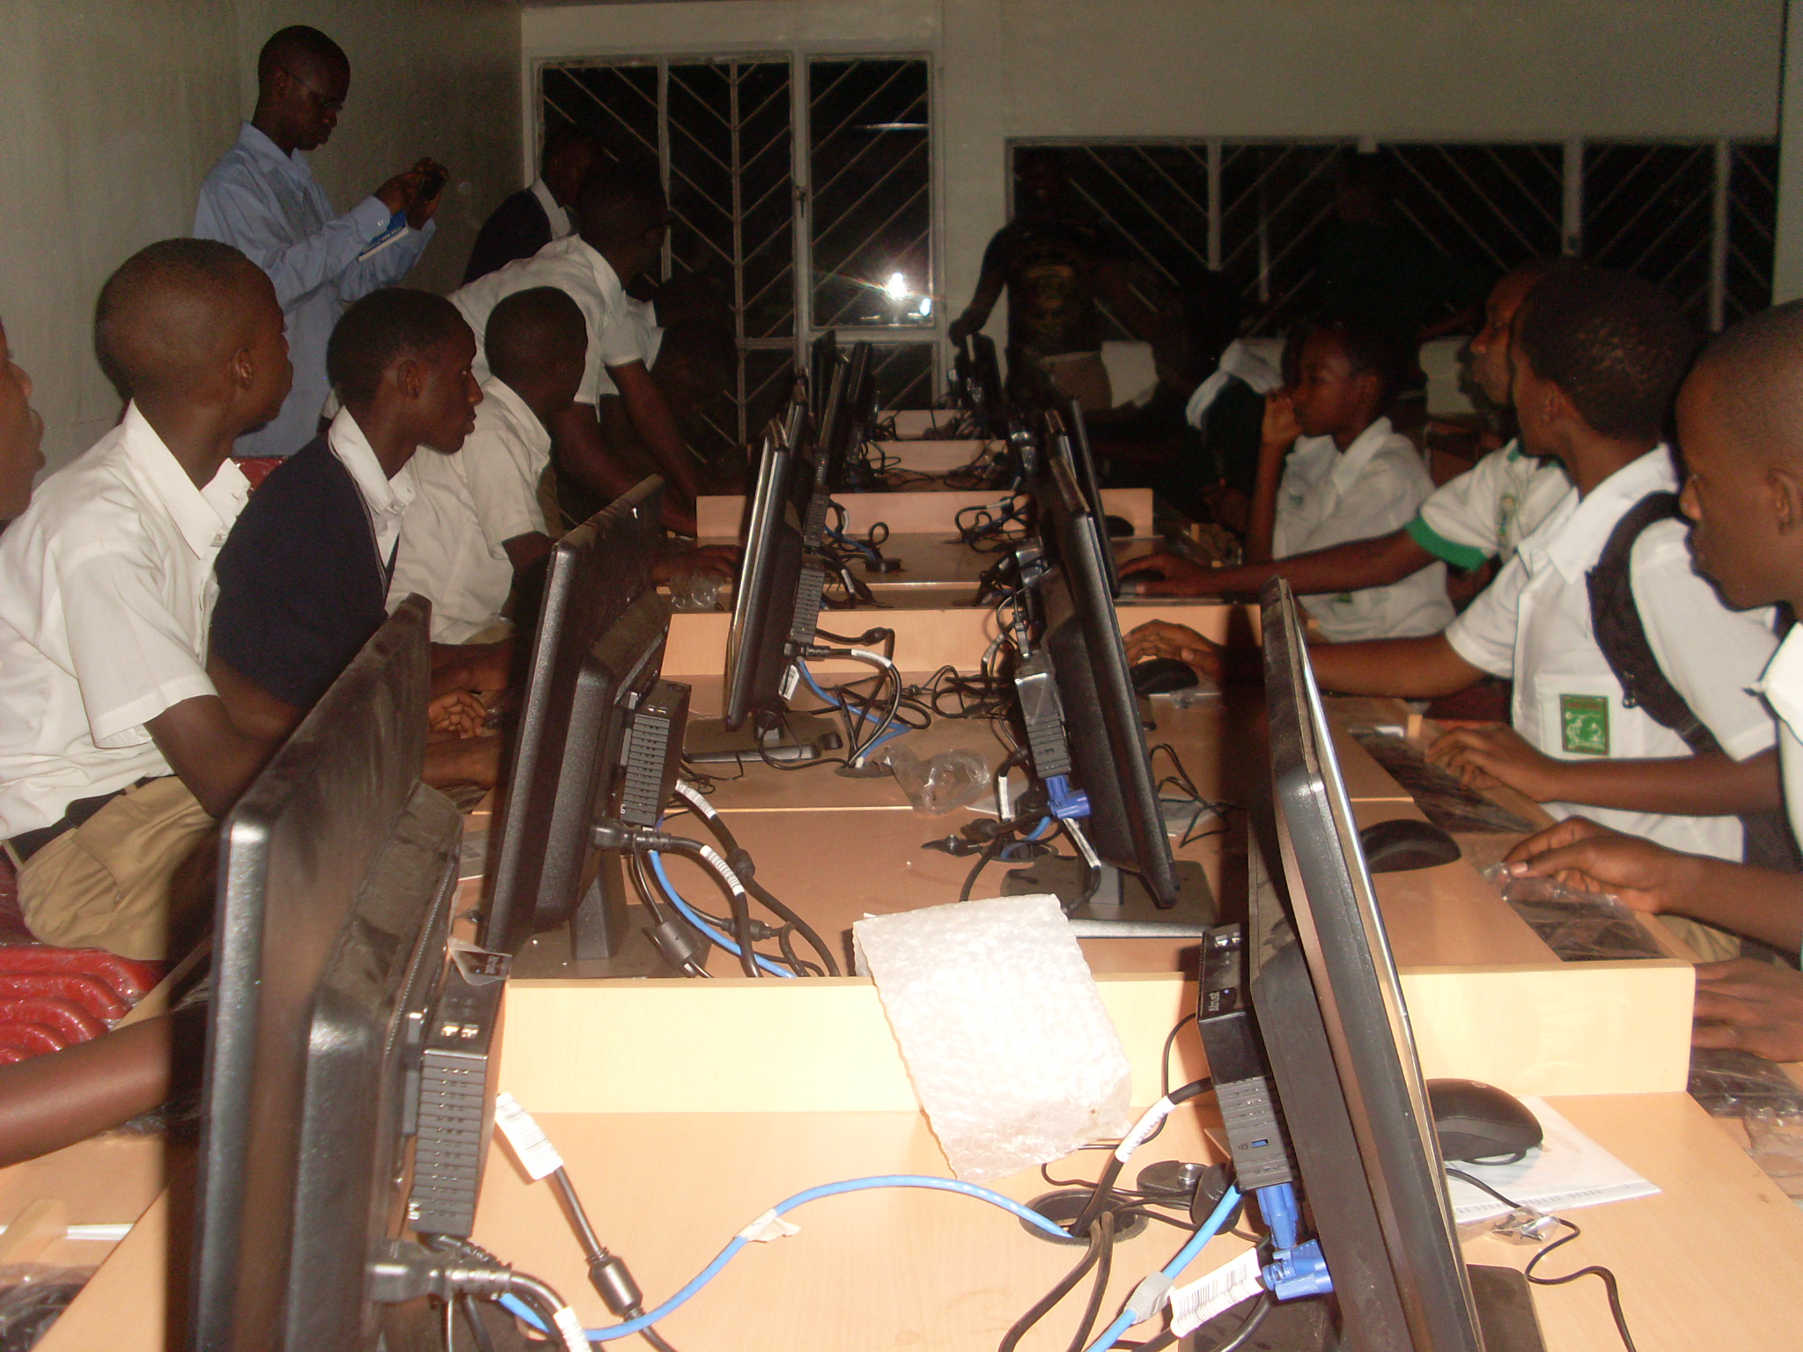
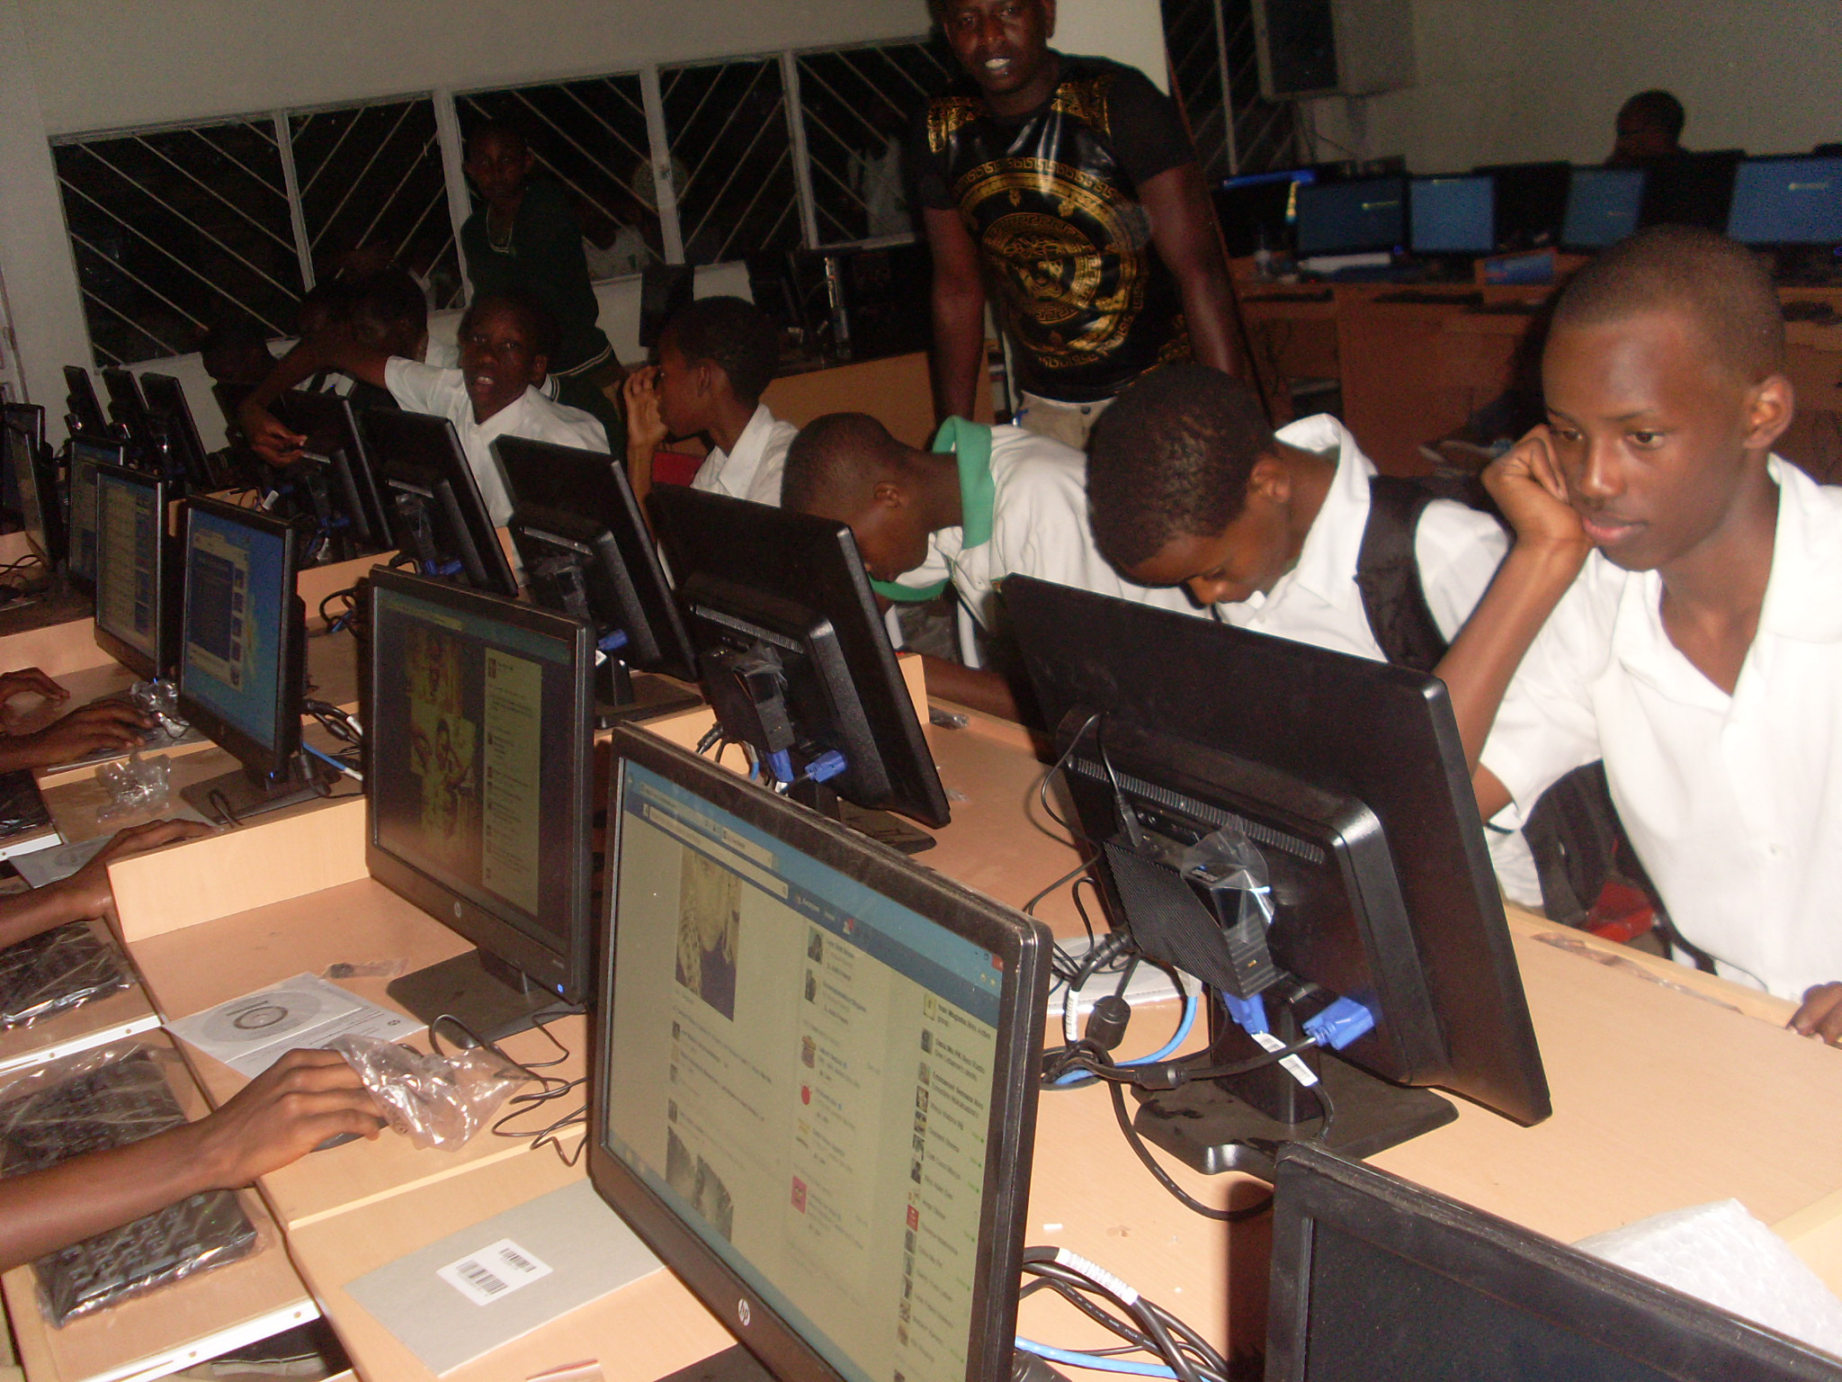
Students in class..

Slide 16
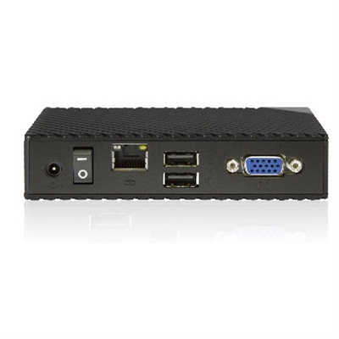

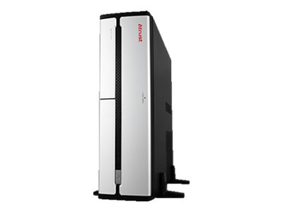
GiraICT Multipoint Platform - components:
Zero client
Monitor, keyboard & mouse
Server
Zero client; Power port, Ethernet port, USB ports for mouse & keyboard and VGA slot.

Slide 17
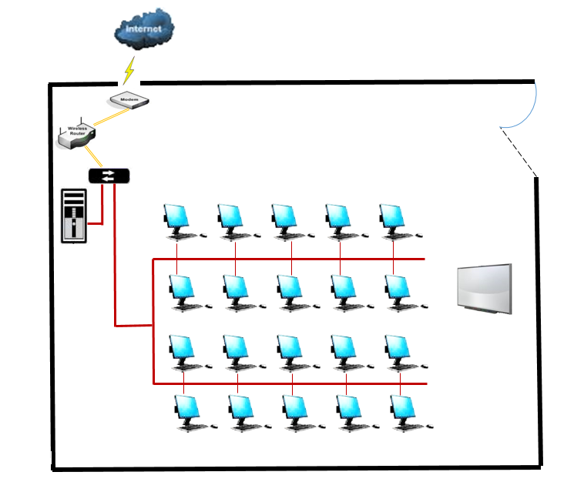
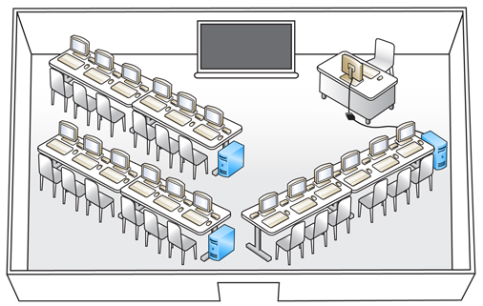
Image sketch, classroom interior design images..
Drafted GiraICT Multipoint Platform
Classroom interior design

Slide 18
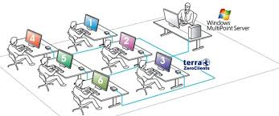
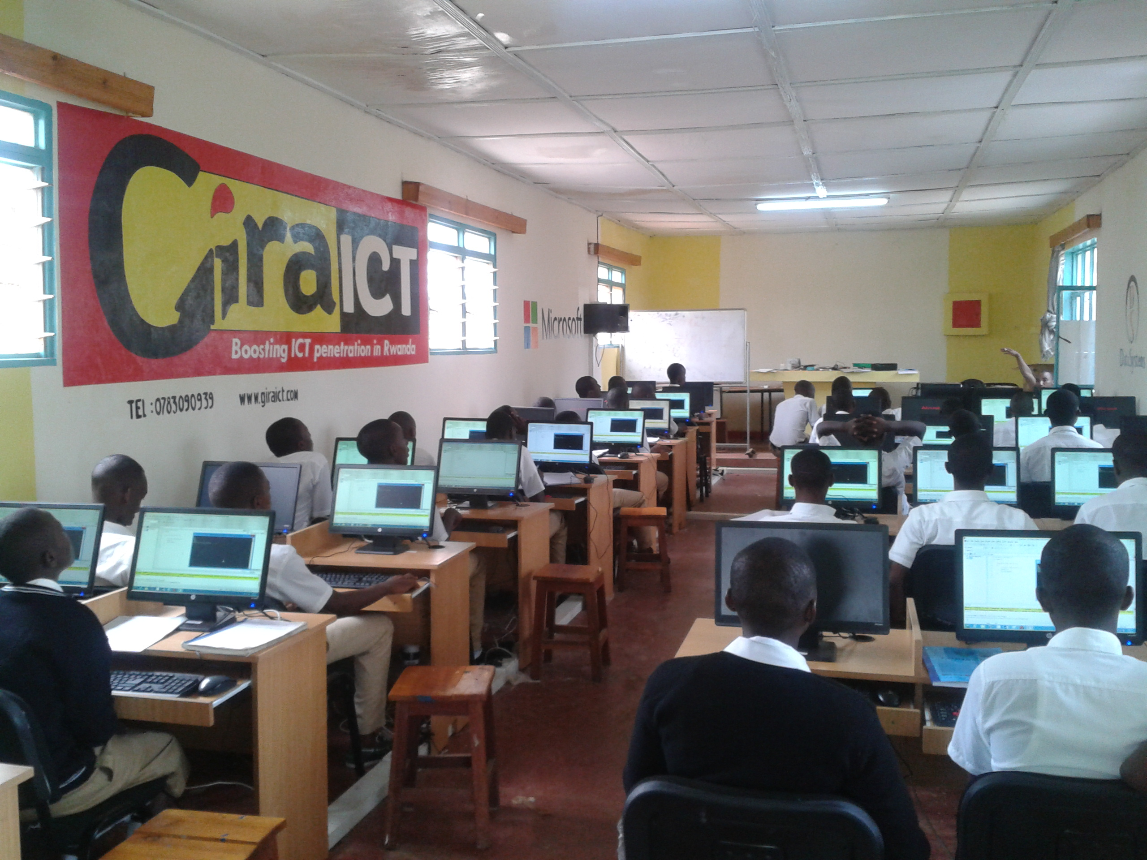
Drafted image & photo

Slide 19
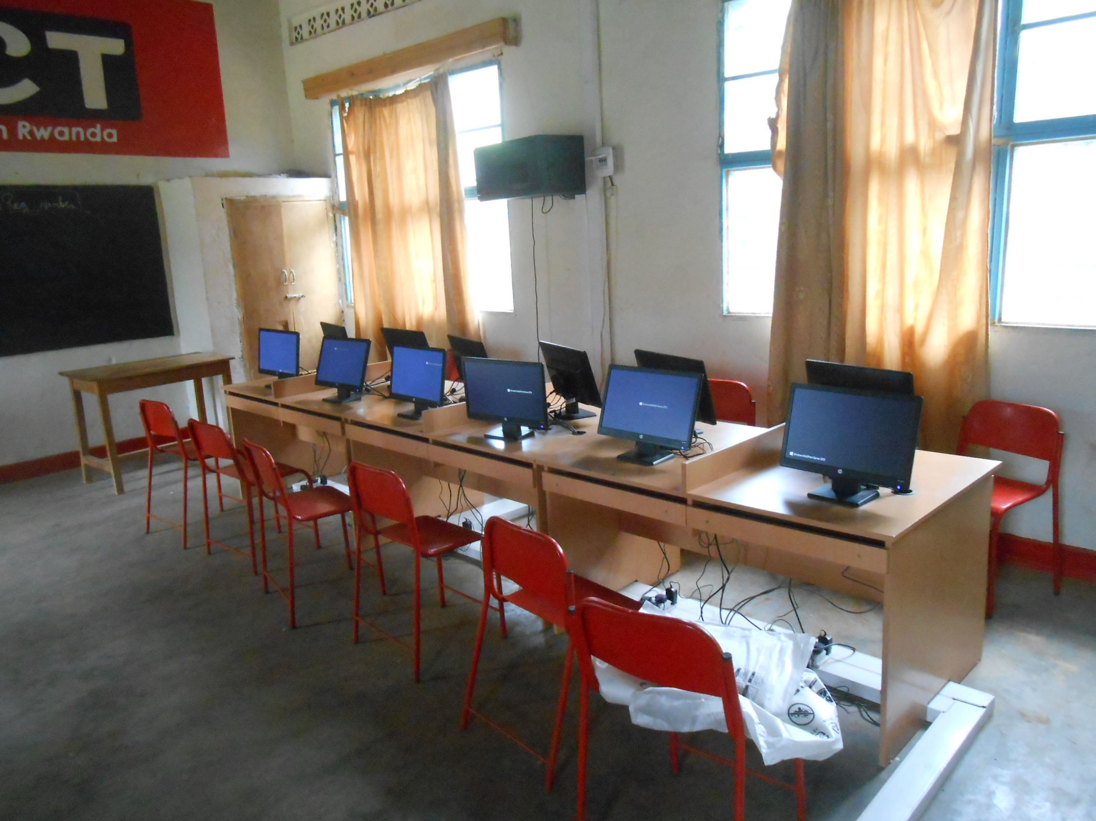
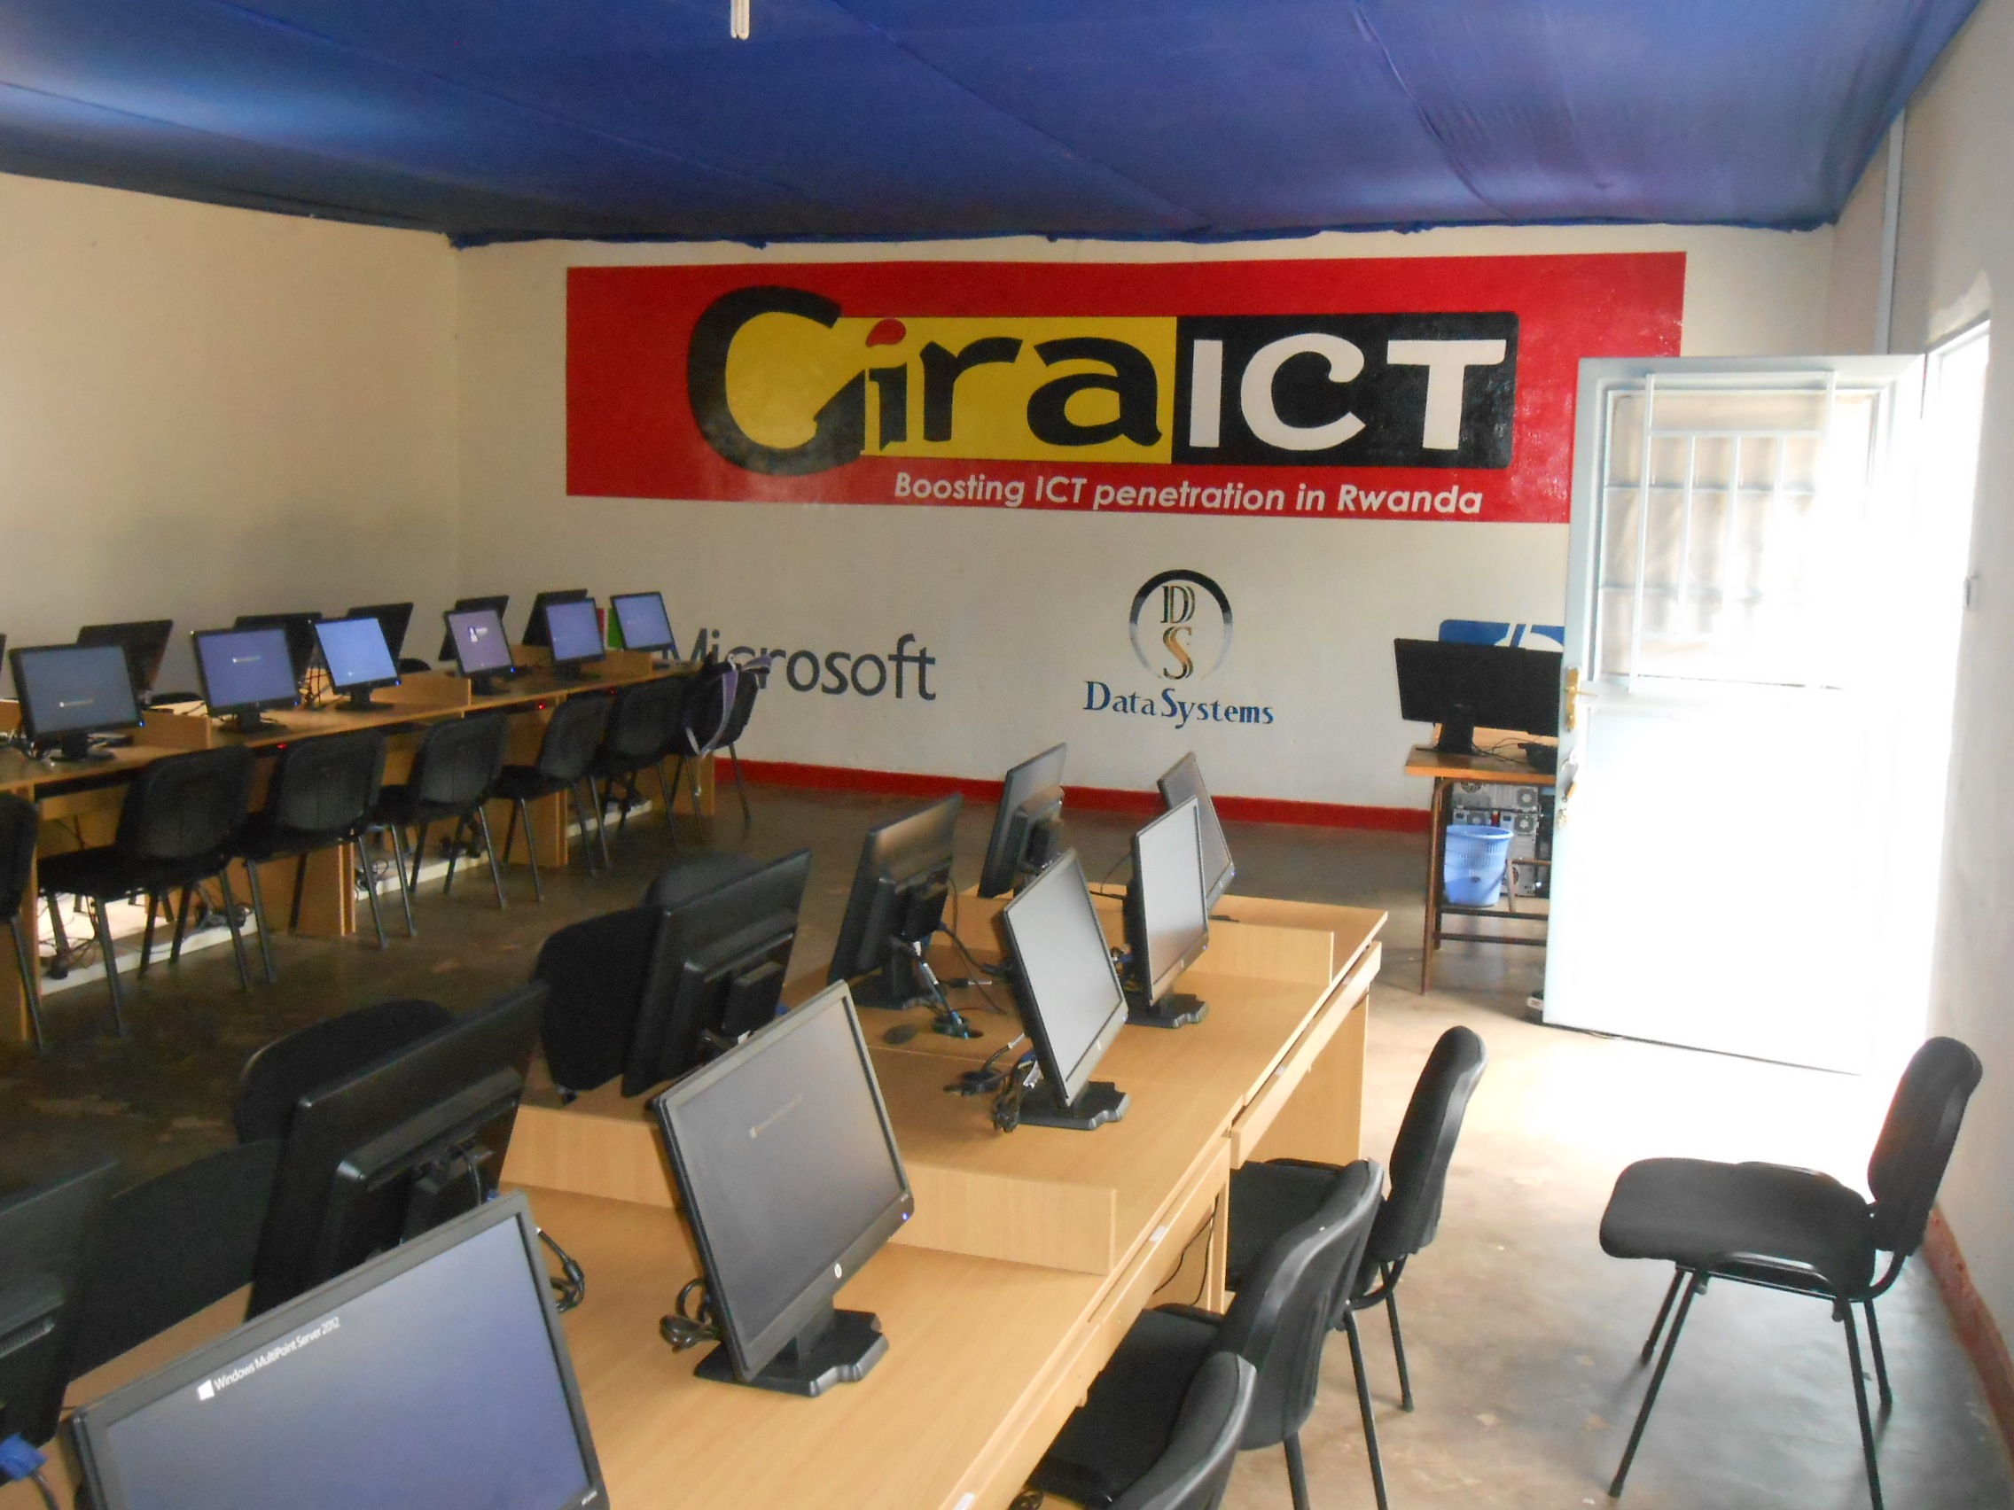
Infrastructure image design

Slide 20
GiraICT Multipoint Platform Vs Traditional Computing Platform..
GiraICT Multipoint Platform | Traditional PC Workstation
* Reduce hardware cost and complexity: One server + Multiple monitors depending on your option of your choice (40 or 20) | * Hardware cost and complexity: No server included hence need for multiple CPUs working independently.
* Reduce expensive licensing costs: Reduced volume license expense since you get 1 license for a set of (20 clients) supposedly CPU by 80% | * Expensive licensing costs: Since each CPU requires an OS, then the license will depend on how many are involved.
* High Performance: Since the systems is running one only One platform, that even safer and reliable due to a processor that is designed to accumulate a heavy amount of work produced by the server. | * Low Performance: Here each CPU has its own defined processor that works independently on each machine thus less performance depending on work flow individually.

Slide 21
GiraICT Multipoint Platform | Traditional Computing Platform
* Independent stations location: Here monitors can be located anywhere as long as they are assigned to the server and can work even virtually. | * Attached location of station: Machines location matters very much here since there need to be available in line with the structure of Networking in place. All in one place making it easily interrupted in case of LAN orientation.
* Electrical Savings: Zero client devices consume 3W of power and can last as long as 10 Years. | * Electrical Savings: Here it is very had to maintain a steady power consumption since very machine machines are involved.

Slide 22




Data systems Ltd
- GiraICT Project
Contacts
TELECOM House,
2nd Floor.
http://www.giraict.rw
0788867992

