Slide 1
Green Jobs in the Construction Sector
Eastern and Southern Africa Youth Employment Knowledge Sharing Forum
Zambia Green Jobs Programme
Evans Lwanga

Slide 2
Background
The Zambia Green Jobs Programme is a UN joint programme, led by the International Labour Organization (ILO), with contributions from United Nations Environment Programme (UNEP), United Nations Conference on Trade and Development (UNCTAD), International Trade Centre (ITC) and Food and Agriculture Organization (FAO).

Slide 3
Challenges
Unemployment, poverty and inequalities especially among youth and women
Environmental costs for present and future generations

Slide 4
Decent Green Jobs
Green jobs - preservation or improvement of environmental quality
Decent green jobs - rights, social dialogue and social protection embedded

Slide 5
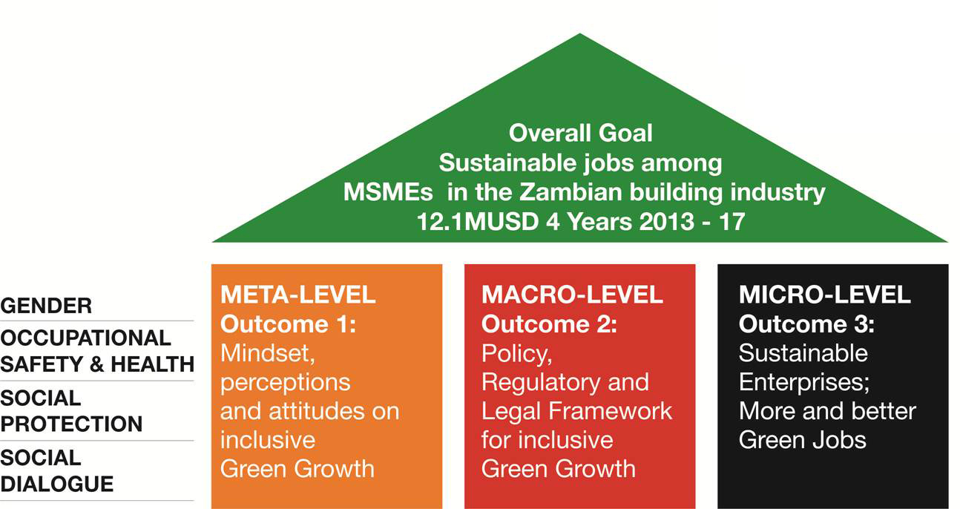
Market System and
Value Chain Development

Slide 6
Outcomes and Target Groups
Outcome | Target Group
Outcome 1: Mindsets, Attitudes and Perceptions | Housing developers, investors and owners as well as the general public
Outcome 2: Green building policy, regulatory and legal framework | Makers and Implementers of the policy, regulatory and legal framework for green business
Outcome 3: Sustainable Enterprises ; More and better (Green) Jobs | Micro, Small and Medium Enterprises (MSMEs) along the building construction value chain based on economic, social and environmentally-friendly (green) business models and practices which utilize green building materials, goods, technology and services

Slide 7
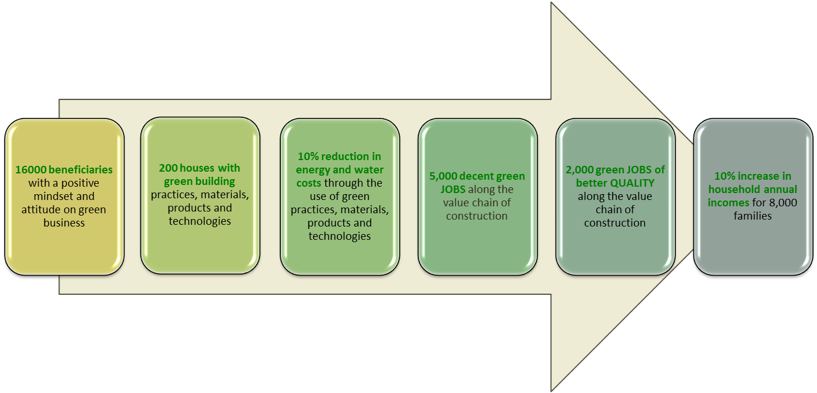
Results dashboard or snapshot

Slide 8
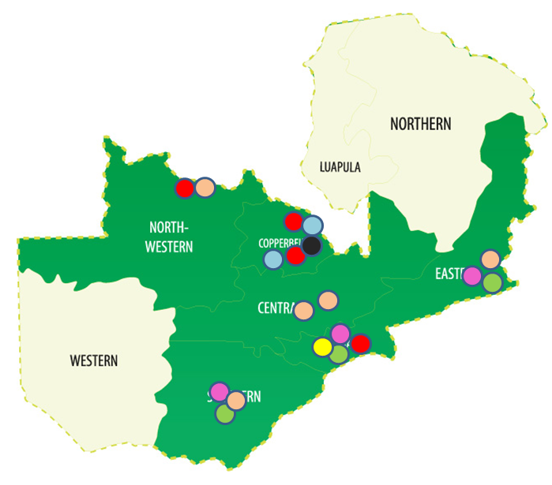
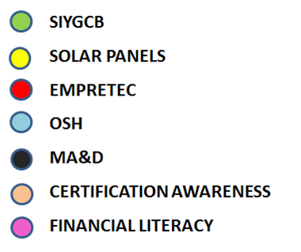
Programme Map
Current outreach has extended to Six (6) Provinces in Zambia

Slide 9
Outreach and Scale: People

Slide 10
Local institutional capacity and competitiveness
Significant capacity for service delivery built in 570 local institutions and organizations to boost beneficiation in future years

Slide 11
MSMEs access to BDS and Financial Services
Accumulatively 866 MSMEs including Small Scale Forestry Enterprises benefitted from the business development service facilitated by the Programme.
Service outreach to outlying remote areas remains a challenge. Limited service provider capacity.

Slide 12
Employment: 331 new green JOBS created
Job creation impacted more on young people and men than women
Job creation rate expected to RISE from the fruition of housing construction projects MSME linkages, competitiveness and productivity improvements from better working conditions

Slide 13
Employment: 417 of jobs better Quality
More job quality improvements from labour law, occupational safety and health as well as social protection services expected.
MSME Labour Law booklet and training on affordable beneficial compliance in collaboration with other projects (NORAD)
Social Protection and Occupational Safety and Health incubator projects for MSMEs and their Associations while influencing policies in collaboration with other projects (FINLAND, IRELAND)

Slide 14
Strategic partnerships
Partnership | Target Income level | Housing units | Area
Lafarge (5 demos) | Middle income construction | 600 | Lusaka Ndola
Kalumbira Mine (2 demos) | Middle income construction | 1200 | Kalumbira Mine
 | Low income construction | 10000 | Kalumbira Town
Barrick Lumwana (2 demos) | Middle income construction | 500 | Lumwana
Poor Peoples’ Process on Housing and Poverty in Zambia (5 demos) | Low Income Construction | xxx | Lusaka, Ndola, Kitwe
 | Low Income Retrofitting | 8 + xxx | Lusaka, Ndola Kitwe
Strategic public and private sector building and skills development partnerships can unlock the housing market for sustainable construction.
Demonstration units are risk incentive tool crucial for stimulating partnerships with housing developers and investors but our allocation is limited.

Slide 15
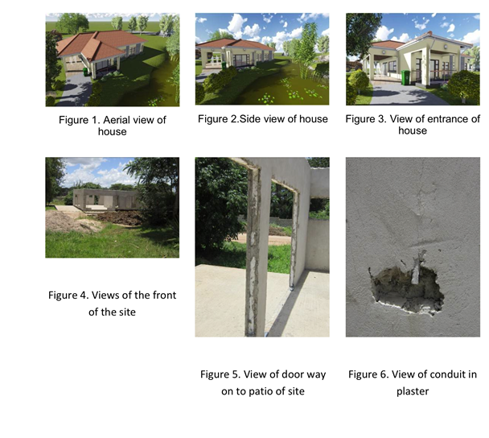
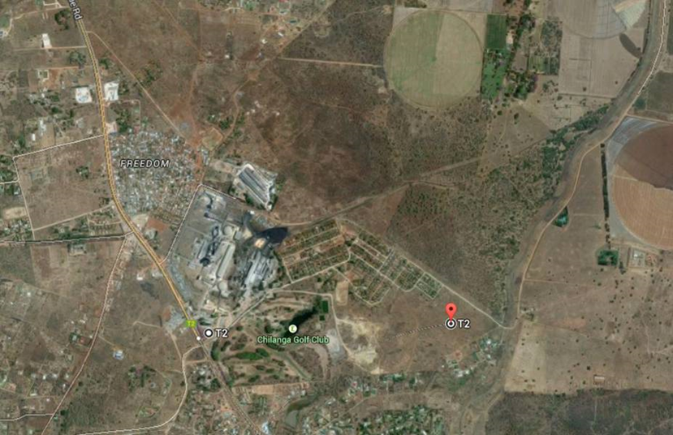
Affordable Housing Project
Demo site
Residential site
Good value proposition even better with additional improvements such as localizing the value chain (20 ➔70%)

Slide 16
Replication and Sustainability - Implementation modalities of the ZGJP
The ZGJP is not an implementing institution
Systemic and sustainable changes (no substitution)
Capacity building of existing institutions and strengthening or nurturing existing structures and networks (rewiring where necessary)
The ZGJP looks for strategic partnerships with key institutions and government offices within the wider construction and building sector

Slide 17
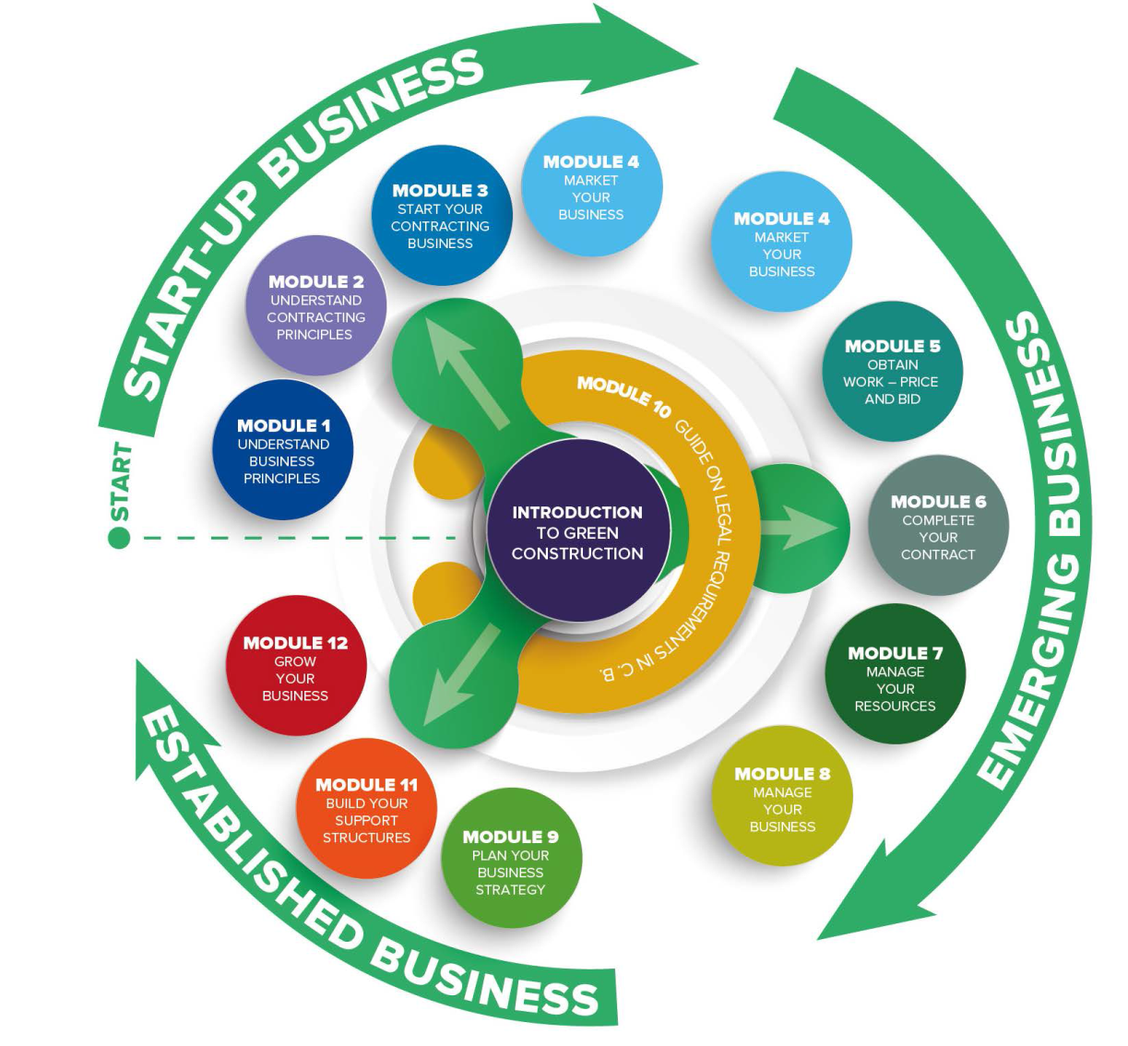
Start and Improve Your Green Construction Business Training Programme

Slide 18

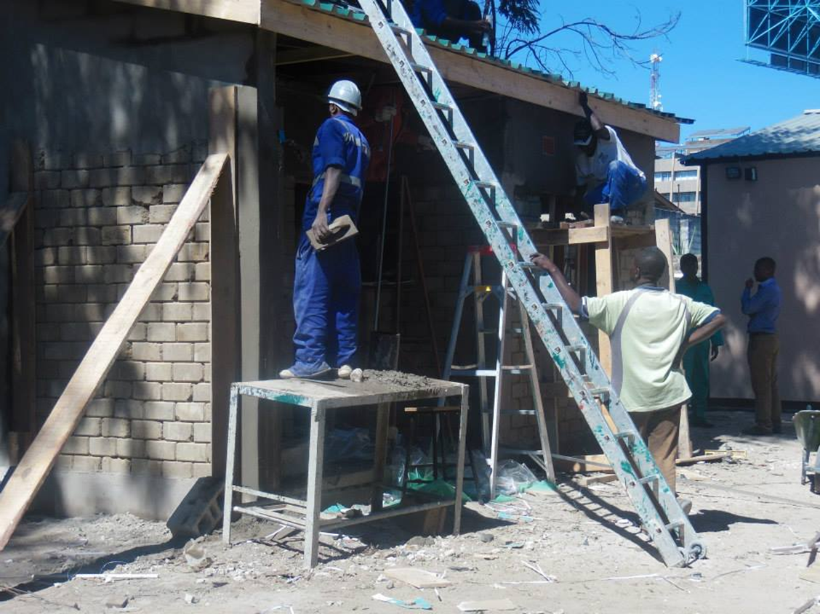
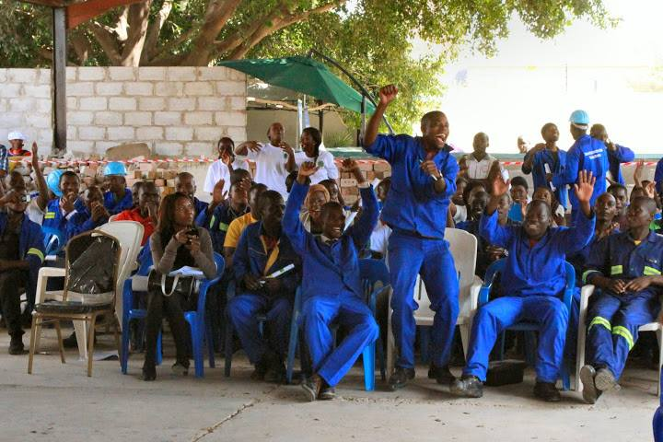
Thorn Park Construction Training Centre

Slide 19

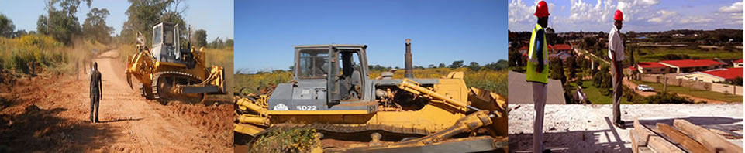
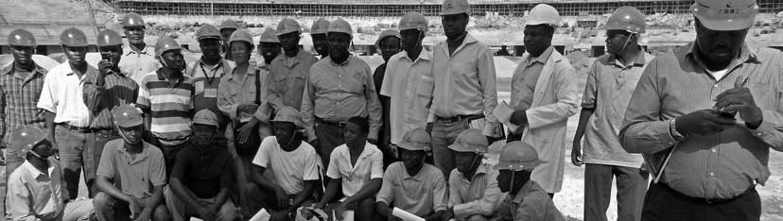
National Council For Construction

Slide 20

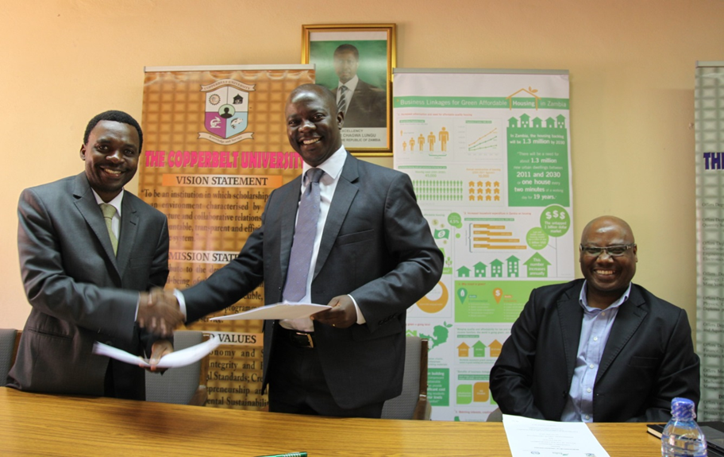
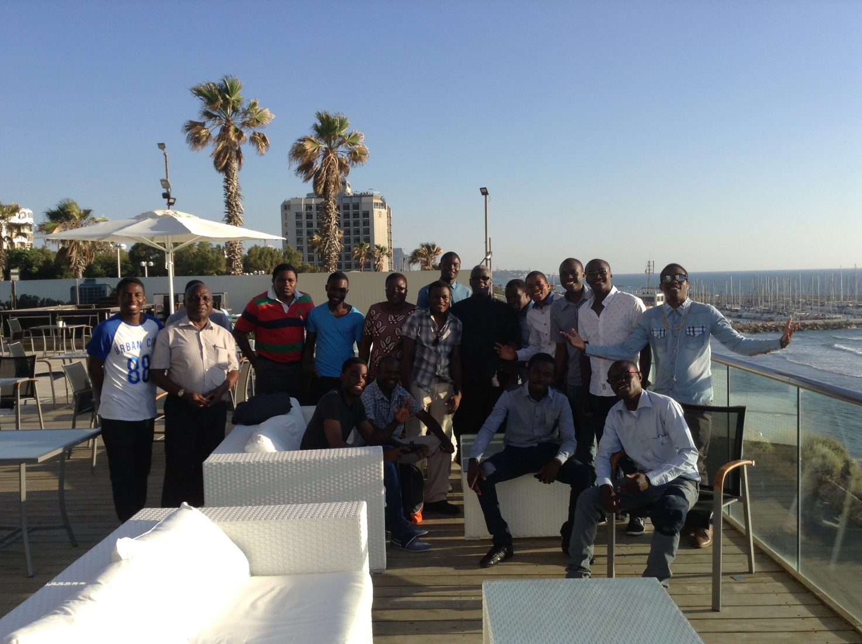
Copperbelt University

Slide 21
Private sector development thrive on promoting sustainable enterprises, creating more and better jobs, protecting people and preserving the quality of the environment
“This can only be sustainable if there is effective participation of the YOUTH”

Slide 22
Thank you!

