Slide 1
  EASTERN & SOUTHERN AFRICA YOUTH EMPLOYMENT SHARING FORUM
RAPID LABOUR INTENSIVE EMPLOYMENT GENERATION (19/07/2015 -22/07/2015)
CRESTA LODGE
HARARE, ZIMBABWE
EXPERIENCE & OPPORTUNITIES FOR LABOUR INTENSIVE PUBLIC WORKS
PRESENTED BY:
Eng. NELSON KUDENGA

Slide 2
CONTENTS
1. BACKGROUND
2. LABOUR BASED CONTRACTORS
3. PROJECTS
4.LESSONS LEARNT
5. RECOMMENDATIONS

Slide 3
1. BACKGROUND
Labour Based rehabilitation of rural feeder roads done in the DOR in 1991.
Sponsored by DANIDA, SIDA and GOZ
To establish technical and economic viability of labour based technology
Pilot projects in four (4) provinces using force account unit, MSE, MAT N, MAT S, & Masvingo
Once successful – labour based Contractors

Slide 4
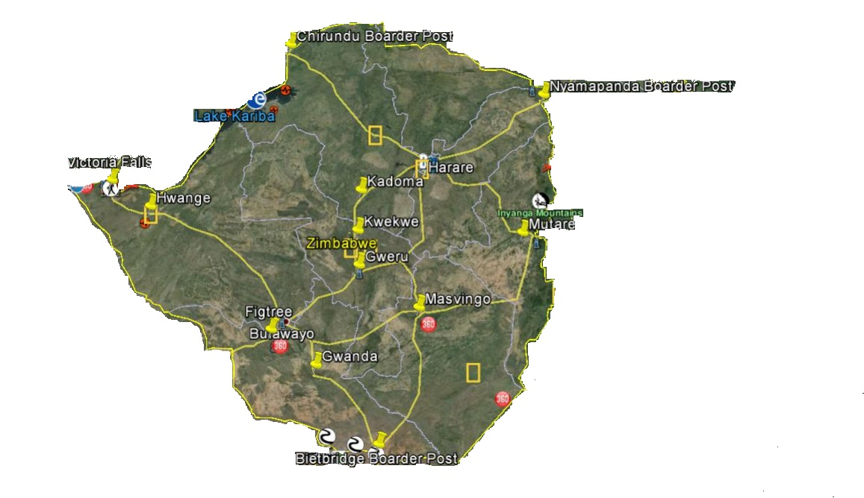
BACKGROUND (Contd)

Slide 5
2.LABOUR BASED CONTRACTORS (Maintenance/ Rehabilitation)
An LBDU formed consisting of SWEROAD Engineers and technicians and DOR Engineers and technicians to train and supervise training and execution of projects.
Many DOR Engineers and Technicians were sent to Kissi Kenya for training on construction and maintenance of roads using labour intensive methods.
Twenty (20) small scale contractors trained (132 had applied)
Twelve (12) consultants trained out of possible 69
About 3000km maintained
Seventy two (72) out of 2553 trained as petty contractors
Training in labour based technology contract administration and management.
Twenty (20) Contractors given projects and the following equipment,

Slide 6
LABOUR BASED CONTRACTORS (Maintenance/ Rehabilitation) Cntd
3 tractors, 6 trailers, towed grader, water bowser, pick up, water pump, motor cycle, 2 roller.
All paid off the loans
Of the Twenty (20) , Two (2) were female contractors
Road projects covered all provinces
Was extended to Rural istrict Councils
Same technology used for labour based surfacing.Videos produced.

Slide 7
LABOUR BASED CONTRACTORS (Maintenance/ Rehabilitation) Cntd
3 tractors, 6 trailers, towed grader, water bowser, pick up, water pump, motor cycle, 2 roller.
All paid off the loans
Of the Twenty (20) , Two (2) were female contractors
Road projects covered all provinces
Was extended to Rural District Councils
Same technology used for labour based surfacing.Videos produced.

Slide 8
LABOUR BASED CONTRACTORS (Maintenance/ Rehabilitation) Cntd
PROVINCE | CONTRACTOR | PROJECT NAME
Manicaland | Geopta (Pvt) Ltd | Headlands – Mayo -Chikore
 | Martel Enterprises | Nyanga - Nyamapanda
 | Martel Enterprises | Nyamaropa - Chisvo
 |  | Nyamaropa – Nyafaro - Katiyo
Masvingo | Woodfare Trading, Strucon P/I | Sarahuru - Maranda
 | All Purpose | Bondofi – Renco - Tokwe
Midlands | Muncol, Roadcon, Strucon | Empress – Copper Queen
 |  | Fairfields - Mashava

Slide 9
LABOUR BASED CONTRACTORS (Maintenance/ Rehabilitation) Cntd
PROVINCE | CONTRACTOR | PROJECT NAME
Mashonaland Central | Infracon (Pvt) Ltd. Kurima 2000 | Katarira - Mahuhwe
 | Infracon (Pvt) Ltd | Katarira - Bullnose
 | Infracon (Pvt) Ltd | Nahwa Junction - Katemere
 | Kurima 2000, Infra - Con | Mukumbura - Muzarabani
Matebeleland North | Equinox Contractors | Berthsaida Maganja
 | Equinox, Gekum Enterprises | Gwaai - Binga
 | Gekum Enterprises | Kamativi - Pashu
 | Force Account Unit | Inkosikazi Road
 | Gekum Enterprises, Equinox Contractors | Siabuwa - Mujere

Slide 10
LABOUR BASED CONTRACTORS (Maintenance/ Rehabilitation) Cntd
PROVINCE | CONTRACTOR | PROJECT NAME
Mshonaland West | Sibmut Construction The Maintenance team | Zvimba - Mupfure
 | LABCA Eng Services | Karoi - Shamrock
Mashonaland East | The Maintenance team | Mutoko - Mayo
 | Sircrow (Pvt) Ltd | Nharira - Mupatsi
 | Foundation Enterprises | Murehwa - Mandicheche
 | LABCA Eng. (Pvt) Ltd | Charter Road
Matebeleland South | Greystone Construction | Mphoeng’s – St Josephs
 | Luckystar Contractors | Plumtree - Somnene

Slide 11
3.LESSONS LEARNT
Provided employment for some people living closed to the road
Poverty alleviation – councillors and village elders chose the most disadvantaged
Women were employed on programme were more responsible than men. There was affirmative action for women in all the provinces.
Preliminary meetings were held with the locals first before project implementation. This helps to bring in ownership and “belonging”

Slide 12
LESSONS LEARNT (Cntd)
5. Improved roads for the communities
6.Knowledge transfer- how to rehabilitate/ build roads and culverts and maintain the same – contractors and locals
7.Other Contractors progressed into other businesses
8.Problem with sustainability once the donors withdrew
9.Principle effective in rural areas where some roads are in a bad state

Slide 13
LESSONS LEARNT (Cntd)
10. The programme was not completed because the donors including SIDA and DANIDA withdrew from Zimbabwe.
11. Was difficult in cases to get quality gravel within the economic distances. Had to make do with some “substandard” material.
There were delays in the payment of certificates to Contractors. Directorate had to be involved to speed up the payments.

Slide 14
LESSONS LEARNT (Cntd)
Frequent transfer of labour based engineers to other projects – breaking continuity. The Engineers were replaced but it affected quality of work and led to delays on project implementation.
11. Once the Zimbabwean economy has improved the labour based principles can be used in maintaining and rehabilitating roads in the rural areas.
Training will however be required . The same principle can be used in repairs, building and maintenance of schools, halls and clinics.
12. Right now this intervention has not been sustainable because of economic problems and donor flight.

Slide 15
RECOMENDATIONS
Labour based projects are at the moment not being done because of financial constraints. When the economic situation has improved then a certain percentage say 25% has to be reserved for disadvantaged youth and also for women.
In Zimbabwe the principle of labour based projects was only adopted within the Ministry of Transport. Other Ministries responsible for Agriculture, Water , Public Works and Local Authorities are encouraged to use this principle in their works.
Dialogue and collaboration has to be continued between Ministry responsible for Youth and the Department of Roads not only for road works but for other tenders within the Department of Roads. Affirmative action for Youths has to be incorporated in the relevant Ministries.

Slide 16
RECOMENDATIONS (Cntd)
While it is important to be self – reliant, Donors will still be required to restart labour intensive projects. Government needs to continue its efforts of attracting donors and the international community.
In line with the principles of ZIMASSET, the Government needs to set aside funds for labour based projects in RDCs and Urban Councils. When this is coordinated properly, it will help create jobs / small scale contractors and transfer of technical skills to the rural and urban councils.
6. Ministry of Education could also add the principles of labour intensive works on the school curricular.

Slide 17
THE END
THANK YOU !!!

