Slide 1
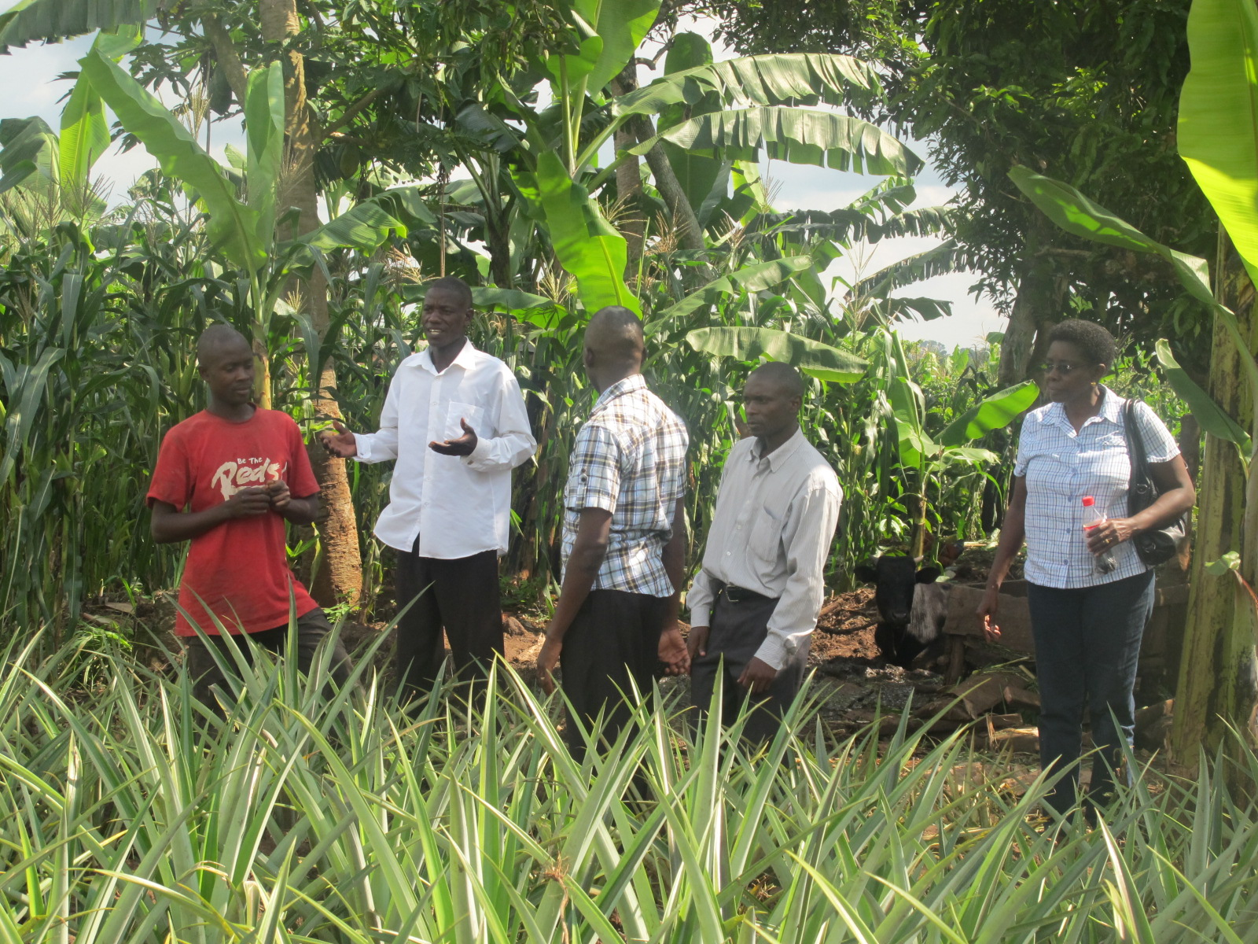

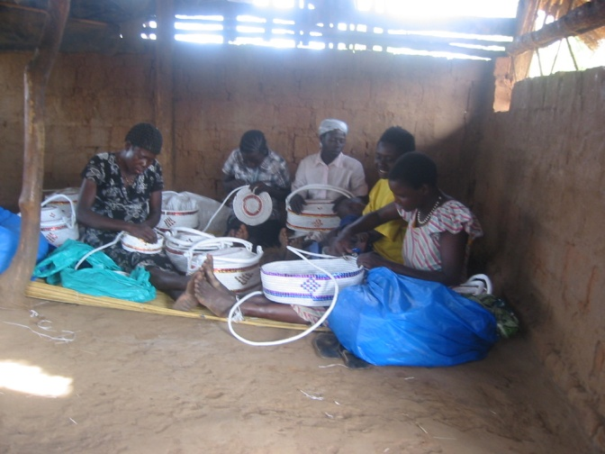
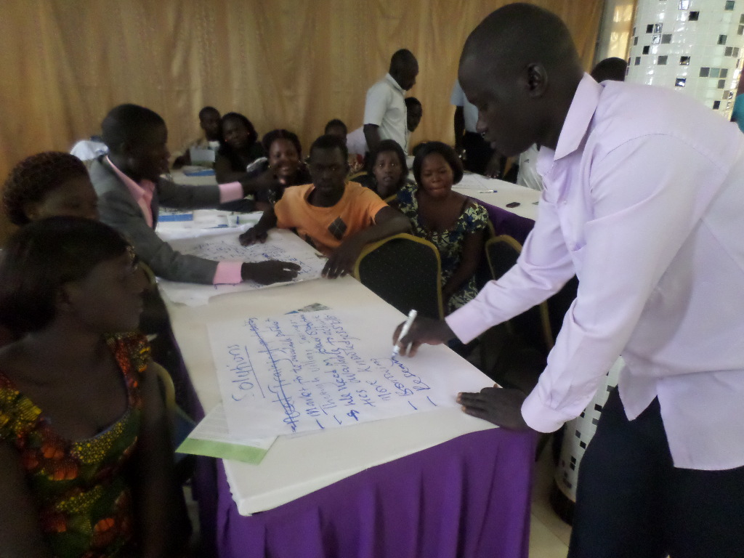
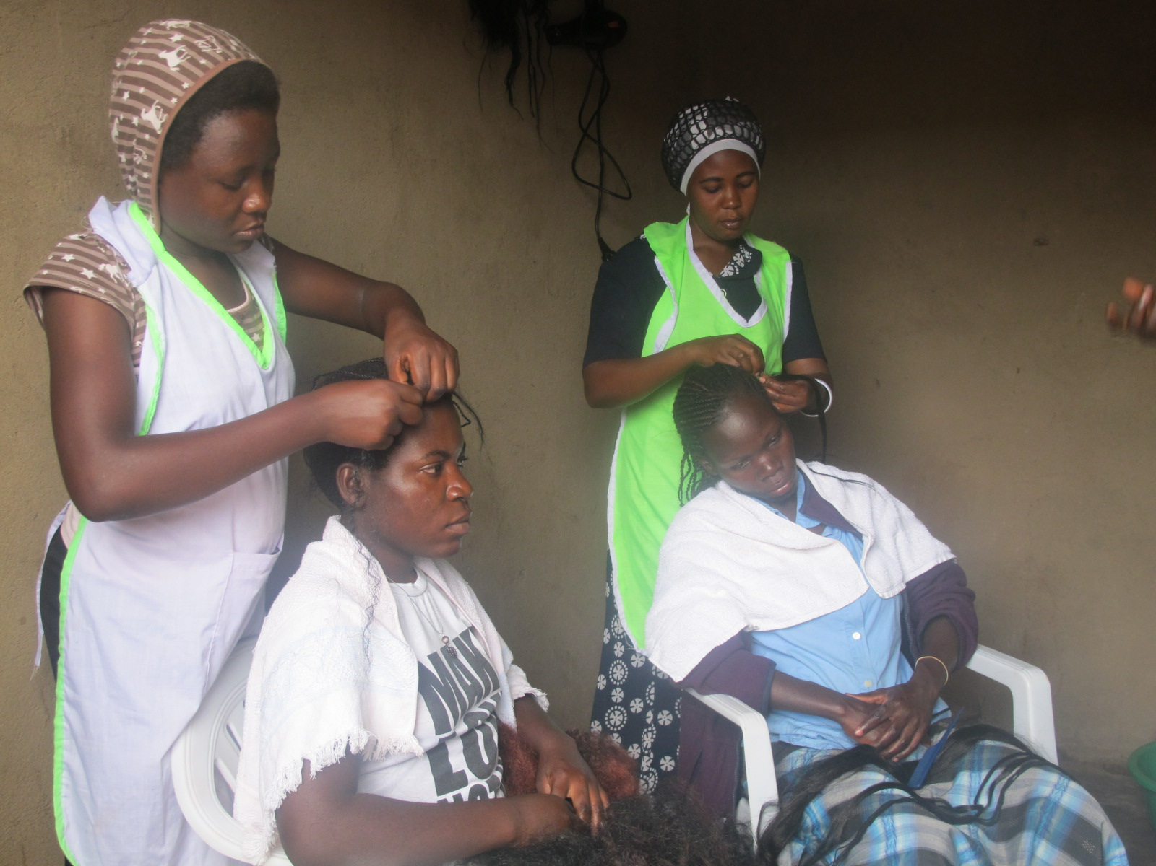

TITLE
Linking BDS and Access to Finance in Government Youth funding schemes
Harare, 20-22 July 2015
Subtitle
www. yefafrica.org

Slide 2
HEADER II I CAPS
Background
Presidential Pledge
  Youth Entrepreneurship Venture Capital Fund (YEVCF)
$18.2m
a) $10m; Youth Fund)
b) $916,000 for Entrepreneurship Skills Training)
Others;
c) $6.6m; work spaces
d) $720,000 for apprenticeship devt

Slide 3


HEADER II I CAPS
Youth Fund
Purpose: business growth/expansion
Loan size; From $2,000 for an individual
Security; No collateral
Interest Rate: 15%
Repayment period; Not exceeding 4 years
No legal fee but facility fee of 1%
Borrower demonstrates evidence of having invested at least 10% of the loan amount
Direct loan facilities to youth through three designated commercial Banks with a matching grant;
a) Stanbic Bank
b) Dfcu Bank
c) Centenary Bank

Slide 4
HEADER II I CAPS
Target Group and criteria
Ugandan citizens aged 18-35 years;
Proof of residence;
Prospects of business enterprise to provide employment for at least two youth;
Registered formal and on-going business enterprise that has existed for not less than three months;
Business proposals and work plans;
Other requirements in accordance with the respective bank’s house rules and procedures;
At least 30% of participants should be female youth
Affirmative action for youth with disability;
Guarantee letters

Slide 5
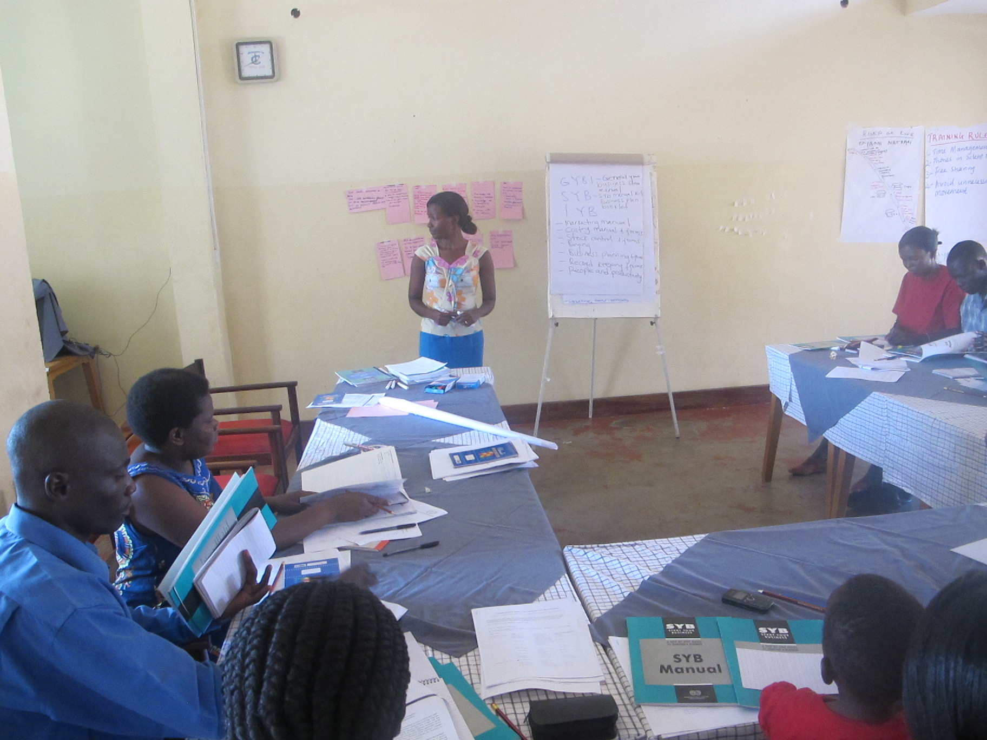
HEADER II I CAPS
Entrepreneurship skills Training
Implemented by Ministry of Gender, Labour and Social Development
Purpose
Equip youth with knowledge and skills required to run successful business enterprises;
Enable youth take on Entrepreneurship as a career path of choice.
7,218 Youth trained
Role and contribution of ILO
Development of training manual
Development of guidelines;
Training 60 trainers;
Supported pilot in 15 districts;
Roll out of training in all districts;
Support towards Monitoring and technical supervision;
Benchmarking visit to Kenya and Swaziland
Database development;
Mini Impact survey carried out

Slide 6
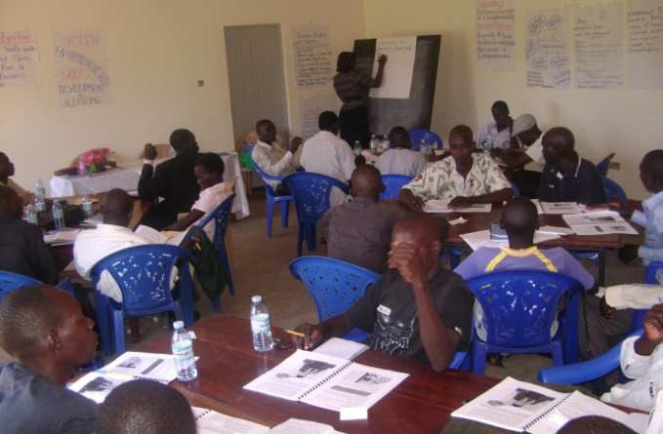
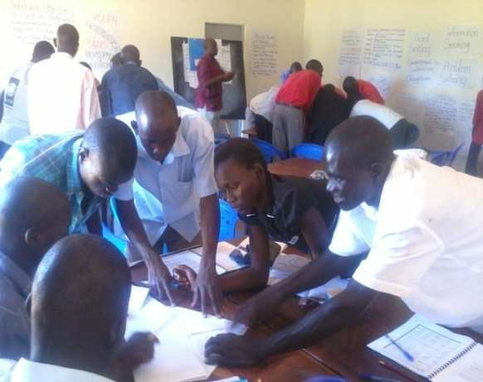
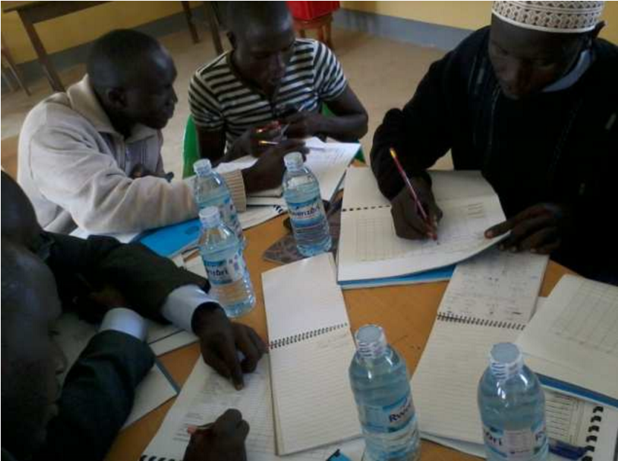
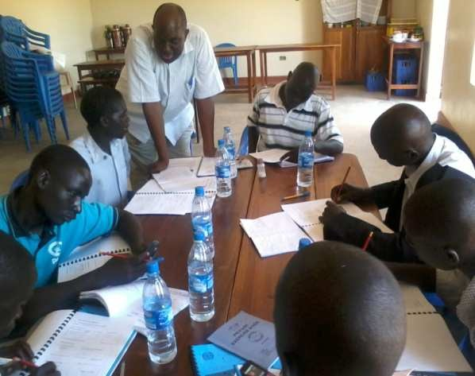
HEADER II I CAPS
Entrepreneurship Training
Participants are guided to fill their business plan
templates.

Slide 7
HEADER II I CAPS
Business Improvement and Job Creation
Header I
Follow-up survey conducted | Item | Before | After | % change
Out of the 514 youth trained during pilot from 15 districts,149 were sampled to assess short term impact of training | Turnover | 470,188 | 809,156 | 72%
 | Costs | 135,514 | 197,367 | 46%
 | Net Profit | 82,553 | 134,539 | 63%
 | Contracts | - | 74,833 | -
 | Taxes | 2,601 | 9,660 | 271%
 | Savings | 51,634 | 103,926 | 101%
 | Salaries | 51,874 | 77,759 | 50%
 | JOBS
 | Permanent | 174 | 269 | 55%
 | Casual | 112 | 185 | 65%
 | Total | 286 | 454 | 59%

Slide 8
HEADER II I CAPS
Challenges
Header I
YOUTH FUND
Inadequate funds;
Lack of legal framework;
Limited branches of financial institutions;
Limited investment in awareness creation
Impersonation and age related issues
TRAINING
Limited access to Youth Fund by trainees
Poor regional representation in access to Youth Fund
Political interference
High demand for training
Limited financial resources

Slide 9
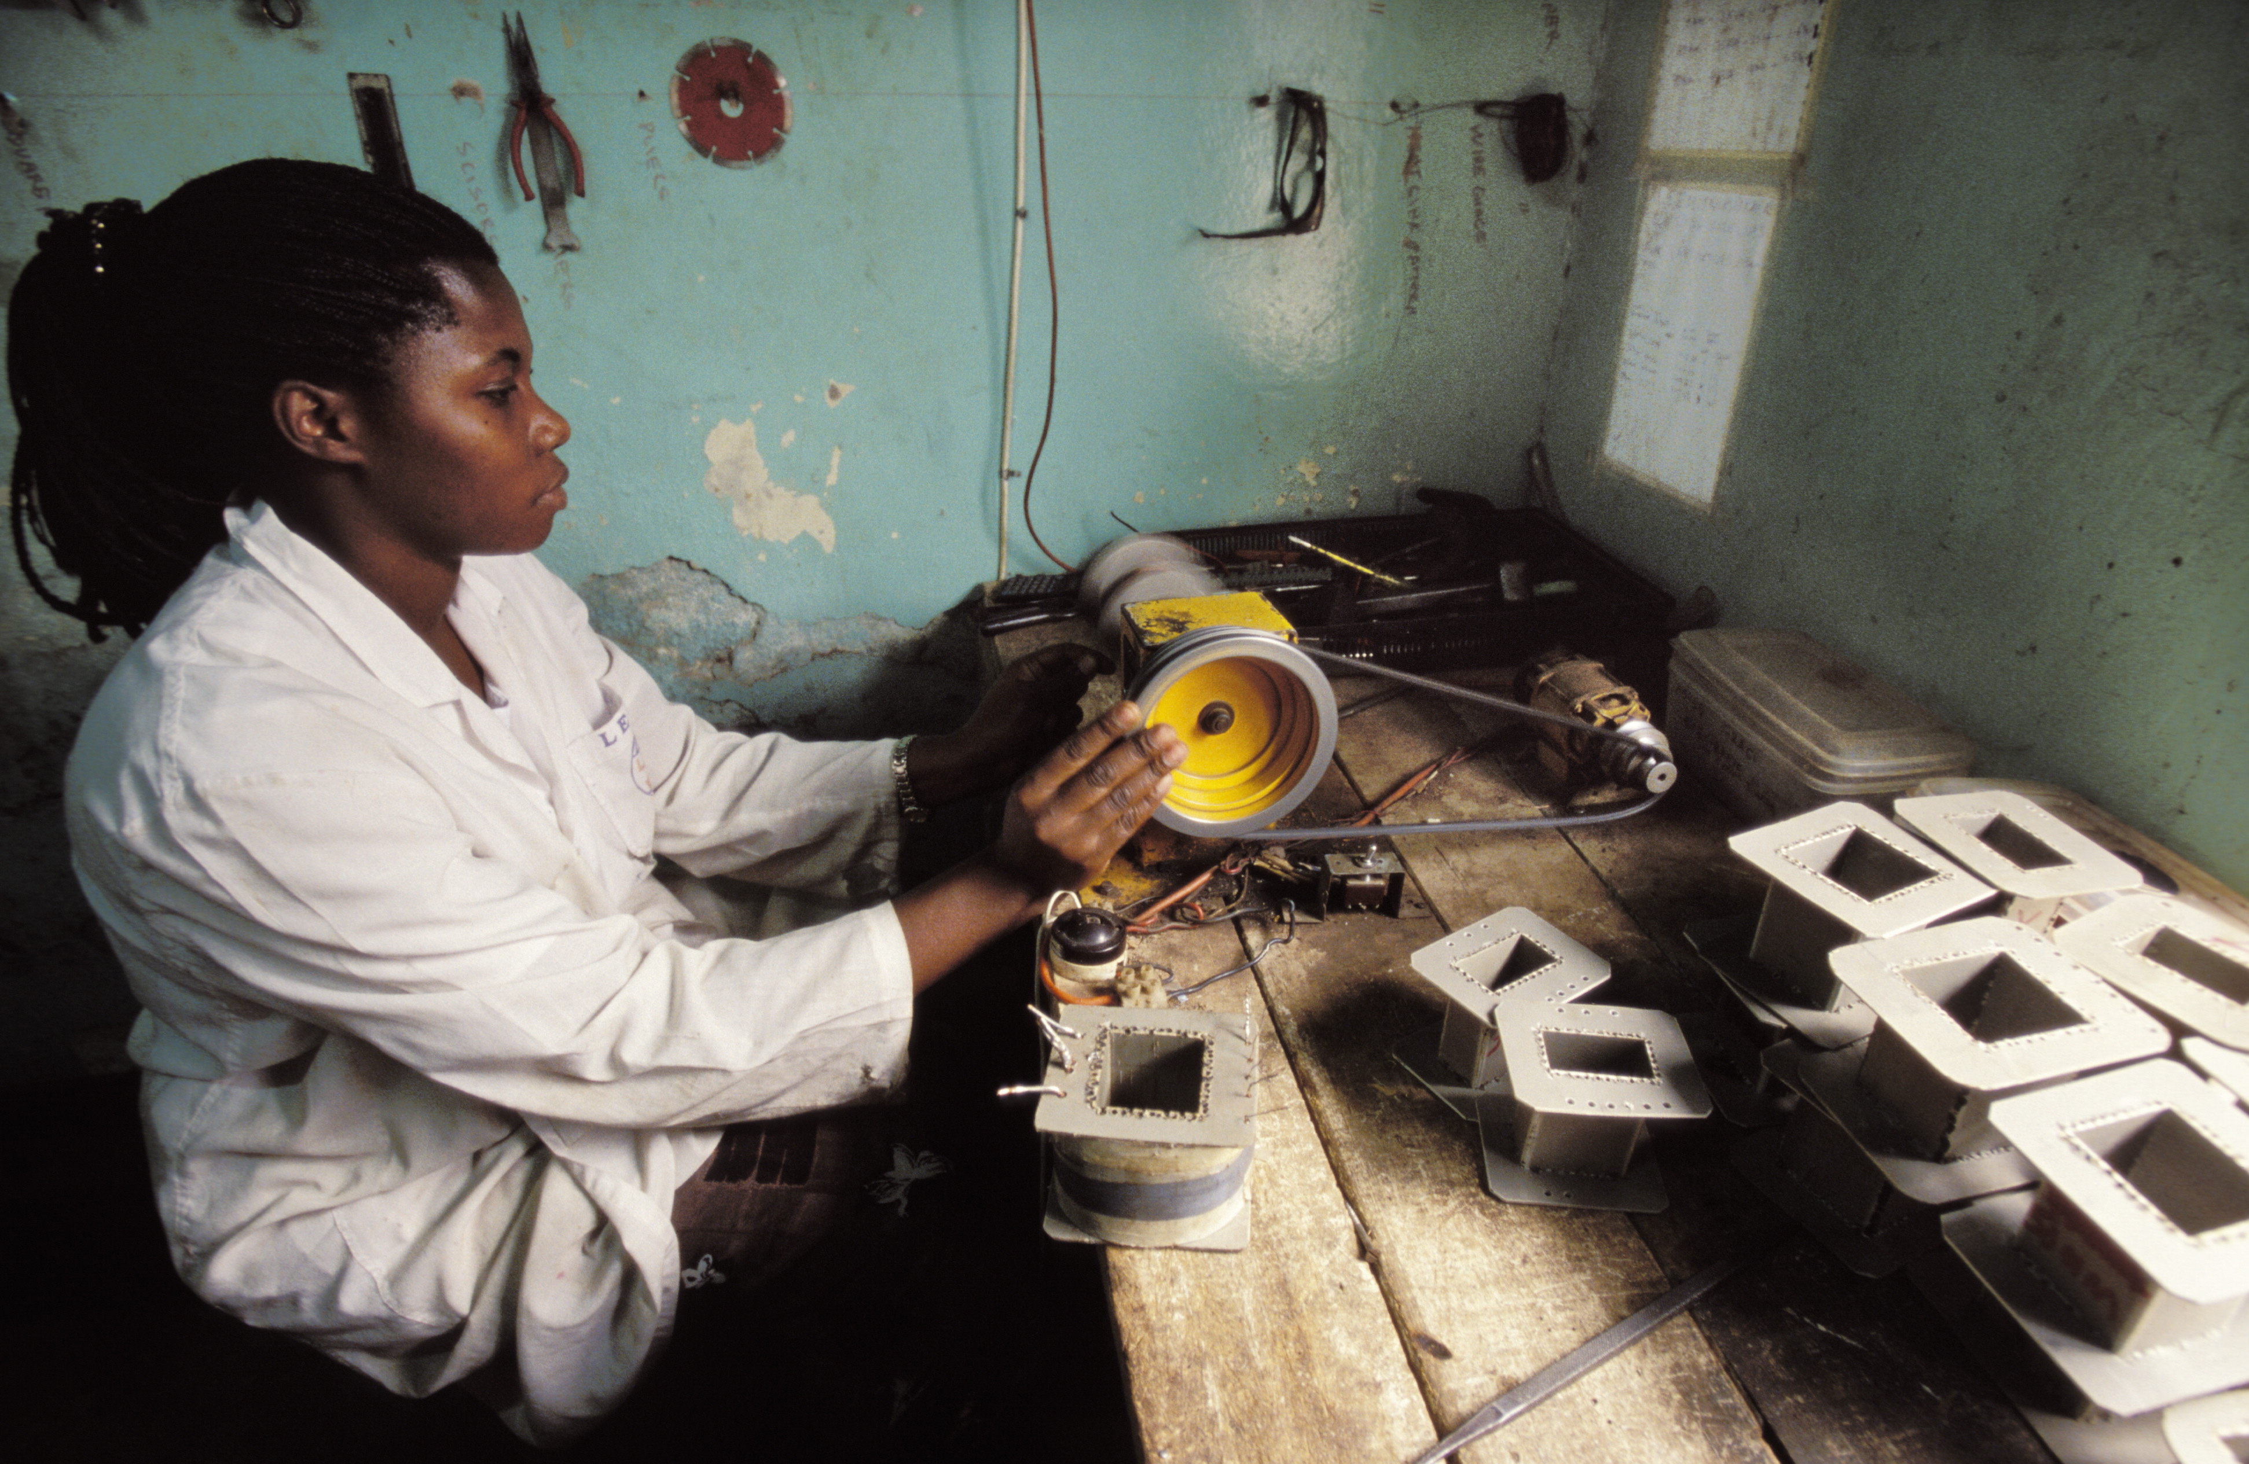
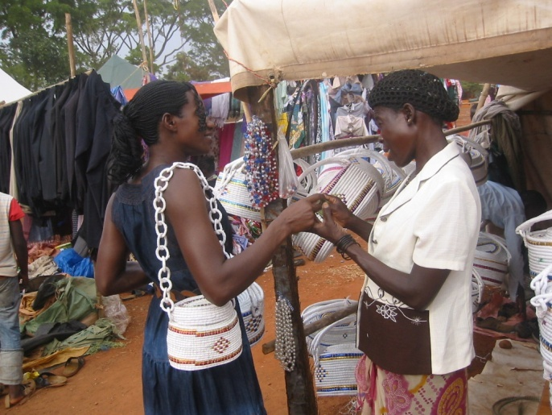
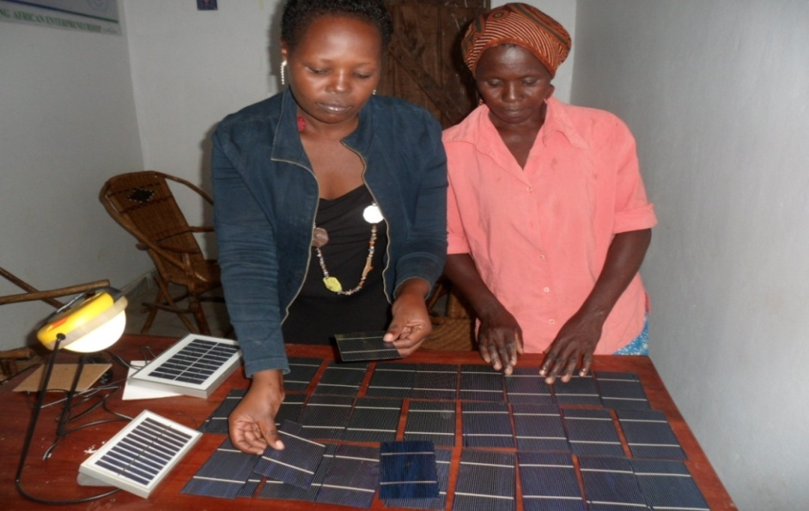
TITLE
Youth Entrepreneurship Facility
‘Giving Youth a Voice’
Subtitle
YOUTH-to-YOUTH Fund
Notes:
9

Slide 10
YOUTH-TO-YOUTH FUND
WHAT?
Identify, test, and promote innovative entrepreneurship solutions to youth employment challenges
IDEA LABORATORY
HOW?
By giving young people a voice, means and capacity to take an active role in youth entrepreneurship development
IDENTIFY
TEST
PROMOTE
Notes:
10

Slide 11
YOUTH-TO-YOUTH FUND – “What”
Competitive Grant Scheme for youth-led organizations to propose innovative project ideas on how to create entrepreneurship and business opportunities for their peers.
The organizations with the most innovative project ideas receive a grant and complementary capacity building to help them implement their projects and test the viability of the ideas (IDENTIFY and TEST).
Promoting the most successful initiatives in order for them to be taken to scale and replicated elsewhere (PROMOTE).
Notes:
11

Slide 12
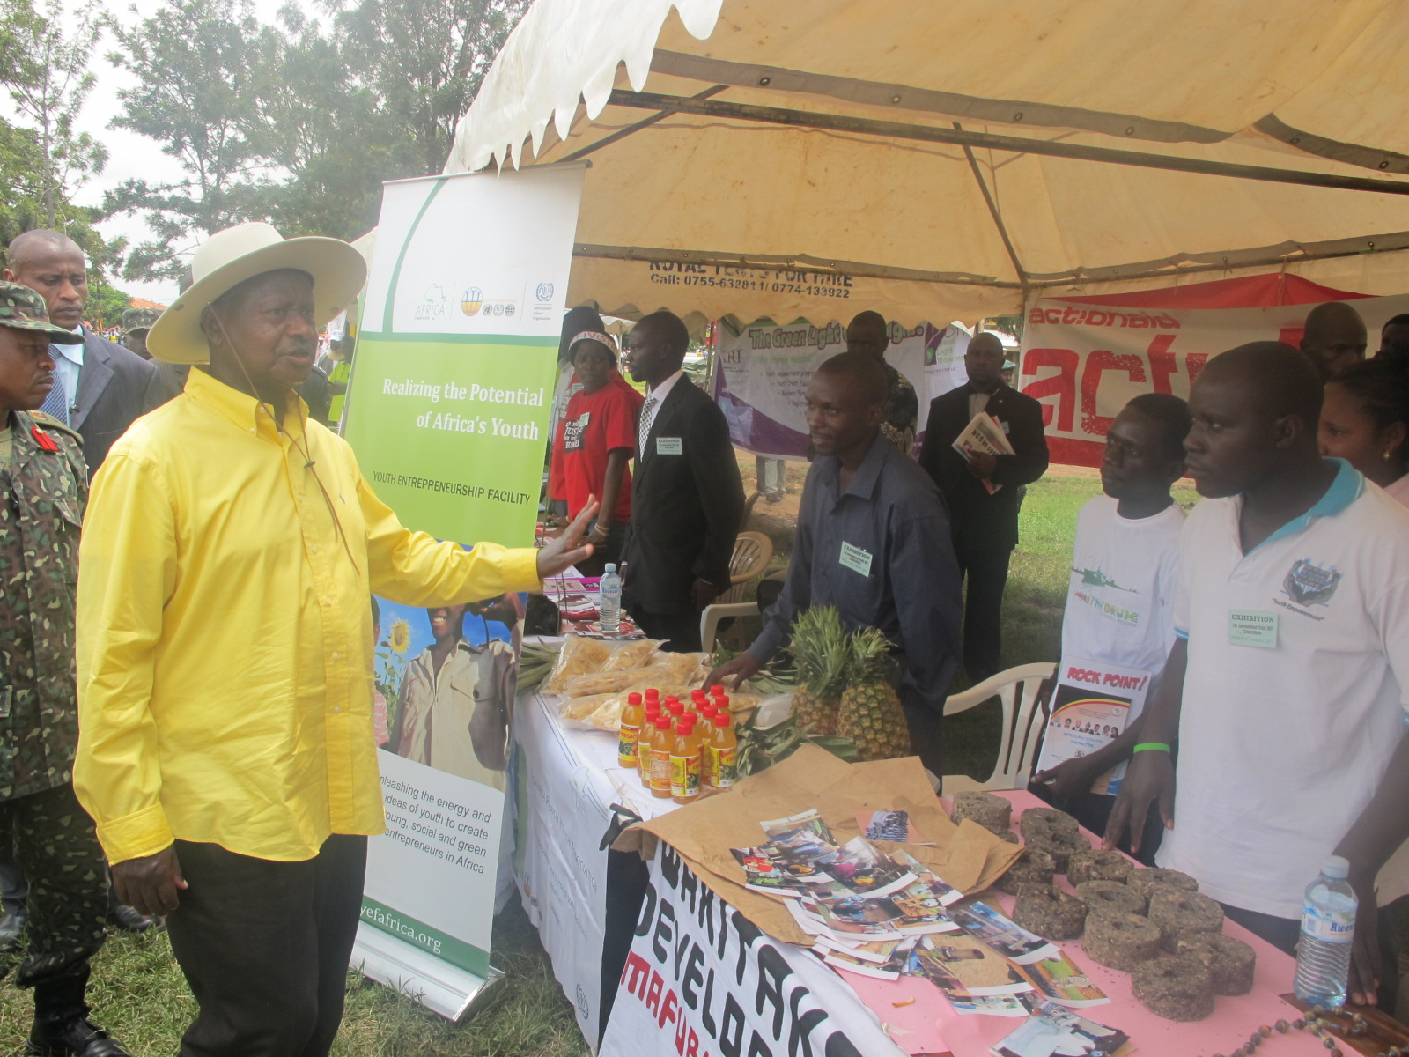


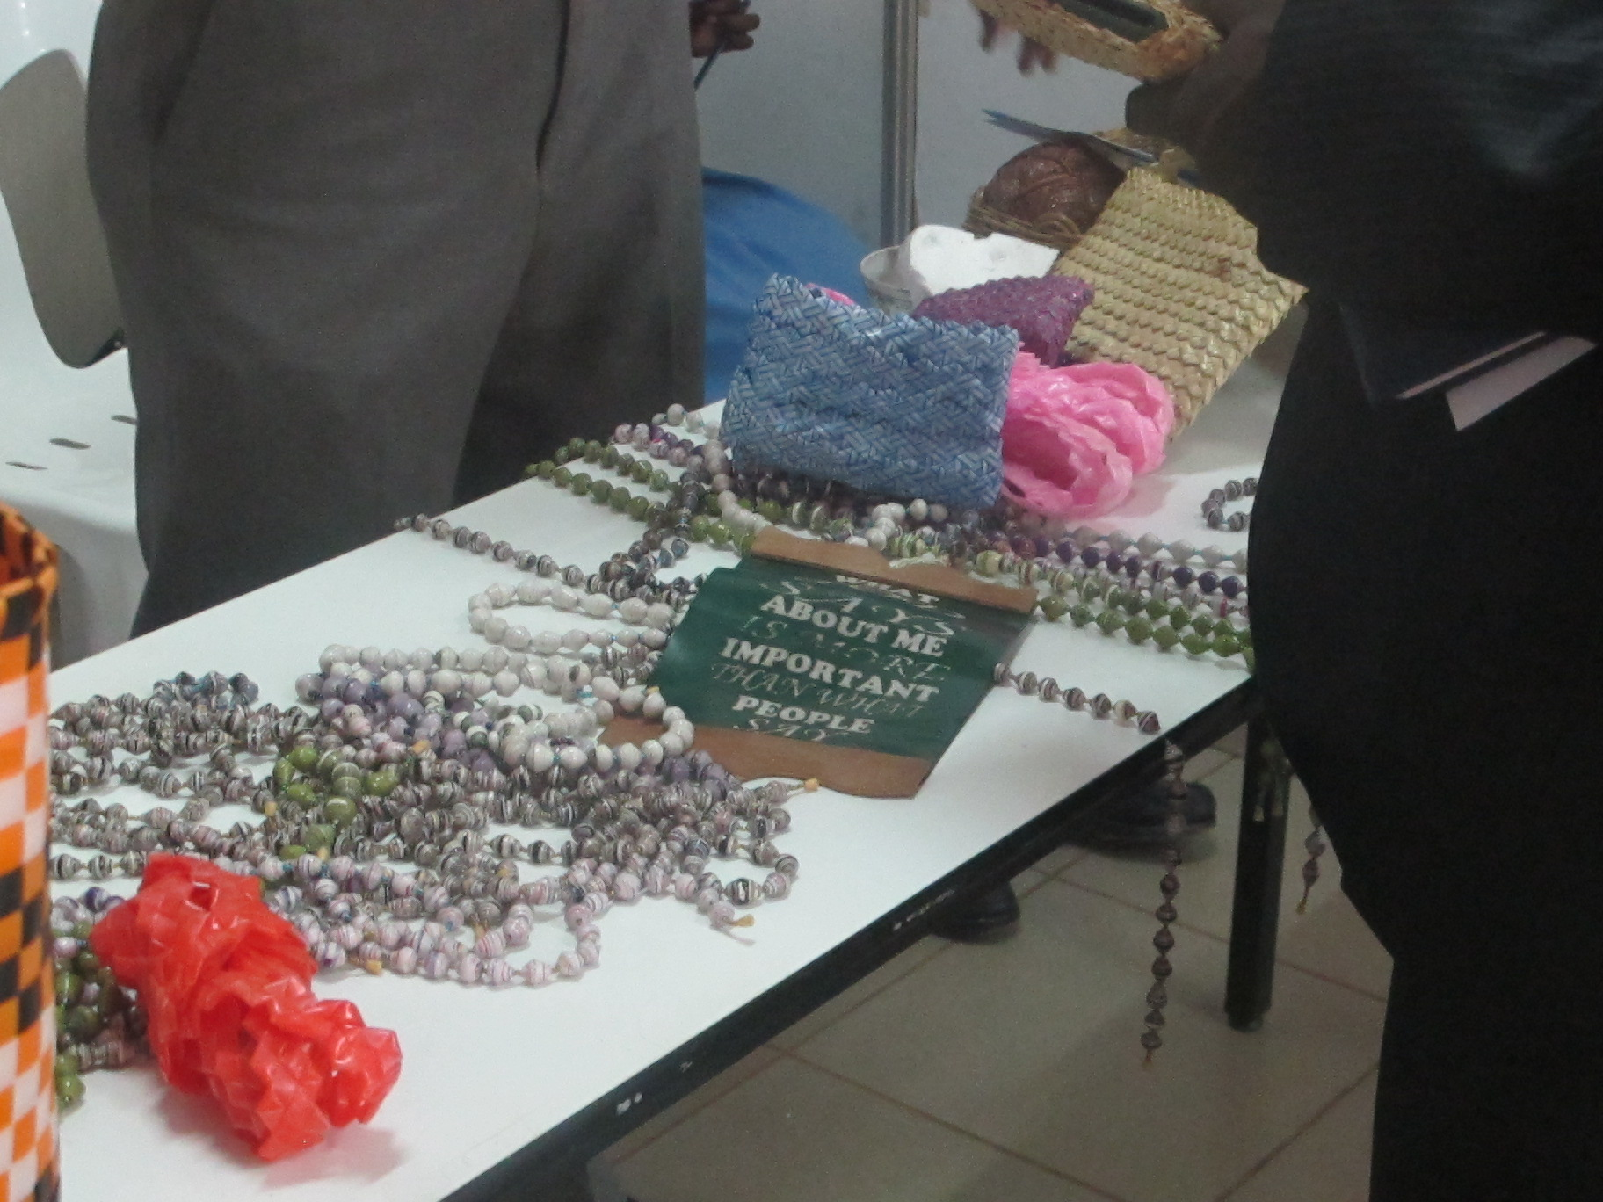
HEADER II I CAPS
Giving youth a Voice

Slide 13
Services to Grantee Organizations
Youth-to-Youth (Y2Y) Fund
Grantee Organization
(youth-led, non-profit NGO)
Grantee Organization
(youth-led, non-profit NGO)
Grantee Organization
(youth-led, non-profit NGO)
Innovative
Project
Innovative
Project
Innovative
Project
Funding, Capacity Strengthening (Training & one-on-one Technical Assistance) M&E, Promotion, Replication and Scaling-up support
Notes:
13

Slide 14
Services to End Beneficiaries
Grantee Organization
(youth-led, non-profit NGO)
Grantee Organization
(youth-led, non-profit NGO)
Grantee Organization
(youth-led, non-profit NGO)
Innovative
Project
Innovative
Project
Innovative
Project
(Potential) Youth Entrepreneurs
(Potential) Youth Entrepreneurs
(Potential) Youth Entrepreneurs
Technical Skills, Soft Skills, and Entrepreneurship Skills Training, Group Formation, Group Formalization, Access to Information, Access to Finance and Business Development Services, Mentoring...
Notes:
14
Mini YEFs

Slide 15
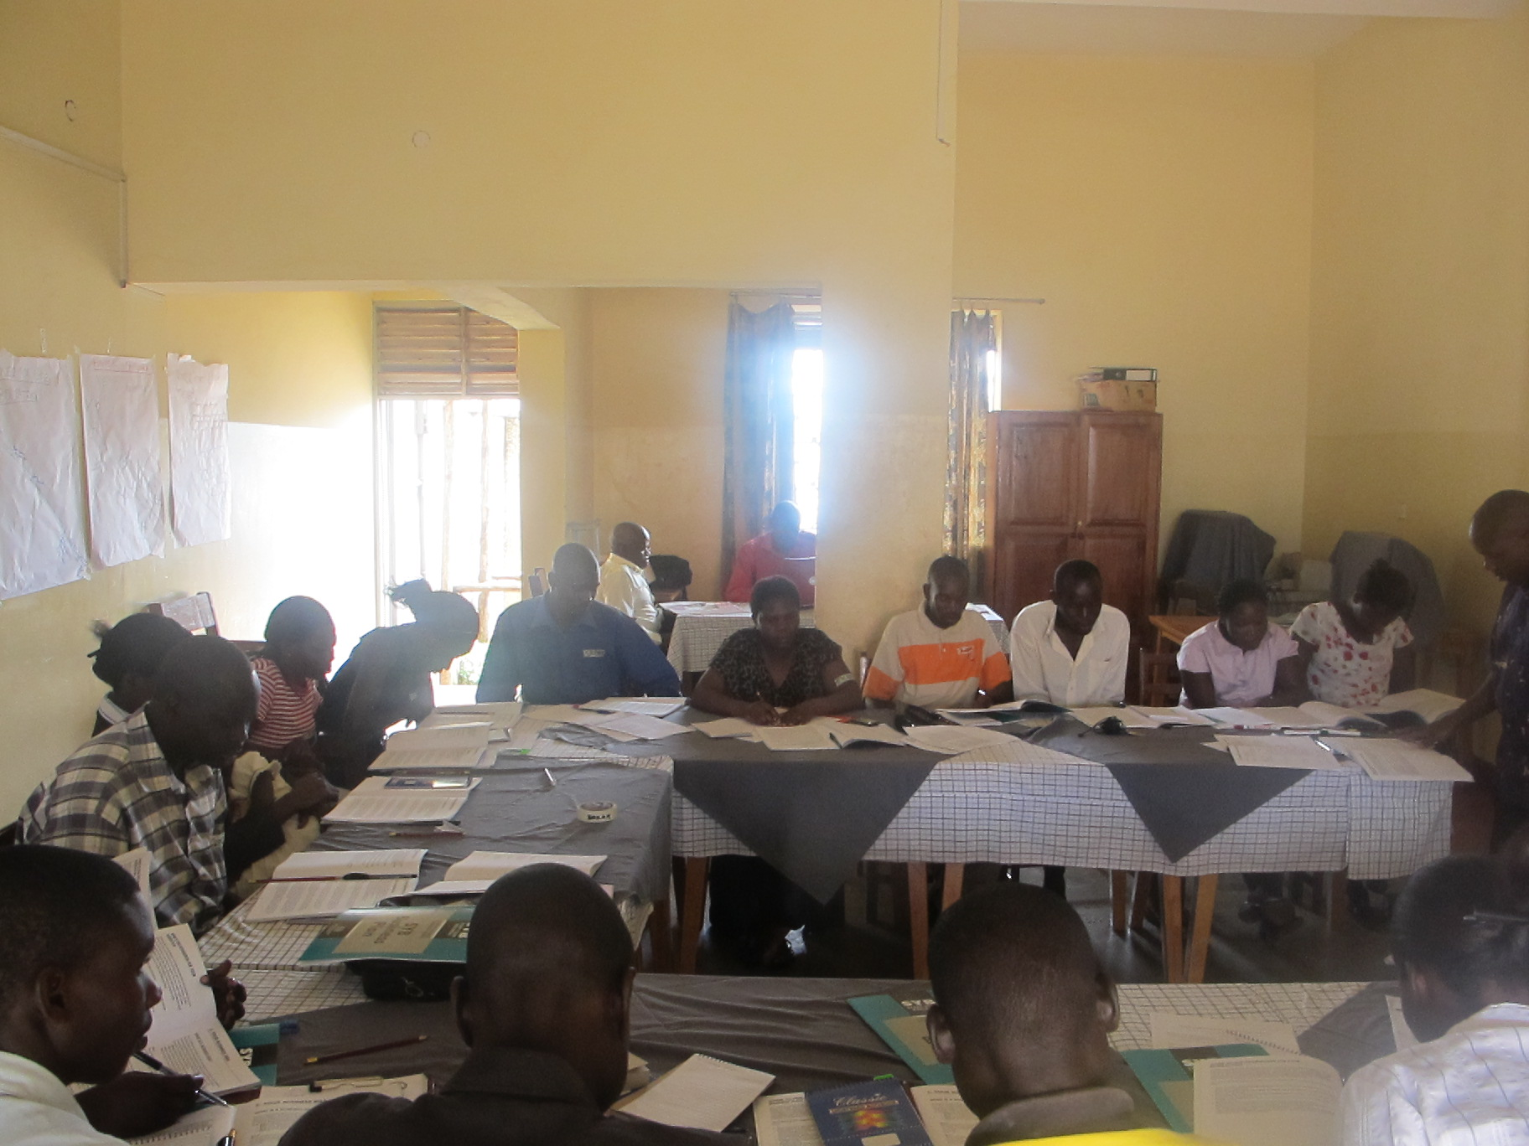
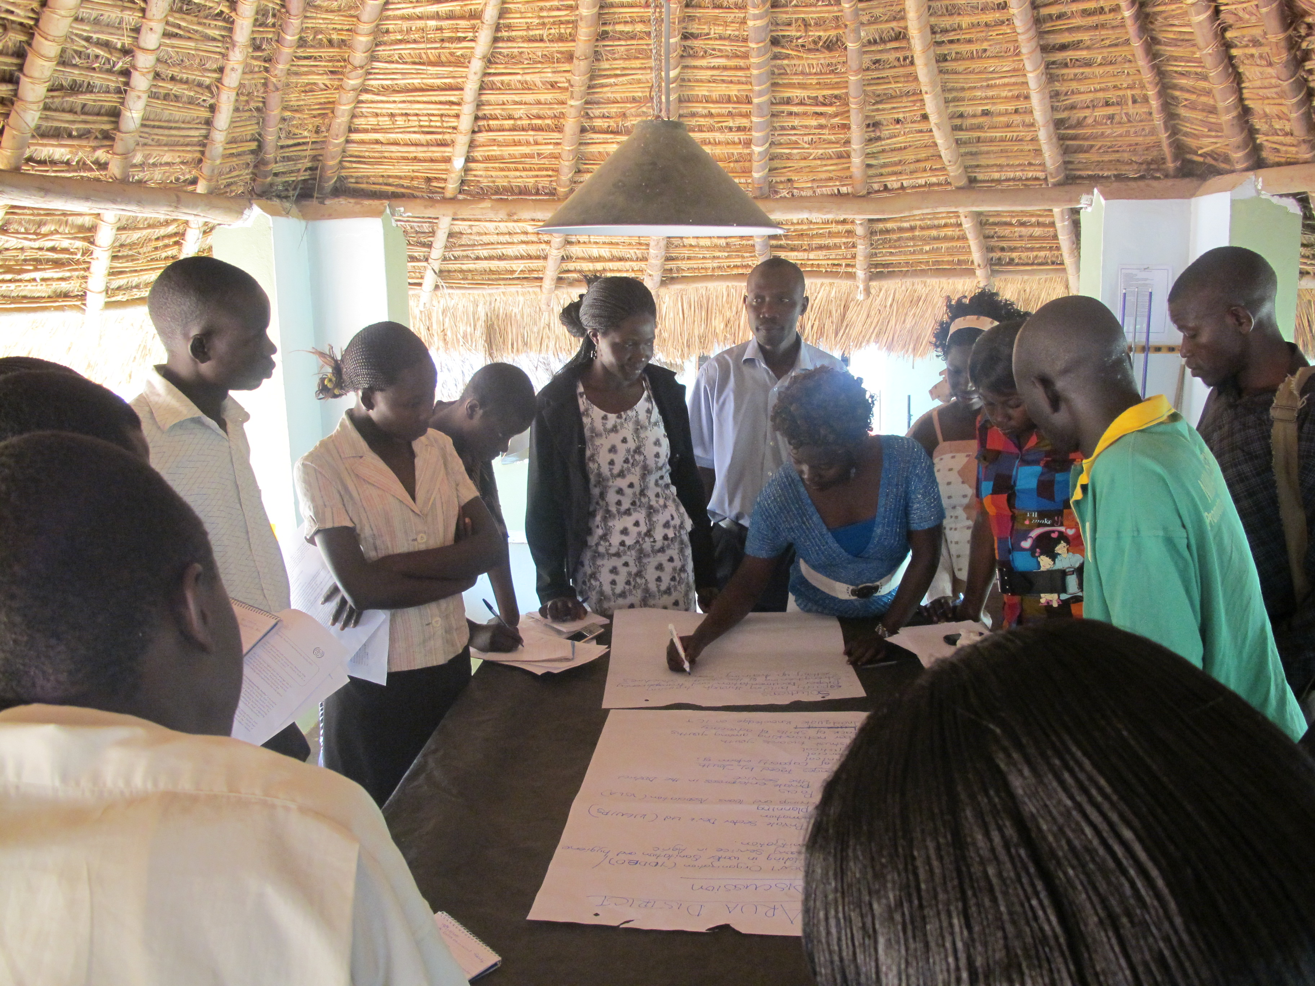
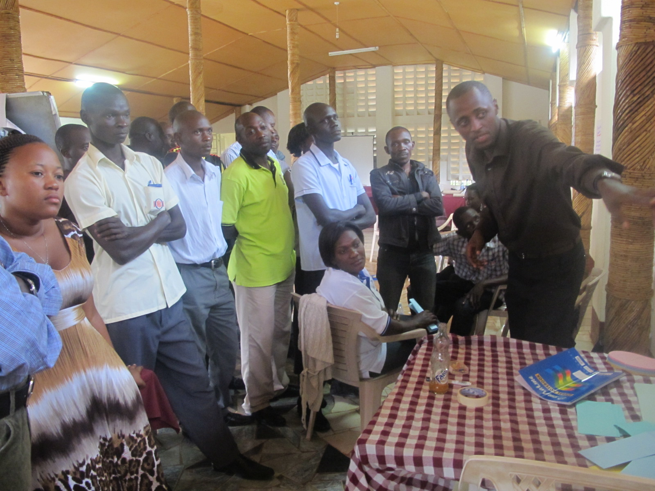
HEADER II I CAPS
Capacity Building
Header I

Slide 16
Y2Y Fund Selection Process
  Self guiding short proposal form, information note
  Project Design and Grant Proposal Writing Workshop
  Technical Assistance in Proposal Writing
  Organizational and Project Management Training
  Marketing and Communications Training
  Presenting & Showcasing of Projects
  Reporting, Monitoring and Evaluation Training
  Technical Assistance in Implementing the Projects
  Knowledge Sharing & Passing
  1. Launch & Outreach
  2. Review & Selection
  3. Implementation
Capacity Strengthening
  4. Monitoring and Evaluation
  5. Sharing & Promotion
  6. Scaling Up & Replication
Notes:
16

Slide 17
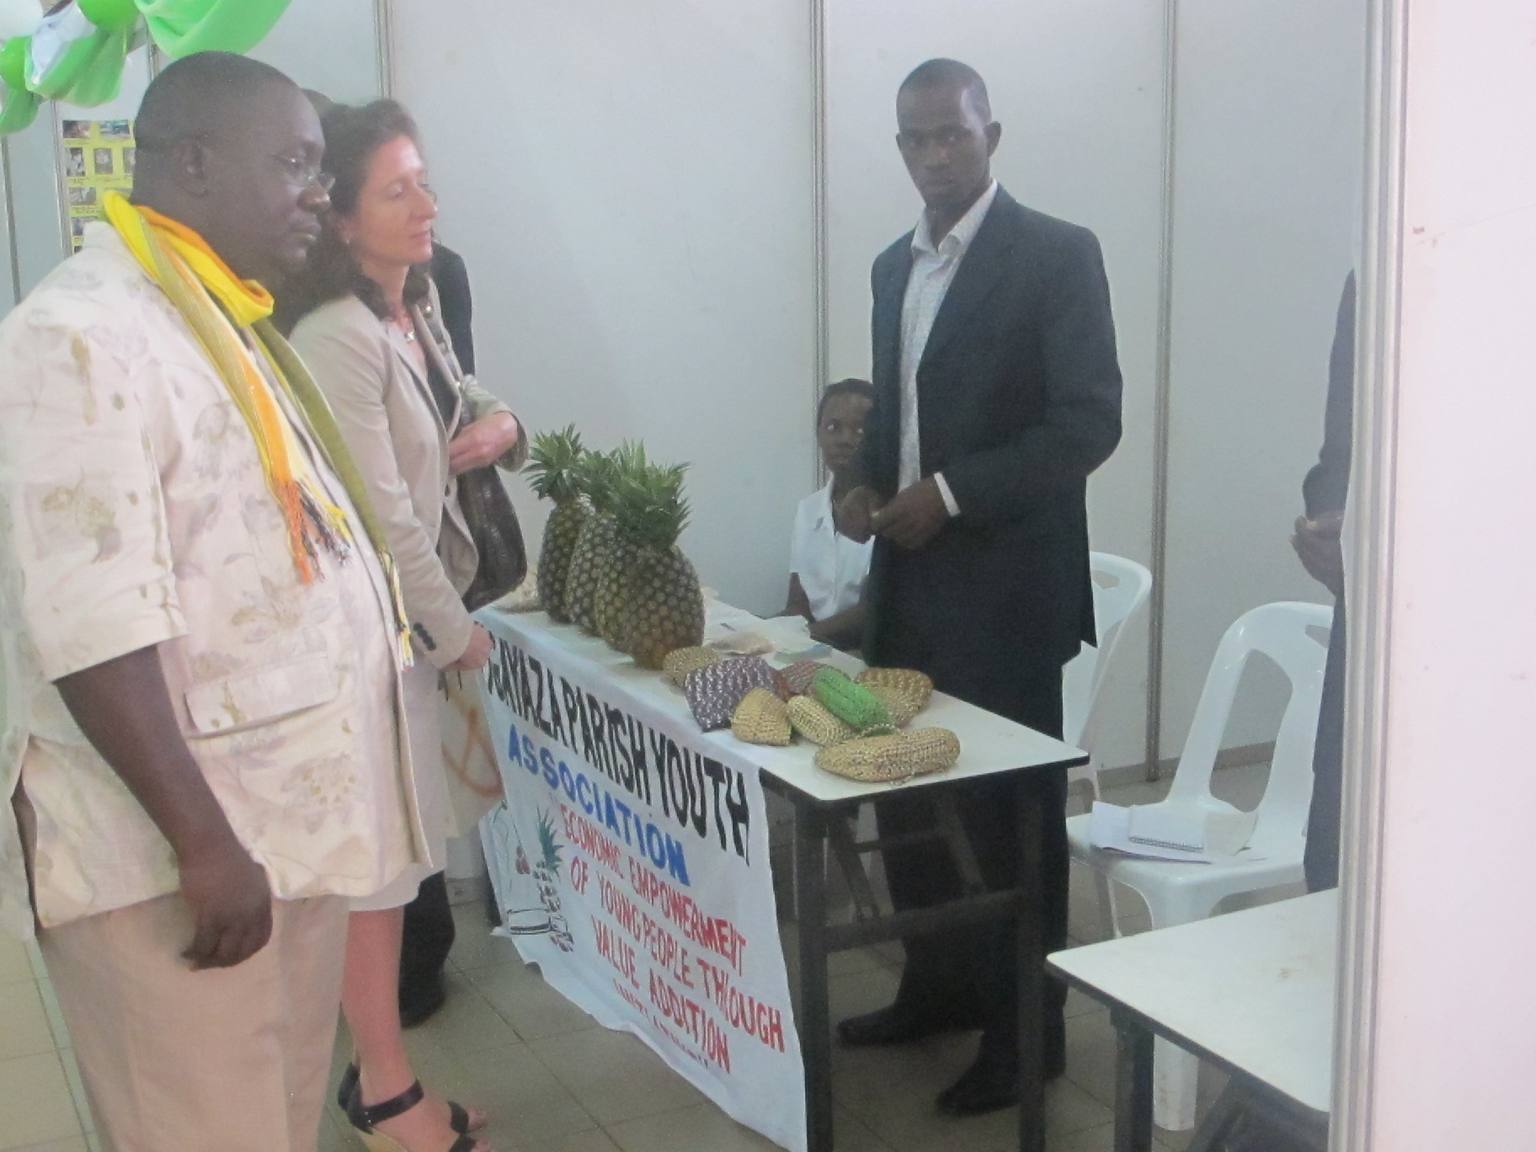
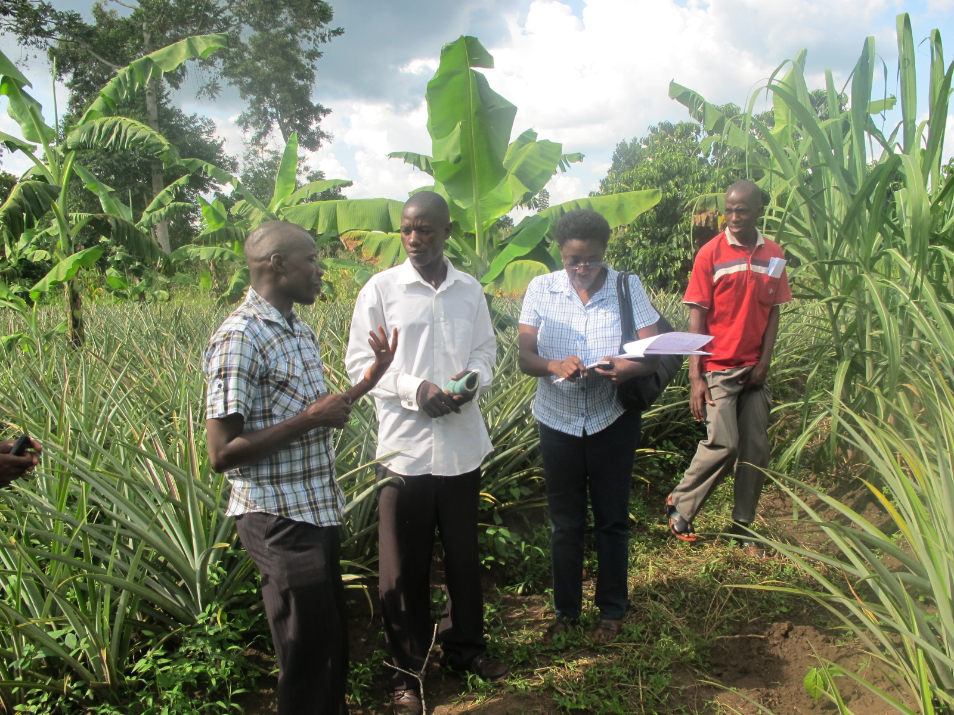
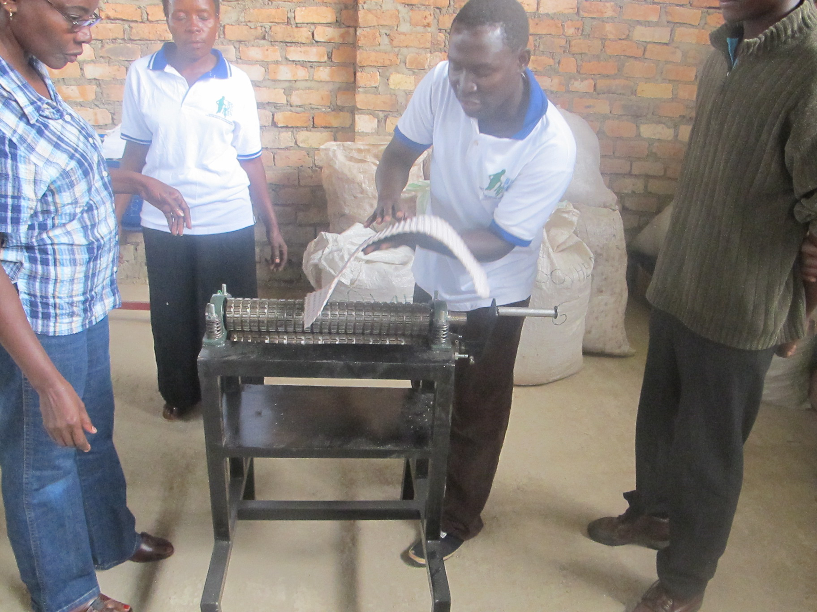
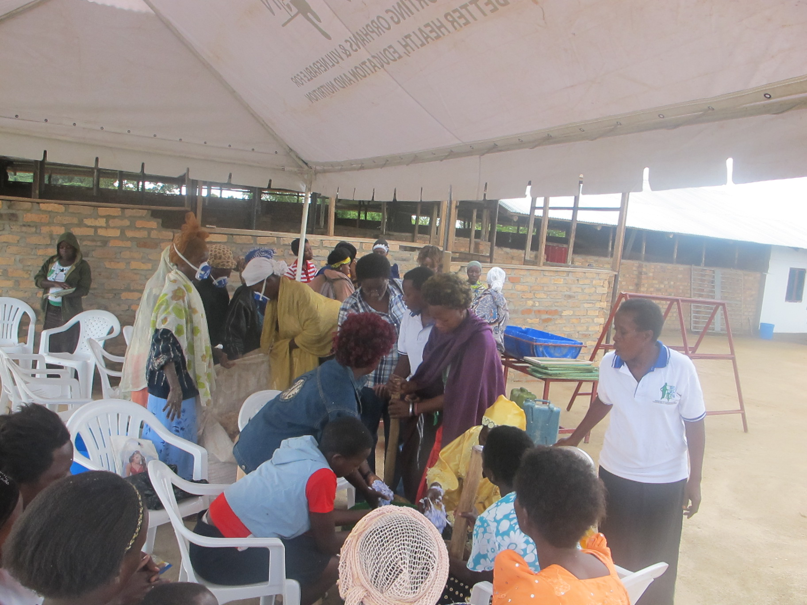
HEADER II I CAPS
Implementation
Header I

Slide 18
HEADER II I CAPS
Reach out
Header I
Window of Funding | Grantee Organ | Direct Beneficiaries | Amount invested
Innovation & Replication | 125 | 9,667 | $1.442m
Scaling-up | 24
 | 149
Businesses started: 3,069
Jobs created: 4,922

Slide 19
HEADER II I CAPS
Challenges/Suggestions
Header I
Challenges
Long selection process
Inadequate financial resources
Limited implementation capacity;
Low involvement of young women;
Limited internet access
Increased population growth
Suggestions
Select local partner
Increased resource mobilization
Provide capacity building/strengthening
Introduce themes for young women
Involve other stakeholders
Sensitization about family planning

Slide 20
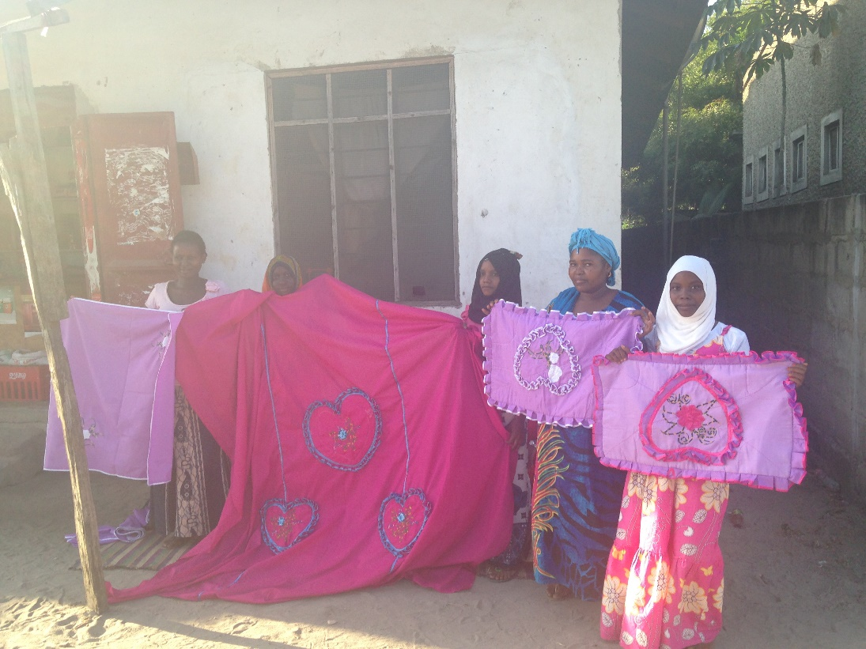
Successful implementation strategies
The competitive grantee selection process
Training/capacity building of project managers and accountants
Engagement of social partners and local leaders
Regular monitoring with effective tools and systems
Openness and non-policing approach to grantees
Consistent and clear
communication
Beneficiary engagement
and co-operation

Slide 21

Y2Y Fund Model

Slide 22
Thank You/ Asante sana!
www. yefafrica.org

