Slide 1
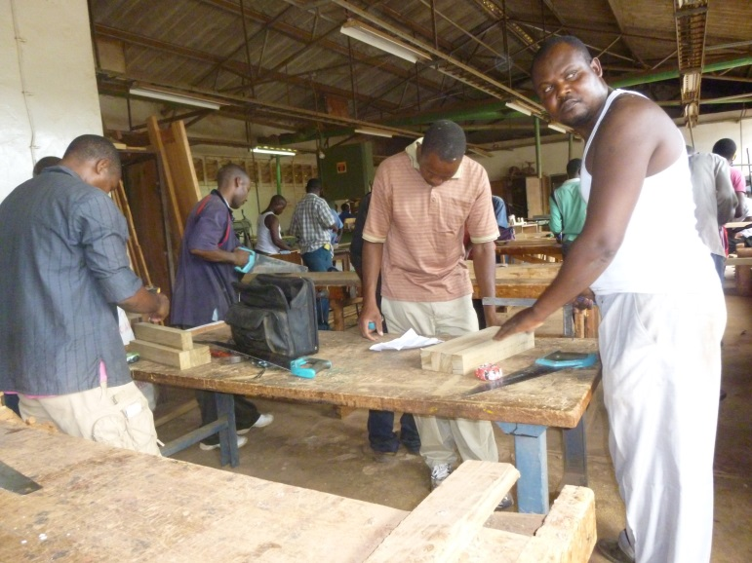
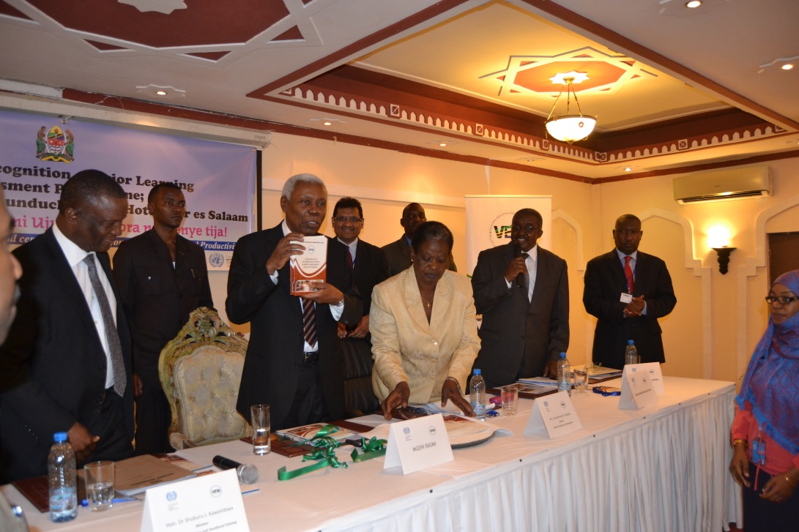
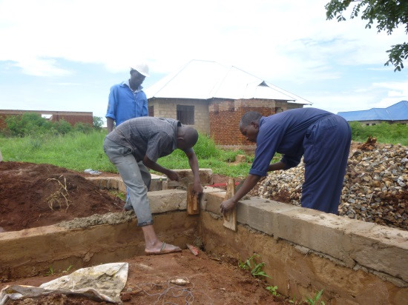
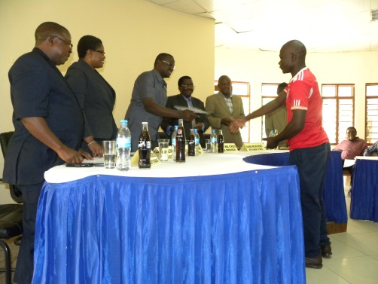
Recognition of Prior Learning Assessment
Tanzanian Experience
Knowledge sharing Forum on youth Employment – Harare
Albert William Okal- ILO Dar es salaam

Slide 2
Outline
Background and context
The Recognition of prior learning assessment
Modules of employable skills VS national VET qualifications framework
Certification
Why RPL
Skills upgrading
Successes
Challenges
Next steps
Lessons learnt

Slide 3
Background and Context
The idea to upgrade informal apprenticeship, comes from the fact that in Tanzania, hundreds of people work and acquire skills informally. They contribute significantly in economic growth through their products and services. They are also a rich source of employment opportunities and skills development
Noting that, the size of young people acquiring skills informally is increasing, the social partners requested ILO support in designing a system that will upgrade informal apprenticeships.
Working with the Vocational Authority (VETA), workplace and informal training dynamics were studied to understand how it takes place and explore linkages with the formal training
Upgrading informal apprenticeships takes many facets, We decided to start with Recognition Prior learning ( RPL )–As we mature into this, we will adopt other facets as our capacities strengthened

Slide 4
The RPL concept
Recognition of Prior Learning (RPL) is a process of assessing and certifying skills and knowledge of a person- regardless of how, when and where the learning has occurred. The assessment is done against prescribed competency standards that meet minimum national standards set.
With RPL exemptions to undertake a full training programme are possible hence reducing time (avoid repetition) and cost of learning
The recognition is done because these are skilled people, but they do not fit into the formal education systems qualification frameworks
In the VET system, there are 3 qualification levels. Levels 2 and 3 are exit levels. But for a candidate to complete one level, they have to do prescribed related vocational skills plus several support subjects(English, maths, entrepreneurship, environmental studies etc)

Slide 5
Modules of Employable skills VS VET Qualification frameworks
One of the most complex task encountered in the process was to break down competency standards to reflect work done by informal apprentices- this reflects what they train in.
The other task was to match the same with competency standards as in national frameworks
After study: the result shows that, the competency standards at workplace are highly specialised vs. national standards which are spread throughout the different levels of qualifications

Slide 6

MES classifications
MES I
Basic entry levels skills to labour market (could entail basic automotive repairs.
MES II
Specialised skills (entails specific competency in specific areas e.g. roofing and ceiling)
MES III
Supervisory and managerial skills –master craftsperson
Managing a contract or a workshop
The competency standards in MES reflects competency standards in the VET curricular except that, in MES all related competencies of a particular specialization are grouped together to form employable module.

Slide 7






The RPL process& certifications
The target group are all who have trained/work for 3-5 years
Not suitable
Not suitable
Not suitable
For the successful tailor made skill upgrading before certification

Slide 8
Why RPL
Promoting lifelong learning; linkages to formal training
Opportunity to get decent jobs, formal self or wage employment
Improved self esteem and respect
Improvement of skills-through skills upgrading
Promotion of equality and inclusiveness
Better productivity and improved image of companies for having certified workers

Slide 9
Success
A clear framework to guide the process is in place this has paved way for institutionalization process in the VET that are now underway
Successfully aggregating competency standards into MES that reflects demand and practice
Adding as an incentive a skills upgrading component is very useful and encouraging
600 assessments have been done, 400 are certified
Implementation tools developed : assessors guides, candidates guide, a bank of tools that can easily be referenced to by assessors.
Positive responses from key partners- Gov. enterprises and informal apprentices
Certificates leads to Decent jobs

Slide 10
Challenges
Weak records/evidence gathering system ,hence costly to gather evidence
Most workplaces are informal; having crude or outdated machinery/technology-making it difficult to compare some competency standards
Institutional gap- absence of vibrant trade associations, that can jointly work with VETA to sanction proper standards setting, aid assessments and-related to meaningful partnerships
Limited capacity for coordination, partnerships and supportive legal frameworks within which all might work.

Slide 11
Next steps
This will include sustainable funding mechanism & ,coordination
Articulate further evidence gathering mechanisms and systems
Mobilize support and deeper institutionalization
Create awareness and support conducive environment to incentivise partners
More capacity building to the master-craftspeople and other partners as well.
Integrates external QA mechanism

Slide 12
Lessons that we have learnt
The modular certification /aggregation of competency standards into MES is more practical ways of matching specificity and relevance in the labour market
The skills upgrading programme prior to certification is an incentive for participation and adds value to the programme
A strong partnership with enterprises /industry/trade associations is very crucial

Slide 13
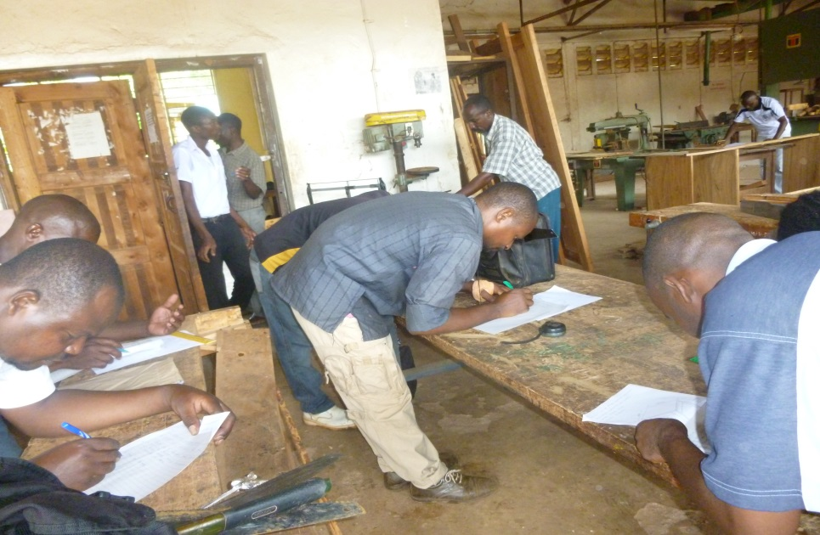
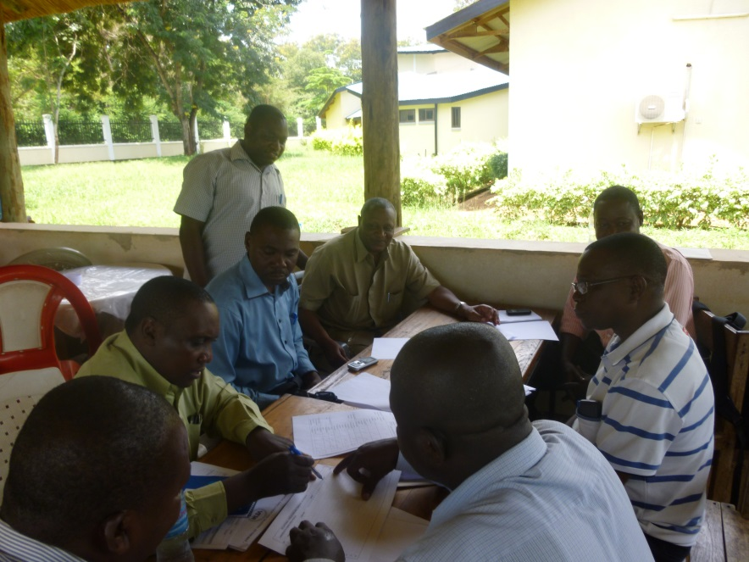
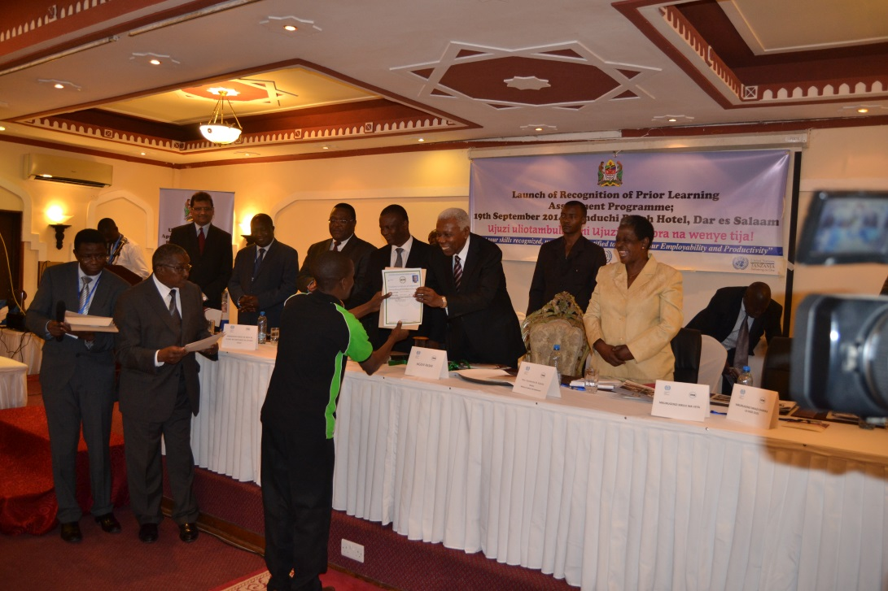
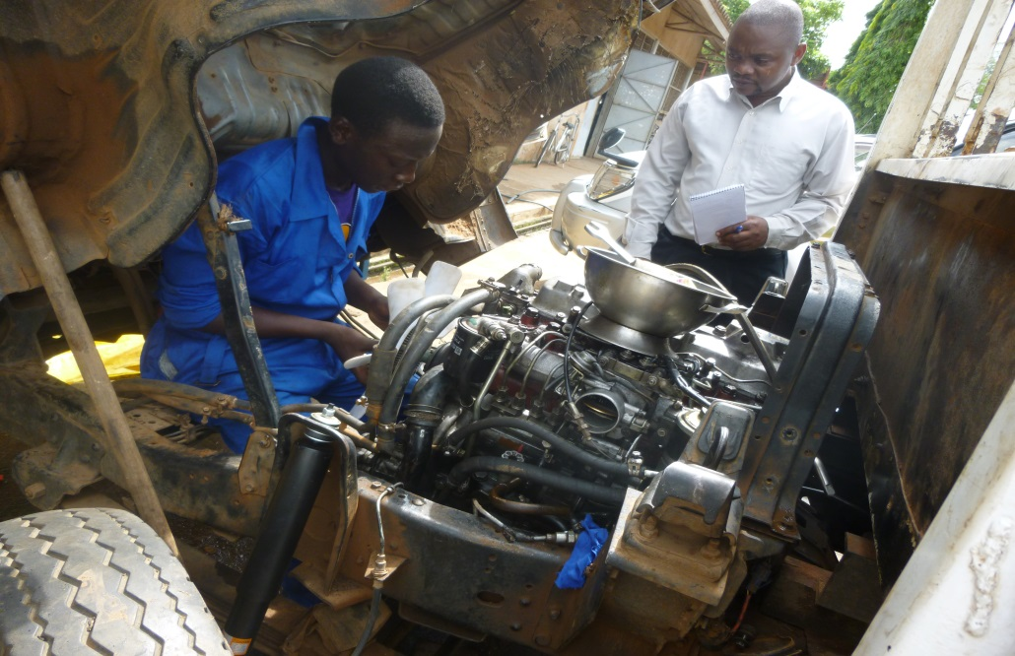
Sites

Slide 14

Ndatenda!
Mazvita!

