Slide 1


Advancing Women Economic Empowerment:
Lessons from Kenya
Presented By:
Jane Maigua
National Project Coordinator, ILO Women Entrepreneurship Development
and Economic Empowerment project
EASTERN AND SOUTHERN AFRICA YOUTH EMPLOYMENT KNOWLEDGE SHARING FORUM

Slide 2

Characteristics of a Young African Woman Entrepreneur
Low business management and technical skills
Low literacy
Little access to BDS and market Opportunities
Little Access to Capital
Culturally Fixed
Low Confidence
Non-homogenous and varied categories
Competing Priorities – “overburdened”

Slide 3
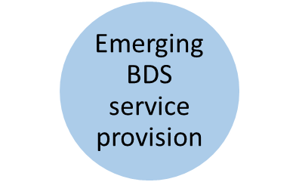
On the Other hand….Growing Opportunities
Pro gender policies
Public Procurement opportunities
EAC/COMESA Markets
Private Sector Supply Chains
Funding Windows in Financial Institutions, Social Economy Financing and Government Funds

Slide 4

Bridging the Gap
The Case of Women Entrepreneurship Development and Economic Empowerment Project

Slide 5
What Intervention?
WOMEN ENTREPRENEURSHIP DEVELOPMENT AND ECONOMIC EMPOWERMENT
Development Objective: More women-led businesses contribute to job creation, economic growth and gender equality
Outcome 1
Kenya
Tanzania
Uganda
Women-led businesses increase their performance
Outcome 2
Selected policies and programmes are reviewed by policy makers to mainstream WED
Outcome 3
Selected WED tools and approaches are available past the project lifespan
Target group
women entrepreneurs (30% young, 30%rural) and women entrepreneurs’ associations.

Slide 6
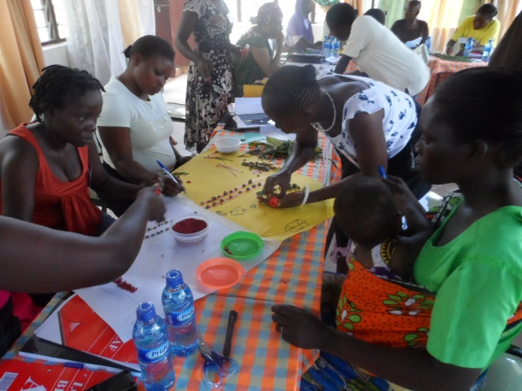



Enhanced capacity for Business Development services provision and outreach by financial service providers
SME Agencies – Public Sector, NGOs, WEAs, Private Sector
Trainers networks strengthening
Financial Services providers
Training
Mentorship
Market Information
Market Linkages
Technology Access
Financial Access
Cross Cutting : Social Security, Formalization, Outreach to Women, Outreach to Youth , Rural outreach

Slide 7



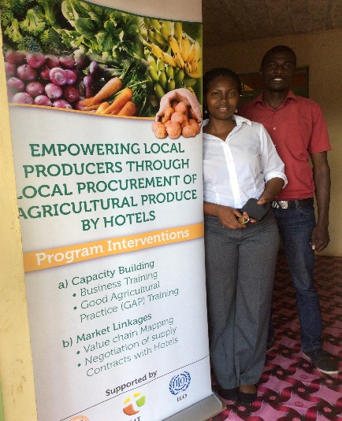

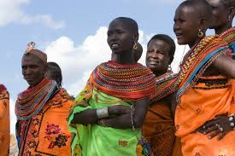
Examples : Integrated BDS and Partnerships
Interventions in Supply and Value Chains – Horticulture, Briquetting, Fish Marketing, Fruit drying
Business management, life skills and production skills training for women in horticulture, mentorship and linking to supply chains : A partnership with APDTC
Business and Life skills training for fish mongers in Western Kenya, cooling equipment, linkages with large retailers : A Partnership with ELCI
Business and Life skills training for women in central and coastal areas, solar drying equipment and linkages with marketers/exporters: A Partnership with ELCI

Slide 8


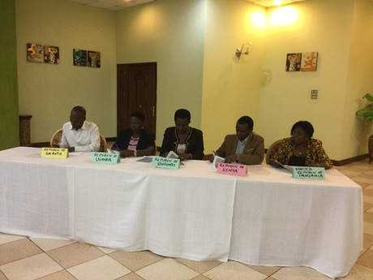


Business training and pilot mentorship programme by Microfinance and Government Funds for Women and Youth : A partnership with Women Enterprise Fund and Kenya Industrial Estates
Partnership with the East Africa Community to simplify the Trade Protocols for utilization by women
Capacity building of women and youth for Business management and Access to government procurement opportunities: Partnership with County Governments

Slide 9
Outcome 2: Support for review of policies and development of national programmes
Gender sensitive Legal and Regulatory system
Effective policy leadership and coordination for the promotion of WED
Gender sensitive Financial services
Gender Sensitive BDS
Gender Sensitive Markets
& Technology Access
Representation and voice
Kenya
Women Economic Empowerment Strategy and Implementation Plan
WED Assessments
Uganda and Tanzania
MSME Policies
WED Action plans

Slide 10
Supporting Dev. of National Programming for Youth and Women:
How it has worked
WED ASSESSMENTS
Technical Assistance
Wide Stakeholder involvement BUT Government on the Driving Seat
County Consultations and Support for Action Planning
Some of the ILO Tools and approaches institutionalized
Women Economic Empowerment Strategy for Kenya and County Implementation Plans
Youth Empowerment Strategy and Action Plan
Coordination
Comprehensive Results Framework and M&E Plan
Links to existing and new interventions
Good Practice Documentation
Technical Assistance
Wide Stakeholder participation But Government on the Driving Seat

Slide 11
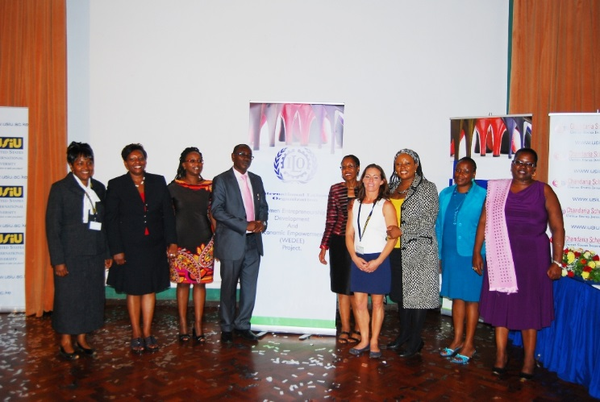
Outcome 3: Sustainability mechanisms for
WED approaches and tools
Trainers networks and Trainer Accreditation system
Institutionalizing the tools
  Working with national partners
  Working with partners with a mandate for SME development

Slide 12
Outcomes and Impacts
74 accredited trainers and BDS providers
Three network of accredited trainers and BDS providers
+15 national, NGO and private sector partners
+3000 women reached with training, 30% in rural and 40% Young women
Jobs created – 2.4 jobs created per enterprise (2014)
Commitments by over 10 national partners to support women entrepreneurship development
Engendered MSME policy in Uganda
Action Plan in Uganda and Tanzania
Women Economic Empowerment Strategy and Implementation Plan in Kenya
Private Sector Commitments to local procurement – at least 6 companies in Kenya
Notes:
Women Enterprise Fund, Kenya Industrial Estates, County Governments, ELCI, APTDC, VSO-J Centenary Bank, Equity Bank, UNWOMEN, UWEAL, FEWA, EAC – BDS, markets, finance, technologies

Slide 13
Challenge and how overcame
High expectations for support -strategic partnerships
Leveraging on partnerships sometimes selective of partners
Approach of providing technical Assistance vis a vis co-financing
Resource Mobilization

Slide 14
Lessons/Recommendations
Integrates Business Development Services – access to finance , BDS, technologies, Markets
Exit /accreditation strategy strategy in design in order to ensure sustainability of tools and approaches
Leveraging on partners - National Partners, Partners with a mandate for SME, Private Sector Partnerships
Targeting/Affirmative programmes – Gender, Rural, youth, HiV/Aids affected,
Lessons
Learnt
Conscious efforts made to ensure that changes made at the micro level cascade to the macro or policy level
It helps to have longer term projects for greater impact and outreach

Slide 15
Thank you!

