Slide 1
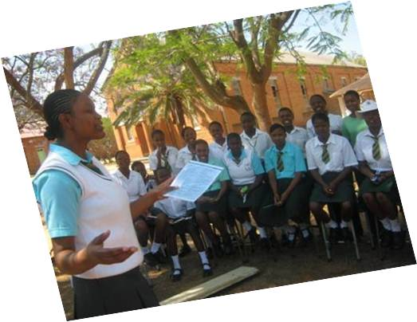
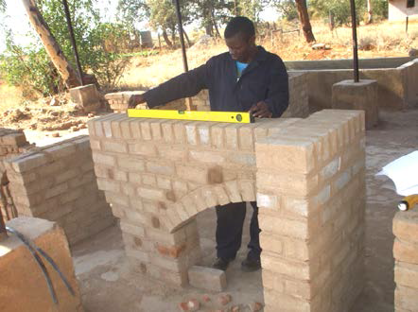
Employment as a Right and an Enabler
ILO Eastern and Southern Africa Youth Employment Knowledge Sharing Forum
Memory Kachambwa,
International Youth Foundation
Zimbabwe:Works Program

Slide 2
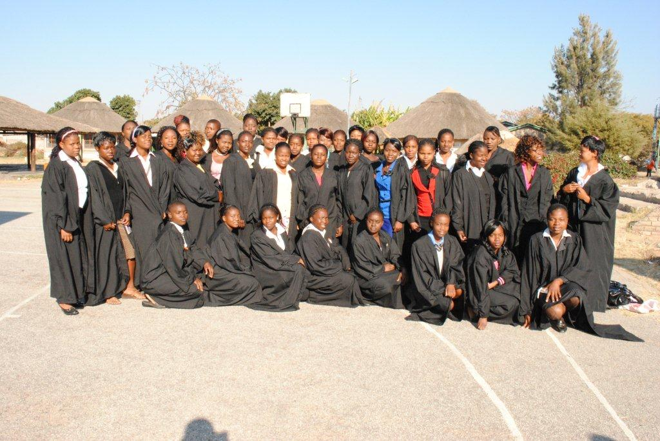
Z:W Building of Prior Impact and Successes
IMPACT AND SUCCESSES
90% Business Survival
25% Job placements
5,500
Entrepreneurship
4800 life skills training

Slide 3
Z:W Program Targets
Income
Jobs
35% start ups
17,000
Entrepre-
neurship
Access to Finance
50% accessing financial services
9,960 Financial Literacy training
Women Economic Empowerment
60% Females
80 % Partner gender main- streamed
40 % intern-ships
Income
Jobs
5,500 Life skills training

Slide 4

Component 1:Organisational Capacity Building ,Gender Equality and Women’s Economic Empowerment
Component 2: Enterprise start-up and growth
Component 3: Financial inclusion
Component 4: Access to formal sector employment
Program Components
Component 1:Organisational Capacity Building ,Gender Equality and Women’s Economic Empowerment
Component 2: Enterprise start-up and growth
Component 3: Financial inclusion
Component 4: Access to formal sector employment

Slide 5
Work as a Human Right
The modern view of human rights has generated a consensus that these rights are universal, indivisible, inter-dependent and interrelated.
Most times we think of rights we refer to rights to freedom, democracy, health and do not explicitly articulate:
  work as a human right as an enforceable human right or
  the states duty to provide employment or
  a corporate obligation to do what is possible within sound business practice to avoid unemployment strategies of doing business.

Slide 6
What is the right to work?
The right to work deals exclusively with access to work, and hence persons who do not have access to work are the main concern in our context the youth.
In spite of its great importance, the right to work itself is relatively little detailed.
Much work has been done on questions like discriminatory access to work, but not on the right to work itself
Work as a human rights standard is not to be seen as a means to have an adequate standard of living (as this is guar­anteed by another human right), but to earn such a standard of living

Slide 7

Defining the right to work
The human right to work recognizes work as something to which each and every individual is entitled.
The right to work means:
  the right to participate in the producing and servicing activities of human society
  the right to participate in the benefits accrued through these joint activities to an extent that guarantees an adequate standard of living.
  the right to work thus ensures that no­body is excluded from the economic sphere.
The type of work a person does de­pends on:
  access to resources, education and training.
Work can be enjoyed as a wage-employed person or as a self-em­ployed per­son.
A crucial feature of work is that it allows persons to earn their living.
Example being a full-time musician can only be considered work if it is rewarded in a way that one can earn one’s living with it

Slide 8
Legal Framework on the Right to Work
The right to work is enshrined in the Universal Declaration of Human Rights and recognised in international human rights law through its inclusion in the International Covenant on Economic, Social and Cultural rights.
Article 23.1 of the Universal Declaration of Human Rights states:
(1) Everyone has the right to work, to free choice of employment, to just and favourable conditions of work and to protection against unemployment —Universal Declaration of Human Rights, United Nations General Assembly
The African Charger on Human and People’s Rights recognises the right, emphasising conditions and pay, i.e. labour rights. Article 15, states:
Every individual shall have the right to work under equitable and satisfactory conditions, and shall receive equal pay for equal work—African Charter on Human and Peoples' Rights, Organisation of African Unity

Slide 9
Duty bearers obligation to the right to work
The generic state obligation under the right to work includes :
  obligation to respect- States must not destroy a person’s opportunity to earn his or her living ,
  obligation to protect -States must prevent this opportunity from being destroyed by third parties and
  obligation to fulfil each person’s access to work to earn one’s living and
  the obligation to guarantee that this work can be freely chosen or accepted.

Slide 10
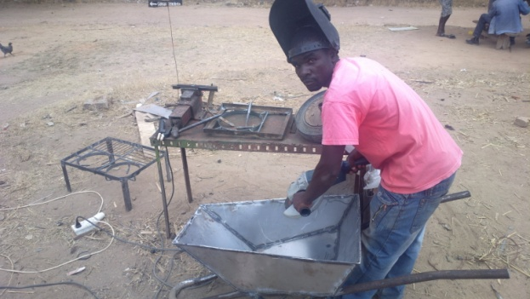
Elements of duty bearers obligations to the right to work
Some elements of the duty bearer’s obligations to fulfil the right to work are as follows:
Access to vocational guidance and training must be possible for everybody, and hence either free of cost or at a cost that does not limit the exercise of a person’s right to technical guidance and training programs.
Non-discrimination - People must not be denied ac­cess to work (or to any policies or programs related to this right) on the basis of gender, eth­nic or national origin, religion, or social or other status.
Full and productive employment- both in terms of wage employment and self-em­ployment- the state should promote the distribu­tion of the existing volume of work available on the labour market to every­body willing and able to carry it out.

Slide 11
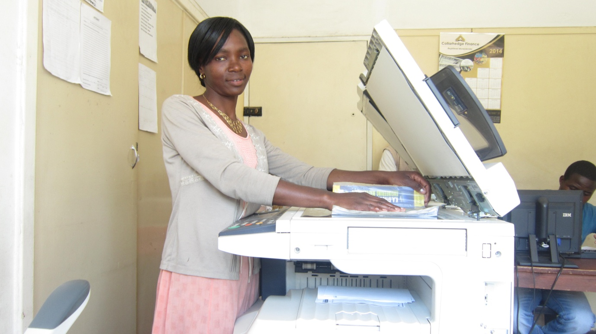
Elements of duty bearers obligations to the right to work
Even the best full employment policies in the world will not be able to provide employment via the labour market or as self-employment in the market economy to each and every person seeking such employment.
Many activities are carried on outside the market sector mostly by women goes unpaid and should be recognised.
All these state obligations, as important as they are, may not prevent widespread unemployment particularly among the youth.

Slide 12
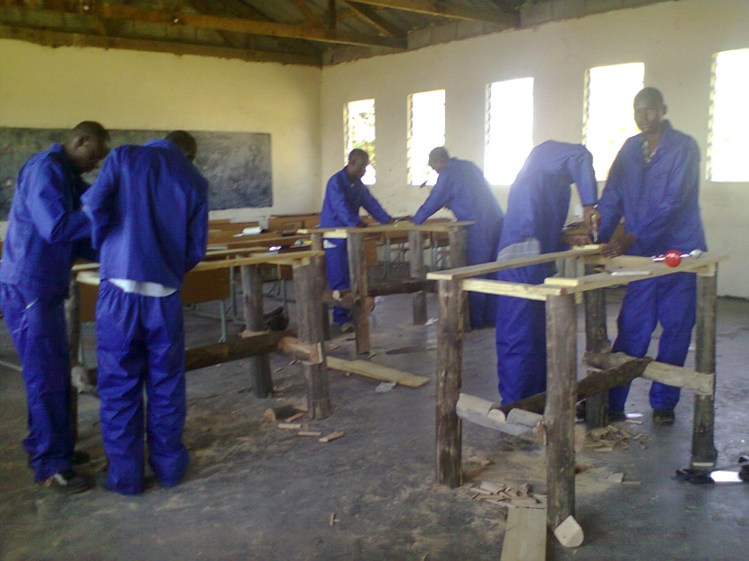
Why jobs are important
We need to create decent jobs for young people (human dignity, self worth, self esteem.
Jobs as a right not only contribute to the formation of the individual, but it is also necessary if one is to be able to support oneself and one’s family, make and keep social contacts and fulfil one’s duties toward society

Slide 13

Work as an enabler
Cambridge Dictionary defines an enabler as something or someone that makes it possible for a particular thing to happen or be done.
A job or decent work is an enabler, but not an end in itself but a means to dignity, an improved standard of living, development and access to resources and many more.
Creating jobs enables progress is other areas, gender equality/access to health - SRH-HIV-AIDS/VAW/, access to education and training/access to information and technology and participation in civic engagement
With jobs and enterprises there is less strain on the economy – health system, education system, youths are engaged in innovative work are happy and active citizens

Slide 14

Young people have a responsibility too..
In as much as young men and women have a right to decent work, to earn an income and have a decent standard of living, they have a responsibility to capitalise and take up opportunities:
  Invest in work readiness programmes
  Persevere in purist for entrepreneurial enterprises
  Engage in vocational technical training
  Life skills training (technical skills are not enough without life skills)

Slide 15

Thank you

