Slide 1
Demographic Dividend window to be opened for Zimbabwe
Yu Yu
Deputy Representative, UNFPA
(Materials quoted from Eliya Msiyaphazi Zulu, PhD, AFIDEP, a joint work with UNFPA, UNPFA SoWP report 2014, and various IMF research)

Slide 2
Population Dynamics

Slide 3
Agenda 2063
To transform Africa into an “integrated, prosperous and peaceful Africa, driven by its own citizens and representing a dynamic force in the global arena”
Recognizes the role of population dynamics in this transformation
  One of the objectives of the Agenda is to unleash the full potential of the youth and women to boost socioeconomic development

Slide 4
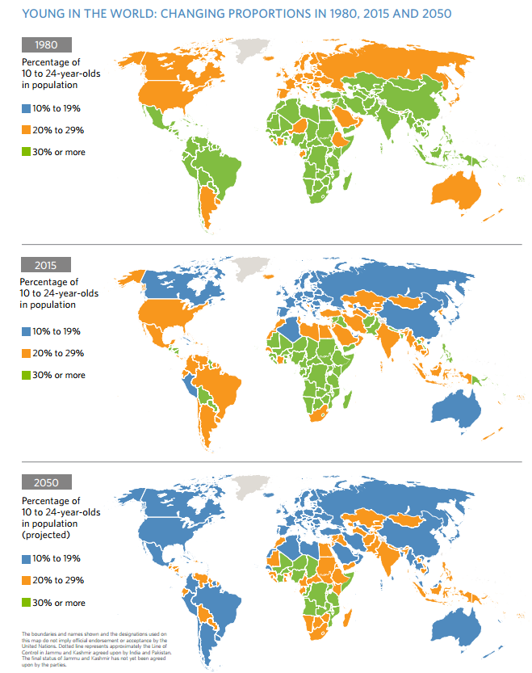
Young Africa

Slide 5
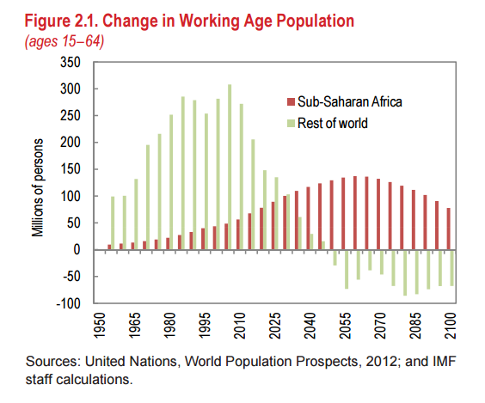
Rising Africa Labor Force

Slide 6
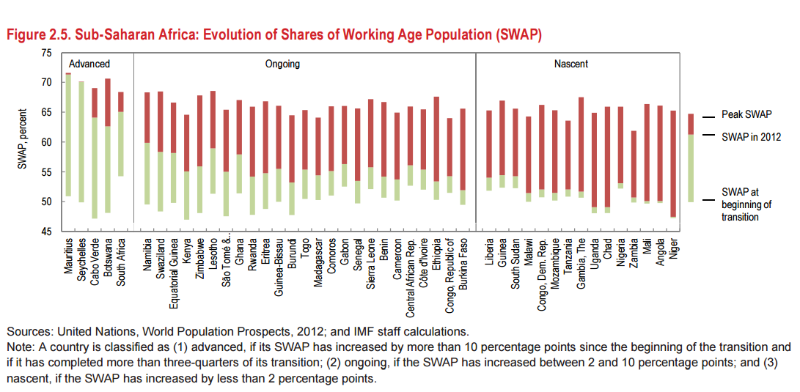
50% Increase in SWAP

Slide 7
The Demographic Dividend
is
the economic benefit arising from a significant increase in the ratio of working-age populations relative to young dependents.
Notes:
When birth rates decline significantly, the age structure shifts in favor of more working-aged adults, which can help accelerate economic growth through increased productivity, greater household savings, and lower costs for basic social services provided to children
The DD is not automatic or guaranteed – it is earned through economic reforms that create jobs, investments in human capital, and efficient governance

Slide 8
Demographic Dividend and Growth, a comparison

Slide 9
The Theory
The rising share of the working age population provides a direct channel for increasing per capita incomes. If the increased workforce is employed, there should be greater economic output and labor income per household.
Declining fertility rates are generally associated with higher female labor force participation rates, further increasing the workforce and contributing to even larger reductions in the fertility rate. Removing legal and institutional impediments to female labor force participation can enable economies to benefit from an expanded pool of labor
Reductions in the number of children and concurrent increases in life expectancy are associated with greater private investment in education and health care, thereby enhancing the productivity of the workforce.
Because saving rates tend to be highest for working age individuals, growth will receive a further temporary boost to the extent that those savings are channeled into investments.

Slide 10
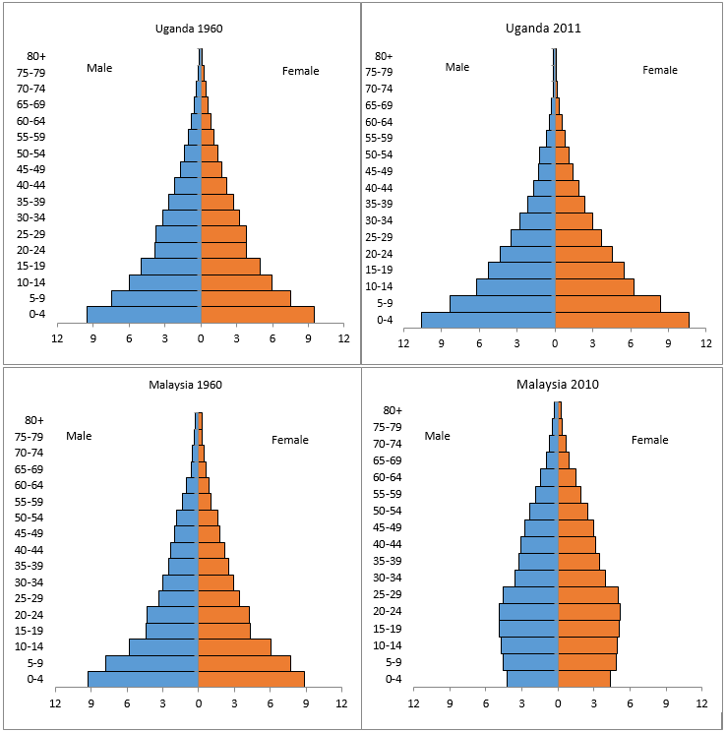
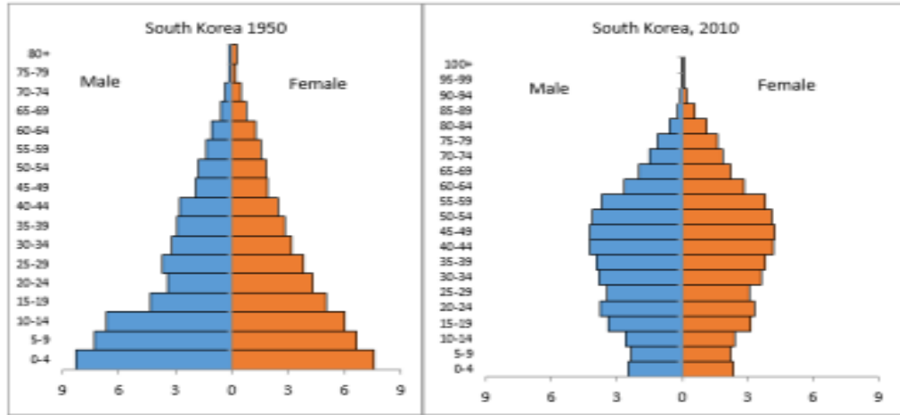
The Empirical
Decline in fertility led to a structure with more working age adults relative to children in East Asia, while high child dependency remained in Africa
Notes:
Uganda 1960 TFR 7.1 GDP per capita 62
Malaysia 1960 TFR 6 GDP per capita 299
Uganda 2010 TFR 7.1 GDP per capita 506
Malaysia 2010 TFR 6 GDP per capita 8,754

Slide 11
Declines in fertility and mortality have historically been associated with improvements in wellbeing
https://docs.google.com/spreadsheets/d/1xT6OBil1awiVHvs-U3_a01-luWNeCFVEbayLdZoVAlU/edit?usp=sharing

Slide 12
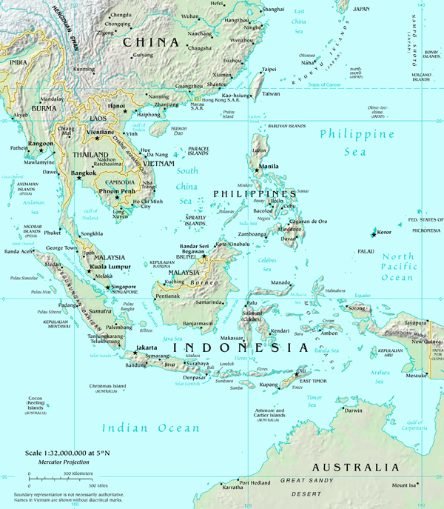
Asian Tigers: Success Story
Change in age structure provided a huge impetus for accelerated economic growth and development in South Korea
Between ¼ to 1/3 of economic growth since 1970 in East and South East Asia can be attributed to the Demographic Dividend” (Bloom and Williamson, 1998; Mason, 2001)
The economic success was made possible by sustained investments in education, health, family planning, and economic reforms
Source: World Population Prospects: The 2012 Revision,
Notes:
By 1965, South Korea’s TFR and GDP per capita was quite similar to that of many newly independent African countries. It had a TFR 5.63 and GDP per capita of USD 105. By 2010 it had realized a significant decline in TFR and a phenomenal increase in GDP. The TFR stood at 1.23 and GDP had increased to USD 22,151

Slide 13
Big Question
Will Zimbabwe optimize the value of its most valuable resource (people) into a valuable development asset for the realization ZIMASSET and the long term development strategies, including the joint African Vision shared?

Slide 14
… Zimbabwe’s pop structure is similar to the rest of Africa’s
Source: Zimstat, 2012 Population Census
Notes:
Uganda 1960 TFR 7.1 GDP per capita 62
Malaysia 1960 TFR 6 GDP per capita 299
Uganda 2010 TFR 7.1 GDP per capita 506
Malaysia 2010 TFR 6 GDP per capita 8,754

Slide 15
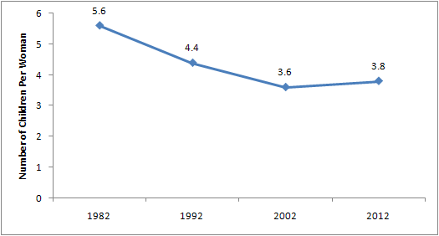
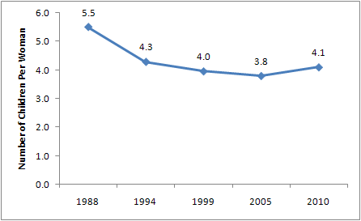
Fertility rates Bouncing Back in Zimbabwe
Pop Censuses
ZDHSs

Slide 16
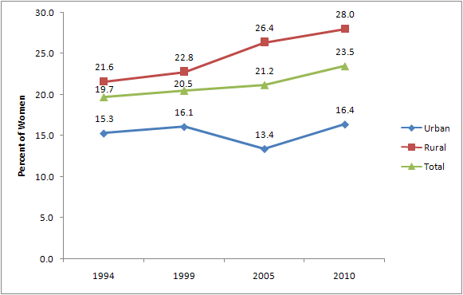
Zimbabwe’s Teenage Pregnancy Rate (% of 15-19 yr olds who have started child bearing)

Slide 17
The demographic dividend is not automatic or guaranteed even in cases where fertility has declined – e.g. Tunisia and South Korea’s Age Structures are Similar, but the DD Earned by Tunisia is Much Smaller than South Korea’s
Source: World Population Prospects: The 2012 Revision, Volume II: Demographic Profiles

Slide 18
The Critical Role of Policies
East Asian countries had a faster transition and captured a larger demographic dividend than Latin American countries. They did this by
  putting in place a macroeconomic framework conducive to tapping the potential provided by the increase in the working age population.
  Health and education policies allowed east Asia to have a faster transition and improved the overall productivity of the workforce,
  while macroeconomic stability and complementary policies—related to structural transformation and international trade—favored job creation and saving
(Bloom, Canning, and Sevilla 2003; Reher 2011).

Slide 19
Policy Options
Policies contributed to a faster demographic transition.
Investments in human capital ensured the workforce was more productive.
Job creation was facilitated by labor market flexibility and a shift to labor-intensive manufacturing sectors.
Increased savings from the demographic transition were channeled toward investment, with simultaneous financial sector development.
Higher trade integration stimulated job creation, structural transformation, and technology transfer.

Slide 20
Opening the Window of Opportunity for Harnessing the DD in Zimbabwe
Enable Demographic Transition
    Cultural/Behavioral change in favor of small family size
    Expand access to effective family planning to reduce unwanted pregnancies, especially among teenagers
Investing in human capital development
    Reinforce progress in reducing maternal and child mortality
    Reinforce gains in HIV/AIDs reduction, and intensifying effort to reduction among adolescent and youth
    Enhance education, particularly female school enrollment and general female empowerment
Economic reforms
  Enhancing economic growth and mass creation of quality jobs
Good Governance & Accountability
  Accountability in use of public resources and in service delivery

Slide 21
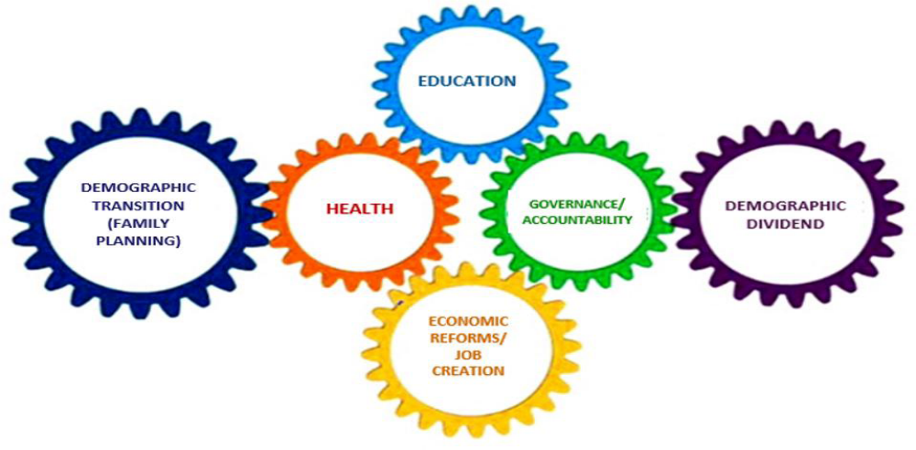
The Framework
Adapted from African Union Commission, 2013

Slide 22
Big Questions Beyond the Numbers
What should we do? What are the game changer interventions we need to adopt?
We cant do everything, how do we prioritize? How di we balance the investments across the five wheels? Dos the evidence from East Asia provide answers to these questions?
How do we go about infusing an integrated approach at planning, resource allocation, and programme implementation?
How do we monitor progress and what accountability mechanisms do we need to improve performance

Slide 23

Thank You

Slide 24
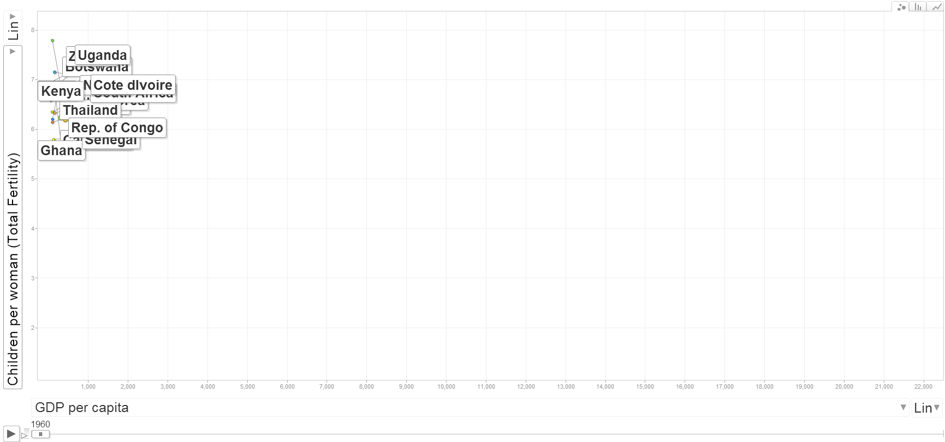
In 1960s, African countries were comparable to East Asian countries, with high fertility (more than five births per woman) and low per capita GDP
Source: UN Population Division & World Bank

Slide 25
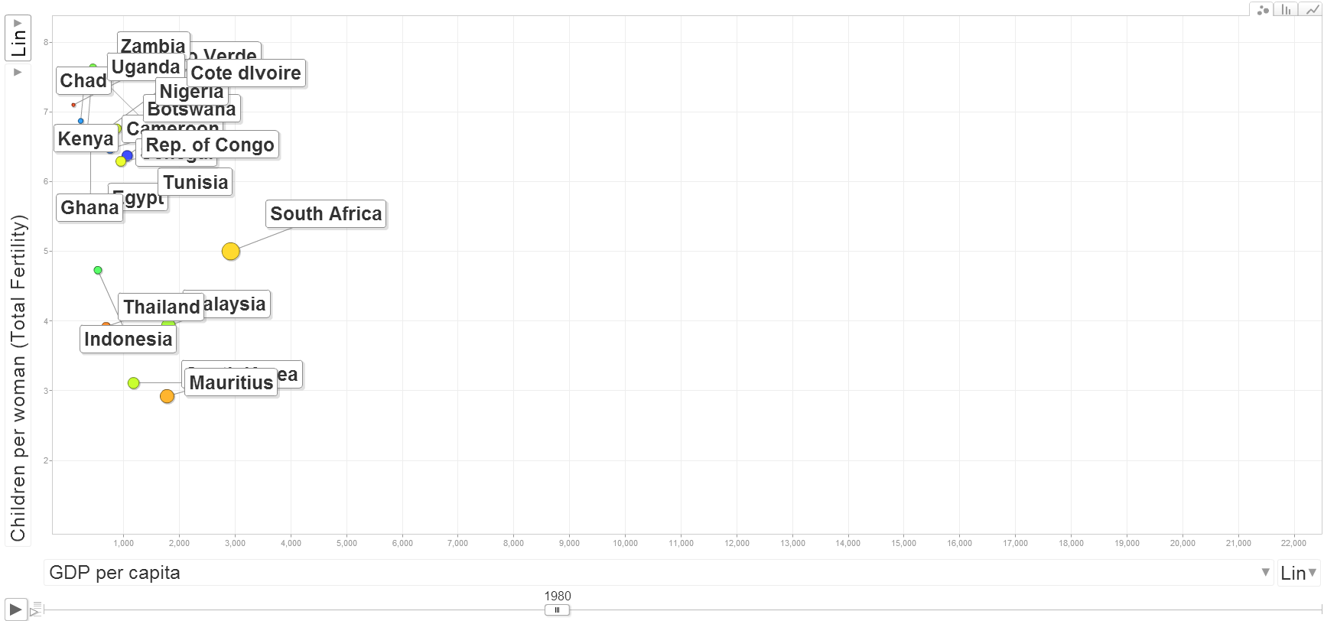
By 1980, rapid fertility decline was underway in most East Asian countries while little change was noted in Africa
Source: UN Population Division & World Bank

Slide 26
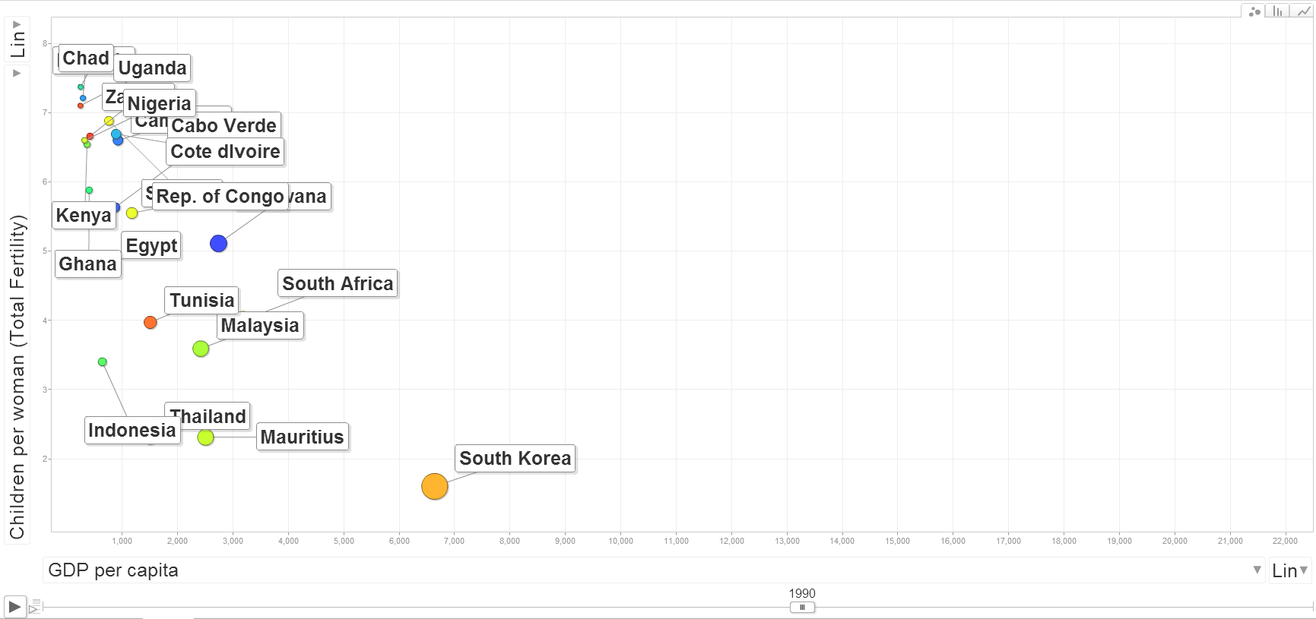
By 1990, per capita GDP increased substantially in countries with fewer than 3 children per woman
Source: UN Population Division & World Bank

Slide 27
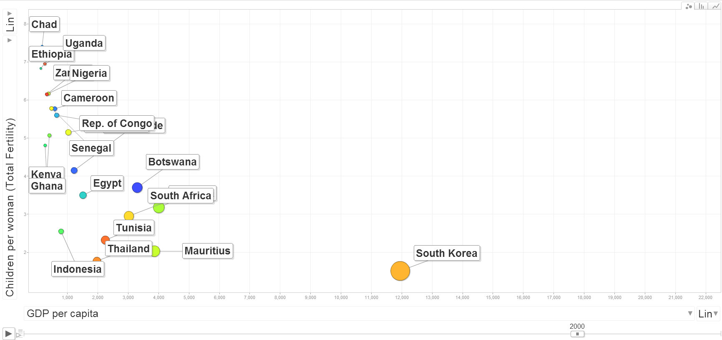
By 2000, per capita GDP increased substantially in countries with fewer than 3 children per woman
Source: UN Population Division & World Bank

Slide 28
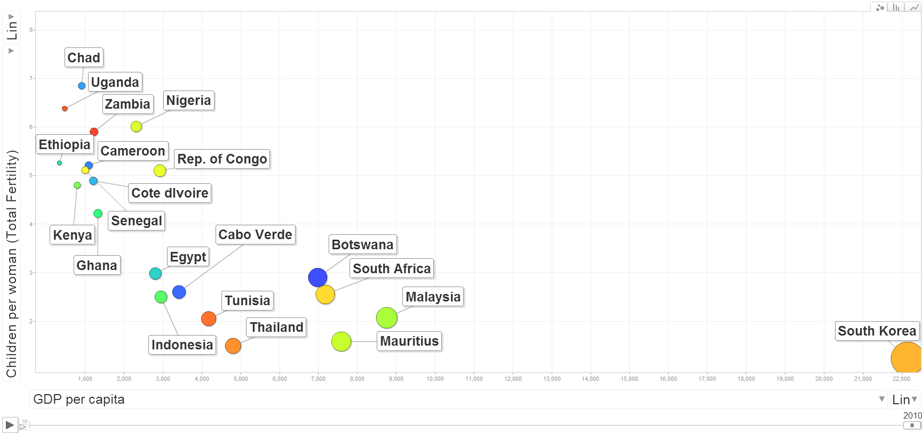
By 2010, fertility had not declined much in the majority of Africa countries, and income levels in the Asian Tigers soared to high levels
Source: UN Population Division & World Bank

