Slide 1
Boosting youth employment through value chain Development
Tapera J. Muzira
Chief Technical Advisor (CTA)
Inclusive Green Growth, Decent Green Jobs
ILO Lusaka Office

Slide 2
Programmes Projects
Zambia Green Jobs Programme (ILO, UNEP, UNCTAD, ITC and FAO). Finland.
ILO ACI4 Project on Working conditions and productivity in SMEs. Social Protection, Occupational Safety and Health.
LGN II Zambia on SME Labour Law and Employment Creation. Norway.

Slide 3
ILO Resources on Value Chains
Herr, M and Muzira T.J. (2009). Value Chain Development for Decent Work. A Guide for private sector initiatives, governments and development organizations (English, Spanish and French). Geneva. International Labour Organization
ITCILO Course on Market-driven BDS and Value Chain Development

Slide 4
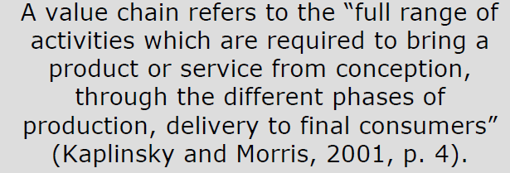
What is a Value Chain

Slide 5
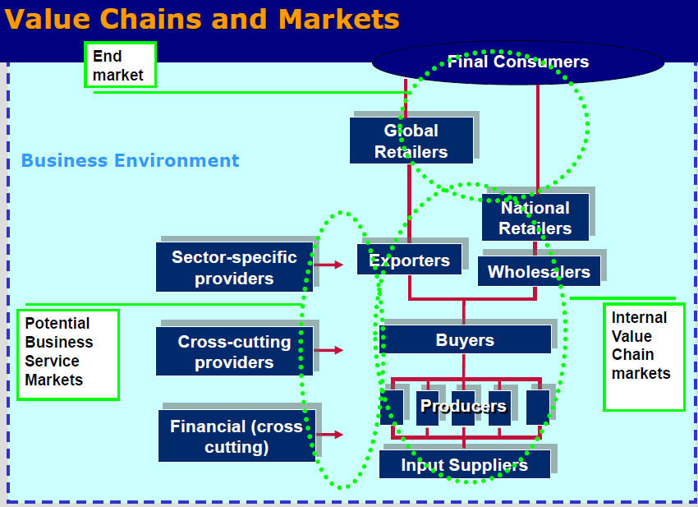

Slide 6
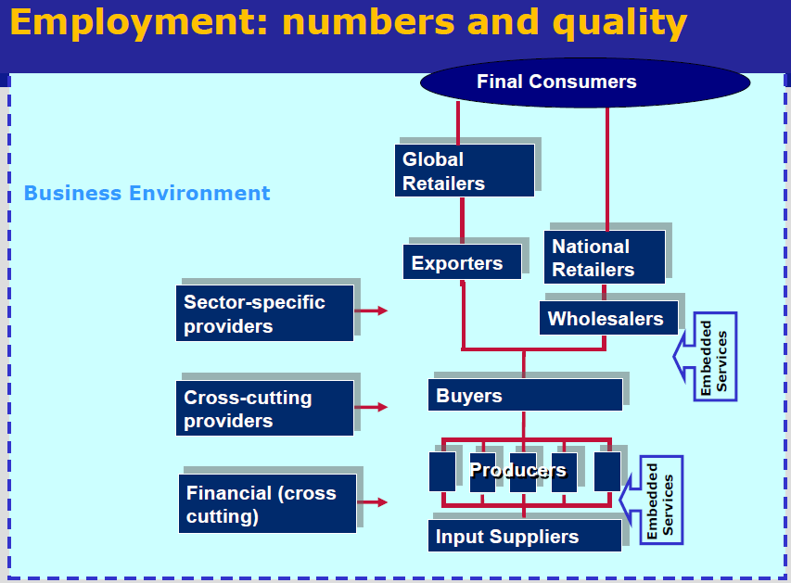

Slide 7
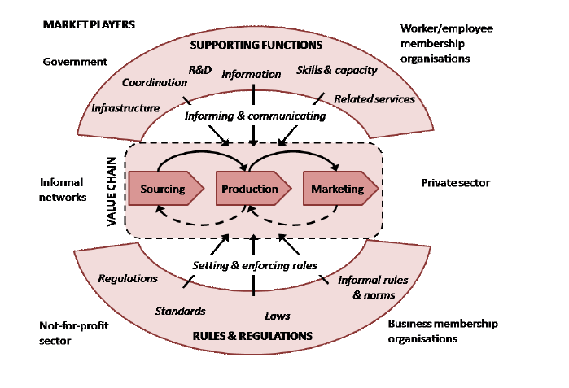

Slide 8
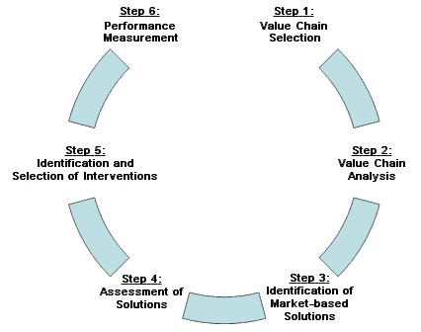
Value Chain Development Process

Slide 9
List of Possible Criteria
Social
Youth Employment e.g. ICTs and Decent Digital Jobs
Women entrepreneurship and economic empowerment
Potential for increasing house hold income and food security to reduce high poverty incidence in selected areas
Geographic Scope and Scale of the sector, bringing development where it is most needed.

Slide 10
List of Possible Criteria
Economic
Economic opportunities in local regional and global value chains
Potential for inclusive growth and increased competitiveness (productivity & value addition) e.g. organic agriculture or ecotourism
High potential for private sector investment and economic recovery

Slide 11
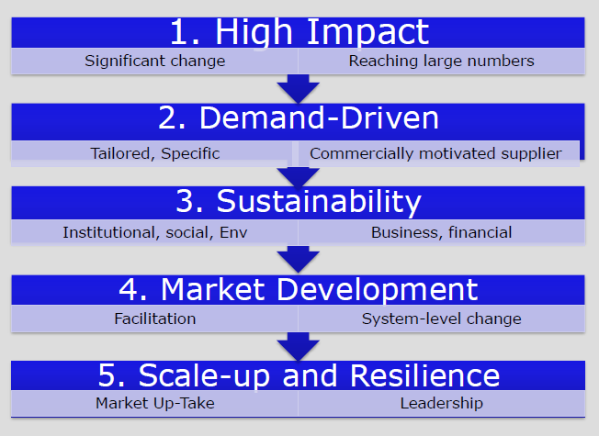
VCD Selection Principles

Slide 12
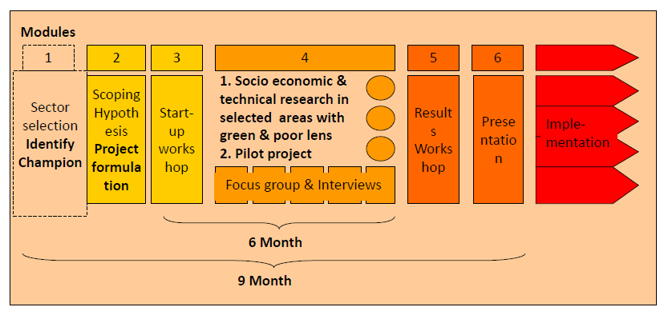
VCD Timeline

Slide 13
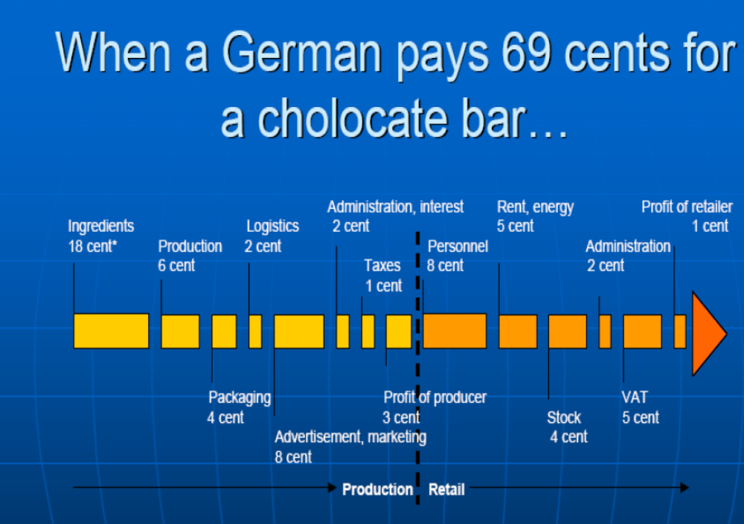
69 Cents for a Chocolate bar

Slide 14
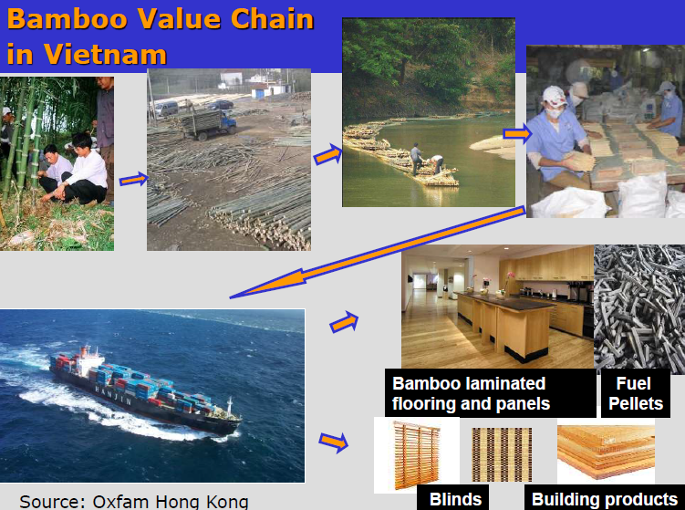

Slide 15

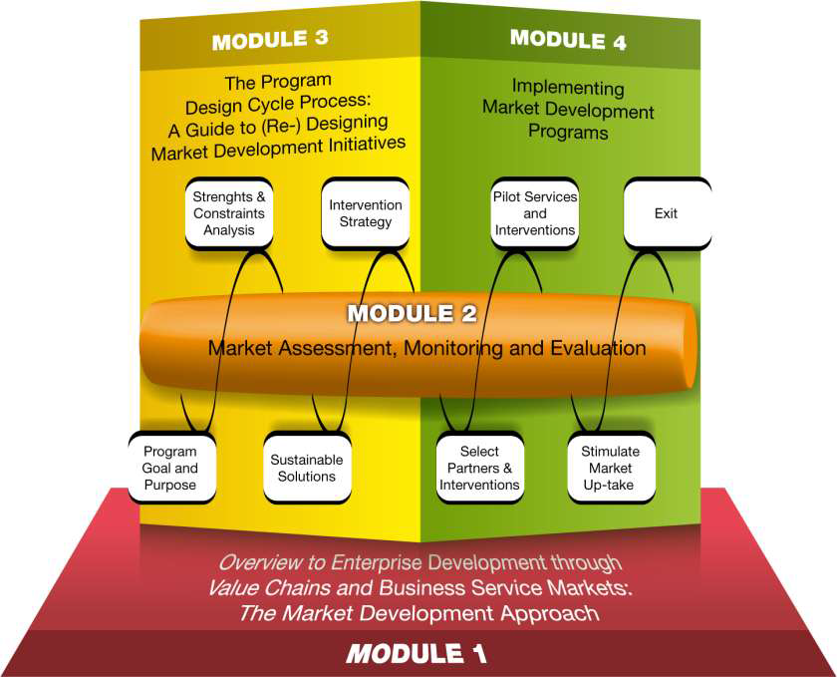

Slide 16
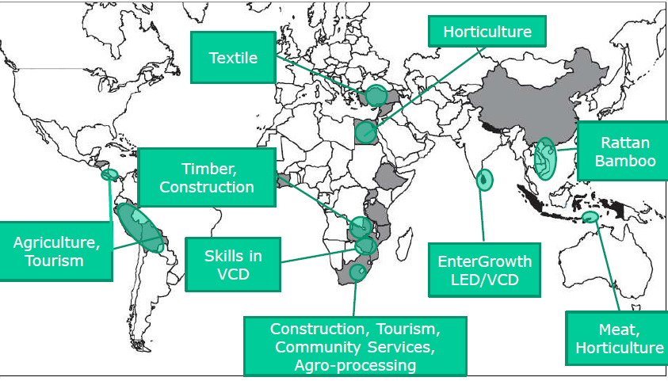
ILO Support in Value Chain Development

Slide 17

Thank You

