Slide 1



National Competitiveness Council 2015

Slide 2

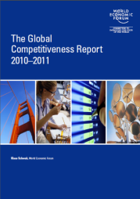
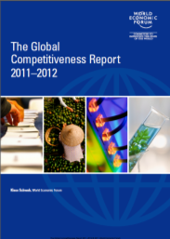
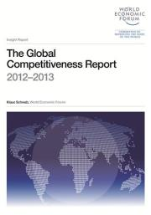
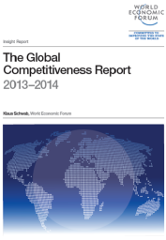
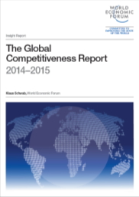
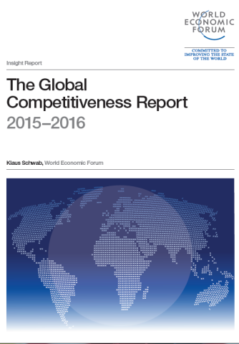
WORLD ECONOMIC FORUM:
GLOBAL COMPETITIVENESS REPORT
2014 -2015

Slide 3

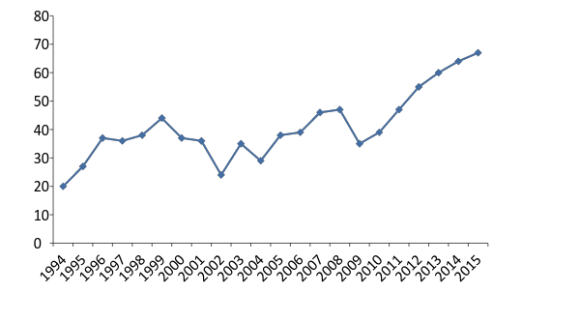
GLOBAL COMPETITIVENESS REPORT
1994 - 2015
Percentile Rank
100
Upper 1/3
90
Middle 1/3
Bottom 1/3
2016

Slide 4
GLOBAL COMPETITIVENESS REPORT CARD
REPORT | 2015 RANK | 2014 RANK | 2013 RANK | CHANGE | ASEAN RANK | TOP 1/3
WEF -Global Competitiveness Report | 47/140 | 52/144 | 59/148 | ↑ 5 | 5 of 9 | 47
IFC- Ease of Doing Business | Oct 2015 | 95/189* | 108/189** | ↑ 13 | 5 of 10 | 63
TI - Corruption Perception Index | Dec 2015 | 85/175 | 94/177 | ↑ 9 | 3 of 9 | 58
HF - Economic Freedom Index | 76/178 | 89/178 | 97/177 | ↑ 13 | 5 of 9 | 59
WEF- Global Information Technology Report | 76/143 | 78/148 | 86/144 | ↑ 2 | 5 of 9 | 48
WEF - Travel and Tourism Report | 74/141 | n/a | 82/140 | ↑ 8 | 5 of 7 | 46
WEF - Global Enabling Trade Index | Mar 2015 | 64/138 | n/a | ↑ 8 | 6 of 10 | 46
IMD -World Competitiveness Report | 41/60 | 42/60 | 38/60 | ↑ 1 | 4 of 5 | 20
WIPO - Global Innovation Index | 83/141 | 100/143 | 90/142 | ↑ 17 | 6 of 8 | 47
WB - Logistics Performance Index | Mar 2015 | 57/160 | n/a | ↓ 5 | 6 of 9 | 53
FFP - Fragile States Index *** | 48/178 | 52/178 | 59/178 | ↓ 4 | 8 of 10 | 118
WEF - Global Gender Gap Report | Oct 2015 | 9/142 | 5/136 | ↓ 4 | 1 of 9 | 47
*Ranking based on the 2015 Doing Business Report
**Ranking based on the 2014 Doing Business Report
***Reverse ranking (1 as worst) – Fragile States Index
***As of September 2014

Slide 5









GLOBAL COMPETITIVENESS REPORT
PHILIPPINES and ASEAN
Country/Economy | 2015 (out of 140) | 2014 (out of 144) | 2013 (out of 148) | 2012 (out of 144) | 2011 (out of 142) | 2010 (Out of 139) | Change 2014-2015 | Change in 4 Years 2010-2015
Singapore | 2 | 2 | 2 | 2 | 2 | 3 | 0 | 1
Malaysia | 18 | 20 | 24 | 25 | 21 | 26 | 2 | 8
Thailand | 32 | 31 | 37 | 38 | 39 | 38 | -1 | 6
Indonesia | 37 | 34 | 38 | 50 | 46 | 44 | -3 | 7
Philippines | 47 | 52 | 59 | 65 | 75 | 85 | 5 | 38
Vietnam | 56 | 68 | 70 | 75 | 65 | 59 | 12 | 3
Lao PDR | 83 | 93 | 81 | n/a | n/a | n/a | 10 | n/a
Cambodia | 90 | 95 | 88 | 85 | 97 | 109 | 5 | 19
Myanmar | 131 | 134 | 139 | n/a | n/a | n/a | 3 | n/a
Brunei Darussalam | n/a | n/a | 26 | 28 | 28 | 28 | n/a | n/a
*Brunei Darussalam is not included in the 2015 Ranking

Slide 6
PHILIPPINE RANKINGS
PILLARS (2010-2015)
INDICATORS | (2015) 0F 140 | (2014) 0F 144 | (2013) 0F 148 | (2012) 0F 144 | (2011) 0F 142 | (2010) OF 139 | CHANGE 2014-2015 | CHANGE 2010-2015
OVER-ALL RANKING | 47 | 52 | 59 | 65 | 75 | 85 | ↑ 5 | 38
1st pillar: Institutions | 77 | 67 | 79 | 94 | 117 | 125 | ↓ 10 | 48
2nd pillar: Infrastructure | 90 | 91 | 96 | 98 | 105 | 104 | ↑ 1 | 14
3rd pillar: Macroeconomic environment | 24 | 26 | 40 | 36 | 54 | 68 | ↑ 2 | 44
4th pillar: Health and primary education | 86 | 92 | 96 | 98 | 92 | 90 | ↑ 6 | 4
5th pillar: Higher education and training | 63 | 64 | 67 | 64 | 71 | 73 | ↑ 1 | 10
6th pillar: Goods market efficiency | 80 | 70 | 82 | 86 | 88 | 97 | ↓ 10 | 17
7th pillar: Labor market efficiency | 82 | 91 | 100 | 103 | 113 | 111 | ↑ 9 | 29
8th pillar: Financial market development | 48 | 49 | 48 | 58 | 71 | 75 | ↑ 1 | 27
9th pillar: Technological readiness | 68 | 69 | 77 | 79 | 83 | 95 | ↑ 1 | 27
10th pillar: Market size | 30 | 35 | 33 | 35 | 36 | 37 | ↑ 5 | 7
11th pillar: Business sophistication | 42 | 46 | 49 | 49 | 57 | 60 | ↑ 4 | 18
12th pillar: Innovation | 48 | 52 | 69 | 94 | 108 | 111 | ↑ 4 | 63
RED – bottom 20% PURPLE – bottom 40-21% GREEN– bottom 50 – 41% BLACK – 49% or higher

Slide 7
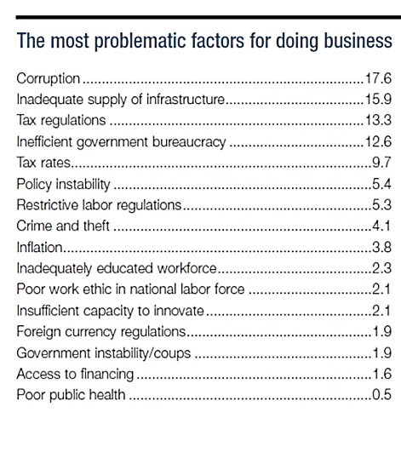
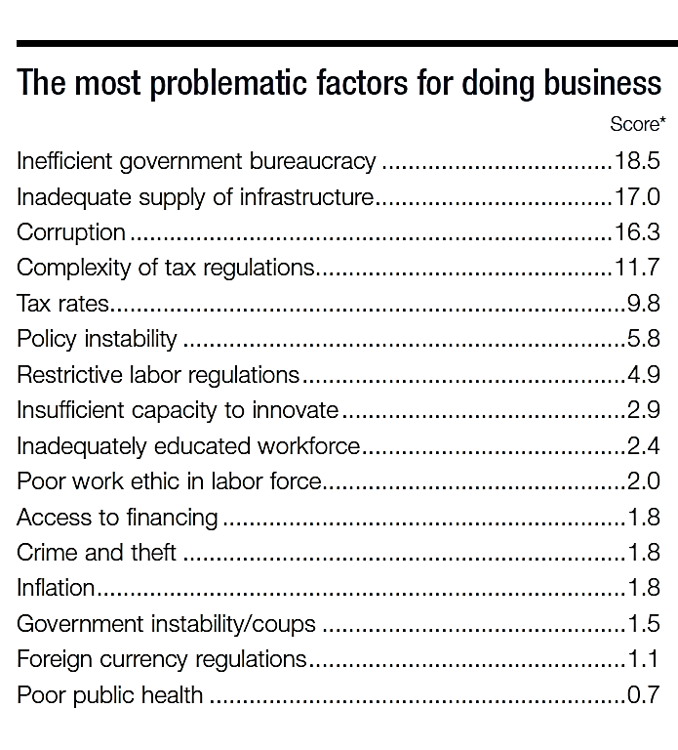
    PHILIPPINE ECONOMIC PROFILE
    MOST PROBLEMATIC FACTORS FOR DOING BUSINESS
2014
2015
WEF-GCI 2015 REPORT

Slide 8
AREA CODE 47
WHO ARE THE ECONOMIES IN THE NEIGHBORHOOD?
2015 | +/- 5
Kazakhstan | 42
Italy | 43
Latvia | 44
Russian Federation | 45
Mauritius | 46
Philippines | 47
Malta | 48
South Africa | 49
Panama | 50
Turkey | 51
Costa Rica | 52
2010 | +/- 5
Rwanda | 80
Egypt | 81
El Salvador | 82
Greece | 83
Trinidad and Tobago | 84
Philippines | 85
Algeria | 86
Argentina | 87
Albania | 88
Ukraine | 89
Gambia, The | 90

Slide 9







facebook.com/compete.philippines
@NCC_ph
www.competitive.org.ph
cmci@competitive.org.ph

