Slide 1
PROSPERA and the Fight Against Child Labour
Understanding Children’s Work Workshop, Manila, Philippines, April 2016

Slide 2
Content
Background
Regulation of child labour in Mexico
Evolution of child labour in Mexico
Results of the 2013 Child Labour Module
PROSPERA , a Social Inclusion Program
PROSPERA and the fight against child labour
How does PROSPERA have an impact in reducing child labour?
Final Reflections

Slide 3

Background
Child labor is a violation of the rights of children and adolescents that hinders them from growing fully as individuals.
The amendments to the Political Constitution of the United Mexican States prohibiting work by minors under 15 years of age and the recent ratification of the International Labour Organization Convention 138 concerning minimum age for admission to employment in April 2015, are proofs that priority has been given to eradicate child labour in Mexico.

Slide 4

Background
The labour policy of prevention and eradication of child labour in PROSPERA, is part of what has been established by the Interministerial Commission for the Prevention and Eradication of Child Labour and Protection of Adolescent Workers of Allowed-Age to Work in Mexico CITI); Strategy 3.2 Preventing and eradicating child labour, and protecting child workers of allowed-age under the Sectoral Labour and Social Security Program; and the Rules of Operation 2016 of the Program, which promote joint actions that can contribute to the eradication of child labour.

Slide 5

Regulation of Child Labour In Mexico
In Mexico, the Federal Labour Law, Title V BIS, strictly prohibits minors under 15 years of age to engage in economic work and establishes the conditions under which those between 15 and 18 years of age may work.
Those under the age of 15 are only allowed to
  Undertake activities related to artistic, sports, scientific or talent development, and as long as these do not interfere with their education, health and integrity.
  Undertake activities at home and only with blood relatives.

Slide 6

Restrictions for those under 18 years old
The Federal Labour Law establishes work restrictions for those under the age of 18. Among other things, they are not allowed to work
In liquor stores, bars or pubs
In jobs likely to affect their morals
In activities endangering their life and health
In rescue and salvage operations and accident brigades
In agricultural, forestry, sawing, hunting and fishing jobs
In the gas, cement, mining, iron and steel, oil, nuclear, brick making, glass, ceramics, wax and tobacco industries
In construction

Slide 7

Evolution of child labour
Child labour rate in Mexico had constantly decreased since 1996
Between 1996 and 2013, the child labour rate in Mexico decreased from 19.6% to 8.42% which translates into a difference of more than 10 percentage points equivalent to 2 million 165 thousand boys and girls who left child labour in order to engage in other activities.

Slide 8
Evolution of child labour in Mexico
Year | Number of minors (millions) | Child labour rate
1995 | 3.632 | 18.4
1996 | 3.891 | 19.6
1997 | 3.683 | 18.7
1998 | 3.693 | 18.3
1999 | 3.695 | 18
2000 | 3.607 | 17.4
2001 | 3.433 | 16.2
2002 | 3.308 | 15.7
2007 | 2.618 | 12.54
2009 | 2.262 | 11.12
2011 | 2.075 | 10.31
2013 | 1.726 | 8.42
%
Sources
Data from 1995 to 2002: Estimate of child labor with data from the 1995-2002 National Employment Surveys taken from "Child labor in Mexico 1995-2002", INEGI, 2004
Data from 2007 to 2009: Child Labour Module ENOE 2013, INEGI-STPS
Note: In 2002 the way child labour in Mexico was estimated changed: data from 1995 to 2002 refer to minors between 6 to 14 years old and include economic employment and domestic work of more than 15 hours a week; data from 2004 to 2013 refer to minors between 5 to 13 years old and include minors engaged in economic activities and minors doing domestic activities and who do not go to school.

Slide 9
Results of the 2013 Child Labour Module
Number of minors | 2011 | 2013 | Percentage Variation 2013-2011
Child population (from 5 to 17 years old) | 29,357,598 | 29,337,620 | -0.07
Overall employed | 3,077,069 | 2,536,693 | -17.6
5 to 13 years old | 896,040 | 745,609 | -16.8
14 to 17 years old | 2,181,029 | 1,791,084 | -17.9
Rates or Percentages | 2011 | 2013 | Differences in percentage points 2013-2011
Child Employment Rate | 10.5% | 8.6% | -1.9
5 to 13 years old | 4.4% | 3.6% | -0.8
14 to 17 years old | 23.7% | 20.3% | -3.4
Working students | 60.9% | 64.0% | 3.1
5 to 13 years old | 90.2% | 91.1% | 0.9
14 to 17 years old | 48.9% | 52.7% | 3.8
Source: Child Labour Module 2013, National Job Survey, INEGI-STPS
From 2011 to 2013 the number of working minors from 5 to 17 years old decreased by 17.6% (the decrease was slightly higher in the 14 to 17 year old group)
In the same period child labour rate decreased by almost two percentage points, which is equivalent to 350 thousand minors who stopped working.

Slide 10

Decrease in the child labour rate
The decrease in child labour is related to
The demographic transition which is changing the population structure, and
The outcomes of public policies, particularly scholarships granted to minors for them to remain in school.
The percentage of children who received scholarships to study increased from 24% in 2011 to 25% in 2013. The aid given to the school of working children increased by 3.1 percent, from 60.9% in 2011 to 64.0% in 2013.
(Source: Ministry of Labour and Social Welfare of the Federal Government)

Slide 11

PROSPERA, A Social Inclusion Program
PROSPERA is a program of the Federal Government that sets incentives for education, health and nutrition, in order to foster capacity building of families living in extreme poverty. Its main objective is to contribute measures in terms of nutrition, health and education, by understanding that the best way to social mobility is through education.
The target population of the program are households with a per capita income estimated to be below the minimum welfare line (LBM), whose socio-economic and income conditions hinder the capacity building of its members in terms of food, health and education.
(rural LBM:$963.11 Mexican currency or 55 USD; urban LBM: $1,343.22 Mexican currency or 76.8 USD as of February 2016)
(Fuente: Secretaría del Trabajo y Previsión Social del Gobierno Federal)

Slide 12

SOCIAL INCLUSION
Oportunidades
2002-2014
PROSPERA
2014
EDUCATION
FINANCIAL INCLUSION
EDUCATION
RIGHT TO A HEARING
NIVEL 1:
Inversión en
capital humano
HEALTH
NUTRITION
LEVEL 1:
Investment in human capital
HEALTH
NUTRITION
PROGRESA
1997-2002
Coverage: | 5.8 MILLION
Scholars: | 5.9 MILLION
Target: | Rural and urban areas
PRODUCTIVE INCLUSION
LEVEL 2:
Capacity building
WORK INCLUSIÓN
LEVEL 3:
Access to social rights
EDUCATION
LEVEL 1:
Investment in human capital
HEALTH
NUTRITION
Coverage: | 300,000
Scholars: | 200,000
Target: | Rural Areas
Coverage | 6.8 MILLION FAMILIES
Scholars: | 6.2 MILLION
Target: | More than 10 thousand new towns that have never been reached by a social program and special strategy in urban areas

Slide 13








What does PROSPERA seek to resolve?
Extreme poverty defined and measured through the multidimensional methodology established by the National Council for Evaluation of Social Development Policy (CONEVAL), considering income (growth/job/welfare) as well as social deprivations associated with human development, capacities and opportunities (rights).
¿Qué busca resolver PROSPERA?
Vulnerable due to social deprivation
31.5 million
26.3%
1.8 average deprivations
Non-poor and non-vulnerable population
24.6 million
20.5%
Welfare and Minimum Welfare Lines
Urban: 155.3 USD, Rural: 100.5 USD¹
Urban: 76.8 USD, Rural: 55 USD²
Moderately poor
43.9 million, 36.6%
1.9 deprivations
Vulnerable due to income
8.5 million
7.1%
Extremely poor
11.4 million (9.5%)
3.6 deprivations
24.6 million people
PROSPERA
6
5
4
3
2
1
Social Rights Deprivations
¹ Urban welfare line: $2,717.1 Mexican currency equivalent to 155.3 USD; Rural: $1,757.9 Mexican currency equivalent to 100.5 USD. Values as of Feb. 2016.
² Minimium Urban Welfare line: $1,343.22 Mexican currency equivalent to 76.8 USD; Rural: $963.11 Mex. equivalent to 55 USD. Values as of Feb. 2016

Slide 14



PROSPERA offers
Education | Health | Nutrition
Scholarships for basic education and senior high school | Guaranteed basic health package containing 13 interventions | Nutritional support
Support for school supplies | Training in health care
‘Jóvenes con PROSPERA’ scholarship (young people with PROSPERA)
+ | + | +
SCHOLARSHIPS FOR HIGHER EDUCATION Scholarships for technical, non-formal education and training for work Scholarships for persons with disabilities | EXTENDING THE UNIVERSAL HEALTH SERVICES CATALOGUE, FROM 13 TO 27 INTERVENTIONS Membership of the entire population in the public insurance and in the medical insurance ,21st century Family planning and prevention of teenage pregnancy measures | Access to milk, LICONSA New nutritional supplements for pregnant and nursing women , and children from 6 to 59 months Counseling service specializing in nutrition Medical equipment units for measuring height and weight
ESIAN

Slide 15








In addition…
Right to a hearing | The Right to a hearing may be exercised by beneficiaries facing a suspension of aid for an indefinite or definite period.
Financial Inclusion | In conjunction with the Ministry of Finance and Public Credit, a financial aid scheme for women was designed that includes: savings, credit, insurance, financial education and other services.
Job Inclusion | Schemes are generated so that beneficiaries may gain access to job trainings and have better preparation to penetrate the formal market.
Productive Inclusion | Coordination with 17 productive programs for the empowerment of women with options to work or to start their own projects.

Slide 16

Program Impact
Education outcomes. Test results of ENLACE between scholars and non-scholars of PROSPERA were compared during two periods: 2008 and 2011
(ENLACE is a standardized exam that the Ministry of Public Education implements in all basic education schools in the country.)
Secondary Level: In the Spanish test it was found that the test results of non-scholars were lower by more than 20 points, while among the scholars there was an increase of 10 points in their results. It was also found that the percentage of scholars in the insufficient and elementary levels decreased by 4%, while the percentage of non-scholars in those same levels increased.
Thanks to the Program’s implementation, health and nutritional factors causing truancy weigh less in areas where PROSPERA scholarships exist.
Besides it has helped close two major gaps in education: ethnic and gender gaps.

Slide 17
PROSPERA beneficiaries in school
6.2 million PROSPERA beneficiaries with educational scholarships:
  In primary school: 2.8 million scholars (45.05%)
  In junior high school: 2.13 million scholars (34.34%)
  In senior high school: 1.3 million scholars (20.6%)
Monthly amount of current educational support (scheme with joint responsibility):
  Primary: from $175 to $350 Mex. currency (from 10 to 20.1 USD) for males and females
  Junior high school: from $515 to $570 Mex. (from 29.6 to 32.8 USD) for males, and from $540 to $660 Mex. (from 31 to 38 USD) for females
  Senior high school: from $865 to $980 Mex. (from 49.7 to 56.3 USD) for males, and from $990 to $1,120 Mex. (from 56.9 to 64.4 USD) for females
Monetary aid for school supplies:
  Primary: $235 Mex. currency plus $115 Mex. for replenishment of supplies (13.5 USD plus 6.6 USD for replenishment)
  Junior high and Senior high school: $440 Mex. currency (25.3 USD)
“Jóvenes con PROSPERA” Scholarship:
  $4,890 Mex. (281 USD) for males and females

Slide 18
PROSPERA and the fight against child labour
PROSPERA promotes joint actions that affect the productive activities of households for the purpose of fostering the generation of independent and sustainable income over time, allowing them to overcome poverty and to stay out of it by their own means.
The actions undertaken by PROSPERA contribute to the eradication of child labour and safeguard labor and collective rights.
Joint actions that affect the productive activity of households
Fostering the generation of independent and sustainable income
Have an impact on reducing child labour

Slide 19
How does PROSPERA have an impact on reducing child labour?
Through its educational component, PROSPERA focuses its actions to support the enrollment, retention and regular attendance in primary, junior and senior high school.
Obtaining support requires compliance with joint responsibility on the part of family beneficiaries. Families with members from 0 to 9 years old, who have previously given proof of the child’s age may receive monthly monetary support every two months for each child in this age range to strengthen his/her growth, by accepting the fulfilment of certain commitments and joint responsibilities.
Commitments | Joint responsibilities
Allocate monetary support for the improvement of the family well-being. Support family members of school age to enable them to regularly attend classes. | Enroll minors below 18 years old who have not finished their studies in authorized primary or junior high schools.

Slide 20
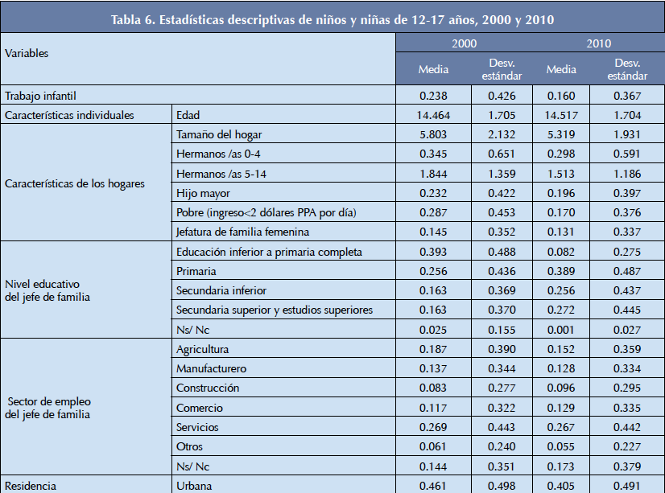
Results / Proof
Based on the different strategies implemented by the Government of Mexico, that includes PROSPERA as an important part, it has made a positive impact on reducing child labour.
Between 2000 and 2010, for example, the program contributed to a decline of around 7 per cent in child labour, from 23.8% in 2000 to 16% in 2010.
Source: UCW (2012)

Slide 21

In the same period (2000-2010), the number of boys and girls aged 12-14 years old and 15-17 years old who work decreased by more than 40% and 30%, respectively.
School aid increased: For boys between the ages of 12-14 years old it increased from 89% to 93%, while for boys and girls between the ages of 15-17 years old it went up from 64% to 71%.
For the 12-14 year old age group, the average number of weekly working hours decreased by five (from 30 to 25 hours a week); while for the 15-17 year old age group, it decreased by almost three hours (from 39.3 to 36.6).
PROSPERA accounts for around 10.8 and 13% of the decrease in labour involving girls and boys between the ages of 12-15 years old, respectively.
Source: UCW (2012)

Slide 22
Final Reflections
PROSPERA’s experience highlights the importance of the role of cash transfer programs, that have helped improve the standard of living and change incentive structures in favor of education.
It is necessary to reflect on the factors underlying the trend in reducing child labour over the last decade in Mexico so that this will promote efforts to address the working child population in this condition.
Improvements in the quality of life and a general decline in poverty - stimulated by reforms and social programs such as PROSPERA - play a central role in reducing child labour.

Slide 23
¡Muchas gracias! (Thank you!)
Mtro. Josué Jasan Vargas Olmos
PROSPERA National Coordination Office
josue.vargas@prospera.gob.mx
Chief Information Officer
Geostatistics, Analysis and Evaluation

