Slide 1






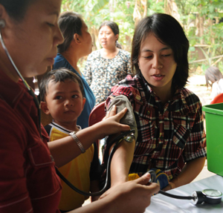
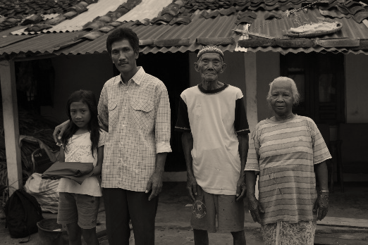
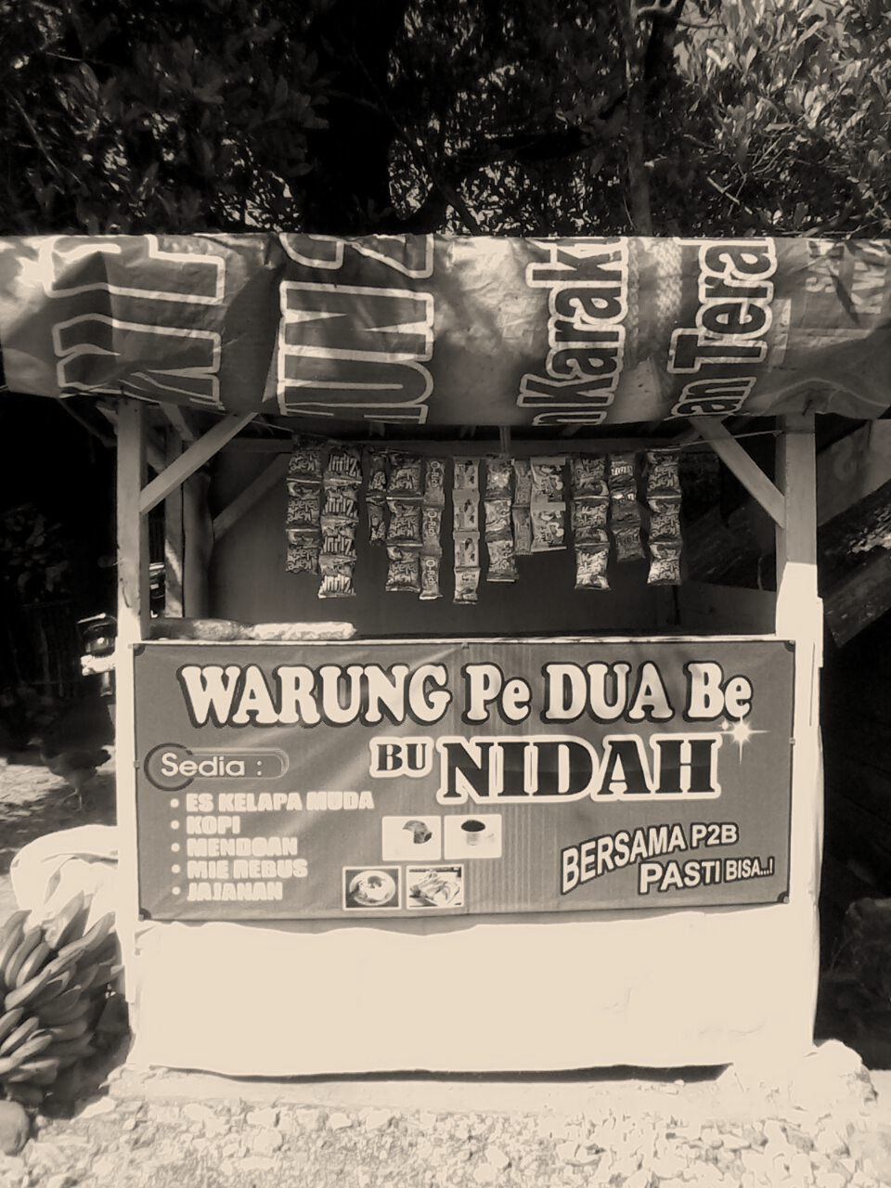
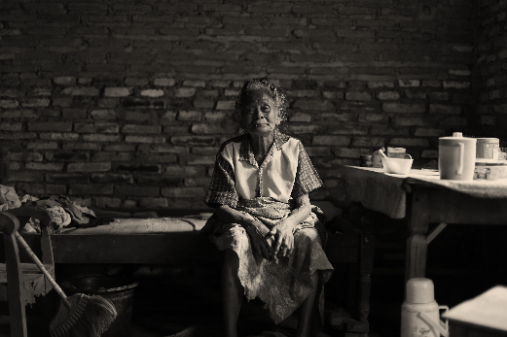
CONDITIONAL CASH TRANSFER
(PROGRAM KELUARGA HARAPAN – PKH)
A LESSON LEARN FROM INDONESIA
“International Workshop: Conditional Cash Transfers as a Tool to Address Child Labour”
Manila, 11 April 2016
Notes:
1

Slide 2
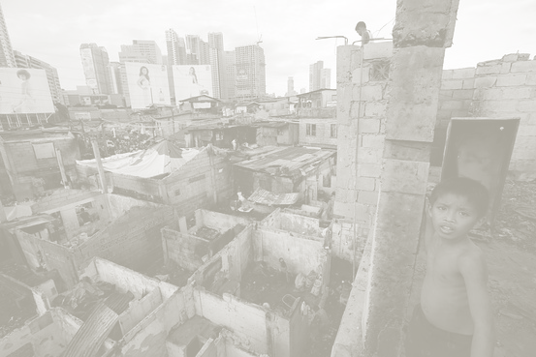
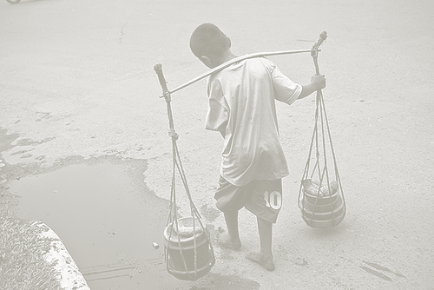
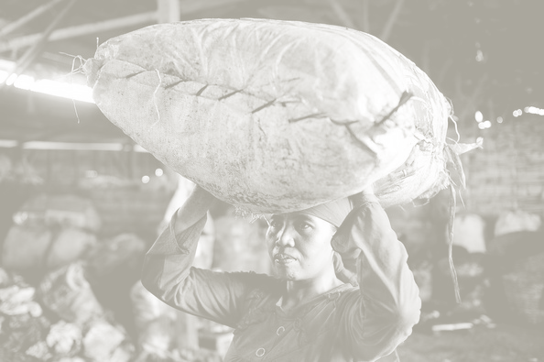

Outline
Child Labor Condition in Indonesia
Poverty Reduction Strategy
Background of Program Keluarga Harapan (PKH)
Contribution of PKH in reducing Child Labor in Indonesia
Space for Improvements
2
Notes:
2

Slide 3
Policy Strategy on
Reducing Poverty and Inequality
IMPLEMENTATION APPROACH
Reducing burden of the poor
Increasing income of the poor and vulnerable (40% below)
Inclusive growth
DEVELOPING QUALITY EMPLOYMENT OPPORTUNITIES | BUILDING A COMPREHENSIVE SOCIAL PROTECTION SYSTEM | PROMOTING SUSTAINABLE LIVELIHOODS | EXPANDING THE ACCESSIBILITY OF BASIC SERVICES
Expanding manufacturing industries for creating new employment opportunities | Restructuring social assistance through expansion of coverage and improvement of program design, e.g.: KIP, KKS, PKH, etc. | Developing primary sectors and local potentials | Expanding infrastructure and facility of basic services
Formulating regulatory framework that stimulates positive investment climate | Expanding coverage of the National Social Security for the vulnerable and informal workers | Expanding access of the vulnerable to capital and financial services through strengthening micro financing system | Facilitating the poor and vulnerable in accessing basic rights and basic services
Tax Reform | Strengthening social assistance institutions and implementers (service standard, data, and referral system, etc. | Strengthening skills and develop entrepreneurship | Strengthening M&E system for basic service delivery
3

Slide 4

CCT (PKH) CONCEPT
PKH is a social protection program targeted to poor families in the form of conditional cash transfer → The main goal of PKH is to break poverty chain, by improving the quality of human resources, especially in the areas of health and education.
2. The implementation of PKH is inseparable from the succesful experience of CCT implementation in many countries → Evaluations of CCT in Indonesia show to:
  Encourage poor families investing in children’s health and education → improve children’s school attendance and educational achievement in the beneficiaries families
  Improve maternal and children health, reduce malnutrition
  Spillovers effect: Reduce child labor and the improvement of healthier lifestyles to the non beneficiaries in the same regions.
Exit Strategy → Transformation/ Complementary Program, and
FDS (Family Development Sessions)
Notes:
4

Slide 5
Program Keluarga Harapan at Glance
Launched in 2007 as Pilot in 6 Provinces, become National Program in 2013.
Target the very poor households/families with the present of the following type of family members:
  Pregnant/lactating mother
  Pre-schooler (under 6 years old)
  School-age children (up to Junior Secondary School)
As other CCT programs, PKH links the benefits to the compliance of the beneficiaries on required conditions
Conditionality includes:
  Pregnant/lactating mother should visit Puskesmas 4 times/as required.
  Pre-schooler needs to be presented at Posyandu or Puskemas for growth monitoring and nutrition supplementation
  School-age children need to have monthly attendance rate at least 85%.

Slide 6
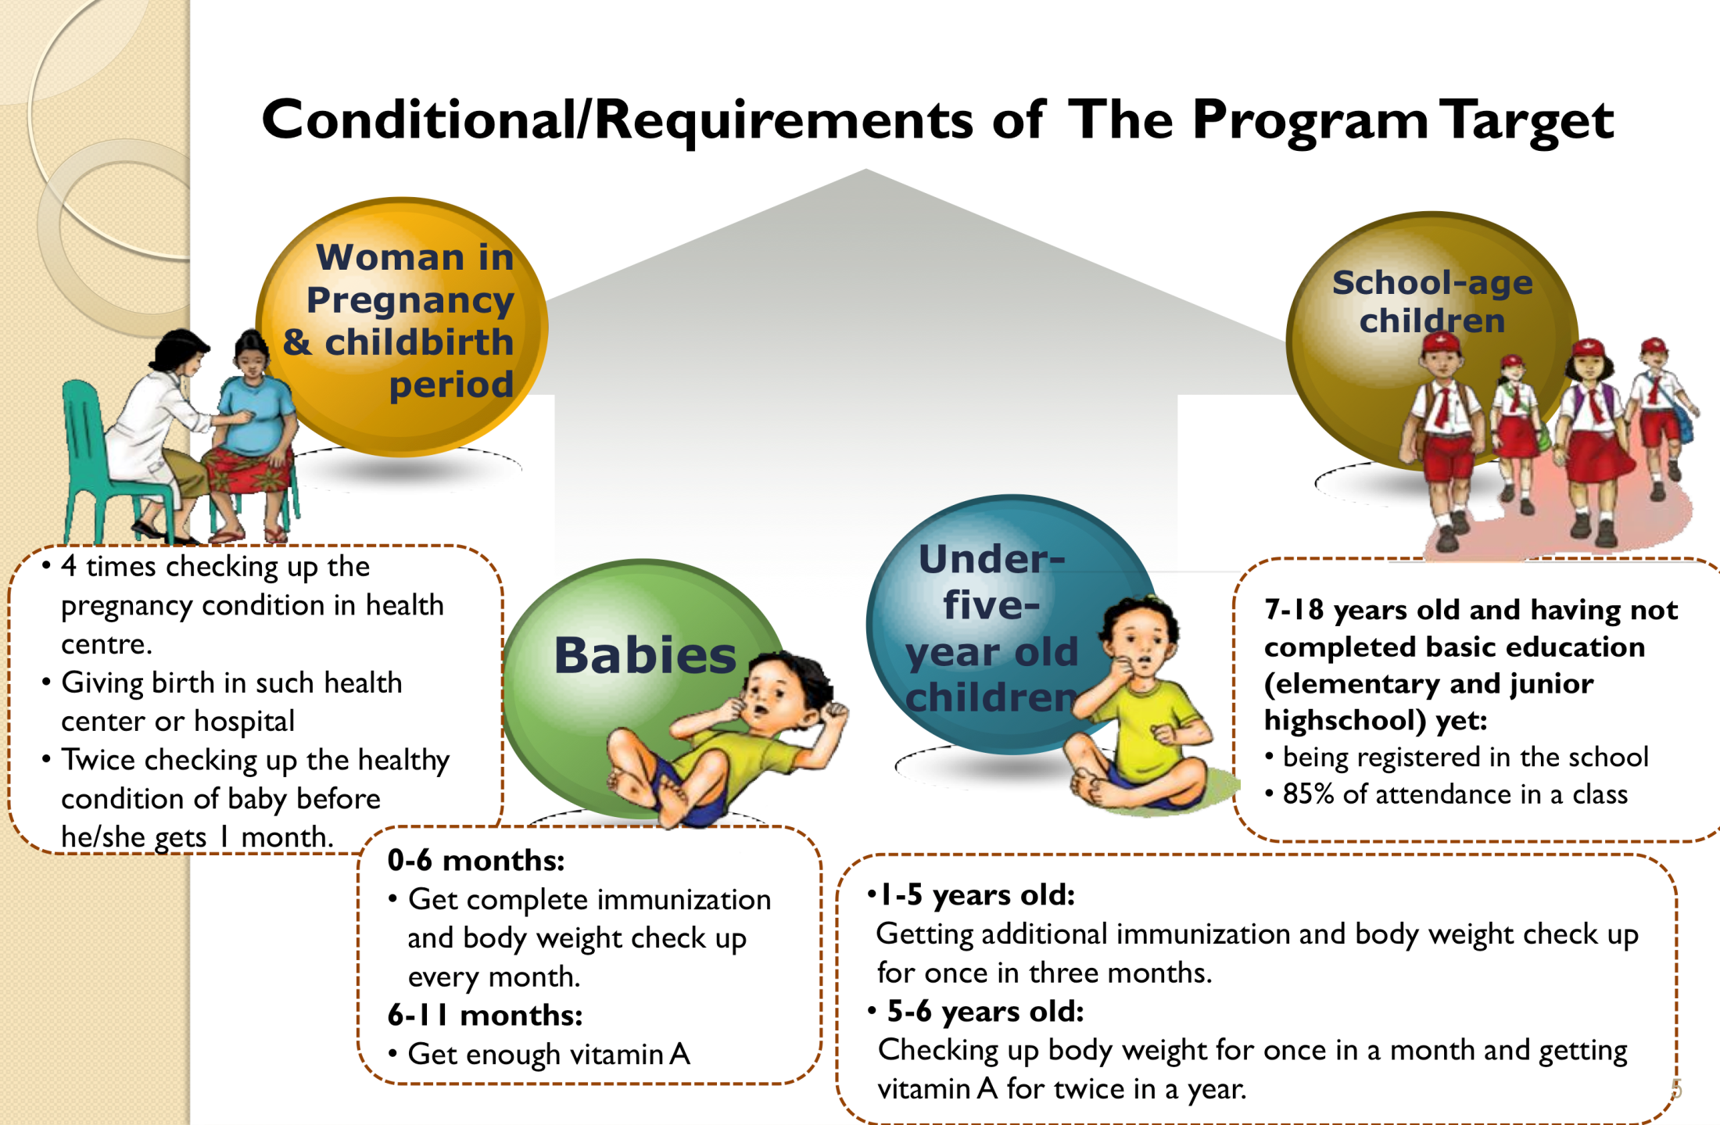
Permanent assistance : Rp. 500.000 (USD 38)
Elementary School : Rp. 450.000 (USD 34)
Junior Highschool : Rp. 750.000 (USD 57)
Senior High School : Rp. 1.000.000 (USD 76)
6

Slide 7
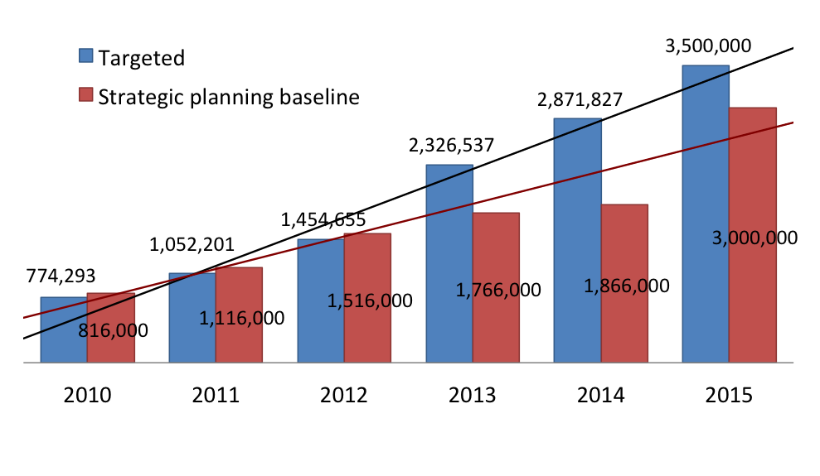
Coverage and Resources PKH
Beneficieries
Area of Coverage
Personnels | Total
Province | 34
Regency | 443
Sub-District | 5.271
Human Resource of PKH
Budget | IDR. 929 | IDR. 1,282 | IDR. 1,867 | IDR. 3,536 | IDR.5,548 | IDR. 6.471
Baseline | IDR. 1,300 | IDR. 1,600 | IDR. 1.884 | IDR. 2,711 | IDR. 2.862 | IDR. 5,222
Personnel | Total
Assitant | 14.594
Operator | 2000
Area Coordinator | 47
Management | 40
From 2007 to present, PKH still becomes a national priority programme in poverty elevation policy
In 2010-2014 Long-term Development there has been an increase of beneficieries and budget allocation for PKH which surpassed planned target baseline.
2015 it sharply increased which reached 3.5 million targeted poorest households and IDR 6.4 trillion on budget (USD 7,6 million))
7
Notes:
7

Slide 8
PKH Beneficiaries in 2015
Family Member | Amount
Pregnant Mother | 100,161
Toddler | 1,544,768
Pre School Children | 124,485
Children of elementary school age | 3,343,755
Children of junior high school age | 1,636,000
Children of senior high school age | 726,014
TOTAL (icl. Pregnant Mother) | 7,475,183
Source: PKH MIS Database, March 2016
8

Slide 9
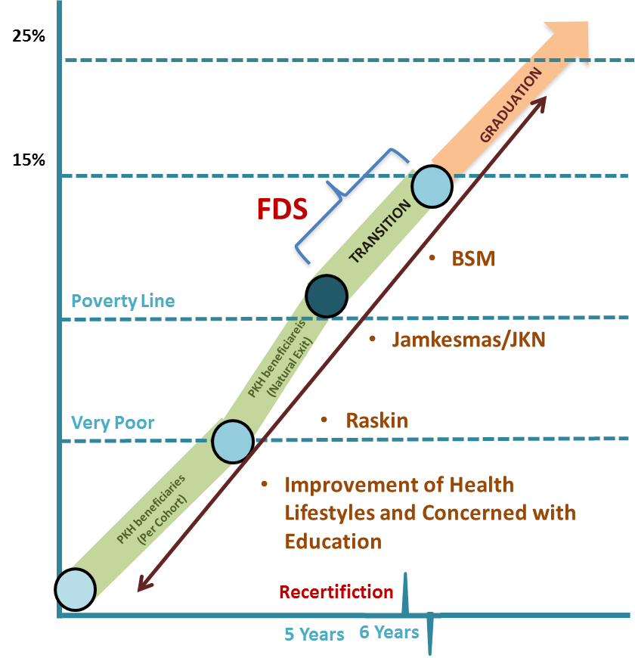
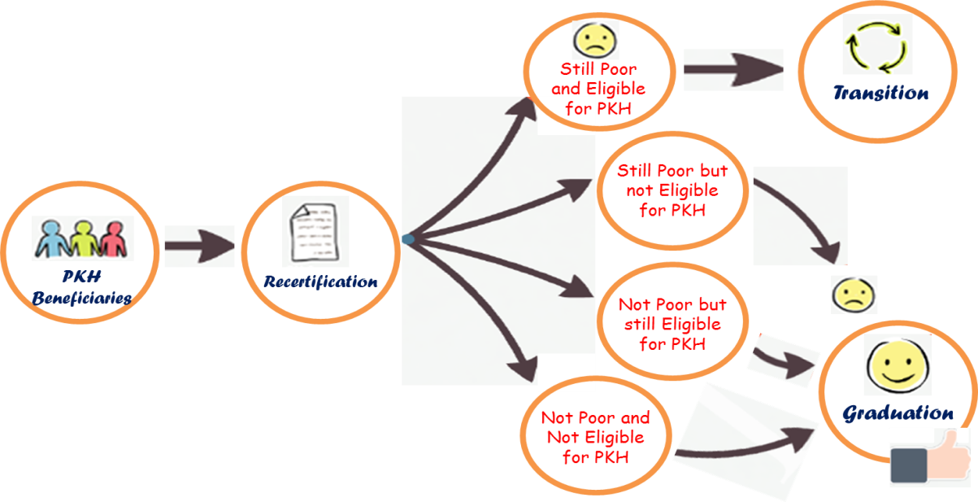
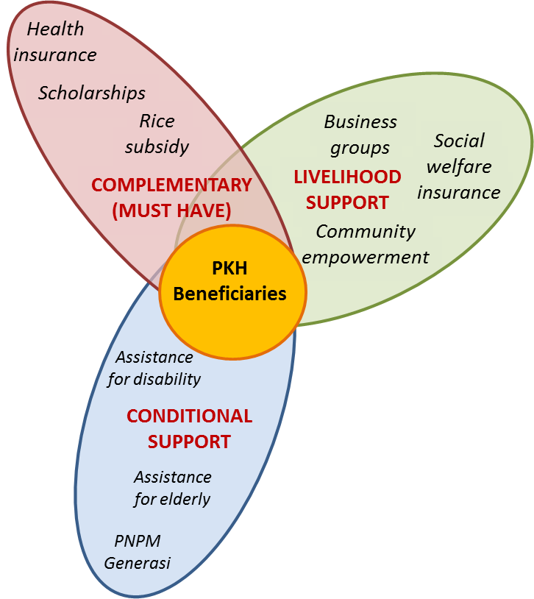
Exit Strategy and Complementary Program
  PKH was designed to target poor families through conditional cash transfers which are given temporarily (6 years) in order to:
    Minimize the dependency of cash transfers;
    Open up the opportunities of other poor people who have not received PKH because of the limited budget;
    Lesson learned from other countries shows that program objectives can begin to be seen after 6 years.
  PKH Transformation as an exit strategy, to:
    Ensure the continuity of good behaviour of poor people resulted from PKH conditionality;
    Avoid retrieval dan revolving door effects after PKH beneficiaries did not received cash assistance anymore;
    Sustainable increase of welfare by directing necessary programs and other complementary social protection programs to PKH beneficiaries.
By supporting PKH beneficiaries with several programs (from central and local government), it was expected that they can accumulate and allocate assets to more productive activities in order to get out of the poverty trap.

Slide 10
Contribution of PKH in Addressing Child Labor

Slide 11




Efectivity of PKH
Education
World Bank, 2010
Increase of school hours by 0.7 hour per week for Secondary School Students
Increase school hours by 20 min per week for Primary School
TNPK, 2014
Decrease of drop out rate at Primary School by 1.2 %
Increase of school participation/enrolment rate at Secondary School level by 5%
Child Labour/Worker
World Bank, 2010
Reduce incident of child labour/worker by 0.6%
TN2PK, 2014
Reduce of child labour prevalance by 3.9%
Spillover
Worldbank, 2010
Increase of pre-natal examination among neigbours who don’t receive PKH by 4%
Increase of child weighning among neigbours who don’t receive PKH by 7%
Almost 8% of PKH participants’ neighbour perform childbirth through support of medical workers
Household Consumption
World Bank, 2010
Increase of consumption almost by 10% of average montly expense
Indicators of nutritous food consumption (meat, fish, egg, milk) increased by 0.75 %
11

Slide 12
Education-related Outcomes
On midline evaluation, impact of PKH on most, if not all, of education outcomes were insignificant
On endline evaluation, impact PKH can be observed on gross enrollment for primary and secondary school and particularly on transition from 6th to 7th grade.
Primary school aged children from beneficiary families were found to be more likely to stay at school as their drop-out rates were 1.6 percentage points lower than their counterparts from non-beneficiary families.
The probability of children aged 13-15 from beneficiary families participating in school was 9.5 percentage points higher than for their counterparts from non-beneficiary families.
Source: TNP2K Evaluation Endline
Notes:
12

Slide 13
Space For Improvements
Unified Data Base
Integrated and Comprehensive Program
Strengthening the Coordination Between Institution in National and Regional Level
Including Child Labor Reduction Objectives in PKH Goals
Strengthening Family Development Session
Notes:
13

Slide 14

TERIMA KASIH
THANK YOU
14
Notes:
Watch your timing! Allocate a time for each slide and stick to it so as to keep track of your presentation and avoid speaking too much.
14

