Slide 1


The Philippines’ Conditional Cash Transfer (CCT) Program
(Pantawid Pamilyang Pilipino Program) : Efforts in Eliminating Child Labour
11 April 2016
Notes:
1

Slide 2
Discussion Flow:
Features of Philippines’ CCT that may contribute to elimination of Child Labour
Design of the CCT in the Philippines
Beneficiary Tracking Report: monitoring of non-compliant partner beneficiaries
Family Development Session
Case Management
Partnership with CSOs and National Government agencies and the Local Council for the Protection of Children (LCPC);

Slide 3

Pantawid Pamilya Pilipino Program
A human investment program for children thru health & education
Provides grants to poor families with children 0-18 years old and pregnant mothers
Main Goals:
To keep the children healthy;
To keep the children in school;
Notes:
First is the Pantawid Pamilya Pilipino Program.
The Pantawid Pamilya is a social protection program of the Philippine government. It is an investment in human capital development through health and education.
Conditional Health and Education Cash Grants are being provided to eligible families. The Program provides an amount of P300/month/child attending primary education and/or P500/month/child in the secondary education, but not exceeding 3 children per family. For health component, an amount of P500/month/family is granted.
They will continue to receive the Cash Grants as long as they comply with the conditionalities to ensure that children are in school and healthy, while pregnant mothers regularly seek health check-ups.
3

Slide 4
Pantawid Pamilyang Pilipino Program (Generic Name: Conditional Cash Transfer)
Focuses on human capital investment through provision of health and education cash grants to eligible poor households;
The provision of cash grants is based upon the compliance of the beneficiaries with the conditions of the program.
Pantawid Pamilya contributes to the improvement of attendance of children in school, maternal and child health, nutrition, and efforts in preventing child labour.

Slide 5
MODES of payment
Land bank ATM (Cash Cash)
Land bank Over-the Counter (Off-site) through conduits e.g. rural banks, cooperatives & other institutions engaged in money remittances authorized by the BSP;
Land Bank EMV Card (on process);

Slide 6
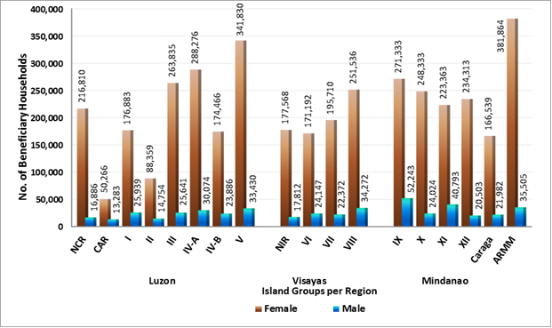
Pantawid Pamilya Card Holders or Authorized Recipients of Grants: 3,922,476 or 89.15% of the beneficiary grantees are female and 477,546 or 10.85% are males (as of march 23, 2016)

Slide 7
Registered and Active Household Beneficiaries as of 23 March 2016
There are 4,400,022 active household beneficiaries or 95.23% of 2016 target of 4,620,630 household beneficiaries.
Regular CCT …… 4,162,163 or 94.59%
Modified CCT ……. 237,859 or 5.41%

Slide 8
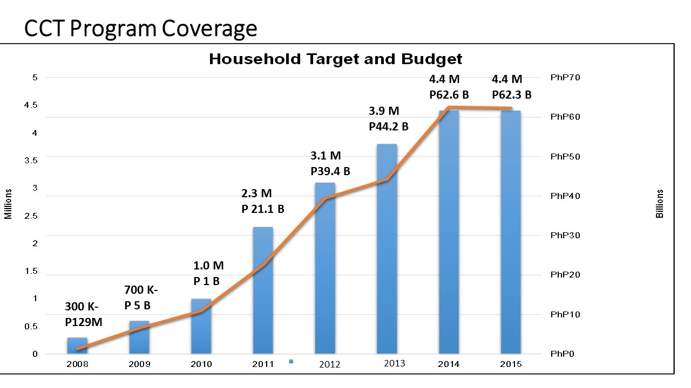
Notes:
Piloted in 2007
Scaled up since 2008
Total registered as of June 2015: 4.39 Million Households
More than 8 Million children supported
100% geographic coverage
Partly supported through loan financing from WB & ADB (less than 1 million beneficiaries)
8

Slide 9
NCR | 233,696
CAR | 63,549
I | 202,822
II | 103,113
III | 289,476
IV A | 318,350
IV B | 198,352
V | 375,260
NIR | 195,380
VI | 195,339
VII | 218,082
VIII | 285,808
IX | 323,576
X | 272,357
XI | 264,156
XII | 254,816
CARAGA | 188,521
ARMM | 417,369
Total | 4,400,022
Number of Household Beneficiaries by Region as of 23 March 2016

Slide 10
The 10.18 million Pantawid Pamilya Children: We want to keep them healthy and keep them in school;

Slide 11
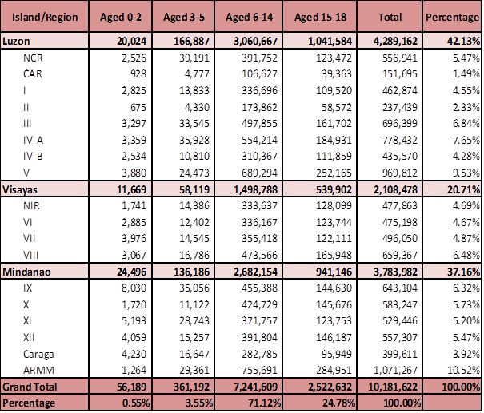
Children of Pantawid Pamilya partner beneficiaries, by Region and age bracket as of 23 March 2016
Notes:
11

Slide 12
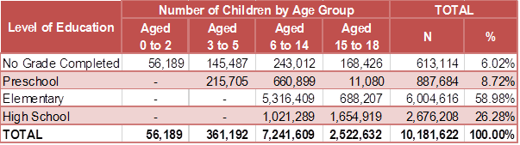

Distribution of Children Aged 0-18 by Level of Education as of 23 March 2016

Slide 13
Compliance Rates
Period Covered: January to December 2015
CONDITIONALITY | RATE
Health Center Visits | 95.46%
Deworming | 99.20%
Day Care | 94.83%
Elementary | 97.16%
High School | 94.02%
Family Development Sessions | 95.31%
13

Slide 14
Compliance Trends (2010-2015)
14

Slide 15
Education Compliance 2010-2012

Slide 16
Education Compliance 2013-2015

Slide 17
Health Compliance 2010-2012

Slide 18
Health Compliance 2013-2015

Slide 19
FDS Compliance 2010-2012

Slide 20
FDS Compliance 2013-2015

Slide 21
Beneficiary Tracking Report (BTR)
Tracking mechanism to facilitate the proper monitoring of partner beneficiaries who were not compliant to program conditions ;
Capture the validated reasons.
Capture the initial interventions.
Outputs from the BTR will be forwarded to the concerned divisions for the possible resolution of the household case.
* A work in progress; Started the manual and offline application in 2014 and online application on March 17, 2016

Slide 22
Standardized Codes
Reasons for non-compliance in Education
BTR Code No. | REASON
1 | Abandoned Child/Neglected
2 | Attend Personal Matters
3 | Beneficiaries nowhere to be found
4 | Beneficiary registered under other facility
5 | Bullied
6 | Can no longer cope with the demands of school
7 | Child in conflict with the law
8 | Child Work - Fishery
9 | Child Work - Mining
10 | Child Work - Farming
11 | Child Work - Domestic
12 | Child Work (Others)
13 | Conflict with Culture/Belief/ Tradition

Slide 23
Standardized Codes: Reasons for non-compliance to
85% Attendance to School
BTR Code No. | REASON
14 | Conflict with Livelihood
15 | Contested Compliance
16 | Cutting Classes
17 | Death in the Family
18 | Deceased
19 | Disability
20 | Distance
21 | Emotionally Unprepared
22 | Family Conflict
23 | Financial
24 | Inaccessible due Terrain
25 | Inaccessible due to no proper road access
26 | Inaccurate Data

Slide 24
Standardized Codes: Reasons for non-compliance to 85% attendance in school
BTR Code No. | REASON
27 | Inclusion Error/Waived/Fraud
28 | Ineligible for Compliance Verification (CV) Monitoring
29 | Lack or Loss of Interest in School
30 | Moved-out but no updates filed
31 | Moved-out with updates already filed
32 | Multiple names reflected in CV Form
33 | No one to accompany in School
34 | Overage
35 | Peer Pressure
36 | Reduced Grants
37 | Sibling Care
38 | Sick
39 | Sickly
40 | Supply-Side due to Unavailability of School facility
41 | Supply-Side due to Unavailability of Teacher/DCW
42 | Teenage Pregnancy

Slide 25
Standardized Codes: Reasons for non-compliance to 85% attendance in school
BTR Code No. | REASON
43 | Unavoidable Circumstances
44 | Victim of Armed Conflict
45 | Victim of Domestic Violence
46 | With Common Law Partner/Early Marriage
47 | Wrong Entry
48 | Other Reasons (Pls. Specify)

Slide 26
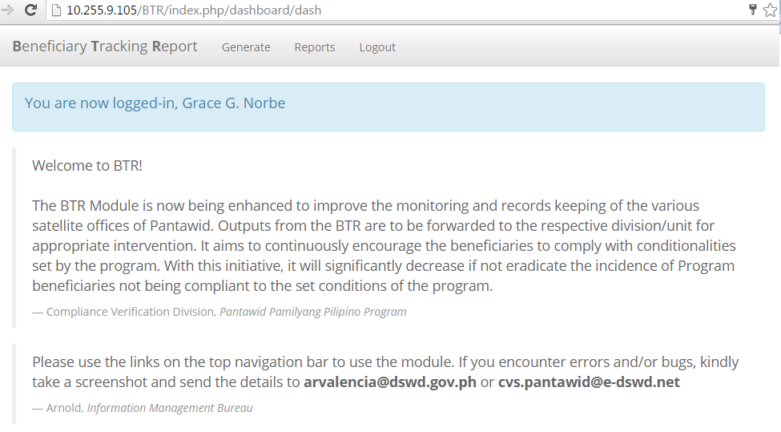
BTR Module - NPMO

Slide 27
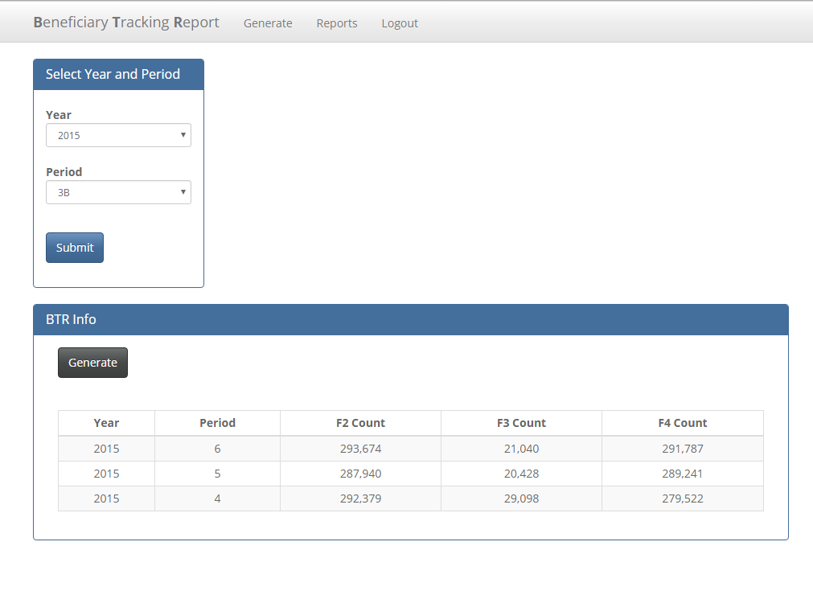
BTR Module - NPMO

Slide 28
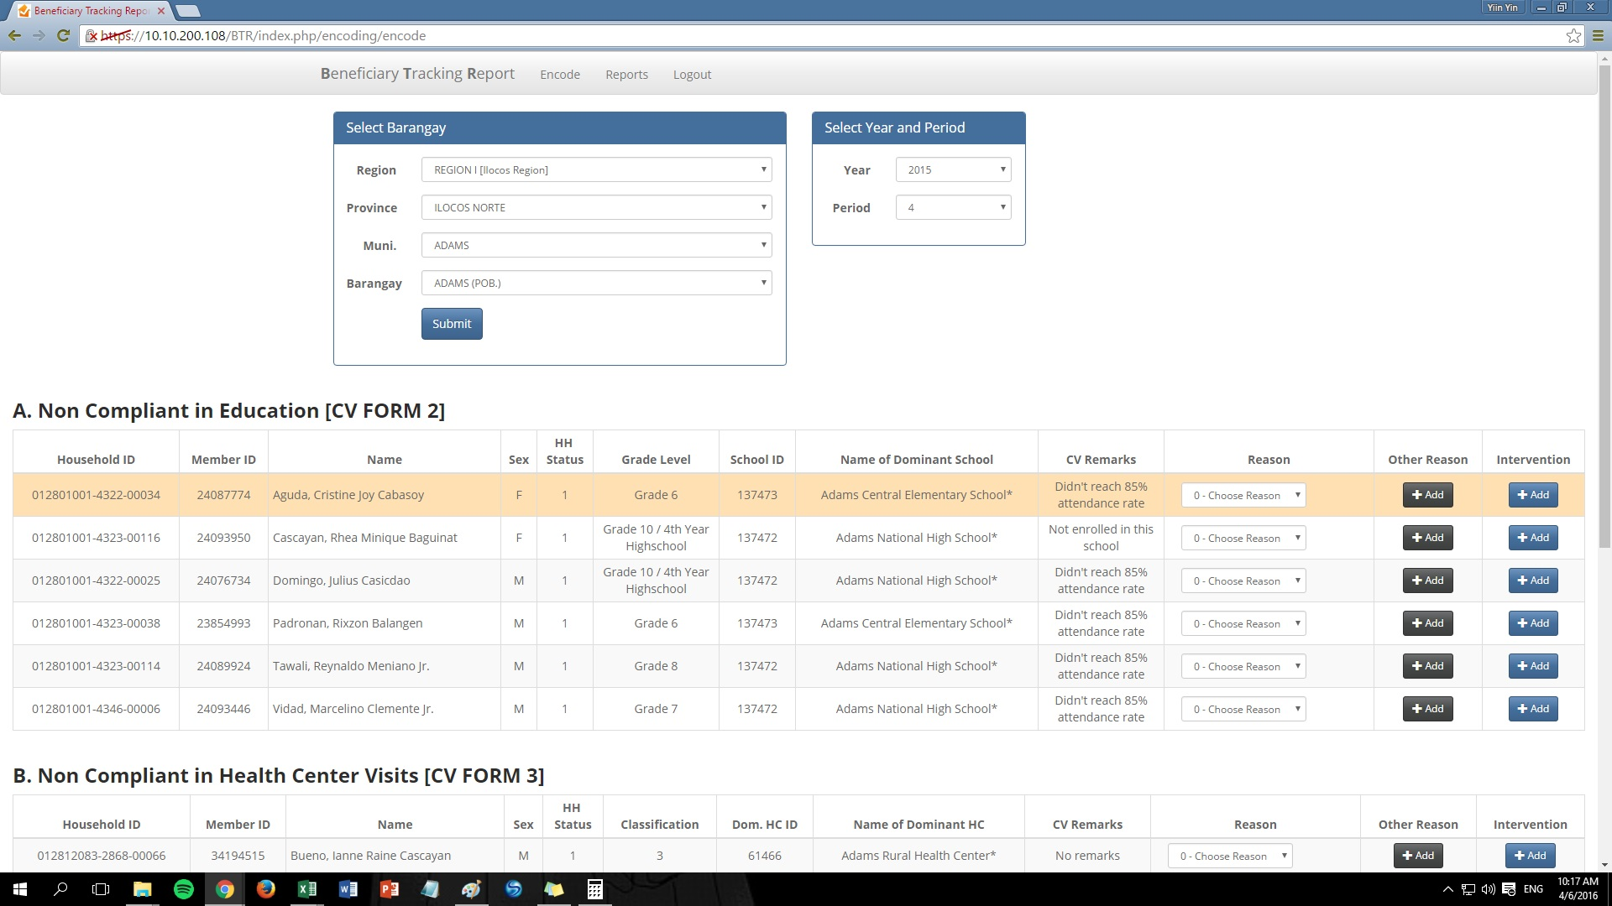
BTR Module - RPMO

Slide 29
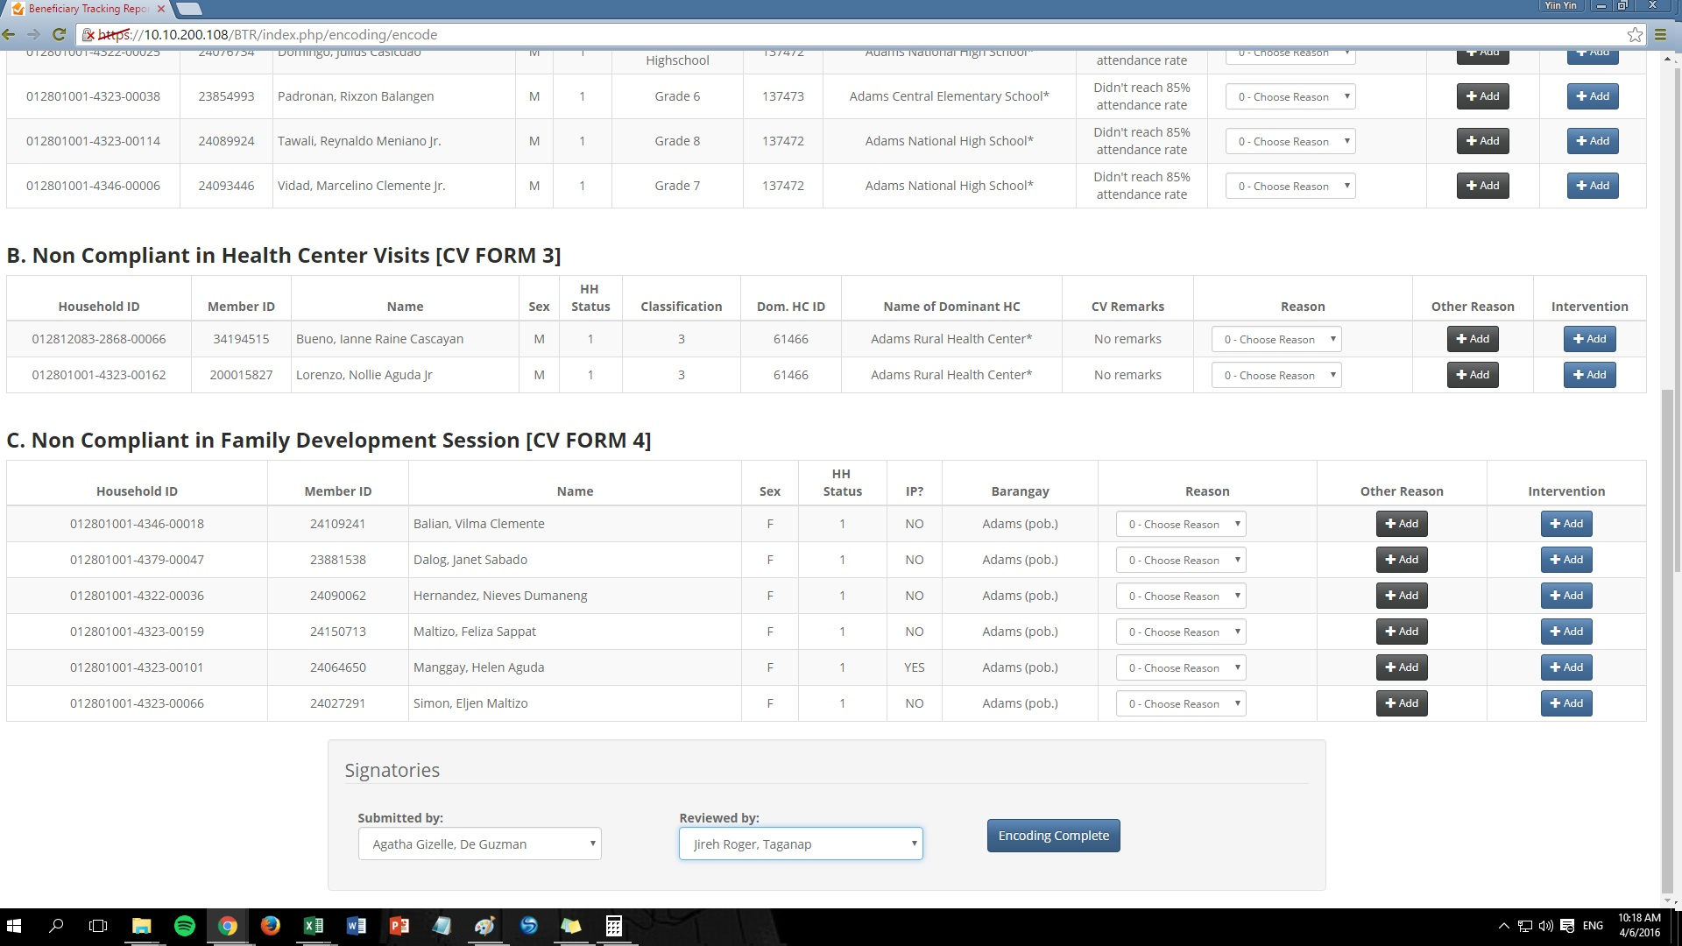
BTR Module - RPMO

Slide 30
Initial Results of Monitoring Non-Compliant Beneficiaries
Monitoring of non-compliant children resulted to reduction by 230,000 of the number children not in school from 908,901 in Dec, 2014 to 676,136 in June, 2015 and an increase by 150,000 the number of children in school from 7,801,611 in Dec, 2014 to 7,950,079 in June, 2015 even if we have an attrition of 92,000 HHs which have graduated and we have no newly registered households;
We hope to have another significant reduction of children not in school by June, 2016;

Slide 31
Family Development Session
A neighborhood-based monthly session designed for parent-grantees of the Conditional Cash Transfer (CCT) program to discuss interactively topics along enhancement of family life such as husband and wife relationship, child and parent relationship, home and financial management and other parenting concerns. It also include topics on livelihood development, disaster risk management, community and environmental protection, among others.

Slide 32
Objectives of the FDS
To capacitate the household beneficiaries to become more productive and responsive to meet family needs;
To enhance the skills and knowledge of household grantees and parents promote positive family values, strengthen marital relationships & parental roles and responsibilities particularly on the health, nutrition and education needs of children.
To promote social awareness, participation and involvement in community development efforts.

Slide 33
Creation of Parent Groups & the FDS
Geographical clustering of Pantawid Pamilya grantees into groups of 25 to 30 households;
The members of each group select a parent leader by consensus;
Parent Groups are organized for the conduct of Family Development Session;
Venues of Session: Neighborhood, brgy hall, DCC, house of member;
2 hours per session

Slide 34
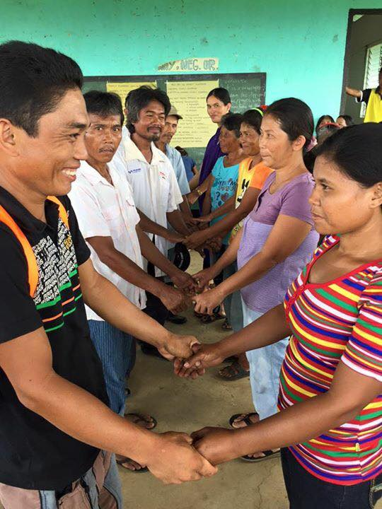
Attendance to Family Development Session is among the conditions
which should be complied by the beneficiaries for them to avail of the cash grant;
Non-attendance of grantee or representative to FDS is equivalent to P500.00 deduction of cash grant;
Couples from Brgy. Bulibulihan, Mabinay, Negros Oriental joins a special Family Development Session

Slide 35
The FDS Module
A module has been developed to guide the FDS implementers and partners in the conduct of the sessions.
CWC member- agencies, UNICEF provided support in the development of the FDS module;
Basic topics in the family development sessions include Understanding Oneself as a Person and as a Parent, Parenting Roles and Duties, Laws on Parenting, Early Childhood Care and Development, Rights and Duties of Parents and Children, Behavior Management, Health and Nutrition, and Home Management, among others.
Supplemental modules: Positive Discipline, Active Citizenship, Interventions for PWDs, Regional Modules for Indigenous Peoples;

Slide 36
Content of FDS Module
Module 1: Laying the Foundation of the CCT
Topic 1: Overview of the CCT (Pantawid Pamilya)
Topic 2: Guiding Principles of Pantawid Pamilyang Pilipino Program
Session 1: Protecting the Rights of Children
Session 2: Promoting Gender Equality and Equity
Session 3: Recognition and Respect of Indigenous Peoples Cultural Communities (IPCCs)

Slide 37
Topic 3: Recognition of Self as a Person, Part of the Family, and Beneficiary of Pantawid Pamilya
Module 2: Preparing and Nurturing the Filipino Family
Sub-Module 2.1: Preparing for Family Life
Topic 1: Equal Treatment between Husband and Wife
Session 1: Unique Qualities of Husband & Wife
Session 2: Strengthening of Husband—Wife Relationship
Topic 2: Good Relationship of Parents and Children
Session 1: Parents –Children Interaction

Slide 38
Sub-Module 2.2: Being Responsible Parents and Planning the Family
Topic 1: Starting and Building a Family
Topic 2: Caring for Pregnant Women
Topic 3: Caring for the Newborn
Topic 4: Understanding the Proper Care & Development of a Child

Slide 39
Sub-Module 2.3: Protecting the Child from Abuse, Violence and Exploitation
Topic 1: Ways to Prevent Violence, Abuse and Exploitation of Children
Topic 2: Monitoring of Children Against Violence, Abuse & Exploitation
RA 7610: Special Protection of Children Against Child Abuse , Exploitation and Discrimination;
RA 9231: Elimination of Worst Forms of Child Labor

Slide 40
Sub-Module 2.4: Promoting the Welfare of the Family
Topic 1: Home Management
Session 1: Effective Time Management
Session 2: Proper Handling of Finances
Session 3: The Importance of Savings
Session 4: Preparing Nutritious Foods for Proper Nutrition

Slide 41
Topic 2: Strengthening and Ensuring Order in the Home
Session 1: Avoiding Violence in the Home
Session 2: Avoiding Vices/ Other Threats to Family Peace
Session 3: Stress / Anger Management
Session 4: Enriching the Spiritual Life of the Family

Slide 42
Module 3: Participation of the Filipino Family in Community Development
Topic 1: The Community and I
Session 1: My Community and I
Session 2: My Dream Community
Session 3: Collective Action & Implementing Community Activities
Topic 2: Maintenance and Improvement of our Community
Session 1: Backyard /Bio-intensive Gardening (BIG)
Session 2: Indigenous Farming Practices
Session 3: Keeping the Surroundings Clean and Orderly
Topic 3: Preparing a Safe Community
Session 1: Disaster: Why is there Disaster? What can I do?
Session 2: Community Preparedness
Session 3: Are we Prepared? How Families can Prepare

Slide 43
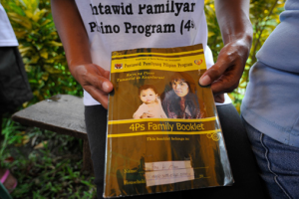
The Pantawid Pamilya Beneficiaries’ Journal or Talaarawan
Diary
Record of learning and insights on the topics discussed during the Family Development Session;

Slide 44
Social Case Management
Social Casework management practice focuses on enabling individuals and primary groups to reach their full potential and on facilitating more effective interaction with the larger social environment.
Focus of case management in Pantawid Pamilya: Non-compliant partner beneficiaries

Slide 45
Social Case Management
as a helping process
Home visit
Assessment of the problem by the Municipal/ City Links;
Intervention Planning with the Municipal Action Team or MSWDO and partner agencies;
Implementation of the intervention plan;
Monitoring, evaluation, exit, closure of case;

Slide 46
Linkage with the Local Council for the Protection of Children
June 17, 1967 – passage of R.A. 4881, An Act Creating a Council for the Protection of Children in every City and Municipality of the Philippines;
The local council for children prepares the following:
Local Dev’t Plan for Children;
Local Investment Plan for Children;
Local Code for Children;
Local State of Children Report;
Responsive Ordinances and policies for children

Slide 47
Next Step
Strengthening of DSWD partnership with the Department of Labor and Employment (DOLE), Department of Interior and Local Government (DILG), Council for the Welfare of Children (CWC) and International Labor Organization (ILO);
Capacitate field personnel of DSWD, DOLE and LGUs on provision of interventions to cases of child labor with the assistance of ILO;
Development of a supplemental module on Child Labor prevention and intervention with the assistance of ILO which can be used as reference during Family Development Sessions;

Slide 48
Summary:
CCT’s interventions to efforts for the elimination of Child Labor
Provision of Cash Grants for Education , Health and Nutrition;
Family Development Session;
Tracking of beneficiaries including child workers who were not compliant to program conditions ;
Case Management
Partnership DOLE, NGAs, LCPC including the MSWDO, CSO partners for appropriate interventions;

Slide 49
Thank you.

