Slide 1

BRICS 2016
Meeting of the Ministers of Labour and Employment
New- Delhi, 27-28 September 2016
Session1- Employment Generation
Azita Berar Awad
International Labour Organization

Slide 2
Topics for discussion
Growth and Employment in the BRICS
Enhancing Employability and Skills
Creating Employment Opportunities
Strengthening Public Employment Services

Slide 3
A1 Synchronous Growth Slowdown
BRICS, GDP Growth Rates 1998-2017
Source: All estimates are derived from IMF (2016) World Economic Outlook, April and its Update in July 2016. Figures for 2016 and 2017 are projections.

Slide 4
A2 A Tightened Labour Market Situation for the Youth
Total and Youth Unemployment Rates (Latest year available)
Source: ILOSTAT and KILM 9th edition for country-level data, ILO, Trends Econometric Models, April 2016 for regional aggregates

Slide 5
A3 Avoiding a Reversal in Employment Quality
Composition of informal employment in the BRICS, in % of total non-agricultural employment
(Latest year available)
Source: ILOSTAT and KILM 9th Edition and data on China and India from ILO, Women and men in the informal economy: a statistical picture (second edition), ILO: Geneva, 2013a

Slide 6
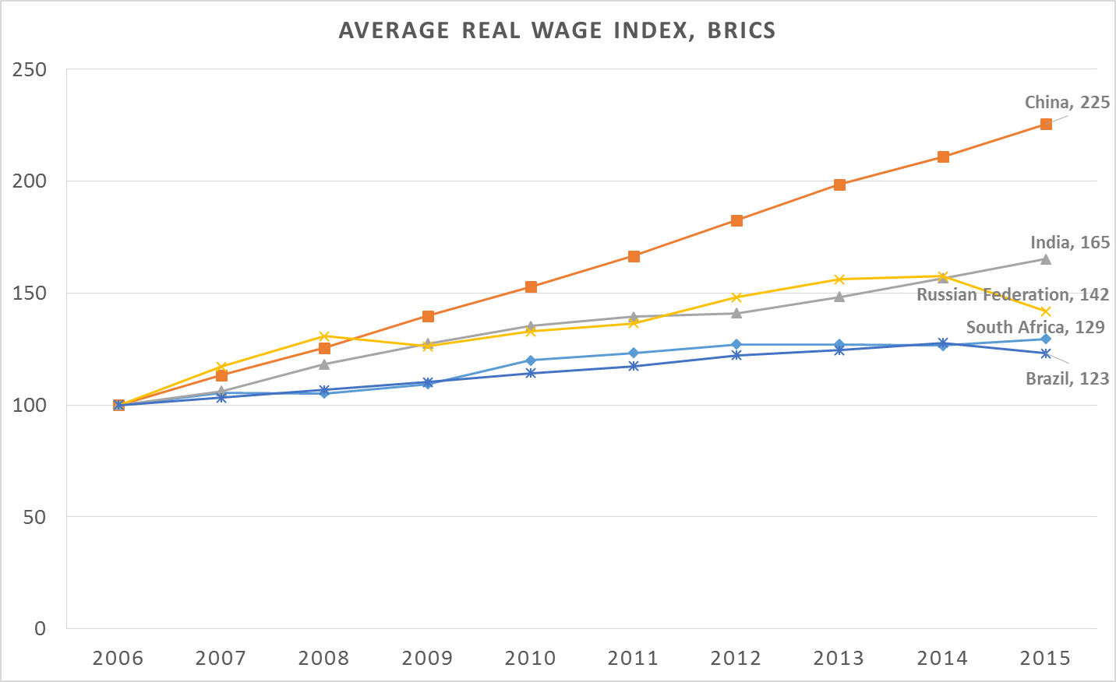
A4 Uneven Trends in Real Wages
Source: ILO estimates based on national statistics

Slide 7
A5 Premature Deindustrialization?
Source: Labour Bureau for Indian data; ILOSTAT and KILM 9th edition for country-level data, ILO, Trends Econometric Models, April 2016 for regional aggregates

Slide 8
B1 Enhancing Employability and Skills
Reform efforts should continue improve the quality and relevance of TVET and skills systems,
improve access and outreach to support the agriculture sector and engage with the informal economy;
deliver greater social equity by increasing educational attainment of women and expanding apprenticeships to target youth NEET;
invest in TVET institutions, managers and trainers to improve quality and lift the social status of programs and pathways; and
increase measures to promote innovation and productivity growth in enterprises through on-the-job training.

Slide 9
B2 Anticipating labour market needs and labour force availability
Technological and structural change drive constant change in skills needs
make TVET and skills development systems responsive to evolving industry skills needs;
anticipate future needs enabling skills development systems to keep pace with change, and share good practices in skills anticipation systems;
effective skills anticipation systems promote policy coherence between ministries ( education , labour and line ministries)
And engage employers, workers’ representatives, skills system

Slide 10
B3 Anticipating labour market needs and labour force availability – examples of good practices from BRICS
Some opportunities to learn between BRICS countries
Sectoral approaches led by industry towards achieving sectoral vision (e.g. SETAs in South Africa, SSCs linked to NSDA in India)
Technology foresight in skills needs anticipation (e.g. Russian Federation inter-ministerial collaboration)
A shared vision for the industry / economy (SENAI’s “Antenas Thematicas” in Brazil)
China State Council’s Decision to Push Ahead the Development of Modern Vocational Education

Slide 11
C 1 Employment generation: An integrated policy approach
Pro-employment macroeconomic policies and economic diversification strategies
Avoid excessive public expenditure cuts and use available fiscal space and fiscal policy : to increase well-targeted investments in infrastructure, quality public services to support aggregate demand and enhance productivity and labour market policies in particular for youth
Industrial policy, value chain upgrading and economic diversification
Promote financial exclusion for SMEs
Wage policy and social protection to stabilize economy and combat inequality and exclusion

Slide 12
C2 ALMPs in BRICS
All the BRICS implement active labour market programmes addressing women, youth, rural poor and migrants
Successful examples: public employment programmes (EPWP in South Africa, NREGA in India); labour market training (Brazil’s Estação Juventude) ; self-employment support and entrepreneurship (PROGER in Brazil, Russia’s TVET program); and youth employment subsidies (China, South Africa)
Evidence that well-designed targeted interventions enable target groups to gain foothold in the labour market: more impact assessment needed including the spillovers for the local economy
Design, implementation and monitoring matter .

Slide 13
D1 Strengthening Public Employment Services
BRICS have graduated from basic to intermediate level of PES service provision but differentiation of services remains low and individualised services are rare.
The market penetration rates remain very low
In all countries, the use of e-services has been adopted
Only Brazil and India have ratified the Employment Services Convention, 1988 (No.88).

Slide 14
D2. Public Employment Services –current challenges
the capacity for the provision of a full range of services and outreach to vulnerable groups
ensuring policy coherence, coordination and service integration
Finding sustainable means of financing PES and ALMPs
Promoting partnerships and ensure decent work through progressive regulation of private employment agencies

Slide 15
D3 Policy coherence , coordination and service integration
PES and ALMPs are part of a comprehensive employment policy framework and must operate in synergy with broader macroeconomic and sectoral policies;
China has a highly coordinated system, in other countries more deliberate efforts are required to strengthen policy coherence at macro, sectoral and labour market levels.
Coordination and integration are also needed to avoid fragmentation and duplication of service provision.

Slide 16
D4 Sustainable funding
A sustainable financing system is vital for PES (and ALMPs) to be effective.
Experience in BRICS vary from state funding at the central level in South Africa to local funding in India to multiple funding in China,Brazil and Russia

Slide 17
D5 Public-Private Partnerships
Partnerships can be necessary in order to expand the outreach of employment services
All BRICS cooperate to different extent, with private and non profit providers at national and local levels. China has the largest share of global staffing industry revenue(23%) followed by Brazil (7%) (CIETT, 2015)
The role of private employment providers - esp. temporary agency work - remains a sensitive issue. Efforts are underway in all BRICS to develop appropriate legal systems
None of the BRICS countries have ratified the Private Employment Agencies Convention, 1977 (No. 181)
Social dialogue should be promoted to adopt a balanced system

Slide 18
Summary: innovative policies for sustaining employment and growth
In the context of economic slowdown : innovative policies including anti-cyclical measures, as well as long term measures addressing structural changes and economic diversification can help maintain achievements and improve labour market outcomes including through:
Pro-employment macroeconomic policies to sustain demand and enhance productivity
Strategies to support private sector productive investment and facilitate transition to formality;
Well-designed and targeted active labour market policies for employability, skills development and entrepreneurship especially for women and youth;
Stronger employment policy support systems eg employment services systems

Slide 19
BRICS 2016
Meeting of the Ministers of Labour and Employment of BRICS countries
27-28 September 2016
Thank You
Azita BerarAwad
Director, Employment Policy
International Labour Organization

