Slide 1
Decent Work Indicators in the SDGs Global Indicator Framework
ILO Department of Statistics &
ILO Regional Office for Asia and the Pacific

Slide 2
Content
Introduction
Monitoring and reporting
Decent Work Agenda in the SDGs
Indicators where ILO is the custodian (13)
Indicators where the ILO is involved (3)
Other SDGs Indicators relevant to DW (14)
UN main documentation on SDGs indicators:
http://unstats.un.org/sdgs/ .

Slide 3
Introduction (1)
Agreement on a global indicator framework for monitoring progress towards achieving SDGs reached on 11 March 2016
Framework proposed by the Inter-Agency and Expert Group on SDG indicators (IAEG-SDGs) to the UN Statistical Commission, hosted by the Statistics Division of the UNDESA
Has been endorsed by the UN Economic and Social Council (ECOSOC, June 2016)
Proposed for future adoption by the UN General Assembly.

Slide 4
Introduction (2)
Issues of data disaggregation (Leaving no one behind):
Sustainable Development Goal indicators should be disaggregated, where relevant, by income, sex, age, race, ethnicity, migratory status, disability and geographic location, or other characteristics, in accordance with the Fundamental Principles of Official Statistics.
(Report of the IAEG-SDGs on SDGs Indicators, Para. 26).

Slide 5
Monitoring and Reporting
National, regional and global level
High-level political forum (HLPF) has been formed, which will be informed by an annual progress report on the SDGs prepared in cooperation with the UN system, based on the global indicator framework
The forum will have the central role in overseeing follow-up and review
It will also conduct national reviews: started with 22 in July 2016, which are voluntary and driven by countries
Regional UN commissions to contribute to the regional reviews.

Slide 6
Decent Work Agenda in SDGs (1)
Decent Work Agenda has a specific Goal 8 on Decent work and economic growth (Promote inclusive and sustainable economic growth, employment and decent work for all);
BUT NOT ONLY IN GOAL 8
Also enshrined in some other 7 SDGs Goals such as Goal 1 (No Poverty), Goal 4 (Quality Education), Goal 5 (Gender Equality), Goal 9 (Industry, Innovation and Infrastructure), Goal 10 (Reduced Inequalities), Goal 14 (Life Below Water), and Goal 16 (Peace and Justice).

Slide 7
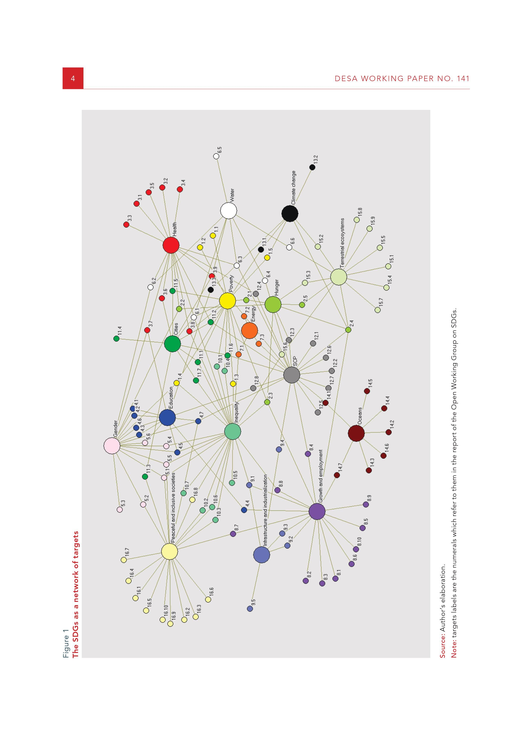
A NETWORK OF GOALS
Source: Le Blanc, D.: Towards integration at last? The sustainable development goals as a network of targets (UN DESA, 2015).
Notes:
The SDGs goals and targets can be seen as a network, in which links among goals exist through targets that refer to multiple goals. True even if the links among goals may not all be explicitly reflected in the SDGs.
The highest connected Goals to others are: 12 (SCP, linked to 14 Goals), 10 (Inequalities, 12 Goals), 1 (Poverty, 10 Goals), and 8 (DW & Growth, 10 Goals); Le Blanc, p.6.

Slide 8
Decent Work Agenda in SDGs (2)
Many of the SDGs connect to the ILO’s mandate and the four pillars of the Decent Work Agenda…
  Social protection, including national floors, is a target (1.3) for action under the poverty goal and is mentioned together with wage and fiscal policies as an important means of reducing inequality (10.4). In addition, the targets on eradication of extreme poverty (1.1) and reduction of poverty (1.2) will require ILO engagement and follow up.
  Technical and vocational skills are the topic of three targets under the education goal (4.3, 4.4 and 4.5).”
  (GB.325/INS/6, Paragraph 10).
Notes:
Decent Work is central to the new global development paradigm.
Centrality of ILO’s mandate recognized in Goal 8 “Promote sustainable, inclusive and sustainable economic growth, full and productive employment, and decent work for all” but reflected under a number of other goals.
The recent UNDP’s Human Development Report 2015 highlighted again the fact that work is, and has been identified as a major building block of sustainable development.

Slide 9
Decent Work Agenda in SDGs (3)
Many of the SDGs connect to the ILO’s mandate and the four pillars of the Decent Work Agenda…
  Other references: rural workers (2.3); unpaid care and domestic work (5.4); migrant workers (10.7); industrial employment (9.2); SMEs and value chains (9.3); shocks and disasters (13.1); international law/standards on oceans and water conservation (14.c); rule of law (16.3); transparent institutions (16.6); and fundamental freedoms (16.10); etc.
  (GB.325/INS/6, Paragraph 10).
Notes:
Decent Work is central to the new global development paradigm.
Centrality of ILO’s mandate recognized in Goal 8 “Promote sustainable, inclusive and sustainable economic growth, full and productive employment, and decent work for all” but reflected under a number of other goals.
The recent UNDP’s Human Development Report 2015 highlighted again the fact that work is, and has been identified as a major building block of sustainable development.
Therefore we have a specific goal, or WE THINK WE HAVE a goal on decent work, i.e. Goal 8!

Slide 10
Decent Work Agenda in SDGs (4)
The current proposal on the Global Indicators Framework for monitoring progress towards achieving SDGs, as recently agreed by the UN Statistical Commission during its 47th Session in New York (11th March), includes some 30 decent work related SDGs indicators (in a total of about 252), spread into many of the 169 Targets;
The 3rd Meeting of the IAEG-SDGs (30 March to 1 April 2016 in Mexico City) has proposed ILO as the custodian for 13 SDGs indicators. Plus 3 other indicators where ILO will be involved.

Slide 11
Indicators where ILO is custodian
Goal 1. End poverty in all its forms everywhere
Target | Indicator
1.3 Implement nationally appropriate social protection systems and measures for all, including floors, and by 2030 achieve substantial coverage of the poor and the vulnerable | 1.3.1 Proportion of population covered by social protection floors/systems, by sex, distinguishing children, unemployed persons, older persons, persons with disabilities, pregnant women, new-borns, work-injury victims and the poor and the vulnerable (Tier I) (Plus the additional disaggregation related to leaving no one behind, ref. slide 4)
1

Slide 12
Indicators where ILO is custodian
Goal 5. Achieve gender equality and empower all women and girls
Target | Indicator
5.5 Ensure women’s full and effective participation and equal opportunities for leadership at all levels of decision-making in political, economic and public life | 5.5.2 Proportion of women in managerial positions (Tier I)
2

Slide 13
Indicators where ILO is custodian
Goal 8. Promote sustained, inclusive and sustainable economic growth, full and productive employment and decent work for all
Target | Indicator
8.2 Achieve higher levels of economic productivity through diversification, technological upgrading and innovation, including through a focus on high-value added and labour-intensive sectors | 8.2.1 Annual growth rate of real GDP per employed person (Tier I)
8.3 Promote development-oriented policies that support productive activities, decent job creation, entrepreneurship, creativity and innovation, and encourage the formalization and growth of micro-, small- and medium-sized enterprises, including through access to financial services | 8.3.1 Proportion of informal employment in non‑agriculture employment, by sex (Tier II)
3
4

Slide 14
Indicators where ILO is custodian
Target | Indicator
8.5 By 2030, achieve full and productive employment and decent work for all women and men, including for young people and persons with disabilities, and equal pay for work of equal value | 8.5.1 Average hourly earnings of female and male employees, by occupation, age and persons with disabilities (Tier II)
 | 8.5.2 Unemployment rate, by sex, age and persons with disabilities (Tier I)
8.6 By 2020, substantially reduce the proportion of youth not in employment, education or training | 8.6.1 Proportion of youth (aged 15-24 years) not in education, employment or training (Tier I)
5
6
7

Slide 15
Indicators where ILO is custodian
Target | Indicator
8.7 Take immediate and effective measures to eradicate forced labour, end modern slavery and human trafficking and secure the prohibition and elimination of the worst forms of child labour, including recruitment and use of child soldiers, and by 2025 end child labour in all its forms | 8.7.1 Proportion and number of children aged 5‑17 years engaged in child labour, by sex and age (Tier I, ILO with UNICEF)
8.8 Protect labour rights and promote safe and secure working environments for all workers, including migrant workers, in particular women migrants, and those in precarious employment | 8.8.1 Frequency rates of fatal and non-fatal occupational injuries, by sex and migrant status (Tier I)
 | 8.8.2 Increase in national compliance of labour rights (freedom of association and collective bargaining) based on International Labour Organization (ILO) textual sources and national legislation, by sex and migrant status (Tier I)
8
9
10

Slide 16
Indicators where ILO is custodian
Target | Indicator
8.b By 2020, develop and operationalize a global strategy for youth employment and implement the Global Jobs Pact of the International Labour Organization | 8.b.1 Total government spending in social protection and employment programmes as a proportion of the national budgets and GDP (Tier III)
11

Slide 17
Indicators where ILO is custodian
Goal 10. Reduce inequality within and among countries
Target | Indicator
10.4 Adopt policies, especially fiscal, wage and social protection policies, and progressively achieve greater equality | 10.4.1 Labour share of GDP, comprising wages and social protection transfers (Tier I)
10.7 Facilitate orderly, safe, regular and responsible migration and mobility of people, including through the implementation of planned and well-managed migration policies | 10.7.1 Recruitment cost borne by employee as a proportion of yearly income earned in country of destination (Tier III, ILO with the WB)
12
13

Slide 18
Indicators where the ILO is involved
Goal | Target | Indicator
Goal 1. End poverty in all its forms everywhere | 1.1 By 2030, eradicate extreme poverty for all people everywhere, currently measured as people living on less than $1.25 a day | 1.1.1 Proportion of population below the international poverty line, by sex, age, employment status and geographical location (urban/rural) (Tier I)
 | 1.a Ensure significant mobilization of resources from a variety of sources, including through enhanced development cooperation, in order to provide adequate and predictable means for developing countries, in particular least developed countries, to implement programmes and policies to end poverty in all its dimensions | 1.a.2 Proportion of total government spending on essential services (education, health and social protection) (Tier III)
1
2

Slide 19
Indicators where the ILO is involved
Goal | Target | Indicator
Goal 16. Promote peaceful and inclusive societies for sustainable development, provide access to justice for all and build effective, accountable and inclusive institutions at all levels | 16.10 Ensure public access to information and protect fundamental freedoms, in accordance with national legislation and international agreements | 16.10.1 Number of verified cases of killing, kidnapping, enforced disappearance, arbitrary detention and torture of journalists, associated media personnel, trade unionists and human rights advocates in the previous 12 months (Tier III)
3

Slide 20
Other Indicators relevant for DW
Goal | Target | Indicator
Goal 1. End poverty in all its forms everywhere | 1.a Ensure significant mobilization of resources from a variety of sources, including through enhanced development cooperation, in order to provide adequate and predictable means for developing countries, in particular least developed countries, to implement programmes and policies to end poverty in all its dimensions | 1.a.1 Proportion of resources allocated by the government directly to poverty reduction programmes
Goal 2. End hunger, achieve food security and improved nutrition and promote sustainable agriculture | 2.3 By 2030, double the agricultural productivity and incomes of small-scale food producers, in particular women, indigenous peoples, family farmers, pastoralists and fishers, including through secure and equal access to land, other productive resources and inputs, knowledge, financial services, markets and opportunities for value addition and non-farm employment | 2.3.1 Volume of production per labour unit by classes of farming/pastoral/forestry enterprise size
 |  | 2.3.2 Average income of small-scale food producers, by sex and indigenous status
1
2
3

Slide 21
Other Indicators relevant for DW
Goal | Target | Indicator
Goal 3. Ensure healthy lives and promote well-being for all at all ages | 3.c Substantially increase health financing and the recruitment, development, training and retention of the health workforce in developing countries, especially in least developed countries and small island developing States | 3.c.1 Health worker density and distribution
Goal 4. Ensure inclusive and equitable quality education and promote lifelong learning opportunities for all | 4.3 By 2030, ensure equal access for all women and men to affordable and quality technical, vocational and tertiary education, including university | 4.3.1 Participation rate of youth and adults in formal and non-formal education and training in the previous 12 months, by sex
 | 4.4 By 2030, substantially increase the number of youth and adults who have relevant skills, including technical and vocational skills, for employment, decent jobs and entrepreneurship | 4.4.1 Proportion of youth and adults with information and communications technology (ICT) skills, by type of skill
 | 4.5 By 2030, eliminate gender disparities in education and ensure equal access to all levels of education and vocational training for the vulnerable, including persons with disabilities, indigenous peoples and children in vulnerable situations | 4.5.1 Parity indices (female/male, rural/urban, bottom/top wealth quintile and others such as disability status, indigenous peoples and conflict-affected, as data become available) for all education indicators on this list that can be disaggregated
4
5
6
7

Slide 22
Other Indicators relevant for DW
Goal | Target | Indicator
Goal 5. Achieve gender equality and empower all women and girls | 5.4 Recognize and value unpaid care and domestic work through the provision of public services, infrastructure and social protection policies and the promotion of shared responsibility within the household and the family as nationally appropriate | 5.4.1 Proportion of time spent on unpaid domestic and care work, by sex, age and location
Goal 8. Promote sustained, inclusive and sustainable economic growth, full and productive employment and decent work for all | 8.9 By 2030, devise and implement policies to promote sustainable tourism that creates jobs and promotes local culture and products | 8.9.2 Number of jobs in tourism industries as a proportion of total jobs and growth rate of jobs, by sex
8
9

Slide 23
Other Indicators relevant for DW
Goal | Target | Indicator
Goal 9. Build resilient infrastructure, promote inclusive and sustainable industrialization and foster innovation | 9.2 Promote inclusive and sustainable industrialization and, by 2030, significantly raise industry’s share of employment and gross domestic product, in line with national circumstances, and double its share in least developed countries | 9.2.2 Manufacturing employment as a proportion of total employment
 | 9.3 Increase the access of small-scale industrial and other enterprises, in particular in developing countries, to financial services, including affordable credit, and their integration into value chains and markets | 9.3.1 Proportion of small-scale industries in total industry value added
 |  | 9.3.2 Proportion of small-scale industries with a loan or line of credit
10
11
12

Slide 24
Other Indicators relevant for DW
Goal | Target | Indicator
Goal 10. Reduce inequality within and among countries | 10.c By 2030, reduce to less than 3 per cent the transaction costs of migrant remittances and eliminate remittance corridors with costs higher than 5 per cent | 10.c.1 Remittance costs as a proportion of the amount remitted
Goal 16. Promote peaceful and inclusive societies for sustainable development, provide access to justice for all and build effective, accountable and inclusive institutions at all levels | 16.2 End abuse, exploitation, trafficking and all forms of violence against and torture of children | 16.2.2 Number of victims of human trafficking per 100,000 population, by sex, age and form of exploitation
13
14

Slide 25
Target and indicators on Data
Goal | Target | Indicator
Goal 17. Strengthen the means of implementation and revitalize the Global Partnership for Sustainable Development | 17.18 By 2020, enhance capacity-building support to developing countries, including for least developed countries and small island developing States, to increase significantly the availability of high-quality, timely and reliable data disaggregated by income, gender, age, race, ethnicity, migratory status, disability, geographic location and other characteristics relevant in national contexts | 17.18.1 Proportion of sustainable development indicators produced at the national level with full disaggregation when relevant to the target, in accordance with the Fundamental Principles of Official Statistics
 |  | 17.18.2 Number of countries that have national statistical legislation that complies with the Fundamental Principles of Official Statistics
 |  | 17.18.3 Number of countries with a national statistical plan that is fully funded and under implementation, by source of funding

Slide 26
Implications on decent work data
Decent work results framework (DWCP M&E to include clear results reflecting ILO and constituents valuable contribution to SDGs);
Filling the data gaps (19th ICLS implementation, other data gaps: IE, CL, OSH, migration, etc.);
Capacity building (involving all ILO constituents and other relevant stakeholders);
Resources;
Revised indicators in the ILO DWI framework.

