Slide 1
Highlights of the 19th ICLS
“Resolution concerning statistics of work, employment and labour underutilization”

Slide 2
(i). A Framework for work statistics
Activities
Productive activities
Market units
Incorporated, unincorporated
Goods
Non-market units
Government, Non-profit institutions
Services
Households
producing for own final use
Goods
Non-productive
activities
Services
Goods
Self-care
Sleeping
Learning
Own-recreation
Begging
Stealing
Services
Included
Previous activity scope for “employment”
New concept of “Work” == ALL productive activities
General production boundary
SNA production boundary

Slide 3
(ii). Forms of work & basic concepts
Own-use production work
  Activities to produce goods & services mainly for own final use by household
Employment work
  Activities to produce goods & services [for others in exchange] for pay or profit
Unpaid trainee work
  Activities to produce goods & services for others performed without pay in order to acquire workplace experience or skills
Volunteer work
  Non-compulsory activities performed without pay to produce goods and services for others
Other work activities
  E.g. Compulsory activities performed without pay to produce goods & services for others

Slide 4
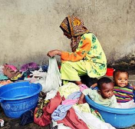
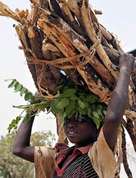
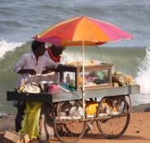
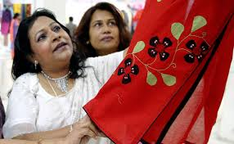
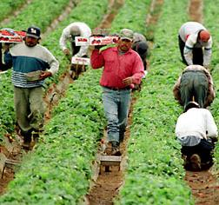
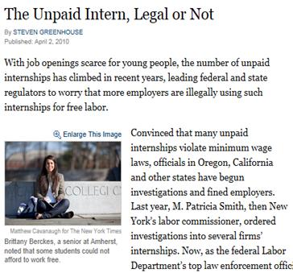
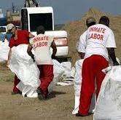

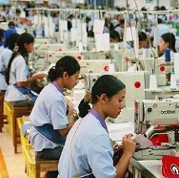
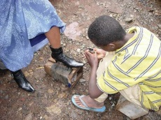
(iii). Form of work: Employment
(by main intended destination & transaction type)
Work
(i.e. ALL activities to produce goods and services)
For own final use
(by households)
For use by others (i.e. other units)
For remuneration (i.e. for pay or profit)
Without remuneration
Unpaid trainee work
Other work activities (e.g. unpaid compulsory work)
Volunteer work
Own-use production work
Employment
(work for pay or profit)
Reference concept for Labour Force statistics
Services
Goods
Services
Goods
S
G
S
G
G
S
SNA labour input

Slide 5
Persons in employment
Operational definition -19th ICLS (§ 27-32)
* Two groups:
  Employed, at work: Worked for pay or profit for at least 1 hour
  Employed, not at work:
    Worked already in the job, but not at work due to:
      Working time arrangement (shift work, flexitime)
      Temporary absence (expects to return within short period)
      * New guidance to establish main intended destination of activity:
      For sale versus for own final use (only or mainly).
Working age persons who in the reference week / last 7 days were engaged in any activity to produce goods or provide services for pay or profit

Slide 6
Employment & unemployment statistics as per previous standards....
Above minimum age ... :
ALL OTHERS, whether or not:
ALL who work for pay
-Provide services for own final use
ALL who work for profit
-Volunteer providing services for households
ALL who produce goods for
own final use
“Not employed”
ALL who work for training
ALL who volunteer for organizations
Who volunteer to produce goods for households
Seeking work AND / OR available for work
Yes
No
Employed
Unemployed
Inactive
Currently active pop. (employed + unemployed)

Slide 7
Employment & Unemployment as per the NEW standards
ALL OTHERS > age, whether or not:
Above minimum age ... :
-Provide services for own final use
-Volunteer providing services for households
ALL who work for pay
-Work unpaid for training
ALL who work for profit
- Employers
- Own account workers in market units
- Contributing family workers
- Members of market producer cooperatives
-Produce goods for own final use
-Volunteer through / for organizations
Volunteer producing goods for households
“Not employed” (for pay/profit)
Seeking AND available for work for pay/profit
Yes
No
Persons in employment
(work for pay / profit)
Unemployed
Outside the labour force
Labour force
Underutilized labour
(with unmet need for employment, for pay/profit)

Slide 8
250
Working Age Population (WAP)
Employed
Employed
Not employed
In paid employment
Producers of goods
for own final use
100
14
Volunteer workers
Self-employed in market units
5
Unpaid trainee workers
30
1
100
Unemployed
Outside
labour force
Unemployed
Outside
labour force
5
15
20
80
 | 13th ICLS (1982)
Employed | 150 | 60.0%
Unemployed | 20 | 11.8%
Labour force | 170 | 68.0%
Outside labour force | 80 | 32.0%
NEW 19th ICLS (2013) |  | Change
130 | 52.0% | ↓
25 | 16.1% | ↑
155 | 62.0% | ↓
95 | 38.0% | ↑
Notes:
The new definition of employment will therefore affect mostly countries with high levels of producers of goods for own final use, that were previously included in employment; and countries with strong employment training programmes that were previously included in employment.

Slide 9
(iv). Labour underutilization:
Improved labour market monitoring across contexts
Working age population
Labour force
Employed
Unemployed
Outside the labour force
Time-related underemployed
Potential
Labour Force
- seeking, not available
- available, not seeking
Want employment
but not seeking,
not available
Do not want employment
Labour underutilization
(unmet need for employment)

Slide 10
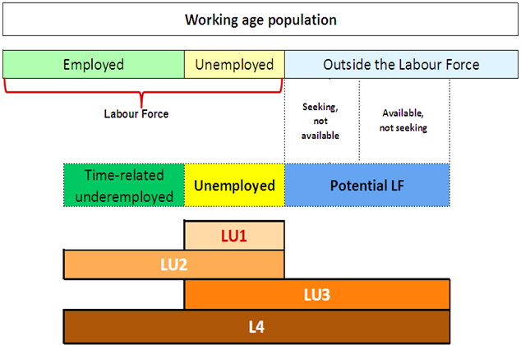
NEW Measures of labour underutilization (LU1-LU4)
LU4

Slide 11

Measures of unpaid work:
Persons and hours of work
Work
(i.e. ALL activities to produce goods and services)
For own final use
(by households)
For use by others (i.e. other units)
For remuneration (i.e. for pay or profit)
Without remuneration
Unpaid trainee work
Other work activities (e.g. unpaid compulsory work)
Volunteer work
Own-use production work
Employment
(work for pay or profit)
Unpaid domestic and care work
Services
Goods
Services
Goods
S
G
S
G
G
S
Notes:
Yellow dotted groups: persons in employment and at the same time involved in other unpaid forms of work; important to know time spent on these as well (hours of work).

