Slide 1

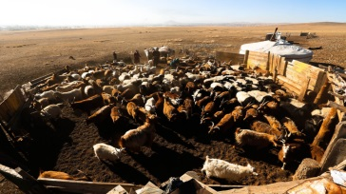
Selected SDG/DW Indicators: Definitions and Methods
Consultation workshop on SDGs and DWIs
Ulaanbaatar, Mongolia| 5 – 6 October 2016

Slide 2

Overview and objectives
Introduction: What do we want to know?
Selected SDG indicators: Understanding the basics
Other DW indicators
Accessing online information resources

Slide 3
Introduction: What do we want to know?
Selected SDG indicators: Understanding the basics
Other DW indicators
Accessing online information resources

Slide 4
What do we want to know?
How is the labour market responding to economic conditions?
How is the labour market adjusting to demographic pressures?
What is the quantity of employment?
What is the quality of employment?
Are we making progress in the labour market?
Are there population groups that are facing difficulties?
What should be priorities for addressing labour market gaps?

Slide 5
Introduction: What do we want to know?
Selected SDG indicators: Understanding the basics
Interpretation examples: What do the numbers tell us?
Accessing online information resources

Slide 6
Social protection coverage (DWI/SDG1)
Definition – ‘social protection’: Social protection includes a broad variety of policy instruments, including social insurance, employment guarantees, social assistance, universal benefits and other forms of cash transfers.
Major areas of social protection:
  Medical care, sickness
  Unemployment
  Old age
  Employment injury
  Family
  Maternity
  Invalidity, survivors

Slide 7
Social protection coverage (DWI/SDG1)
Definition – ‘coverage’: It is useful to measure the effective coverage (in relation to the legal coverage). In aggregate, % of population receiving benefits/services in total legally entitled population. For a given social protection measure, % of population affected by the contingency (e.g. unemployment, old age, sickness, injury, maternity) who actually receives benefits or services.
Interpretation guidelines
  Need to be clear on what the social protection system is in a country.
  Need to be clear on who is entitled – universal benefits is for all population
  Measures the extent to which laws on social protection is implemented.
  To measure the adequacy of coverage, need more information on the level of effective coverage (in relation to average incomes/earnings, minimum wages, poverty lines).

Slide 8
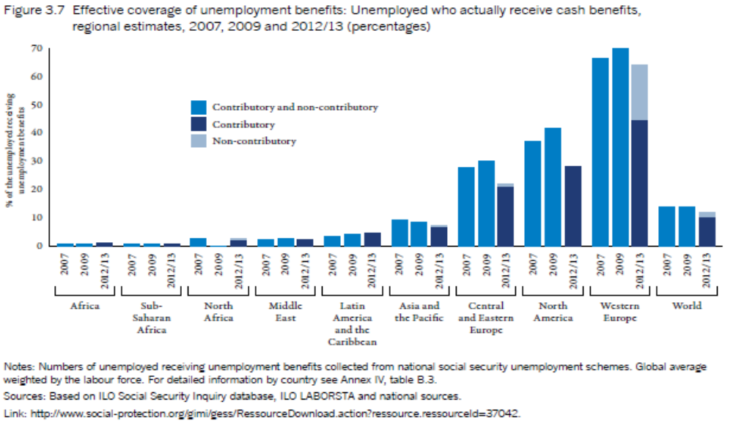
Social protection coverage (DWI/SDG1)
Example: Unemployment benefits
Notes:
World Social Protection Report 2014/15

Slide 9
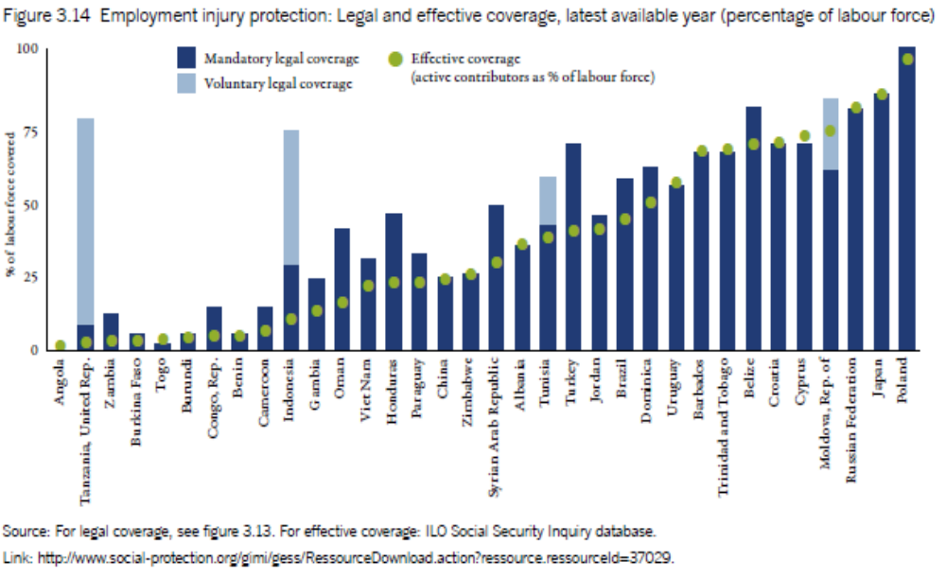
Social protection coverage (DWI/SDG1)
Example: Employment injury protection
Notes:
World Social Protection Report 2014/15

Slide 10
Women in managerial positions (SDG5)
Definition: Employed women in ‘managerial’ occupations as % of all employed in the same group of occupations.
Definition – ‘managerial’: ISCO-08 major group 1 (Managers).
Interpretation guidelines
  Increases in share of women may reflect more equal opportunities for leadership
  Useful to disaggregate and monitor a trend – some managerial occupations may be historically female-dominated (e.g. some services)
  Does not fully capture occupational segregation in the labour market
  It may be useful to look at female shares in all occupations (including high-skilled – ISCO-08 major groups 2 + 3).

Slide 11
Women in managerial positions (SDG5)
Example: Thailand (ILO estimates)

Slide 12
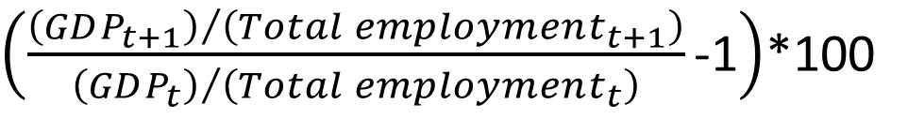
Labour productivity growth (DWI/SDG8)
Definition: Annual(ized) growth of gross domestic product per employed person
Interpretation guidelines
  Reflects the role of labour input in terms of GDP growth
  Some growth rates capturing initial low base in the level of LP
  Does not reflect contribution of other inputs (capital, technology, etc.)
  Can signal the quality of employment at a macro-level
  Higher LP associated with better wages and working conditions
  Shaped by economic structure (low LP in agriculture)
  Look at economic sub-sectors (agriculture, industry, services)
$\left(\frac{{\left(GDP_{t+1}\right)}/{\left(Total employment_{t+1}\right)}}{{\left(GDP_{t}\right)}/{\left(Total employment_{t}\right)}}\text{-1}\right)$*100

Slide 13
Labour productivity growth (DWI/SDG8)
Example: Selected higher middle-income countries in AP – signs of slowdown

Slide 14
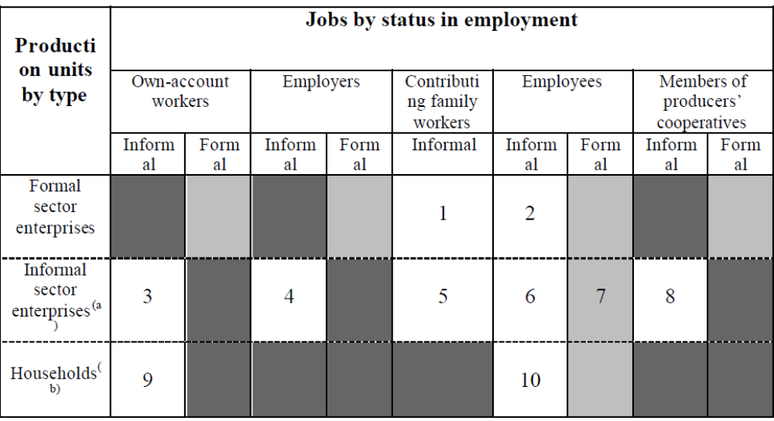
Informal employment (DWI/SDG)
Definition (2003, 17th ICLS): Conceptual framework

Slide 15
Informal employment (DWI/SDG)
Definition (2003, 17th ICLS): Job-based concept and includes:
  Own-account workers in informal sector enterprises
  Employers of informal sector enterprises
  Contributing family workers whether formal/informal enterprises
  Members of informal producers’ cooperatives
  Employees holding informal jobs whether formal/informal enterprises
  Paid domestic workers employed by households
  Own-account workers producing exclusively for own final HH use

Slide 16
Informal employment (DWI/SDG)
Definition (v): Informal jobs
  Employment relationship (in law or in practice) not subject to:
    National labour legislation
    Income tax
    Social protection
    Entitlement to some employment benefits (severance pay, paid leave, etc.)
Interpretation guidelines:
  Capture persons lacking basic social or legal protections
  How ‘strict’ should the definition be: what kind of entitlements, protection, legislation?
  Useful to examine different categories of informal employment (including disaggregation by informal/formal sectors)

Slide 17
Informal employment (DWI/SDG)
Example: ILO STATISTICS, selected countries in Asia

Slide 18
Unemployment rate (SDG8)
Definition: Unemployed as % of labour force
Interpretation guidelines
  Signals labour underutilization where unemployment is an option
  Does not reflect the quality of employment
  Shaped by economic structure/demand and the supply of labour
  Progress measured by achieving acceptably low levels
  Useful to examine together with labour force participation rate
  Short-term trends can be relatively volatile
  Duration matters
  Look at sub-groups (youth/adults, female/male, education level, regions)

Slide 19
Unemployment rate (SDG8)
Example: Quarterly fluctuations (usually peaks around Q1-Q2, but in recent years, also in Q3)

Slide 20
Youth NEET (DWI/SDG8)
Definition: % of youth who are not in employment and not in education or training
Definition – youth: Internationally recommended: 15-24 year olds
Interpretation guidelines
  Captures ‘discouraged’ youth and difficulties in accessing education & training and for new LM entrants to obtain employment
  Excludes youth in informal education
  Excludes employer-based training
  Further analysis to design ‘activation’ measures of youth
Unemployed + Out-of-school inactive youth
Youth population
NEET (%)
100

Slide 21
Youth NEET (DWI/SDG8)
Example: KILM 9th edition, table 10c

Slide 22
Average hourly earnings (DWI/SDG8)
Total earnings (i.e. regular remuneration received from employers) in cash and in kind, including:
  Direct wages and salaries for time worked (including overtime) or work done (including piece-rate and sales commissions)
  Remuneration for time not worked (e.g. paid annual leave)
  Bonuses and gratuities
Should be reported gross, not net:
  Before deduction of taxes and mandatory social security contributions
  Exclude employers’ contributions to social security and pension schemes
  Excludes severance and termination pay
Covers paid employees in employment relationship with an employer

Slide 23
Average hourly earnings (DWI/SDG8)
Definition: Arithmetic mean of total monthly earnings (divided by total hours worked per month) for employees for all jobs
Disaggregation: Male/female, occupation, age, specific target groups
Data sources: LFS or establishment surveys
Interpretation guidelines
  Can signal the quality and conditions of employment
  Higher wages associated with more productive and higher skilled jobs
  Shaped by economic structure (low wages in agriculture)
  Progress measured by achieving higher average real wages (applying consumer price index)
  Look at disparities (female/male, industry, education)
  Inform wage setting & collective bargaining process
  Difficulties in estimating hourly earnings (insufficient information)

Slide 24
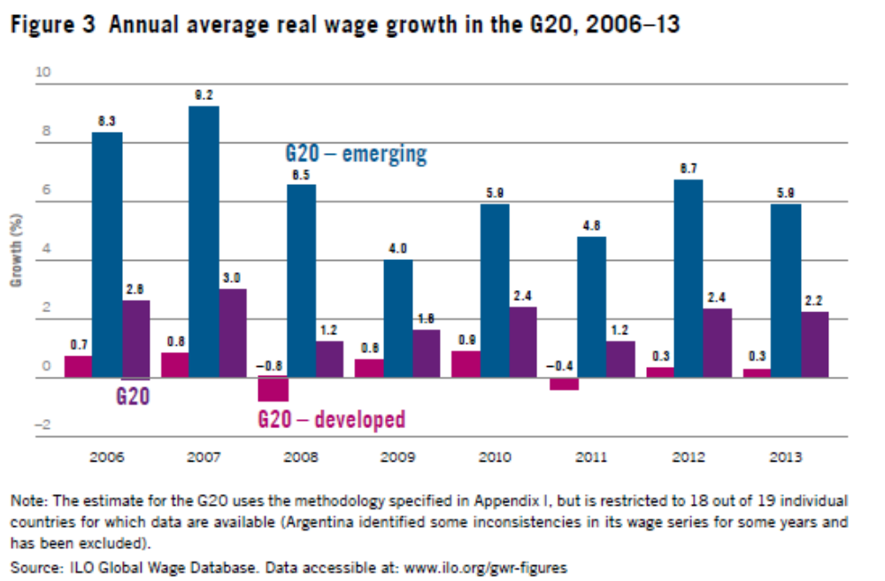
Average hourly earnings (DWI/SDG8)
Example: Growth in average (monthly) earnings
Notes:
GWR 2014/15

Slide 25
Child labour (DWI/SDG)
Definition: Child labour is children aged 5-17 years old in prohibited work and type of work that should be eliminated
Age (5-17) | Worst form of CL (hazardous + other) | Normal work | Light work
5-11 | CL | CL | CL
12-14 | CL | CL
15-17 | CL
# of CL (5-17)
100
Total # of children (5-17)

Slide 26
Child labour (DWI/SDG)
Interpretation guidelines
  Consistency with national legislation:
    Hazardous occupations/industries
    Legal minimum age of employment
  Life-long implications for future employment/income prospects
  Household-level characteristics matter (education of parents, parents’ income, etc.)
  Requires good analysis/understanding of why children work

Slide 27
Child labour (DWI/SDG)
Example: Cambodia – CLS + LFS (2012)

Slide 28
Fatal and non-fatal occupational injuries (DWI/SDG8)
Definition - incidence: # of new cases of fatal/non-fatal occupational injury as % of total # of workers in reference group during the reference year
Definition – fatal: leading to death within 1 year of the day of the occupational accident
Interpretation guidelines
  Serious & potentially long-lasting risks and income losses for workers
  Productivity losses for employers
  Less means progress, but often, data limitations
  Analysis needed for effective preventive measures
# of new cases of occupational injuries
100,000
Total # of workers in the reference group during the reference period

Slide 29
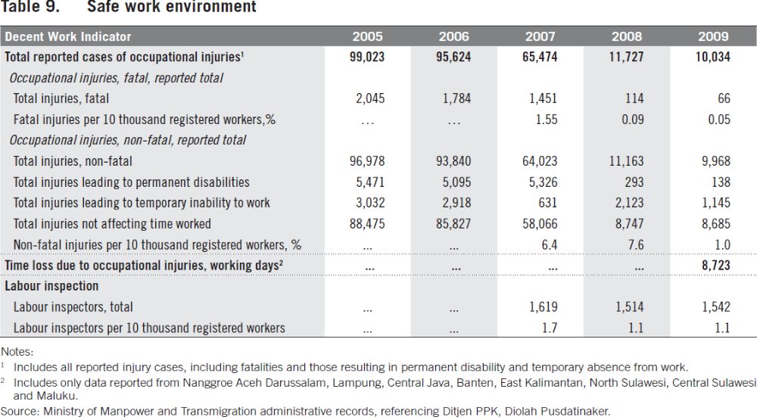
Fatal and non-fatal occupational injuries (DWI/SDG)
Example: DW country profile – Indonesia

Slide 30
Labour share of GDP (DWI/SDG)
Definition: Ratio of total compensation of employees to GDP
Definition: Total compensation of employees includes:
  Wages & salaries (in cash or in kind)
  Social insurance contributions by employers
Data sources: National accounts
Interpretation guidelines
  Captures distribution of national income between labour & capital
  Underestimates the % of gross value added accrued to labour (excludes self-employment pay/contributions)
  To be analyzed together by labour productivity growth & incidence of wage & salaried employment
  Concern – declining in many developed and emerging economies

Slide 31
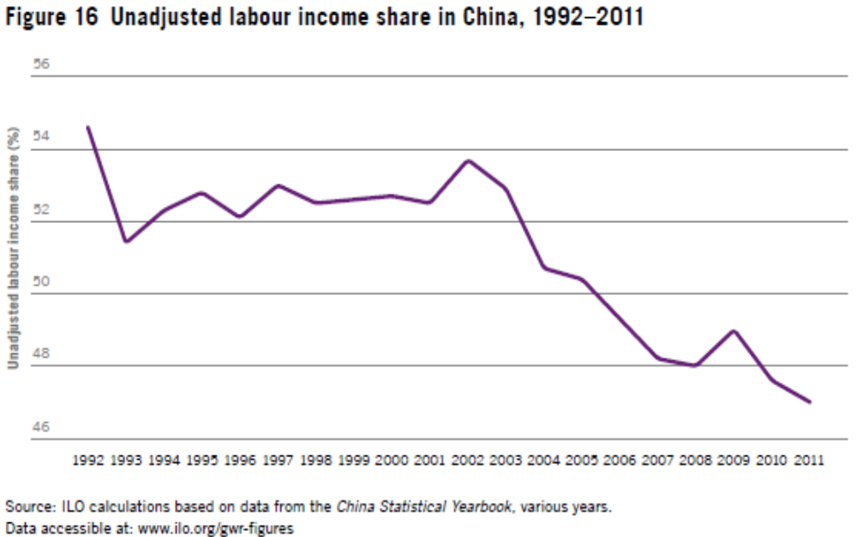
Labour share of GDP (DWI/SDG)
Example: China
Notes:
GWR 2014/15.

Slide 32
Employment disaggregation (DWI/SDG9)
A disaggregated trend examination of employment/earnings by occupation, status & industry, further disaggregated by sex, age, education & other socio-demographic attributes always provides a good first-stage analysis of LM developments
Some of the DWI/SDG indicators highlights specific types of disaggregation

Slide 33
Introduction: What do we want to know?
Selected SDG indicators: Understanding the basics
Other DW indicators
Accessing online information resources

Slide 34
Other DW indicators
They capture 10 substantive elements of decent work (DW) + economic and social context for DW
 | Substantive elements | Statistical | Legal
C | Economic and social context for DW | 12 | 1
1 | Employment opportunities (1+2) | 11 (4M) | 2
2 | Adequate earnings and productive work (1+3) | 7 (2M) | 1
3 | Decent working time (1+3) | 5 (1M) | 2
4 | Combining family and personal life (1+3) | 2 | 2
5 | Work that should be abolished (1+3) | 5 (1M) | 2
6 | Stability and security of work (1,2+3) | 4 (1M) | 1
7 | Equal opportunity and treatment in employment (1,2+3) | 8 (2M) | 2
8 | Safe work environment (1+3) | 4 (1M) | 2
9 | Social security (1+3) | 10 (2M) | 3
10 | Social dialogue, employers’ & workers’ representation (1+4) | 4 (2M) | 3
1=Rights at work, 2=Employment opportunities, 3=Social protection, 4=Social dialogue

Slide 35
Other DW indicators
The selected SDG indicators may be limited in capturing:
  Inequality across socio-demographic groups, e.g.:
    Low pay rate, P90/P10 comparisons
    Gender wage gaps
    Various segregation and inequality indices
  Work that should be abolished:
    Forced labour
  Stability and security of work:
    Precarious employment, job tenure
    Earnings of casual workers

Slide 36
Other DW indicators
The selected SDG indicators may be limited in capturing:
  Social dialogue and representation of workers/employers
  Legal frameworks
  Contextualization needed to understand and analyze the indicators

Slide 37
Introduction: What do we want to know?
Key labour market indicators: Understanding the basics
Interpretation examples: What do the numbers tell us?
Accessing online information resources

Slide 38
Further information resources
ILO: Decent Work Indicators for Asia and the Pacific (2008) http://www.ilo.org/asia/whatwedo/publications/WCMS_099163/lang--en/index.htm
ILO: Decent Work Indicators: Concepts and definitions (2012) http://www.ilo.org/integration/resources/pubs/WCMS_229374/lang--en/index.htm
ILO: Guide to the Millennium Development Goals Employment Indicators (2013) http://www.ilo.org/global/topics/post-2015/documents/WCMS_208796/lang--en/index.htm
ILO: Key Indicators of the Labour Market (2013) http://www.ilo.org/kilm
Resolutions of the 13th (1982) and 19th (2013) International Conference of Labour Statisticians (2013) http://www.ilo.org/global/statistics-and-databases/standards-and-guidelines/lang--en/index.htm

Slide 39

Thank you
Makiko Matsumoto
Employment Specialist
ILO Regional Office for Asia and the Pacific
matsumoto@ilo.org

